Slide 1
Project: IEEE P802.15 Working Group for Wireless Specialty Networks (WSN)
Submission Title: UWB MMS. Up to 20 x LOS range.
Date Submitted: 11 September 2023
Source: Michael McLaughlin (Qorvo)
Contact:
E-Mail: michael dot mclaughlin at Qorvo dot com
Re: Task Group 4ab: 802.15.4 UWB Next Generation
Abstract: How to implement MMS without narrowband assist and get up to 20 x range
Purpose: To inform task group of possibilities with UWB MMS.
Notice: This document has been prepared to assist the IEEE P802.15. It is offered as a basis for discussion and is not binding on the contributing individual(s) or organization(s). The material in this document is subject to change in form and content after further study. The contributor(s) reserve(s) the right to add, amend or withdraw material contained herein.
Release: The contributor acknowledges and accepts that this contribution becomes the property of IEEE and may be made publicly available by P802.15.
Notes:
Jul 12, 2010
Page 1

Slide 2
Executive Summary
MMS with NBA can give 21dB Link margin benefit
(~10x LOS distance) That’s a game changer!
UWB MMS without NBA can give 26dB
(~20x LOS distance) That’s even better!

Slide 3

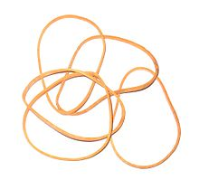
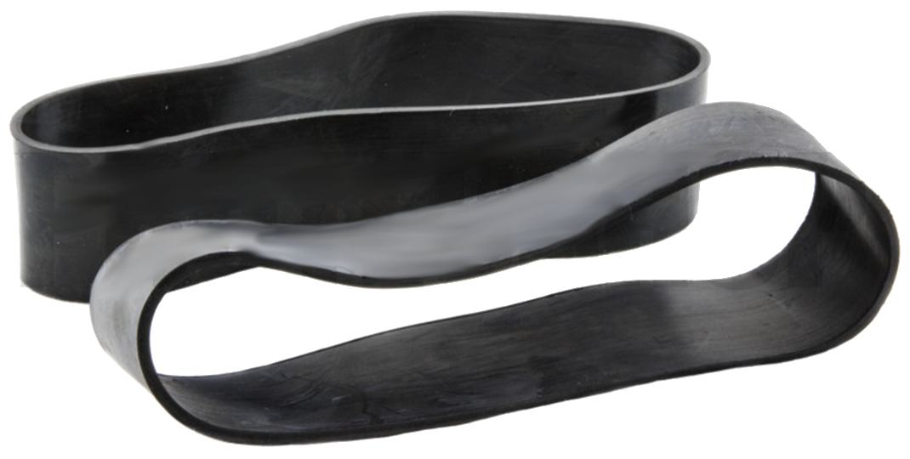
How does narrowband actually assist UWB?
Anything we can do to help?

Slide 4
How does NBA actually do the assisting?
NBA PHY Receives NB packet and measures frequency offset to accuracy of ~0.005ppm

Slide 5
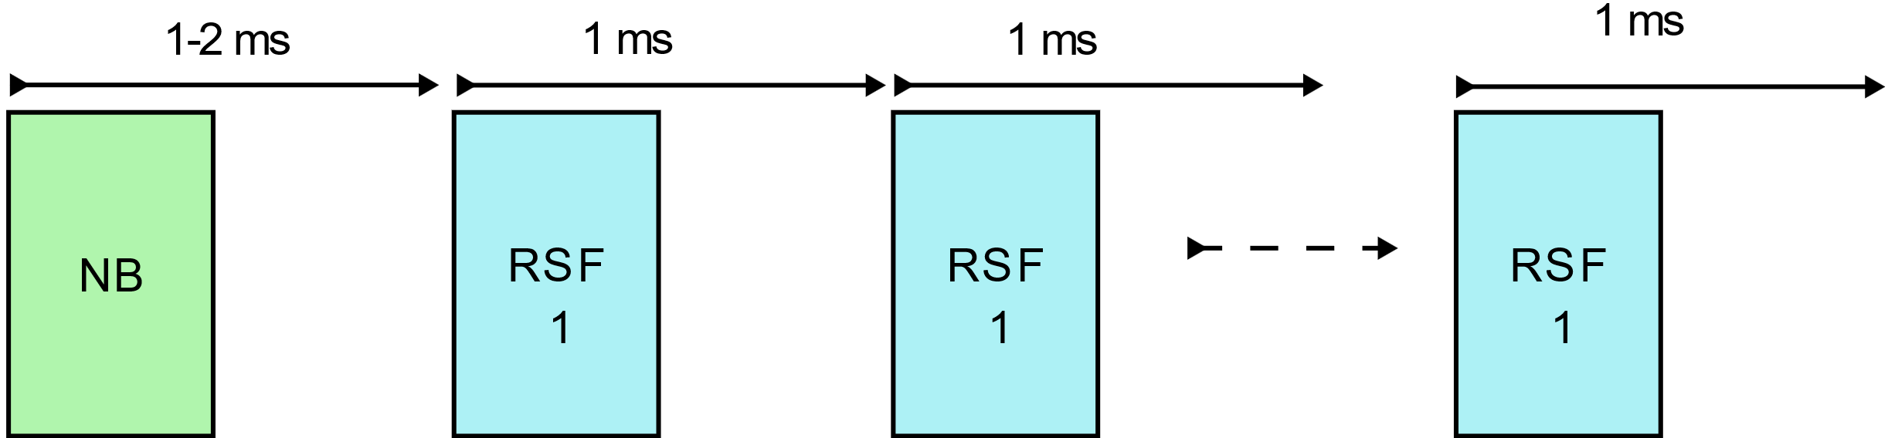
Process UWB fragments
Assumes link margin supports NB
NB tells UWB when to start demod
No need for signal detection => +12dB
UWB and NB PHY run off same xtal
So, know UWB carrier/timing offset
Can apply rotation and timing offset to each fragment after receiving
Correlate the corrected fragments with known transmitted signal
Add 8 results together to get a coherent compound signal with further
+9dB SNR
How can we do this without NBA?

Slide 6
NBA summary
There are two aspects to the improvement
  12 dB from knowing when to listen to the first fragment
    Assuming coherent accumulation
  Up to 9 dB from accumulating 8 fragments
Potential hurdles to NBA+MMS
  Adds another radio (cost, complex, extra antenna, regulatory hurdles, Wi-Fi opposition)
  Needs same clock source for NB and UWB radios
  Still need Bluetooth to start the exchange (for FiRa, CCC, etc).

Slide 7

What if we had a supercomputer in the receiver?
HoreKa Supercomputer at KIT campus

Slide 8
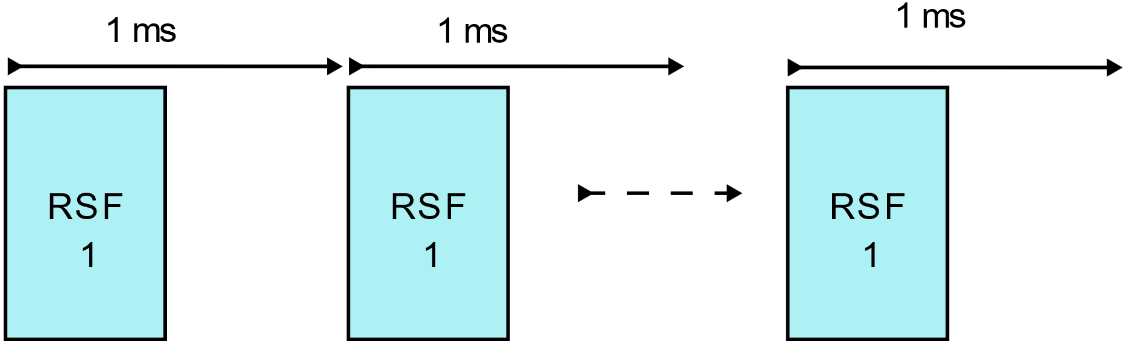
What if we had a supercomputer
We only have the UWB fragments but:
  Pretend we know the carrier offset is x ppm
  Pretend we know when the signal is coming at time t
Do the same thing as in narrowband case.
  Rotation and timing shift to each offset
  Correlate the corrected fragments with known transmitted signal
  Add the results of fragments together
Repeat the above for all possible offsets from x i.e. -40ppm to +40ppm in 5 ppb steps
Repeat for all possible t in 0.25μs steps
See which offset produces a peak in the output.
Bad news : We don’t have a supercomputer in the receiver
Good news: We don’t need one
  We can drastically reduce the processing requirements

Slide 9
Use out of band (OOB) signalling
Use OOB to tell us when UWB is coming to within, say, 0.25 μs
  e.g. All FiRa and CCC protocols have Bluetooth preamble
  channel sounding will tell us exact arrival time
Use OOB signals to tell us approximate CFO between BT (or other OOB radio) & UWB xtals
  BT PHY in target receiver reports BT CFO to within e.g. 0.1ppm
  Parallel processing for better accuracy if required (Often not necessary)
Often, we have previously paired with device we are looking for and so have already measured the CFO of the UWB PHY

Slide 10
Reducing processing: Better ppm estimate
Narrow down the +80ppm range
  The UWB transmitter knows the offset between its Bluetooth Tx signal and its UWB Tx signal
    E.g. Device has way of measuring this when offline
    OR
    When device transmits BT or UWB or both (MMS), remote receiver measures offset and reports back
  UWB transmitter reports this to remote receiver (OOB)
  Remote receiver measure BT offset so has a much better estimate of UWB CFO error range

Slide 11
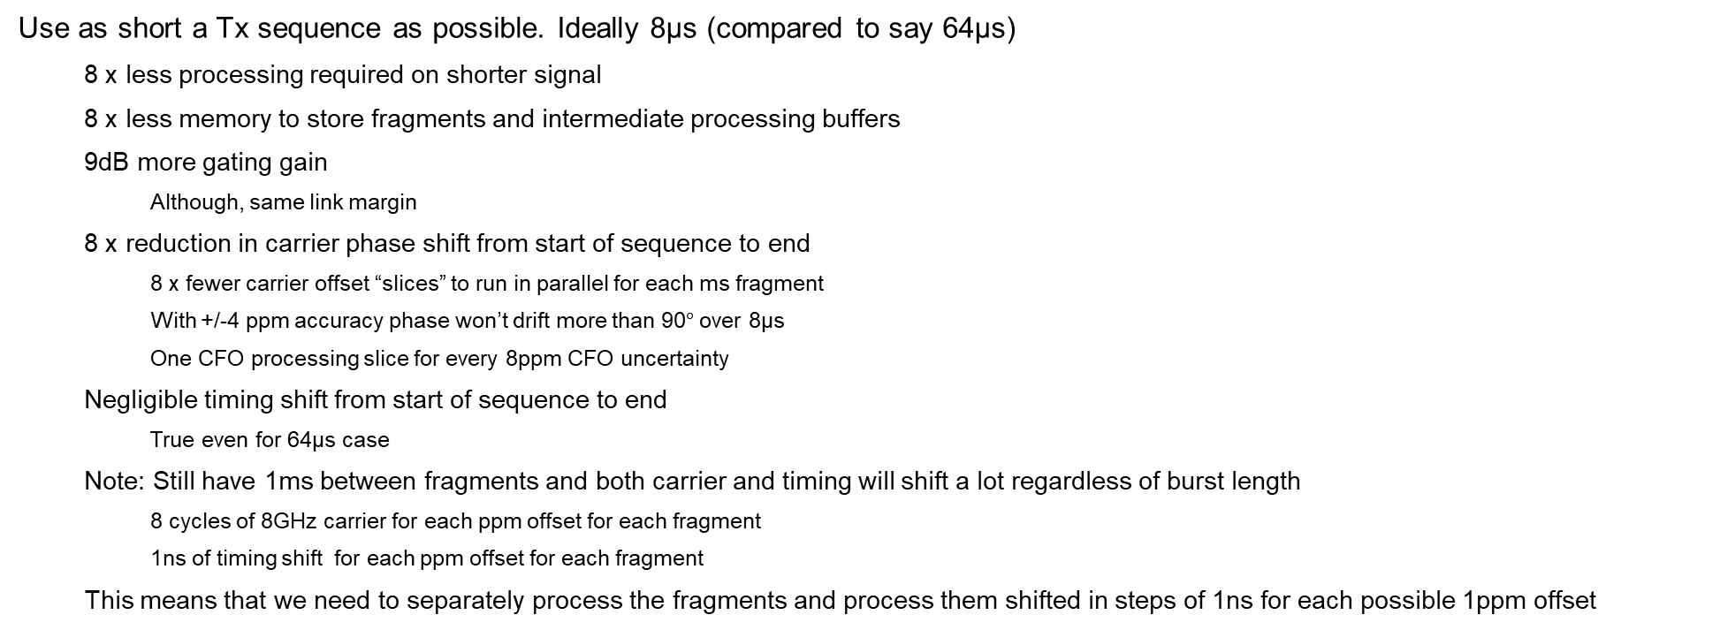
Reduced processing: Shorter sequence
Use as short a Tx sequence as possible. Ideally 8µs (compared to say 64µs)
  8 x less processing required on shorter signal
  8 x less memory to store fragments and intermediate processing buffers
  9dB more gating gain
    Although, same link margin
  8 x reduction in carrier phase shift from start of sequence to end
    8 x fewer carrier offset “slices” to run in parallel for each ms fragment
    With +/-4 ppm accuracy phase won’t drift more than 90$°$ over 8µs
    One CFO processing slice for every 8ppm CFO uncertainty
  Negligible timing shift from start of sequence to end
    True even for 64µs case
  Note: Still have 1ms between fragments and both carrier and timing will shift a lot regardless of burst length
    8 cycles of 8GHz carrier for each ppm offset for each fragment
    1ns of timing shift for each ppm offset for each fragment
  This means that we need to separately process the fragments and process them shifted in steps of 1ns for each possible 1ppm offset
Even with 64µs fragments and just one fragment, a gain of 12dB is possible

Slide 12
How accurate can BT/UWB offsets be?
Different classes of devices
  Devices which use the same clock for UWB and BT. (Golden Timing devices)
    These are the best and their use should be “encouraged” in the eco-system
      Easy to do in a tag, not so easy in a phone
      Phone manufacturers should insist that tags be made like this
    Every time the phone talks to a device like this it gets a high-quality measurement of its own offsets
      In the intervening time, the phone needs to downgrade its personal estimates for aging and temperature
  Devices which can internally measure the offset (Silver Timing Devices)
    E.g., Could feed a clock or an event signal from BT chip to UWB chip for measurement
    These are not quite as good, not because the offset is non-zero, but because the offset will drift in the time since the last measurement
  Devices we have communicated with previously and devices which have, at some time in the past, got a “same exchange” measurement of offset between BT and UWB with a Golden Timing Device
    By measuring BT CFO, a have a very good estimate for UWB CFO under current conditions (voltage, temp etc.)
  Devices which have at some time got a “same exchange” measurement of offset between BT and UWB with a non Golden Timing Device
  Devices which were factory calibrated
  Devices whose only estimate is xtal manufacturers specs

Slide 13
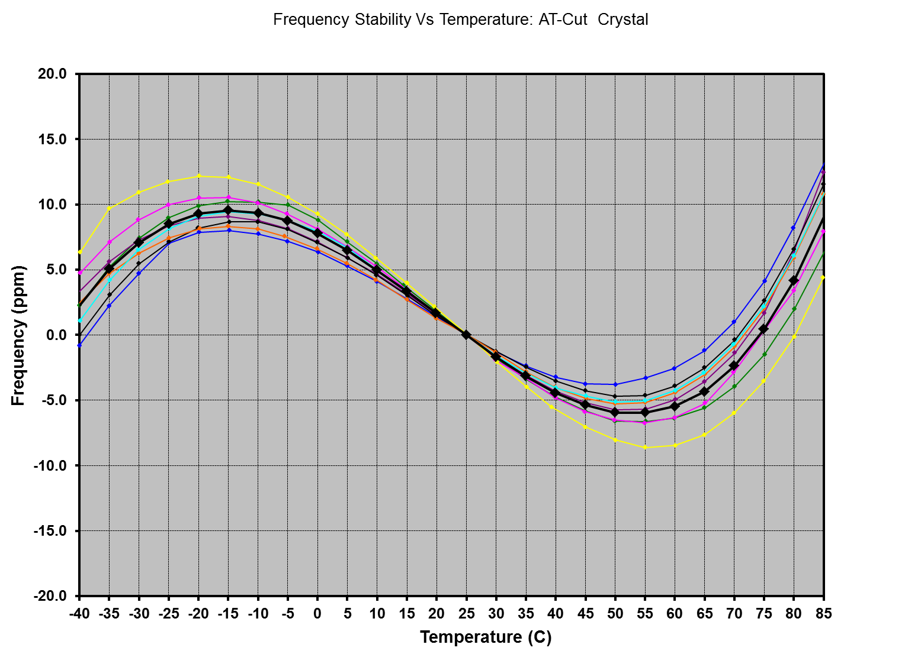
Device Timing Classes
Class 1
CFO STD
0ppm
Expected CFO Range
0ppm
Class 2
CFO STD
f(∆t , ∆T)
Expected CFO Range
0.1ppm : ∆t<20ms
X ppm : ∆t< 1day,
Class 3
CFO STD
f(∆t , ∆T)
Expected CFO Range
0.2ppm : ∆t<20ms
X+0.2 ppm: ∆t< 1day
Class 4
CFO STD
f(∆t , ∆T)
Expected CFO Range
R+0.2ppm : ∆tmeas<20ms
R+X+0.3 ppm: ∆tmeas< 1day
Need to gather data on this
∆t = time since last measurement
∆T = Temperature change since measurement
f(∆t, ∆T) function giving CFO uncertainty due to knowledge of temperature and time differences
I estimate that both X and R are about 4ppm from the graph on the right here but it will be xtal dependant. Consult with xtal manufacturer.
Class 5
CFO STD
f(∆t, ∆T )
Expected Range
5ppm : ∆t< 1yr, ∆T<
R+X+0.3 ppm: ∆tmeas< 1day
Class 6
CFO STD
Depends on Xtal specs but order of 10s of parts permillion

Slide 14
Device Processing Power Classes
Type A
1M Byte RAM ~(0.6mm²)*
Can process 32x32μs quasi-coherent fragments in 1ms
Type B
256 kByte RAM ~(0.15mm²)*
Can process 8x32μs non ‑ coherent fragments in 1ms
Non coherent addition of the coherent sums loses you <2dB of Link Margin
Type C
64 kByte RAM ~(0.04mm²)*
Can process 8x8μs non‑coherent fragments in 1ms
Type D
8kByte RAM ~(0.01mm²)*
Can process 1x8μs non ‑ coherent fragments in 1ms
MMS Scheme | Processor Class | Clock Class Dev A | Clock Class Dev B | Max # fragments | UWB Link Margin | Link Margin Improvement
Fully Coherent Scheme with NBA CFO | N/A | N/A | 5ppb CFO extract | 8 | <121dB | ~21dB ~10x
UWB + OOB signalling | Type A | Class 1 | Class 1 | 32 | <126dB | ~26dB ~20x
UWB + OOB signalling | Type B | Class 1 | Class 2 | 8 | <120dB | ~20dB ~10x
UWB + OOB signalling | Type B | Class 3 | Class 3 | 8 | <119.5dB | ~20dB ~10x
UWB + OOB signalling | Type D | Class 6 | Class 6 | 1 | <112dB | ~12dB ~4x
* This assumes 22nm CMOS process. 4x for 40nm, ½ x for 16nm

Slide 15
Summary
UWB MMS without NBA can give an extra 26dB link margin
(~20x LOS distance)
This requires just over 0.5mm of silicon at in 22nm CMOS
Can get +20dB with just 0.15mm of silicon for 32μs fragments or just 0.04mm for 8μs fragments.
Coherent fragment processing plus non-coherent fragment summation is only
1.5dB worse than a fully-coherent solution. Quasi-coherent methods are possible for even better LM
The UWB preamble before the MMS fragments is redundant and could be dropped for this use case
Would require change to draft
If we do not drop it, receiver should ignore it because it serves no purpose and is often too weak to detect

