Slide 1
Project: IEEE P802.15 Working Group for Wireless Specialty Networks
Submission Title: Error Correcting Scheme for IEEE 802.15.6ma
Date Submitted: 13 September 2023
Source: Kento Takabayashi¹, Ryuji Kohno^{2,3}
Company: (1) Toyo University (2)Yokohama National University (3) YRP International Alliance Institute
Address: (1) 2100 Kujirai, Kawagoe, Saitama, Japan 351-8585, (2)79-5 Tokiwadai, Hodogaya-ku, Yokohama, 240-8501 Japan,
(3) YRP1 Blg., 3-4 Hikarinooka, Yokosuka-City, Kanagawa, 239-0847 Japan
Voice:[(1) +81-866-94-2104 , (2) +81-90-5408-0611] E-Mail:[takabayashi.kento.xp@gmail.com, kohno@ynu.ac.jp, kohno@yrp-iai.jp]
Re: In response to call for technical contributions
Abstract: The concept of error correcting codes for IEEE 802.15.6ma is provided. IEEE 802.15.6ma will deal with various QoS level data. Hence, it is required to consider an error control scheme corresponding to these QoS. We introduce the concept of applying a single error correcting code to low priority data and an outer and an inner error correcting codes to high priority data. In addition, we also consider coexistence with IEEE 802.15.4ab.
Purpose: Material for discussion in P802.15.6ma TG corresponding to comments in EC Meeting
Notice: This document has been prepared to assist the IEEE P802.15. It is offered as a basis for discussion and is not binding on the contributing individual(s) or organization(s). The material in this document is subject to change in form and content after further study. The contributor(s) reserve(s) the right to add, amend or withdraw material contained herein.
Release: The contributor acknowledges and accepts that this contribution becomes the property of IEEE and may be made publicly available by P802.15.

Slide 2
Error Correcting Scheme for IEEE 802.15.6ma
September 2023,
Hybrid Session ,
Grand Hyatt - Buckhead, GA, US
Kento Takabayashi ⁽¹⁾, Ryuji Kohno^{(2, 3)}
⁽¹⁾ Toyo University
⁽²⁾ Yokohama National University,
⁽³⁾ YRP-International Alliance Institute

Slide 3
Importance of QoS control
In WBAN systems, a wearable vital sign sensor node can include various types of sensors with different data rates, the allowable communication error ratio and delay
IEEE 802.15.6 based WBAN may deal with 8 levels of user priority data
Those data have a wide range of quality of service (QoS)
Therefore, optimal error control for input data is an important feature in sensor data transmission procedures
User priority | Traffic designation | Frame type
0 | Background (BK) | Data
1 | Best effort (BE) | Data
2 | Excellent effort (EE) | Data
3 | Video (VI) | Data
4 | Voice (VO) | Data
5 | Medical data or network control | Data or management
6 | High-priority medical data or network control | Data or management
7 | Emergency or medical implant event report | Data

Slide 4
Error control in current IEEE 802.15.6
IEEE 802.15.6 shall use a (63, 51) BCH code as an error correcting code in narrowband, UWB and HBC PHY
Only user priority 6 data in UWB-PHY may use a hybrid ARQ with a (126, 63) shortened BCH code
However, the error control scheme of the current IEEE 802.15.6 cannot deal with the QoS because of lack of flexibility
In IEEE 802.15.6ma, we indicate a concept of channel coding technique to deal with various types of QoS data as shown in a next figure

Slide 5
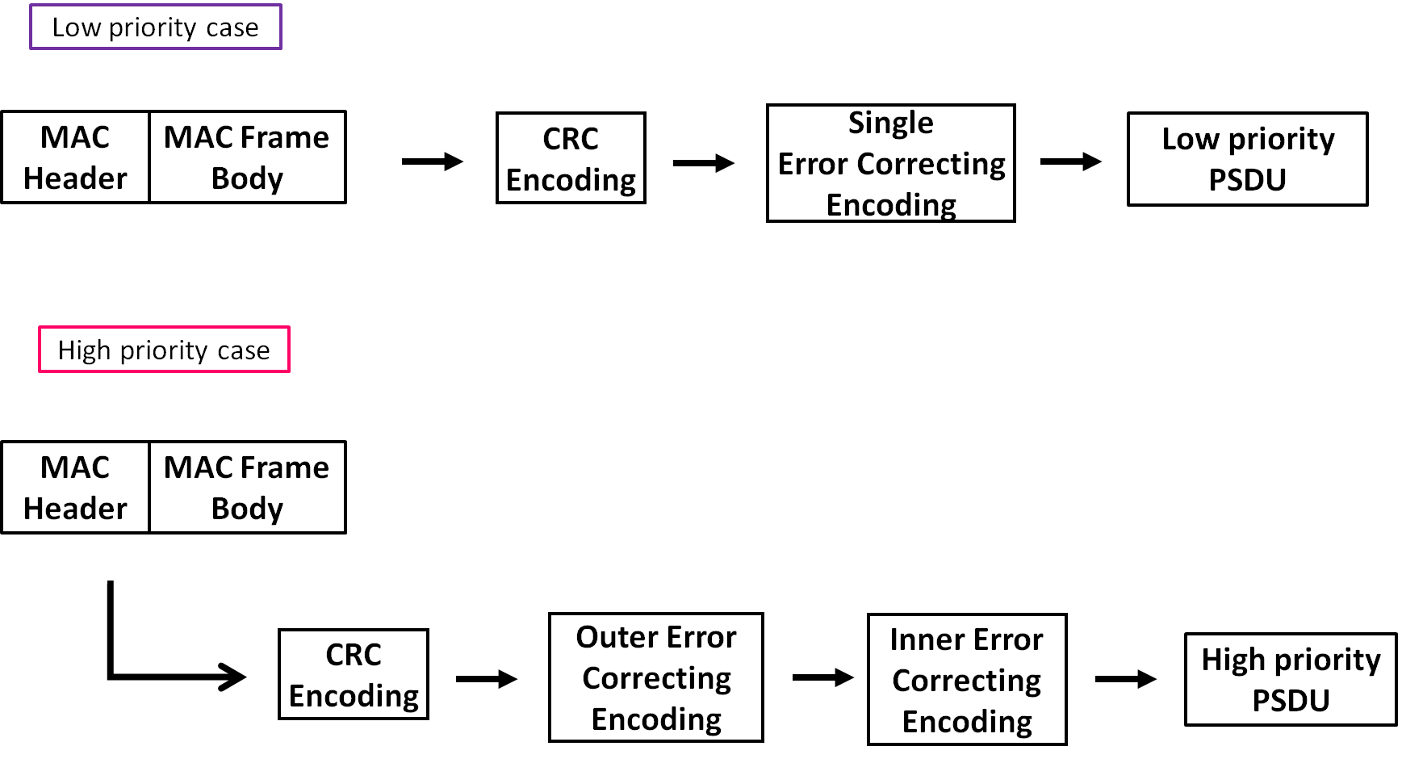
Concept of channel coding for PSDU
In a low priority QoS case, only a single error correcting code will be applied for PSDU
In a high priority QoS case, an outer and an inner error correcting codes will be serially applied for PSDU
MPDU is encoded by CRC-16-CCITT to detect bit errors

Slide 6
Concept Table
User priority | Inner code | Outer code | HARQ
0 | 15.4ab LDPC or BCC (R=1/2) |  | -
1 | 15.4ab LDPC or BCC (R=1/2) |  | -
2 | 15.4ab LDPC or BCC (R=1/2) |  | -
3 | 15.4ab LDPC or BCC (R=1/2) |  | -
4 | 15.4ab LDPC or BCC (R=1/2) | (54, 46) shortened RS code | -
5 | 15.4ab LDPC or BCC (R=1/2) | (54, 38) shortened RS code | -
6 | 15.4ab LDPC or BCC (R=1/2) | (54, 28) shortened RS code | -
7 | 15.4ab LDPC or BCC (R=1/2) | (54, 14) shortened RS code | -
As an outer code, shortened Reed-Solomon (RS) codes with N=54 (original code length N=63) will be selected to correct burst errors due to interference from other WBANs and the coding rates are changed according to each QoS and channel condition
As an inner code, 15.4ab LDPC (K=324, 648, 972, R=1/2) or BCC will be selected for the coexistence of 15.6ma and 15.4ab
This updated concept table is considered as the first priority
Notes:
N=54 shortened Reed-Solomon codes has 324 bits code length (m=6, 54*6=324)
Hence, this code length matches the information bit length of 15.4ab LDPC codes in multiples
For low QoS case, original 15.6 BCH codes will be applied as a one idea
Coexistence class 0~7

Slide 7
Evaluations
Bit error ratio of (54,46), (54,38), (54,28), (54,14) shortened RS codes and no encoding were evaluated under an
AWGN channel and BPSK modulation
Performances were improved as the coding rate decreased

Slide 8
Evaluations
Inner code: BCC (R=1/2), soft decision Viterbi decoding
Outer code: (54,46), (54,38), (54,28), (54,14) shortened RS codes and no encoding
Performances were improved as the coding rate of the RS codes decreased
Low coding rate cases was able to correct a lot of bit errors
AWGN channel and BPSK modulation

Slide 9
Evaluations
Inner code: LDPC (N=1296-bit, R=1/2)
Outer code: (54,46), (54,38), (54,28), (54,14) shortened RS codes and no encoding
There was almost no change in performance regardless of the coding rate of the RS code
Next slide adds another element to check the effectiveness of these combinations
AWGN channel and BPSK modulation

Slide 10
Evaluations
Inner code: N=1296-bit (R=1/2) LDPC code
Outer code: (54,46), (54,38), (54,28), (54,14) shortened RS codes and no encoding
Performances were improved as the coding rate of the RS code decreased
Low coding rate cases could correct a lot of error and erasure
AWGN channel and BPSK modulation
Burst erasure occurs at 32.5% of the code length of the LDPC code (70 consecutive 6-bit erasures)

Slide 11
Coexistence environment level
Coexistence environment class | Technologies
0 | BCC; LDPC
1 | Outer encoder shorted RS encoder and inner encoder BCC; LDPC
2
3
4
5
6
7 | HARQ
  A hybrid ARQ (HARQ) shall be utilized at the highest class “7”

Slide 12
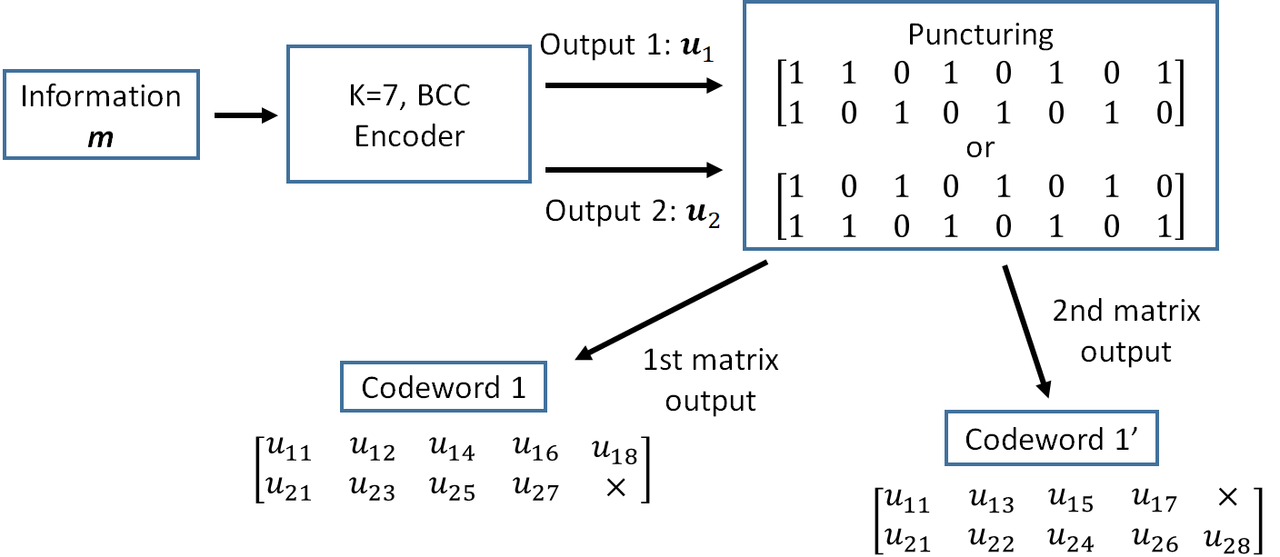
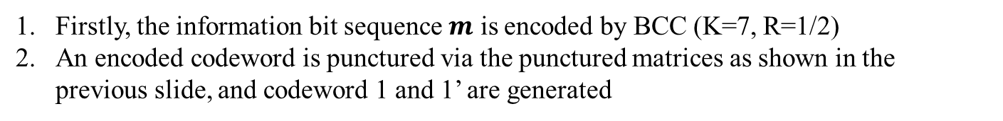
Hybrid ARQ mechanism (BCC case)
Firstly, the information bit sequence $m$ is encoded by BCC (K=7, R=1/2)
An encoded codeword is punctured via the punctured matrices as shown in the previous slide, and codeword 1 and 1’ are generated

Slide 13
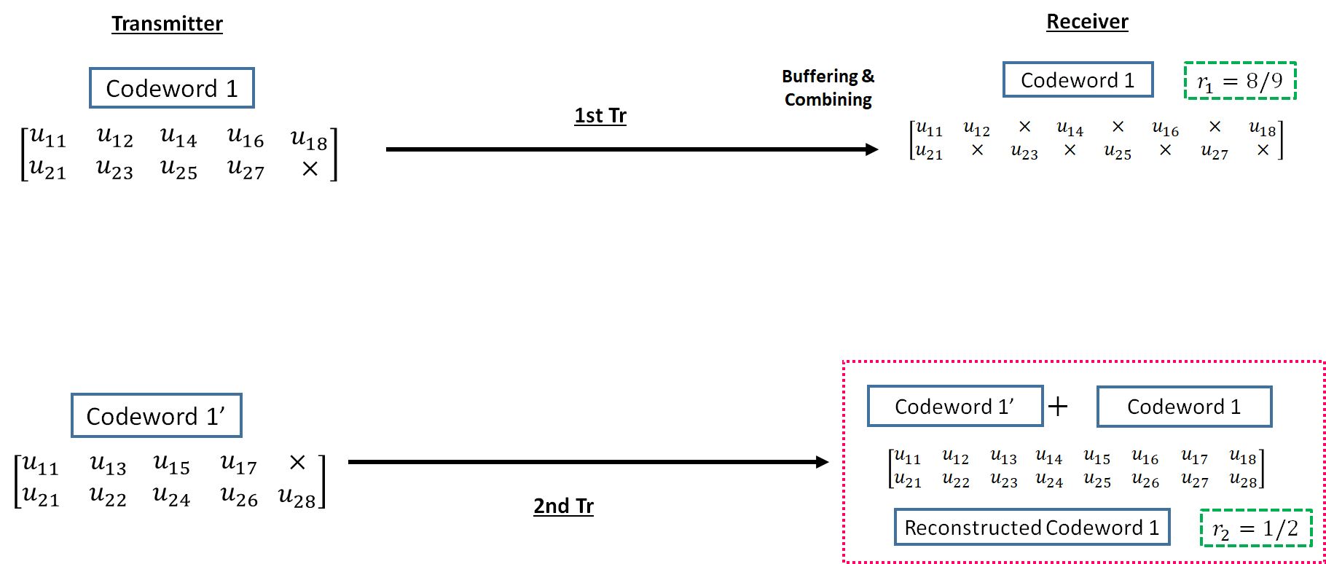
Hybrid ARQ mechanism (BCC case)
3. The codeword 1 is transmitted to a receiver
4. If bit errors are detected after decoding the codeword 1, a receiver buffers the transmitted codeword 1, and a transmitter re-sends the codeword 1’ to a receiver
5. At the receiver, transmitted codeword 1’ is combined with a buffered codeword 1, and a reconstructed codeword 1 (R=1/2) is generated

Slide 14
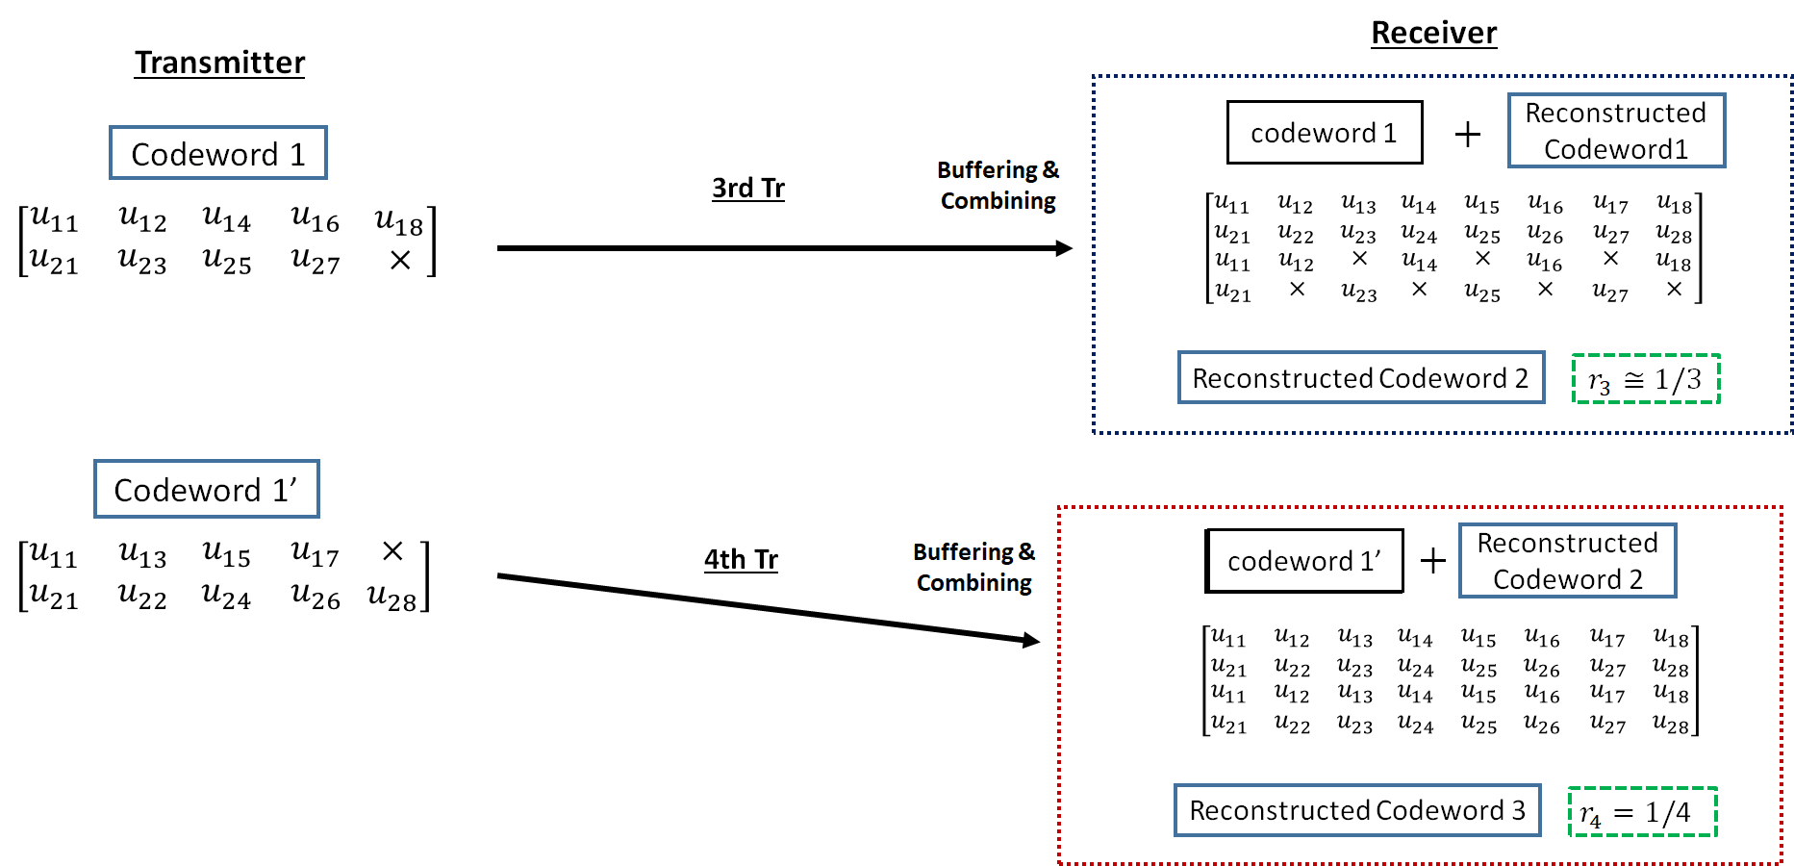
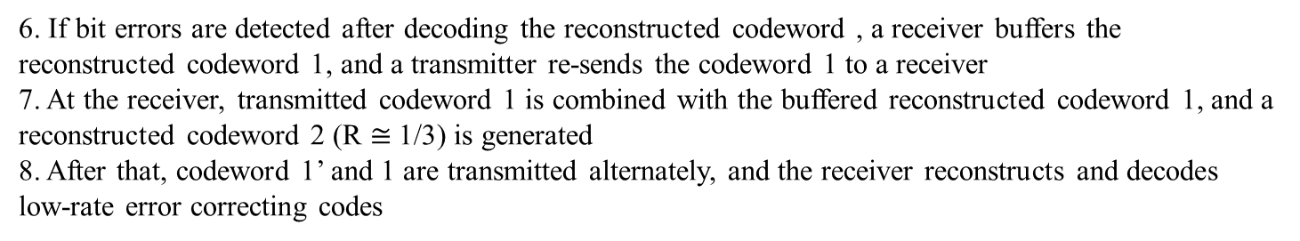
Hybrid ARQ mechanism (BCC case)
6. If bit errors are detected after decoding the reconstructed codeword , a receiver buffers the reconstructed codeword 1, and a transmitter re-sends the codeword 1 to a receiver
7. At the receiver, transmitted codeword 1 is combined with the buffered reconstructed codeword 1, and a reconstructed codeword 2 (R $≅$1/3) is generated
8. After that, codeword 1’ and 1 are transmitted alternately, and the receiver reconstructs and decodes low-rate error correcting codes

Slide 15
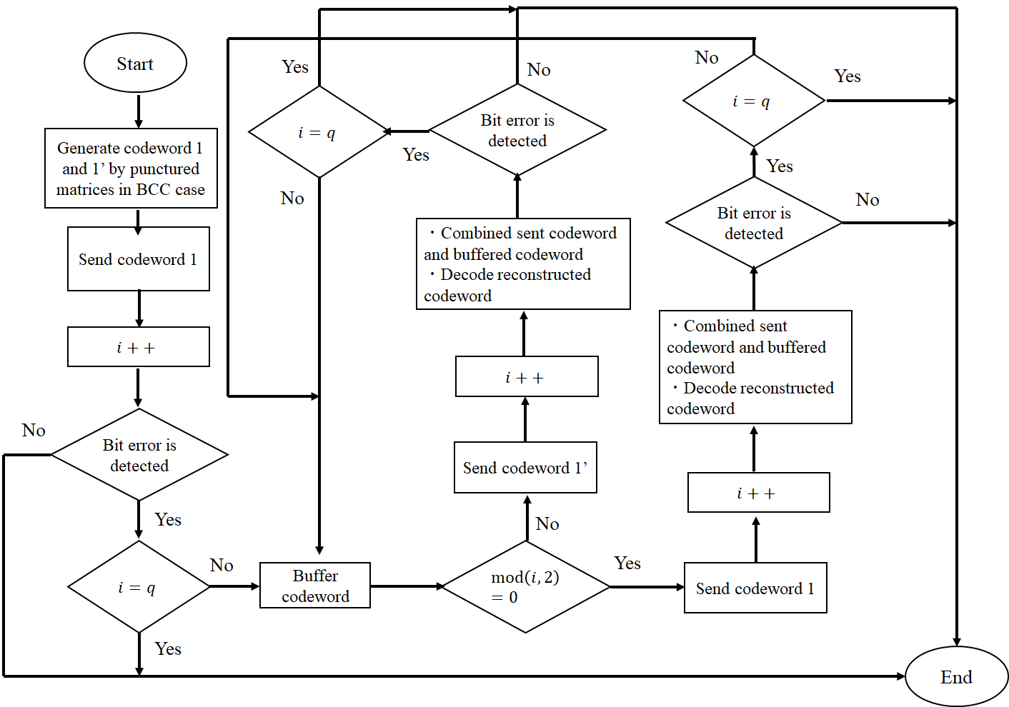
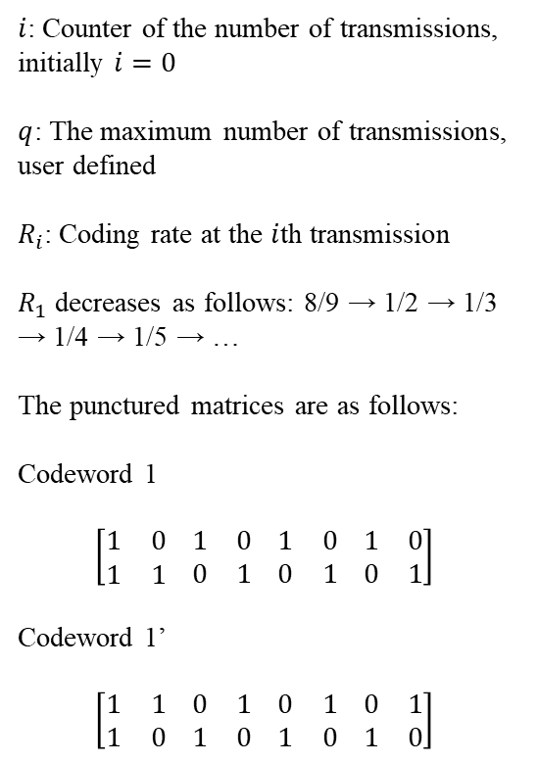
Hybrid ARQ mechanism (BCC case)
$i$: Counter of the number of transmissions, initially $i=0$
$q$: The maximum number of transmissions, user defined
$R_{i}$: Coding rate at the $i$th transmission
$R_{1}$ decreases as follows: 8/9 → 1/2 → 1/3 → 1/4 → 1/5 → …
The punctured matrices are as follows:
Codeword 1
$$\left[\begin{matrix}1 & 0 \\ 1 & 1\end{matrix} \begin{matrix}1 & 0 \\ 0 & 1\end{matrix} \begin{matrix}1 & 0 \\ 0 & 1\end{matrix} \begin{matrix}1 & 0 \\ 0 & 1\end{matrix}\right]$$
Codeword 1’
$$\left[\begin{matrix}1 & 1 \\ 1 & 0\end{matrix} \begin{matrix}0 & 1 \\ 1 & 0\end{matrix} \begin{matrix}0 & 1 \\ 1 & 0\end{matrix} \begin{matrix}0 & 1 \\ 1 & 0\end{matrix}\right]$$

Slide 16
Concept of Hybrid ARQ mechanism
Advantages of the hybrid ARQ mechanism
  The coding rate is very wide
    Bit errors are sufficiently eliminated at the high coding rate under very good channel conditions
    Very low coding rates remove bit errors under bad channel conditions
    A coding rate at the first transmission may be changed according to channel conditions
  In the case of the small number of retransmissions, it is sufficient to transmit the small number of redundant bits
    This characteristic leads to improvement of energy efficiency and reduction of transmission delay at retransmission

Slide 17
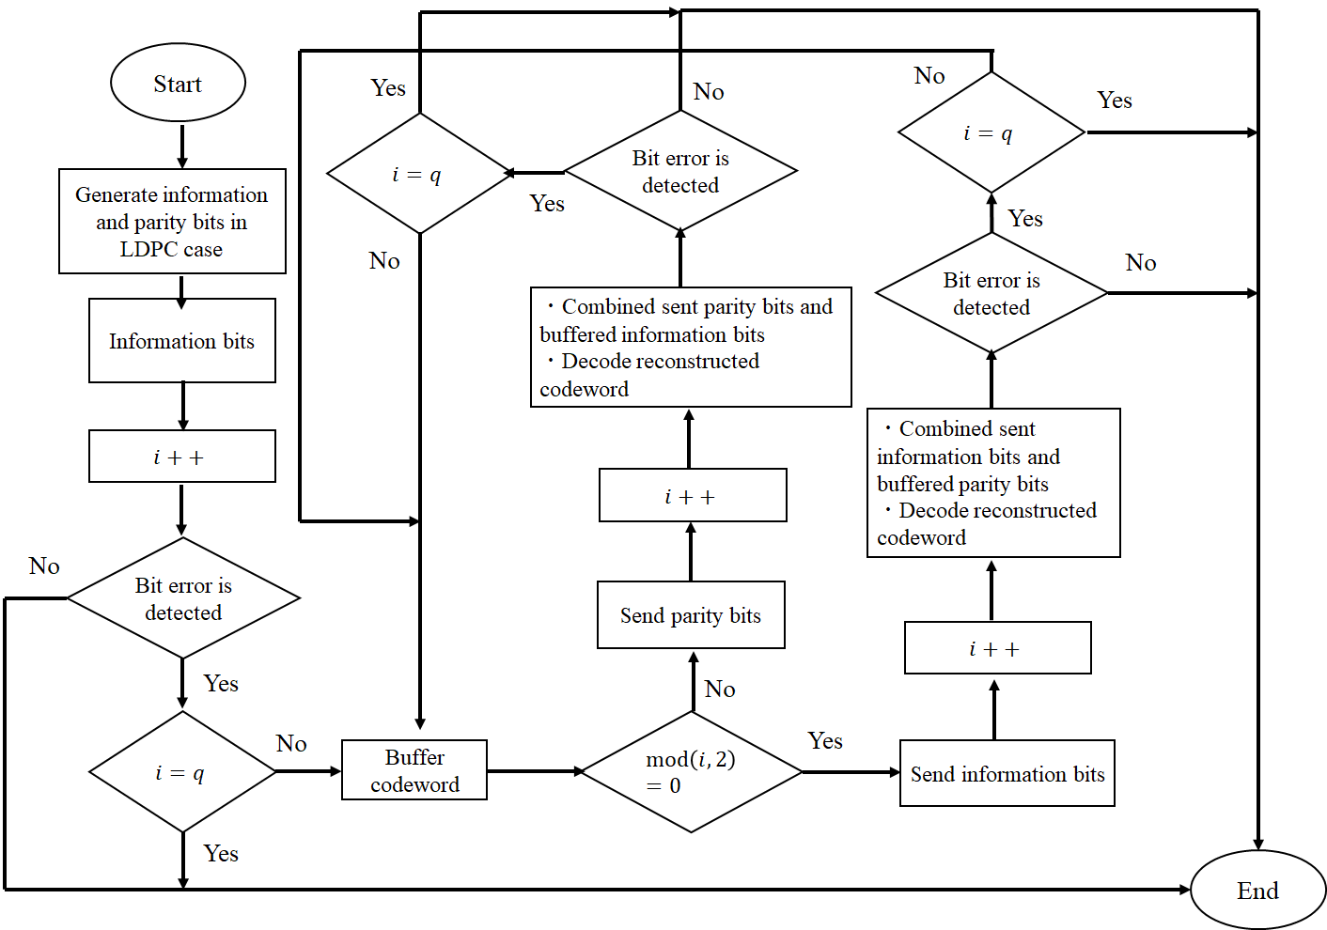
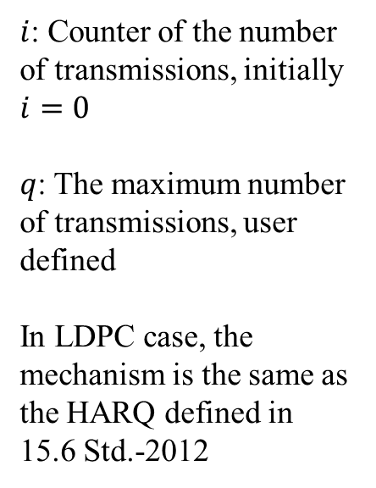
Hybrid ARQ mechanism (LDPC case)
$i$: Counter of the number of transmissions, initially $i=0$
$q$: The maximum number of transmissions, user defined
In LDPC case, the mechanism is the same as the HARQ defined in 15.6 Std.-2012

Slide 18
Summary of Concept Tables
Concept Table
  Inner code: 15.4ab BCC and LDPC codes (R=1/2, K=324, 648, 972)
  Outer code: Shortened RS code (N=54, K=46, 38, 28, 14, original code length N=63)
  A hybrid ARQ shall not be utilized
  The table shall be applied to coexistence class 0~6
Hybrid ARQ
  A hybrid ARQ shall be applied to coexistence class 7 (the highest)
  The BCC case decreases the coding rate depending on the number of retransmissions
  The LDPC case is basically the same as the HARQ mechanism defined in 15.6 Std.-2012

Slide 19
Thank you for your attention ! ! !

Slide 20
Another evaluation
Inner code: N=1296-bit (R=1/2) LDPC code
Outer code: (54,46), (54,38), (54,28), (54,14) shortened RS codes and no encoding
Performances were improved as the coding rate of the RS code decreased
AWGN channel (SNR=10dB) and BPSK modulation, burst erasure occurs at 30~40% of the code length of the LDPC code (65-86 consecutive 6-bit erasures)

Slide 21
Previous Concept Table #2
User priority | Inner code | Outer code | HARQ
0 | - | 15.4ab LDPC or BCC (R=1/2) | -
1 | - | 15.4ab LDPC or BCC (R=1/2) | -
2 | - | 15.4ab LDPC or BCC (R=1/2) | -
3 | - | 15.4ab LDPC or BCC (R=1/2) | -
4 | 15.4a/z based convolutional code, R=4/5 | 15.4ab LDPC or BCC (R=1/2) | ◯
5 | 15.4a/z based convolutional code, R=2/3 | 15.4ab LDPC or BCC (R=1/2) | ◯
6 | 15.4a/z convolutional code, R=1/2 | 15.4ab LDPC or BCC (R=1/2) | ◯
7 | 15.4a/z based convolutional code, R=1/4 | 15.4ab LDPC or BCC (R=1/2) | ◯
As an outer code, 15.4ab LDPC (K=324, 648, 972, R=1/2) or BCC will be selected for the coexistence of 15.6ma and 15.4ab
As an inner code, 15.4a/z based convolutional codes (which are almost the same of our proposed decomposable codes) will be selected, and the coding rates are changed according to each QoS and channel condition, which can be applied to hybrid ARQ
This table will be considered as the choice for coexistence class 8
Notes:
Coexistence class 8
Hybrid ARQ is utilized
Table #1 and #2 are shared by One drive

