Slide 1
Project: IEEE P802.15 Working Group for Wireless Specialty Networks (WSN)
Submission Title: Further considerations on frequency stitching and CIR reports
Source: Bin Qian, Chenchen Liu, Lei Huang, Xiaohui Peng, David Xun Yang (Huawei Technologies)
Address : [Huawei Bantian Base, Longgang District, Shenzhen, 518129 China]
E-Mail: [qianbin14@huawei.com]
Re: Task Group 4ab: UWB Next Generation for 802.15.4
Abstract: [UWB, frequency stitching, CIR reports]
Purpose:
Notice: This document has been prepared to assist the IEEE P802.15. It is offered as a basis for discussion and is not binding on the contributing individual(s) or organization(s). The material in this document is subject to change in form and content after further study. The contributor(s) reserve(s) the right to add, amend or withdraw material contained herein.
Release: The contributor acknowledges and accepts that this contribution becomes the property of IEEE and may be made publicly available by P802.15.
Notes:
Jul 12, 2010
Page 1

Slide 2
PAR Objective | Proposed Solution (how addressed)
Safeguards so that the high throughput data use cases will not cause significant disruption to low duty-cycle ranging use cases
Interference mitigation techniques to support higher density and higher traffic use cases
Other coexistence improvement
Backward compatibility with enhanced ranging capable devices (ERDEVs)
Improved link budget and/or reduced air-time
Additional channels and operating frequencies
Improvements to accuracy / precision / reliability and interoperability for high-integrity ranging
Reduced complexity and power consumption
Hybrid operation with narrowband signaling to assist UWB
Enhanced native discovery and connection setup mechanisms
Sensing capabilities to support presence detection and environment mapping | Frequency stitching parameters and channel order mapping CIR reports with multiple segments
Low-power low-latency streaming
Higher data-rate streaming allowing at least 50 Mbit/s of throughput
Support for peer-to-peer, peer-to-multi-peer, and station-to-infrastructure protocols
Infrastructure synchronization mechanisms

Slide 3
Reference
[1] IEEE 802.15/23-284r1, "Latest Consensus on UWB Sensing PHY and MAC"
[2] IEEE 802.15/22-538r7, “Proposal of sensing framework"
[3] IEEE 802.15/23-178r0, “Frequency stitching considerations"
[4] IEEE 802.15/23-332r0, “Considerations on channel order in frequency stitching"

Slide 4
Background
In [1-2], the frequency stitching parameters are discussed as below
Bits: 0 | 1-4 | 5-6 | 7 | 8-11 | 12-13 | 14-15
Frequency Stitching Direction | Base Channel | Carrier Frequency Grid | Channel Sequence Order | Number of Transmissions | Feedback Control | Reserved
  Frequency Stitching Direction field indicates the center frequency change direction of subsequent channels based on the base channel. When 1, the base channel has the lowest center frequency, when 0, the base channel has the highest center frequency
  Base Channel field indicates the starting channel
  Carrier Frequency Grid is equal to the overlap factor (OF)
    0, no overlap; 1, 25% overlap; 2, 50% overlap; 3, 75% overlap
  Channel Sequence Order field specifies the sequence of channel use
    0, in-sequence channel order; 1, out-of-sequence channel order

Slide 5
Channel Sequence Order
When the out-of-sequence channel order is applied, the channel order are computed according to
CH((p*(OF+1) MOD (N)) + (p*(OF +1) DIV (N)))
  p starts sequentially from 0 to N-1
  Let M denote the total number of transmissions.
    If M is divisible by (OF + 1), N equals to M
    Otherwise, N is the smallest integer greater than M and divisible by (OF + 1). In this case, CH(0), CH(1), … , CH(N-1) is padded with unused channels, which corresponds to idle transmitter
  OF is the overlap factor
  MOD is the modulo operator, and DIV denotes integer division

Slide 6
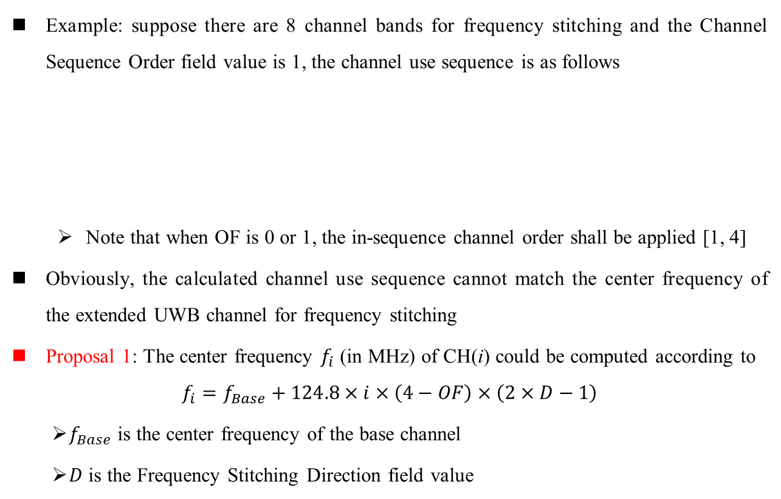
Channel Sequence Order (cont.)
Example: suppose there are 8 channel bands for frequency stitching and the Channel Sequence Order field value is 1, the channel use sequence is as follows
  Note that when OF is 0 or 1, the in-sequence channel order shall be applied [1, 4]
Obviously, the calculated channel use sequence cannot match the center frequency of the extended UWB channel for frequency stitching
Proposal 1: The center frequency $f_{i}$ (in MHz) of CH(i) could be computed according to
$$f_{i}=f_{Base}+124.8×i×\left(4−OF\right)×\left(2×D−1\right)$$
  $f_{Base}$ is the center frequency of the base channel
  $D$ is the Frequency Stitching Direction field value
OF | Channel Use Sequence
2 | CH(0), CH(3), CH(6), CH(1), CH(4), CH(7), CH(2), CH(5)
3 | CH(0), CH(4), CH(1), CH(5), CH(2), CH(6), CH(3), CH(7)

Slide 7
Channel Sequence Order (cont.)
Example
  There are 8 channel bands for frequency stitching
  The Channel Sequence Order field value is 1
  The center frequency of the base channel is 7987.2 MHz
OF | Channel Use Sequence | Center frequency (in MHz) of channel used when the Frequency Stitching Direction field value is 1 | Center frequency (in MHz) of channel used when the Frequency Stitching Direction field value is 0
2 | CH(0), CH(3), CH(6), CH(1), CH(4), CH(7), CH(2), CH(5) | 7987.2, 8736.0, 9484.8, 8236.8, 8.9856, 9734.4, 8486.4, 9235.2 | 7987.2, 7238.4, 6489.6, 7737.6, 6988.8, 6240.0, 7488.0, 6739.2
3 | CH(0), CH(4), CH(1), CH(5), CH(2), CH(6), CH(3), CH(7) | 7987.2, 8361.6, 8736.0, 8112.0, 8486.4, 8860.8, 8236.8, 8611.2 | 7987.2, 7612.8, 7238.4, 7862.4, 7488.0, 7113.6, 7737.6, 7363.2

Slide 8
Intra-packet and Inter-packet Frequency Stitching
Three types of frequency stitching
  Intra-packet: Across segments in the SENS field
  Inter-packet: Across multiple packets
  The combination of intra-packet and inter-packet
Proposal 2: Add Frequency Stitching Type field to the frequency stitching parameters
  Occupy 2 bits
  0, Intra-packet; 1, Inter-packet; 2, Combination of intra-packet and inter-packet; 3, Reserved

Slide 9
CIR Report IE
Bits: 0-1 | 2-3 | 4-13 | 14-15 | Octets: 4/8/16/32 | Variable
Antennas | Bitmap Length | Bitmap Offset | Number of Segments | CIR Bitmap | Receive Report(s)
The Receive Report(s) field is per segment per Rx chain
Proposal 3: Add Number of Segments field to the CIR Report IE to make it self-contained.
  The number of receive reports in the Receive Report(s) field is equal to the number of receiver chain times the number of segments
Proposal 4: Multiple receive reports shall be arranged in a certain way, e.g., in the sequence of antenna ID first and the segment index second
  Example: there are two Rx antennas and two segments, the Receive Report(s) field is formatted below
Receive Report for Antenna 1 and Segment 1 | Receive Report for Antenna 1 and Segment 2 | Receive Report for Antenna 2 and Segment 1 | Receive Report for Antenna 2 and Segment 2

Slide 10
Summary
It is suggested to associate the center frequency of the extended UWB channel with the out-of-sequence channel order calculation formula
It is suggested to add Frequency Stitching Type field to the frequency stitching parameters
It is suggested to add Number of Segments field to the CIR Report IE
It is suggested to arrange the multiple receive reports included in the Receive Report(s) field in a certain way

Slide 11
Thank You

