Slide 1
Project: IEEE P802.15 Working Group for Wireless Personal Area Networks (WPANs)
Submission Title: Clarification of NB CCA for UWB channel access
Date Submitted: September, 2023
Source: Huan-Bang Li, Takeshi Matsumura (NICT, Japan).
Address: 3-4 Hikarino-oka, Yokosuka-shi, Kanagawa, 239-0847 Japan
E-Mail: {lee, matsumura}@nict.go.jp
Abstract: Further explanation on NB-assisted UWB channel access.
Purpose: To improve coexistence among UWB systems.
Notice: This document has been prepared to assist the IEEE P802.15. It is offered as a basis for discussion and is not binding on the authoring individual(s) or organization(s). The material in this document is subject to change in form and content after further study. The authors(s) reserve(s) the right to add, amend or withdraw material contained herein.

Slide 2
PAR Objective | Proposed Solution (how addressed)
Safeguards so that the high throughput data use cases will not cause significant disruption to low duty-cycle ranging use cases | Effective and efficient CCA reduce disruption between UWB devices
Interference mitigation techniques to support higher density and higher traffic use cases | Use NB radio to facilitate CCA so as to improve coexistence.
Other coexistence improvement | Use NB radio to improve coexistence among UWB devices.
Backward compatibility with enhanced ranging capable devices (ERDEVs)
Improved link budget and/or reduced air-time
Additional channels and operating frequencies
Improvements to accuracy / precision / reliability and interoperability for high-integrity ranging
Reduced complexity and power consumption
Hybrid operation with narrowband signaling to assist UWB | Exploiting NB PHY and concurrent operation with UWB to assist UWB channel access
Enhanced native discovery and connection setup mechanisms
Sensing capabilities to support presence detection and environment mapping
Low-power low-latency streaming
Higher data-rate streaming allowing at least 50 Mbit/s of throughput
Support for peer-to-peer, peer-to-multi-peer, and station-to-infrastructure protocols
Infrastructure synchronization mechanisms

Slide 3
Contents
Roles of NB coordination and NB CCA
Use sub-GHz band to avoid interference with Wi-Fi
Complexity Reduction
NB Pattern

Slide 4
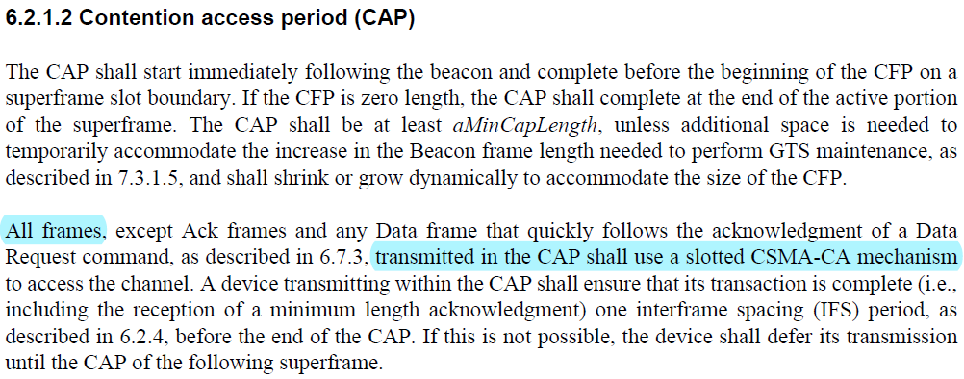
Roles of NB Coordination and NB CCA
Medium access using either coordination or CSMA-CA are specified with different roles in IEEE802.15.4-2020. CCA is used to assist CSMA-CA.
Similarly, NB coordination may be used to allocate time slots in CFP, whereas NB CCA is used to assist CSMA-CA mechanism, which is necessary for transmission in CAP.

Slide 5
NB CCA May Simplify Channel Access
Six CCA modes are defined in 10.2.8 Clear channel assessment (CCA) of IEEE 802.15.4-2020. The proposed NB CCA adds one more option, which may simplify CCA especially when different types of UWB exist.
An HRP UWB PHY shall implement one CCA Mode 1 through CCA Mode 4 or one of the following methods:
CCA Mode 5: HRP UWB preamble sense based on the SHR of a frame. CCA shall report a busy medium upon detection of a preamble symbol as specified in 15.2.6. An idle channel shall be reported if no preamble symbol is detected up to a period not shorter than the maximum packet duration plus the maximum period for acknowledgment.
CCA Mode 6: HRP UWB preamble sense based on the packet with the multiplexed preamble as specified in 15.6. CCA shall report a busy medium upon detection of a preamble symbol as specified in 15.2.6.
CCA Mode 7: NB CCA
existed
proposed

Slide 6
Avoid Interference with Wi-Fi
We modify NB CCA to only use sub-GHz channel defined in subclause 10.1.3.9 (Table 10-14) of IEEE802.15.4-2020. Channel spacing is 200 kHz.
Multiple frequency bands are available to meet local regulations.
ChanCenterFreq = ChanCenterFreq0 + NumChan × ChanSpacing
ChanCenterFreq0 is the first channel center frequency
ChanSpacing is the separation between adjacent channels
NumChan is the channel number from 0 to TotalNumChan–1
TotalNumChan is the total number of channels for the available frequency band

Slide 7
Available Frequency Bands from Table 10-14
Band (MHz) | Range (MHz) | ChanSpacing (MHz) | TotalNumChan | ChanCenterFreq0 (MHz)
915 | 902-928 | 0.2 | 129 | 902.2
780 | 779-787 | 0.2 | 39 | 779.2
863 | 863-870 | 0.2 | 35 | 863.1
470 | 470-510 | 0.2 | 199 | 470.2

Slide 8
To Reduce Complexity
Use already standardized O-QPSK in Clause 21 of IEEE 802.15.4-2020 (no new PHY).
Use PSDU rate mode 3.
rate 1/2 FEC + interleaver
no spreading
no binary differential encoding
One out of the optional CCA modes is required in IEEE 802.15.4-2020. NB CCA add one optional mode which is useful especially when multiple types of UWB radios coexist.

Slide 9
Use One NB CCA Pattern
$$\begin{matrix}if N_{UWB}≤12 NB symbols, & only transmit End Time pattern \\ if 12 NB symbols<N_{UWB}≤20 NB symbols, & \begin{aligned}transmit \left(N_{UWB}−12\right) NB symbols \\ \text{+ }End Time pattern\end{aligned} \\ if N_{UWB}>20 NB symbols, & \begin{aligned}transmit 8 NB symbols, stop, \\ transmit End Time pattern\end{aligned}\end{matrix}$$
${∗N}_{UWB}$ is the length of UWB transmission.
NB signal
End Time pattern (12 symbols)
…
4-symbol
2 2 2 2
8-symbol
Time (symbols)
*The required CCA duration is 8 symbols for 915MHz band and 780MHz band, 4 symbols for 863MHz band and 470 MHz band.

Slide 10
Summary
NB coordination and NB CCA play different roles.
NB CCA uses sub-GHz frequencies with multiple available bands to fit for different regulations.
NB CCA adopts already standardized PHY with simple selected PSDU parameters.
NB CCA provides a simple solution for collision avoidance when multiple types of UWB radios coexist.
Suggest to add NB CCA as an optional CCA mode

Slide 11
Backup Slides

Slide 12
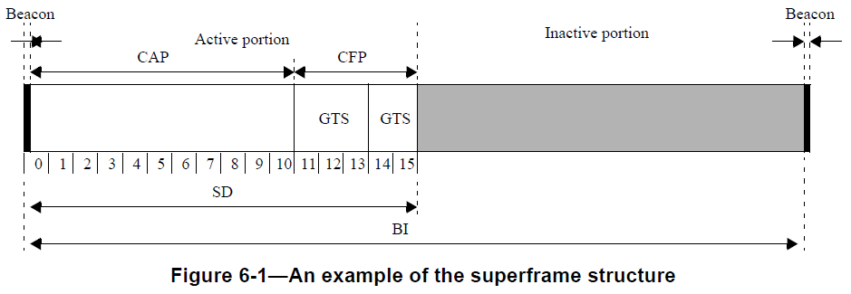
CAP and CFP in a Superframe

