Slide 1
Project: IEEE P802.15 Working Group for Wireless Specialty Networks (WSN)
Submission Title: Considerations on CIR report for non-sensing transmission
Source: Bin Qian, Chenchen Liu, Lei Huang, Xiaohui Peng, David Xun Yang (Huawei Technologies)
Address : [Huawei Bantian Base, Longgang District, Shenzhen, 518129 China]
E-Mail: [qianbin14@huawei.com]
Re: Task Group 4ab: UWB Next Generation for 802.15.4
Abstract: [UWB, CIR report, non-sensing PPDU]
Purpose:
Notice: This document has been prepared to assist the IEEE P802.15. It is offered as a basis for discussion and is not binding on the contributing individual(s) or organization(s). The material in this document is subject to change in form and content after further study. The contributor(s) reserve(s) the right to add, amend or withdraw material contained herein.
Release: The contributor acknowledges and accepts that this contribution becomes the property of IEEE and may be made publicly available by P802.15.
Notes:
Jul 12, 2010
Page 1

Slide 2
PAR Objective | Proposed Solution (how addressed)
Safeguards so that the high throughput data use cases will not cause significant disruption to low duty-cycle ranging use cases
Interference mitigation techniques to support higher density and higher traffic use cases
Other coexistence improvement
Backward compatibility with enhanced ranging capable devices (ERDEVs)
Improved link budget and/or reduced air-time
Additional channels and operating frequencies
Improvements to accuracy / precision / reliability and interoperability for high-integrity ranging
Reduced complexity and power consumption
Hybrid operation with narrowband signaling to assist UWB
Enhanced native discovery and connection setup mechanisms
Sensing capabilities to support presence detection and environment mapping | Enable non-sensing packet to perform sensing
Low-power low-latency streaming
Higher data-rate streaming allowing at least 50 Mbit/s of throughput
Support for peer-to-peer, peer-to-multi-peer, and station-to-infrastructure protocols
Infrastructure synchronization mechanisms

Slide 3
Reference
[1] IEEE 802.15/23-284r1, "Latest Consensus on UWB Sensing PHY and MAC"
[2] IEEE 802.15/23-277r1, "Re-purpose transmissions for sensing"
[3] IEEE 802.15/23-437r0, "Updates to using non-sensing transmissions for sensing"
[4] IEEE 802.15/23-438r0, "Text for CIR report for non-sensing transmission"

Slide 4
Background
In the latest sensing consensus TFD [1], the CIR report could be generated by non-sensing PPDU format
Expand the capability of 4z device and 4ab non-sensing device
In [2-4], the parameters of CIR report for non-sensing PPDU are as follows
Bits: 0-1 | 2 | 3-7
Transmission Packet Format Identifier | Source of CIR Report | Reserved
Transmission Packet Format Identifier: 0, Ranging; 1, Data Communication; 2, MMS Ranging
Source of CIR Report: 0, CIR report is generated from SYNC field only (RSF in case of MMS ranging); 1, CIR report is generated from SYNC field and other parts of the packet - STS, PHY Payload (RSF and RIF in case of MMS ranging)

Slide 5
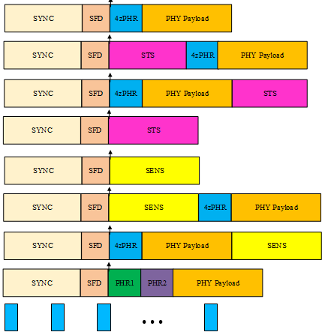
Background
PPDU formats
SP0
SP1
SP2
Device Type | Mandatory Supported PPDU
4z device | SP0, SP1, SP3
4ab ranging device (HRP-ARDEV) | SP0, SP1, SP3, MMS
4ab sensing device (HRP-SDEV) | SP0, SP1, SP3, SENS0
4ab data device (HRP-LLDDEV) | SP0, SP1, SP3, Dynamic data
SP3
SENS0
SENS1
SENS2
Dynamic data
MMS
In this contribution, we consider the scenarios where non-sensing PPDU formats are used to perform sensing only

Slide 6
Transmission Packet Format Identifier Field
It is not reasonable to apply the dynamic data packet for sensing
The encoding and decoding of PHR1 will introduce additional complexity
All the devices supported the dynamic data packet will definitely support SP0, SP1, and SP3
Suggested 1-bit Transmission Packet Format Identifier Field
Transmission Packet Format Identifier | Transmission Packet Format
0 | SP0-SP3 packet
1 | MMS packet

Slide 7
Source of CIR Report Field
Current Source of CIR Report field allows to apply PHY Payload to generate the CIR report, which will introduce much more complexity
Further, the current description when Source of CIR Report field being 1 is not clear
Additionally, some combinations of the transmission packet and the source of CIR are not valid, e.g., NBA RIF-only MMS and generation of CIR report from SYNC, SP0 and generation of CIR report from STS
It is suggested to indicate the source of CIR report according to the transmission packet instead of a specific Source of CIR Report field
Example
Transmission Packet | Source of CIR report
SP0 | SYNC
SP1-SP3 | STS
RSF-only MMS | RSF
RIF-only MMS | RIF
Mixed MMS | RSF

Slide 8
Summary
To avoid unnecessary complexity, it is proposed not to apply the dynamic data packet to perform sensing and not to generate the CIR report from PHY payload
It is suggested to use an 1-bit Transmission Packet Format Identifier field
It is suggested to indicate the source of CIR report according to the transmission packet instead of a specific field

Slide 9
Thank You

