Slide 1

144th Session of meetings of the
IEEE 802.15 Working Group for Wireless Specialty Networks (WSN)
Closing Report
July 10-13, 2023
Held in Berlin & Hybrid via Webex

Slide 2
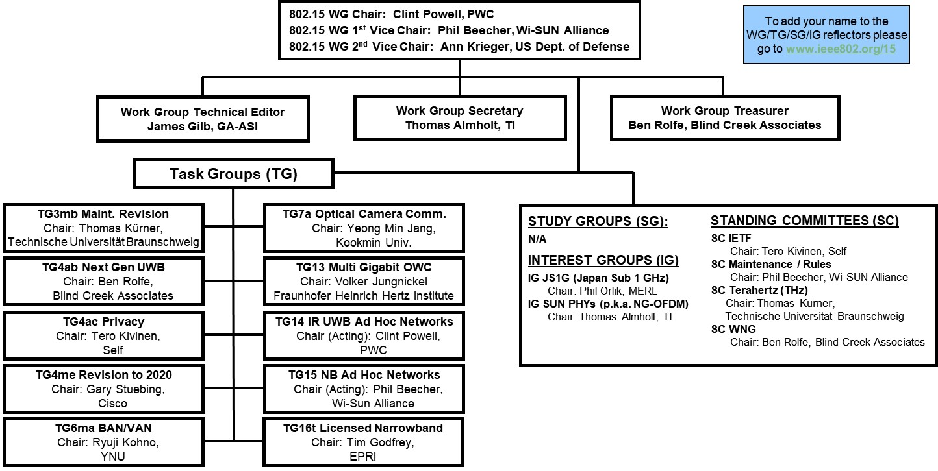
802.15 WG Org. Chart

Slide 3
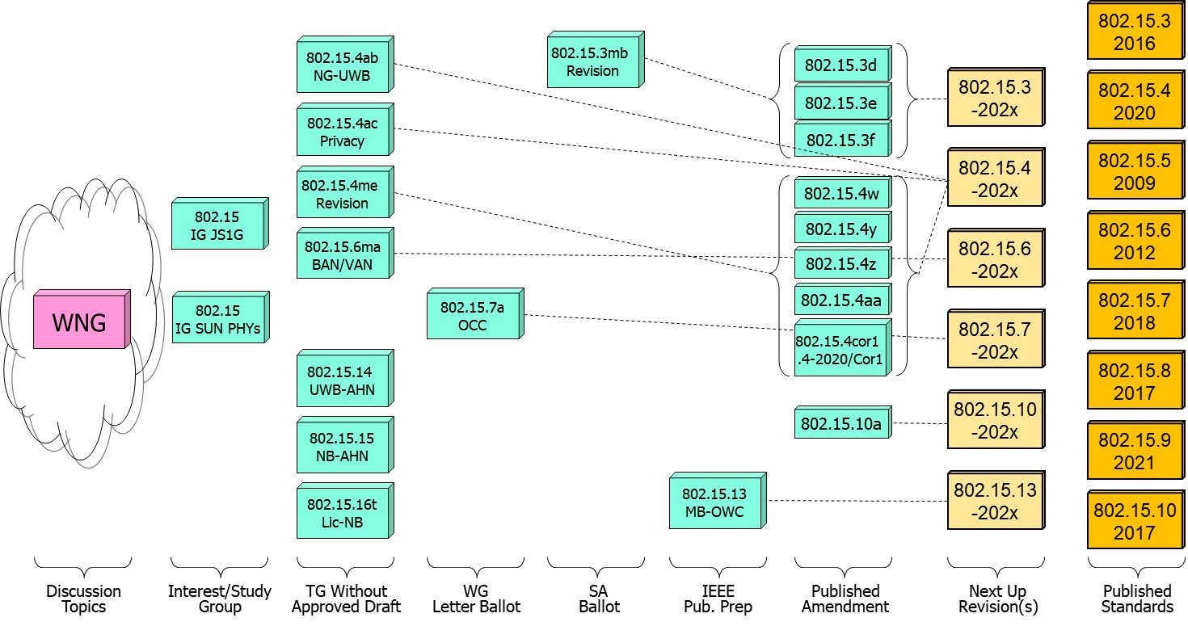
802.15 WG Standards Pipeline

Slide 4
802.15 WG Administrative
Voting members: 133
Nearly voting members: 18
Aspirant voting member: 26
802.15 WG Officer Elections
Clint Powell - Chair (elected March 2022)
Phil Beecher - 1st Vice-Chair (elected March 2022)
Ann Krieger - 2nd Vice-Chair (elected Nov. 2022)
Thomas Almholt - Secretary (appointed May 2023)
James Gilb - Tech. Editor (appointed March 2023)
Ben Rolfe - Treasurer (appointed March 2023)

Slide 5
Meeting Slots for 802.15 WG July Plenary

Slide 6








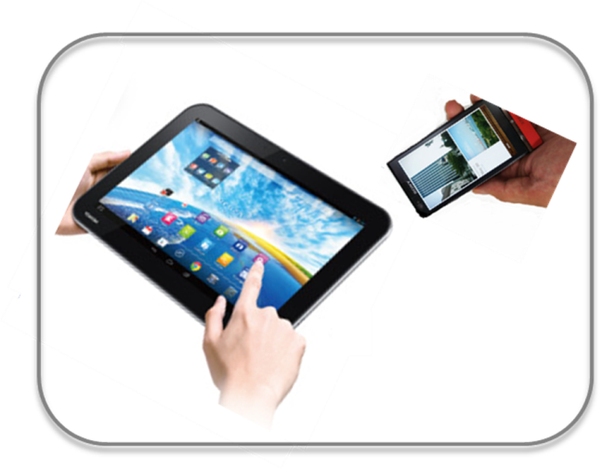








IEEE 802.15 Standards & their Applications
802.15.16
802.15.4
Locating and Tracking
Ultra-low Power Sensors
Automotive
FAN/MAN/RAN
802.15.4
Multi-media networks
&
High Speed
Interconnect
802.15.3
Industrial Networks
802.15.7
802.15.13
Medical
802.15.6
Critical Infrastructure Networks
Consumer Devices
Optical
Communications
Agricultural Sensing
Structural Monitoring
Slide 6

Slide 7
802.15 WG Subgroups/Objectives
TG 3mb – Revision b, Maintenance (mb)
Objective: revision for 802.15.3, extension of the frequency range to 300 GHz and review the 802.1D references and replace them with 802.1Q as appropriate
TG 4ab – Next Generation Ultra WideBand (NG-UWB) Amendment
Objective: enhancements to 802.15.4 Ultra Wideband (UWB) physical layers (PHYs) media access control (MAC), and associated ranging techniques while retaining backward compatibility with enhanced ranging capable devices (ERDEVs)
TG 4ac – Privacy Amendment
Objective: modifications to the IEEE Std 802.15.4 medium access control (MAC) specification to specify mechanisms that address and improve user privacy
TG 4me – Revision e, Maintenance (me)
Objective: revision to 802.15.4-2020, rolling up amendments 802.15.4w, 802.15.4y, 802.15.4z, and 802.15.4aa and work on errors, omissions, updates, etc.

Slide 8
802.15 WG Subgroups/Objectives
TG 6ma – Revision a, Maintenance (ma)
Objective: enhancements to the BAN Ultra Wideband (UWB) physical layer (PHY) and media access control (MAC) to support enhanced dependability to a human BAN (HBAN) and adds support for vehicle body area networks (VBAN), a coordinator in a vehicle with devices around the vehicular cabin
TG 7a – Optical Camera Communication (OCC) Amendment
Objective: high-rate OCC Physical Layer (PHY) using light wavelengths from 10,000 nm to 190 nm delivering data rates up to 100 Mb/s for point-to-point and point-to-multipoint communication
TG 13 – Multi-Gigabit/sec Optical Wireless Communication (MG-OWC)
Objective: define OWC specifications to enable high data rate transfer among end points with up to multi-Gigabit throughput and ranges up to 200 m unrestricted line of site targeting support for ceiling-mounted infrastructure serving stationary and mobile devices as well as point-to-point links

Slide 9
802.15 WG Subgroups/Objectives
TG 14 – Impulse Radio Ultra Wideband Wireless Ad Hoc Networks (UWB-AHN) ---IN HIBERNATION---
Objective: focused on impulse radio (IR) Ultra Wideband (UWB) PHY and MAC providing precision ranging capability that is accurate to the centimeter level by including (via. referencing) the 802.15.4 IR UWB functionality into a simple focused specification
TG 15 – Narrow Band Wireless Ad Hoc Networks (NB-AHN)
---IN HIBERNATION---
Objective: focused on narrow band ad hoc network PHY and MAC by including (via referencing) functionality and features of 802.15.4 into a simple focused specification

Slide 10
802.15 WG Subgroups/Objectives
TG 16t – Licensed Narrowband (Lic-NB)
Objective: specify new PHY in licensed spectrum with channel bandwidths greater than or equal to 5 kHz and less than 100 kHz focusing on spectrum less than 2 GHz.
IG JS1G – Japan Sub 1 GHz
Objective: hear presentations and determine interest in forming a Study Group to develop a PAR & CSD for extending the Sub 1 GHz PHY for Japan
IG SUN PHYs (p.k.a. Next Generation OFDM)
Objective: hear presentations and determine interest in forming a Study Group to develop a PAR & CSD for extending the SUN PHYs

Slide 11
802.15 WG Subgroups/Objectives
SC Maintenance/Rules
Objective: review errors noted in published standards providing a response/proposal to the 802.15 WG; review the 802.15 WG operations manual and suggest changes to 802.15 WG; review PARs submitted by other WGs
SC IETF – Internet Engineering Task Force standing committee
Objective: provides an 802.15 liaison to IETF for projects associated with 802.15 standards
SC THz – Terahertz (THz)
Objective: follow the developments of THz communications, providing input to the regulatory framework for THz comms. in close cooperation IEEE 802.18 TAG; trigger the start of projects to amend existing and develop new standards for THz comms.
SC WNG – Wireless Next Generation (WNG)
Objective: provides an opportunity to individuals to make technical presentations to the 802.15 WG on new technologies and/or proposals for new projects

Slide 12
Session Objectives July 10-13, 2023
TG 3mb (Revision)
  Prepare motions and package to go to RevCom
TG 4ab (NG-UWB)
  Continue to assemble & review initial rough draft baseline
  Identify missing pieces and determine work assignments
TG 4ac (Privacy)
  Hear presentations on contributions
  Develop draft timeline
TG 4me (Revision)
  Review/resolve comments from pre-Letter Ballot review of reorganized structure draft
  Assess readiness to start Initial Letter Ballot
TG 6ma (Revision + BAN/VAN)
  Continue to assemble & review initial rough draft baseline
  Present TG6 Architecture presentation to 802.1

Slide 13
Session Objectives July 10-13, 2023
TG 7a (OCC)
  Conduct comment resolution for 2nd Letter Ballot Recirc
  Assess readiness to start 3rd Letter Ballot Recirc
TG 13 (MG-OWC)
  In IEEE Publication Preparation
TG 14 (UWB-AHN) – in hibernation, no meetings
TG 15 (NB-AHN) – in hibernation, no meetings
TG 16t (Lic-NB)
  Continue pre-draft reviews/development
  Assess readiness to start pre-Letter Ballot review
Joint 802.1/802.15
  Present TG6 Architecture presentation at Joint Mtg. w/802.1
  Discuss next steps

Slide 14
Session Objectives July 10-13, 2023
IG JS1G
  Hear additional presentations and determine next steps
IG SUN PHYs
  Hear additional presentations and determine interest in forming a Study Group addressing SUN PHYs
SC MAINTENANCE
  Review PARs and CSDs submitted by other Work Groups
  Review draft of detailed development process steps checklist
SC IETF
  Discuss IETF activities related to 802/802.15
SC THz
  Discuss THz activities related to 802/802.15
SC WNG
  Hearing presentations

Slide 15
WG15 July 2023 Berlin Mtg. Recap
WG15,
I'm pleased to announce that both WG15 motions were approved at today's LMSC's Closing Plenary.
- The LMSC approved the formation of the Study Group on Next Generation Smart Utility Networks (SUN) PHY.
- The TG3mb draft for the revision to 802.15.3 was approved by the LMSC to be forwarded to RevCom for final approvals, followed by IEEE editing and final publication.
In general WG15 had a very productive week all around. Below are the highlights for each group.
- TG4ab is in the final throes of assembling a baseline draft for the 802.15.4 amendment on Next Generation UWB.
- TG4ac, after some discussion internally and a presentation to 802.1, will begin drafting text for the 802.15.4 amendment on Privacy.
- TG4me received approval from WG15 to start its initial Letter Ballot for the revision to 802.15.4 2020, rolling up several amendments to 802.15.4, as well as restructuring the document to make it more readable.
- TG6ma reviewed their first cut pre draft and is looking to do an informal comment period between now and the September meeting and looking to start their initial Letter Ballot shortly thereafter. They also gave a presentation on the 802.15.6 architecture as part of 802.15's continued collaboration with 802.1. A joint 802.1 / 802.15.6 video conference session will be held during the September mtg., in one of the regular 2-hour blocks, to draft a PAR for an 802.1 amendment project addressing 802.15.6 needs.
- TG7a completed comment resolution on their 2nd Letter Ballot Recirculation and received conditional approval from WG15 to start their 3rd Letter Ballot Recirculation of the amendment to 802.15.7.
- P802.15.13, on Optical Wireless Communications is due to be published any day now.
- TG16t, on Licensed Narrow Band, is preparing to go out for informal comments before starting their initial Letter Ballot after the September meeting.
- The Standing Committee on IETF gave a preview of things to come at the upcoming IETF mtg. being held at the Hilton that's not owned by Hilton anymore, in San Francisco.
- The Standing Committee on Maintenance and Rules reviewed the other WG’s PARs submitted for approval this mtg. and prepared comments and feedback on a few of them. It was a recommendation of the SC that the WG15 Chair not approve the P802.11bn PAR and CSD submitted by 802.11, unless additional changes were made prior to the LMSC Closing Plenary on Friday. On Thursday 802.11 made further changes that alleviated the concerns of the SC and 802.15 leadership.
- The Standing Committee on Tera Hertz (THz) prepared two liaison statements and worked with 802.18 to prepare the motions for the LMSC Closing Plenary, where both of them were approved.
- The Standing Committee on Wireless Next Generation (WNG) heard a quick overview on the 802.15.4 revision draft structure, given by WG15's very own Mr Everything and Super Technical Editor Extraordinaire, Tero Kivinen.
Finally, several 802.15 members involved in 15.4 UWB, through the help of the 802.18 Chair and the coordination of the IEEE SA program on Government Engagement Program on Standards (GEPS), prepared and gave a presentation to a group of constituents involved in the upcoming WRC-23, on the topic of the importance of maintaining and coordinating available and useful spectrum with common rules globally, for UWB.

Slide 16
TG3mb (HDR)
July 2023
Closing Report

Slide 17
Starting Point of the week:
Results of SA Ballot Recirc2
(Re) circulation | Ballot Close Date | Document / draft number | Total Comments
Initial | 13 Mar 2023 | P802.15.13/D4 | 87 (55 T, 29 E, 3 G)
R1 | 07 Apr 2023 | P802.15.13/D5 | 3 (2 T, 1E)
R2 | 06 July 2023 | P802.15.13/D6 | 0
Total |  |  | 90 (57 T, 30E, 3 G)

Slide 18
Activities during the week
Preparing the submission of IEEE 802.15.3Revb/D06 to Revcom

Slide 19
Review of Time Line for TG3ma
  January 2022 Kick-Off; Issuing Call for Proposals
  March 2022 Roll-up available ; start reviewing the roll-up version; Listening proposals;
  Webcons April/May Roll-up available; start reviewing roll-up
  May 2022 Start drafting D0
  July 2022 Starting TG Review /WG Editor Review
  September 2022 Starting LB
  November 2022 LB Comment Resolution
  January 2023 Starting SB
  March 2023 SB Comment Resolution
  July 2023 Submission to RevCom

Slide 20
TG Motion
Move that 802.15 TG3mb approves P802.15.3RevB Report to LMSC on Unconditional Approval to go to RevCom 15-23-0226-07-03ma-p802-15-3RevB-report-to-ec-on-approval-to-go-to-revcom.ppt.
Moved By: Iwao Hosako
Seconded By: Shigenobu Sasaki
Motion carries with unanimous consent

Slide 21
TG Motion
Move that TG3mb formally request that the WG 802.15 reviews and approves the CSD 15-21-0477-04-03ma-draft-csd-15-3ma.docx, and the CA document 15-22-0462-05-03ma-coexistence-assurance.doc; and requests unconditional approval from the EC to submit P802-15-3-Rev B-D6.pdf to RevCom.
Moved By: Iwao Hosako
Seconded By: Shigenobu Sasaki
Motion carries with unanimous consent

Slide 22
WG Motion
Move “WG 802.15 has reviewed and approves the CSD 15-21-0477-04-03ma-draft-csd-15-3ma.docx and the CA document 15-22-0462-05-03ma-coexistence-assurance.doc and requests unconditional approval from the EC to submit P802-15-3-Rev B-D6.pdf to RevCom.”
Moved By: Thomas Kürner
Seconded By: Phil Beecher

Slide 23
TG Motion
Move that 802.15.3mb TG approve the formation of a Comment Resolution Group (CRG) for the Standards Association balloting of the P802-15-3-Rev B-D6.pdf with the following membership: Thomas Kürner (Chair), Iwao Hosako, Josep Jornet, Shoichi Kitazawa and Jörg Robert. The CRG is authorized to approve comment resolutions, edit the draft according to the comment resolutions, and to approve the start of recirculation ballots of the revised draft on behalf of the 802.15 WG. Comment resolution on recirculation ballots between sessions will be conducted via reflector email and via teleconferences announced to the reflector as per the LMSC 802 WG P&P.
Moved By: Iwao Hosako
Seconded By: Shigenobu Sasaki
Motion carries with unanimous consent

Slide 24
WG Motion
Move that 802.15 WG approve the formation of a Comment Resolution Group (CRG) for the Standards Association balloting of the P802-15-3-Rev B-D6.pdf with the following membership: Thomas Kürner (Chair), Iwao Hosako, Josep Jornet, Shoichi Kitazawa and Jörg Robert. The CRG is authorized to approve comment resolutions, edit the draft according to the comment resolutions, and to approve the start of recirculation ballots of the revised draft on behalf of the 802.15 WG. Comment resolution on recirculation ballots between sessions will be conducted via reflector email and via teleconferences announced to the reflector as per the LMSC 802 WG P&P.
Moved By: Thomas Kürner
Seconded By: Phil Beecher

Slide 25
TG4ab (NG-UWB)
July 2023
Closing Report

Slide 26
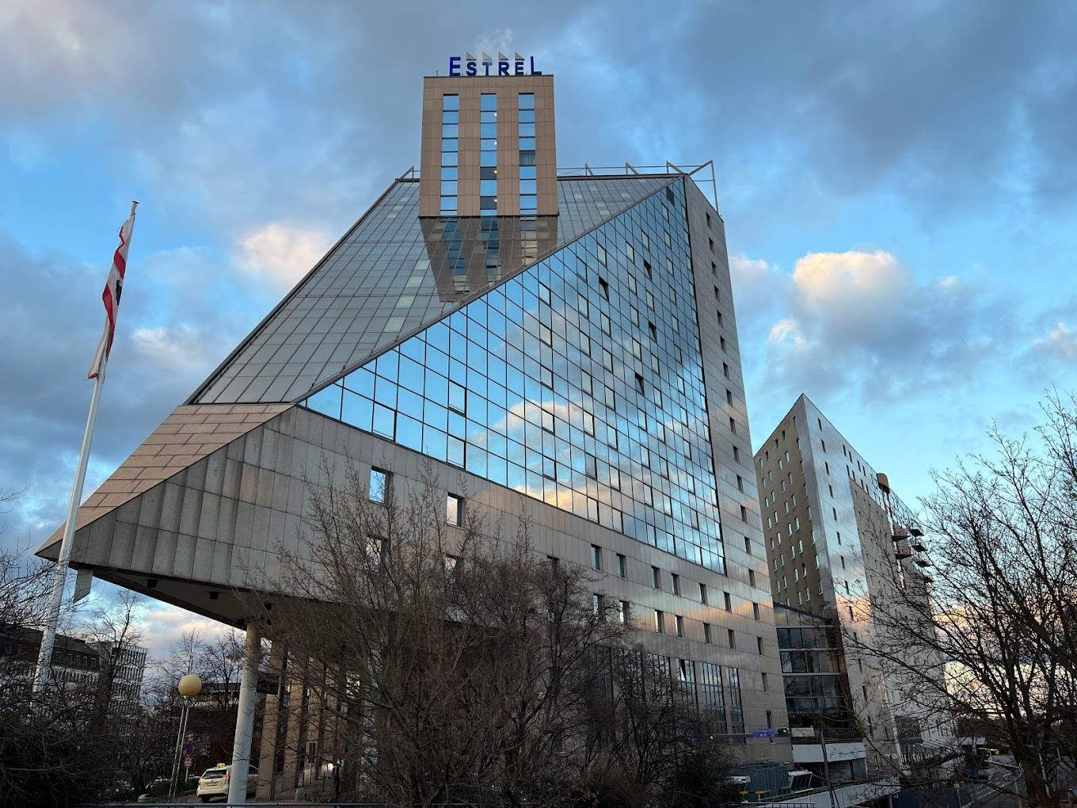

Task Group 15.4ab
Next Generation UWB Amendment
Mixed Mode 802 Plenary, July 2023
Live from Berlin Germany!
Objective: enhancements to 802.15.4 Ultra Wideband (UWB) physical layers (PHYs) medium access control (MAC) and associated ranging techniques while retaining backward compatibility with enhanced ranging capable devices (ERDEVs).

Slide 27
Task Group Organization
Chair: Benjamin Rolfe (BCA)¹
Vice Chair: Clint Powell (HID)
Vice Chair: Clint Chaplin (SRA) [Remote]
Vice Chair and Recording Secretary: David Xun Yang (Huawei)
Lead Technical Editor: Billy Verso (Qorvo)
  Thank you to all the volunteers!
¹ Affiliation Details here: https://mentor.ieee.org/802-ec/dcn/22/ec-22-0061-00-00EC-rolfe-affiliations-by-802-activity.pdf

Slide 28
Useful Links
Agenda: https://mentor.ieee.org/802.15/dcn/23/15-23-0305-08-04ab-july-2023-tg4ab-agenda.xlsx
Meeting Slides: https://mentor.ieee.org/802.15/dcn/23/15-23-0370-02-04ab-tg-15-4ab-july-2023-meeting-slides.pptx

Slide 29
Session Objectives
Refine and Complete TFDs for the baseline draft
Refine and Complete TFDs for the baseline draft
Plan for review and WG Comment collection

Slide 30
Technical Updates (1)
15-23-0185 | https://mentor.ieee.org/802.15/dcn/23/15-23-0185-01-04ab-discussion-on-mms-mac-tfd.pptx
15-23-0332 | https://mentor.ieee.org/802.15/dcn/23/15-23-0332-00-04ab-considerations-on-channel-order-in-frequency-stitching.pptx
15-23-0331 | https://mentor.ieee.org/802.15/dcn/23/15-23-0331-00-04ab-follow-up-on-cir-scaling-and-quantization.pptx
15-23-0334 | https://mentor.ieee.org/802.15/dcn/23/15-23-0334-00-04ab-public-advertisement-for-nba-uwb-mms-native-discovery-follow-up.pptx
15-23-0327 | https://mentor.ieee.org/802.15/dcn/23/15-23-0327-00-04ab-way-forward-on-rif-waveform.ppthttps://mentor.ieee.org/802.15/dcn/23/15-23-0327-00-04ab-way-forward-on-rif-waveform.pptx
15-23-0330 | https://mentor.ieee.org/802.15/dcn/23/15-23-0330-00-04ab-uwb-wake-up-burst-modulation-method.pptx
15-23-0376 | https://mentor.ieee.org/802.15/dcn/23/15-23-0376-01-04ab-post-processing-information-exchange-for-uwb-sensing.ppt
15-23-0373 | https://mentor.ieee.org/802.15/dcn/23/15-23-0373-01-04ab-tfd-for-nb-assisted-data-communications.docx
15-23-0372 | https://mentor.ieee.org/802.15/dcn/23/15-23-0372-00-04ab-uwb-based-report-in-nba-mms.docx
15-23-0314 | https://mentor.ieee.org/802.15/dcn/23/15-23-0314-00-04ab-proposed-modifications-on-nba-uwb-mac-text-proposal.docx
15-23-0335 | https://mentor.ieee.org/802.15/dcn/23/15-23-0335-00-04ab-text-proposal-for-15-4ab-secure-compressed-psdu.docx

Slide 31
Technical Updates (2)
15-23-0355 | https://mentor.ieee.org/802.15/dcn/23/15-23-0355-00-04ab-multiple-rsf-transmission-in-a-slot-framework-proposal.docx
15-23-0376 | https://mentor.ieee.org/802.15/dcn/23/15-23-0376-01-04ab-post-processing-information-exchange-for-uwb-sensing.ppt
15-23-0337 | https://mentor.ieee.org/802.15/dcn/23/15-23-0337-00-04ab-grouped-responders.pptx
15-23-0336 | https://mentor.ieee.org/802.15/dcn/23/15-23-0336-00-04ab-ds-twr-with-mms-ranging.pptx
15-23-0329 | https://mentor.ieee.org/802.15/dcn/23/15-23-0329-00-04ab-follow-up-on-the-cir-feedback-patterns.pptx
15-23-0403 | https://mentor.ieee.org/802.15/dcn/23/15-23-0403-00-04ab-optional-spreading-factor-l-16-for-ranging-integrity-fragments-rif.pptx
15-23-0338 | https://mentor.ieee.org/802.15/dcn/23/15-23-0338-01-04ab-nb-coexistence.pptx
15-23-0308 | https://mentor.ieee.org/802.15/dcn/23/15-23-0308-03-04ab-4ab-device-s-and-feature-sets.pptx
15-23-0413 | https://mentor.ieee.org/802.15/dcn/23/15-23-0413-00-04ab-summary-of-consensus-nba-uwb-mms-mac-updates.pptx
15-22-0538 | https://mentor.ieee.org/802.15/dcn/22/15-22-0538-06-04ab-proposal-of-sensing-framework.docx
15-23-0296 | https://mentor.ieee.org/802.15/dcn/23/15-23-0296-02-04ab-tfd-of-nb-cca-for-assisting-uwb-channel-access.docx

Slide 32
Project Schedule (working baseline)
Proposed project schedule |  | May-22 | Jun-22 | Jul -22 | Aug-22 | Sep-22 | Oct-22 | Nov-22 | Dec-22 | Jan-23 | Feb-23 | Mar-23 | Apr-23 | May-23 | Jun-23 | Jul-23 | Aug-23 | Sep-23 | Oct-23 | Nov-23 | Dec-23 | Jan-24 | Feb-24 | Mar-24 | Apr-24 | May-24 | Jun-24 | Jul-24 | Aug-24 | Sep-24 | Oct-24 | Nov24 | Dec 25 | Jan 26 | Feb 26 | Mar 26 | Apr 26
Hear and evaluate proposals
Cut-off for new proposals, PHY features
Cut-off for new proposals, MAC features
Integrate poposals/contributions into TFD
Develop draft from TFD
Draft 0
TG draft review and revision
Working group pre-ballot review
Pre-ballot review and comment resolution
First letter ballot
LB Comment Resolution
WG Recirculatoin
Comment resolution, 1st recirc
Conditional approval for SA ballot
WG Recirculatoin
Comment resolution, 2nd recirc and final recirc
First SA ballot
Comment resolution, first SA ballot
SA Resirculation
Comment resolution, SA recirculation
SA Resirculation
Comment resolution, 2nd SA recirc
Conditional or unconditional approval to RevCom
Optional 3rd SA recirc if needed
RevCom meets |  |  |  |  |  |  |  |  |  |  |  |  |  |  |  |  |  |  |  |  |  |  |  |  |  |  |  |  |  |  |  |  |  |  |  |  |  | `
You Are Here
Notes: SASB/RevCom schdule for 2024 a guess

Slide 33
Schedule Major Milestones
Near Term Working Milestones
 | Original Schedule | Current Schedule
Call for proposals | November 2021
Cut-off for new features (high level feature set), PHY | May 2022
Cut-off for new features (high level feature set), MAC | July 2022
Draft 0 | Post-January 2023 | Post March May 2023
TG draft review and revision complete | February - March 2023 | Mar-June 2023
Working group pre-ballot review and comment collection commence | March – May 2023 (following March meeting) | July 2023
First letter ballot | June 2023 (following meeting) | Oct 2023 [November]
…

Slide 34

Next Steps

Slide 35
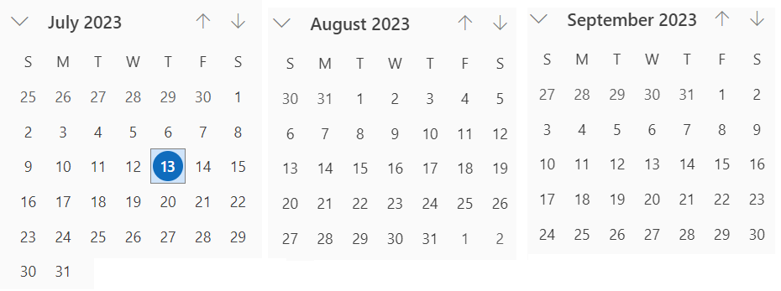
Interim Virtual Meeting (telecon) Schedule
You are Here
September Interim
Next
Cadence and Phase: Alternating weekly (25th,1st,8th,22nd,29th,5th)
Every other Tuesday 06:00 PT and Alternate Tuesdays 10:00pm (22:00) PT
Note: If no agenda items by end of preceding Friday (AoA) call will be cancelled
06:00 PT
22:00 PT

Slide 36
Interim Virtual Meeting (telecon) Schedule
Date | San Diego | Berlin | Beijing | Seoul
July 25th | 06:00 | 15:00 | 21:00 | 22:00
August 1st | 22:00 | 07:00 | 13:00 | 14:00
August 8th | 06:00 | 15:00 | 21:00 | 22:00
August 15th | 22:00 | 07:00 | 13:00 | 14:00
August 22nd | 06:00 | 15:00 | 21:00 | 22:00
August 29th | 22:00 | 07:00 | 13:00 | 14:00
September 5th | 06:00 | 15:00 | 21:00 | 22:00

Slide 37
TG4ac (Privacy)
July 2023
Closing Report

Slide 38
Detailed Agenda for July
Tuesday 11th of July 1030-1230
    Opening slides
              Approve agenda 15-23-0365 page 11
              Approve minutes 15-23-0289-00
    Go through submissions
    Discuss about the format of the privacy MAC address
Thursday 13th of July 1600-1800
    Go through list of issues that privacy group needs to address
    Closing report

Slide 39
More information
List of issues can be found in the document 15-23-0253.
See WNG presentation 15-22-0477-00.

Slide 40
Meeting achievements
Presentation about privacy addresses to the joint 802.15/802.1.
Decided to use AAI-64 for privacy addresses.
Updated the list of issues.
Appointed vice-chair and secretary for the TG.

Slide 41
Meeting achievements
Two sessions
Try to coordinate so it does not overlap 802.11bi, or 802.11bh.
  Continue working on the issues

Slide 42
TG4me (Revision to 802.15.4 2020)
July 2023
Closing Report

Slide 43
15.4me Sessions this Week
 | Monday | Tuesday | Wednesday | Thursday
AM 1 | Opening Plenary
AM 2 |  |  | Midweek Plenary
PM 1 |  |  | 802.14.4me Working Session | 802.14.4me Working Session
PM 2 |  | 802.14.4me Working Session
6:30p |  |  |  | Closing Plenary

Slide 44
Agenda
  Call for Patents
  Approve Minutes
  Review Submissions
  Next Steps
  Review Draft Timeline
  Reviewed and Upload Task List
  Next meetings

Slide 45
CLOSING REPORT
2 sessions held
All pre-letter ballot submitted comments were addressed: DCN 15-23-294-02-4me
Task Group approved moving 15.4 D00 to Letter Ballot
Task Group Motion:
Move that TG 802.15.4me formally request that the 802.15 WG start a WG Letter Ballot requesting approval of document P802-15-04me-D00 and to forward document P802-15-04me-D00, to Standards Association ballot .
Moved: Phil Beecher
Second: Tero Kivinen
No Objections
P802.15.4 D00 Has been posted to private area

Slide 46
CLOSING REPORT
P802.15.4 D00 Has been posted to private area
Motion for letter ballot sent to chair
Workgroup Ballot:
Move that 802.15 WG start a WG Letter Ballot requesting approval of document P802-15-04me-D00, to Standards Association ballot.
Moved: Gary Stuebing
Second: Phil Beecher\
Task List posted DCN 15-23-0400-4me
Minutes posted DCN 15-23-0399-4me
Preliminary Draft September agenda posted DCN 15-23-0386-00-4me

Slide 47
Task Group Motion:
Move that TG 802.15.4me formally request that the 802.15 WG start a WG Letter Ballot requesting approval of document P802-15-04me-D00 and to forward document P802-15-04me-D00, to Standards Association ballot
Moved: Phil Beecher
Second: Tero Kivinen
No Objections

Slide 48
Workgroup Ballot:
Move that 802.15 WG start a WG Letter Ballot requesting approval of document P802-15-04me-D00, to Standards Association ballot.
Moved: Gary Stuebing
Second: Phil Beecher

Slide 49
Draft Timeline
Jul/23 – REVIEW DRAFT REVISION – Workgroup Ballot
Sep/23 – Review of Comments (Form CRG)
Nov/23 – Comment Resolution and Recirc (Reform CRG)
Mar/24 – Sponsor Ballot and CRG
May/24 – Sponsor Recirc (CRG)
Jul/24 – Sponsor Recirc(CRG)
Sep/24 – Submit to Revcom

Slide 50
TG6ma (BAN/VAN)
July 2023
Closing Report

Slide 51
Objectives of TG 6ma – Enhanced Dependability Body Area Network (ED-BAN)
Objective: Enhancements to the BAN Ultra Wideband (UWB) physical layer (PHY) and media access control (MAC) to support enhanced dependability to a human BAN (HBAN) and adds support for vehicle body area networks (VBAN), a coordinator in a vehicle with devices around the vehicular cabin.
Action:
Making draft#1 of Summered Draft Proposals
Finalize Channel and Coexisting Models
Summary of Technologies in PHY; Channel Coding According to 8 QoS Levels of Packets and Coexistence Levels, Interference Mitigation, etc.
Summary of Technologies in MAC; Channel Management, CCA, Hybrid Contention Free/Access Protocol According to 8 QoS’s and Coexistences.
Harmonization or Commonality with 4ab in Coexistence and Feasible Implementation of 6ma and 4ab
Feasibility of TSN of 802.1 in MAC
Next Things to Do：
Finalize draft#1 of Integrated Proposal to Satisfy Technical Requirements
Slide 51

Slide 52
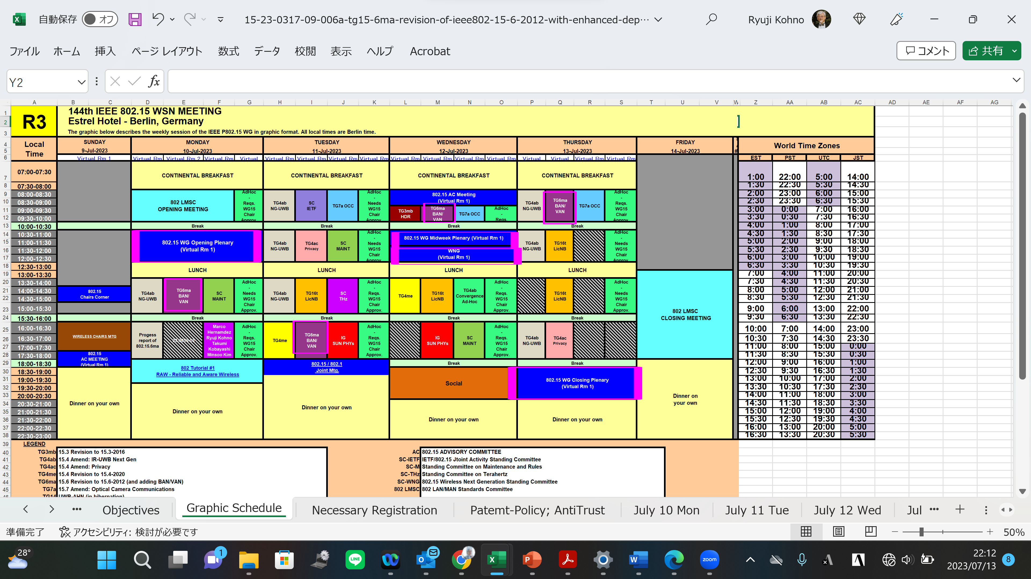
TG15.6ma Interim Session Schedule for 10-14th, July 2023
TG15.6ma has three own sessions such as
Session1(Virtual RM#2) PM1 13:30-15:30 July 10(MON) in Berlin time, 20:30-22:30 July 10(MON) in JST/KST
Session2(Virtual RM#2) PM2 16:00-18:00 July 11(TUE) in Berlin time, 23:00 July 11-1:00 July 12(WED) in JST/KST
Session3(Virtual RM#2) AM1 9:00-10:00 July 12(WED) in Berlin time, 16:00-17:00 July(WED) in JST/KST
Session4(Virtual RM#2) AM1 8:00-10:00 July 13(THU) in Berlin time, 15:00-17:00 July 13(THU) in JST/KST
Slide 52

Slide 53
TG15.6ma Interim Session Schedule for 10-14th, July 2023
TG15.6ma has three own sessions such as
Session1(Virtual RM#2) PM1 13:30-15:30 July 10(MON) in Berlin time, 20:30-22:30 July 10(MON) in JST/KST
Session2(Virtual RM#2) PM2 16:00-18:00 July 11(TUE) in Berlin time, 23:00 July 11-1:00 July 12(WED) in JST/KST
Session3(Virtual RM#2) AM1 9:00-10:00 July 12(WED) in Berlin time, 16:00-17:00 July(WED) in JST/KST
Session4(Virtual RM#2) AM1 8:00-10:00 July 13(THU) in Berlin time, 15:00-17:00 July 13(THU) in JST/KST
TG 15.6ma Session1, MON PM1 (Virtual Room #2)
1:30 PM - 3:30PM July 10(MON) Local Atlanta Time of Berlin (UTC+2)
8:30PM July 10(MON) -10:30 July 10(MON) (UTC-4:00) Japan & Korea Time,
11:30-13:30AM July 10(MON) UTC
TG 15.6ma Session2, Tue PM2 (Virtual Room #2)
4:00-6:00PM July 11 (TUE)Local Berlin Time(UTC+2)
11:00PM July 11(TUE) -1:00 July 12(WED) (UTC-4:00) Japan & Korea Time,
2:00 - 4:00PM July 11(TUE) UTC
TG 15.6ma Session3, WED AM1 (Virtual Room #2) 9:00 – 10:00 July 12(WED) ocal Berlin Time(UTC+2)
16:00 - 17:00 July 12(WED) (UTC-4:00) Japan & Korea Time,
TG 15.6ma Session4, THU AM1 (Virtual Room #2)
8:00-10:00 July 13(THU)Local Berlin Time(UTC+2)
3:00 -5:00PM July 13(THU) (UTC-4:00) Japan & Korea Time,
6:00-8:00AM July 13(THU) UTC
https://ieeesa.webex.com/ieeesa/j.php?MTID=ma228bfce333fa1ab3f9fcf3bc1421dfd
Meeting number: 2347 246 7070
Password: 80215julymtgrm2
Slide 53

Slide 54
Agenda items for the week
TG15.6ma meeting call to order
Call for essential patents and policies & procedures reminder
Opening report of TG6ma in July meeting doc.#15-23-0318-01-06ma
Approve last meeting minutes: TG 15.6ma Meeting Minutes for May 2023 doc.#15-23-0282-00-06ma
Agenda of TG15.6ma July Meeting doc.#15-23-0317-00-06ma
Review and Summary
  1. IG DEP, SG & TG15.6a Activity for Revision of IEEE802.15.6 BAN with Enhanced Dependability 22-0339-03-06ma
  2. Progress and Action Items for Draft#1 doc.#15-23-0360-00-006ma
  Rescheduling Timeline doc.#15-23-0361-01-06ma
  Preliminary harmonization with 4ab doc.#15-23-0634-03-06ma
  Presentation
  Overview and convergence of MAC proposals for 15.6ma doc.#15-23-0408-00-006ma
  Qualitative approach to coexistence and QoS mechanisms doc.#15-23-0101-03-06ma
  Definition of Coexistence Levels and How to Support Higher Levels doc.#15-22-0631-04-06ma
  Simulation results for Nagoya I. T. and YRP-IAI MAC proposal Based on TG6ma Channel Model 23-0352-00-06ma
  MAC Protocol Proposal for Multiple BAN Environment (Level 1,2,3) doc.#15-22-0639-02-06ma
  Proposed text for 6ma MAC - 4. General framework elements doc.#15-23-0322-00-0dma
  Proposed text for 6ma MAC - Beacon Access Phase doc.#15-23-0367-00-06ma
  Proposal of control and data channels unification for 6ma MAC doc.#15-23-0387-00-06ma
  Overview and convergence of MAC proposals for 15.6ma doc.#15-23-0408-00-06ma
  Ranging and localization in TG6ma doc.#15-23-0402-00-06ma
  Preliminary performance evaluation of ranging in coexience environment doc.#15-23-0353-00-06ma
  Summary Table of Channel and Environmental Modeling Activities for BANs on TG15.6madoc.#15-23-00045-04-06ma
  Low Complexity Adaptive Schemes for Energy Detection Threshold in the IEEE802.15.6 CSMA/CA 23-0406-00-06ma
  Overview of Ranging and Localization of TG6ma doc.#15-23-0402-00-06ma
  Overview of FEC proposals for 15.6ma doc.#15-22-0611-04-06ma
  16. Harmonization with 4ab: data rates & FEC doc.#15-22-0610-04-06ma
  17. Progress Report of TG6ma doc.#15-23-0056-03-06ma
  18. TG6ma draft revision doc.#15.23-0405-00-06ma
Slide 54

Slide 55
QoS Levels of Packets corresponding to User Priority
In Std.15.6 WBAN systems, a various data such as vital signs, skin temperature, blood pressure, ECG, EEG, ECoG, and vehicle controlling commons have different QoS levels corresponding to user priority.
In 15.6ma for dependable WBAN for human and vehicles, data packet transmission should be dependable according to QoS levels even in various classes of coexistence environment.
Therefore, appropriate sets of error controlling scheme with FEC and hybrid ARQ corresponding to QoS levels have been standardized in 15.6ma,
User priority | Traffic designation | Frame type
0 | Background (BK) | Data
1 | Best effort (BE) | Data
2 | Excellent effort (EE) | Data
3 | Video (VI) | Data
4 | Voice (VO) | Data
5 | Medical data or network control | Data or management
6 | High-priority medical data or network control | Data or management
7 | Emergency or medical implant event report | Data

Slide 56
Definition of Coexistence Environment Classes
Coexistence Class | Coexisting system(s) |  |  |  |  | Category
Level | 802.15.6ma | 802.15.6-2012 | Non-UWB (ex. Wi-Fi / Unlicensed / 3GPP) | 802.15 UWB (ex. 802.15.4) | Non-802.15 UWB (ex. ETSI SmartBAN) | Category
0 | - | - | - | - | - | Single BAN
1 (1a) | ✓ | - | - | - | - | Multiple 15.6 BANs
2 (1b) | ✓ | ✓ | - | - | -
3 | ✓ | - | ✓ | - | - | Non-UWB
4 (2a) | ✓ | - | - | ✓ | - | Multiple UWB systems
5 (2b) | ✓ | - | - | - | ✓
6 (2c) | ✓ | - | - | ✓ | ✓
7 | ✓ | ✓ | ✓ | ✓ | ✓ | Final Boss
The coexistence class has been redefied to 8 levels, which can be represented by 3 bits and would be suitable to include in PHY or MAC headers.

Slide 57
Timeline details.
Topic | Deadline | Notes
Technical Requirements Document (TRD). Channel Model Document (CMD). Call for Proposals. | Sept. 2022 | TRD describes the technical requirements baseline for the evaluation of proposals. The CMD contains the channel models for different use cases targeted by the Std. Announcement of call for proposals.
Due day for proposals | March 10th, 2023 | Postponed from January 2023
Presentation of proposals | Nov. 2022, January, March 2023 | Start of discussions for harmonization of proposals.
Harmonization of Proposals | March 2023 | Agreements on key technologies.
Std Draft v.0 | May 2023 | Mostly editorial revisions and start integrating text of agreed proposals.
Preliminary Std Draft v. 1 | July 2023 | Upload preliminary draft V1 in WG private repository and collecting comments to be used for revision.
Std Draft v. 1 | August 2023 | TG approval
WG pre-ballot | September 2023 | WG pre-ballot submission.
Comments and resolution for pre-ballot. | November 2023 | Finish resolutions to pre-ballot comments and recirculation.
WG letter ballot (LB) | January 2024 | LB submission
LB recirculation | January 2024 | Comment-resolutions to LB recirculation
Conditional approval for Sponsor Ballot (SB) | January 2024 | Seek conditional approval
Final LB recirculation. EC approval | March 2024 | Just before the March meeting.
EC approval to SB | March 2024
SB submission | March 2024
SB recirculation | May 2024 | Resolutions to SB.
Conditional/unconditional approval to RevCom | May 2024 | Submission to SASB agenda
SB recirculation if required | June 2024
RevCom submission | June 2024 | RevCom approval
Note: the deadlines are subject to change.

Slide 58
Contributions
・TG15.6ma opening report for July 2023 meeting 15-23-0318-02-06ma
・TG15.6ma Agenda of July Meeting in 2023 15-23-0317-10-06ma
・TG6ma Progress Report 15-23-0056-03-06ma
・Definition of Coexistence Levels and How to Support Higher Levels 15-22-0631-03-06ma
・Qualitative approach to coexistence and QoS mechanisms 15-23-0101-02-06ma
・ Rescheduling Timeline 15-23-0361-01-06ma
・Preliminary harmonization with 4ab 15-23-0634-03-06ma
・Overview and convergence of MAC proposals for 15.6ma 15-23-0408-00-006ma
・Simulation results for Nagoya I. T. and YRP-IAI MAC proposal Based on TG6ma Channel Model 23-0352-00-06ma
・MAC Protocol Proposal for Multiple BAN Environment (Level 1,2,3) 15-22-0639-02-06m
・Proposed text for 6ma MAC - 4. General framework elements 15-23-0322-00-0dma
・Proposed text for 6ma MAC - Beacon Access Phase 15-23-0367-00-06ma
・Proposal of control and data channels unification for 6ma MAC 15-23-0387-00-06ma
・Overview and convergence of MAC proposals for 15.6ma 15-23-0408-00-06ma
・Ranging and localization in TG6ma 15-23-0402-00-06ma
・Preliminary performance evaluation of ranging in coexience environment 15-23-0353-00-06ma
・Summary Table of Channel and Environmental Modeling Activities for BANs on TG15.6ma23-00045-04-06ma
・Low Complexity Adaptive Schemes for Energy Detection Threshold in the IEEE802.15.6 CSMA/CA 23-0406-00-06ma
・Overview of Ranging and Localization of TG6ma 15-23-0402-00-06ma
・Overview of FEC proposals for 15.6ma 15-22-0611-04-06ma
・Harmonization with 4ab: data rates & FEC 15-22-0610-04-06ma
・Progress Report of TG6ma 15-23-0056-03-06ma
・TG6ma draft revision 15.23-0405-00-06ma
・TG15.6ma closing report for July 2023 meeting 15-23-0404-00-06ma
・ TG15.6ma July 2023 meeting minutes 15-23-0405-00-06ma
Slide 58

Slide 59
Contacts and Conference call
Chair; Ryuji Kohno, YNU/YRP-IAI
kohno@ynu.ac.jp, kohno@yrp-iai.jp
Vice-Chair; Marco Hernandez, YRP-IAI/CWC
Marco.Hernandez@ieee.org
Daisuke Anzai, NIT anzai@nitech.ac.jp
Secretary; Takumi Kobayashi, YNU/TCU
kobayashi-takumi-ch@ynu.ac.jp
Technical Coeditors; Minsoo Kim, YRP-IAI
minsoo@minsookim.com
Seong-Soon Joo, Korea Platform Service Technology (KPST) wowbk@kpst.co.kr
Slide 59

Slide 60
TG7a (HR LR OCC)
July 2023
Closing Report

Slide 61
Accomplishment for the meeting
3 Slots (on Tue., Wed., and Thur.)
1st Slot:
  Meeting Objectives and Agenda Approval (377-00)
  Approval May meeting minutes (291-00)
  Comment Resolution for 802.15 Letter Ballot 2nd Recirculation (381-00)
2nd Slot:
  Meeting Objectives and Agenda Approval (377-01)
  Comment Resolution for 802.15 Letter Ballot 2nd Recirculation (381-00)
  3rd Slot:
  Meeting Objectives and Agenda Approval (377-02)
  Comment Resolution for 802.15 Letter Ballot 2nd Recirculation (381-02)
  Discussion of TG and WG Motion
  Plan for Teleconference schedule
  Plan for September meeting
Slide 61

Slide 62
TG Motion #1
TG7a Motion to approve May 2023 Interim Meeting Minutes
Motion to approve the May 2023 Interim Meeting minutes of TG7a in IEEE P802.15-23-291-00-007a
Moved By: Yeong Min Jang
Seconded By: Sang-Kyu Lim
Approved by unanimous consent
Slide 62

Slide 63
TG Motion #2
TG7a Motion to approve comment resolutions for LB196
Move that the TG7a approve the comment resolutions for LB196 as described in document IEEE P802.15-23-0381-02-007a
Moved By: Yeong Min Jang
Seconded By: Sang-Kyu Lim
Approved by unanimous consent
Slide 63

Slide 64
TG Motion #3
      TG Motion to start 3rd recirculation
Move that TG7a formally request that the 802.15 WG start recirculation WG Letter Ballot requesting approval of CA document [15-22-0292-r3] and document P802-15-7a_D5 and to forward document P802-15-7a_D5, to Standards Association ballot
Moved By: Yeong Min Jang
Seconded By: Sang-Kyu Lim
Approved by unanimous consent
Slide 64

Slide 65
TG Motion #4
    TG Motion to approve the formation of CRG for the WG recirculation ballot
Move that 802.15.7a TG approve the formation of a Comment Resolution Group (CRG) for the WG balloting of the P802.15.7a_D5 with the following membership: Yeong Min Jang(Chair), Sang-Kyu Lim, Ryuji Kohno, and Seongsoon Joo. The 802.15.7a CRG is authorized to approve comment resolutions, edit the draft according to the comment resolutions, and to approve the start of recirculation ballots of the revised draft on behalf of the 802.15 WG. Comment resolution on recirculation ballots between sessions will be conducted via reflector email and via teleconferences announced to the reflector as per the LMSC 802 WG P&P.
Moved By: Yeong Min Jang
Seconded By: Sang-Kyu Lim
Approved by unanimous consent
Slide 65

Slide 66
WG Motion #1
      Draft needs to be edited prior to letter ballot
Move that 802.15 WG start a WG recirculation Letter Ballot requesting approval of CA document 15-22-0292-r3 and document P802.15.7a_D5 (as edited in accordance with the instructions in document 15-23-0381-02-007a) and to forward document P802.15.7a_D5, as edited in accordance with the instructions in document 15-23-0381-02-007a, and CA document 15-22-0292-r3 to Standards Association ballot pending the completion and inclusion of the edits in the draft.
Moved By Yeong Min Jang
Seconded By Phil Beecher
Approved by 38/0/2 (Yes/No/Abstain)
Slide 66

Slide 67
WG Motion #2
    CRG formation for a WG Letter Ballot
Move that 802.15 WG approve the formation of a Comment Resolution Group (CRG) for the WG balloting of the P802.15.7a_D5 with the following membership: Yeong Min Jang(Chair), Sang-Kyu Lim, Ryuji Kohno, and Seongsoon Joo. The 802.15.7a CRG is authorized to approve comment resolutions, edit the draft according to the comment resolutions, and to approve the start of recirculation ballots of the revised draft on behalf of the 802.15 WG. Comment resolution on recirculation ballots between sessions will be conducted via reflector email and via teleconferences announced to the reflector as per the LMSC 802 WG P&P.
Moved By Yeong Min Jang
Seconded By Phil Beecher
Approved by 36/0/1(Yes/No/Abstain)
Slide 67

Slide 68
Plan for Teleconference Schedule
2 teleconferences (9:00 pm (EST) on Aug. 23 and Sep. 6)
- (10:00 am (KST) on Aug. 24 and Sep. 7)
Complete comment resolution for LB4 (LB 3rd Recirculation)
Slide 68

Slide 69
Plan for September Meeting
3 slots (8:00 am on Tue., Wed., and Thur.)
Complete comment resolution for LB4 (LB 3rd Recirculation)
Prepare the D6 document for initial SA Ballot
Slide 69

Slide 70
TG16t (Lic-NB)
July 2023
Closing Report

Slide 71
Plan for week
Tuesday PM1 1:30pm EDT
Wednesday PM1 1:30pm EDT
Thursday AM2 10:30am EDT
Thursday PM1 1:30pm EDT
Slide 71

Slide 72
TG16t July Plenary Agenda
Introductions, Secretary, Review and Approve Agenda
Policy Review
Contributions and Comment Resolution on pre-Draft
Adjourn
Slide 72

Slide 73
July Meeting Start Status
Discussions at 30 May teleconference on developing next draft
Draft 0.92 was not ready for comment collection
Several updates to document 643 on DPP text have been uploaded.
Slide 73

Slide 74
Contributions for July 2023 Plenary
Tuesday
11-Jul-2023 ET | 2023 | 385 | 0 | TG16t (Lic-NB) | D0.92 for Vishal comments | Juha Juntunen (MCC) | 11-Jul-2023 05:26:33 ET | Download, Revise
11-Jul-2023 ET | 2022 | 643 | 21 | TG16t (Lic-NB) | Direct Peer to Peer | Vishal Kalkundrikar (Ondas) | 11-Jul-2023 05:16:15 ET | Download, Revise
11-Jul-2023 ET | 2023 | 382 | 0 | TG16t (Lic-NB) | DPP Relative Changes | Vishal Kalkundrikar (Ondas) | 11-Jul-2023 05:16:54 ET | Download, Revise
Slide 74

Slide 75
Contributions for July 2023 Plenary
Wednesday
12-Jul-2023 ET | 2023 | 398 | 0 | TG16t (Lic-NB) | DPP Pairing and Authentication PPT | Vishal Kalkundrikar (Ondas) | 12-Jul-2023 07:13:09 ET | Download, Revise
12-Jul-2023 ET | 2022 | 643 | 22 | TG16t (Lic-NB) | Direct Peer to Peer | Vishal Kalkundrikar (Ondas) | 12-Jul-2023 04:30:40 ET | Download, Revise
12-Jul-2023 ET | 2023 | 385 | 2 | TG16t (Lic-NB) | D0.92 for Vishal comments | Juha Juntunen (MCC) | 12-Jul-2023 02:11:43 ET | Download, Revise
Slide 75

Slide 76
Contributions for July 2023 Plenary
Thursday
13-Jul-2023 ET | 2022 | 643 | 23 | TG16t (Lic-NB) | Direct Peer to Peer | Vishal Kalkundrikar (Ondas) | 13-Jul-2023 03:29:13 ET | Download, Revise
13-Jul-2023 ET | 2023 | 410 | 0 | TG16t (Lic-NB) | direct peer to peer comments JJ | Juha Juntunen (MCC) | 13-Jul-2023 03:09:52 ET | Download, Revise
12-Jul-2023 ET | 2023 | 385 | 3 | TG16t (Lic-NB) | D0.92 for Vishal comments | Juha Juntunen (MCC) | 12-Jul-2023 09:26:06 ET | Download, Revise
Slide 76

Slide 77
Meeting Notes
Review draft P802.16t_ D0.92_forVishal.pdf (Dated 6/27)
Review notes in “15-23-0385-01-016t-d0-92-for-vishal-comments (Review Notes)”
  Upload to Mentor with review comments up to 8.6.7.5 TX signal filtering
Wednesday
  Presentation of “: DPP Pairing and Authentication Presentation” 398r0.
  Further work on TLS details and mode for AES will be applied to additional update to DPP document 643 next revision.
  Upload notes in “15-23-0385-03-016t-d0-92-for-vishal-comments (Review Notes)”
    Actions for Yael and Vishal
  Adjust 15-22-0643 to follow draft format and structure. Align Word clauses to draft structure.
  Vishal will update 643r22 and convert to framemaker, and use it as master going forward.
Thursday
  Define “Band” as a “frequency range that is partitioned into sub-channels”
Slide 77

Slide 78
Output Documents
Tuesday and Wednesday comment resolutions in 15-23-0385-03-016t-d0-92-for-vishal-comments.docx
Thursday comment resolutions in 15-23-0410-02-016t-direct-peer-to-peer-comments-jj.docx.
Latest DPP Clause draft text 15-22-0643-23-016t-direct-peer-to-peer.docx
Slide 78

Slide 79
Next Steps following July Plenary
Comment resolutions from Thursday in are in 15-23-0410-01-016t-direct-peer-to-peer-comments-jj.docx.
Other comment resolutions in 15-23-0385-03-016t-d0-92-for-vishal-comments.docx
Incorporate new definition into Clause 3:
  Define “Band” as a “frequency range that is partitioned into sub-channels”
Vishal and Yael to create updated DPP text in 643r24.
Vishal and Harry to update draft to 0.93 based on 643r24 and new definition for Clause 3.
Develop list of 3rd party stakeholders to review draft from participants in TG in first year.
Draft 0.93 created by August 3rd
  Conduct WG Comment Collection starting August 5th running for 30 days.
  Share Draft 0.93 and 802.16-2017 with 3rd parties
Conduct Comment Resolution in September Interim (Sept 11-14)
Based on resolutions, develop draft 1.0 following September Interim.
Start WG Letter Ballot 1.0 when D1.0 is ready (Late September)
Slide 79

Slide 80
Project Timeline
Milestone | Date
Task Group Start | Jan 2020
SRD Approval | April 2021
SDD Approval | Jan 2022
Draft Development
Informal TG review of draft | Mar 2023
Working Group Letter Ballot | July Sept 2023
Working Group Recirculation Letter Ballot | Sep Nov 2023
SA Ballot | Jan Mar 2024
Forward to RevCom | July Sept 2024
PAR Expiration Date: 31 Dec 2024
If needed, request PAR extension July 2024
Slide 80

Slide 81
IG (NG-SUN PHYs)
July 2023
Closing Report

Slide 82
Closing Report for SUN-PHY IG
Review Call to action submissions
  64-QAM extension for the SUN OFDM PHY (15-23-0389-00-04ad)
  Preamble proposal for the SUN OFDM-LR PHY (15-23-0391-00-04ad)
  SUN extension related to SUN-OFDM and SUN-FSK (15-23-0390-00-04ad)
IG worked on creating a Study Group formation ask to the WG chair
  Name and short description of what we are going to study
  Name : Next Generation SUN PHY Study Group
  Description : Additional improvement to the SUN-OFDM specification with a particular focus on long-range communication in highly congested environments. Higher data rate options for SUN-OFDM, improved robustness, and additional frequency range for SUN PHY.
  Chair of Study Group : Thomas Almholt (TI)
Next steps:
  Draft a PAR in September
    Ask for 2 sessions at the September meeting AM1 or AM2
    Schedule 1 or 2 calls between now and next F2F meeting
  Working Group approval
  Submit 30 day in advance of Plenary (Next one is in November)

Slide 83
Webex meeting schedule
Date | San Diego | Berlin | Beijing | Seoul
August 1st | 06:00 | 15:00 | 21:00 | 22:00
August 15th | 22:00 | 07:00 | 13:00 | 14:00

Slide 84
List of Participants
Almholt, Thomas
Anzai, Daisuke
Baykas, Tuncer
Bims, Harry
Cha, Jaesang
Chen, Run
Choi, Jinsoo
Danev, Boris
Gilb, James
Gruber, Josef
Harada, Hiroshi
Hartman, James
Henry, Jerome
Huang, Lei
Jungnickel, Volker
Kalkundrikar, Vishal
Kerry, Stuart
Kitazawa, Shoichi
Kohno, Ryuji
Korn, Clemens
kristem, vinod
Lee, Jaegook
Li, Huan-Bang
LIU, CHENCHEN
Maman, Mickael
Nagai, Yukimasa
Palmer, Clark
Powell, Clint
Redlich, Oded
Robert, Joerg
Sasaki, Shigenobu
Schmidt, Reinhold
SHAHAR, MENASHE
Shilo, Shimi
Xiao, Libra
Zakaib, Larry

Slide 85
Motions
Motion:
That the 802.15 Working Group seeks approval from the IEEE 802 LMSC to form a study group in 802.15 to develop the PAR and CSD documents for “Next Generation SUN PHY” and additionally authorize the 802.15 WG Chair to make any necessary changes to these docs required to support the submission.
Moved: Thomas Almholt
Seconded: Phil Beecher

Slide 86
SC IETF
July 2023
Closing Report

Slide 87
Agenda for July
Discuss what will be going on IETF 117 in San Francisco (July 22 – 28, 2023)
Slide 87

Slide 88
IETF 116
IETF 116 was held in Yokohama, Japan between 25th of March and 31st of March, 2023.
The proceedings are available:
  https://datatracker.ietf.org/meeting/116/proceedings
Slide 88

Slide 89
IETF 117
IETF 117 will be held in San Francisco, CA, USA between 22th of July and 28th of July, 2023.
Registration is now open:
  https://registration.ietf.org/
Slide 89

Slide 90
Raw – Reliable and Available Wireless
Did meet in 116, will not meet 117
Document Status
  L-Band Digital Aeronautical Communications System (LDACS) was published as RFC9372
  RFC Editor queue
    https://datatracker.ietf.org/doc/draft-ietf-raw-use-cases/
  Awaiting write up
    https://datatracker.ietf.org/doc/draft-ietf-raw-technologies/

Slide 91
Raw WG Documents
WG Documents
  https://datatracker.ietf.org/doc/draft-ietf-raw-architecture/
  https://datatracker.ietf.org/doc/draft-ietf-raw-oam-support/
Expired WG drafts
  https://datatracker.ietf.org/doc/draft-ietf-raw-framework/
  https://datatracker.ietf.org/doc/draft-ietf-raw-industrial-requirements/
Slide 91

Slide 92
6lo – IPv6 over Networks of Resource-constrained Nodes
Did meet in 116, will meet in 117
  No agenda, no slides yet
Document status
  In RFC Editor queue
    https://datatracker.ietf.org/doc/draft‐ietf‐6lo‐nfc/
    https://datatracker.ietf.org/doc/draft‐ietf‐6lo‐use-cases/
Slide 92

Slide 93
6lo Work in progress
  Publication requested
    IPv6 ND Multicast Address Listener Registration
      https://datatracker.ietf.org/doc/draft‐ietf‐6lo‐multicast‐registration/
  Work in progress
    Transmission of SCHC-compressed Packets over IEEE 802.15.4
      https://datatracker.ietf.org/doc//draft-gomez-6lo-schc-15dot4/
    Path-Aware Semantic Addressing (PASA) for Low power and Lossy Networks
      https://datatracker.ietf.org/doc/draft-ietf-6lo-path-aware-semantic-addressing/
Slide 93

Slide 94
Lpwan – IPv6 over Low Power Wide-Area Networks
Did meet in 116, will meet in 117
  No agenda, no slides yet
Document status
  Static Context Header Compression over Narrowband Internet of Things was published as RFC9391
  RFC Editor queue
    https://datatracker.ietf.org/doc/draft-ietf-lpwan-schc-over-sigfox/
    https://datatracker.ietf.org/doc/draft-ietf-lpwan-schc-compound-ack/
Slide 94

Slide 95
Lake – Lightweight Authenticated Key Exchange
Did meet in 116, will meet in 117
  No agenda, no slides yet
Document status
  In IETF Last Call
    https://datatracker.ietf.org/doc/draft-ietf-lake-edhoc/
  Publication requested
    https://datatracker.ietf.org/doc/draft-ietf-lake-traces/
Slide 95

Slide 96
Suit – Software Updates for Internet of Things
Did meet in 116, will meet in 117
  No agenda, no slides yet
Document status
  Publication requested
        https://datatracker.ietf.org/doc/draft-ietf-suit-manifest/
Work in Progress
  https://datatracker.ietf.org/doc/draft-ietf-suit-firmware-encryption/
  https://datatracker.ietf.org/doc/draft-ietf-suit-report/
  https://datatracker.ietf.org/doc/draft-ietf-suit-mud/
  https://datatracker.ietf.org/doc/draft-ietf-suit-trust-domains/
  https://datatracker.ietf.org/doc/draft-ietf-suit-update-management/
  https://datatracker.ietf.org/doc/draft-moran-suit-mti/
Slide 96

Slide 97
BoFs in IETF 117
List of requested BoFs can be found from https://datatracker.ietf.org/doc/bof-requests
List of approved BoFs can be found from https://datatracker.ietf.org/wg/bofs/
BoFs for IETF 117
  dult
  keytrans
Slide 97

Slide 98
Detecting Unwanted Location Trackers (dult)
This document’s goal is to, in part, help protect the privacy of individuals from unwanted tracking by location-tracking accessories. Location-tracking accessories provide numerous benefits to consumers, but, as with all technology, it is possible for them to be misused. Misuse of location-tracking accessories can result in unwanted tracking of individuals or items for nefarious purposes such as stalking, harassment, and theft. Formalizing a set of best practices for manufacturers will allow for scalable compatibility with unwanted tracking detection technologies on various smartphone platforms and improve privacy and security for individuals.
Unwanted tracking detection can both detect and alert individuals that a location tracker separated from the owner's device is traveling with them, as well as provide means to find and disable the tracker. This document outlines technical best practices for location tracker manufacturers, which will allow for their compatibility with unwanted tracking detection and alerting technology on platforms.
Slide 98

Slide 99
Key Transparency
  The KEYTRANS working group will develop a standard for providing public verifiability for identity-to-public-key bindings in an end-to-end encrypted system. This standardized approach will be integrated into other, more complete end-to-end protocols and services.
  The solution the WG defines is expected to:
    Allow an end-user to upload their public key to a communications service provider, and download the public keys of other end-users.
    Allow end-users to verify on an ongoing basis (through the communications service provider) that they have a globally consistent view of which public keys have been associated with which accounts, including their own.
Slide 99

Slide 100
SC MAIN/RULES
July 2023
Closing Report

Slide 101
SC Meeting Achievements
    Reviewed PARs from 802.1 and 802.11
    Change requests for Operations Manual - none
    Reviewed and edited Project Action Items template –will be reposted as https://mentor.ieee.org/802.15/dcn/23/15-23-0083-03-0mag-project-task-list.xlsx
    Identified gaps in the Operations Manual

Slide 102
SCM Action Items for September 2023
      Provide template for SG report to LMSC - S2.4
      Provide latest CSD template into S2.7
      S2.10 reference in LMSC – OM
      Confirm existence of voter spreadsheet and provide reference S6.9
      Confirm existence of LB comment spreadsheet and provide reference S6.10
      Template motion to approve comment resolution spreadsheet S6.14
      Authorise SCM to act contribute PAR comments

Slide 103
SC THz
July 2023
Closing Report

Slide 104
Meetings/Contributions
2 meetings on Mon PM2, Tue PM1
Listening contributions:
  Thomas Kürner (TU Braunschweig, Germany): Presentation of ETSI ISG THz (23/0354
  H. Ogawa (NCT, Japan) Proposal to send information to APG23-6 meeting (23/0312)
  Thomas Kürner (TU Braunschweig, Germany): Simulation Scenarios for the Assessment of Reflective Intelligent Surfaces in THz Backhaul Applications (23/0342)
  Shigenobu Sasaki (Niigata University, Japan): Measurement and Characterization of 300 GHz Channel in a Corridor Environment (23/0328)
  Seung-Hyun Cho (ETRI, Korea): THz-band indoor network based on photonics technology (23/0346)
  Thomas Kürner (TU Braunschweig, Germany): xxx (23/0xxx)

Slide 105
Drafting Liaison Statements
Discussing the Liaison Statement from ETSI ISG THz (18-23-0343)
Formulating the response to the liaison statement form ETSI (15-23-344r2)
Formulating a Liaison Statement to APG (15-23-345r2)

Slide 106
SC Motion
Move that SC THz formally request that the 802.15 WG reviews and approve the response to the liaison from ETSI ISG THz in doc. IEEE 802.15-23-0344-02 and forward it to 802.18 TAG for submission to 802 EC.
Mover: Iwao Hosako
Seconder: Shigenobu Sasaki
4/0/0 Abstain

Slide 107
WG Motion
Move that 802.15 WG reviews and approves the response to the liaison from ETSI ISG THz in doc. IEEE 802.15-23-0344-02 and forward it to 802.18 TAG for submission to 802 EC.
Mover: Thomas Kürner
Seconder: Phil Beecher

Slide 108
SC Motion
Move that SC THz formally request that the 802.15 WG reviews and approve the liaison to APG in doc. IEEE 802.15-23-0345-02 and forward it to 802.18 TAG for submission to 802 EC.
Mover: Iwao Hosako
Seconder: Shigenobu Sasaki
5/0/0 Abstain

Slide 109
WG Motion
Move that 802.15 WG reviews and approves the response to the liaison to APG in doc. IEEE 802.15-23-0345-02 and forward it to 802.18 TAG for submission to 802 EC.
Mover: Thomas Kürner
Seconder: Phil Beecher

Slide 110
Next Meetings
  Requested September meetings slots for SC THz:
    None
    There will be alos no meeting in November
    Next SC THz meeting is planned for January at the Panama City Interim
      Workshop on future SC THz activities

Slide 111
SC WNG
July 2023
Closing Report

Slide 112

Agenda 12 July 2023
Opening and Meeting Reminders
Presentations and discussion
  Brief Overview of 802.15.4 Revision E
Any other business
Adjourn

Slide 113

The usual question
What do you propose the Working Group do next?

Slide 114
The answer to the usual question
The working group members, especially contributors to current 802.15.4 projects, please:
Review the draft
Become familiar with the new organization
Find the flaws!
Provide comments during LB!

