Slide 1
Project: IEEE P802.15 Working Group for Wireless Specialty Networks (WSN)
Submission Title: TG 15.4ab July 2023 Interim Session Closing Report
Date Submitted: 13 July 2023
Source: Benjamin A. Rolfe (Blind Creek Associates)
Contact:
Voice: [deprecated], E-Mail: ben.rolfe @ ieee.org
Re: Task Group 4ab: 802.15.4 UWB Next Generation
Abstract: Mixed-mode interim session closing report
Purpose: Emulate organization, encourage participation and make further progress
Notice: This document has been prepared to assist the IEEE P802.15. It is offered as a basis for discussion and is not binding on the contributing individual(s) or organization(s). The material in this document is subject to change in form and content after further study. The contributor(s) reserve(s) the right to add, amend or withdraw material contained herein.
Release: The contributor acknowledges and accepts that this contribution becomes the property of IEEE and may be made publicly available by P802.15.
Notes:
Jul 12, 2010
Page 1

Slide 2
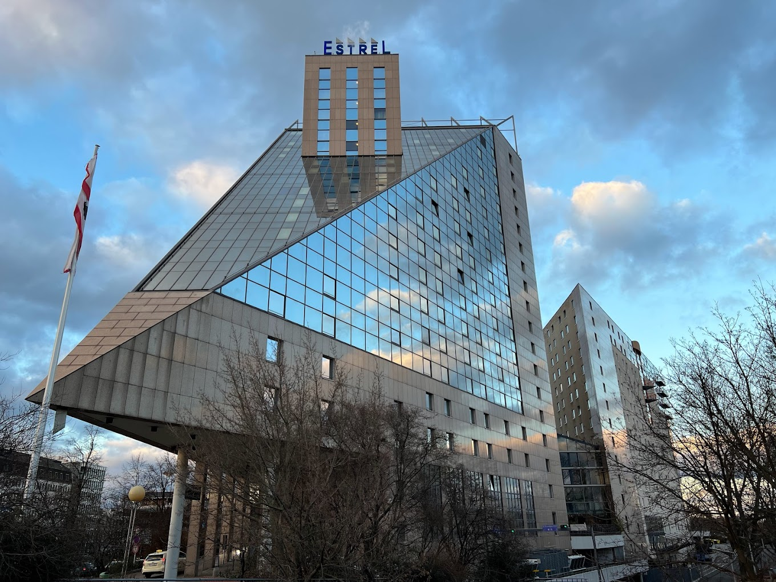
Task Group 15.4ab Next Generation UWB Amendment
Mixed Mode 802 Plenary, July 2023
Live from Berlin Germany!
Objective: enhancements to 802.15.4 Ultra Wideband (UWB) physical layers (PHYs) medium access control (MAC) and associated ranging techniques while retaining backward compatibility with enhanced ranging capable devices (ERDEVs).

Slide 3
Task Group Organization
Chair: Benjamin Rolfe (BCA)¹
Vice Chair: Clint Powell (Meta)
Vice Chair: Clint Chaplin (SRA) [Remote]
Vice Chair and Recording Secretary: David Xun Yang (Huawei)
Lead Technical Editor: Billy Verso (Qorvo)
Thank you to all the volunteers!
¹ Affiliation Details here: https://mentor.ieee.org/802-ec/dcn/22/ec-22-0061-00-00EC-rolfe-affiliations-by-802-activity.pdf

Slide 4
Useful Links
Agenda: https://mentor.ieee.org/802.15/dcn/23/15-23-0305-08-04ab-july-2023-tg4ab-agenda.xlsx
Meeting Slides: https://mentor.ieee.org/802.15/dcn/23/15-23-0370-02-04ab-tg-15-4ab-july-2023-meeting-slides.pptx

Slide 5
Session Objectives
Refine and Complete TFDs for the baseline draft
Refine and Complete TFDs for the baseline draft
Plan for review and WG Comment collection

Slide 6
Technical Updates (1)
15-23-0185 | https://mentor.ieee.org/802.15/dcn/23/15-23-0185-01-04ab-discussion-on-mms-mac-tfd.pptx
15-23-0332 | https://mentor.ieee.org/802.15/dcn/23/15-23-0332-00-04ab-considerations-on-channel-order-in-frequency-stitching.pptx
15-23-0331 | https://mentor.ieee.org/802.15/dcn/23/15-23-0331-00-04ab-follow-up-on-cir-scaling-and-quantization.pptx
15-23-0334 | https://mentor.ieee.org/802.15/dcn/23/15-23-0334-00-04ab-public-advertisement-for-nba-uwb-mms-native-discovery-follow-up.pptx
15-23-0327 | https://mentor.ieee.org/802.15/dcn/23/15-23-0327-00-04ab-way-forward-on-rif-waveform.ppthttps://mentor.ieee.org/802.15/dcn/23/15-23-0327-00-04ab-way-forward-on-rif-waveform.pptx
15-23-0330 | https://mentor.ieee.org/802.15/dcn/23/15-23-0330-00-04ab-uwb-wake-up-burst-modulation-method.pptx
15-23-0376 | https://mentor.ieee.org/802.15/dcn/23/15-23-0376-01-04ab-post-processing-information-exchange-for-uwb-sensing.ppt
15-23-0373 | https://mentor.ieee.org/802.15/dcn/23/15-23-0373-01-04ab-tfd-for-nb-assisted-data-communications.docx
15-23-0372 | https://mentor.ieee.org/802.15/dcn/23/15-23-0372-00-04ab-uwb-based-report-in-nba-mms.docx
15-23-0314 | https://mentor.ieee.org/802.15/dcn/23/15-23-0314-00-04ab-proposed-modifications-on-nba-uwb-mac-text-proposal.docx
15-23-0335 | https://mentor.ieee.org/802.15/dcn/23/15-23-0335-00-04ab-text-proposal-for-15-4ab-secure-compressed-psdu.docx

Slide 7
Technical Updates (2)
15-23-0355 | https://mentor.ieee.org/802.15/dcn/23/15-23-0355-00-04ab-multiple-rsf-transmission-in-a-slot-framework-proposal.docx
15-23-0376 | https://mentor.ieee.org/802.15/dcn/23/15-23-0376-01-04ab-post-processing-information-exchange-for-uwb-sensing.ppt
15-23-0337 | https://mentor.ieee.org/802.15/dcn/23/15-23-0337-00-04ab-grouped-responders.pptx
15-23-0336 | https://mentor.ieee.org/802.15/dcn/23/15-23-0336-00-04ab-ds-twr-with-mms-ranging.pptx
15-23-0329 | https://mentor.ieee.org/802.15/dcn/23/15-23-0329-00-04ab-follow-up-on-the-cir-feedback-patterns.pptx
15-23-0403 | https://mentor.ieee.org/802.15/dcn/23/15-23-0403-00-04ab-optional-spreading-factor-l-16-for-ranging-integrity-fragments-rif.pptx
15-23-0338 | https://mentor.ieee.org/802.15/dcn/23/15-23-0338-01-04ab-nb-coexistence.pptx
15-23-0308 | https://mentor.ieee.org/802.15/dcn/23/15-23-0308-03-04ab-4ab-device-s-and-feature-sets.pptx
15-23-0413 | https://mentor.ieee.org/802.15/dcn/23/15-23-0413-00-04ab-summary-of-consensus-nba-uwb-mms-mac-updates.pptx
15-22-0538 | https://mentor.ieee.org/802.15/dcn/22/15-22-0538-06-04ab-proposal-of-sensing-framework.docx
15-23-0296 | https://mentor.ieee.org/802.15/dcn/23/15-23-0296-02-04ab-tfd-of-nb-cca-for-assisting-uwb-channel-access.docx

Slide 8
Project Schedule (working baseline)
Proposed project schedule |  | May-22 | Jun-22 | Jul -22 | Aug-22 | Sep-22 | Oct-22 | Nov-22 | Dec-22 | Jan-23 | Feb-23 | Mar-23 | Apr-23 | May-23 | Jun-23 | Jul-23 | Aug-23 | Sep-23 | Oct-23 | Nov-23 | Dec-23 | Jan-24 | Feb-24 | Mar-24 | Apr-24 | May-24 | Jun-24 | Jul-24 | Aug-24 | Sep-24 | Oct-24 | Nov24 | Dec 25 | Jan 26 | Feb 26 | Mar 26 | Apr 26
Hear and evaluate proposals
Cut-off for new proposals, PHY features
Cut-off for new proposals, MAC features
Integrate poposals/contributions into TFD
Develop draft from TFD
Draft 0
TG draft review and revision
Working group pre-ballot review
Pre-ballot review and comment resolution
First letter ballot
LB Comment Resolution
WG Recirculatoin
Comment resolution, 1st recirc
Conditional approval for SA ballot
WG Recirculatoin
Comment resolution, 2nd recirc and final recirc
First SA ballot
Comment resolution, first SA ballot
SA Resirculation
Comment resolution, SA recirculation
SA Resirculation
Comment resolution, 2nd SA recirc
Conditional or unconditional approval to RevCom
Optional 3rd SA recirc if needed
RevCom meets |  |  |  |  |  |  |  |  |  |  |  |  |  |  |  |  |  |  |  |  |  |  |  |  |  |  |  |  |  |  |  |  |  |  |  |  |  | `
You are Here
Notes: SASB/RevCom schdule for 2024 a guess

Slide 9
Schedule Major Milestones
Near Term Working Milestones
 | Original Schedule | Current Schedule
Call for proposals | November 2021
Cut-off for new features (high level feature set), PHY | May 2022
Cut-off for new features (high level feature set), MAC | July 2022
Draft 0 | Post-January 2023 | Post March May 2023
TG draft review and revision complete | February - March 2023 | Mar-June 2023
Working group pre-ballot review and comment collection commence | March – May 2023 (following March meeting) | July 2023
First letter ballot | June 2023 (following meeting) | Oct 2023 [November]
…

Slide 10
Next Steps

Slide 11
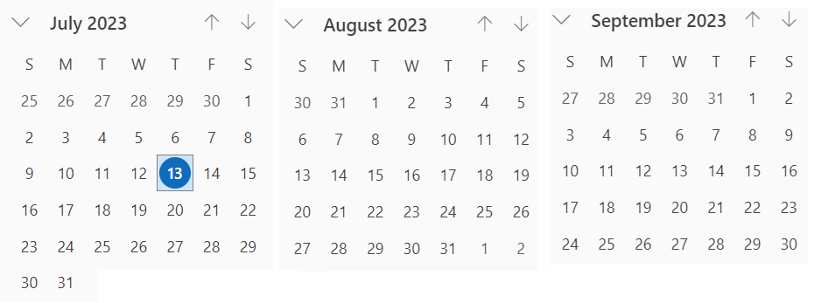
Interim Virtual Meeting (telecon) Schedule
You are Here
September Interim
Next
Cadence and Phase: Alternating weekly (25th,1st,8th,22nd,29th,5th)
Every other Tuesday 06:00 PT and Alternate Tuesdays 10:00pm (22:00) PT
Note: If no agenda items by end of preceding Friday (AoA) call will be cancelled
06:00 PT
22:00 PT

Slide 12
Interim Virtual Meeting (telecon) Schedule
Date | San Diego | Berlin | Beijing | Seoul
July 25th | 06:00 | 15:00 | 21:00 | 22:00
August 1st, | 22:00 | 07:00 | 13:00 | 14:00
August 8th, | 06:00 | 15:00 | 21:00 | 22:00
August 22nd, | 22:00 | 07:00 | 13:00 | 14:00
August 29th, | 06:00 | 15:00 | 21:00 | 22:00
September 5th | 22:00 | 07:00 | 13:00 | 14:00

Slide 13
Thanks

