Slide 1
Project: IEEE P802.15 Working Group for Wireless Personal Area Networks (WPANs)
Submission Title: [TG15.6ma Closing Report for July 2023]
Date Submitted: [13th July 2023]
Source: [Ryuji Kohno1,2,] [1;Yokohama National University, 2;YRP International Alliance Institute(YRP-IAI)]
Address [1; 79-5 Tokiwadai, Hodogaya-ku, Yokohama, 240-8501 Japan
2; YRP1 Blg., 3-4 HikarinoOka, Yokosuka-City, Kanagawa, 239-0847 Japan]
Voice:[1; +81-90-5408-0611], FAX: [+81-45-383-5528],
Email:[1: kohno@ynu.ac.jp, 2: kohno@yrp-iai.jp] Re: []
Abstract: [This document contains closing report for TG15.6ma for Revision of P802.15.6-2012 with Enhanced Dependability July 2023.]
Purpose: [information]
Notice: This document has been prepared to assist the IEEE P802.15. It is offered as a basis for discussion and is not binding on the contributing individual(s) or organization(s). The material in this document is subject to change in form and content after further study. The contributor(s) reserve(s) the right to add, amend or withdraw material contained herein.
Release: The contributor acknowledges and accepts that this contribution becomes the property of IEEE and may be made publicly available by P802.15.

Slide 2
IEEE 802.15 TG6ma
(Revision of IEEE802.15.6-2012)
Closing Report
In Personal and Virtual Hybrid Plenary Session
Berlin, Germany
July 13th, 2023
Ryuji Kohno
Yokohama National University(YNU),
YRP International Alliance Institute(YRP-IAI)

Slide 3
Objectives of TG 6ma – Enhanced Dependability Body Area Network (ED-BAN)
Objective: Enhancements to the BAN Ultra Wideband (UWB) physical layer (PHY) and media access control (MAC) to support enhanced dependability to a human BAN (HBAN) and adds support for vehicle body area networks (VBAN), a coordinator in a vehicle with devices around the vehicular cabin.
Action:
Making draft#1 of Summered Draft Proposals
Finalize Channel and Coexisting Models
Summary of Technologies in PHY; Channel Coding According to 8 QoS Levels of Packets and Coexistence Levels, Interference Mitigation, etc.
Summary of Technologies in MAC; Channel Management, CCA, Hybrid Contention Free/Access Protocol According to 8 QoS’s and Coexistences.
Harmonization or Commonality with 4ab in Coexistence and Feasible Implementation of 6ma and 4ab
Feasibility of TSN of 802.1 in MAC
Next Things to Do：
Finalize draft#1 of Integrated Proposal to Satisfy Technical Requirements

Slide 4
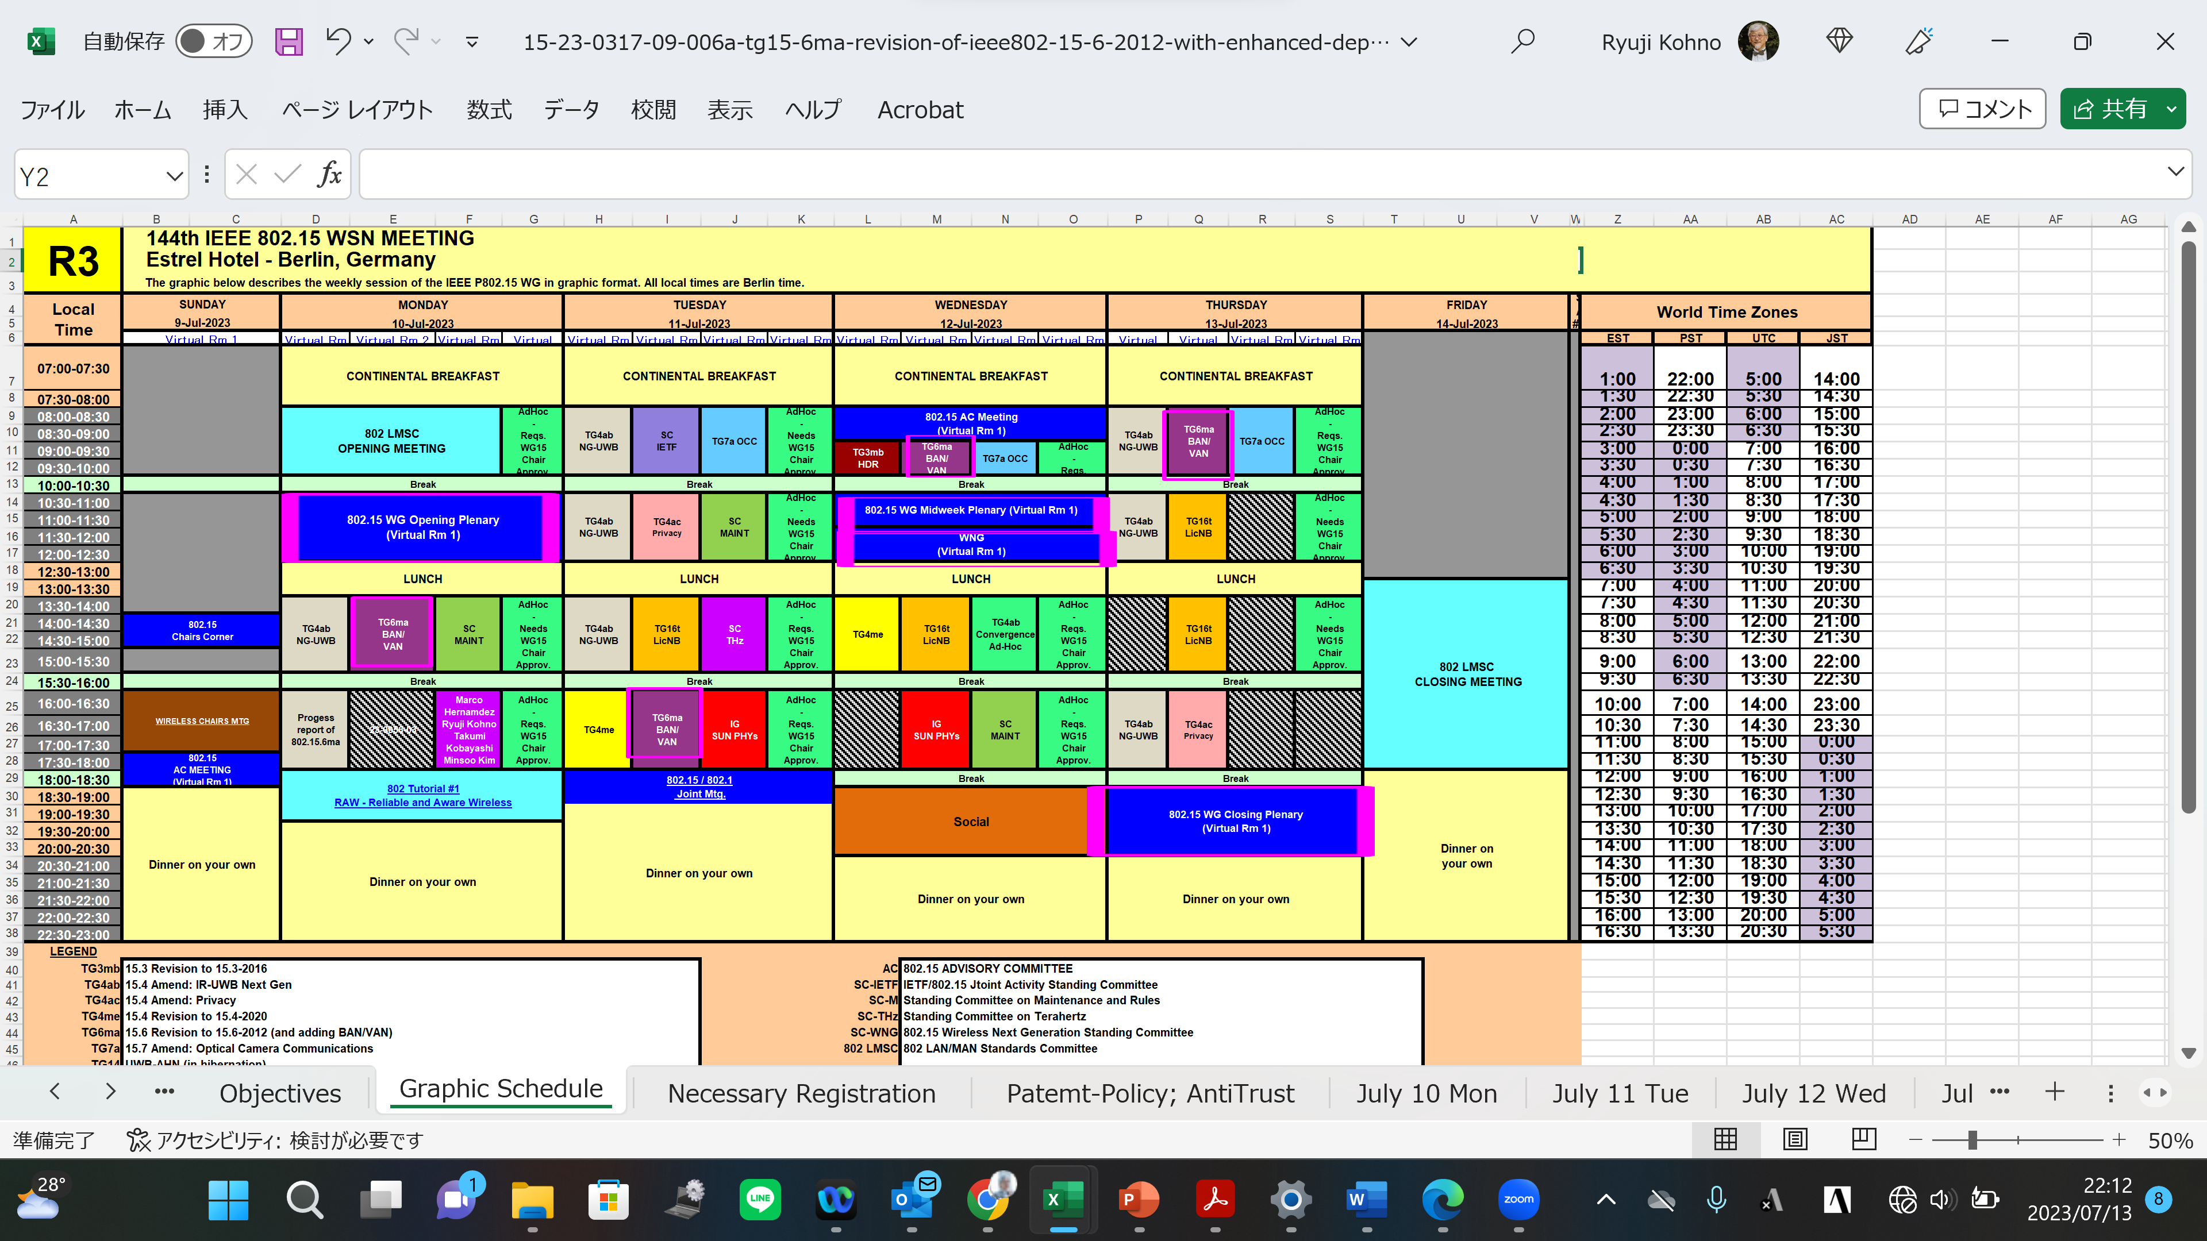
TG15.6ma Interim Session Schedule for 10-14th, July 2023
TG15.6ma has three own sessions such as
Session1(Virtual RM#2) PM1 13:30-15:30 July 10(MON) in Berlin time, 20:30-22:30 July 10(MON) in JST/KST
Session2(Virtual RM#2) PM2 16:00-18:00 July 11(TUE) in Berlin time, 23:00 July 11-1:00 July 12(WED) in JST/KST
Session3(Virtual RM#2) AM1 9:00-10:00 July 12(WED) in Berlin time, 16:00-17:00 July(WED) in JST/KST
Session4(Virtual RM#2) AM1 8:00-10:00 July 13(THU) in Berlin time, 15:00-17:00 July 13(THU) in JST/KST

Slide 5
TG15.6ma Interim Session Schedule for 10-14th, July 2023
TG15.6ma has three own sessions such as
Session1(Virtual RM#2) PM1 13:30-15:30 July 10(MON) in Berlin time, 20:30-22:30 July 10(MON) in JST/KST
Session2(Virtual RM#2) PM2 16:00-18:00 July 11(TUE) in Berlin time, 23:00 July 11-1:00 July 12(WED) in JST/KST
Session3(Virtual RM#2) AM1 9:00-10:00 July 12(WED) in Berlin time, 16:00-17:00 July(WED) in JST/KST
Session4(Virtual RM#2) AM1 8:00-10:00 July 13(THU) in Berlin time, 15:00-17:00 July 13(THU) in JST/KST
TG 15.6ma Session1, MON PM1 (Virtual Room #2)
1:30 PM - 3:30PM July 10(MON) Local Atlanta Time of Berlin (UTC+2)
8:30PM July 10(MON) -10:30 July 10(MON) (UTC-4:00) Japan & Korea Time,
11:30-13:30AM July 10(MON) UTC
TG 15.6ma Session2, Tue PM2 (Virtual Room #2)
4:00-6:00PM July 11 (TUE)Local Berlin Time(UTC+2)
11:00PM July 11(TUE) -1:00 July 12(WED) (UTC-4:00) Japan & Korea Time,
2:00 - 4:00PM July 11(TUE) UTC
TG 15.6ma Session3, WED AM1 (Virtual Room #2) 9:00 – 10:00 July 12(WED) ocal Berlin Time(UTC+2)
16:00 - 17:00 July 12(WED) (UTC-4:00) Japan & Korea Time,
TG 15.6ma Session4, THU AM1 (Virtual Room #2)
8:00-10:00 July 13(THU)Local Berlin Time(UTC+2)
3:00 -5:00PM July 13(THU) (UTC-4:00) Japan & Korea Time,
6:00-8:00AM July 13(THU) UTC
https://ieeesa.webex.com/ieeesa/j.php?MTID=ma228bfce333fa1ab3f9fcf3bc1421dfd
Meeting number: 2347 246 7070
Password: 80215julymtgrm2

Slide 6
Agenda items for the week
TG15.6ma meeting call to order
Call for essential patents and policies & procedures reminder
Opening report of TG6ma in July meeting doc.#15-23-0318-01-06ma
Approve last meeting minutes: TG 15.6ma Meeting Minutes for May 2023 doc.#15-23-0282-00-06ma
Agenda of TG15.6ma July Meeting doc.#15-23-0317-00-06ma
Review and Summary
  1. IG DEP, SG & TG15.6a Activity for Revision of IEEE802.15.6 BAN with Enhanced Dependability 22-0339-03-06ma
  2. Progress and Action Items for Draft#1 doc.#15-23-0360-00-006ma
  Rescheduling Timeline doc.#15-23-0361-01-06ma
  Preliminary harmonization with 4ab doc.#15-23-0634-03-06ma
  Presentation
  Overview and convergence of MAC proposals for 15.6ma doc.#15-23-0408-00-006ma
  Qualitative approach to coexistence and QoS mechanisms doc.#15-23-0101-03-06ma
  Definition of Coexistence Levels and How to Support Higher Levels doc.#15-22-0631-04-06ma
  Simulation results for Nagoya I. T. and YRP-IAI MAC proposal Based on TG6ma Channel Model 23-0352-00-06ma
  MAC Protocol Proposal for Multiple BAN Environment (Level 1,2,3) doc.#15-22-0639-02-06ma
  Proposed text for 6ma MAC - 4. General framework elements doc.#15-23-0322-00-0dma
  Proposed text for 6ma MAC - Beacon Access Phase doc.#15-23-0367-00-06ma
  Proposal of control and data channels unification for 6ma MAC doc.#15-23-0387-00-06ma
  Overview and convergence of MAC proposals for 15.6ma doc.#15-23-0408-00-06ma
  Ranging and localization in TG6ma doc.#15-23-0402-00-06ma
  Preliminary performance evaluation of ranging in coexience environment doc.#15-23-0353-00-06ma
  Summary Table of Channel and Environmental Modeling Activities for BANs on TG15.6madoc.#15-23-00045-04-06ma
  Low Complexity Adaptive Schemes for Energy Detection Threshold in the IEEE802.15.6 CSMA/CA 23-0406-00-06ma
  Overview of Ranging and Localization of TG6ma doc.#15-23-0402-00-06ma
  Overview of FEC proposals for 15.6ma doc.#15-22-0611-04-06ma
  16. Harmonization with 4ab: data rates & FEC doc.#15-22-0610-04-06ma
  17. Progress Report of TG6ma doc.#15-23-0056-03-06ma
  18. TG6ma draft revision doc.#15.23-0405-00-06ma

Slide 7
QoS Levels of Packets corresponding to User Priority
In Std.15.6 WBAN systems, a various data such as vital signs, skin temperature, blood pressure, ECG, EEG, ECoG, and vehicle controlling commons have different QoS levels corresponding to user priority.
In 15.6ma for dependable WBAN for human and vehicles, data packet transmission should be dependable according to QoS levels even in various classes of coexistence environment.
Therefore, appropriate sets of error controlling scheme with FEC and hybrid ARQ corresponding to QoS levels have been standardized in 15.6ma,
User priority | Traffic designation | Frame type
0 | Background (BK) | Data
1 | Best effort (BE) | Data
2 | Excellent effort (EE) | Data
3 | Video (VI) | Data
4 | Voice (VO) | Data
5 | Medical data or network control | Data or management
6 | High-priority medical data or network control | Data or management
7 | Emergency or medical implant event report | Data

Slide 8
Definition of Coexistence Environment Classes
Coexistence Class | Coexisting system(s) |  |  |  |  | Category
Level | 802.15.6ma | 802.15.6-2012 | Non-UWB (ex. Wi-Fi / Unlicensed / 3GPP) | 802.15 UWB (ex. 802.15.4) | Non-802.15 UWB (ex. ETSI SmartBAN) | Category
0 | - | - | - | - | - | Single BAN
1 (1a) | ✓ | - | - | - | - | Multiple 15.6 BANs
2 (1b) | ✓ | ✓ | - | - | -
3 | ✓ | - | ✓ | - | - | Non-UWB
4 (2a) | ✓ | - | - | ✓ | - | Multiple UWB systems
5 (2b) | ✓ | - | - | - | ✓
6 (2c) | ✓ | - | - | ✓ | ✓
7 | ✓ | ✓ | ✓ | ✓ | ✓ | Final Boss
The coexistence class has been redefied to 8 levels, which can be represented by 3 bits and would be suitable to include in PHY or MAC headers.

Slide 9
TG 6ma Timeline
EC approval to SB, SB submission
Mar 2024
SB recirculation
May 2024
Tech Req Doc(TRD) July 2022
TRD,CMD
Call Proposals Sept 2022
Presentation of proposalsNov2022 Jan.2023
Harmonization of Proposals
Mar 2023
^{Std Draft V0}
May 2023
Upload preliminary draft v1 on WG repository to revise for finalizing v1
July2023
WG pre-ballot
Sept 2023
Comments and resolution for pre-ballot.
Nov 2023
WG letter ballot (LB)
Jan. 2024
Revcom Approve
Jul 2024
^{Finalize Std Draft V1}
August 2023
SB recirculation if required
Jun 2024
RevcomSubmission
June 2024
Notes: SASB/RevCom scheduled for 2024 a guess

Slide 10
Timeline details.
Topic | Deadline | Notes
Technical Requirements Document (TRD). Channel Model Document (CMD). Call for Proposals. | Sept. 2022 | TRD describes the technical requirements baseline for the evaluation of proposals. The CMD contains the channel models for different use cases targeted by the Std. Announcement of call for proposals.
Due day for proposals | March 10th, 2023 | Postponed from January 2023
Presentation of proposals | Nov. 2022, January, March 2023 | Start of discussions for harmonization of proposals.
Harmonization of Proposals | March 2023 | Agreements on key technologies.
Std Draft v.0 | May 2023 | Mostly editorial revisions and start integrating text of agreed proposals.
Preliminary Std Draft v. 1 | July 2023 | Upload preliminary draft V1 in WG private repository and collecting comments to be used for revision.
Std Draft v. 1 | August 2023 | TG approval
WG pre-ballot | September 2023 | WG pre-ballot submission.
Comments and resolution for pre-ballot. | November 2023 | Finish resolutions to pre-ballot comments and recirculation.
WG letter ballot (LB) | January 2024 | LB submission
LB recirculation | January 2024 | Comment-resolutions to LB recirculation
Conditional approval for Sponsor Ballot (SB) | January 2024 | Seek conditional approval
Final LB recirculation. EC approval | March 2024 | Just before the March meeting.
EC approval to SB | March 2024
SB submission | March 2024
SB recirculation | May 2024 | Resolutions to SB.
Conditional/unconditional approval to RevCom | May 2024 | Submission to SASB agenda
SB recirculation if required | June 2024
RevCom submission | June 2024 | RevCom approval
Note: the deadlines are subject to change.

Slide 11
Contributions
・TG15.6ma opening report for July 2023 meeting 15-23-0318-02-06ma
・TG15.6ma Agenda of July Meeting in 2023 15-23-0317-10-06ma
・TG6ma Progress Report 15-23-0056-03-06ma
・Definition of Coexistence Levels and How to Support Higher Levels 15-22-0631-03-06ma
・Qualitative approach to coexistence and QoS mechanisms 15-23-0101-02-06ma
・ Rescheduling Timeline 15-23-0361-01-06ma
・Preliminary harmonization with 4ab 15-23-0634-03-06ma
・Overview and convergence of MAC proposals for 15.6ma 15-23-0408-00-006ma
・Simulation results for Nagoya I. T. and YRP-IAI MAC proposal Based on TG6ma Channel Model 23-0352-00-06ma
・MAC Protocol Proposal for Multiple BAN Environment (Level 1,2,3) 15-22-0639-02-06m
・Proposed text for 6ma MAC - 4. General framework elements 15-23-0322-00-0dma
・Proposed text for 6ma MAC - Beacon Access Phase 15-23-0367-00-06ma
・Proposal of control and data channels unification for 6ma MAC 15-23-0387-00-06ma
・Overview and convergence of MAC proposals for 15.6ma 15-23-0408-00-06ma
・Ranging and localization in TG6ma 15-23-0402-00-06ma
・Preliminary performance evaluation of ranging in coexience environment 15-23-0353-00-06ma
・Summary Table of Channel and Environmental Modeling Activities for BANs on TG15.6ma23-00045-04-06ma
・Low Complexity Adaptive Schemes for Energy Detection Threshold in the IEEE802.15.6 CSMA/CA 23-0406-00-06ma
・Overview of Ranging and Localization of TG6ma 15-23-0402-00-06ma
・Overview of FEC proposals for 15.6ma 15-22-0611-04-06ma
・Harmonization with 4ab: data rates & FEC 15-22-0610-04-06ma
・Progress Report of TG6ma 15-23-0056-03-06ma
・TG6ma draft revision 15.23-0405-00-06ma
・TG15.6ma closing report for July 2023 meeting 15-23-0404-00-06ma
・ TG15.6ma July 2023 meeting minutes 15-23-0405-00-06ma

Slide 12
Contacts and Conference call
Chair; Ryuji Kohno, YNU/YRP-IAI
kohno@ynu.ac.jp, kohno@yrp-iai.jp
Vice-Chair; Marco Hernandez, YRP-IAI/CWC
Marco.Hernandez@ieee.org
Daisuke Anzai, NIT anzai@nitech.ac.jp
Secretary; Takumi Kobayashi, YNU/TCU
kobayashi-takumi-ch@ynu.ac.jp
Technical Coeditors; Minsoo Kim, YRP-IAI
minsoo@minsookim.com
Seong-Soon Joo, Korea Platform Service Technology (KPST) wowbk@kpst.co.kr

Slide 13
Thank You !
Any Questions ?

