Slide 1
Project: IEEE P802.15 Working Group for Wireless Personal Area Networks (WPANs)
Submission Title: [Ranging functionality of 15.6ma(Revision of IEEE802.15.6-2012)]
Date Submitted: [12th July 2023]
Source: [Ryuji Kohno] [1;Yokohama National University(YNU), 2;YRP International Alliance Institute(YRP-IAI)]
Address [1; 79-5 Tokiwadai, Hodogaya-ku, Yokohama, 240-8501 Japan
2; YRP1 Blg., 3-4 HikarinoOka, Yokosuka-City, Kanagawa, 239-0847 Japan]
Voice:[1; +81-90-5408-0611], FAX: [+81-45-383-5528],
Email:[1: kohno@ynu.ac.jp, 2: kohno@yrp-iai.jp] Re: []
Abstract: [This document contains ranging functionality in the TG15.6ma, that is a task group of Revision of IEEE802.15.6-2012.]
Purpose: [information]
Notice: This document has been prepared to assist the IEEE P802.15. It is offered as a basis for discussion and is not binding on the contributing individual(s) or organization(s). The material in this document is subject to change in form and content after further study. The contributor(s) reserve(s) the right to add, amend or withdraw material contained herein.
Release: The contributor acknowledges and accepts that this contribution becomes the property of IEEE and may be made publicly available by P802.15.

Slide 2
Ranging functionality of 15.6ma
(Revision of IEEE802.15.6-2012)
In Personal and Virtual Hybrid Plenary Session
Berlin, Germany, USA
July 12th, 2023
Ryuji Kohno
Yokohama National University(YNU),
YRP International Alliance Institute(YRP-IAI)

Slide 3
1. Necessity of Ranging in 15.6ma
15.6ma(revision of IEEE802.15.6-2012) focuses on enhanced dependability in cases of coexistence of multiple BANs and different PANs.
To identify geographical distribution of multiple BANs and PANs, ranging capability between BAN coordinators is useful and localization is more useful among more than three BANs and PANs.
In particular, practical use cases with coexistence for instance two BANs are coming to cross and overlaid their covering ranges. Relative distance between BAN coordinators and 3D location information in such a dynamic and mobile environment may be used to recognize geographical situation of interference in physical layer and contention in MAC layer.

Slide 4
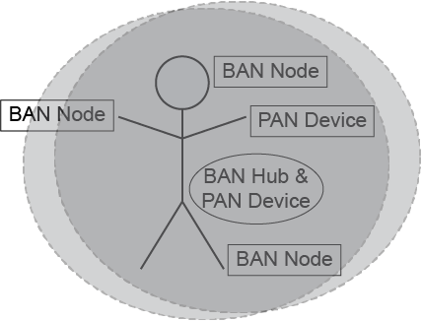
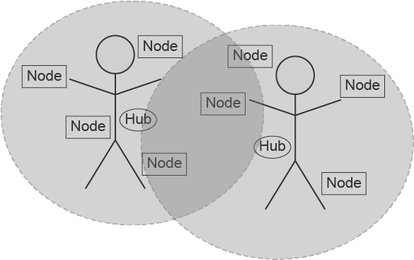
1.1 Use cases of overlaid multiple BANs and moving BANs
Ranging between two BAN coordinators and localization by multiple coordinators may be used to identify a class of coexistence and avoid interference.
ranging
Coordinator 3
Coordinator 1
ranging
Coordinator 2
ranging
Approaching cross
Case 2: BAN and PAN are coming cross to be overlaid.
  Case 1: already overlaid BANs, using same frequency bands

Slide 5

1.2 Ranging and localization between vehicle and human bodies by 15.6ma HBAN and VBAN
ranging
ranging
ranging
ranging
localization

Slide 6
2. Feasibility of Ranging in 15.6ma
15.6ma PHY uses IR-UWB which can perform two way ranging(TWR) by exchanging time data packets between BAN coordinators.
MAC of 15.6ma uses hybrid contention free and contention access period in a superframe. TWR in cases of moving BAN coordinators can be perform in contention free period while TWR in case of fixed locations of BAN coordinators may be done in either contention free or contention access period.
This means ranging can be performed under MAC for data transmission and no need for different MAC for ranging.
In case of more than two BANs coexisting environment, combination of ranging achieves three dimensional localization.
However, ranging performance must be proceeded in multiple BAN coexisting environment with interference mitigation in PHY and contention avoidance in MAC.

Slide 7
3. Summary of Ranging in 15.6ma
According to technical requirement document(TRD), 15.6ma must have functionality of two way ranging(TWR) by exchanging time data packets between BAN coordinators.
Using data transmission MAC of 15.6ma, TWR can be implemented in contention free and contention access periods in moving and fixed BAN coordinators.
This means ranging can be performed under MAC for data transmission and no need for different MAC for ranging.
Dependable ranging must be proceeded in multiple BANs and other classes of coexistence by introducing technologies in PHY and MAC to mitigate interference and avoiding packet contention.

Slide 8
Thank you for your attention

