Slide 1
Project: IEEE P802.15 Working Group for Wireless Specialty Networks (WSN)
Submission Title: DPP Pairing and Authentication Presentation
Date Submitted: 2023-07-12
Source: Yael, ONDAS Networks
Abstract: DPP Pairing and Authentication changes presentation.
Notice: This document has been prepared to assist the IEEE P802.15. It is offered as a basis for discussion and is not binding on the contributing individual(s) or organization(s). The material in this document is subject to change in form and content after further study. The contributor(s) reserve(s) the right to add, amend or withdraw material contained herein.
Release: The contributor acknowledges and accepts that this contribution becomes the property of IEEE and may be made publicly available by P802.15.

Slide 2
DPP SS Identifier
Public-private key pair
MAC Address or another Name identifier
A certificate or certificate chain that binds the two

Slide 3
Identity filtering
Automatic mode
  Identity of candidate peers is pre-configured
  Couples of: Name or MAC address, public key
Manual mode
  Identity of CA signing candidate peer
  Couples of: CA name, CA public key

Slide 4
Pre-association – Automatic mode
Start association with any peer that pass identity filtering
Send Periodic ASSOCIATE Requests
Upon receiving
ASSOCIATE Request
Identity Filtering
Upon receiving ASSOCIATE Response
Associate State
Associate State

Slide 5
Pre-association (Manual)
  Accumulate peers that pass identity filtering
  On manual operator request display the list of peers
  Start association with the manually selected peer
Send Periodic ASSOCIATE Requests
Upon receiving
ASSOCIATE Request
Identity Filtering
Upon receiving ASSOCIATE Response
Associate State
If passed:
Add peer to List
Upon manual peer selection
Send Associate Response
Associate State

Slide 6
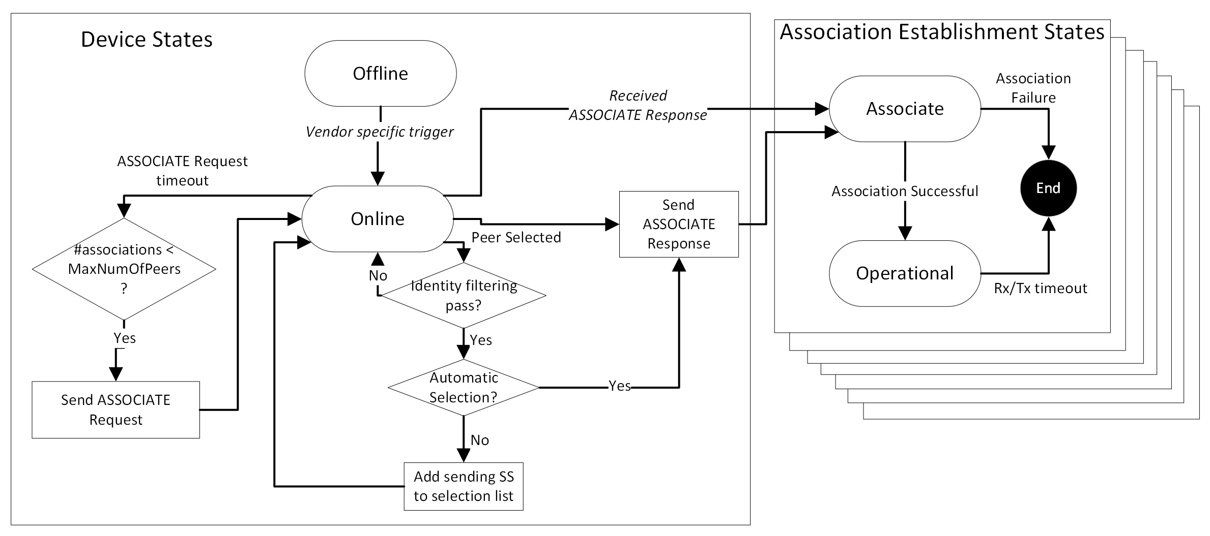
Pairing and association state machine

Slide 7
Authentication
Authentication is performed by DPP-SS
No external AAA / CA to authenticate with
Mutual TLS (mTLS) v1.3
One TLS session per association
Server / Client selection
  Preconfigured (server or client), or
  Higher MAC Address is server, lower MAC address is client

