Slide 1
Project: P802.15 Working Group for Wireless Specialty Networks
Submission Title: Proposal of control and data channels unification for 6ma MAC
Date Submitted: November 16th, 2022
Source: Minsoo Kim, Takumi Kobayashi, Daisuke Anzai, Marco Hernandez and Ryuji Kohno
Company: YRP-IAI, NIT, CWC Oulu, YNU
Address: 3-4 Hikarino-oka, Yokosuka, 239-0847, Japan
Voice: +81 46-847-5439 Fax: +81 46-847-5431 E-Mail:
Re: In response to the call for technical contributions
Abstract:
Purpose: In response to the call for technical contributions
Notice: This document has been prepared to assist P802.15.6ma. It is offered as a basis for discussion and is not binding on the contributing individual(s) or organization(s). The material in this document is subject to change in form and content after further study. The contributor(s) reserve(s) the right to add, amend or withdraw material contained herein.
Release: The contributor acknowledges and accepts that this contribution becomes the property of IEEE and may be made publicly available by P802.15.6ma.

Slide 2
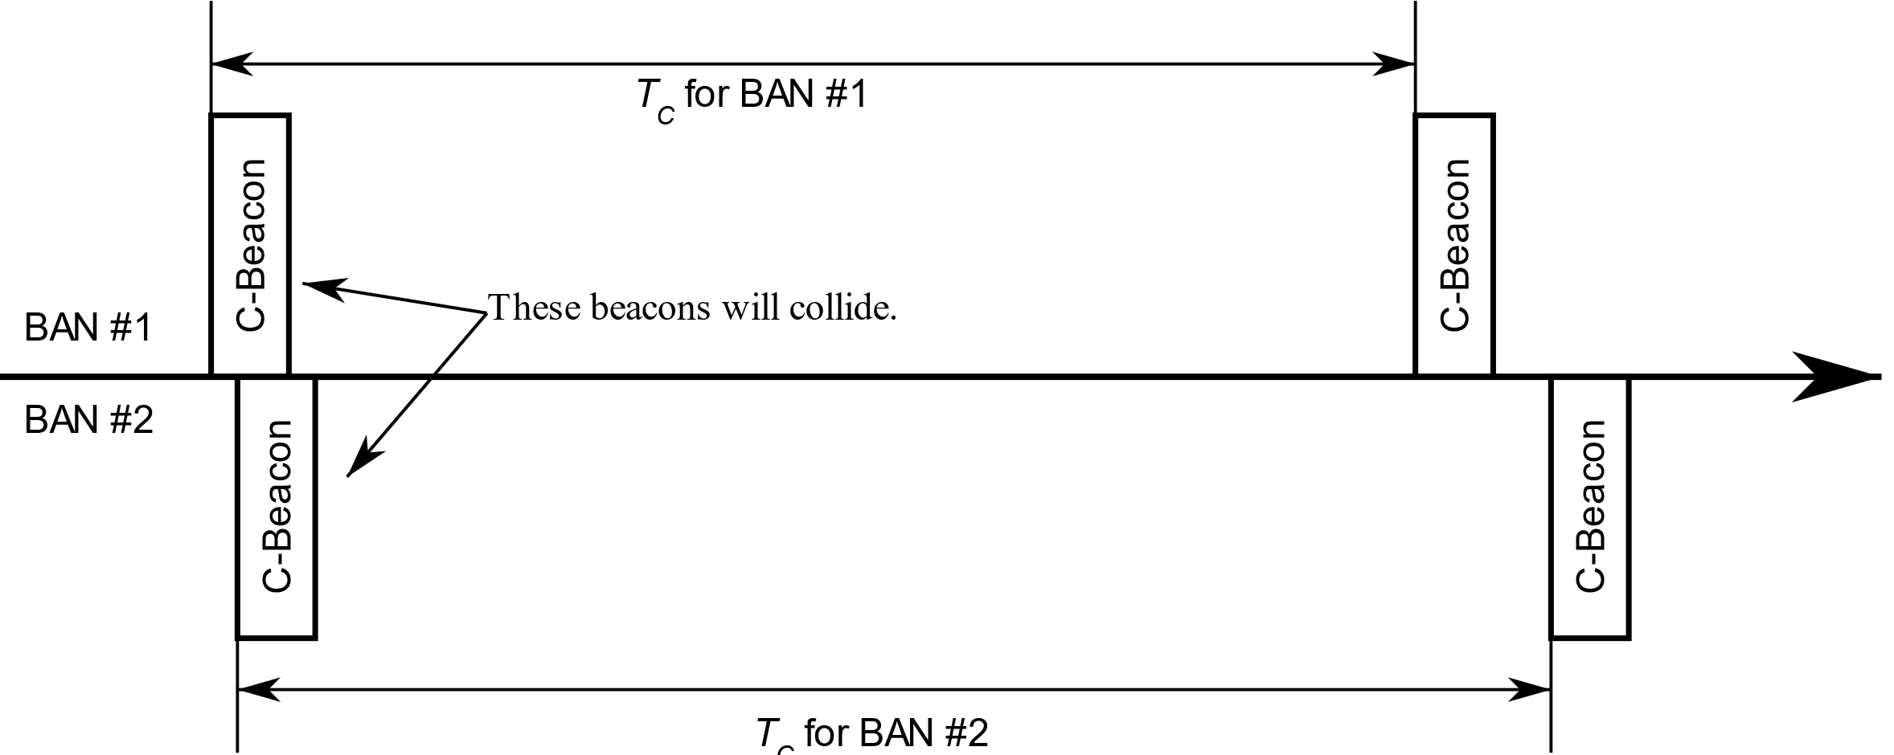
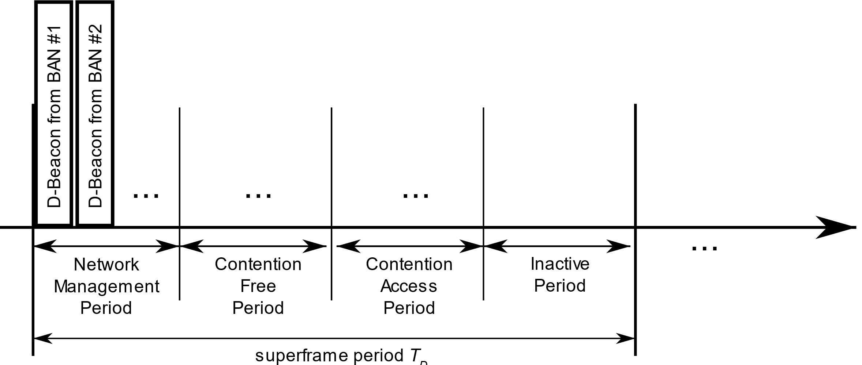
Unifying Control and Data Channels
Control Channel
Data Channel
Frames for both Control Channel and Data Channels are accommodated into one single channel.
The time axis is divided into separate time periods for each frame types.
Time period
for C2C frames
Time period
for Coordinator-to-Nodes frames
Time axis
Superframe

Slide 3
Channel usage strategy
Case of low band, according to this proposal
Band group | Channel number | Central frequency (MHz) | Bandwidth (MHz) | Channel attribute in 802.15.6-2012 | Channel attribute for the revision
Low band | 0 | 3494.4 | 499.2 | Optional | Control | Optional
 | 1 | 3993.6 | 499.2 | Mandatory | Control/Data | Mandatory
 | 2 | 4492.8 | 499.2 | Optional | Control/Data | Optional
Band group | Channel number | Central frequency (MHz) | Bandwidth (MHz) | Channel attribute in 802.15.6-2012 | Channel attribute for the revision
Low band | 0 | 3494.4 | 499.2 | Optional | Control/Data | Optional
 | 1 | 3993.6 | 499.2 | Mandatory | Control/Data | Mandatory
 | 2 | 4492.8 | 499.2 | Optional | Control/Data | Optional
All channels carry both Coordinator-to-Coordinator Frames
and Coordinator-to-Node Frames.

Slide 4
Motivation
Low implementation difficulties
  Requires only one UWB RF.
Increase channel efficiency
  All channel can carry Coordinator-to-Node frames.
  Previously we had 1 control channel and n data channels.
  Now we have n+1 channels.

