Slide 1
Project: IEEE P802.15 Working Group for Wireless Personal Area Networks (WPANs)
Submission Title: September, 2023 IEEE 802.15.4me Opening Agenda and Closing
Date Submitted: September 14, 2023
Source: Gary Stuebing Company: Cisco Systems
Address 5310 N Ocean Blvd, Unit 9A, North Myrtle Beach, SC
Voice 803 230-3027 E-Mail: gstuebin@cisco.com
Re: DCN 15-23-0386-06-04me Abstract: September, 2023 IEEE 802.15.4me Plenary Agenda and Closing
Purpose: Agenda and Closing for Task Group Meeting
Notice: This document has been prepared to assist the IEEE P802.15. It is offered as a basis for discussion and is not binding on the contributing individual(s) or organization(s). The material in this document is subject to change in form and content after further study. The contributor(s) reserve(s) the right to add, amend or withdraw material contained herein.
Release: The contributor acknowledges and accepts that this contribution becomes the property of IEEE and may be made publicly available by P802.15.

Slide 2
  Participants have a duty to inform the IEEE of the identity of each holder of any potential Essential Patent Claims of which they are personally aware if the claims are owned or controlled by the participant or the entity the participant is from, employed by, or otherwise represents
  Please see the entire policy at this link:
  https://development.standards.ieee.org/myproject/Public/mytools/mob/slideset.pdf

Slide 3
IEEE 802.15.4me
September, 2023 Interim Plenary
Agenda and Closing

Slide 4
15.4me Sessions this Week
 | Monday | Tuesday | Wednesday | Thursday
AM 1 | Opening Plenary |  | 802.15.4me Session 2 Starts at 9:00
AM 2 |  |  | Midweek Plenary | 802.15.4me Session 4
PM 1 |  | 802.15.4me Session 1
PM 2 |  |  | 802.15.4me Session 3
6:30p |  |  |  | Closing Plenary

Slide 5
Agenda
Agenda
  Call for Patents
  Approve Agenda
  Approve Minutes
  Review Results of Letter Ballot
    Task List Document DCN 15-23-400-01-04me
    Tally Sheet DCN 15-23-471-00-04me
    Comments DCN 15-23-472-02-04me
  Review Letter Ballot Comment Submissions
  Comment resolution

Slide 6
Agenda
Agenda
  Next Steps
  Review Draft Timeline
  Next meetings

Slide 7
Results of Workgroup Ballot
VOTERS | 133
VOTED | 97
YES | 87
ABSTAIN | 5
NO | 5
% VOTERS | 72.93%
% YES | 94.57%
% ABSTAIN | 5.15%
Did Not Vote (cum.) | 41
Did Not Vote (cum.) % | 30.8%
Open Date | 7/27/23
Close Date | 9/8/23
Draft P802.15.4me | D2 LB197
Accepted Comments: 139
Rogue Comments: 163+15+1 179

Slide 8
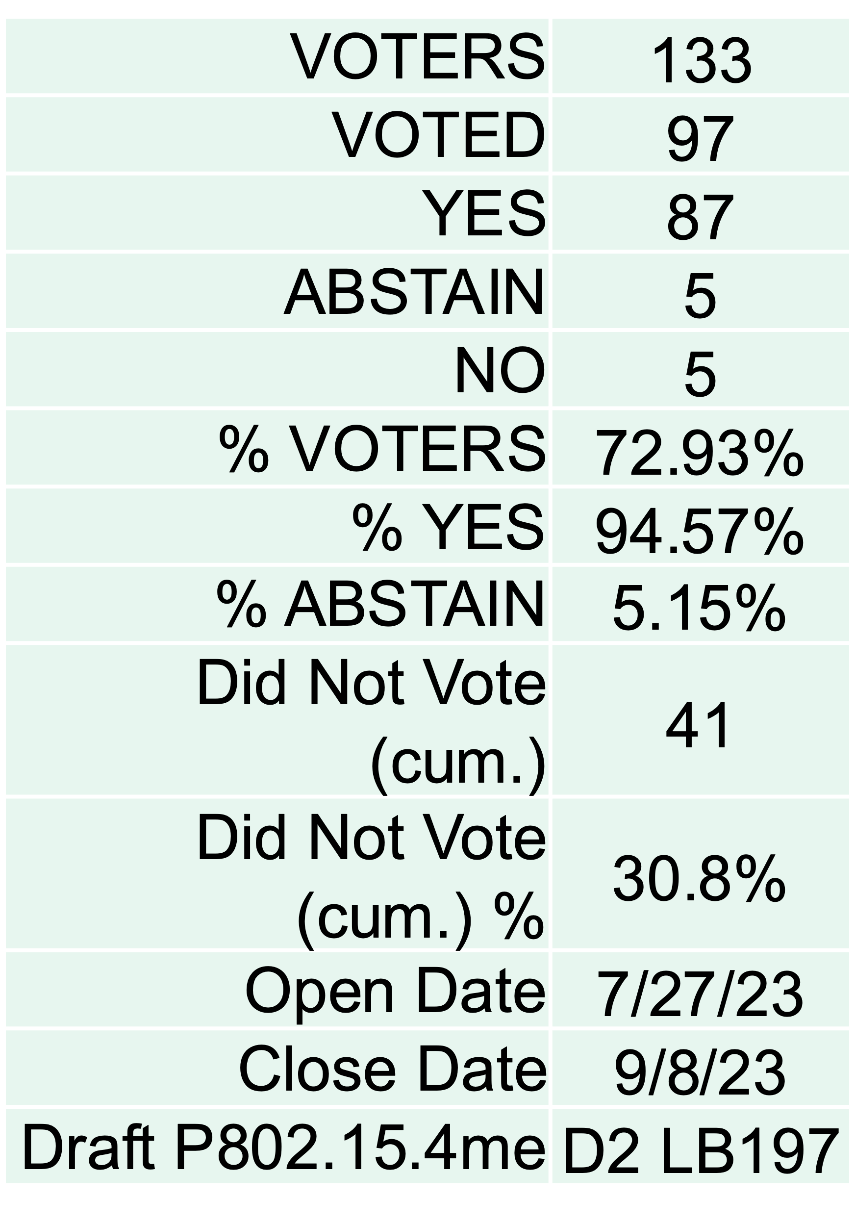
CLOSING REPORT
Four Sessions were held this week
Results of Workgroup Ballot were given:
Task Group worked on Comment resolution for the week
Document DCN 15-23-0497-06-04me
 |  | Category |  |  |  | Disposition status
Letter ballot | Total | Editorial | Technical | General | Unknown | Accepted | Revised | Rejected | Unresolved
LB197 | 141 | 115 | 21 | 3 | 2 | 89 | 20 | 32 | 0
LB197_rogue | 182 | 126 | 56 | 0 | 0 | 151 | 26 | 5 | 0

Slide 9
CLOSING REPORT
As a result, two Task Group motions were made to hold a recirculation ballot once new Draft is complete as well as form a CRG.
Motions were sent to the Working Group for Recirculation and CRG
Minutes are posted at:
DCN 15-23-0511-00-04me
Task list is at:
DCN 15-23-0400-02-04me
November Draft Agenda posted at:
DCN 15-23-0518-00-04me
Four sessions are requested for November Plenary

Slide 10
TG Motion for Recirculation
Move that 802.15.4me formally request that 802.15 WG start a WG recirculation requesting approval of document P802-15-04.me-D01 (as edited in accordance with the instructions in document 15-23-0497-06-04me) and to forward document P802-15-04.me-D01, as edited in accordance with the instructions in document 15-23-0497-06-04me, to Standards Association ballot pending the completion and inclusion of the edits in the draft.
Moved: Phil Beecher
Second: Ann Krieger

Slide 11
TG Motion for CRG
Move that TG4me formally request that 802.15 WG approve the formation of a Comment Resolution Group (CRG) for the WG balloting of the P802.15.04.me_D01 with the following membership: Gary Stuebing(chair), Tero Kivinen, Phil Beecher, Billy Verso, Ann Krieger and Ben Rolfe. The 802.15.4me CRG is authorized to approve comment resolutions, edit the draft according to the comment resolutions, and to approve the start of recirculation ballots of the revised draft on behalf of the 802.15 WG. Comment resolution on recirculation ballots between sessions will be conducted via reflector email and via teleconferences announced to the reflector as per the LMSC 802 WG P&P.
Moved: Phil Beecher
Second: Ann Krieger

Slide 12
WG Motion for Recirculation
Move that 802.15 WG start a WG recirculation requesting approval of document P802-15-04.me-D01 (as edited in accordance with the instructions in document 15-23-0497-06-04me) and to forward document P802-15-04.me-D01, as edited in accordance with the instructions in document 15-23-0497-06-04me, to Standards Association ballot pending the completion and inclusion of the edits in the draft.
Moved: Gary Stuebing
Second:

Slide 13
WG Motion for CRG
Move that 802.15 WG approve the formation of a Comment Resolution Group (CRG) for the WG balloting of the P802.15.04.me_D01 with the following membership: Gary Stuebing(chair), Tero Kivinen, Phil Beecher, Billy Verso, Ann Krieger and Ben Rolfe. The 802.15.4me CRG is authorized to approve comment resolutions, edit the draft according to the comment resolutions, and to approve the start of recirculation ballots of the revised draft on behalf of the 802.15 WG. Comment resolution on recirculation ballots between sessions will be conducted via reflector email and via teleconferences announced to the reflector as per the LMSC 802 WG P&P.
Moved: Gary Stuebing
Second:

Slide 14
Draft Timeline
Sep/23 – Review of Comments (Form CRG)
Oct/23 – Recirculation of Draft
Nov/23 – Comment Resolution and Recirc (LSMC Package and conditional approval?) (CRG)
Dec/23 – Optimistic SA Ballot
Jan 23– SA Ballot comment resolution and CRG
Feb-Mar/24 – SA Recirc (CRG)
May/24 – Optimistic SA to Revcom
Sep/24 – SA to Revcom

