Slide 1
Project: IEEE P802.15 Working Group for Wireless Personal Area Networks (WPANs)
Submission Title: MAC address format for private addresses
Date Submitted: 11th July, 2023
Source: Tero Kivinen Company -
E-Mail: kivinen@iki.fi
Re: TG4ac Privacy Meeting in Berlin
Abstract:
Questions about the possible MAC address formats for private addresses.
Purpose: Provide information which kind of changes are needed to the standard.
Notice: This document has been prepared to assist the IEEE P802.15. It is offered as a basis for discussion and is not binding on the contributing individual(s) or organization(s). The material in this document is subject to change in form and content after further study. The contributor(s) reserve(s) the right to add, amend or withdraw material contained herein.
Release: The contributor acknowledges and accepts that this contribution becomes the property of IEEE and may be made publicly available by P802.15.

Slide 2
TG4ac and privacy addresses
TG4ac Privacy is an task group to enhance privacy in IEEE Std 802.15.4.
TG4ac needs to decide how privacy addresses are generated and what kind of format is used for them
IEEE Std 802.15.4 uses 64-bit address with mixed byte ordering.

Slide 3
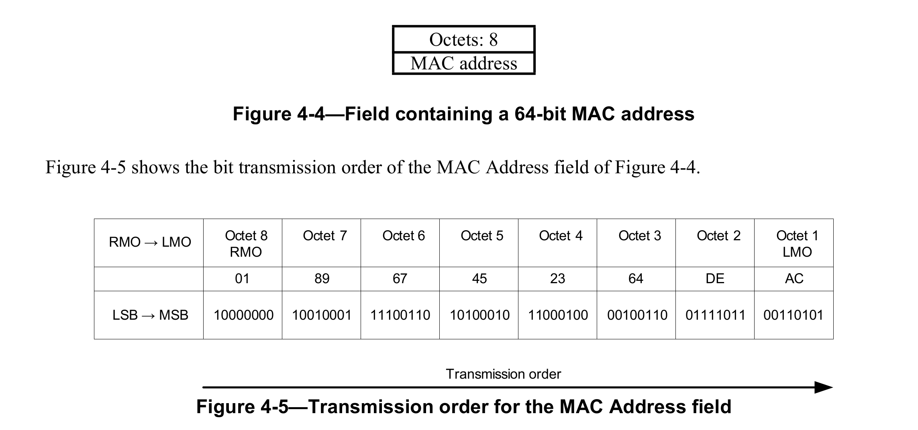
Extended addresses in 802.15.4
In frames it uses least significant bit first and least significant byte first:

Slide 4
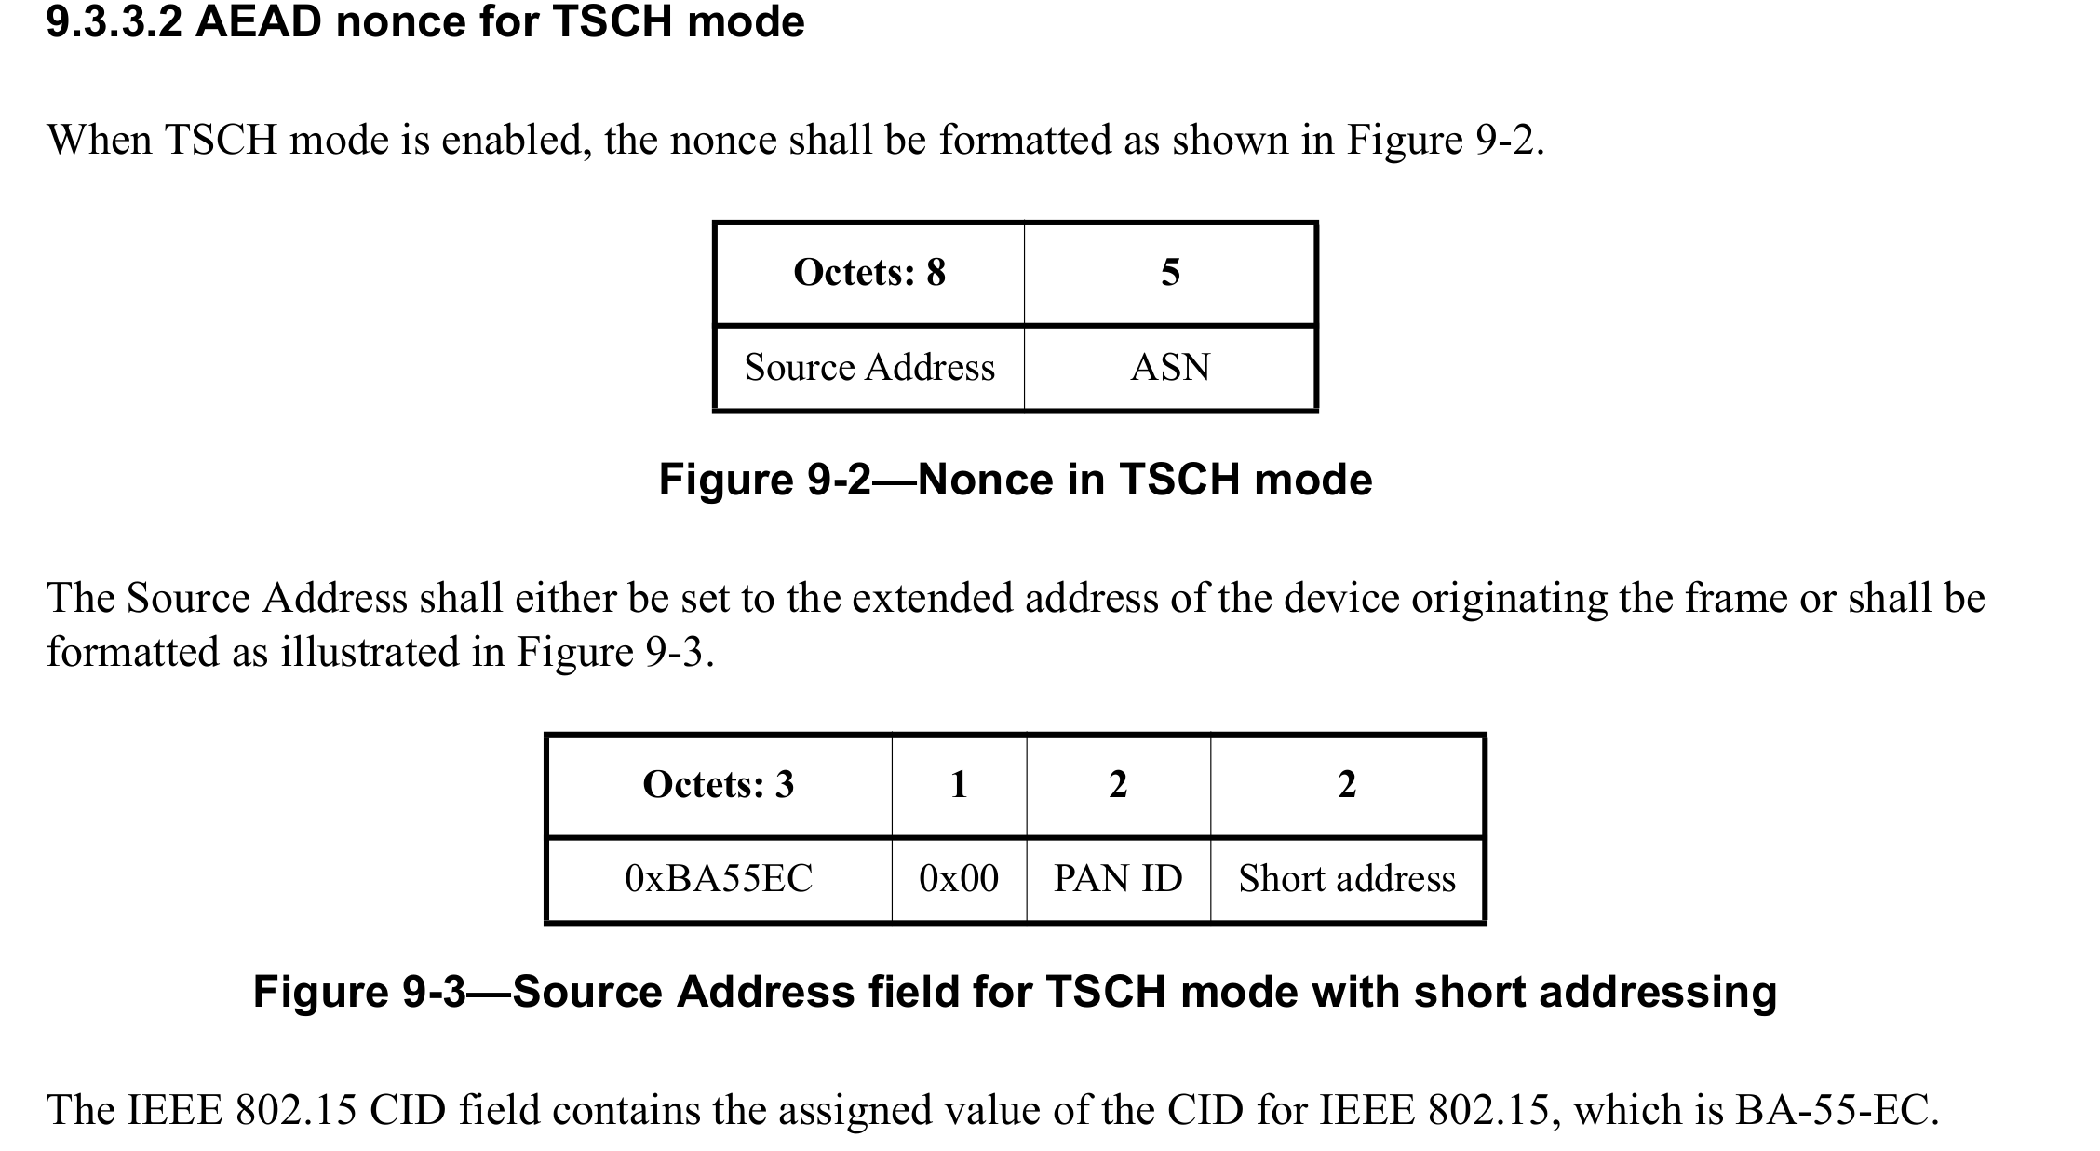
Extended addresses in security
In security when generating nonces the extended addresses are used as octet string with most significant byte first:

Slide 5
Extended addresses
IEEE Std 802.15.4 only defines one special extended address, i.e., broadcast address is speficied to be 0xffff ffff ffff ffff.
It does not use or define meaning for I/G, or U/L bits for the address.

Slide 6
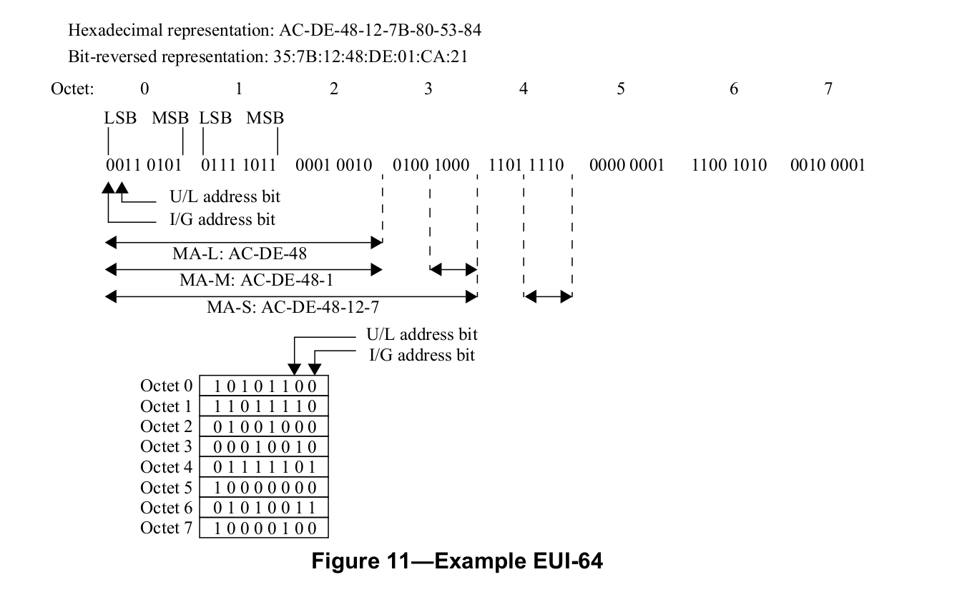
802-2014
Define 64-bit addresses using different byte order:

Slide 7
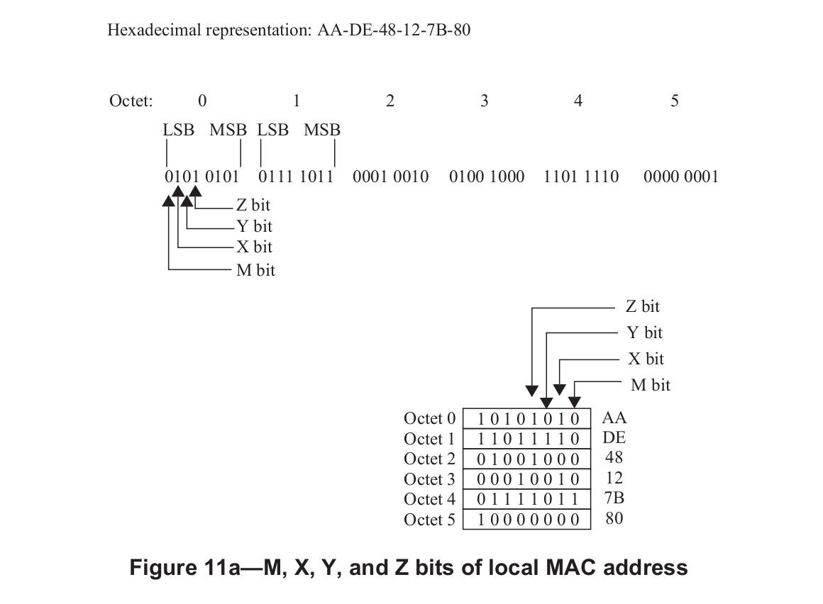
802c-2017
Defines new structured local address plan:

Slide 8
Options for the TG4ac
Use AAI-64 as defined in the 802c-2017, setting M/X/Y/Z bits as x/1/0/0 and leaving rest of 60 bits for private addressing.
Use already existing 802.15 CID BA-55-EC and use one bit from the next octet to separate it for already specified use of it for TSCH and rest of the 39 bits for private addressing.
Allocate new CID for private addressing.
Use ELI-64 as defined in the 802c-2017, setting M/X/Y/Z bits as x/1/0/1 and leaving rest of 40 bits for private addressing.

Slide 9
Comments
Note, that most 802.15.4 implementations do not understand anything about the I/G, U/L etc bits in the addresses they just assume address is given to them by upper layer and they use it as is in the frames.
Thus there might be implementations that are using I/G and U/L bits incorrectly, thus assuming that we can just set U/L bit to one and assume we get local addresses that does not collide with other addresses might not be true.
Also as the location of the U/L bit is different in 802.15.4 than in other 802 standard use this might also cause confusion, having 24-bit CID will make private addresses more separate than just setting few bits.

