Slide 1
Project: IEEE P802.15 Working Group for Wireless Personal Area Networks (WPANs)
Submission Title: [Incorporating compressed packet format]
Date Submitted: [11th July 2023]
Source: [Billy Verso] Company [Qorvo, Inc.]
Address [ ]
E-Mail:[billy.verso (at) qorvo.com]
Re: [How do add compressed packet format without breaking the 4ab MAC]
Abstract: [Compressed packet format in MAC for TG4ab.]
Purpose: [To prompt discussion and smooth the development of the TG4ab amendment draft.]
Notice: This document has been prepared to assist the IEEE P802.15. It is offered as a basis for discussion and is not binding on the contributing individual(s) or organization(s). The material in this document is subject to change in form and content after further study. The contributor(s) reserve(s) the right to add, amend or withdraw material contained herein.
Release: The contributor acknowledges and accepts that this contribution becomes the property of IEEE and may be made publicly available by P802.15.

Slide 2
The Problem
A new compressed MAC frame format has been proposed in for 4ab
The proposers view this okay since it is intended to be sent over new PHY channel bands
Some problems with this:
(A) Once IEEE 802.15.4 has new PHY channel bands, the 15.4 MAC should be usable on it
  Essentially 4ab is providing a ready made PHY definition which may facilitate other users migrating to this band (CSA Zigbee/Matter, etc.)
(B) Other NB PHYs may want to use compressed messages
  e.g., in regions where the new 5.8 / 6 GHz channels are not allowed
  The proposal to send the compressed messages over UWB encapsulated in an IE is somewhat inelegant
Immediately A and B can potentially give problems for original MAC format and new compressed format coexisting using the same PHY radio channels

Slide 3
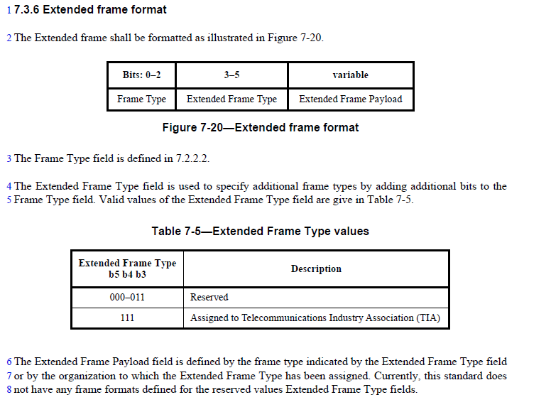
The Solution
So how can we have both 4ab compressed frame format and IEEE 802.15.4 MAC able to coexist….?
Well, the IEEE 802.15.4 MAC has a mechanism to allow for extension of the frame formats.
The simple solution is to use one of these codes prepended to the compressed frames being defined in 4ab
A single octet, e.g., 0x37, prepended to the compressed messages allows the MAC to simultaneously handle existing 802.15.4 frames and recognise the extended frame and decode the compressed frame message.
This solves the problem of coexistence when the same PHY are used for both formats, the receiver can decode both as both follow a consistent set of rules
  All PHY (including UWB) can be used to send the compressed messages with same encoding and without any clunky IE encapsulation.
Older MAC implementations decoding the new extended frame should follow existing rules and safely ignore it.

Slide 4
THE END

