Slide 1
Project: IEEE P802.15 Working Group for Wireless Personal Area Networks (WPANs)
Submission Title: Preliminary Performance Evaluation of Ranging in Coexistence Environment
Date Submitted: Sept. 13th, 2023
Source: Daisuke Anzai, Shunsuke Ishiguro, Takumi Kobayashi
Company: Nagoya Institute of Technology (NIT), Japan
Address: Gokiso-cho, Showa-ku, Nagoya, 466-8555, Japan
Voice: +81-52-735-5389, FAX: +81-52-735-5389, E-Mail: anzai@nitech.ac.jp
Re: In response to call for technical contributions
Abstract: This provides a preliminary investigation of UWB ranging accuracy under multiple BAN coexistence situations, and some simulation results are discussed.
Purpose: Material for discussion in P802.15.6a TG corresponding to comments in EC Meeting
Notice: This document has been prepared to assist the IEEE P802.15. It is offered as a basis for discussion and is not binding on the contributing individual(s) or organization(s). The material in this document is subject to change in form and content after further study. The contributor(s) reserve(s) the right to add, amend or withdraw material contained herein.
Release: The contributor acknowledges and accepts that this contribution becomes the property of IEEE and may be made publicly available by P802.15.

Slide 2
Preliminary Performance Evaluation of Ranging in Coexistence Environment
Daisuke Anzai, Shunsuke Ishiguro,
and Takumi Kobayashi
Nagoya Institute of Technology (NIT)

Slide 3
Introduction
Ranging is a key issue in various kinds of UWB applications, including IEEE 802.15.6ma, 4ab, and 4z
UWB techniques have the potential to achieve high accuracy in supporting important applications in HBAN and VBAN
It is important to discuss the ranging accuracy under multiple BAN coexistence situations under the BAN channel models

Slide 4
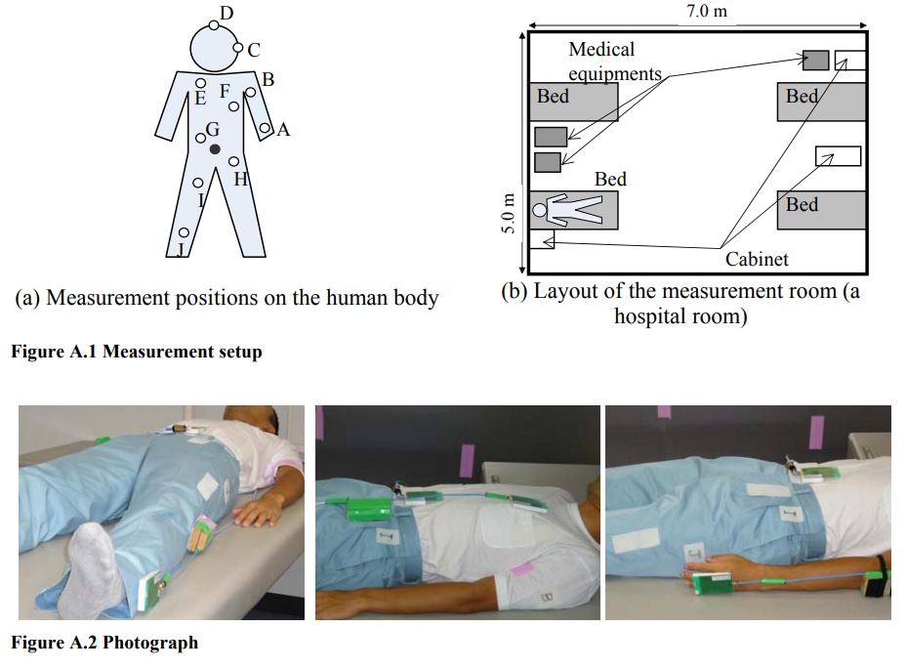
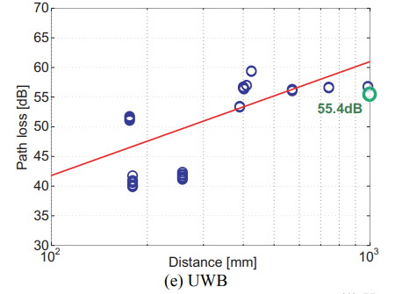
Path loss model for UWB transmission
[1] IEEE 802.15.6-2012 Standard

Slide 5

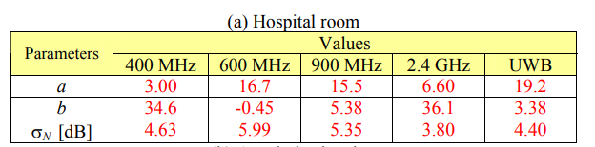
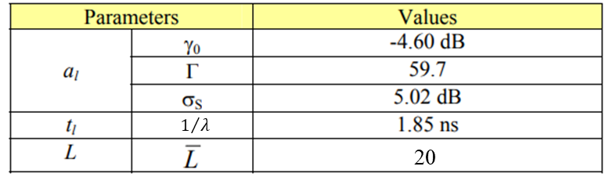


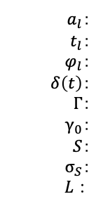
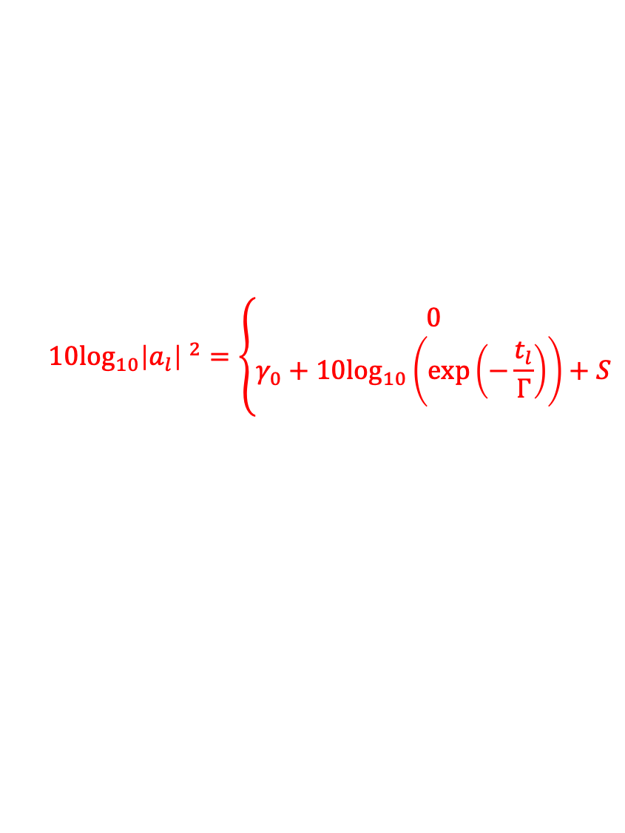
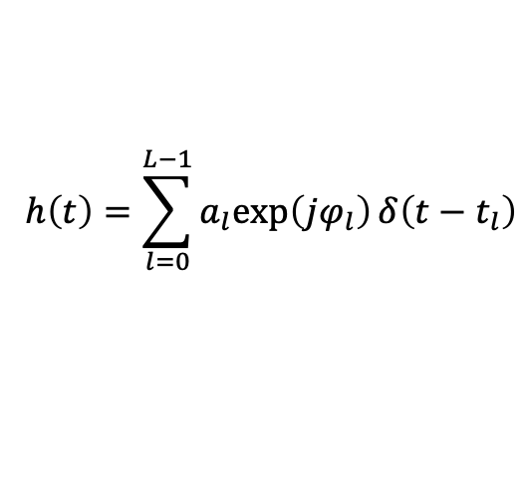
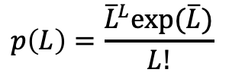

Channel parameters of power delay profile
$$h\left(t\right)=\sum_{l=0}^{L−1}{a_{l}exp\left(jφ_{l}\right)}δ\left(t−t_{l}\right)$$
$$10\log_{10}{\left|a_{l}\right| }^{2}=\left\{\begin{aligned}0 \\ γ_{0}+10\log_{10}\left(exp\left(−\frac{t_{l}}{Γ}\right)\right)+S\end{aligned}\right.$$
$$l=0$$
$$l≠0$$
$a_{l}$：
$t_{l}$：
$φ_{l}$：
$δ\left(t\right)$：
$Γ$：
$γ_{0}$：
$S$：
$σ_{S}$：
$L：$
Path amplitude
Path arrival time
Path phase
Dirac function
Exponential decay
Rician factor
Log-normal distribution
Standard deviation
Number of the arrival paths
$$p\left(t_{l}|t_{l−1}\right)=λexp\left(−λ\left(t_{l}−t_{l−1}\right)\right)$$
$$p\left(L\right)=\frac{{\overline{L}}^{L}exp(\overline{L})}{L!}$$
[1] IEEE 802.15.6-2012 Standard

Slide 6
Preliminary simulation model

Slide 7
Preliminary simulation model

Slide 8
Preliminary evaluation results
Example of received signals
RMS location estimation error

Slide 9
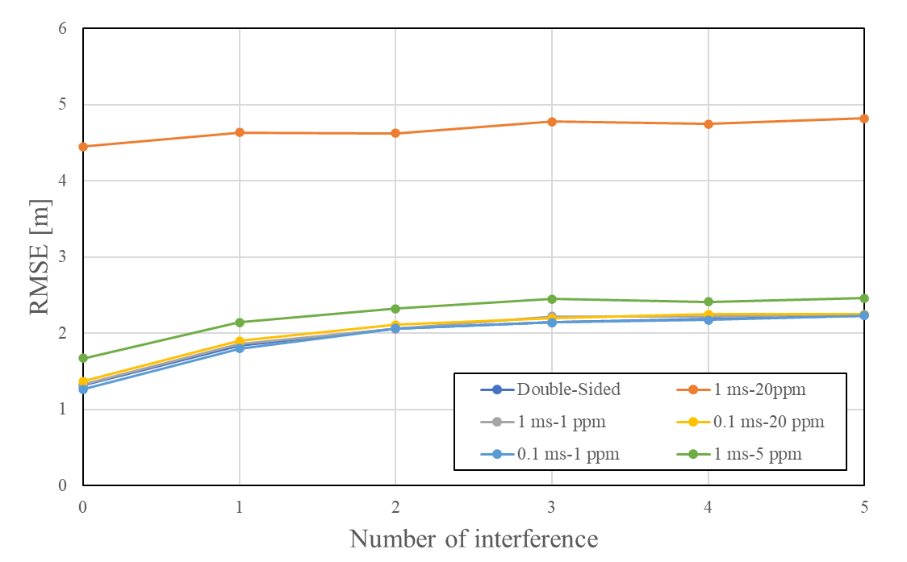
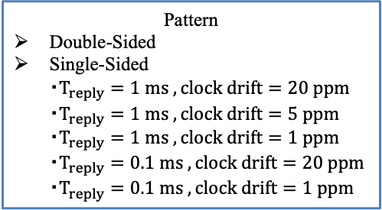
Effect of TWR method on accuracy
Double-sided TWR (Only ranging considered)
Single-sided TWR (Both ranging and data transmission considered)
Pattern
Double-Sided
Single-Sided
・$T_{reply}=1 ms ,clock drift=20 ppm$
・$T_{reply}=1 ms ,clock drift=5 ppm$
・$T_{reply}=1 ms ,clock drift=1 ppm$
・$T_{reply}=0.1 ms ,clock drift=20 ppm$
・$T_{reply}=0.1 ms ,clock drift=1 ppm$

Slide 10
References
D. Anzai, I. Balasingham, G. Fischer, J. Wang, “Reliable and High-Speed Implant Ultra-Wideband Communications with Transmit–Receive Diversity,” EAI/Springer Innovations in Communication and Computing, pp. 27-32, March 2020.
Y. Shimizu, D. Anzai, R. C-Santiago, P. A. Floor, I. Balasingham, and J. Wang, “Performance evaluation of an ultra-wideband transmit diversity in a living animal experiment” IEEE Trans. Microw. Theory Tech., vol. 65, no. 7, pp. 2596-2606, July 2017.
D. Anzai, K. Katsu, R. Chavez-Santiago, Q. Wang, D. Plettemeier, J. Wang, and I. Balasingham, “Experimental evaluation of implant UWB-IR transmission with living animal for body area networks,” IEEE Trans. Microw. Theory Tech., vol. 62, no. 1, pp. 183-192, Jan. 2014.
J. Shi, D. Anzai, and J. Wang, “Channel modeling and performance analysis of diversity reception for implant UWB wireless link,” IEICE Trans. Commun., no. E95-B, vol. 10, pp. 3197-3205, Oct. 2012.

