Slide 1
Project: IEEE P802.15 Working Group for Wireless Personal Area Networks (WPANs)
Submission Title: Simulation Results for Nagoya I. T. and YRP-IAI MAC Proposal Based on TG6ma Channel Model
Date Submitted: Nov 15th, 2023
Source: Daisuke Anzai¹, Ryosuke Inusuka¹, Takumi Kobayashi¹, Minsoo Kim², Marco Hernandez², Ryuji Kohno²
Company: ¹Nagoya Institute of Technology (NIT), Japan; ²Yokosuka Research Park International Alliance Institute (YRP-IAI), Japan
Address: Gokiso-cho, Showa-ku, Nagoya, 466-8555, Japan
Voice: +81-52-735-5389, FAX: +81-52-735-5389, E-Mail: anzai@nitech.ac.jp
Re: In response to call for technical contributions
Abstract: This provides fundamental MAC simulation setup and performance evaluation results for the Nagoya Institute of Technology and YRP-IAI proposal under the TG6ma channel model.
Purpose: Material for discussion in P802.15.6a TG corresponding to comments in EC Meeting
Notice: This document has been prepared to assist the IEEE P802.15. It is offered as a basis for discussion and is not binding on the contributing individual(s) or organization(s). The material in this document is subject to change in form and content after further study. The contributor(s) reserve(s) the right to add, amend or withdraw material contained herein.
Release: The contributor acknowledges and accepts that this contribution becomes the property of IEEE and may be made publicly available by P802.15.

Slide 2
Simulation Results for Nagoya I. T. and YRP-IAI MAC Proposal Based on TG6ma Channel Model
Daisuke Anzai, Ryosuke Inuzuka, Takumi Kobayashi
Minsoo Kim, Marco Hernandez, and Ryuji Kohno
Nagoya Institute of Technology (NIT),
YRP International Alliance Institute (YRP-IAI)

Slide 3
Introduction
Coexistence of multiple BANs and other UWB applications (e.g. IEEE 802.15.4ab) is a key issue in providing high dependability
In multiple BAN coexistence, we propose a managed synchronous superframe structure to avoid packet collisions even between different BANs, which is optimally controlled under multiple BAN coexistence situations
We carry out fundamental MAC performance evaluation to demonstrate the importance of the proposed structure based on the TG6ma channel model with IR-UWB modulation

Slide 4
Proposal of managed synchronous superframe
Timeslot assignment perfectly controlled in TDMA (CFP)

Slide 5
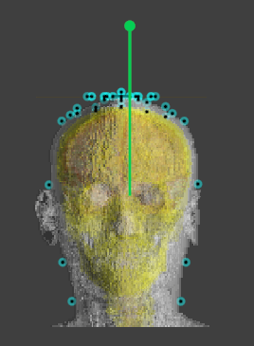
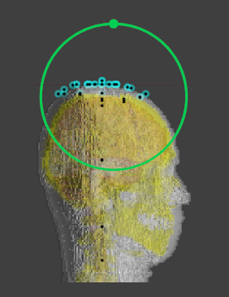
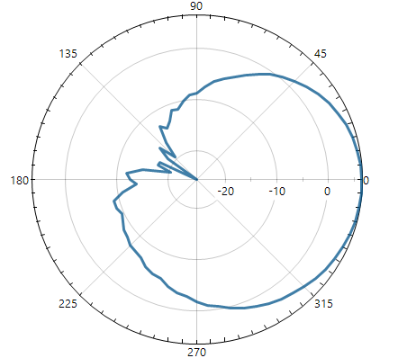


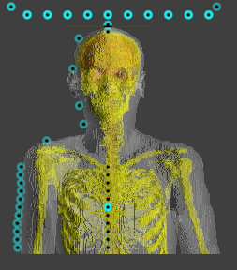
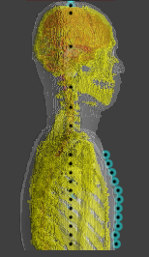

Antenna pattern
We confirmed that the antenna gain was degraded to -20 dBi, compared with 4 dBi in free space

Slide 6
MAC evaluation simulation setup
Here, the antenna gain was modified based on the FDTD calculation results

Slide 7
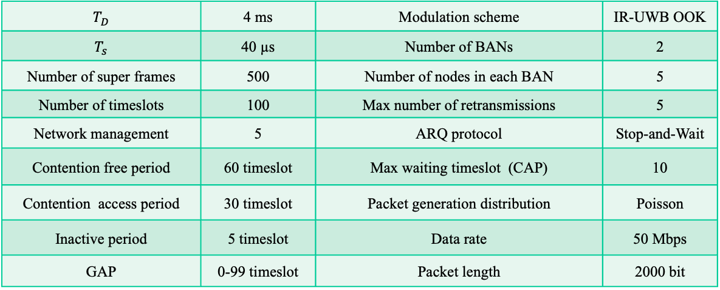
MAC simulation parameters
$T_{D}$ | 4 ms | Modulation scheme | IR-UWB OOK
$T_{s}$ | 40 µs | Number of BANs | 2
Number of super frames | 500 | Number of nodes in each BAN | 5
Number of timeslots | 100 | Max number of retransmissions | 5
Network management | 5 | ARQ protocol | Stop-and-Wait
Contention free period | 60 timeslot | Max waiting timeslot (CAP) | 10
Contention access period | 30 timeslot | Packet generation distribution | Poisson
Inactive period | 5 timeslot | Data rate | 50 Mbps
GAP | 0-99 timeslot | Packet length | 2000 bit

Slide 8
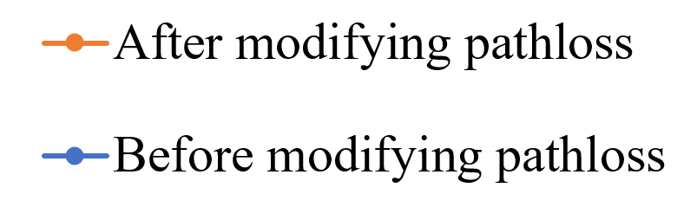
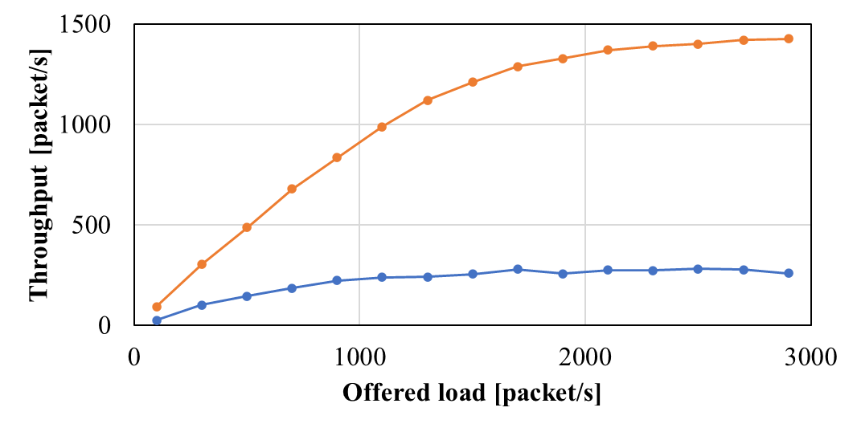
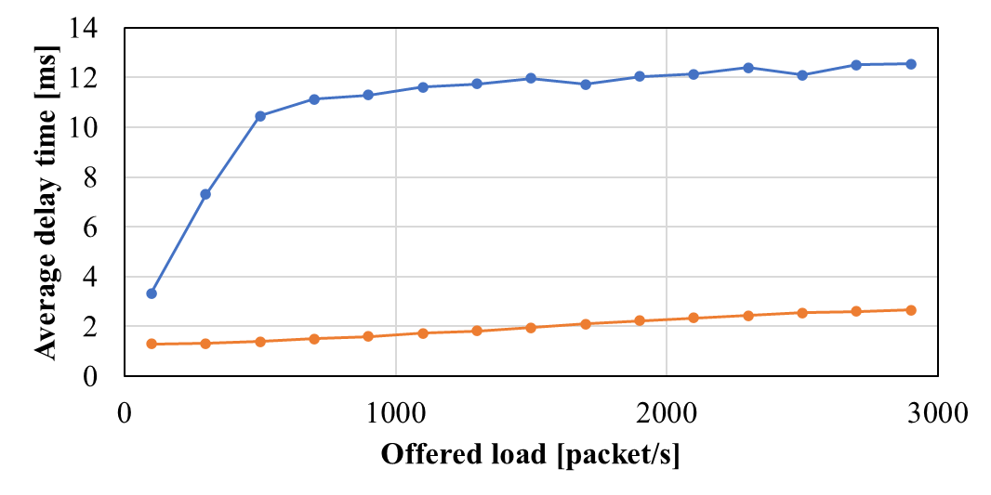
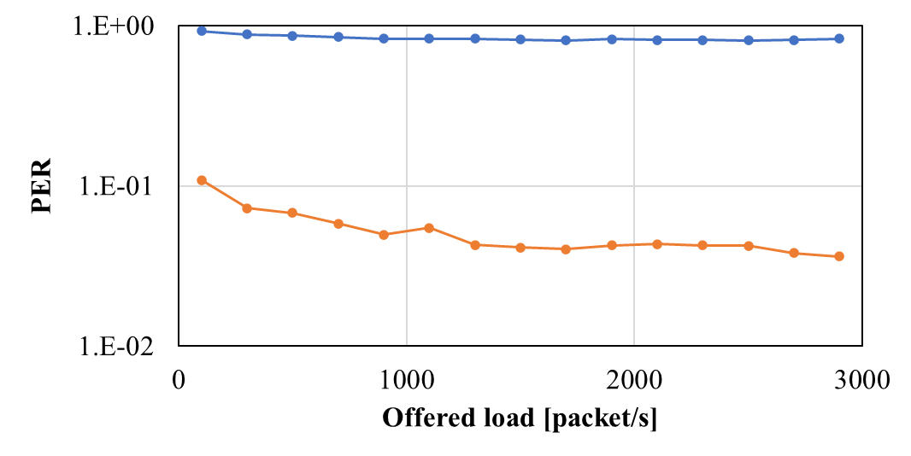
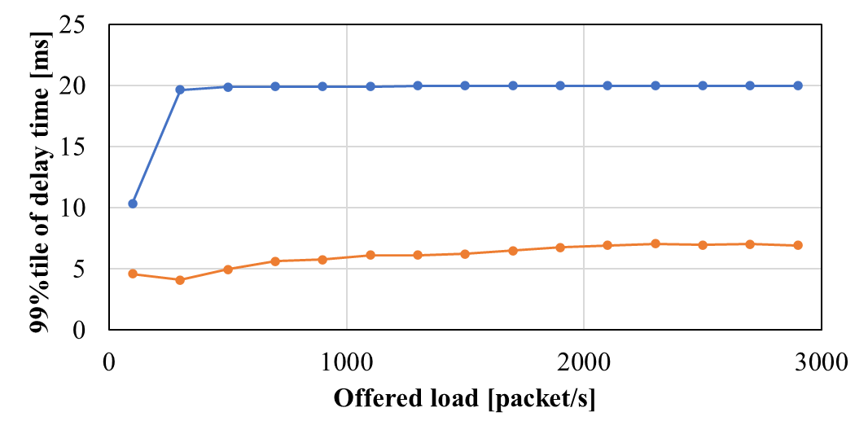
Evaluation results in CFP for managed synchronous superframe
Offered load (CAP) = 2000 packet/sec

Slide 9
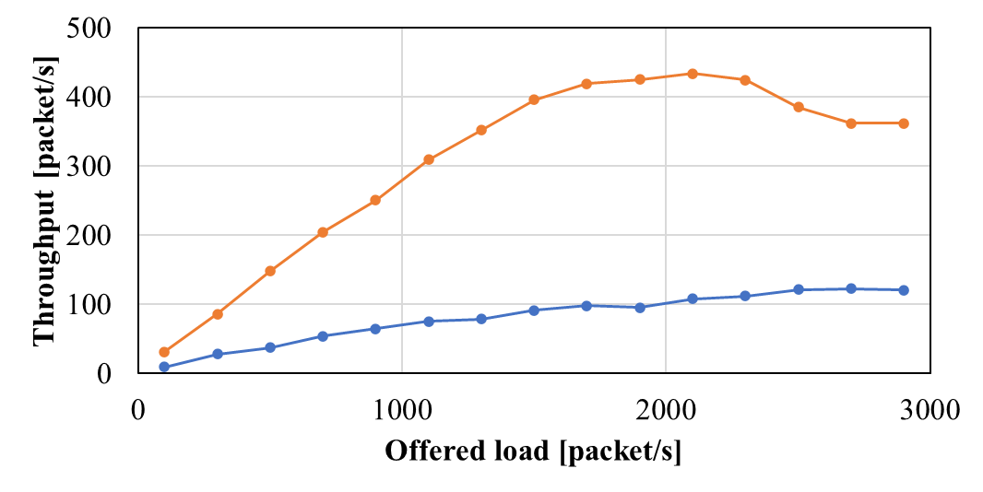
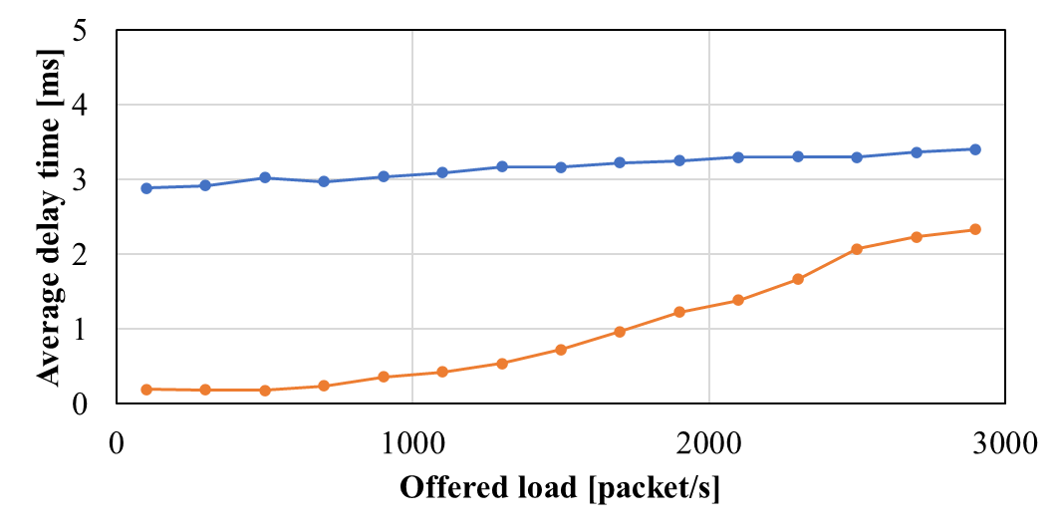
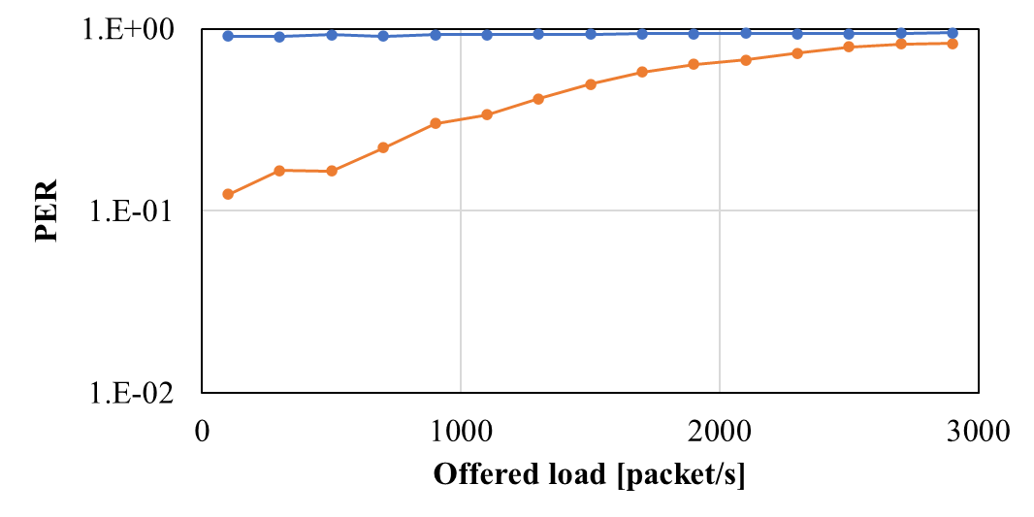
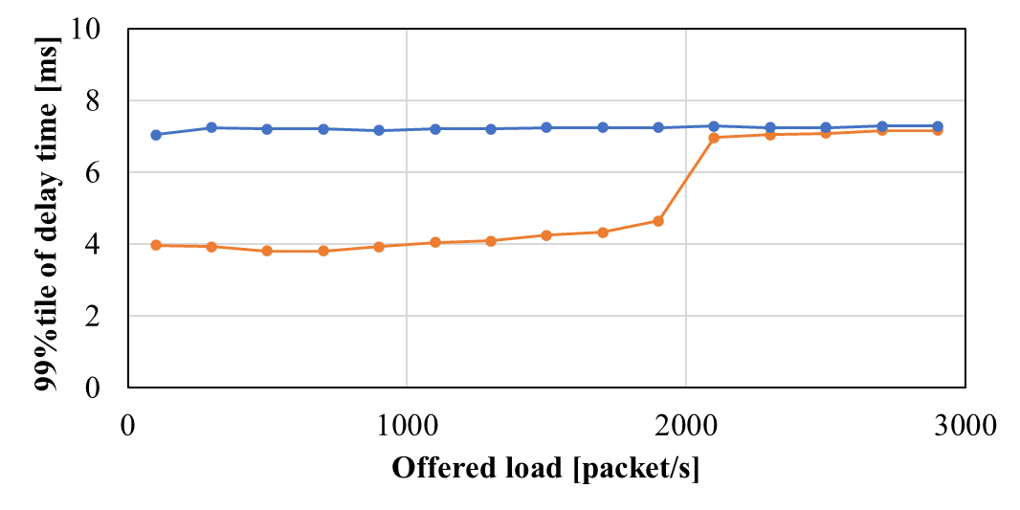
Evaluation results in CAP for managed synchronous superframe
Offered load (CFP) = 3000 packet/sec

Slide 10
References
D. Anzai, R. Inuzuka, M. Kim, T. Kobayashi, M. Hernandez, R. Kohno, “Fundamental MAC Performance Evaluation under Multiple IEEE802.15.6ma BAN Co-Existence,” in Proc. IEEE ISMICT 2023, Lincoln, USA, Mach 2023.
D. Anzai, I. Balasingham, G. Fischer, J. Wang, “Reliable and High-Speed Implant Ultra-Wideband Communications with Transmit–Receive Diversity,” EAI/Springer Innovations in Communication and Computing, pp. 27-32, March 2020.
Y. Shimizu, D. Anzai, R. C-Santiago, P. A. Floor, I. Balasingham, and J. Wang, “Performance evaluation of an ultra-wideband transmit diversity in a living animal experiment” IEEE Trans. Microw. Theory Tech., vol. 65, no. 7, pp. 2596-2606, July 2017.
D. Anzai, K. Katsu, R. Chavez-Santiago, Q. Wang, D. Plettemeier, J. Wang, and I. Balasingham, “Experimental evaluation of implant UWB-IR transmission with living animal for body area networks,” IEEE Trans. Microw. Theory Tech., vol. 62, no. 1, pp. 183-192, Jan. 2014.
J. Shi, D. Anzai, and J. Wang, “Channel modeling and performance analysis of diversity reception for implant UWB wireless link,” IEICE Trans. Commun., no. E95-B, vol. 10, pp. 3197-3205, Oct. 2012.

