Slide 1
Project: IEEE P802.15 Working Group for Wireless Specialty Networks (WSN)
Submission Title: Considerations on channel order in frequency stitching
Source: Bin Qian, Chenchen Liu, Xiaohui Peng, Lei Huang, David Xun Yang (Huawei Technologies)
Address : [Huawei Bantian Base, Longgang District, Shenzhen, 518129 China]
E-Mail: [qianbin14@huawei.com]
Re: Task Group 4ab: UWB Next Generation for 802.15.4
Abstract: [UWB, sensing, frequency stitching]
Purpose:
Notice: This document has been prepared to assist the IEEE P802.15. It is offered as a basis for discussion and is not binding on the contributing individual(s) or organization(s). The material in this document is subject to change in form and content after further study. The contributor(s) reserve(s) the right to add, amend or withdraw material contained herein.
Release: The contributor acknowledges and accepts that this contribution becomes the property of IEEE and may be made publicly available by P802.15.
Notes:
Jul 12, 2010
Page 1

Slide 2
PAR Objective | Proposed Solution (how addressed)
Safeguards so that the high throughput data use cases will not cause significant disruption to low duty-cycle ranging use cases
Interference mitigation techniques to support higher density and higher traffic use cases
Other coexistence improvement
Backward compatibility with enhanced ranging capable devices (ERDEVs)
Improved link budget and/or reduced air-time
Additional channels and operating frequencies
Improvements to accuracy / precision / reliability and interoperability for high-integrity ranging
Reduced complexity and power consumption
Hybrid operation with narrowband signaling to assist UWB
Enhanced native discovery and connection setup mechanisms
Sensing capabilities to support presence detection and environment mapping | Different channel orders in frequency stitching
Low-power low-latency streaming
Higher data-rate streaming allowing at least 50 Mbit/s of throughput
Support for peer-to-peer, peer-to-multi-peer, and station-to-infrastructure protocols
Infrastructure synchronization mechanisms

Slide 3
Reference
[1] IEEE 802.15/22-061r0, “Sensing Continued”
[2] IEEE 802.15/22-422r0, “UWB Sensing - Scheduling”
[3] IEEE 802.15/23-178r0, “Frequency Stitching Considerations”
[4] IEEE 802.15/23-284r0, “Latest Consensus on UWB Sensing PHY and MAC”

Slide 4
Recap: Frequency Stitching
The frequency stitching is discussed in [1-3] to improve the effective bandwidth of sensing by aggregating multiple frequency segments together.
Two factors are considered further in the frequency stitching
Time scale. The time to obtain each measurement of frequency stitching should be less than the coherent time of the channel. Short total time span per measurement is good.
Transmission power loss. Overlap between adjacent used channels may lead to mean EIRP accumulation when minimizing the total time span, which may result in transmission power loss. Small transmission power loss is good.

Slide 5
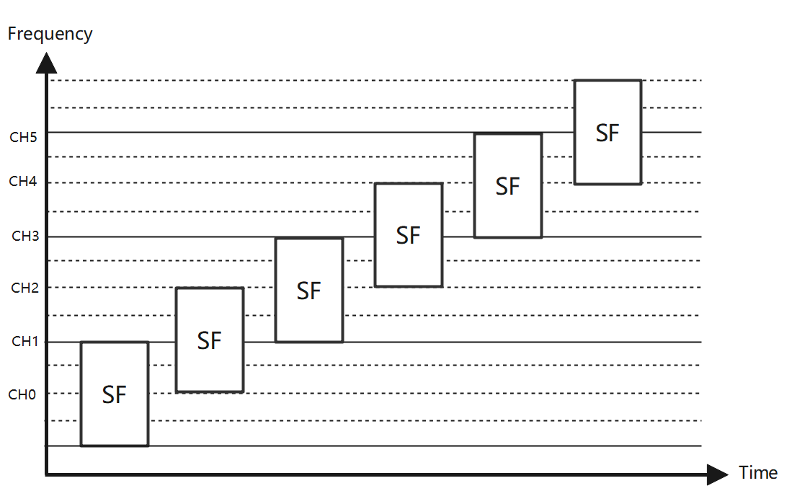
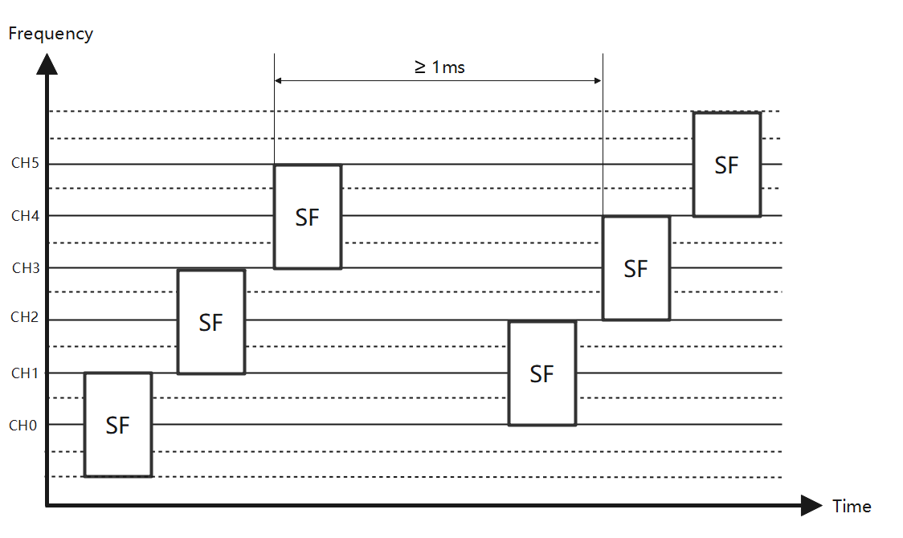
Recap: Channel Order in Frequency Stitching
Two types of channel order in frequency stitching
In-sequence channel order: shorter total time span, possible transmission power loss
Out-of-sequence channel order [3]: longer total time span, no transmission power loss
In-sequence channel order
Out-of-sequence channel order

Slide 6
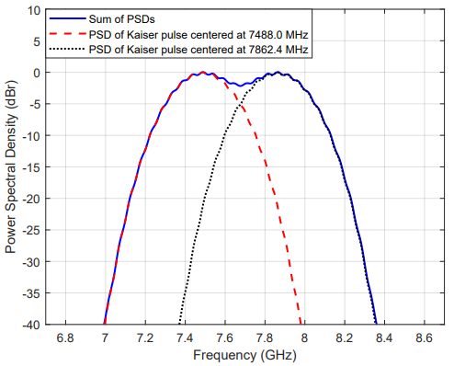
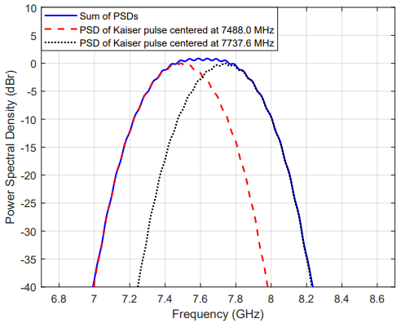
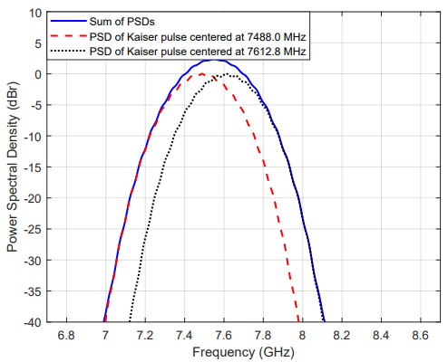
PSD Accumulation
The channel overlapping in frequency stitching could be 124.8 MHz (25% overlap), 249.6 MHz (50% overlap), and 374.4 MHz (75% overlap).
Different overlaps leads to different PSD accumulation result
Sensing pulse shape: the time-bounded Kaiser with 3 chips [4]
25% overlap
50% overlap
75% overlap

Slide 7
PSD Accumulation (Cont.)
For 25% overlap, the PSD accumulation will not exceed 0 dBr. In-sequence channel order will achieve short total time span and no transmission power loss simultaneously
For 50% overlap, the maximum value of PSD accumulation is about 1 dBr. In this case, in-sequence channel order may have 20% transmission power loss
For 75% overlap, the maximum value of PSD accumulation is about 3 dBr. In this case, in-sequence channel order may have 50% transmission power loss

Slide 8
Possible Solution
In [3], there is an one-to-one mapping between the overlap factor (OF) and overlap rate as follow
(No overlap, 0), (25% overlap, 1), (50% overlap, 2), (75% overlap, 3)
The out-of-sequence channel order could be computed according to
CH((p*(OF+1) MOD (N)) + (p*(OF+1) DIV (N))), where p = 0 ... (N-1) and DIV denotes integer division
When the out-of-sequence channel order is used, we propose to change the value of overlap factor as follows
Overlap Factor (OF) Value | Description
0 | Non-overlapping, 25% overlap
1 | Reserved
2 | 50% overlap
3 | 75% overlap

Slide 9
Summary
Based on the observations of the PSD accumulation, the out-of-sequence channel order does not bring any benefit under 25% overlap
We suggest that the in-sequence channel order shall be used for frequency stitching under 25% overlap
Whether the in-sequence channel order or the out-of-sequence channel order is used for frequency stitching depends on the tradeoff between the time span per measurement and the transmission power loss under 50% overlap and 75% overlap

Slide 10
Thank You

