Slide 1
Project: IEEE P802.15 Working Group for Wireless Specialty Networks (WSN)
Submission Title: Follow-up on CIR scaling and quantization
Source: Bin Qian, Chenchen Liu, Xiaohui Peng, Rojan Chitrakar, Lei Huang, David Xun Yang (Huawei Technologies)
Address : [Huawei Bantian Base, Longgang District, Shenzhen, 518129 China]
E-Mail: [qianbin14@huawei.com]
Re: Task Group 4ab: UWB Next Generation for 802.15.4
Abstract: [UWB, sensing, CIR]
Purpose:
Notice: This document has been prepared to assist the IEEE P802.15. It is offered as a basis for discussion and is not binding on the contributing individual(s) or organization(s). The material in this document is subject to change in form and content after further study. The contributor(s) reserve(s) the right to add, amend or withdraw material contained herein.
Release: The contributor acknowledges and accepts that this contribution becomes the property of IEEE and may be made publicly available by P802.15.
Notes:
Jul 12, 2010
Page 1

Slide 2
PAR Objective | Proposed Solution (how addressed)
Safeguards so that the high throughput data use cases will not cause significant disruption to low duty-cycle ranging use cases
Interference mitigation techniques to support higher density and higher traffic use cases
Other coexistence improvement
Backward compatibility with enhanced ranging capable devices (ERDEVs)
Improved link budget and/or reduced air-time
Additional channels and operating frequencies
Improvements to accuracy / precision / reliability and interoperability for high-integrity ranging
Reduced complexity and power consumption
Hybrid operation with narrowband signaling to assist UWB
Enhanced native discovery and connection setup mechanisms
Sensing capabilities to support presence detection and environment mapping | Adaptive power-of-two scaling scheme to reach a better performance in terms of SQNR
Low-power low-latency streaming
Higher data-rate streaming allowing at least 50 Mbit/s of throughput
Support for peer-to-peer, peer-to-multi-peer, and station-to-infrastructure protocols
Infrastructure synchronization mechanisms

Slide 3
Reference
[1] IEEE 802.15-23-0284-00-04ab-latest-consensus-on-uwb-sensing-phy-and-mac
[2] IEEE 802.15-23-0267-00-04ab-channel-impulse-response-cir-signal-to-quantization-noise-sqnr-analysis
[3] IEEE 802.15-23-0239-01-04ab-considerations-on-cir-scaling-and-quantization

Slide 4
Introduction
In [1], the group agreed that encoding signed I/Q-component values each with 16 bits is mandatory, 10, 12 bits and other values of bit-width could be optional
In [2]-[3], the SQNR performance of the power-of-two scaling and quantization method is analyzed
  In [2], the scaling factor is fixed per segment and Rx antenna
  In [3], the scaling factor is adaptive per CIR tap
In this contribution, the SQNR performance and complexity of [2] and [3] are further compared

Slide 5
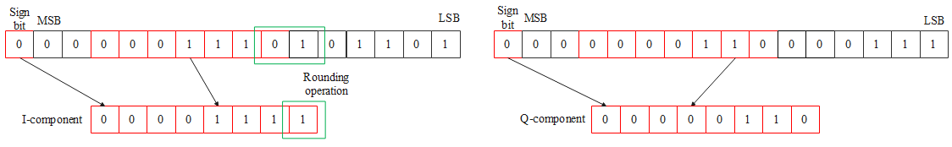
Recap: Fixed Power-of-two Scaling Scheme
To avoid the overflow, the scaling factor is computed based on the largest absolute value of the real and imaginary component per segment and Rx antenna
The scaling factor is a power of 2, converting multiplication and division into bit shifts
Example
I-component
Q-component

Slide 6
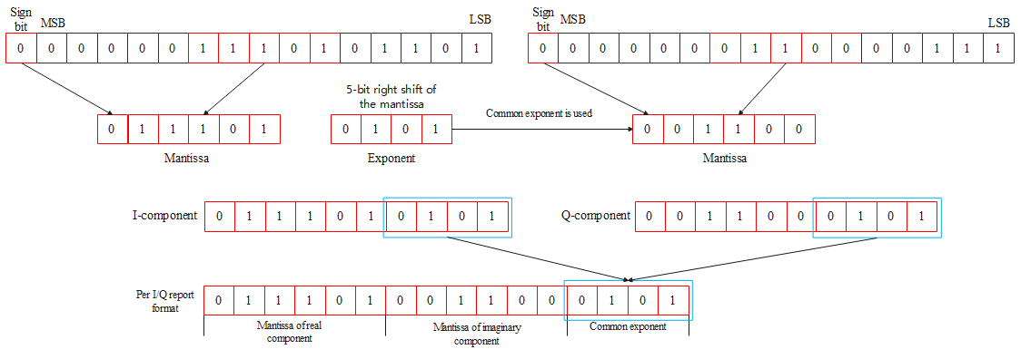
Recap: Adaptive Power-of-two Scaling Scheme
The scaling factor is computed based on the leading bit search per CIR tap
The scaling factor is a power of 2, converting multiplication and division into bit shifts
Example
I-component
Q-component

Slide 7
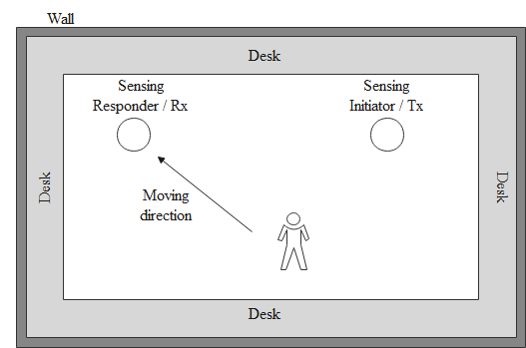
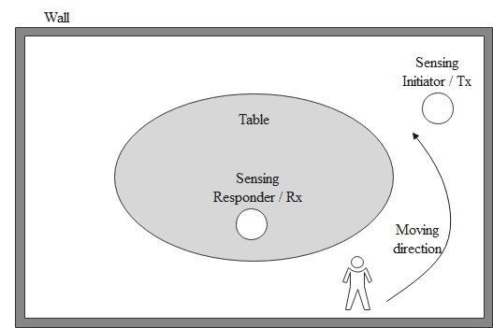
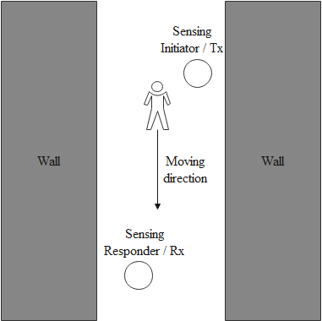
Simulation Scenarios
Scenario A: a large office
The distance between the sensing initiator and the sensing responder is about 5m. A person is walking towards the sensing responder
Scenario B: a small office
The distance between the sensing initiator and the sensing responder is about 3m. A person is walking around the table
Scenario C: a corridor
The distance between the sensing initiator and the sensing responder is about 5m. A person is walking along the corridor

Slide 8
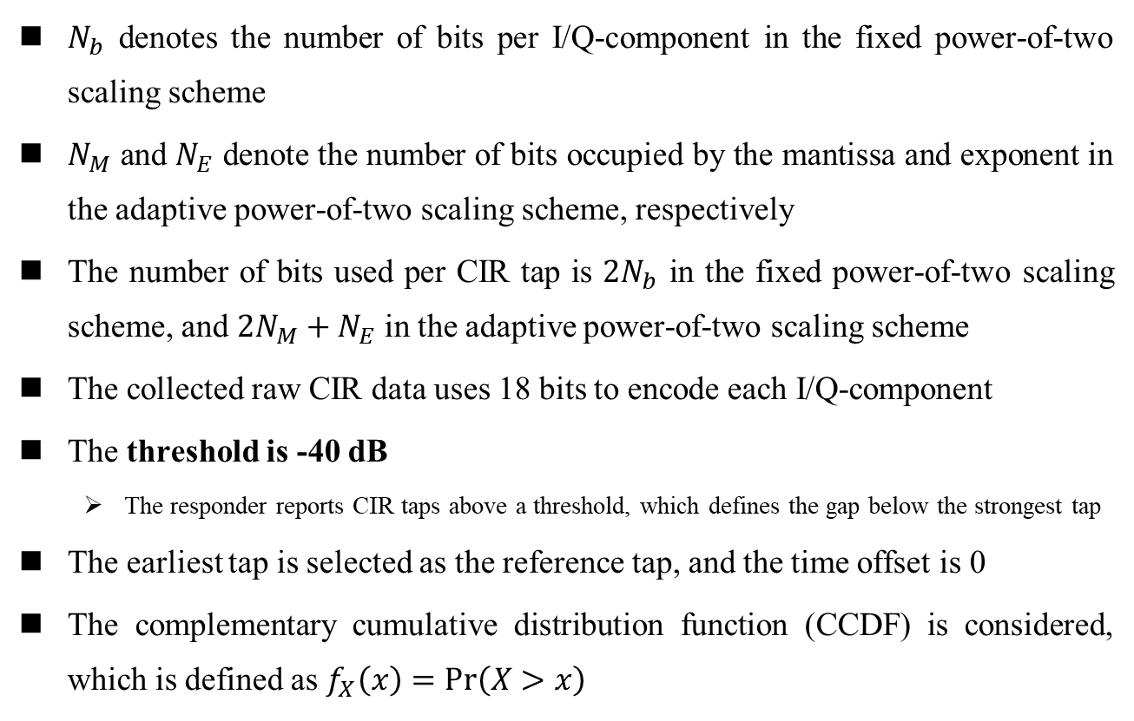
Simulation Parameter Settings
$N_{b}$ denotes the number of bits per I/Q-component in the fixed power-of-two scaling scheme
$N_{M}$ and $N_{E}$ denote the number of bits occupied by the mantissa and exponent in the adaptive power-of-two scaling scheme, respectively
The number of bits used per CIR tap is $2N_{b}$ in the fixed power-of-two scaling scheme, and ${2N}_{M}+N_{E}$ in the adaptive power-of-two scaling scheme
The collected raw CIR data uses 18 bits to encode each I/Q-component
The threshold is -40 dB
  The responder reports CIR taps above a threshold, which defines the gap below the strongest tap
The earliest tap is selected as the reference tap, and the time offset is 0
The complementary cumulative distribution function (CCDF) is considered, which is defined as $f_{X}\left(x\right)=Pr\left(X>x\right)$

Slide 9
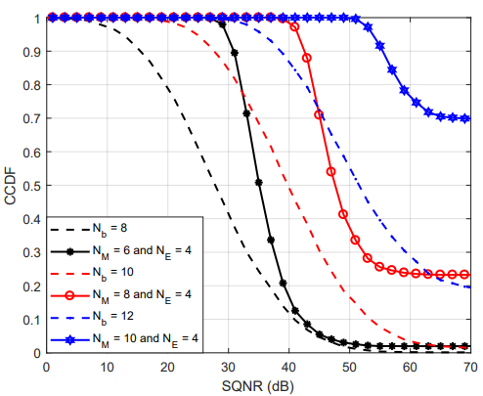
Scenario A
33 sensing packets are tested with bitmap length 128.

Slide 10
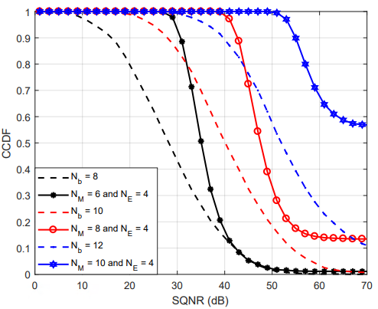
Scenario B
58 sensing packets are tested with bitmap length 64.

Slide 11
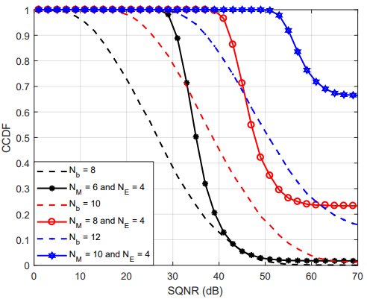
Scenario C
48 sensing packets are tested with bitmap length 64.

Slide 12
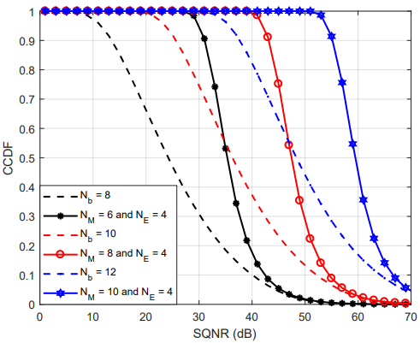
Tap CCDF of UWB Channel Model
5000 channel realizations for UWB channel model 1 is captured
The raw I/Q-component of the CIR data is a real value
Threshold = -40 dB

Slide 13
Overhead Reduction
Given the minimum acceptable SQNR, different schemes will occupy different number of bits per CIR tap
Minimum acceptable SQNR | Number of bits per CIR tap required
 | Fixed power-of-two scaling scheme | Adaptive power-of-two scaling scheme
20 dB | 20 bits | 16 bits
25 dB | 24 bits | 16 bits
30 dB | 24 bits | 20 bits

Slide 14
Hardware Complexity Analysis
Both schemes could convert the multiplication and division to bit shifts
The largest absolute value of the real and imaginary component per segment and Rx antenna is needed in the fixed power-of-two scaling scheme, which is detrimental to the pipeline operation of the hardware.
  Prior pass over the CIR taps is needed to find the above largest absolute value
Leading bit search per CIR tap is needed in the adaptive power-of-two scaling scheme, which is easy to the pipeline operation of the hardware

Slide 15
Software Complexity Analysis
The CIR measurement reports do not need to be generated in real time, which allows the usage of software to construct the CIR report for the OTA transmission
Detailed operations
Scheme | Scaling selection | I/Q bit extraction and packing
Fixed power-of-two scaling | Method 1: Select the largest value of CIR and search the leading bit of the largest value to obtain scaling factor Method 2: Search the leading bit of each tap and select the largest leading bit to obtain scaling factor | Needed
Adaptive power-of-two scaling | Obtain the scaling factor by searching the leading bit of each tap | Needed
  Leading bit search can be operated by a “Count Leading Zeros” instruction (like CLZ instruction in ARM), which takes one cycle
  I/Q bit extraction and packing are used for constructing or parsing the I/Q report format
The processing delay introduced by the complexity gap is insignificant compared to the interval between the sensing phase and report phase, or the interval between the reception of CIR report and the upper layer’s processing

Slide 16
Summary
The adaptive power-of-two scaling scheme outperforms the fixed power-of-two scaling scheme in terms of SQNR in all typical scenarios considered with the same number of bits per CIR tap.
Given the minimum acceptable SQNR, the adaptive power-of-two scaling scheme will occupy less bit
The implementation complexity gap is insignificant
We prefer the adaptive power-of-two scaling scheme

Slide 17
Thank You

