Slide 1
Project: IEEE P802.15 Working Group for Wireless Personal Area Networks (WPANs)
Submission Title: Measurement and Characterization of 300 GHz Channel in a Corridor Environment
Date Submitted: July 2023
Source: Anirban Ghosh, Riku Takahashi, Kosuke Shibata, Minseok Kim, Shigenobu Sasaki
Graduate School of Science and Technology, Niigata University, 8050 Ikarashi 2-no-cho, Nishi-ku, Niigata, Niigata, Japan
Voice:+81-25-262-7478, E-Mail: anirban.g@eng.niigata-u.ac.jp, mskim@eng.niigata-u.ac.jp
Re: N/A
Abstract: In the face of increasing demand for higher data rates and ultra-reliable communication with low latency, the terahertz (THz) band (with frequencies upward of 100 GHz) has garnered a lot of interest. In this presentation the developed 300 GHz channel sounder is first presented followed by an extensive elucidation of a measurement campaign conducted with the described sounder in a corridor. The obtained data for 7 transmitter (Tx)-receiver (Rx) positions are further processed to generate the power delay profiles (PDPs) and angular delay power spectrum (ADPS). An environment geometry aided intuitive ray tracing validated by simulation is used to understand the cluster formation from the generated results. The large-scale parameters (LSP) such as delay and angle (azimuth spread of arrival/departure) spreads are also evaluated to assist channel model development. Finally, a transmission loss model is generated and compared with available literature in ITU-R.
Purpose: Information document for IEEE 802.15 SC THz
Notice: This document has been prepared to assist the IEEE P802.15. It is offered as a basis for discussion and is not binding on the contributing individual(s) or organization(s). The material in this document is subject to change in form and content after further study. The contributor(s) reserve(s) the right to add, amend or withdraw material contained herein.
Release: The contributor acknowledges and accepts that this contribution becomes the property of IEEE and may be made publicly available by P802.15.

Slide 2
Measurement and Characterization of 300 GHz Channel in a Corridor Environment
Anirban Ghosh, Riku Takahashi, Kosuke Shibata, Minseok Kim, Shigenobu Sasaki
Niigata University, Japan

Slide 3
Motivation
Beyond 5G Communication requirements
  Ubiquitous connection for a heterogenous network
  High data rate: upwards of 100 Gbps
    Tens of GHz worth bandwidth available in 0.1-10 THz
  Ultra-reliable communication for life-critical applications
  Low latency to support real-time application
Our Effort
  Channel measurement at 300 GHz in a corridor environment
  Contribute measurement results
  Analyze measurement data
  Generate path loss model
Notes:
In recent times many new applications have emerged which would require ubiquitous connection over heterogenous network. In addition, critical applications like automated driving, intelligent sensing and notification would require low latency and high reliability. The prior requirements are further supplemented by the requirement of higher data rates to the tune of tera bits per second. The current implementations using spectrum below 100 GHz cannot achieve such high data rate and hence the need to foray into spectrum beyond 100 GHz.
In order to properly understand the propagation characteristics of any new band, extensive measurement campaigns in various environments are required. In this context, we conducted a campaign in a corridor at 300 GHz emulating a scenario where two smart devices at approximately the same height communicate.

Slide 4
Outline
300-GHz Double-Directional Channel Sounder Development
  System parameters and specifications
Channel Measurement and Results
  Corridor
    Measurement and Post processing
    Power Spectra and Identification of Specular Paths
    Evaluation of Large Scale Parameters (LSP) and Generation of Path Loss Model
      Conclusion
Future Works
Notes:
The outline of the presentation is as follows
The development of the channel sounder is described first in terms of its architecture, the sounding signal used, system parameters, link budget and dynamic range.
The measurement scenario is described next in conjunction with the directional measurement parameters.
The post processing and data analysis of the measurement data is followed by identification of specular paths, evaluation of LSP and generation of path loss model.
The presentation is concluded by summarizing the results and providing future direction of the current work.

Slide 5
Channel Sounder

Slide 6
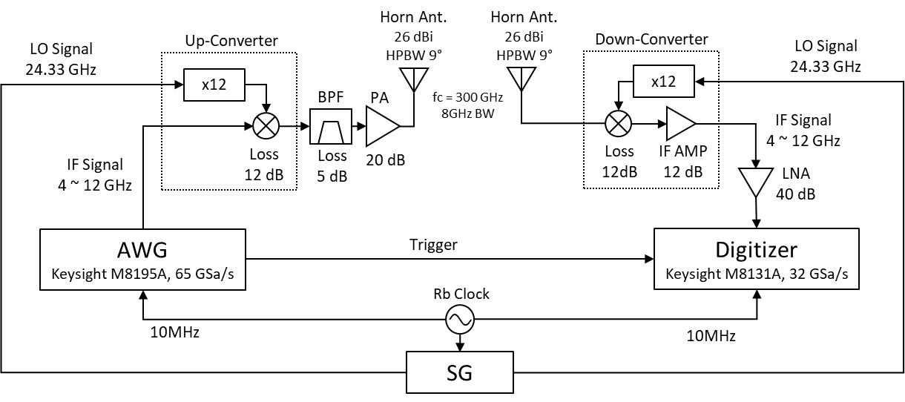
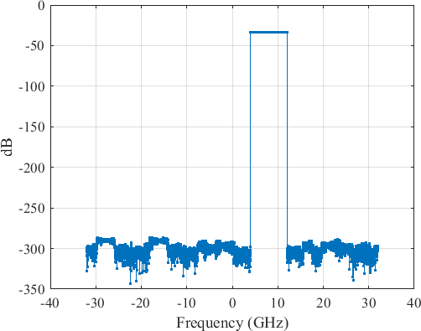
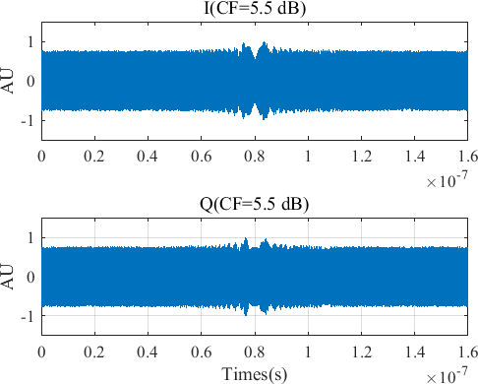
Sounder Architecture and Sounding Signal
Super-heterodyne architecture with IF stage
8 GHz
Up- Conversi on
BPF
280~288
296~304
GHz
GHz
292 300 (LOx12)
< RF stage >
8
f [GHz]
284
f [GHz]
< IF stage >
300 GHz Freq. Conversion
8 GHz
Sounding Signal*
160 ns
160 ns
*Minseok Kim, Shuaiqin Tang, Keiichiro Kumakura, “Fast Double-Directional Full Azimuth Sweep Channel Sounder Using Low-Cost COTS Beamforming RF Transceivers,” IEEE Access, Vol.9, pp. 80288-80299, Jun. 2021
Notes:
The super-heterodyne architecture of the novel channel sounder is shown here with the following features
At the transmitter
The LO signal generated by the signal generator (SG) is passed through a times 12 frequency multiplier and mixed with a IF signal of bandwidth 8 GHz generated by the arbitrary waveform generator (AWG)
In order to remove the image frequency after up-conversion the signal is passed through a BPF centred at 300 GHz.
The filtered is passed through a high gain power amplifier (PA) to accommodate for the different losses before being transmitted through a horn antenna with HPBW of 9⁰ and gain of 26 dBi
At the receiver
The signal received through a horn antenna similar to the one used at the transmitter is initially passed through a down-converter whose other input is a LO signal (similar to the one at Tx) after passing through a time 12 frequency multiplier
The down-converted signal is initially passed through an IF amplifier of gain 12 dB and then through a low noise amplifier (LNA) of gain 40 dB to compensate for the losses during propagation and reception
The amplified signal is given as input to the digitizer to obtain the baseband signal.
The AWG, SG and Digitizer are synchronized using a stable Rubidium clock
A Newman phase multitone signal of bandwidth 8 GHz is used as the sounding signal whose frequency and I/Q representation are as shown.

Slide 7
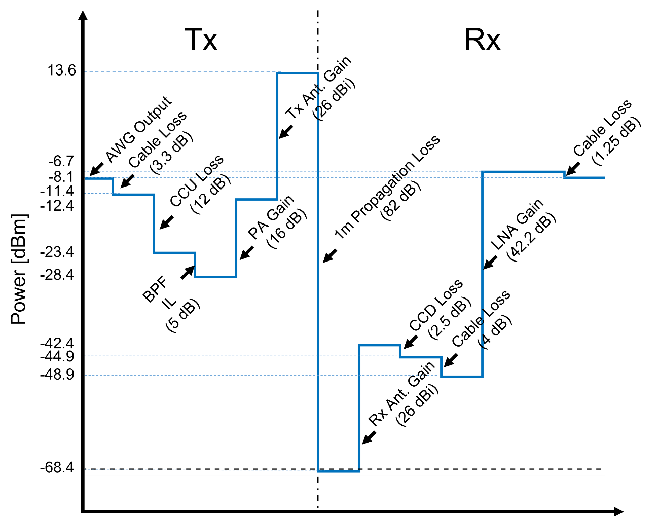
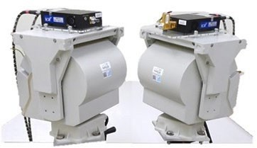
System Parameter and Link Budget
 | 300 GHz
Freq. | 300 GHz
Signal BW | 8 GHz
Sounding signal | 1,280
Delay resolution | 125 ps
Delay span | 160 ns
Ant./Dir Gain | 26 dBi
EIRP | 14 dBm
HPBW | 9°
Dynamic range | 60~80 dB
Notes:
The significant system parameters of the sounder are shown in this slide where
The sounding signal consists of 1280 tones
Has a delay resolution of 125 ps and a total delay span of 160 ns
The dynamic range (which will be discussed in more detail in the next slide) is between 60-80 dB depending on the Tx-Rx separation
The link budget of the sounder is also presented alongside

Slide 8
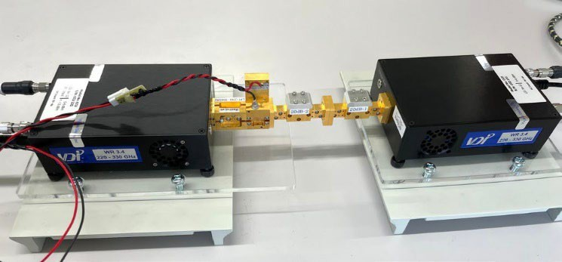
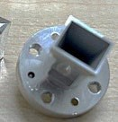
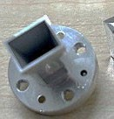

Dynamic Range
Back-to-back evaluation
ATT (20dB)
0.3 m
B2B ATT level = 20+26*2 = 72 dB
FSPL@ 0.3 m = 71.5 dB
Tx Ant. 26 dBi Rx Ant. 26 dBi
20
Channel transfer function (1)
Channel impulse response (1)
w/o | aver | aging
20
0
0
-20
-20
DR=52dB
Averaging 1000 snapshots
Path Gain [dB]
-40
Power [dB]
-60
Calibration point
（Maximum）
-40
-60
-60
-80
-80
-80
-100
-100
-4
-2 0
Freq [GHz]
2
4
-100
-50
0
Delay [ns]
50
PG [dB]
-120
DR~80dB
20
Channel transfer function (1000)
Channel impulse response (1000)
50dB
w/ | 1000 | snaps | hots
ave | ragin | g
20
-140
30dB
0
0
Ave. noise
-20
-160
30 cm
level
10 m
100 m
Path Gain [dB]
-20
-40
Power [dB]
-40
DR=81dB
-180
₁₀ -1
10 ⁰ 10 ¹ 10 ² 10 ³
-60
-60
distance [m]
Targeted distance of 30 cm~100 m (Indoor/Outdoor)
can be covered
-80
-80
-100
-4
2
4
-100
-50
50
Notes:
Back to back calibration is conducted to compensate for the different system response of the filters, amplifiers, etc. used on either side (Tx and Rx). A 20 dB attenuator is used for the process emulating a propagation distance of 0.3m as indicated by the calculations.
The dynamic range is obtained as 52 dB for the said calibration setup. However, with the help of coherent averaging of 1000 snapshots the dynamic range can be improved to 81 dB for the same setup.
Figure on the left bottom corner indicates the variation of dynamic range with separation distance between Tx and Rx where at a separation of even 100 m the sounder provides a dynamic range of 30 dB and hence can be used for measurement.

Slide 9
Measurement and Post-processing

Slide 10
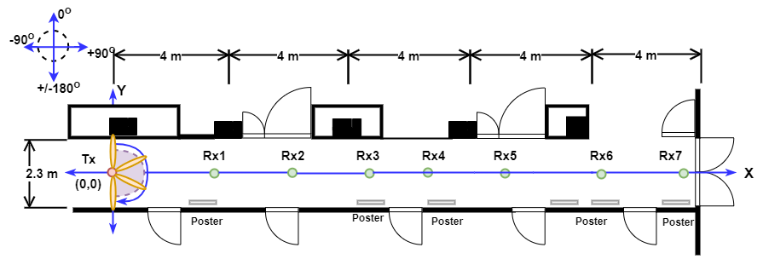
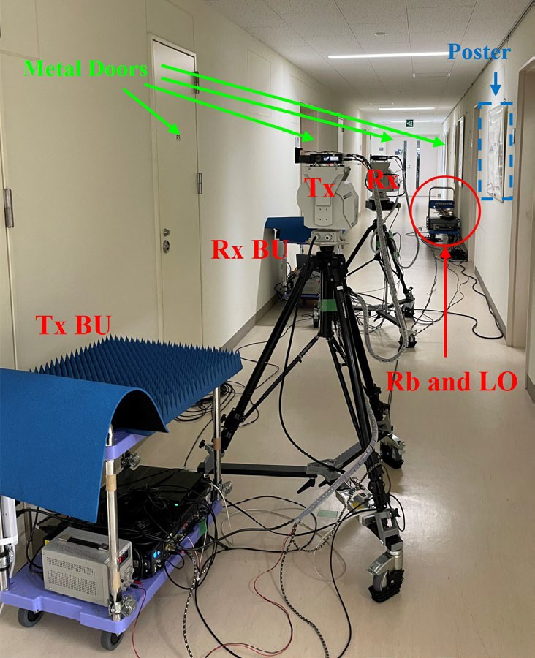
Measurement Scenario and Scanning
Corridor dimensions
  Length: 20 m
  Width: 2.3 m
Tx position fixed, Rx moved to 8 different positions as shown
  Tx and Rx Height – 1.5 m
  Tx – Rx separation range: 2.85 to 19.67 m
Angle scanning – azimuth only
Scenario | Tx | Rx
InC | 0⁰:9⁰:180⁰ | 0⁰:9⁰:351⁰
Notes:
In this campaign two measurement scenarios were investigated. The current slide describes the in corridor scenario. The length of the corridor within the measurement purview was 20 m whereas its width was 2.3 m. Whereas one side of the corridor was lined with single panel metal doors the other side comprised of broader double panel metal door. The concrete walls of the corridor were intermittently covered smooth plastic posters on the south side. The Tx was kept fixed at the position shown whereas the Rx was moved over 7 different positions (Rx1-Rx7) spanning a distance of 2.85 m to 19.67 m. The Tx and Rx were maintained at the same height of 1.5 m for all the positions.
Since the Tx and Rx were maintained at the same height angle scanning was conducted only in the azimuth plane where the Rx underwent a full azimuth sweep in steps of 9⁰ whereas the Tx was rotated over the range 0⁰ - 180⁰. The same angle scanning is also used for the other room to corridor scenario as well. A static environment was maintained during measurement by keeping area off-limits.

Slide 11
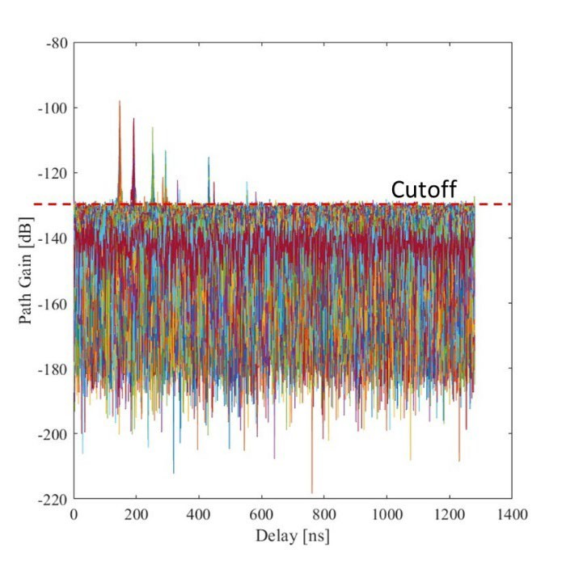
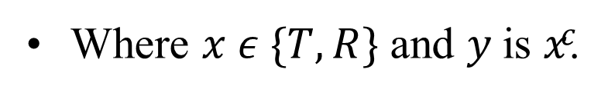
Post – Processing of Measurement Data
Noise filtering
– Cut-off level: set to -130 dB
Spectra Synthesis
Where $x ε \{T,R\}$ and 𝑦 is 𝑥^{𝑐}.
Notes:
The obtained resolved channel transfer function (CTF) was first converted into channel impulse response (CIR) using discrete inverse Fourier transform. The double directional angular delay power spectrum (DDADPS) is then approximately obtained by squaring the CIR. The DDADPS is then noise filtered with a cut off-level of -130 dB. The different power spectrum power delay profile, angular power spectrum (at both Tx and Rx) and angular delay power spectrum (at both Tx and Rx) is then evaluated using the formulas as shown.

Slide 12
Power Spectra and Identification of Specular Paths

Slide 13
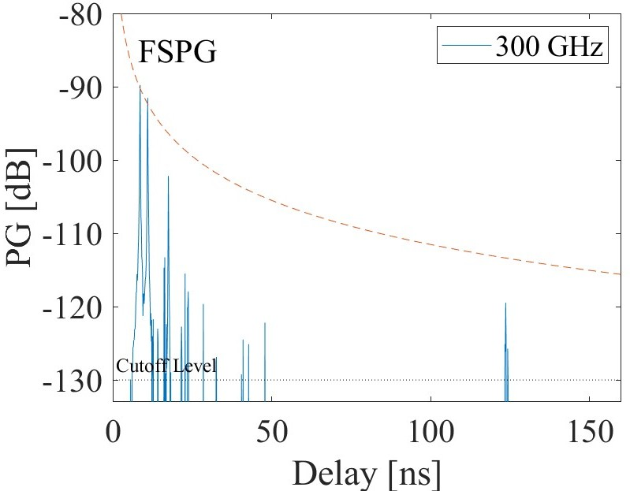
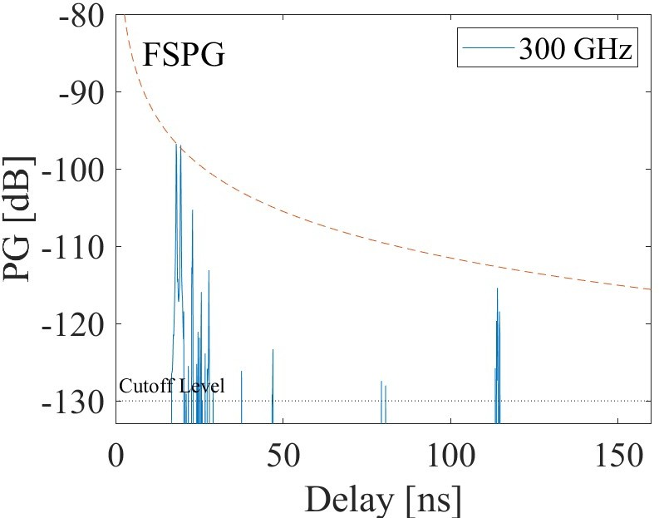
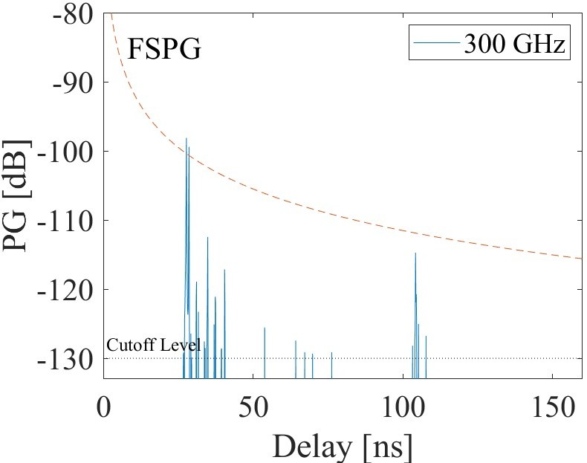
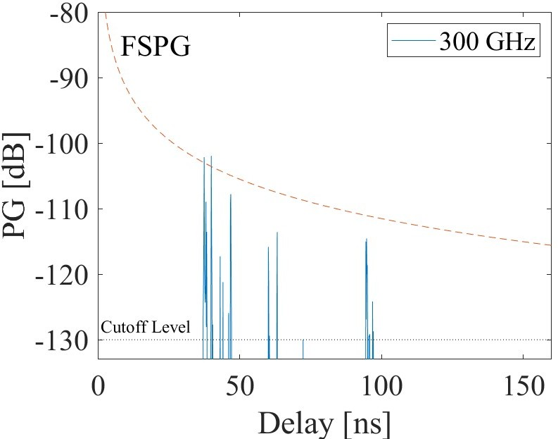
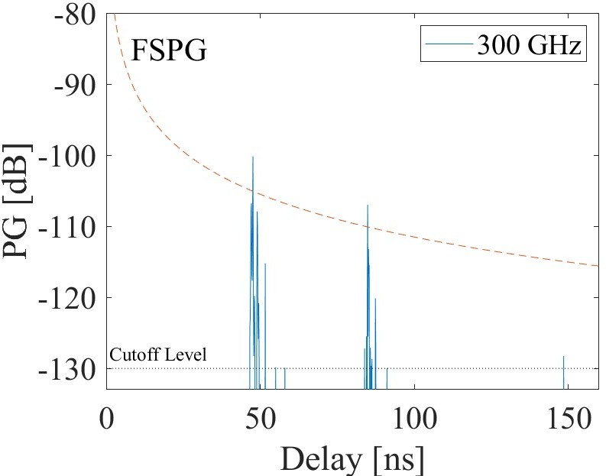
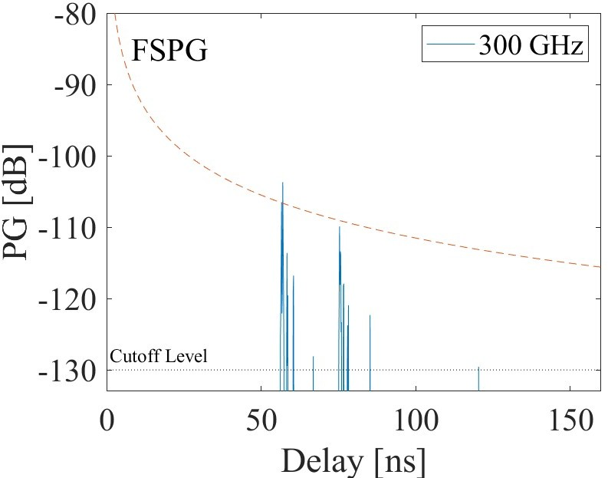
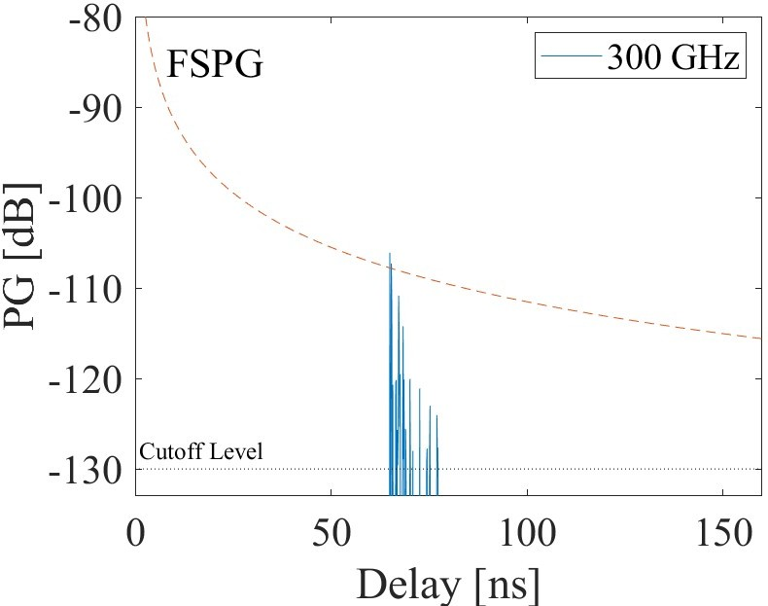
Power Delay Profile (PDP)
D
D
D
DR
DR
DR
Two significant clusters clearly visible – direct
(D) and door reflected
(DR) for Rx1 to Rx6.
For Rx7 the two significant clusters are almost merged, since the Rx is at the door in this position!
Rx1
Rx2
Rx3
D
D
D
DR
DR
DR
Rx4
Rx5
Rx6
D
Rx7
DR
Notes:
The omnidirectional PDP for all the Rx positions are presented in this slide. As can be observed the nature of the PDPs are impulse like and they are sparse. This gives motivation to try and decipher the reason for the peaks from the environment and by using ADPS at Tx and Rx.
However, prior to that,
using the time of arrival values and the subsequent mathematics it is easy to identify that the PDPs for LoS position consist of two main clusters, one due to direct path between Tx and Rx and the other due to reflection from the door at the back of the Rx as shown in the plots.
At Rx7 the direct and the door reflected paths almost merge onto to one another as the Rx is placed very close to the door such that the directed and the reflected path are almost same.

Slide 14
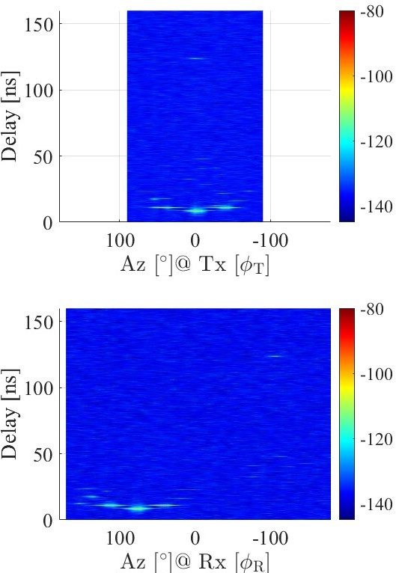


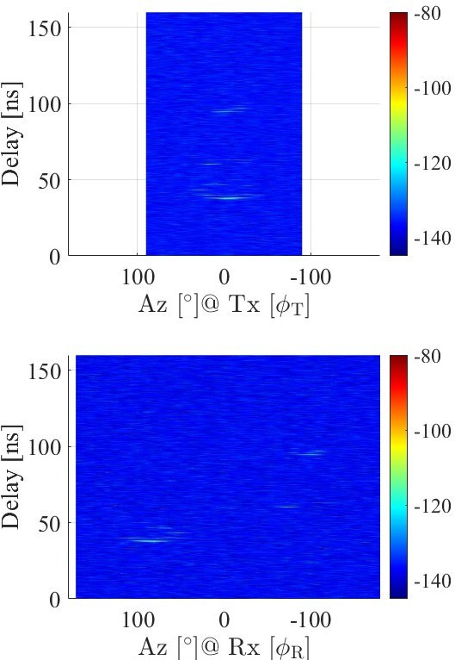

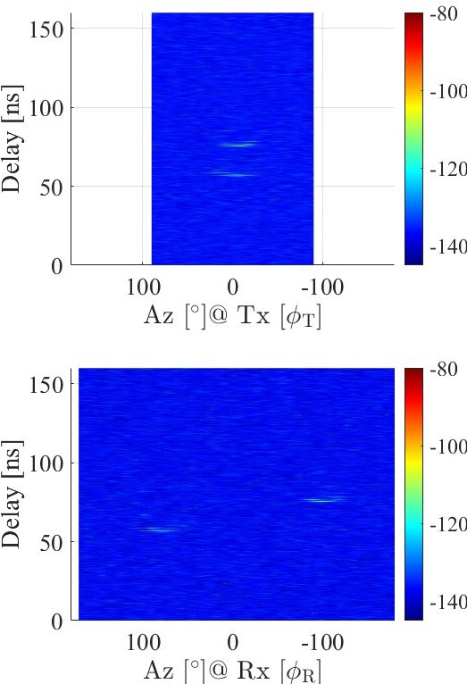

Angular Delay Power Spectrum
DR
DR
DR
DR
DR
DR
DR
D
D
D
D
D
D
D
DR
DR
DR
DR
DR
DR
DR
D
D
D
D
D
D
D
Rx1
Rx2
Rx3
Rx4
Rx5
Rx6
Rx7
Notes:
In this slide the ADPS for the various measurement positions are shown along with the identification of direct (D) and door reflected (DR) paths.

Slide 15
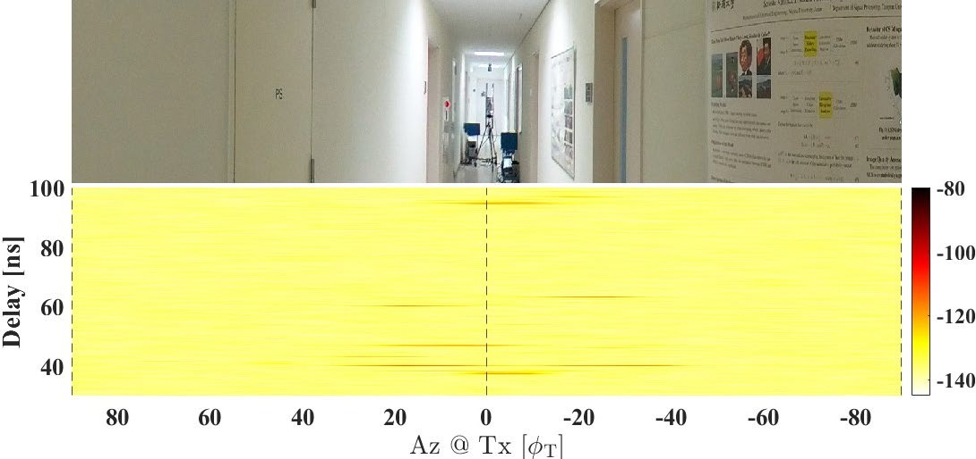
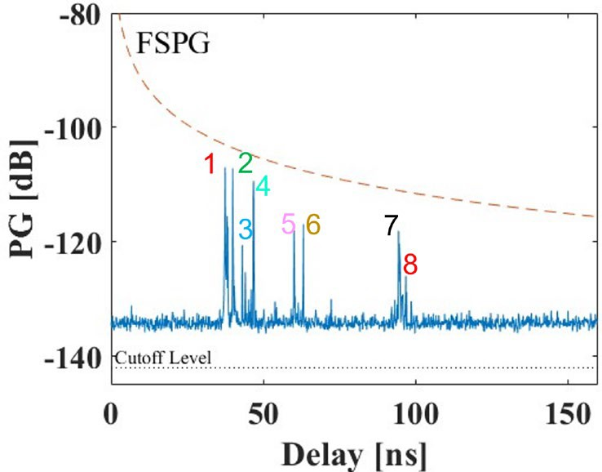
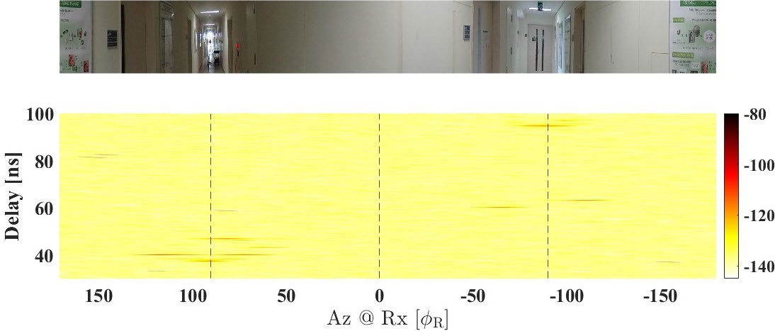
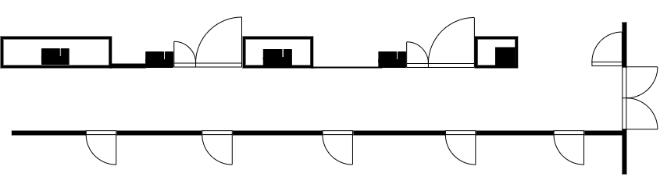



Identification of Specular Path at Rx4
July 2023
        doc.: IEEE 802.15-23-0328-00-0thz
5 ₄ ₁7
₈ 6
3
2
7
8
5
6
2
Path #1 is direct and Path #7 is door reflected.
Path #5 and #6 remain closer to cluster around path #1 when Tx-Rx separation is less and closer to cluster around #7 otherwise.
Narrow waveguide structure of corridor environment gives rise to several significant triple bounce paths (#2, #3, #4 #5, #6, #8 in Rx4)
3
4
1
2
₁ 4 3
5
₇ 8 ₆
7
8
4
5
6
2
3
1
#4
#8
#5
$$FSPG={(\frac{4πcτ}{λ})}^{2}$$
#7
#1
#2
#3
#6
Submission
Anirban Ghosh et al., Niigata University
Notes:
As observed in the earlier slide the synthesized PDPs are sparse in nature and hence we try to identify the specular phenomenon causing the peaks in the PDP for Rx4 which is approximately placed midway (11.43 m from the Tx, total span – 20 m) in the measurement span. Using the time of arrival from the PDPs as reference we identify the significant MPCs in the corresponding ADPS plots at Tx and Rx. The ADPS plots are further embedded with the panorama of the measurement environment which eases the identification of the interacting objects causing the specular path. Once the scatterers are identified manual ray tracing is employed to trace the specular path of each significant MPC as shown.
As before, we first identify #1 as the direct and #7 as the door reflected path based on the time of arrival and subsequent mathematics and validate the same from environment geometry
Delay = distance/speed of light
It is observed that path #5 and #6 appear in all the PDPs for Rx1 – Rx7. However for Rx1 to Rx3 they are closer to cluster around path #1 and closer to cluster around path #7 for other positions.
Due to waveguide structure of corridor most of the paths are observed to be triple bounce with significant power.

Slide 16
Evaluation of Large Scale Parameters and Generation of Path Loss Model

Slide 17
Definitions used for Large Scale Parameter Calculation
Mean Delay:
where $ℒ$ = set of all significant MPCs,
= total power
Rms Delay Spread: DS =
Angle Spread: AS =
where $A_{i}=φ_{T},φ_{R}$ for Azimuth Tx or Rx
Notes:
This slide provides the definition for evaluating the large scale parameters such delay spread and azimuth angular spread.

Slide 18
Evaluated Large Scale Parameter – Angle and Delay Spread
Parameters | Rx1 | Rx2 | Rx3 | Rx4 | Rx5 | Rx6 | Rx7
DS (ns) | 2.99 | 8.87 | 10.35 | 12.89 | 13.59 | 8.26 | 2.02
log₁₀(DS[s]) | 𝜇_{DS} = −8.16, 𝜎_{DS} = 0.32
ASD (⁰) | 27.06 | 17.53 | 11.32 | 15.17 | 9.7 | 8.9 | 9.01
log₁₀(ASD) | 𝜇_{ASD} = 1.11, 𝜎_{ASD} = 0.18
ASA (⁰) | 25.72 | 20.8 | 20.59 | 38.89 | 50.13 | 65.2 | 69.75
log₁₀(ASA) | 𝜇_{ASA} = 1.57, 𝜎_{ASA} = 0.23
Delay Spread (DS): is found to be in the range ~ 2 – 14 ns.
Azimuth Spread of Departure (ASD): is found to be in the range 8⁰-28⁰
Azimuth Spread of Arrival (ASA):
is in the range of ~ 20⁰-70⁰
Parameters |  | This work | SJTU* | 3GPP#
log₁₀(DS[s]) | ^{𝜇}DS | -8.16 | -7.69 | -7.71
 | ^{𝜎}DS | 0.32 | 0.1 | 0.18
log₁₀(ASD) | ^{𝜇}ASD | 1.11 | - | 1.6
 | ^{𝜎}ASD | 0.18 | - | 0.18
log₁₀(ASA) | ^{𝜇}ASA | 1.57 | 1.58 | 1.31
 | ^{𝜎}ASA | 0.23 | 0.06 | 0.42
For 3GPP the frequency is set to 99.9 GHz.
*Y. Li, Y. Wang, Y. Chen, Z. Yu, and C. Han, “Channel measurement and analysis in an indoor corridor scenario at 300 ghz,” in ICC 2022 – IEEE International Conference on Communications, 2022, pp. 2888– 2893
#3GPP, “Study on channel model for frequencies from 0.5 to 100 ghz,” 3rd Generation Partnership Project (3GPP), Technical Report 38.901, 2019
Notes:
From the evaluated LSPs it is observed that
DS is in the range of 2 to 14 ns.
Azimuth Spread of Departure (ASD) is in the range of 8° to 28° whereas the azimuth spread of arrival (ASA) has a wider range of 20° to 70°.
While the measured ASA has good agreement with the values observed in the literature, the mean of the lognormal DS is slightly lower.

Slide 19
Comparison with existing ITU-R results – Angle and Delay Spreads
Freq (GHz) | Environ ment | Polariz ation | Time Delay Resolut ion (ns) | Tx Beamw idth (⁰) | Rx Beamw idth (⁰) | A (ns)* | B (ns)# | C (ns)* | Note for A,B,C
2.625 | Corridor | VV | 1.8 | Omni | Omni | 8.49 | 18.53 | 25.16 | -
67 – 73 | Corridor | VV/H H | 0.5 | 40 | 14.4 | 0.36 | 0.47 | 1.2 | (3)
 |  |  |  |  |  | 0.49 | 6.11 | 35.2 | (3,6)
300 | Corridor | VV | 0.125 | 9 | 9 | 2.02 | 8.87 | 13.1
Threshold: 20 dB
Rx antenna was rotated in steps of 5⁰ around 360⁰ in measurements. The value represents a directional delay spread when the bore-sight of receiver antenna is not aligned to the direction of transmitter.
* A and C correspond to 10% and 90% values of cumulative distribution.
# B represents median.
Freq. | Environment | Polarization | Tx beam width (degrees) | Rx beam width (degrees) | r.m.s. azimuth angular spread (deg) |  |  | Note
(GHz) |  |  |  |  | 10% | median | 90%
39.5 | Corridor⁽³⁾ | VV | 120 | Omni | 37 35 | 61 56 | 84 78 | (1, 4)
 |  | VH | 120 | Omni | 71 71 | 85 83 | 100 94
300 | Corridor | VV | 180 | Omni | 24.95 | 53.32 | 76.17
(1) Using a high gain Tx horn antenna rotated in azimuth with a 10° increment to cover 120° and a fixed elevation AoD of -5°. Meanwhile, a high gain Rx horn antenna was rotated in azimuth for all 360° to simulate an omnidirectional antenna with two fixed elevation angles (0° and 10°). The parameters are calculated following the definition in Recommendation ITU-R P.1407. ⁽³⁾ Measurement in a corridor (2.57 m × 80.72 m) with co- and cross-polarization using the transmitter in the hall. ⁽⁴⁾ Measurement in a corridor (2.57 m × 80.72 m) with co- and cross-polarization, where the upper and lower values are using the transmitter in the hall and in the corridor cases, respectively.
ITU-R, “Propagation data and prediction methods for the planning of indoor radiocommunication systems and radio local area networks in the frequency range 300 mhz to 450 ghz,” ITU=R P.1238-11, Tech. Rep., 2021. [Online]. Available: https://www.itu.int/rec/R-REC-P.1238
Notes:
This slide presents the comparison of the obtained results in terms of angle and delay spread with the results presented in ITU-R P.1238 for different frequencies in a corridor environment. It can be observed that the results at the 300 GHz is quite unique compared to the other frequencies.

Slide 20
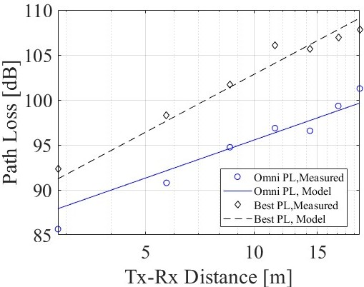
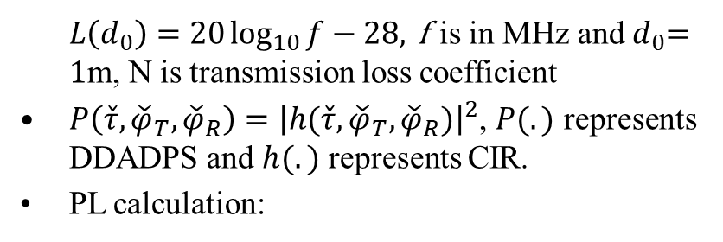

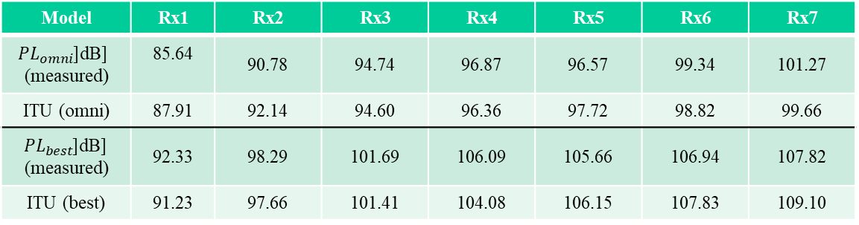
Transmission Loss Model
$$L_{total}=L\left(d_{0}\right)+N\log_{10}{\frac{d}{d_{0}}}$$
ITU Model#:
where
$L\left(d_{0}\right)=20\log_{10}{f}−28$, f is in MHz and $d_{0}$= 1m, N is transmission loss coefficient
$P\left(\check{τ},{\check{φ}}_{T},{\check{φ}}_{R}\right)={\left|h(\check{τ},{\check{φ}}_{T},{\check{φ}}_{R})\right|}^{2}$, $P(.)$ represents DDADPS and $h(.)$ represents CIR.
PL calculation:
Model | Rx1 | Rx2 | Rx3 | Rx4 | Rx5 | Rx6 | Rx7
${PL}_{omni}$[dB] (measured) | 85.64 | 90.78 | 94.74 | 96.87 | 96.57 | 99.34 | 101.27
ITU (omni) | 87.91 | 92.14 | 94.60 | 96.36 | 97.72 | 98.82 | 99.66
${PL}_{best}$[dB] (measured) | 92.33 | 98.29 | 101.69 | 106.09 | 105.66 | 106.94 | 107.82
ITU (best) | 91.23 | 97.66 | 101.41 | 104.08 | 106.15 | 107.83 | 109.10
*Y. Li, Y. Wang, Y. Chen, Z. Yu, and C. Han, “Channel measurement and analysis in an indoor corridor scenario at 300 ghz,” in ICC 2022 – IEEE International Conference on Communications, 2022, pp. 2888–2893
#ITU-R, “Propagation data and prediction methods for the planning of indoor radiocommunication systems and radio local area networks in the frequency range 300 mhz to 450 ghz,” ITU=R P.1238-11, Tech. Rep., 2021. [Online]. Available: https://www.itu.int/rec/R-REC-P.1238
Notes:
This slide presents the transmission model as defined by ITU-R and the formula used for evaluation from the measurement data. A comparison of the measured result and that obtained from the ITU-R model is presented in the table along with the best fit curve for development of the transmission model for the current scenario.

Slide 21

Comparison of Path loss exponent (PLE) and Shadow fading
July 2023
        doc.: IEEE 802.15-23-0328-00-0thz
Parameter | Our Work |  | SJTU |  | ITU-R | 3GPP (<100 GHz)
 | Best | Omni | Best | Omni
PLE | 2.13 | 1.40 | 1.88 | 1.35 | 1.95 | 1.73
Frequency (GHz) | Standard Deviation (dB)
12.65-14.15 | 2.5(2,5) | 1.8 (2,5)
25.3-28.3 | 12.5 (2,5) | 1.3 (2,5)
67-73 | 2.1 (2,5) | 2.5 (2,5)
300 (this work) | 0.96
3GPP (<100) | 3 (Indoor scenario)
The standard deviation is calculated using the following formula
$$σ=std[L\left(dB\right)−PL(dB)]$$
(2) The left number is for LoS case and the right number is for NLoS case.
(5) The Tx beamwidth is 18⁰, Rx: omnidirectional.
Submission
Anirban Ghosh et al., Niigata University
Notes:
The path loss exponent (PLE) obtained by curve fitting the measurement data with the ITU-R model is presented in this slide. A further comparison is provided with other works in literature, 3GPP and ITU-R . The shadow fading is also evaluated.

Slide 22
Conclusion
Sparse nature of the synthesized PDP eased the identification of specular phenomenon in both scenarios.
In narrow corridor like indoor environment, LoS communication can be easily supported up to 20 m.
While the mean and standard deviation of lognormal ASA agrees well with literature there is some deviation of the parameters for lognormal DS.
The PLE parameter is close to that observed in literature even for below 100 GHz but the shadow fading has significant deviation with lower frequencies.
Notes:
Based on the analysis of the measurement data from the current measurement campaigns the following inferences can be drawn.
Due to larger bandwidth of the transmitting signal (8 GHz) used during the measurement the delay resolution the measured data is quite high. This leads to the synthesis of sparse PDP which eases the identification of the specular components, especially when done in conjunction with environment embedded ADPS.
A corridor environment presents an alley-way like waveguide structure where long distance (upto 20m is shown in the campaign) LoS communication can be supported. In addition, due to the guided nature of the environment, MPCs upto triple bounce with significant power are observable depending on the scatterers in the environment.
The LSPs show good agreement with literature for ASA and slight deviation for DS.
Similarly for transmission loss model, the PLE is closer to the results in literature even with lower frequencies but the shadow fading has significant deviation with results from lower frequencies.

Slide 23
Future works
MPC extraction and clustering to model intracluster parameters
Efforts to model the stochastic processes in signal propagation at THz band
Further extensive campaigns with more number of measurement points for more accurate evaluation of LSP and generation of transmission loss model.
Notes:
The logical next step would be to
Design a MPC estimation algorithm and compare how it performs with existing algorithm and our manual approach.
Model the stochastic processes in signal propagation at the band of interest (300 GHz). Also find out the intra-cluster parameters.
Conduct more extensive measurement campaign to provide a further accurate and robust transmission model.

Slide 24


Thank You
http://radio.eng.niigata-u.ac.jp/
mskim@eng.niigata-u.ac.jp
+81 – 025 – 262 – 7478
This work includes the research results conducted under the National Institute of Information and Communications Technology (NICT)
Beyond 5G R&D Promotion Program (Grant No. 02701).

