Slide 1
        DOC: 15-23-0315-01-04ab
Project: IEEE P802.15 Working Group for Wireless Personal Area Networks (WPANs)
Submission Title: HRP-ARDEV and UWB MMS Operations
Date Submitted: July 2023
Source: Xiliang Luo, Vinod Kristem, Moche Cohen (Apple)
Address: One Apple Park Way, Cupertino, CA 95104, USA
E-Mails: xiliang_luo@apple.com
Abstract: More on HRP-ARDEV and the mandatory operating parameter sets.
Purpose: Clarifying the definition of HRP-ARDEV and the corresponding operating parameter sets in 4ab.
Notice: This document has been prepared to assist the IEEE P802.15. It is offered as a basis for discussion and is not binding on the contributing individual(s) or organization(s). The material in this document is subject to change in form and content after further study. The contributor(s) reserve(s) the right to add, amend or withdraw material contained herein.
Release: The contributor acknowledges and accepts that this contribution becomes the property of IEEE and may be made publicly available by P802.15.

Slide 2
        DOC: 15-23-0315-01-04ab
PAR Objective | Proposed Solution (how addressed)
Safeguards so that the high throughput data use cases will not cause significant disruption to low duty-cycle ranging use cases
Interference mitigation techniques to support higher density and higher traffic use cases | Periodicity-Division Multiple Access
Other coexistence improvement
Backward compatibility with enhanced ranging capable devices (ERDEVs)
Improved link budget and/or reduced air-time | MMS
Additional channels and operating frequencies
Improvements to accuracy / precision / reliability and interoperability for high-integrity ranging | MMS for high-integrity ranging
Reduced complexity and power consumption
Hybrid operation with narrowband signaling to assist UWB | NBA-MMS
Enhanced native discovery and connection setup mechanisms
Sensing capabilities to support presence detection and environment mapping
Low-power low-latency streaming
Higher data-rate streaming allowing at least 50 Mbit/s of throughput
Support for peer-to-peer, peer-to-multi-peer, and station-to-infrastructure protocols
Infrastructure synchronization mechanisms

Slide 3
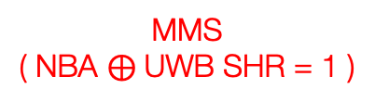
HRP-ARDEV
        DOC: 15-23-0315-01-04ab
HRP-ARDEV definition:
HRP-ARDEV supports the minimum feature set in 4ab
MMS is mandatory for HRP-ARDEV
HRP-ARDEV shall support either NB O-QPSK in UNII-3/5 or UWB SHR for initial frequency and timing sync of MMS operations
  UNII-3 is mandatory in case NB O-QPSK is used for initial sync
HRP-ARDEV can optionally use other tightly coupled radios to initiate MMS
Min Feature Set
MMS
( NBA $⊕$UWB SHR = 1 )
HRP-ARDEV
Note: NB refers to O-QPSK

Slide 4

HRP-ARDEV: NBA $⊕$ UWB SHR = 1
        DOC: 15-23-0315-01-04ab

Slide 5
UWB SHR for Initial Sync
        DOC: 15-23-0315-01-04ab

Slide 6
HRP-ARDEV: UWB-Only MMS
        DOC: 15-23-0315-01-04ab
A straightforward extension of 4z STS packet configuration 3
  Baseline: X=0, Y=1
4z STS Packet Config Three
SYNC
S
F
D
1us
gap
STS
SYNC
S
F
D
STS
4ab
1ms

Slide 7
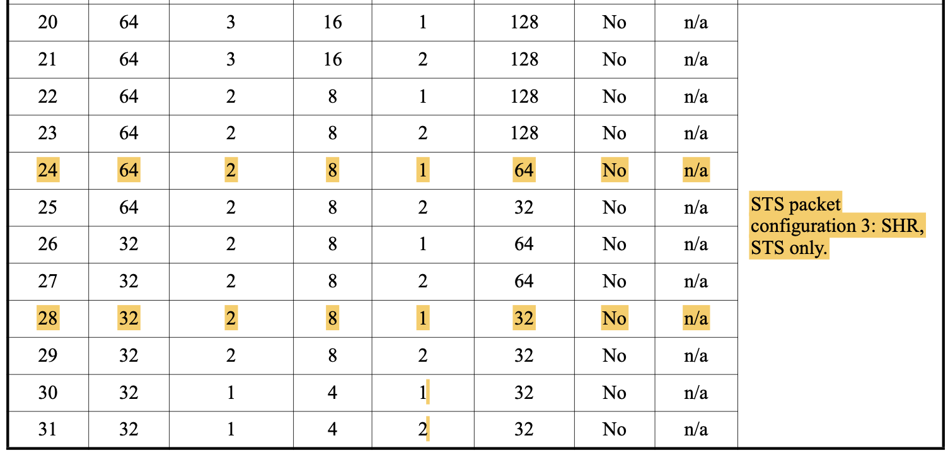
HRP-ARDEV: UWB-Only MMS
        DOC: 15-23-0315-01-04ab
Mandatory Parameter Sets
UWB-only MMS Set# | UWB Sync PSR | UWB SFD # | SFD Length | Number of RSFs: X | Number of RIFs: Y | RIF: STS length | Note
1 | 32 | 2 | 8 | 0 | 1 | 32 | Ref to HPRF#28 in 4z Table 15-16
2 | 64 | 2 | 8 | 0 | 1 | 64 | Ref to HPRF#24 in 4z Table 15-16

Slide 8
NBA-UWB RSF-Only
        DOC: 15-23-0315-01-04ab

Slide 9
HRP-ARDEV: NBA-UWB RSF-Only MMS
        DOC: 15-23-0315-01-04ab
Each configuration set will be able to maximize the link budget improvement of 4ab wrt 4z
  A total of 16 RSFs can be coherently combined
  Each RSF can utilize the energy budget efficiently
    a larger MMRS gap size is configured
Each RSF is kept around 64us to minimize the chance of collision to other MMS packets
  a larger MMRS gap is combined with a smaller N_MSR

Slide 10
HRP-ARDEV: NBA-UWB RSF-Only MMS
        DOC: 15-23-0315-01-04ab
Mandatory Parameter Sets
RSF-Only Set# | NB Config# | Number of RSFs: X | N_MSR | MMRS Config |  | RSF Length (us) | Note
 |  |  |  | MMRS Config Set# | Gap Size
1 | 1 | 16 | 40 | 27 | 33 | 62.2 | Note-1
2 | 1 | 16 | 40 | 30 | 37 | 64.7 | Note-1
3 | 1 | 16 | 40 | 32 | 39 | 66.0 | Note-1
4 | 1 | 16 | 40 | 34 | 43 | 68.6 | Note-1
5 | 1 | 16 | 40 | 36 | 45 | 69.9 | Note-1
6 | 1 | 16 | 32 | 39 | 49 | 57.9 | Note-1
7 | 1 | 16 | 32 | 45 | 57 | 62.0 | Note-1
8 | 1 | 16 | 32 | 47 | 59 | 63.1 | Note-1
9 | 1 | 16 | 32 | 48 | 61 | 64.1 | Note-1
10 | 1 | 16 | 32 | 49 | 64 | 65.6 | Note-1
Note-1: this configuration enables the max link budget gain by 4ab wrt 4z

Slide 11
NBA-UWB Mixed MMS
        DOC: 15-23-0315-01-04ab

Slide 12
HRP-ARDEV: NBA-UWB Mixed MMS
        DOC: 15-23-0315-01-04ab
Each RSF contains the same number of UWB pulses as each RIF
A larger MMRS gap is used in RSF to optimize the energy efficiency
Each RSF duration is kept below 92us & each RIF duration is 65.6us
Baseline modes:
  (X=Y=1,2,4,8)
  (X=1, Y=2,4,8)

Slide 13
HRP-ARDEV: NBA-UWB Mixed MMS
        DOC: 15-23-0315-01-04ab
Mandatory Parameter Sets
Mixed MMS Set# | NB Config# | Number of RSFs: X | N_MSR | MMRS Config |  | Number of RIFs: Y | RIF: STS length | Note
 |  |  |  | MMRS Config Set# | Gap Size
1 | 1 | 1 | 64 | 21 | 25 | 1 | 64 | Note-1
2 | 1 | 1 | 64 | 21 | 25 | 2 | 64 | Note-1
3 | 1 | 1 | 64 | 21 | 25 | 4 | 64 | Note-1
4 | 1 | 1 | 64 | 21 | 25 | 8 | 64 | Note-1
5 | 1 | 2 | 64 | 21 | 25 | 2 | 64 | Note-1
6 | 1 | 4 | 64 | 21 | 25 | 4 | 64 | Note-1
7 | 1 | 8 | 64 | 21 | 25 | 8 | 64 | Note-1
Note-1: each RSF and RIF contain the same number of pulses

Slide 14
MMRS Configurations
        DOC: 15-23-0315-01-04ab

Slide 15
MMRS Configurations
        DOC: 15-23-0315-01-04ab
MMRS Config Set# | MMRS Code Index | Gap Size | MMRS Period with Gap | Note
1 ~ 6 | 37 Note-1 | 0, 2, 3, 4, 5, 7 | 128 ~ 142 | Note-2
7 ~ 12 | 37 Note-1 | 8, 9, 10, 11, 12, 15 | 144 ~ 158 | Note-2
13 ~ 18 | 37 Note-1 | 16, 17, 18, 19, 21, 22 | 160 ~ 172 | Note-2
19 ~ 24 | 37 Note-1 | 23, 24, 25, 26, 28, 30 | 174 ~ 188 | Note-2
25 ~ 30 | 37 Note-1 | 31, 32, 33, 35, 36, 37 | 190 ~ 202 | Note-2, Note-3
31 ~ 36 | 37 Note-1 | 38, 39, 42, 43, 44, 45 | 204 ~ 218 | Note-2, Note-3
37 ~ 42 | 37 Note-1 | 46, 47, 49, 50, 51, 52 | 220 ~ 232 | Note-2, Note-3
43 ~ 49 | 37 Note-1 | 54, 56, 57, 58, 59, 61, 64 | 236 ~ 256 | Note-2, Note-3
Note-1: each one of the 16 MMRS codes can be used in this table. Code 37 with 0 mean is picked to facilitate inter-op. Note-2: all the sequence periods are coprime with {31, 91, 127} Note-3: a larger gap size enables higher energy efficiency Note-4: a subset can be chosen to enable optimum interference suppression, e.g., by ensuring the GCD among the MMRS periods to be as small as possible. One such subset of gap sizes could be {0, 3, 5, 7, 9, 15, 19, 21, 25, 33, 37, 39, 43, 45, 49, 57}. Another subset of gap sizes could be {64, 61, 59, 57, 49, 45, 43, 39, 37, 33, 25, 19, 15, 9, 7, 3}

Slide 16
References
        DOC: 15-23-0315-01-04ab
15-23-0097-02-04ab: NBA-UWB MMS Operating Parameter Sets
15-23-0100-02-04ab: NBA-UWB Technical Framework
15-23-0308-02-04ab: 4ab Devices(s) and Feature Sets

