Slide 1
        doc.: 15-23-0308-01-04ab
Project: IEEE P802.15 Working Group for Wireless Personal Area Networks (WPANs)
Submission Title: 4ab Device(s) and feature sets
Date Submitted: June, 2023
Source: Vinod Kristem, Xiliang Luo, Alexander Krebs, Moche Cohen (Apple), Riku Pirhonen, Frank Leong, Wolfgang Kuchler, Pablo Corbalan Pelegrin (NXP), Mingyu Lee (Samsung), Chenchen Liu, Bin Qian, Lei Huang, David Yang (Huawei), Billy Verso, Carl Murray, Jarek Niewczas (Qorvo), Carlos Aldana, Kangjin Yoon, Claudio da Silva, Guoqing Li (Meta), Bin Tian, Pooria Pakrooh, Steve Shellhammer, Koorosh Akhavan (Qualcomm), Tushar Patel (LitePoint)
Address: One Apple Park Way, Cupertino, CA 95104, USA
E-Mails: vkristem@apple.com
Abstract: Further thoughts on defining the 4ab device(s)
Purpose: To advance the discussions on 4ab devices and help converge on the feature sets
Notice: This document has been prepared to assist the IEEE P802.15. It is offered as a basis for discussion and is not binding on the contributing individual(s) or organization(s). The material in this document is subject to change in form and content after further study. The contributor(s) reserve(s) the right to add, amend or withdraw material contained herein.
Release: The contributor acknowledges and accepts that this contribution becomes the property of IEEE and may be made publicly available by P802.15.

Slide 2
        doc.: 15-23-0308-01-04ab
PAR Objective | Proposed Solution (how addressed)
Safeguards so that the high throughput data use cases will not cause significant disruption to low duty-cycle ranging use cases | Defines device categories
Interference mitigation techniques to support higher density and higher traffic use cases | Defines device categories
Other coexistence improvement | Defines device categories
Backward compatibility with enhanced ranging capable devices (ERDEVs) | Defines device categories
Improved link budget and/or reduced air-time | Defines device categories
Additional channels and operating frequencies | Defines device categories
Improvements to accuracy / precision / reliability and interoperability for high-integrity ranging | Defines device categories
Reduced complexity and power consumption | Defines device categories
Hybrid operation with narrowband signaling to assist UWB | Defines device categories
Enhanced native discovery and connection setup mechanisms | Defines device categories
Sensing capabilities to support presence detection and environment mapping | Defines device categories
Low-power low-latency streaming | Defines device categories
Higher data-rate streaming allowing at least 50 Mbit/s of throughput | Defines device categories
Support for peer-to-peer, peer-to-multi-peer, and station-to-infrastructure protocols | Defines device categories
Infrastructure synchronization mechanisms | Defines device categories

Slide 3
Introduction
        doc.: 15-23-0308-01-04ab
Many new interesting features proposed in 4ab for enhanced ranging, low latency data streaming, sensing, …
  Large feature set, with 10’s of config. parameters per feature
  Several 100’s of possible parameter sets!!!
Single 4ab device support all of them ?
  Very challenging and might not be meaningful
[1] proposed the idea of defining the 4ab devices
  Features and the parameter sets to be defined per device category
  Simplifies parameter set definition, inter-operability, and testing burden
  Vendor can target for the specific 4ab device(s) of interest
This contribution further develop the ideas by defining the minimal feature set for a 4ab device
[1] 15-23-0177-00-04ab, “Some thoughts on 4ab device categories”, Vinod Kristem, Xiliang Luo, Moche Cohen (Apple)

Slide 4
4ab Devices
        doc.: 15-23-0308-01-04ab
Good to define a minimal feature set common across the 4ab device(s)
  4ab device(s) could be defined as enhancements of minimal feature set
  Simplifies inter-operability between the 4ab device(s)
One illustration of 4ab device(s) for ranging, low latency data and sensing
Ranging
Sensing
Minimal
feature set
Sensing features
Ranging features
Low latency data
features
Low-latency Data

Slide 5
Minimal 4ab feature set: Basic Building Block
        doc.: 15-23-0308-01-04ab
K = 7 BCC
HRP-ERDEV
1.95 Mbps with
4z HPRF PHR
62.4 Mbps with 4z HPRF PHR
Mandatory Features
Simple and effective features, without significant design changes to 4z
  62.4 Mbps enhances low-latency data transfer
    Simultaneously supporting 4z ranging
  1.95 Mbps enables higher link budget for ranging and other uses
    Improve the achieved range for in-band data on top of 4z
Provides co-existence with millions of existing 4z devices on the field

Slide 6
Minimal 4ab feature set: Mandatory data rates
        doc.: 15-23-0308-01-04ab
K = 7 BCC
HRP-ERDEV
1.95 Mbps with
4z HPRF PHR
62.4 Mbps with 4z HPRF PHR
Mandatory Features
Additional mandatory data rates and encoding:
PSDU bit rate (Mb/s) | PSDU encoding | PHR bit rate (Mb/s) | PHR encoding | Comments
1.95 (4ab) | K=7 BCC | 1.95 | K=7 BCC | New in 4ab
7.8 (4z) | K=7 BCC | 7.8 | K=7 BCC | Already defined in 4z. Uses K=7 BCC instead of RS & K=3 BCC defined for 6.8 and 27.2 Mb/s in 4z.
31.2 (4z) | K=7 BCC | 31.2 | K=7 BCC
62.4 (4ab) | K=7 BCC | 62.4 | K=7 BCC | New in 4ab

Slide 7
Minimal 4ab feature set: packet configurations
        doc.: 15-23-0308-01-04ab
K = 7 BCC
HRP-ERDEV
1.95 Mbps with
4z HPRF PHR
62.4 Mbps with 4z HPRF PHR
Mandatory Features
Mandatory packet types:
SYNC
SFD
PHR
PHY Payload
SYNC
SFD
STS
PHR
PHY Payload
SYNC
SFD
STS

Slide 8
Way forward
        doc.: 15-23-0308-01-04ab
We agree that the following minimal feature set is mandatory in 4ab
  HRP-ERDEV
  1.95 Mbps with 4z HPRF PHR
  62.4 Mbps with 4z HPRF PHR
  K = 7 BCC

Slide 9
(Advance) 4ab Device(s)
        doc.: 15-23-0308-01-04ab

Slide 10
Minimal 4ab feature set
        doc.: 15-23-0308-01-04ab
Additional mandatory data rates and encoding:
K = 7 BCC
PSDU bit rate (Mb/s) | PSDU encoding | PHR bit rate (Mb/s) | PHR encoding
1.95 (4ab) | K=7 BCC | 1.95 | K=7 BCC
7.8 (4z) | K=7 BCC | 7.8 | K=7 BCC
31.2 (4z) | K=7 BCC | 31.2 | K=7 BCC
62.4 (4ab) | K=7 BCC | 62.4 | K=7 BCC
HRP-ERDEV
1.95 Mbps with
4z HPRF PHR
62.4 Mbps with 4z HPRF PHR
ERPDEV
Mandatory Features
ERPDEV: Enhanced Ranging Plus Device
Mandatory packet types:
SYNC
SFD
PHR
PHY Payload
SYNC
SFD
STS
PHR
PHY Payload
SYNC
SFD
STS

Slide 11

Advanced 4ab devices
        doc.: 15-23-0308-01-04ab
HRP-ARDEV
HRP-LLDDEV¹
Minimal 4ab feature set
MMS
(NBA $⊕$UWB SHR = 1)
Minimal 4ab feature set
Dynamic PHR
ERPDEV
ERPDEV
HRP-SDEV
Mandatory Features
ERPDEV : Enhanced Ranging Plus Device
ARDEV : Advanced Ranging Device
LLDDEV¹: Low Latency Data Device
SDEV : Sensing Device
Minimal 4ab feature set
Mandated features
(TBD)
ERPDEV
Note 1: LLDDEV name is yet to be agreed upon and subject to change

Slide 12
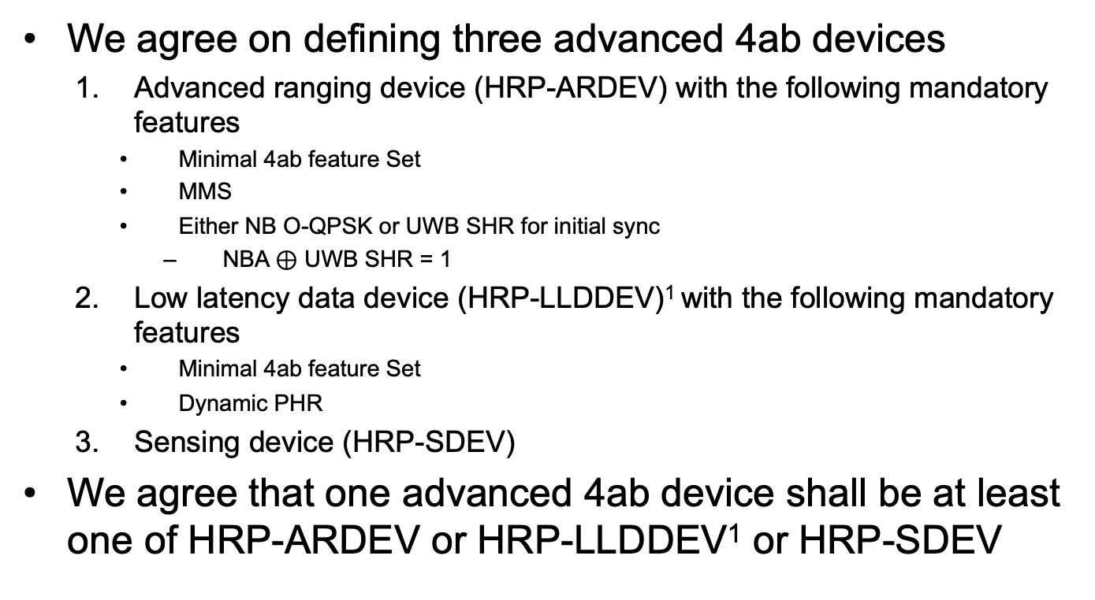
Way forward on 4ab devices
        doc.: 15-23-0308-01-04ab
We agree on defining three advanced 4ab devices
  Advanced ranging device (HRP-ARDEV) with the following mandatory features
    Minimal 4ab feature Set
    MMS
    Either NB O-QPSK or UWB SHR for initial sync
      NBA $⊕$ UWB SHR = 1
  Low latency data device (HRP-LLDDEV)¹ with the following mandatory features
    Minimal 4ab feature Set
    Dynamic PHR
  Sensing device (HRP-SDEV)
We agree that one advanced 4ab device shall be at least one of HRP-ARDEV or HRP-LLDDEV¹ or HRP-SDEV
Note 1: LLDDEV name is yet to be agreed upon and subject to change

