Slide 1
doc.: 15-23-0307-00-04ab
Project: IEEE P802.15 Working Group for Wireless Personal Area Networks (WPANs)
Submission Title: Recommended parameter sets for ERPDEV
Date Submitted: June, 2023
Source: Vinod Kristem, Xiliang Luo, Alexander Krebs, Moche Cohen (Apple)
Address: One Apple Park Way, Cupertino, CA 95104, USA
E-Mails: vkristem@apple.com
Abstract: Provides recommended 4ab parameter sets for the minimal 4ab feature set
Purpose: To initiate the discussions on the HPRF parameter sets for different packet configurations
Notice: This document has been prepared to assist the IEEE P802.15. It is offered as a basis for discussion and is not binding on the contributing individual(s) or organization(s). The material in this document is subject to change in form and content after further study. The contributor(s) reserve(s) the right to add, amend or withdraw material contained herein.
Release: The contributor acknowledges and accepts that this contribution becomes the property of IEEE and may be made publicly available by P802.15.

Slide 2
doc.: 15-23-0307-00-04ab
PAR Objective | Proposed Solution (how addressed)
Safeguards so that the high throughput data use cases will not cause significant disruption to low duty-cycle ranging use cases | Provide 4ab HPRF operating parameter sets
Interference mitigation techniques to support higher density and higher traffic use cases | Provide 4ab HPRF operating parameter sets
Other coexistence improvement | Provide 4ab HPRF operating parameter sets
Backward compatibility with enhanced ranging capable devices (ERDEVs) | Provide 4ab HPRF operating parameter sets
Improved link budget and/or reduced air-time | Provide 4ab HPRF operating parameter sets
Additional channels and operating frequencies | Provide 4ab HPRF operating parameter sets
Improvements to accuracy / precision / reliability and interoperability for high-integrity ranging | Provide 4ab HPRF operating parameter sets
Reduced complexity and power consumption | Provide 4ab HPRF operating parameter sets
Hybrid operation with narrowband signaling to assist UWB | Provide 4ab HPRF operating parameter sets
Enhanced native discovery and connection setup mechanisms | Provide 4ab HPRF operating parameter sets
Sensing capabilities to support presence detection and environment mapping | Provide 4ab HPRF operating parameter sets
Low-power low-latency streaming | Provide 4ab HPRF operating parameter sets
Higher data-rate streaming allowing at least 50 Mbit/s of throughput | Provide 4ab HPRF operating parameter sets
Support for peer-to-peer, peer-to-multi-peer, and station-to-infrastructure protocols | Provide 4ab HPRF operating parameter sets
Infrastructure synchronization mechanisms | Provide 4ab HPRF operating parameter sets

Slide 3
Minimal 4ab feature set Zoomed-In
doc.: 15-23-0307-00-04ab
Additional mandatory data rates and encoding:
PSDU bit rate (Mb/s) | PSDU encoding | PHR bit rate (Mb/s) | PHR encoding
1.95 (4ab) | K=7 BCC | 1.95 | K=7 BCC
7.8 (4z) | K=7 BCC | 7.8 | K=7 BCC
31.2 (4z) | K=7 BCC | 31.2 | K=7 BCC
62.4 (4ab) | K=7 BCC | 62.4 | K=7 BCC
K = 7 BCC
HRP-ERDEV
1.95 Mbps with
4z HPRF PHR
62.4 Mbps with 4z HPRF PHR
Mandatory parameter sets:
ERPDEV
Sync (Ipatov 91) PSR: 32, 64, 128 (Only Tx)
SFD (binary) length: 4, 8, 16
STS segment length: 32, 64, 128
STS # segments: 1, 2
PSDU rates: 1.95, 7.8, 31.2 and 62.4 Mb/s
PHR and PSDU encoding: K= 7 BCC
Mandatory packet types:
SYNC
SFD
PHR
PHY Payload
packet cfg. 0 (36 configurations)
SYNC
SFD
STS
PHR
PHY Payload
packet cfg. 1 (216 configurations)
SYNC
SFD
STS
packet cfg. 3 (54 configurations)
~300 packet configurations in total !!!

Slide 4
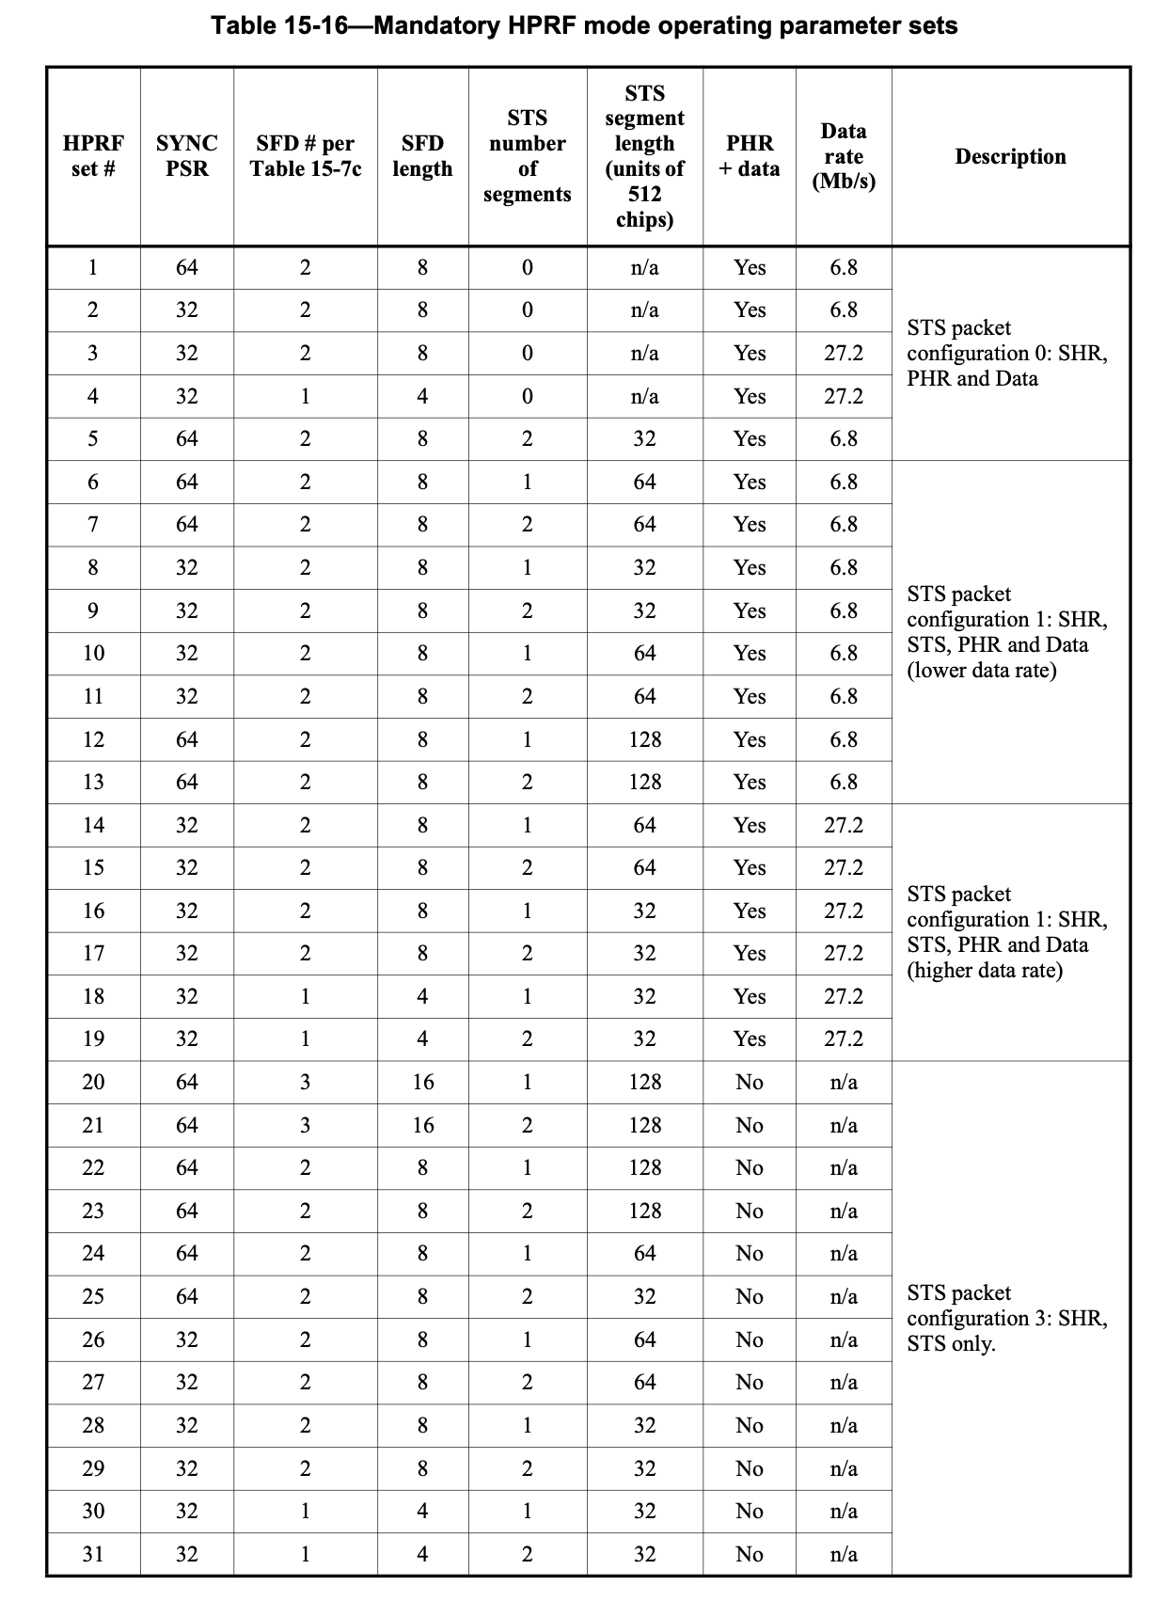
Mandatory parameter sets in 4z
doc.: 15-23-0307-00-04ab
4z spec defines the mandatory parameter sets for BPRF and HPRF
Provides a minimal set
Simplifies the testing burden, while enabling interoperability
Defining similar parameter sets would be beneficial in 4ab
Reuse the 4z HPRF table for the 4z PSDU rates
Additional entries to be defined for PSDU rates 1.95, 62.4, 7.8, 31.2 Mb/s Data rates
HPRF table from 4z Spec.

Slide 5
Some thoughts on new parameter sets in 4ab
doc.: 15-23-0307-00-04ab
Limit the parameter sets for the newly added data rates
1-2 SYNC, SFD parameter set per data rate
1-2 STS configuration(s) per data rate
Need to define new parameter sets for 4ab data rates 1.95 Mb/s and 62.4 Mb/s
Reuse some existing parameter sets from 4z table for the data rates 7.8 Mb/s and 31.2 Mb/s?
7.8 Mb/s uses same symbol structure and modulation as 6.8 Mb/s
31.2 Mb/s uses same symbol structure and modulation as 27.2 Mb/s
Encoding is different: RS & K=3 BCC for 6.8, 27.2 Mb/s vs K=7 BCC for 7.8, 31.2 Mb/s
RS & K=3 BCC has similar performance as K=7 BCC
Simplifies the effort

Slide 6
62.4 Mb/s with packet config 0
doc.: 15-23-0307-00-04ab
PHR and Payload transmitted at 62.4 Mb/s, K=7 BCC encoded
Note that payload and PHR duration would be quite short for 62.4 Mb/s (100 Byte ~13 us)
Possible Sync PSR and SFD configurations
(32, 4), (32, 8), (32,16), (64, 4), (64, 8), (64, 16), (128, 4), (128, 8), (128, 16)
Sync PSR 32 would provide sufficient margin to support PHR and Payload at 62.4 Mb/s
Smaller overhead than PSR 64 and 128, facilitate higher energy per bit for payload
SFD length options: 4, 8, and 16
SFD length 4 would minimize the overhead
Recommended SYNC PSR, SFD configuration: (32, 4)
SYNC
SFD
PHR
PHY Payload

Slide 7
62.4 Mb/s with packet config 1
doc.: 15-23-0307-00-04ab
PHR and Payload transmitted at 62.4 Mb/s, K=7 BCC encoded
Possible STS configurations for SYNC PSR 32 and SFD length 4
1x32, 1x64, 1x128, 2x32, 2x64, 2x128
For simplicity, limit to just 1 STS segment
STS segment length options: 1x32, 1x64 and 1x128
STS segment length 32 provides good balance between ranging integrity and packet acquisition
Recommended SYNC PSR, SFD, and STS configuration: (32, 4) SHR, 1x32 STS
SYNC
SFD
STS
PHR
PHY Payload

Slide 8
1.95 Mb/s with packet config 0
doc.: 15-23-0307-00-04ab
PHR and Payload transmitted at 1.95 Mb/s, K=7 BCC encoded
Possible Sync PSR and SFD configurations
(32, 4), (32, 8), (32,16), (64, 4), (64, 8), (64, 16), (128, 4), (128, 8), (128, 16)
Only for Transmission: (128, 4), (128, 8), (128, 16)
Sync PSR 64 would provide sufficient margin to support PHR and Payload at 1.95 Mb/s; some receiver implementations could benefit from Sync PSR 128
SFD length options: 4, 8, and 16
SFD length 8 would be a good choice for Sync PSR 64, and length 16 for Sync PSR 128
Recommended SYNC PSR, SFD configuration:
(64, 8) for transmission and reception
(128, 16) for transmission only
SYNC
SFD
PHR
PHY Payload

Slide 9
1.95 Mb/s with packet config 1
doc.: 15-23-0307-00-04ab
PHR and Payload transmitted at 1.95 Mb/s, K=7 BCC encoded
Possible STS configurations
1x32, 1x64, 1x128, 2x32, 2x64, 2x128
For simplicity, limit to just 1 STS segment
STS segment length options: 1x32, 1x64 and 1x128?
Having STS segment length same as Sync PSR would provides good balance between ranging integrity and packet acquisition
Recommended SYNC PSR, SFD, and STS configuration:
(64, 8) SHR, 1x64 STS for transmission and reception
(128, 16) SHR, 1x128 STS for transmission only
SYNC
SFD
STS
PHR
PHY Payload

Slide 10
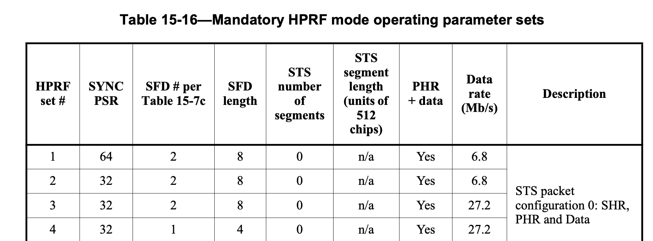
31.2 Mb/s with packet config 0
doc.: 15-23-0307-00-04ab
Similar to 27.2 Mb/s data rate in 4z
K = 7 BCC and RS & K = 3 BCC has similar performance
Sync PSR and SFD configurations for 27.2 Mb/s in 4z
Recommended SYNC PSR, SFD configuration: (32, 8)
SYNC
SFD
PHR
PHY Payload

Slide 11
31.2 Mb/s with packet config 1
doc.: 15-23-0307-00-04ab
Similar to 27.2 Mb/s data rate in 4z
K = 7 BCC and RS & K = 3 BCC has similar performance
Sync PSR, SFD, STS configurations for 27.2 Mb/s in 4z
Recommended SYNC PSR, SFD, STS configuration: (32, 8) SHR, 1x32 STS
SYNC
SFD
STS
PHR
PHY Payload

Slide 12
7.8 Mb/s with packet config 0
doc.: 15-23-0307-00-04ab
Similar to 6.8 Mb/s data rate in 4z
K = 7 BCC and RS & K = 3 BCC has similar performance
Sync PSR and SFD configurations for 6.8 Mb/s in 4z
Recommended SYNC PSR, SFD configuration: (32, 8), (64, 8)
SYNC
SFD
PHR
PHY Payload

Slide 13
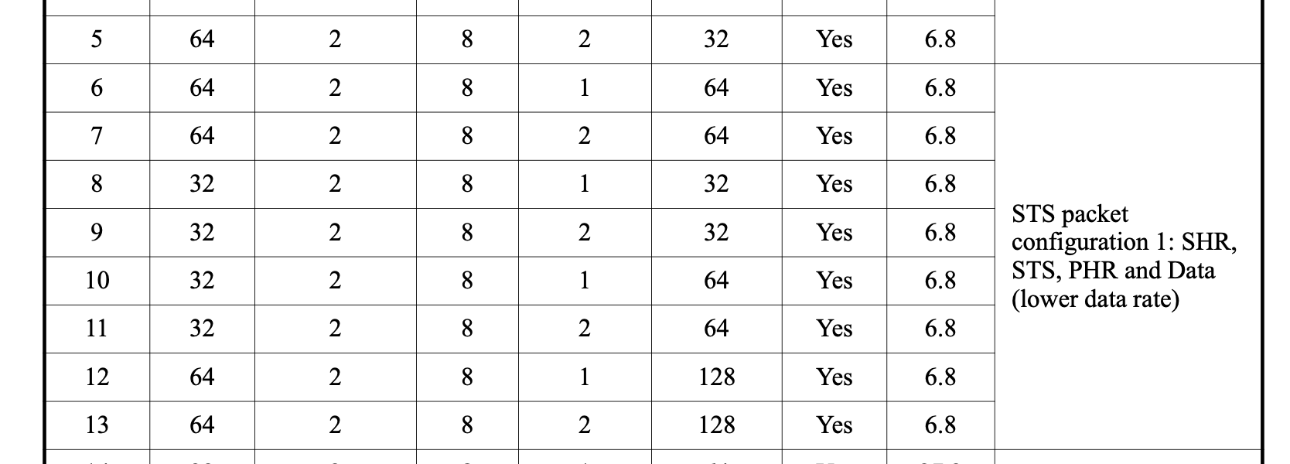
7.8 Mb/s with packet config 1
doc.: 15-23-0307-00-04ab
Similar to 6.8 Mb/s data rate in 4z
K = 7 BCC and RS & K = 3 BCC has similar performance
Sync PSR, SFD, STS configurations for 6.8 Mb/s in 4z
Recommended SYNC PSR, SFD, STS configuration:
(32, 8) SHR, 1x32 STS
(64, 8) SHR, 1x64 STS
SYNC
SFD
STS
PHR
PHY Payload

Slide 14
Recommended additional parameter sets for ERPDEV
doc.: 15-23-0307-00-04ab
Set # | Sync PSR | SFD# Table | SFD length | #STS segments | STS Segment length (in 512 chips) | Data Rate (Mb/s) | STS Configuration | Comments
1 | 64 | 2 | 8 | 0 | n/a | 1.95 | Config 0 (SHR, PHR, Data) | For transmission and reception
2 | 128 | 3 | 16 | 0 | n/a |  |  | For transmission only
3 | 64 | 2 | 8 | 1 | 64 | 32 | Config 1 (SHR, STS, PHR, Data) | For transmission and reception
4 | 128 | 3 | 16 | 1 | 128 |  |  | For transmission only
5 | 32 | 2 | 8 | 0 | n/a | 7.8 | Config 0 (SHR, PHR, Data) | For transmission and reception
6 | 64 | 2 | 8 | 0 | n/a
 |  |  |  |  |  |  |  | For transmission and reception
7 | 32 | 2 | 8 | 1 | 32
25 | 64 | 2 | 8 | 1 | 64 |  | Config 1 (SHR, STS, PHR, Data) | For transmission and reception
8 | 64 | 2 | 8 | 1 | 64 |  | 32 | For transmission and reception
9 | 32 | 2 | 8 | 0 | n/a | 31.2 | Config 0 (SHR, PHR, Data) | For transmission and reception
8 | 32 | 2 | 8 | 1 | 32 |  | Config 1 (SHR, STS, PHR, Data) | For transmission and reception
10 | 32 | 2 | 8 | 1 | 32
11 | 32 | 1 | 4 | 0 | n/a | 62.4 | Config 0 (SHR, PHR, Data) | For transmission and reception
12 | 32 | 1 | 4 | 1 | 32 |  | Config 1 (SHR, STS, PHR, Data) | For transmission and reception

