Slide 1
Project: IEEE P802.15 Working Group for Wireless Personal Area Networks (WPANs)
Submission Title: Effect of no-LBT NB on 802.11 devices
Source: Carlos Aldana (Meta), Qiong Wu (Meta), Guoqing Li (Meta)
Address : [1 Hacker Way, Menlo Park, CA 94025]
E-Mail: [caldana (at) meta.com, qiongwu (at) meta.com, guoqingli (at) meta.com]
Re: Study Group 4ab: UWB Next Generation
Abstract: [This provides experimental results of how no-LBT NB affects 802.11 devices]
Purpose: [Suggests a way forward to improve coexistence]
Notice: This document has been prepared to assist the IEEE P802.15. It is offered as a basis for discussion and is not binding on the contributing individual(s) or organization(s). The material in this document is subject to change in form and content after further study. The contributor(s) reserve(s) the right to add, amend or withdraw material contained herein.
Release: The contributor acknowledges and accepts that this contribution becomes the property of IEEE and may be made publicly available by P802.15.
Notes:
Jul 12, 2010
Page 1

Slide 2
Technical Guidance
PAR Objective | Proposed Solution (how addressed)
Safeguards so that the high throughput data use cases will not cause significant disruption to low duty-cycle ranging use cases.
Interference mitigation techniques to support higher density and higher traffic use cases
Other coexistence improvement
Backward compatibility with enhanced ranging capable devices (ERDEVs).
Improved link budget and/or reduced air-time
Additional channels and operating frequencies
Improvements to accuracy / precision / reliability and interoperability for high-integrity ranging;
Reduce complexity and power consumption;
Hybrid operation with narrowband signaling to assist UWB; | LBT should be employed by NB as a coexistence mechanism
Enhanced native discovery and connection setup mechanisms;
Sensing capabilities to support presence detection and environment mapping;
Low-power low-latency streaming
higher data-rate streaming allowing at least 50 Mbit/s of throughput.
Support for peer-to-peer, peer-to-multi-peer, and station-to-infrastructure protocols;
Infrastructure synchronization mechanisms.

Slide 3
Background
In 15-23-243, it is suggested to use NB for Data Communications for gate entry applications. We should also consider the effects on other technologies in high device density scenario (e.g., apartment buildings, malls)
In 15-23-119 the effect of NB interference on Wi-Fi at the PHY level was presented. It was shown that for 20 MHz Wi-Fi and a 31% duty cycle NB, the SIR > 20 dB for PER to be < 10%.
This work focuses on the effects of NB interference on Wi-Fi at the MAC level.
This compares 2 scenarios:
1) effect of NB (without LBT) and with 33%,100% duty cycle on Wi-Fi link
2) effect of Wi-Fi (with LBT) on Wi-Fi link
We ask the question: Is NB (without LBT) a similar neighbor to Wi-Fi than another Wi-Fi neighbor?

Slide 4
Europe 6 GHz NB vs VLP Wi-Fi spectrum
NB with 14 dBm EIRP is 15/18/21 dB stronger than VLP Wi-Fi with 80/160/320 MHz
NB
10 dBm/MHz
Note that skirts associated with NB spectrum not shown and affect many Wi-Fi sub-carriers
-5 dBm/MHz
80 MHz Wi-Fi
-8 dBm/MHz
160 MHz
Wi-Fi
-11 dBm/MHz
320 MHz Wi-Fi

Slide 5
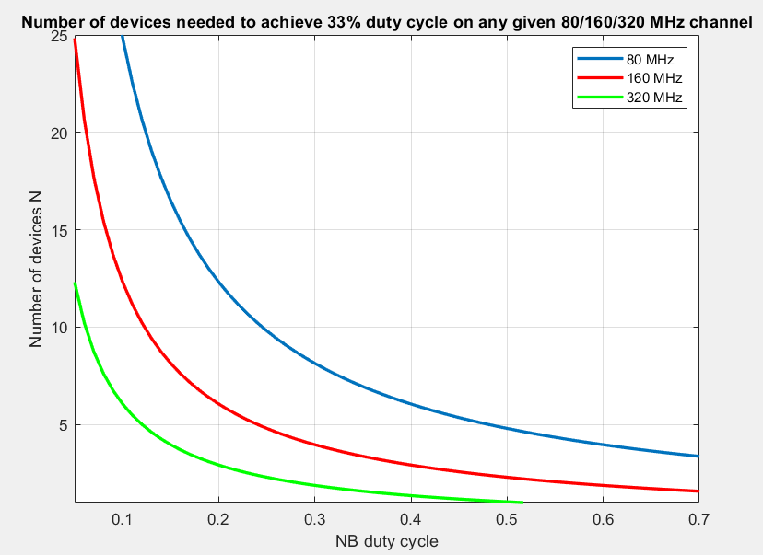
Number of NB Devices and Aggregate Duty cycle
When N narrowband transmitting UWB devices are using UNII-5 only (500 MHz), each with duty cycle x, the aggregate duty cycle on any B MHz channel is given by 1-(1-x*B/500)^{N}
We can reach 33% aggregate duty cycle with x=10% duty cycle with 6/13/25 NB devices on a 320/160/80 MHz Wi-Fi channel.
0.05

Slide 6
Derivation of Aggregate Duty Cycle
Prob(one channel is occupied) = 1- prob (one channel is free)
=1 – prob (all N devices are not transmitting in that one channel)
=1- (a single device is not transmitting in that one channel)^{N}
= 1- (1-prob(a single device is transmitting on that one channel))^{N}
=1 – (1-x *B/W)^{N} where x is the duty cycle, B is the channel bandwidth and W is the total bandwidth that may be occupied by NB.

Slide 7
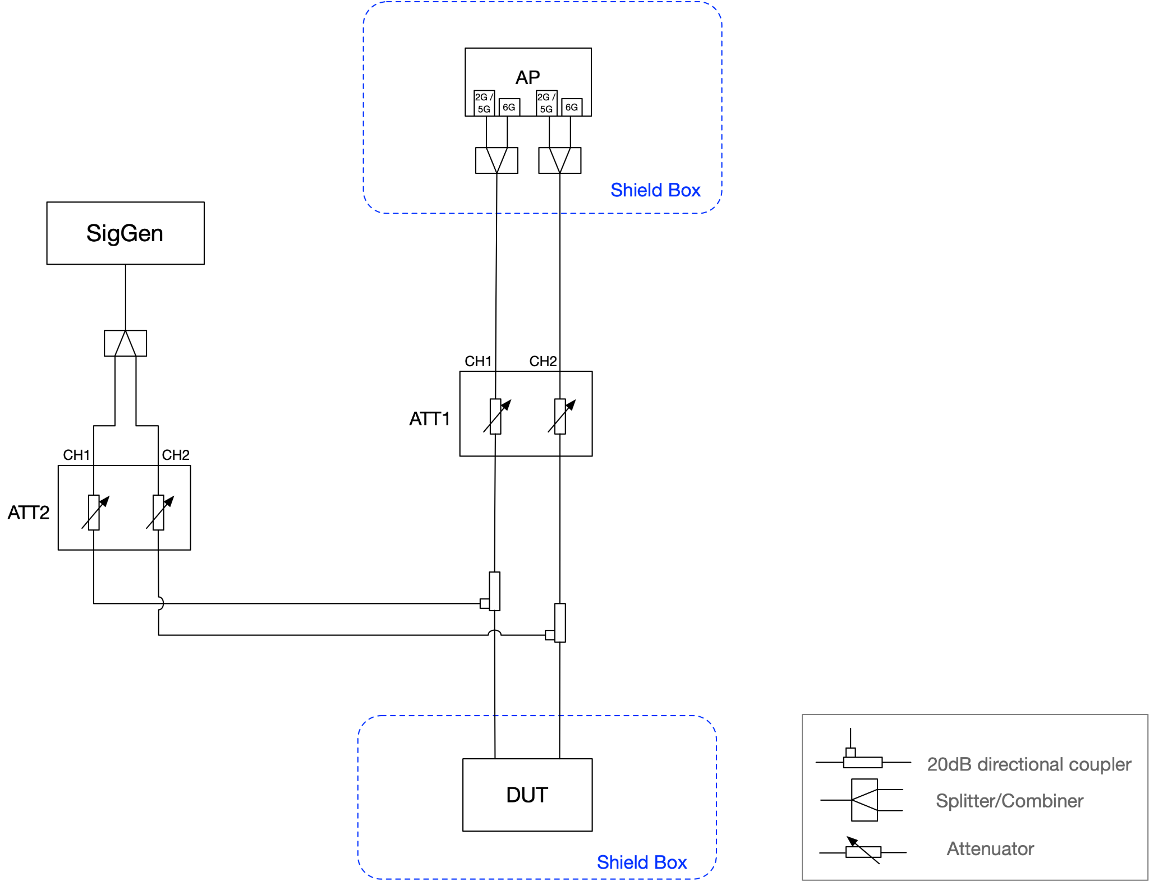
Setup – NB Interferer
SigGen: R&S SMBV100B
Wi-Fi Channel: 5GHz CH36 (160MHz) centered at 5250 MHz (5170-5330 MHz)
  Max PHY rate 2.0-2.4 Gbps (depends on guard interval)
Wi-Fi does its own rate adaptation and AMPDU is enabled.
Iperf udp traffic
ATT2 is used to set the NB RX power to the desired level at the DUT and ATT1, called “Attenuation” in following plots is what is swept
NB RX Power is swept from -50 to -90 dBm via ATT2

Slide 8
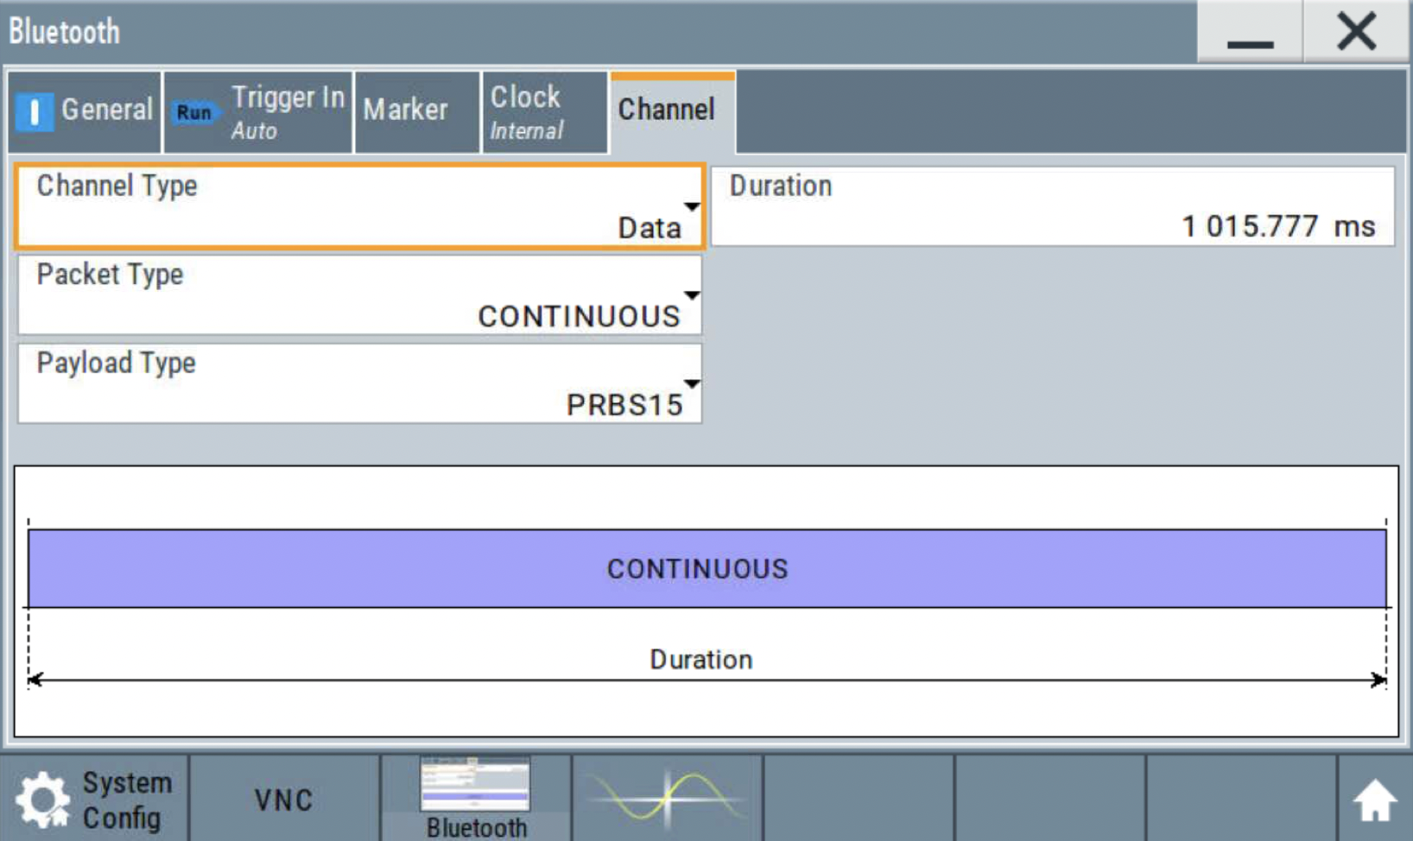
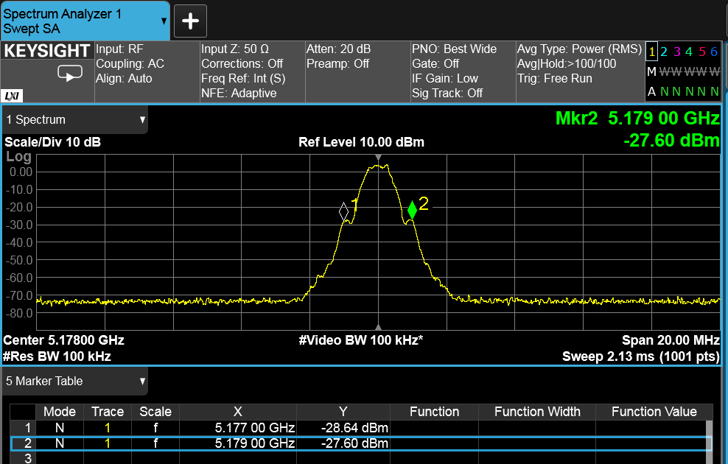
NB Profile 1
Continuous BLE Signal, 2 MHz BW

Slide 9
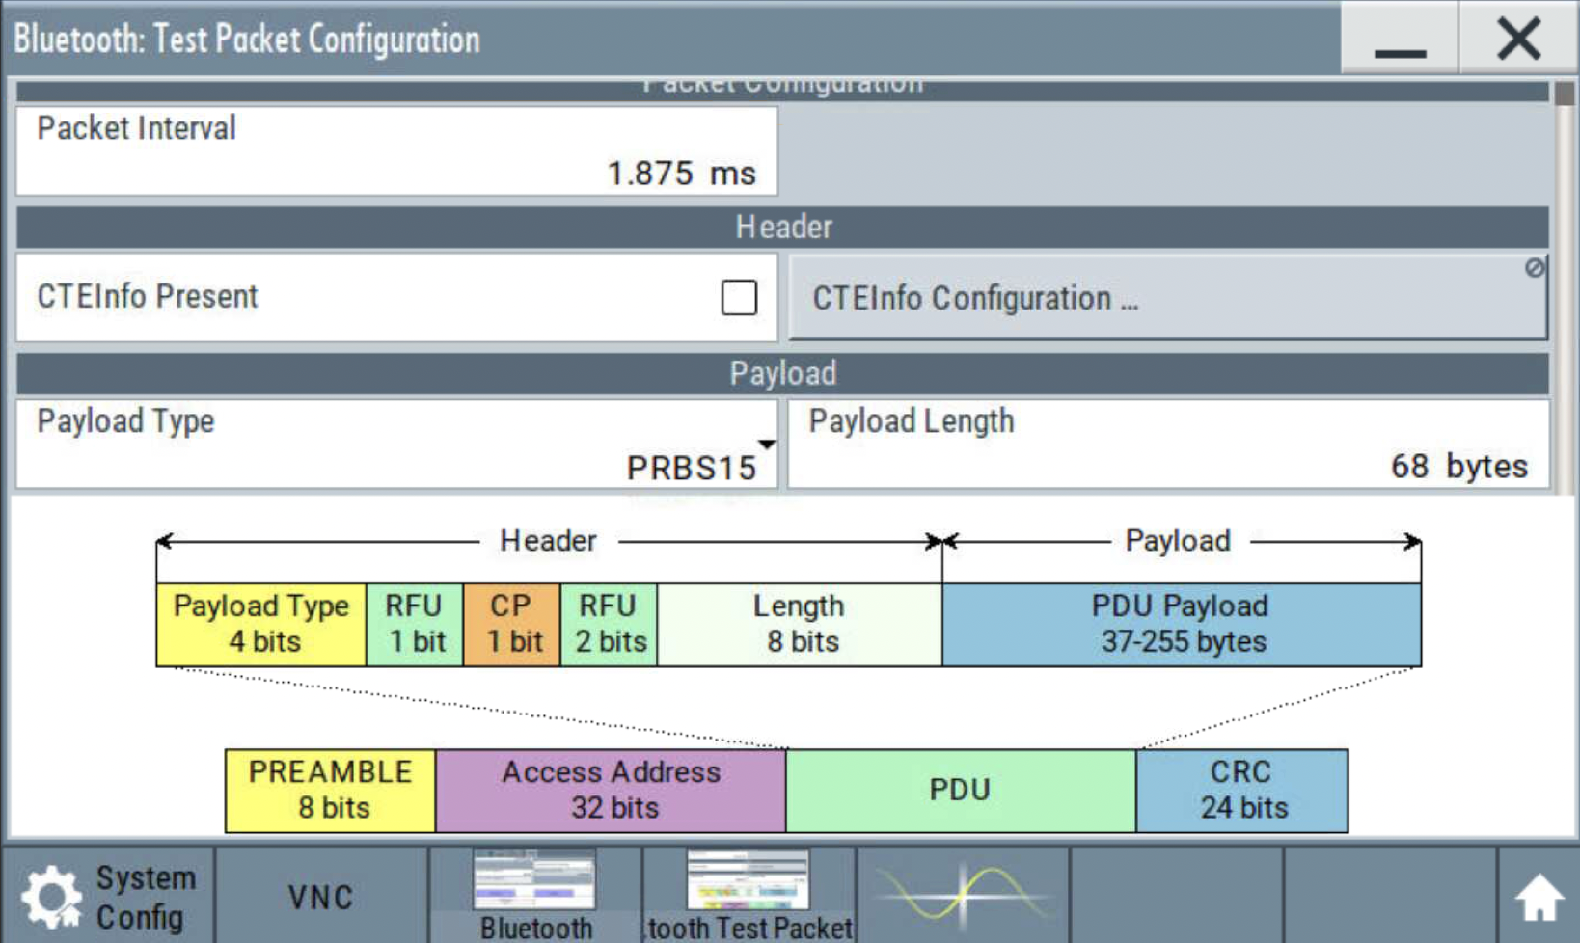
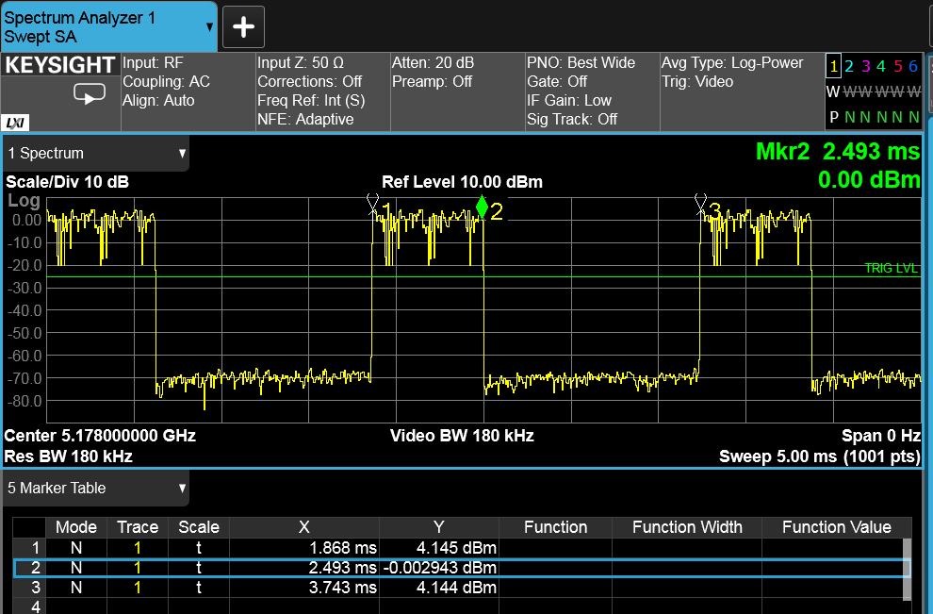
NB Profile 2
BLE with dwell time 625us with a packet interval of 1.875ms, 33.3% duty cycle

Slide 10
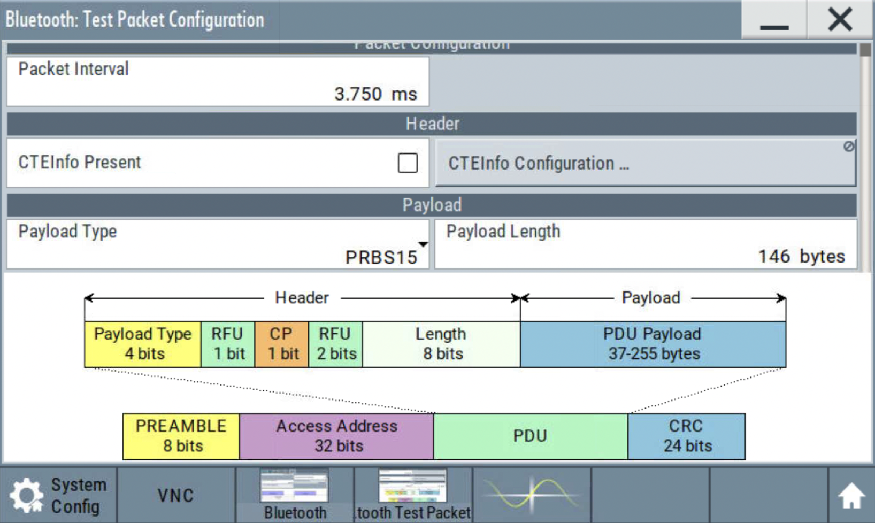
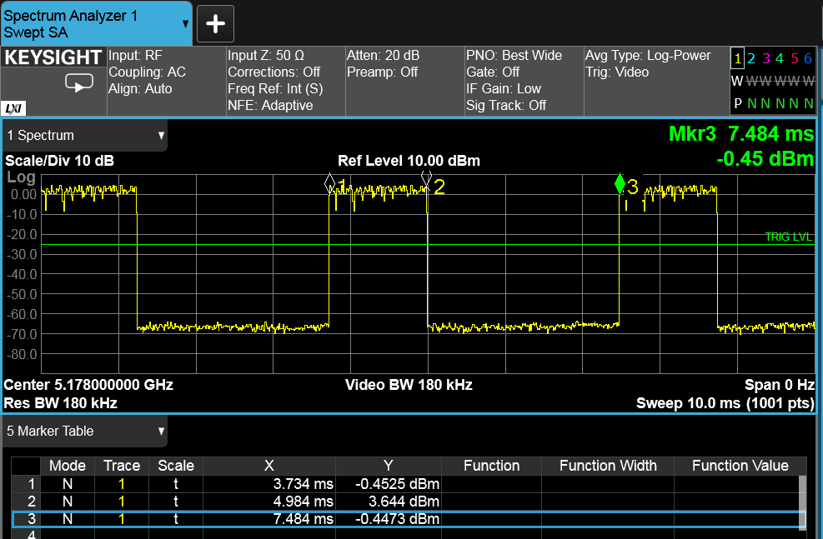
NB Profile 3
BLE with dwell time 1.25ms with a packet interval of 3.75ms, 33.3% duty cycle

Slide 11
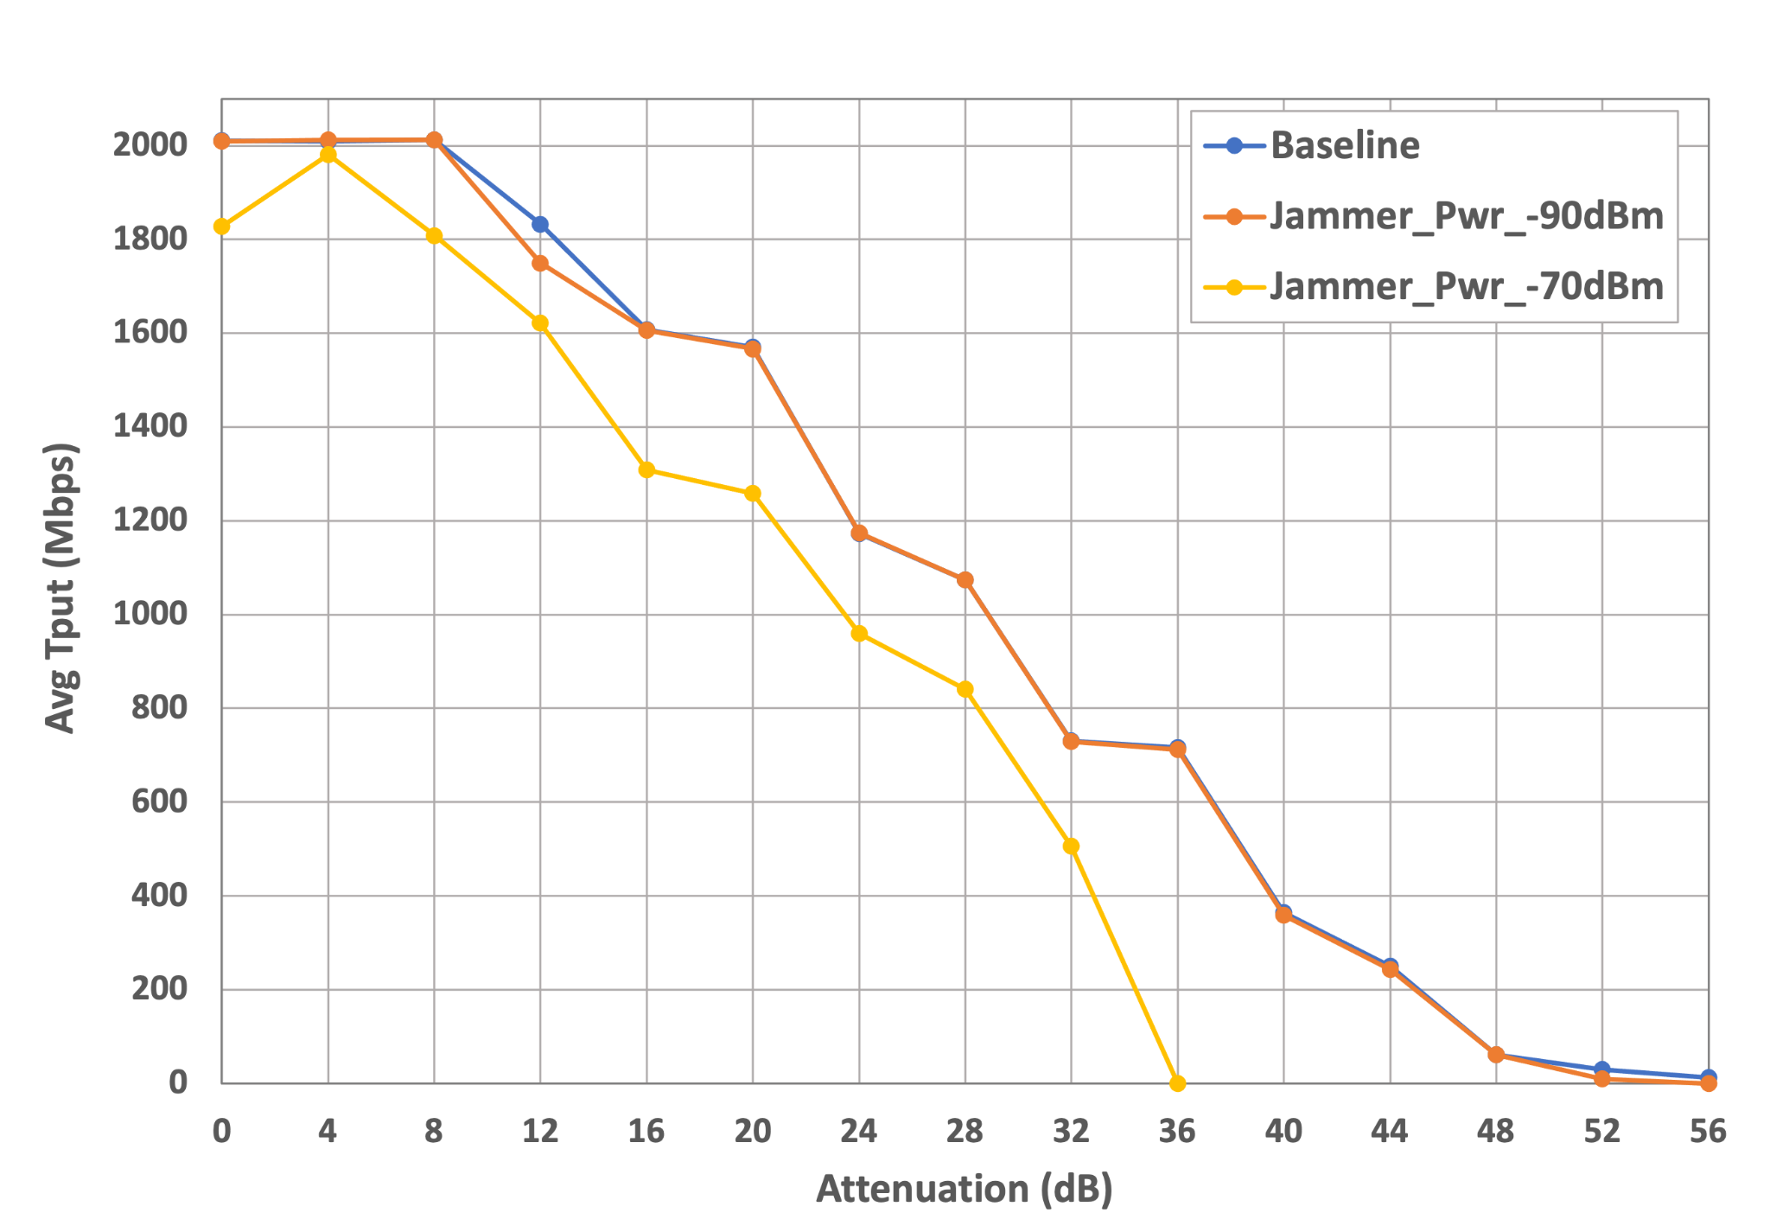
NB Profile 1 at 5178MHz
WI-Fi throughput is 0 when the NB power is -60dBm or -50dBm. At these interference levels, NB interferer completely prevents DUT from transmitting because Wi-Fi performs LBT.
Uplink
Attenuation is ATT1 or ATT2?
Note that 0 dB Attenuation is equivalent to -31 dBm RSSI
NOTE:
Wi-Fi throughput is 0 when
NB power is >= -60 dBm

Slide 12
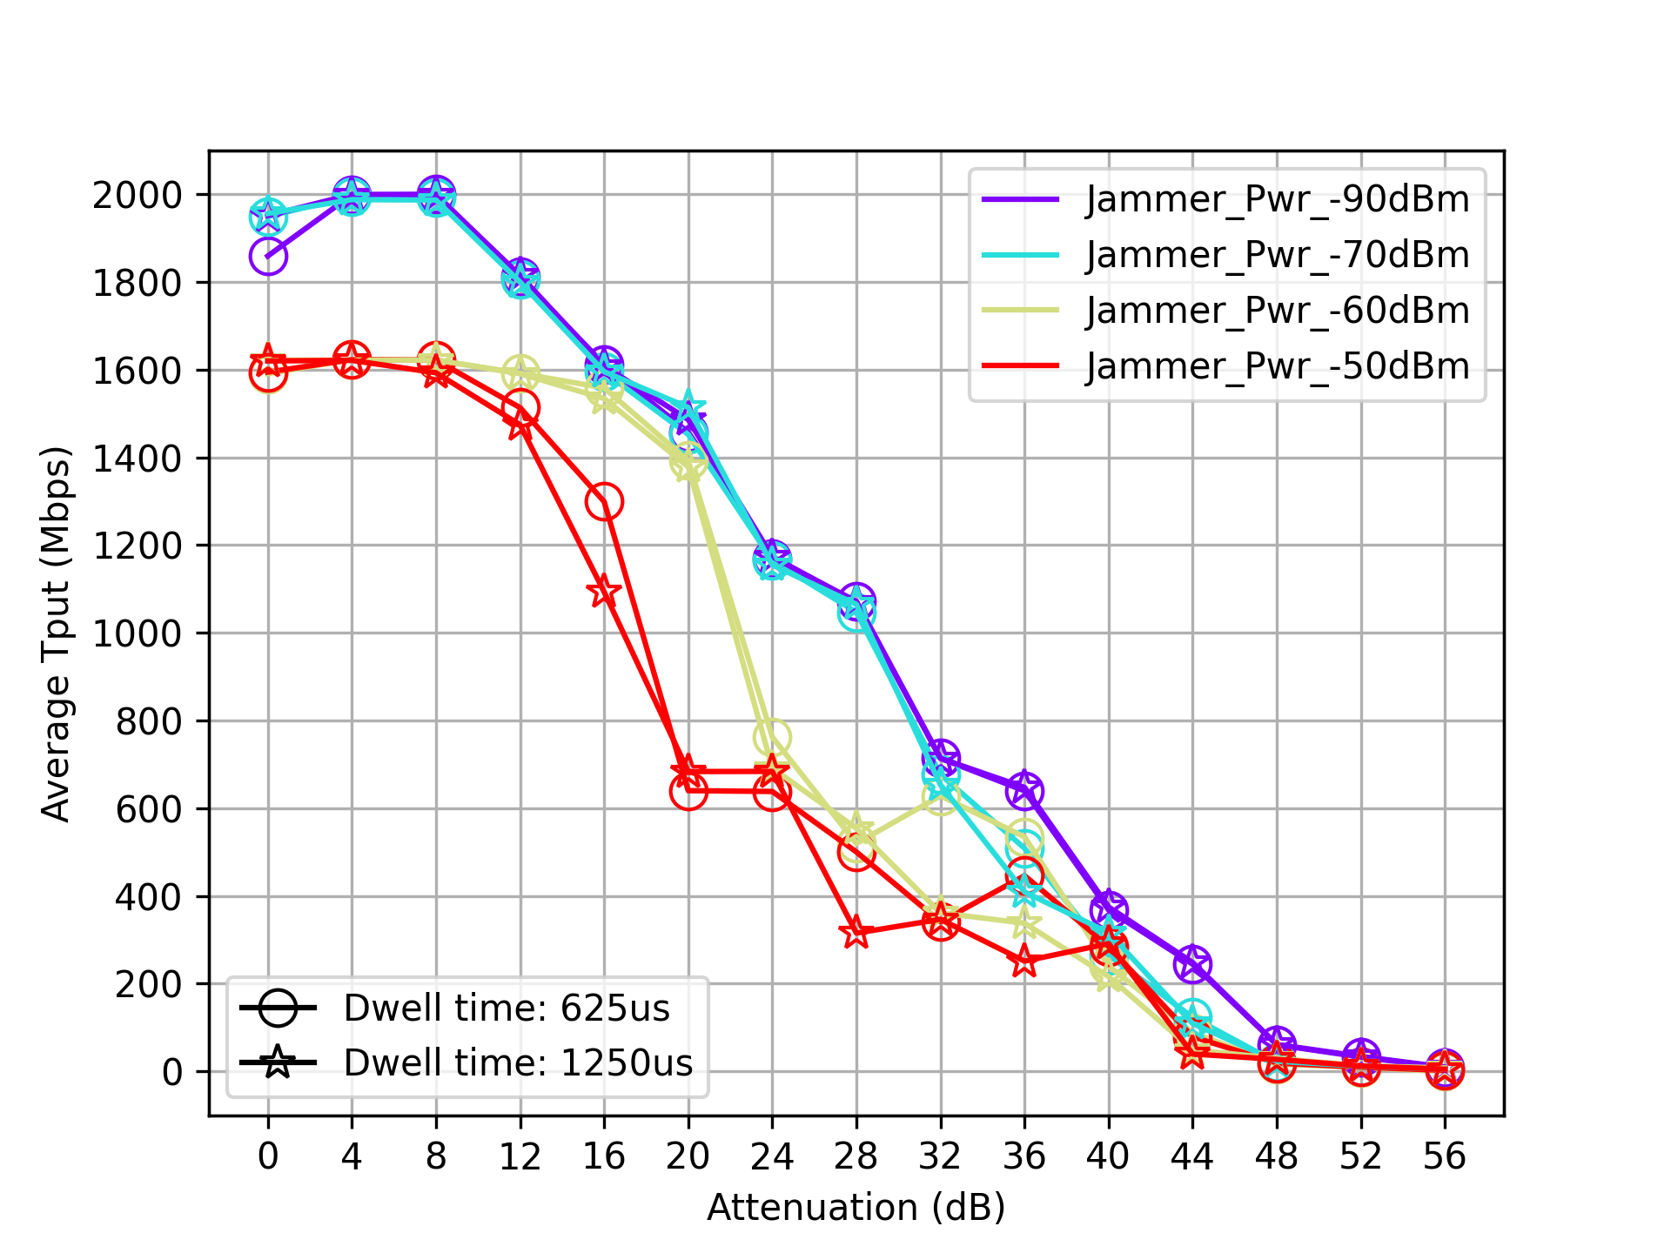
NB Profiles 2 and 3 at 5178MHz
Uplink

Slide 13
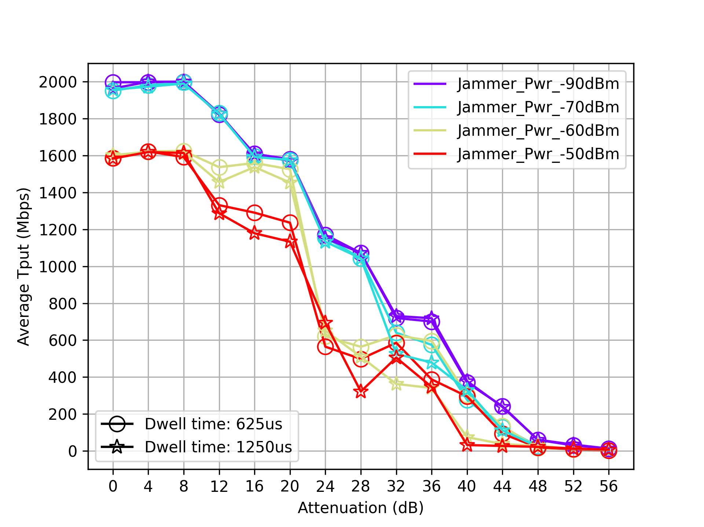
NB Profiles 2 and 3 at 5258MHz
Uplink
Location of NB interferer within the channel does not seem to matter

Slide 14
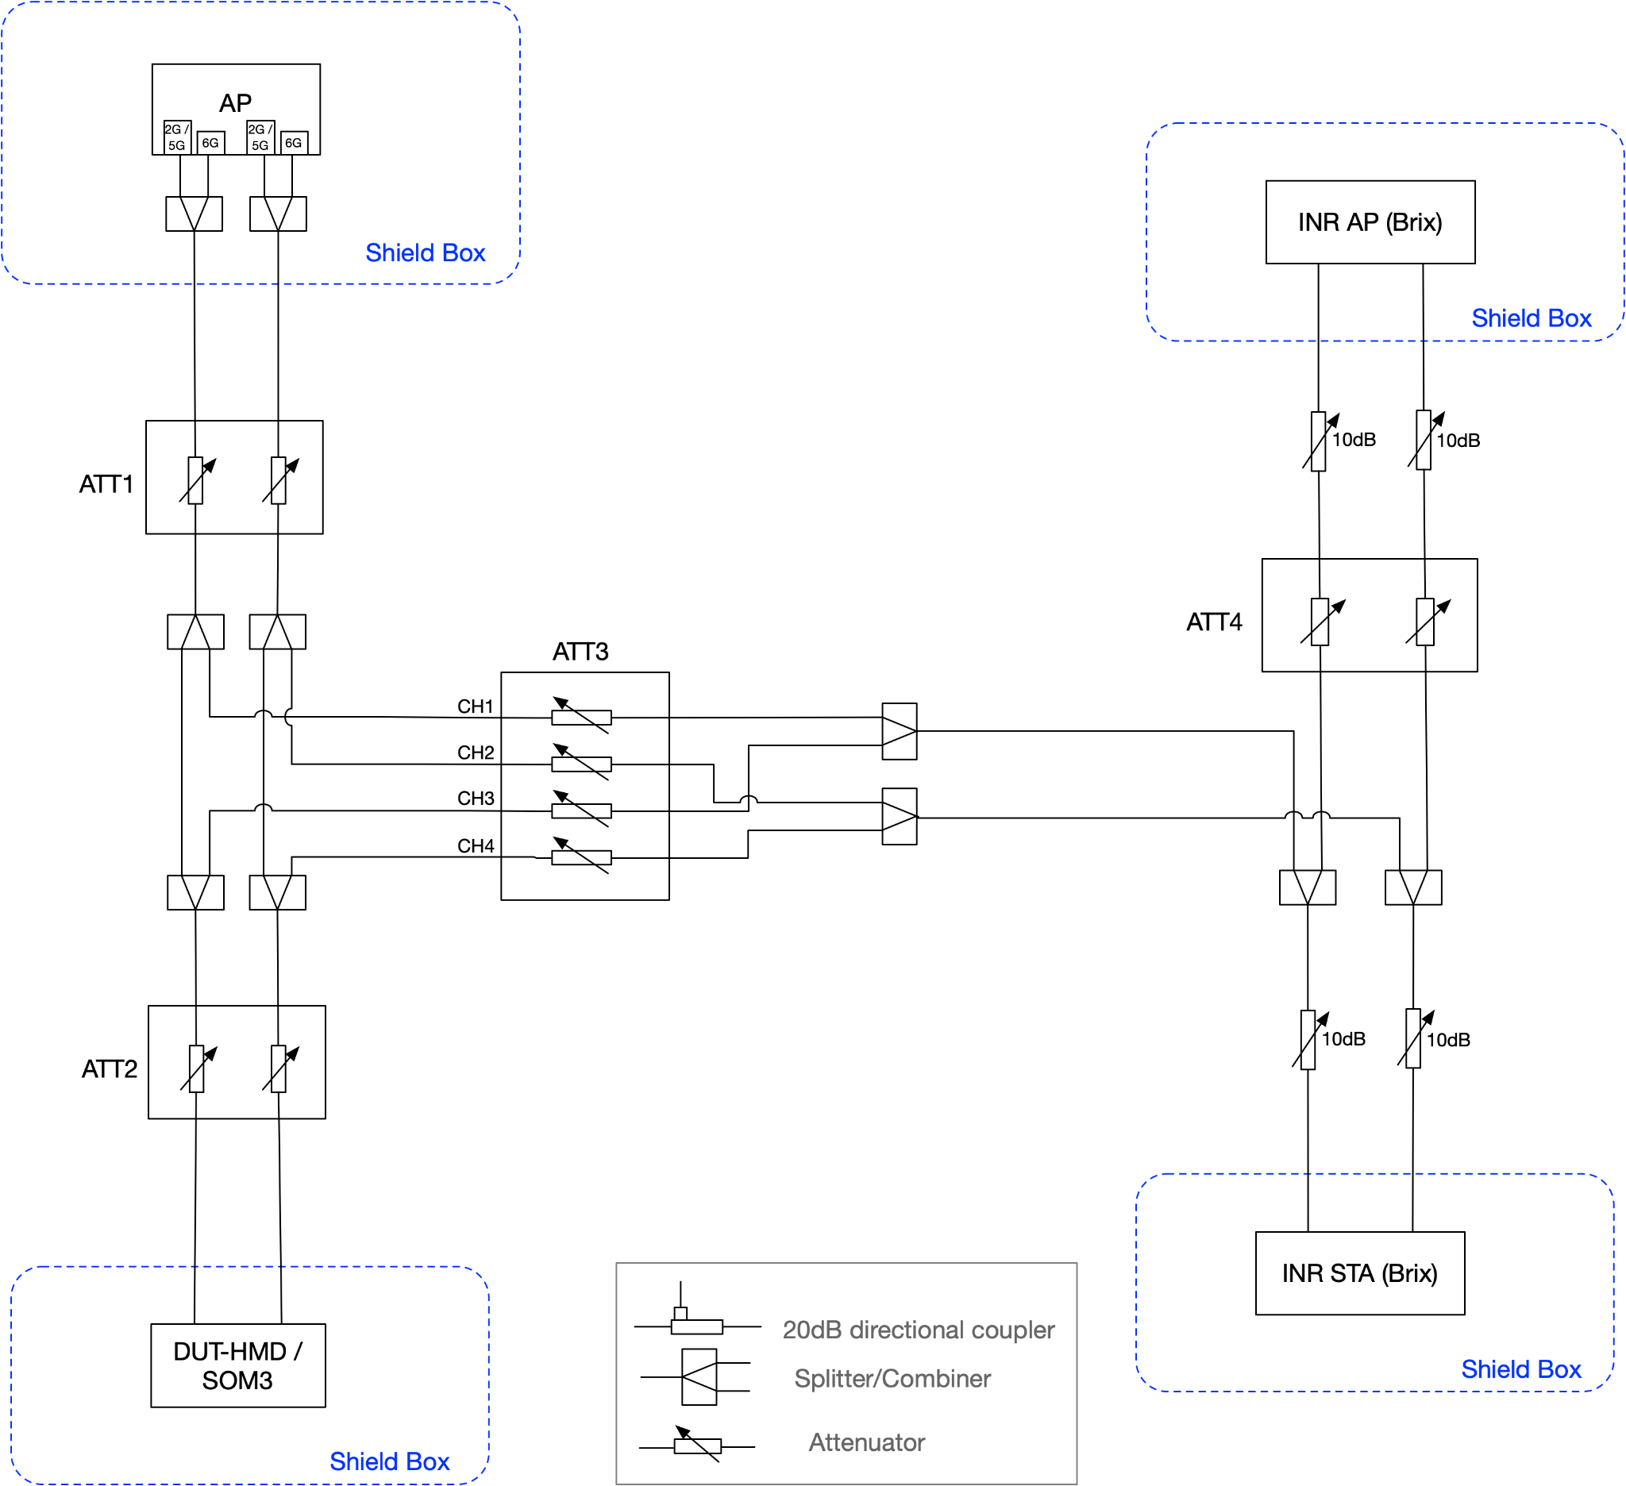
Setup - WiFi Interferer
Desired Link:
  Wi-Fi Channel: 5GHz CH36/160MHz
Interference Link:
  AP/STA:
  Wi-Fi Channel: 5GHz CH36/160MHz
  iperf UDP UL 3Mbps
ATT1 is swept for the main link, as before
ATT2 is set to 0
ATT3 controls the interference level

Slide 15
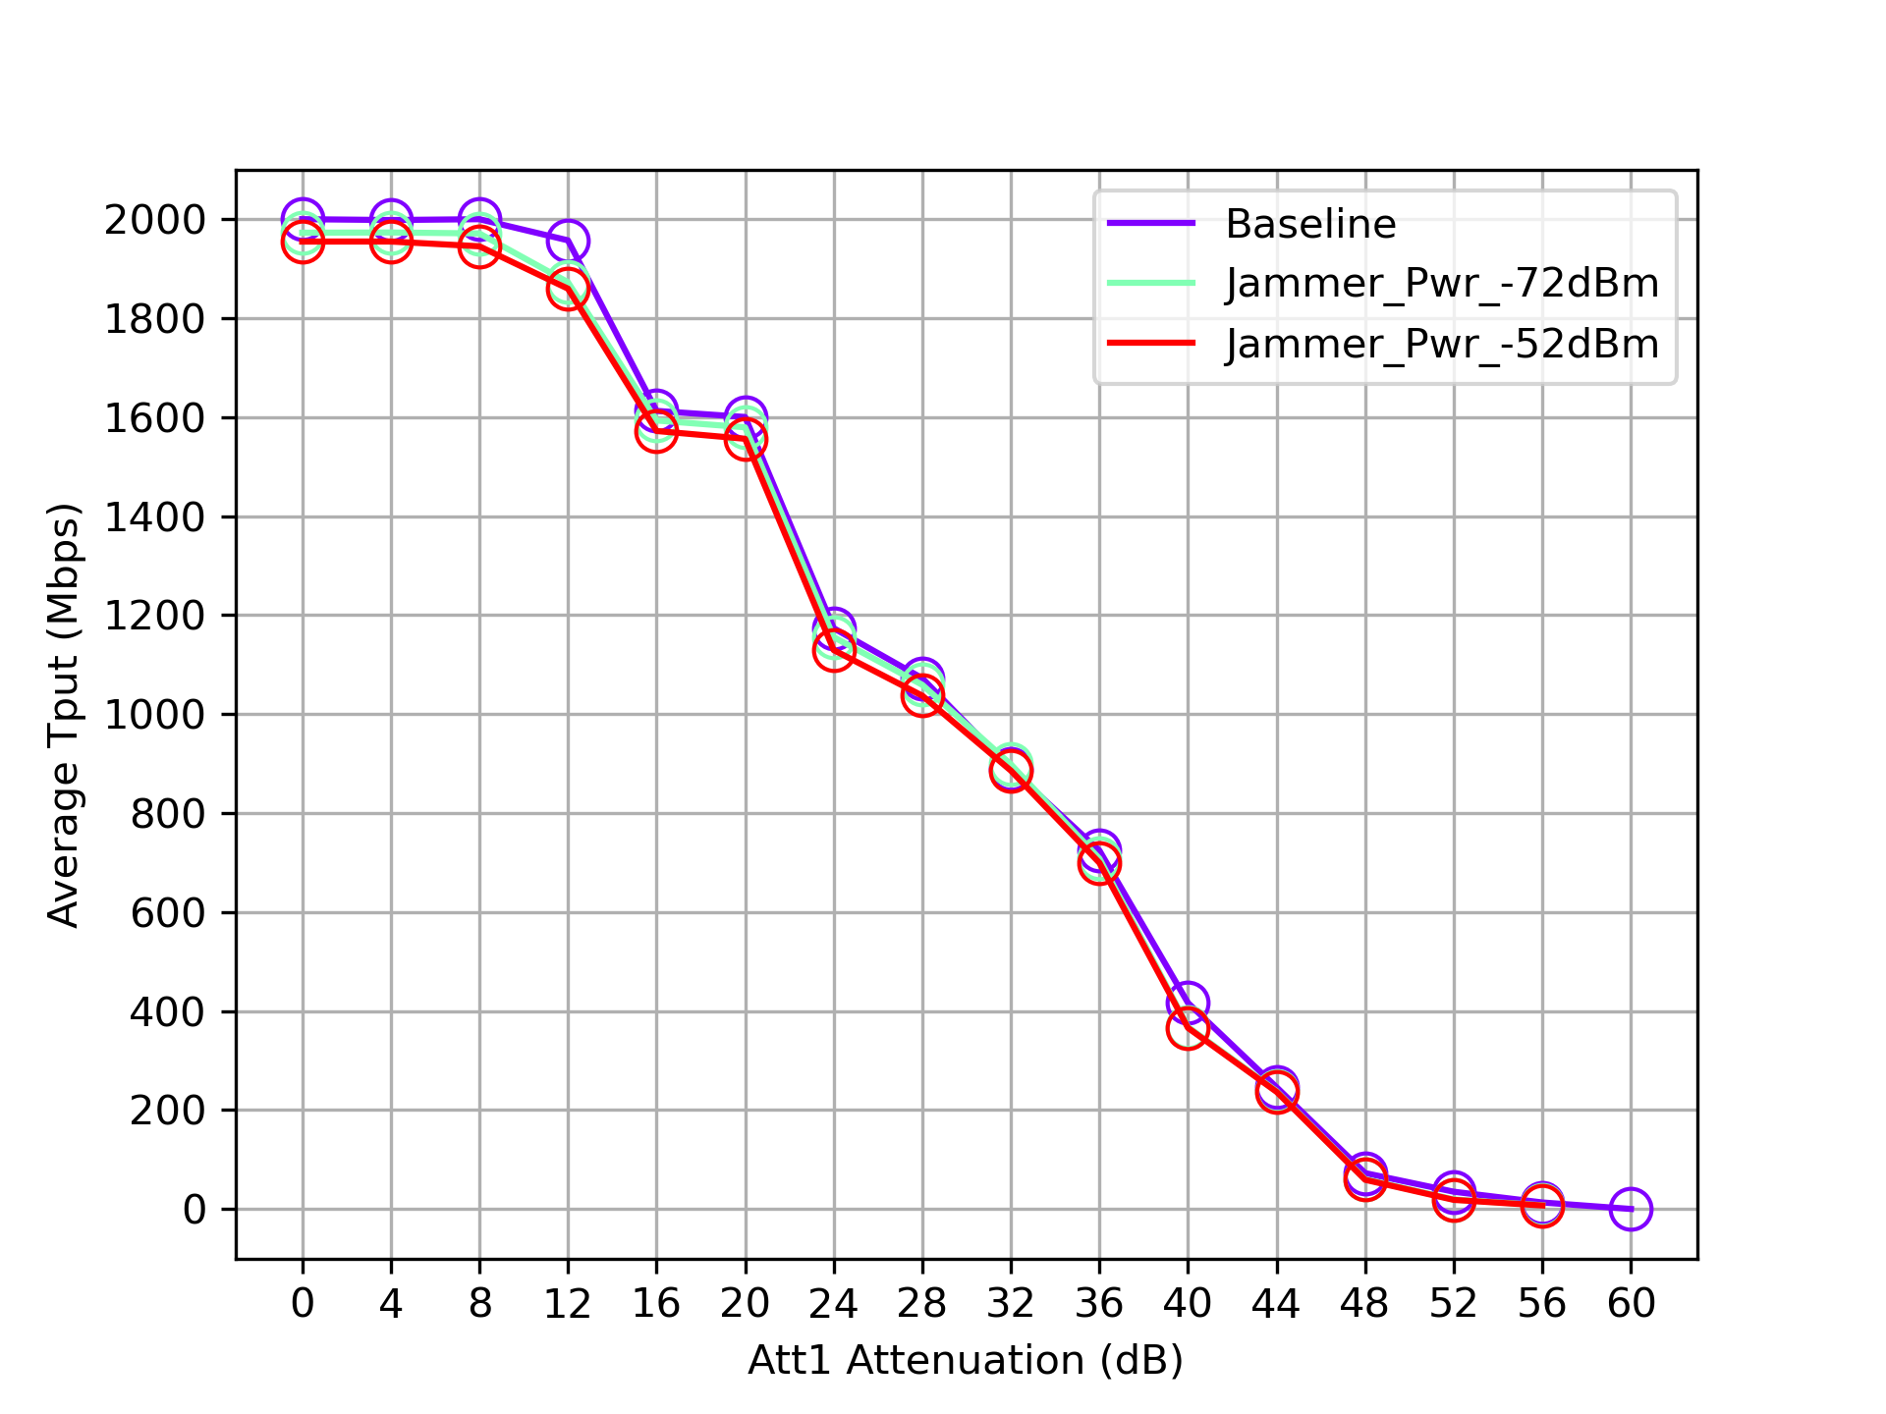
Result - WiFi Interferer
Uplink

Slide 16
Observations
For duty cycles of >=~33%, to minimize effect on Wi-Fi (~30% degradation in throughput), NB interferer should have received power <= -70 dBm
  This is equivalent to ~10m/60m in 3GPP indoor/FSPL (Free Space Path Loss) channel model.
The Wi-Fi interferer with similar data rates as NB can be as large as -52dBm without significant degradation to the victim Wi-Fi link.

Slide 17
Conclusions
This work shows that, for similar throughput, NB (without LBT) is not a better neighbor to Wi-Fi than another Wi-Fi node.
33% aggregate duty cycle NB devices without LBT is shown to be very detrimental to Wi-Fi.
  This can happen when multiple low duty cycle NB devices are co-located.
  The problem becomes worse when Wi-Fi uses 320 MHz and/or higher constellations (with higher SNR requirements).
In 6 GHz, LBT is a promising technique to reduce NB effect on Wi-Fi and is already recommended by regulatory bodies. LBT is proven, robust, and should be adopted in 802.15.4ab for NB devices as a default coexistence mechanism.

Slide 18
Appendix

Slide 19
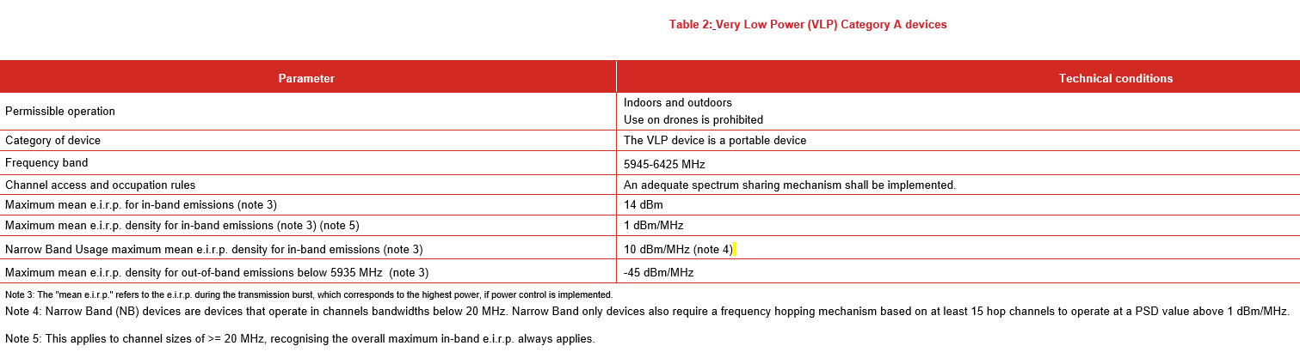
Background
In Europe, Narrowband transmissions with high PSD are allowed in the lower 6 GHz band.
In ETSI BRAN(21) 111033r3, the following VLP requirements for Narrowband (NB) devices were added into the 6GHz item:
Mean EIRP density of 10dBm/MHz if 15 hops are used and 1 dBm/MHz if less than 15 hops are used
BW restriction <= 20 MHz
frequency hopping mechanism
Frequency range (MHz) | Level (dBm)
 | LPI usage | VLP usage | NB Usage
5 925 to 6 425 | 23 | 14 | 14
Frequency range (MHz) | Level (dBm/MHz)
 | LPI usage | VLP usage | NB Usage
5 925 to 6 425 | 10 | 1 | 10 (Note 1)
NOTE : For NB systems with <15 hopping channels the limit shall be 1dBm/MHz

Slide 20
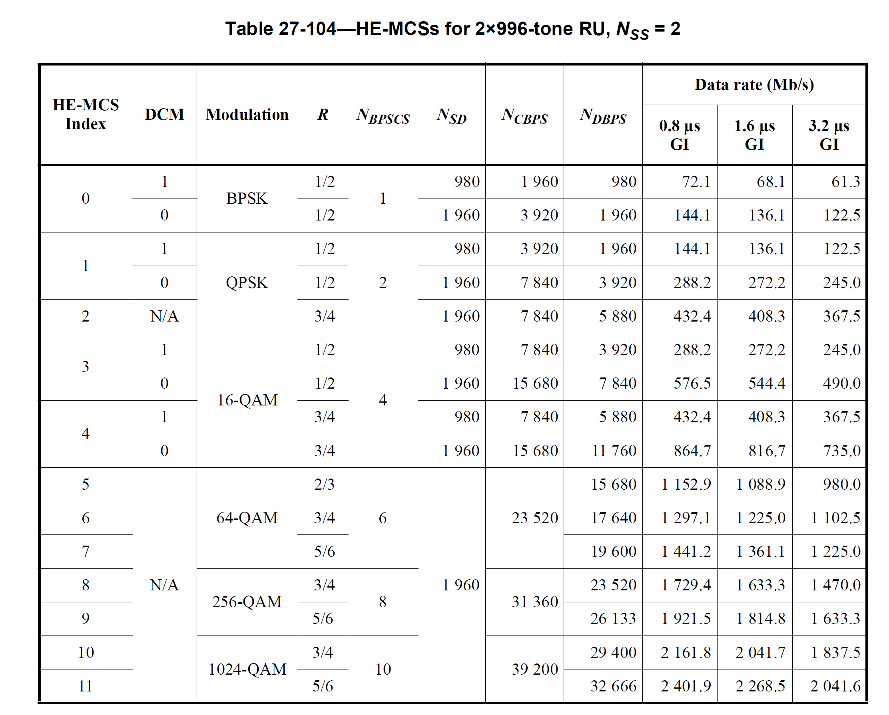
Wi-Fi Throughput

Slide 21
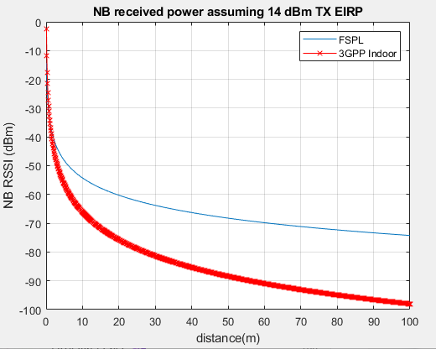
NB Received power vs distance
Assume NB has 14 dBm TX EIRP, per regulations
“FSPL” = free space path loss
“3GPP Indoor” = 3GPP 38.901 indoor channel model

