Slide 1
Project: IEEE P802.15 Working Group for Wireless Personal Area Networks (WPANs)
Submission Title: Latest Consensus on UWB Sensing for 802.15.4ab
Date Submitted: May 18, 2023
Authors: Pooria Pakrooh, Bin Tian, Steve Shellhammer, Koorosh Akhavan (Qualcomm), Xiaohui Peng, David Xun Yang, Bin Qian, Lei Huang, Rojan Chitrakar, Li Sun (Huawei), Frank Leong, Wolfgang Küchler, Riku Pirhonen, Bernhard Großwindhager (NXP Semiconductors), Dag Wisland, Håkon Hjortland, Kristian Granhaug, Jan Roar Pleym (Novelda), Dries Neirynck (Ultra Radio Ltd), Claudio da Silva, Carlos Aldana, Kangjin Yoon (Meta), Billy Verso, Carl Murray, Igor Dotlic, Michael McLaughlin (Qorvo), Xiliang Luo, Vinod Kristem, Jinjing Jiang (Apple), Aniruddh Rao, Mingyu Lee (Samsung), Li Ma, Li-Hsiang Sun (MediaTek)
Abstract: Latest consensus among co-authors on UWB sensing topics for 802.15.4ab
Notice: This document has been prepared to assist the IEEE P802.15. It is offered as a basis for discussion and is not binding on the contributing individual(s) or organization(s). The material in this document is subject to change in form and content after further study. The contributor(s) reserve(s) the right to add, amend or withdraw material contained herein.
Release: The contributor acknowledges and accepts that this contribution becomes the property of IEEE and may be made publicly available by P802.15.

Slide 2
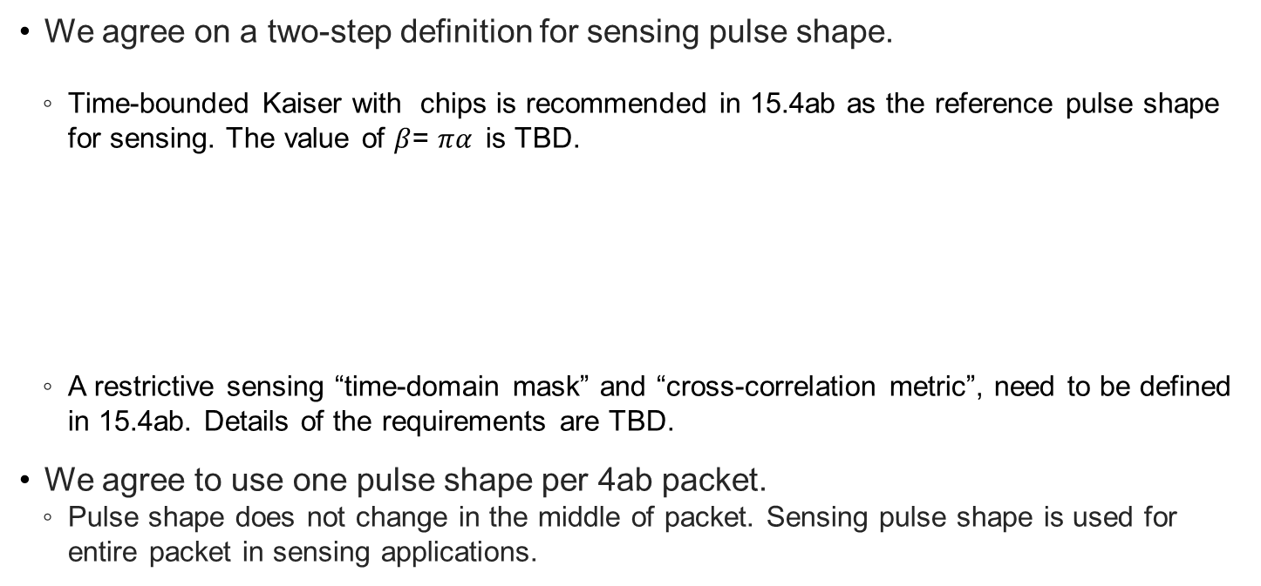
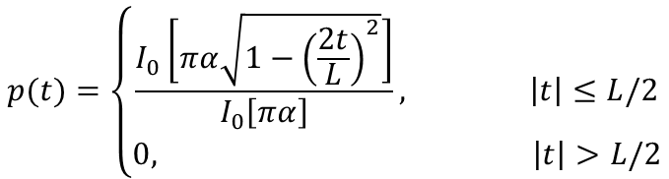
Sensing Pulse Shape
We agree on a two-step definition for sensing pulse shape.
  Time-bounded Kaiser with chips is recommended in 15.4ab as the reference pulse shape for sensing. The value of $β$= $πα$is TBD.
  A restrictive sensing “time-domain mask” and “cross-correlation metric”, need to be defined in 15.4ab. Details of the requirements are TBD.
We agree to use one pulse shape per 4ab packet.
  Pulse shape does not change in the middle of packet. Sensing pulse shape is used for entire packet in sensing applications.
$$p(t)=\left\{\begin{aligned}\frac{I_{0}\left[πα\sqrt{1−{\left(\frac{2t}{L}\right)}^{2}}\right]}{I_{0}\left[πα\right]}, \left|t\right|≤L/2 \\ 0, \left|t\right|>L/2\end{aligned}\right.$$
Slide 2
Pakrooh et al. (Qualcomm)

Slide 3
Sensing Packet Format
We agree to define the following PPDUs for bi/multi-static sensing.
  SENS0: Mandatory sensing packet format, SHR + sensing
  SENS1: Optional packet format, sensing + data comm
  SENS2: Optional packet format, data comm + sensing
SENS0
SYNC
SFD
SENS
Mandatory
SENS1
SYNC
SFD
SENS
PHR
Payload
Optional
SENS2
SYNC
SFD
PHR
Payload
SENS
Optional
Arrow shows RMARKER
reference position.
Slide 3
Pakrooh et al. (Qualcomm)

Slide 4
Sensing Sequence and Pulse Pattern
We agree on mandatory support of Ipatov sequences of length 91, as specified in table 15-7a of 802.15.4z-2020, with spreading factor of L=4 for sensing.
An SDEV may optionally support additional mode sensing only for SENS0 packet, where all three fields (SYNC, SFD, and SENS) use the same length 127 code from Table 15-7 of the 15.4 standard, with spreading factor of L=4. This brings the PRF to 62.4MHz.
  SYNC PSR and SFD length options in this mode are the same as HPRF mode, as discussed in slide 10.
Slide 4
Pakrooh et al. (Qualcomm)

Slide 5
Sensing Packet Structure
Segments
  We agree that in the baseline mandatory mode, SENS field has one segment.
  We agree on optional support for 2, 3 and 4 segments in the SENS field.
Gap
  We agree that SENS field includes silent intervals called “gaps”
    When multiple segments are used, we agree to include gaps between segments.
    The duration of each gap interval is one SENS symbol.
    See next slides for figures
RMARKER
  We agree to have one RMARKER for sensing packets. The position of the RMARKER is at the peak of first pulse after SFD (as per 4z).
Slide 5
Pakrooh et al. (Qualcomm)

Slide 6
Sensing Packet Structure
Number of SENS Symbols
  Each symbol corresponds to one period of SENS sequence with spreading
  We agree to support 32, 64, 128 (Mandatory) 16, 256, 512 (optional) symbols per segment for SENS.
  Sequence selection
    We agree that both SENS and SYNC in the same sensing packet shall use same Ipatov code index.
CIR Report
  For sensing packets SENS0, SENS1 and SENS2, we agree to support one CIR report per SENS segment per Rx. No CIR report from SYNC field.
  Sensing CIR report is optionally supported with non-sensing packets (dynamic-data packet, MMS and SP0-3)
    The field used for CIR report generation should be agreed during control phase.
Slide 6
Pakrooh et al. (Qualcomm)

Slide 7
SENS0 Packet
Support for one segment is mandatory, 2,3 and 4 segments is optional
RMARKER
SYNC
SFD
SENS
Gap
SENS active
Gap
SENS active
Single segment SENS
Two segment SENS
Slide 7
Pakrooh et al. (Qualcomm)

Slide 8
SENS1 Packet
Support for one segment is mandatory, 2,3 and 4 segments is optional
RMARKER
SYNC
SFD
SENS
PHR
Payload
Gap
SENS active
Gap
SENS active
Gap
Single segment SENS
Two segment SENS
Slide 8
Pakrooh et al. (Qualcomm)

Slide 9
SENS2 Packet
Support for one segment is mandatory, 2,3 and 4 segments is optional
RMARKER
SYNC
PHR
Payload
SFD
SENS
Gap
SENS active
Gap
SENS active
Single segment SENS
Two segment SENS
Slide 9
Pakrooh et al. (Qualcomm)

Slide 10
Sensing Packet Fields
We agree on the following values for SYNC and SFD configs for sensing packets
  SYNC PSR: 32, 64 (mandatory), 16, 128, 256 (optional).
  SFD length: Same as 15.4z, as specified in table 15-7c.
  For sensing, we agree that fixed PSR is negotiated at higher layers, and the value does not change from packet to packet.
We agree to use 4z PHR, with payload data rates of 1.95, 7.8, 31.2, 62.4 (mandatory), and 124.8Mbps (optional).
  FEC: We agree on BCC K=7 as the FEC for SNES1 and SENS2 packets.
Slide 10
Pakrooh et al. (Qualcomm)

Slide 11





Sensing Report
We agree to have window-based CIR report, as shown in the figure below.
  A sensing report bitmap is used to signal the taps present in the CIR report. The bitmap length is equal to the CIR window length.
Additionally, we agree that other processed results may be included in the sensing report.
  For monostatic sensing, or for bi-static sensing with external synchronization, CIR report may be optionally processed, to generate range/velocity for each object. The definition of computation method is TBD.
  Angle of Arrival (AoA) for each object may be reported.
Reference Point: Earliest detected tap
Noise Threshold
$$t_{0}$$
$$t_{0}+W_{offset}$$
$t_{0}+W_{offset}$+ $W_{length}$
$${BM}_{offset}$$
$${BM}_{length}$$
Sensing window parameters defined relative to the earliest detected tap
Slide 11
Pakrooh et al. (Qualcomm)

Slide 12
Sensing Report
We agree on the following parameters for the window-based CIR report.
  Reference: The earliest detected tap can be specified as the mandatorily supported reference for the CIR report. Other reference options under consideration, to be supported optionally:
    Other specific time instances can be specified as reference points (for example via OOB) when there is external synchronization.
    The strongest detected tap, if there are multiple equally strongest taps, then the earliest one is selected.
  CIR sampling rate: We agreed on OSR=2, to balance reasonable accuracy, complexity and report overhead. OSR is defined with respect to signal BW.
    For frequency stitching, OSR is defined with respect to the aggregated BW.
  Bit-width: Bit-width is defined for encoding signed I/Q values each, normalized per Rx chain.
    16 bits (mandatory), 10, 12 bits, and other values are under consideration as optional values.
Slide 12
Pakrooh et al. (Qualcomm)

Slide 13
Sensing Report
We agree on the following points for the window-based CIR report.
  The CIR report window has configurable duration and position, to cover a large sensing area.
  Further agreements regarding CIR report bitmap
    Single CIR window with bitmap of a fixed length is specified through OOB means.
    The bitmap length is negotiated and determined through other means, and it is fixed during sensing session.
    In the mandatory mode, initiator proposes the bitmap, based on its sensing area of interest, from a limited set of bitmap options.
      Bitmap is fixed during the session and does not change from packet to packet.
    For the optional modes, the bitmap can change from packet to packet.
Slide 13
Pakrooh et al. (Qualcomm)

Slide 14
Modes for Report Bitmap
  In the mandatory bitmap mode, we agreed that a limited set of reasonable bitmap options will be defined in the standard. Initiator proposes one bitmap based on its area of interest. The allowed configs are one or two continuous strings of 1s within the bitmap length.
    The SDEVs shall support the mandatory window configurations → No need for negotiation.
  In the optional bitmap mode, we agreed that the bitmap can change from packet to packet
    The responder reports CIR taps above a threshold, and the associated bitmap
    Initiator determines the threshold value
      The responder reports taps above a threshold level T (for example, strongest tap level – T)
      T is determined by initiator
      If initiator does not want the CIR report to be thresholded, it specifies a very low value for T (for example, -100dB).

Slide 15
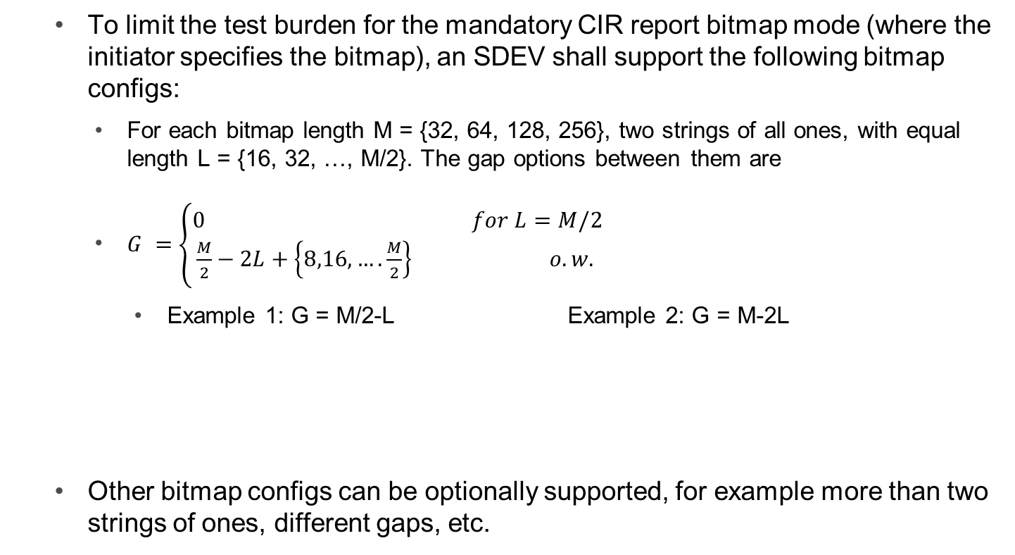
Mandatory CIR Report Bitmap Configs
    To limit the test burden for the mandatory CIR report bitmap mode (where the initiator specifies the bitmap), an SDEV shall support the following bitmap configs:
      For each bitmap length M = {32, 64, 128, 256}, two strings of all ones, with equal length L = {16, 32, …, M/2}. The gap options between them are
      $G =$ $\left\{\begin{aligned}0 for L=M/2 \\ \frac{M}{2}−2L+\left\{8,16,….\frac{M}{2}\right\} o.w. \end{aligned}\right.$
        Example 1: G = M/2-L Example 2: G = M-2L
    Other bitmap configs can be optionally supported, for example more than two strings of ones, different gaps, etc.
M/2
L
G
L
L
G
L
Slide 15

Slide 16
Mandatory CIR Report Bitmap Configs
  Total of 88 bitmap options:
    One string of all ones for M={32,64,128,256}
    Two strings of equal length L, with gap G
      M = 64, L = 16, G = {8, 16, 24, 32} → 4 cases
      M = 128, L = 16, G = {40, 48,….,96} → 8 cases
      M = 256, L = 16, G = {104, 112, …., 224} → 16 cases
      M = 128, L = 32, G = {8, 16, …, 64} → 8 cases
      M = 256, L = 32, G = {72, …, 192} → 16 cases
      M = 256, L = 64, G = {8, 16, …,128} → 32 cases
Slide 16

Slide 17
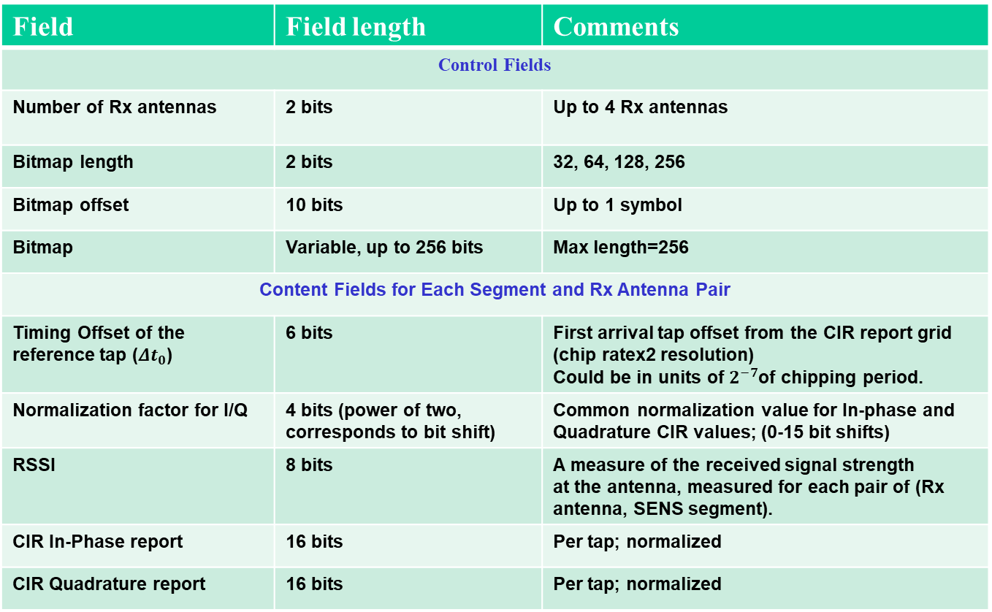
Baseline Sensing Report Parameters
Field | Field length | Comments
Control Fields
Number of Rx antennas | 2 bits | Up to 4 Rx antennas
Bitmap length | 2 bits | 32, 64, 128, 256
Bitmap offset | 10 bits | Up to 1 symbol
Bitmap | Variable, up to 256 bits | Max length=256
Content Fields for Each Segment and Rx Antenna Pair
Timing Offset of the reference tap (${Δt}_{0}$) | 6 bits | First arrival tap offset from the CIR report grid (chip ratex2 resolution) Could be in units of $2^{−7}$of chipping period.
Normalization factor for I/Q | 4 bits (power of two, corresponds to bit shift) | Common normalization value for In-phase and Quadrature CIR values; (0-15 bit shifts)
RSSI | 8 bits | A measure of the received signal strength at the antenna, measured for each pair of (Rx antenna, SENS segment).
CIR In-Phase report | 16 bits | Per tap; normalized
CIR Quadrature report | 16 bits | Per tap; normalized
Slide 17
Pakrooh et al. (Qualcomm)

Slide 18
Frequency Stitching
We agree to adopt frequency stitching across carrier frequencies to improve sensing link budget and accuracy, as an optional feature for mono-static, bi/multi-static modes.
  Consider to limit channels where this option is available to avoid interference with multiple UWB channels.
  For frequency stitching mode, if intra-packet frequency stitching is enabled, extended gap size between SENS segments will be adopted. The duration of extended gap is TBD.

Slide 19

Sensing Session
A sensing session consists of three phases:
  Session setup
  Sensing measurement instance(s)
  Session termination

Slide 20
Sensing Session Setup
Session setup: The session setup phase can be done OOB, and it consists of the following steps
  Transmission of a sensing session setup request frame by the sensing initiator to a sensing responder, followed by transmission of an Ack frame by the responder, and
  Transmission of a sensing session setup response by the responder (followed by an Ack) to the sensing initiator to either
    Accept the parameters proposed by the initiator, or
    Reject and provide responder’s preferred operational parameters in the sensing session response frame.

Slide 21
Measurement instance
Sensing measurement instance(s):
  Sensing session parameters configured during session setup phase may be updated during the control phase.
  A sensing initiator or a sensing responder starts a sensing phase by transmitting a sensing PPDU type which is agreed upon during the session setup or control phase.
  A measurement report phase may follow the sounding PPDU transmission.

Slide 22
Measurement report
Sensing measurement report: The measurement report phase is performed after the measurement phase. For the case that the initiator is the transmitter, responder shall provide measurement report to the initiator. This can be sent in-band or OOB.
  When initiator is transmitter, measurement report phase is mandatory.
Two types of sensing measurement report are defined
  MAC Layer Management Entity report: Used to send sensing measurement results to the application layer of the initiator device.
  OTA CIR measurement report: Used to send sensing measurement report from responder to the initiator.

Slide 23
Round/block/slot structure
Sensing round/block/slot structure: Common structure is used for sensing, ranging, and data comm. Sensing round/block and slots are structured the same as ranging, illustrated in the figure below.
Sensing Block
Sensing
Round 0
Sensing
Round 1
Sensing
Round 2
Sensing
Round 3
…..
Sensing
Round N-1
Sensing
Slot 0
Sensing
Slot 1
Sensing
Slot 2
Sensing
Slot 3
…..
Sensing
Slot M-1

Slide 24
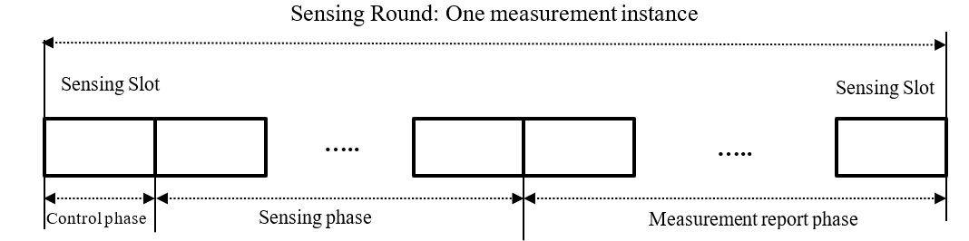
Round/block/slot structure
A sensing measurement instance is performed during a sensing round.
  First slot (slot0) of each round is used for control phase.
  One or multiple slots are used for sensing phase. A sensing PPDU is transmitted during sensing phase.
  Multiple slots may be used for measurement report phase.

Slide 25
Sensing Scheduling and Control
The Scheduling IE defined in DCN 15-23-62/r3 for 15.4ab is used for scheduling a sensing round.
The AC control IE defined in DCN 15-23-61/r1 is used to define sensing control parameters.
  The control field of the AC IE includes at least the following parameters
  Extra field will be added to enable CIR report request for non-sensing packets (STS 0-3, dynamic data, MMS)
  The content of each field is expanded in the next slides.
Bits: 0 | 1 | 2 | variable | variable | variable
Common Sensing Control Present | CIR Report Parameters Present | Frequency Stitching Parameters Present | Common Sensing Control Config | CIR Report Parameters Config | Frequency Stitching Parameters Config

Slide 26
Common Sensing Control
Common sensing control field of AC IE includes the following parameters
0: Transmitter
1: Receiver
0: Monostatic
1: Bi-static
2: Multi-static
3: Proxy
Bits: 0-1 | 2 | 3-4 | 5-7
Sensing mode | Responder role | Sensing Packet format | Reserved

Slide 27
CIR Report and Frequency Stitching Fields
CIR Report field of AC IE includes the following parameters
Frequency stitching field AC IE
Bitmap mode
0: Initiator sets bitmap from predefined subset of bitmaps
1: Initiator sets bitmap from configs not specified in the defined subset
2: Responder sets bitmap and reports it
Only present if bitmap mode=1
Only present if bitmap mode=0
See next slide for sub-window length (L) and Gap (G)
Bits: 0-1 | 2-3 | 4-5 | 6 | 7 | 8 | 9-18 | 19-20 | 21-25 | 4-64 octets
CIR I/Q number of bits | Bitmap length | Bitmap mode | Process CIR report for Range | Process CIR report for Velocity | Process CIR report for AOA measurement | Bitmap offset | Bitmap sub-window length | Bitmap Gap | Bitmap
0 | 1-4 | 5-6 | 7-8 | 9-10 | 11-15
Frequency stitching direction | Base channel number or channel number | Carrier frequency grid configuration ID | Aggregated Bandwidth | Feedback control | Reserved

