Slide 1
        doc.: 15-23-0274-00-04ab
Project: IEEE P802.15 Working Group for Wireless Personal Area Networks (WPANs)
Submission Title: More on clock-related attacks against UWB ranging
Date Submitted: 17 May 2023
Source: Claudio Anliker, Giovanni Camurati, Srdjan Capkun (ETH Zurich)
Address: Universitätsstrasse 6, 8092 Zürich, Switzerland
E-Mail: claudio.anliker@inf.ethz.ch
Abstract: Presentation of Mix-Down (MD) and Stretch-and-Advance (S&A), two attacks related to device clocks of UWB transceivers.
Purpose: Raising awareness for security issues
Notice: This document has been prepared to assist the IEEE P802.15. It is offered as a basis for discussion and is not binding on the contributing individual(s) or organization(s). The material in this document is subject to change in form and content after further study. The contributor(s) reserve(s) the right to add, amend or withdraw material contained herein.
Release: The contributor acknowledges and accepts that this contribution becomes the property of IEEE and may be made publicly available by P802.15.

Slide 2
        doc.: 15-23-0274-00-04ab
PAR Objective | Proposed Solution (how addressed)
Safeguards so that the high throughput data use cases will not cause significant disruption to low duty-cycle ranging use cases
Interference mitigation techniques to support higher density and higher traffic use cases
Other coexistence improvement
Backward compatibility with enhanced ranging capable devices (ERDEVs)
Improved link budget and/or reduced air-time
Additional channels and operating frequencies
Improvements to accuracy / precision / reliability and interoperability for high-integrity ranging | Describes challenges related to clock frequency offsets in combination with multi-millisecond frames.
Reduced complexity and power consumption
Hybrid operation with narrowband signaling to assist UWB | Describes risks of an NB-based offset estimation.
Enhanced native discovery and connection setup mechanisms
Sensing capabilities to support presence detection and environment mapping
Low-power low-latency streaming
Higher data-rate streaming allowing at least 50 Mbit/s of throughput
Support for peer-to-peer, peer-to-multi-peer, and station-to-infrastructure protocols
Infrastructure synchronization mechanisms

Slide 3
References
        doc.: 15-23-0274-00-04ab
This is a follow-up to:
15-22-0410-00-04ab: "NBA-MMS UWB - Security Considerations" (https://mentor.ieee.org/802.15/dcn/22/15-22-0410-00-04ab-nba-mms-uwb-security-considerations.pptx)
Further documents:
15-22-0499-00-04ab: RMARKERs in Mixed MMS for Ranging Integrity (https://mentor.ieee.org/802.15/dcn/22/15-22-0499-00-04ab-rmarkers-in-mixed-mms-for-ranging-integrity.pptx)
15-23-0100-02-04ab: NBA-UWB Technical Framework (for Draft0) (https://mentor.ieee.org/802.15/dcn/23/15-23-0100-02-04ab-nba-uwb-technical-framework-for-draft0.docx)
Preprint of our paper:
https://arxiv.org/abs/2305.09433

Slide 4
The Mix-Down (MD) Attack against SS-TWR
        doc.: 15-23-0274-00-04ab

Slide 5

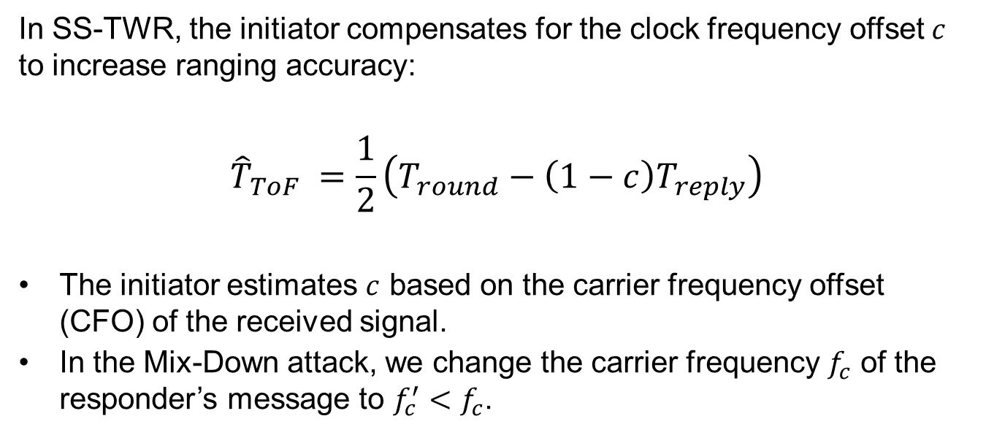

MD: Introduction
        doc.: 15-23-0274-00-04ab
In SS-TWR, the initiator compensates for the clock frequency offset $c$ to increase ranging accuracy:
$${\hat{T}}_{ToF} =\frac{1}{2}\left(T_{round}−\left(1−c\right)T_{reply}\right)$$
The initiator estimates $c$ based on the carrier frequency offset (CFO) of the received signal.
In the Mix-Down attack, we change the carrier frequency $f_{c}$ of the responder’s message to $f_{c}^{′}<f_{c}$.
RESP
INIT
$$f_{c}$$
$$f_{c}^{′}$$

Slide 6
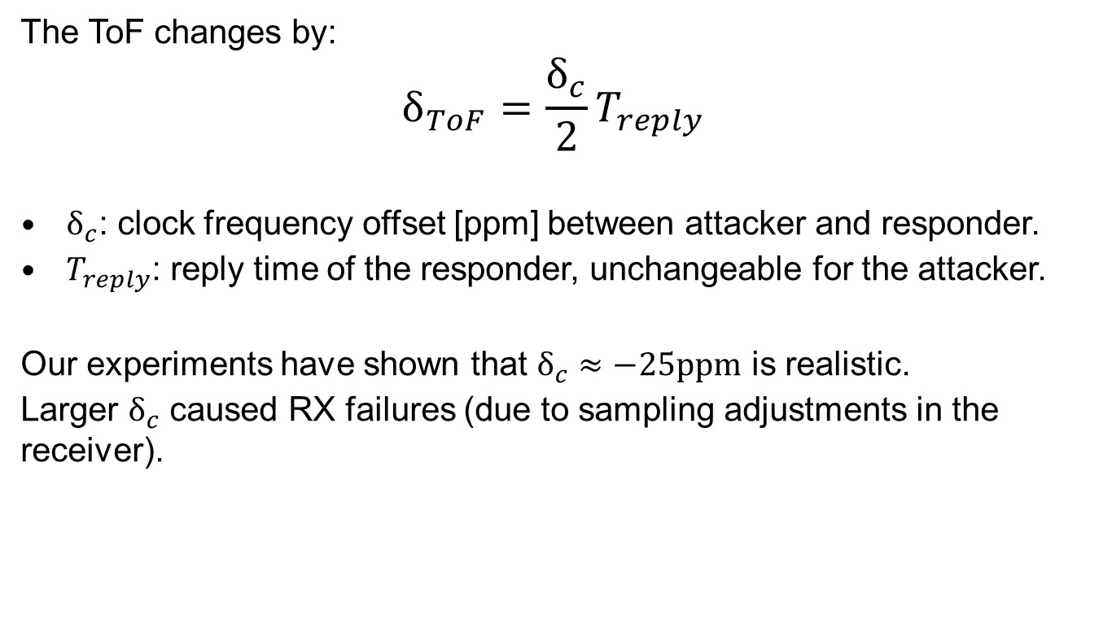
MD: Distance reduction
        doc.: 15-23-0274-00-04ab
The ToF changes by:
$$δ_{ToF}=\frac{δ_{c}}{2}T_{reply}$$
$δ_{c}$: clock frequency offset [ppm] between attacker and responder.
$T_{reply}$: reply time of the responder, unchangeable for the attacker.
Our experiments have shown that $δ_{c}≈−25ppm$ is realistic.
Larger $δ_{c}$ caused RX failures (due to sampling adjustments in the receiver).

Slide 7
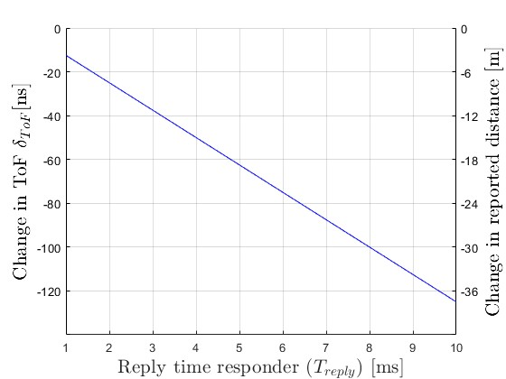

MD: Example for $δ_{c}=−25ppm$
        doc.: 15-23-0274-00-04ab

Slide 8
The Stretch-and-Advance (S&A) Attack against NBA-MMS-UWB (4ab)
        doc.: 15-23-0274-00-04ab

Slide 9

S&A: Starting Point
        doc.: 15-23-0274-00-04ab
RSFs: estimate ToA of ranging message
RIFs: for ranging integrity
NB: used to transmit data and estimate clock frequency offset
RMARKER
TX
NB
RSF
RIF
RX
NB
RSF
RIF
ToF
$$t$$

Slide 10

S&A: Attack
        doc.: 15-23-0274-00-04ab
RMARKER
TX
NB
RSF
RIF
Attacker
NB
RSF
RIF
1
2
3
RX
NB
NB
RSF
RSF
RIF
RIF
ToF
1
reduce carrier frequency (MD)
2
stretch and advance RSFs
3
stretch and replay RIFs

Slide 11

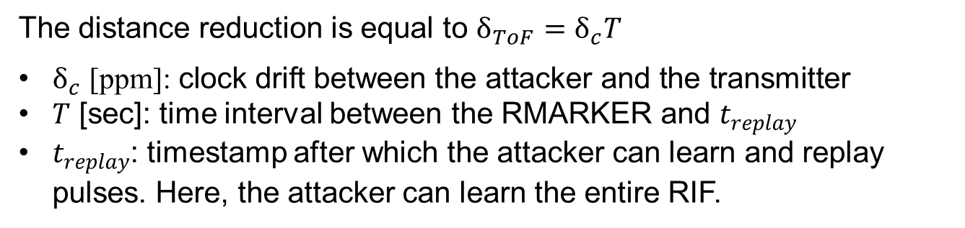


S&A: Distance reduction
        doc.: 15-23-0274-00-04ab
RMARKER
$$t_{replay}$$
$$T$$
Received by the attacker:
...
RSF
RIF
Transmitted by the attacker:
...
RSF
RIF
$$δ_{ToF}$$
The distance reduction is equal to $δ_{ToF}=δ_{c}T$
$δ_{c}\text{ [}\text{ppm}\text{]: }\text{clock} \text{drift} \text{between} \text{the} \text{attacker} \text{and} \text{the} \text{transmitter}$
$T$ [sec]: time interval between the RMARKER and $t_{replay}$
$t_{replay}$: timestamp after which the attacker can learn and replay pulses. Here, the attacker can learn the entire RIF.

Slide 12

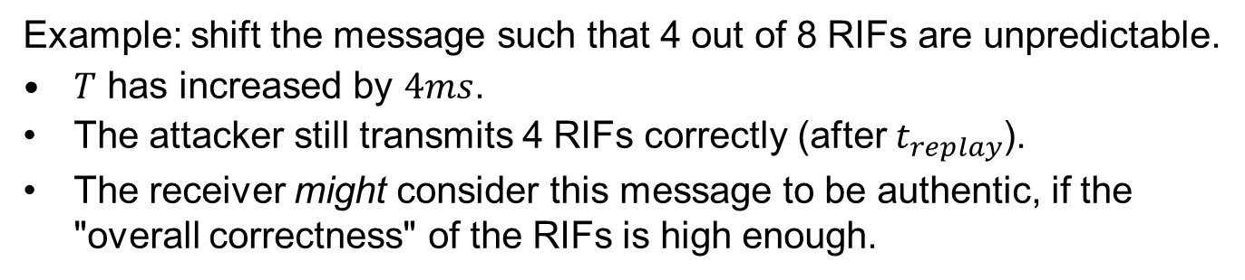

S&A: Exploiting RIF error tolerance
        doc.: 15-23-0274-00-04ab
RMARKER
$$t_{replay}$$
$$T$$
Received by the attacker:
RSF
RIF
Transmitted by the attacker:
RSF
RIF
unknown pulses
Example: shift the message such that 4 out of 8 RIFs are unpredictable.
$T$ has increased by $4ms$.
The attacker still transmits 4 RIFs correctly (after $t_{replay}$).
The receiver might consider this message to be authentic, if the "overall correctness" of the RIFs is high enough.

Slide 13

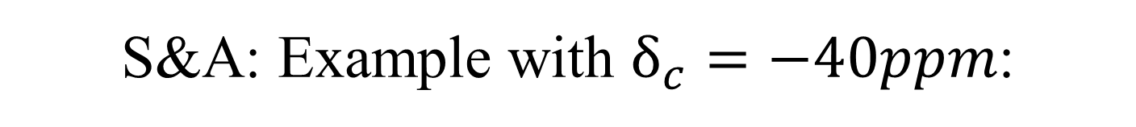
S&A: Example with $δ_{c}=−40ppm$:
        doc.: 15-23-0274-00-04ab
Deterministic reductions (without exploiting RIF error tolerance):
1 RSF: $δ_{ToF}=1ms ∙\left(−40ppm\right)=−40ns ⇒−12m$
8 RSF: $δ_{ToF}=8ms ∙\left(−40ppm\right)=−320ns ⇒−96m$
If the receiver accepts $x$ corrupt/missing RIF, the possible reduction grows by $δ_{ToF}=−12m∗x$.

Slide 14
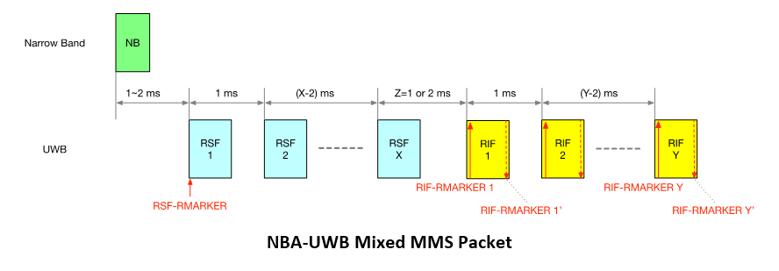
S&A: Countermeasures I
        doc.: 15-23-0274-00-04ab
Status Quo: The draft envisions two additional RMARKERS per RIF.
These RMARKERS may help against S&A if used correctly:
If the ToA is defined by the average of RIF-RMARKER 1 and RIF-RMARKER Y’, then the countermeasure mitigates the attack.
If the ToA equals to the timestamp of the RSF-RMARKER, then the additional RIF-RMARKERs do not mitigate the attack.
→ Currently, the draft lacks both motivation and recommendation.

Slide 15
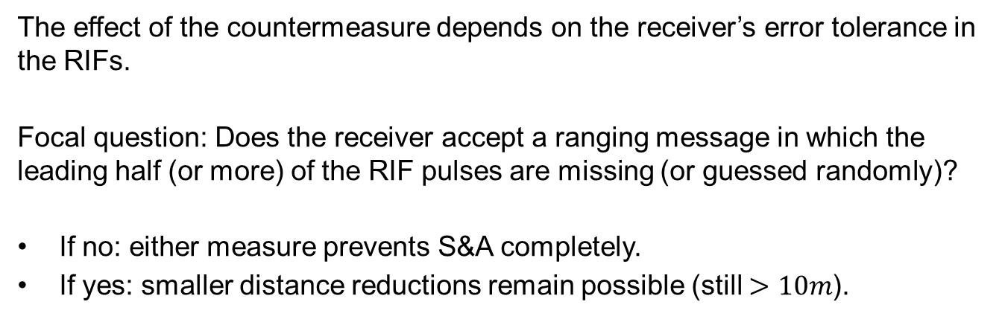
S&A: Countermeasures II
        doc.: 15-23-0274-00-04ab
The effect of the countermeasure depends on the receiver’s error tolerance in the RIFs.
Focal question: Does the receiver accept a ranging message in which the leading half (or more) of the RIF pulses are missing (or guessed randomly)?
If no: either measure prevents S&A completely.
If yes: smaller distance reductions remain possible (still $>10m$).

Slide 16
Take-Aways
        doc.: 15-23-0274-00-04ab
Mix-Down attack:
Only affects SS-TWR
Easy to execute, demonstrated on 4z-compliant devices.
SS-TWR (with real-time clock drift compensation) is not suited for secure ranging. This should be pointed out in the standard.
Stretch-and-Advance:
Irrelevant for mandatory 4z configurations
But: impact on NBA-MMS-UWB in 4ab (potential reductions >96m)
SS-TWR and DS-TWR are equally affected.
Standard should motivate and recommend a countermeasure.
Generally speaking, the standard should provide guidance and recommendations to prevent known security issues.

Slide 17
APPENDIX
        doc.: 15-23-0274-00-04ab

Slide 18


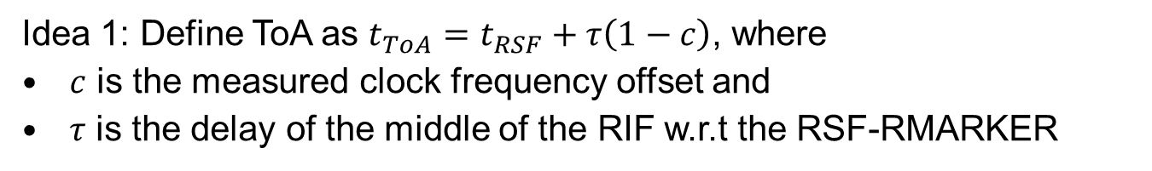



S&A: Countermeasures II
        doc.: 15-23-0274-00-04ab
Idea 1: Define ToA as $t_{ToA}=t_{RSF}+τ\left(1−c\right)$, where
$c$ is the measured clock frequency offset and
$τ$ is the delay of the middle of the RIF w.r.t the RSF-RMARKER
$$t_{RSF}$$
$$t_{ToA}$$
no change
$$τ\left(1−c\right)$$
no attack ($c=0ppm$):
RSF
RIF
attack ($c<0ppm$):
RSF
RIF
unknown pulses

