Slide 1
Project: IEEE P802.15 Working Group for Wireless Personal Area Networks (WPANs)
Submission Title: Simulation Update about CSMA Gap between IEEE 802.15.4 and Japanese Utility Standard JJ.300
Date Submitted: 10th March 2023
Source: Takenori Sumi, Philip Orlik, Jianlin Guo, Yukimasa Nagai, Kieran Parsons, Perry Wang, Benjiman Rolfe (Mitsubishi Electric)
E-Mail: Sumi.Takenori@dc.MitsubishiElectric.co.jp
Abstract: Based on comments received for document 15-23-0167-00 presented in March Meeting, this document provides SUN OFDM PHY (MCS 4 and 5) simulation results in addition to 2-FSK to evaluate higher PHY rates.
Purpose: Discuss issues unique to Japanese Sub-1 GHz frequency regulations and existing metering systems.
Notice: This document has been prepared to assist the IEEE P802.15. It is offered as a basis for discussion and is not binding on the contributing individual(s) or organization(s). The material in this document is subject to change in form and content after further study. The contributor(s) reserve(s) the right to add, amend or withdraw material contained herein.
Release: The contributor acknowledges and accepts that this contribution becomes the property of IEEE and may be made publicly available by P802.15.

Slide 2
Summary
This document aims to discuss issues unique to Japanese Sub-1 GHz frequency regulations and existing metering systems and to discuss the concerns about the ability of existing IEEE Std 802.15.4 to support the expected metering application needs in Japan’s Sub-1 GHz frequency bands and congested situation.
This document provides responses to the comments received for document 15-23-0167-00 presented in May Meeting. It analysed the CSMA gap between IEEE 802.15.4 and Japanese Standard JJ-300.10 from two aspects: protocol and performance.
This document provides SUN OFDM PHY (MCS 4 and 5) simulation results in addition to 2-FSK to evaluate higher PHY rates.
The results shows that suspendable CSMA/CA used in JJ-300.10 can improve packet delivery rate up to 9.5% under congested and higher offered load situations.

Slide 3
[1]
Background of Japanese Utility Systems
Japanese utility systems operate in Sub-1 GHz frequency band
  More specifically in 920 MHz band with limited frequency bandwidth
Japanese electric utilities are now updating their 1st generation smart metering infrastructure
New requirements are coming to light
  Meter reporting duty cycles are expected to decrease from 30 minutes to 5 minutes
    At least a 6x increase in throughput will be needed
  Likely need for multi-metering functionality on single radio
  Over-the-air (OTA) firmware/software capability are needed
This means more data traffic and more channel access
[1] See details at15-23-0167-00

Slide 4
[1]
Issues in Japanese Utility Systems
Japanese utility systems support ECHONET protocols, which are based on a Japanese Communication Standard JJ-300.10
In Japan, Sub-1 GHz spectrum is scarce
  At most 2.9 MHz* is optimized for metering applications using CSMA
  leads to congestion and interference issues as more devices with different protocols exists in narrower bandwidth
  See IEEE802.19.3 for issues arising from limited spectrum availability and protocol differences among 802.15.4g and 802.11ah
For IEEE Std 802.15.4 to better support utility applications in Japan, more enhancements are needed
  Consider improved support for JJ-300.10
  Consider coexistence with more aggressive protocols such as IEEE Std 802.11
In addition, IEEE Std 802.15.4 also needs to take advantage of devices without power constraints, e.g., grid powered smart meters
* See pg. 113: 920MHz-BAND TELEMETER, TELECONTROL AND DATA TRANSMISSION RADIO EQUIPMENT ARIB STANDARD
[1] See details at15-23-0167-00

Slide 5
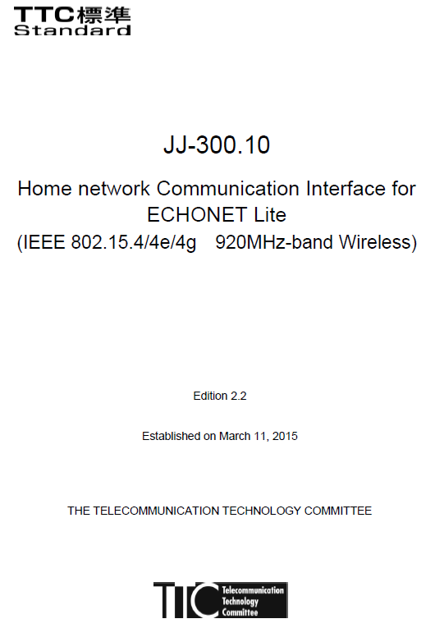
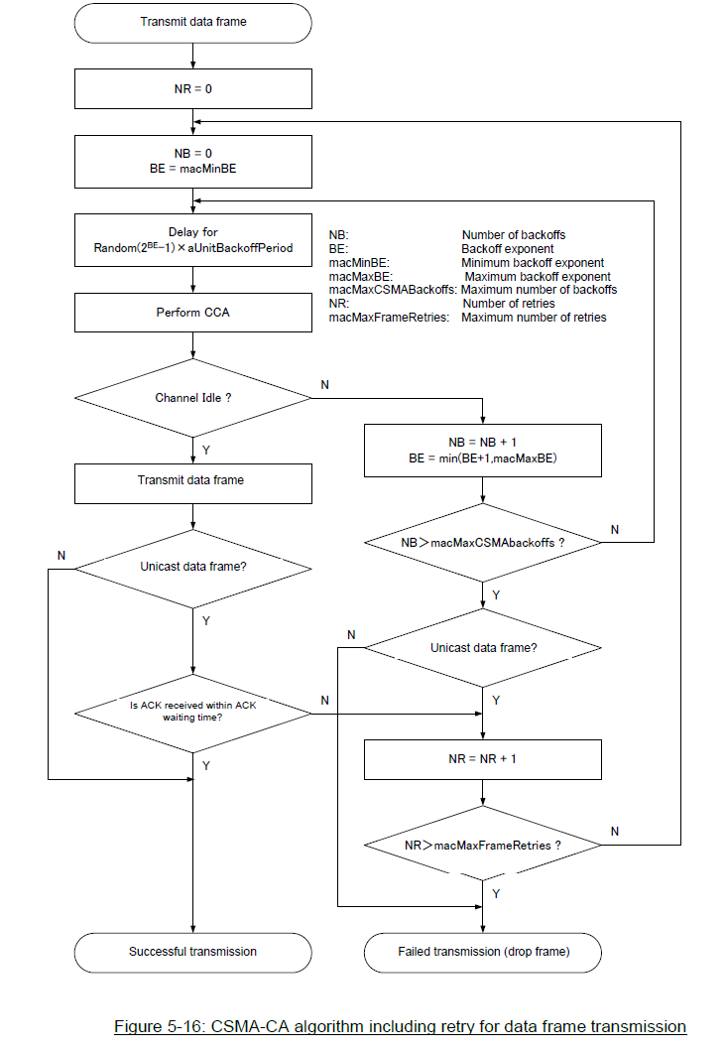
CSMA/CA in JJ-300.10
[1]
Incorporate Number of Retries (NR)
Key differences reside inside of this box
Distinguishes unicast and multicast
[1] See details at15-23-0167-00

Slide 6
CSMA Differences Between JJ-300.10 and 802.15.4
[1]
802.15.4-2011
JJ-300.10 CSMA/CA differences
  Consider non-slotted scenario
  Consider data frame
  Incorporate number of retries (NR)
  Distinguish unicast and multicast
  Outcome of 802.15.4 CSMA is backoff success/failure and outcome of JJ-300.10 CSMA is transmission success/failure
  Wait for LIFS time before backoff starts
  Backoff suspension
Differences 1-2 make JJ-300.10 a special case of 802.15.4
Differences 3-5 provide more details
However, differences 6-7 make JJ-300.10 channel access different from 802.15.4
[1] See details at15-23-0167-00

Slide 7
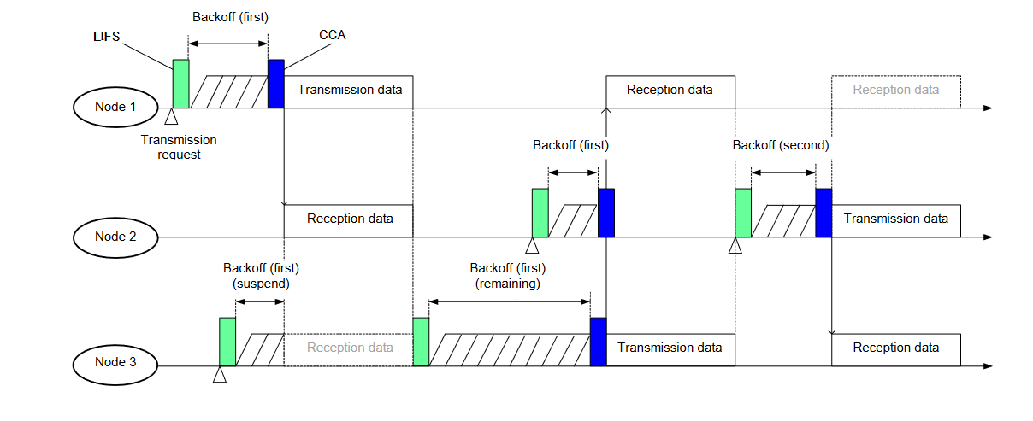
JJ-300.10 Backoff Operation
[1]
Backoff operation specified in Figure 5-17 of JJ-300.10
Expected impact of LIFS wait
  Increase latency due to the delayed backoff start
Expected impact of backoff suspension
  Improve packet delivery reliability due to less frame drop caused by backoff failure
  Increase latency due to longer backoff time
  Reduce number of backoffs
    JJ-300.10 performs re-backoff only if busy channel starts in CCA period
    802.15.4 performs re-backoff if channel is busy in CCA period
Wait
Backoff suspension of Node 3
[1] See details at15-23-0167-00

Slide 8
Simulation Parameters
Parameter | Value | Note
Nodes | 20, 50, 100
Offered load(Network)[kbps] | 10 – 100
Packet size[Byte] | 100 | MAC payload
PHY parameters | MAC parameters (JJ 300.10 v2.2, Table 5-28, 5-29) | MAC parameters (JJ 300.10 v2.2, Table 5-28, 5-29)
Frequency[MHz] | 920
Modulation | 2-FSK OFDM Option3 MCS4 OFDM Option3 MCS5 | 100kbps 300kbps 400kbps
Channel spacing[kHz] | 400
MAC parameters (JJ-300.10 v2.2, Table 5-28, 5-29)
LIFS[us] | 1000 | for JJ-300.10
phyCCADuration[us] | 130
aTurnaroundTime[us] | 1000
aUnitBackoffPeriod[us] | 1130
Rx-to-Tx Turnaround time[us] | 300 | 300 us or more, 1000 us or less
Tx-to-Rx Turnaround time[us] | 300 | Less than 300 us
macMaxBE | 8
macMinBE | 8
macMaxCsmaBackoffs | 4
macMaxFrameRetries | 3

Slide 9
Node Deployment of 20 Nodes
[1]
PANC is placed at the center of a 100 m circle.
Each node is placed using the sunflower algorithm.
Each node sends packets to PANC.
[1] See details at15-23-0167-00

Slide 10
Packet Delivery Rate Curve and Latency Curve for 20 Nodes
Packet Delivery Rate:
・Packet delivery rate of 2-FSK improved from 94.2% to 98.8% when offered load is 50kbps by applying JJ-300.10.
・For OFDM MCS4 and MCS5, packet delivery rates of IEEE 802.15.4 CSMA/CA and JJ-300.10 are almost same.
Latency:
・For 2-FSK, latency increased by about 30 ms.
・For OFDM MCS4, latency increased by about 10 ms.
・For OFDM MCS5, latency increased by about 5 ms.

Slide 11
Packet Delivery Rate Curve and Latency Curve for 50 Nodes
Packet Delivery Rate:
・Packet delivery rate of 2-FSK Packet delivery rate improved from 89.9% to 98.1% when offered load is 50kbps by applying JJ-300.10
・Packet delivery rate of OFDM MCS4 improved from 94.3% to 99.5% when offered load is 70 kbps.
・Packet delivery rate of OFDM MCS5 improved from 94.7% to 99.6% when offered load is 80 kbps.
Latency:
・For 2-FSK, latency increased about twofold when offered load is 50 kbps
・For OFDM MCS4, latency increased by about 120 ms when offered load is 70 kbps.
・For OFDM MCS5, latency increased by about 80 ms when offered load is 80 kbps.

Slide 12
Packet Delivery Rate Curve and Latency Curve for 100 Nodes
Packet Delivery Rate:
・Packet delivery rate of 2-FSK Packet delivery rate improved from 89.9% to 99.6% when offered load is 50kbps by applying JJ-300.10
・Packet delivery rate of OFDM MCS4 improved from 90.0% to 99.1% when offered load is 80 kbps.
・Packet delivery rate of OFDM MCS5 improved from 89.8% to 99.1% when offered load is 90 kbps.
Latency:
・For 2-FSK, latency increased about twofold when offered load is 50 kbps
・For OFDM MCS4, latency increased about twofold when offered load is 80 kbps
・For OFDM MCS5, latency increased about twofold when offered load is 90 kbps

Slide 13
Simulation Results Summary
Packet delivery rate
  For light traffic load or small network size (number of nodes), JJ-300.10 and 802.15.4g have similar performance
  For heavier traffic load and larger network size is, JJ-300.10 outperforms 802.15.4g up to 9.5%.
Packet latency
  JJ-300.10 incurs longer latency, due to the backoff suspension, but this has the significant benefit of much improved packet delivery rate.
  When network size (number of nodes) is smaller, the latency difference is smaller. However, for larger network size, JJ-300.10 increases latency twofold.

Slide 14
Summary
This document aims to discuss issues unique to Japanese Sub-1 GHz frequency regulations and existing metering systems and to discuss the concerns about the ability of existing IEEE Std 802.15.4 to support the expected metering application needs in Japan’s Sub-1 GHz frequency bands and congested situation.
This document provides responses to the comments received for document 15-23-0167-00 presented in May Meeting. It analyzed the CSMA gap between IEEE 802.15.4 and Japanese Standard JJ-300.10 from two aspects: protocol and performance.
This document provides SUN OFDM PHY (MCS 4 and 5) simulation results in addition to 2-FSK to evaluate higher PHY rates.
The results shows that suspendable CSMA/CA used in JJ-300.10 can improve packet delivery rate up to 9.5% under congested and higher offered load situations.
We propose suspendable CSMA/CA to put on the 802.15.4 revision.

