Slide 1
doc.: 15-23-0264-00-04ab
Project: IEEE P802.15 Working Group for Wireless Personal Area Networks (WPANs)
Submission Title: Some thoughts on 4ab capabilities
Date Submitted: May 15, 2023
Source: Carlos Aldana (Meta), Kangjin Yoon (Meta), Chunyu Hu (Meta), Claudio da Silva (Meta), Guoqing Li (Meta)
Address: [1 Hacker Way, Menlo Park, CA 94025]
E-Mails: [caldana (at) meta.com, kyoon (at) meta.com, chunyuhu (at) meta.com, claudiodasilva (at) meta.com, guoqingli (at) meta.com]
Abstract: Initial thoughts on defining the 4ab capabilities
Purpose: To start discussion on the subject
Notice: This document has been prepared to assist the IEEE P802.15. It is offered as a basis for discussion and is not binding on the contributing individual(s) or organization(s). The material in this document is subject to change in form and content after further study. The contributor(s) reserve(s) the right to add, amend or withdraw material contained herein.
Release: The contributor acknowledges and accepts that this contribution becomes the property of IEEE and may be made publicly available by P802.15.

Slide 2
PAR Objective | Proposed Solution (how addressed)
Safeguards so that the high throughput data use cases will not cause significant disruption to low duty-cycle ranging use cases | Defines device categories
Interference mitigation techniques to support higher density and higher traffic use cases | Defines device capabilities
Other coexistence improvement | Defines device capabilities
Backward compatibility with enhanced ranging capable devices (ERDEVs) | Defines device capabilities
Improved link budget and/or reduced air-time | Defines device capabilities
Additional channels and operating frequencies | Defines device capabilities
Improvements to accuracy / precision / reliability and interoperability for high-integrity ranging | Defines device capabilities
Reduced complexity and power consumption | Defines device capabilities
Hybrid operation with narrowband signaling to assist UWB | Defines device capabilities
Enhanced native discovery and connection setup mechanisms | Defines device capabilities
Sensing capabilities to support presence detection and environment mapping | Defines device capabilities
Low-power low-latency streaming | Defines device capabilities
Higher data-rate streaming allowing at least 50 Mbit/s of throughput | Defines device capabilities
Support for peer-to-peer, peer-to-multi-peer, and station-to-infrastructure protocols | Defines device capabilities
Infrastructure synchronization mechanisms | Defines device capabilities

Slide 3
Introduction
In 15-23-177, the concept of device classes was proposed
For data, 2 device types were defined: enhanced data device and advanced data device
Would 2 device types also apply to ranging and sensing?
If so, then we might end up with 6 total classes, which is highly undesirable
Defining device types at this stage may lead to interop issues in the future.
e.g. What happens when a sensing device wants to interact with a ranging device?
e.g. What happens when a device wants to do ranging, sensing, and data or just ranging/sensing, ranging/data, or data/sensing?
There is an alternate way forward
Define mandatory/optional features along with conditional mandatory features that are advertised in a capabilities field

Slide 4
802.15.4ab Feature Set Option 1
Legend
Bold blue : mandatory
Purple : conditional mandatory
Black : optional
Mandatory features
62.4 and 1.95 Mbps with K=7 BCC
Legacy 4z PHR with new Data rates using BCC only
Optional features
LDPC
124.8 Mbps
NOTE : For enhanced ranging, conditional mandatory features are still TBD
Enhanced Ranging | Sensing | Enhanced Data
Length 128 complementary set MMRS | CIR report | Dynamic PHR
NBA | Time-bounded Kaiser pulse shape | SYNC PSR and SFD sequence negotiation with Dynamic PHR
RIF-only MMS | SENS with 1,2,3, or 4 segments
Mixed MMS | Range/velocity for each object
Length 91 and 127 4z ternary codes MMRS | Freq Stitching
RSF-only MMS | AoA
 | Sensing Packet 0,1, and 2

Slide 5
802.15.4ab Feature Set Option 2
Legend
Bold blue : mandatory
Purple : conditional mandatory
Black : optional
Mandatory features
62.4 and 1.95 Mbps with K=7 BCC
Legacy 4z PHR with new Data rates using BCC only
Optional features
LDPC
124.8 Mbps
Dynamic PHR with SYNC PSR and SFD sequence negotiation
Enhanced Ranging | Sensing
Length 128 complementary set MMRS | CIR report
NBA | Time-bounded Kaiser pulse shape
RIF-only MMS | SENS with 1,2,3, or 4 segments
Mixed MMS | Range/velocity for each object
Length 91 and 127 4z ternary codes MMRS | Freq Stitching
RSF-only MMS | AoA
 | Sensing Packet 0,1, and 2
NOTE : For
Enhanced Ranging, conditional mandatory features are still TBD

Slide 6
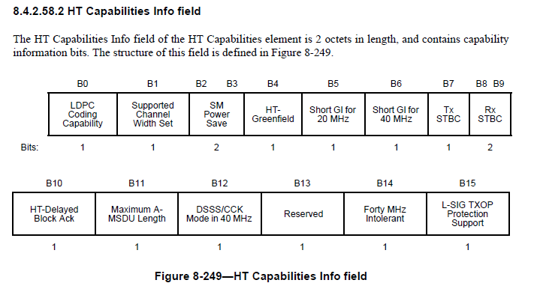
How did IEEE 802.11n do it?
From 802.11-2012 specification

Slide 7
Summary
Defining device classes may lead to interop issues in the future
This presentation suggests ways forward in declaring mandatory/optional features as well as conditional mandatory features
This allows for flexible solutions in the future

