Slide 1
Project: IEEE P802.15 Working Group for Wireless Personal Area Networks (WPANs)
Submission Title: Compressed PSDU for One-to-Many Ranging using NBA-MMS
Date Submitted: May 15, 2023
Source: Jinjing Jiang, Robert Golshan, Alexander Krebs, Xiliang Luo, SK Yong (Apple Inc.)
Address: One Apple Park Way, Cupertino, CA 95104, USA
E-Mail: jinjing@apple.com
Abstract: Basic frame exchange sequences for one-to-many ranging using NBA-MMS.
Purpose: Extend NBA-MMS usage to one-to-many use cases.
Notice: This document has been prepared to assist the IEEE P802.15. It is offered as a basis for discussion and is not binding on the contributing individual(s) or organization(s). The material in this document is subject to change in form and content after further study. The contributor(s) reserve(s) the right to add, amend or withdraw material contained herein.
Release: The contributor acknowledges and accepts that this contribution becomes the property of IEEE and may be made publicly available by P802.15.

Slide 2
PAR Objective | Proposed Solution (how addressed)
Safeguards so that the high throughput data use cases will not cause significant disruption to low duty-cycle ranging use cases
Interference mitigation techniques to support higher density and higher traffic use cases
Other coexistence improvement
Backward compatibility with enhanced ranging capable devices (ERDEVs)
Improved link budget and/or reduced air-time
Additional channels and operating frequencies
Improvements to accuracy / precision / reliability and interoperability for high-integrity ranging
Reduced complexity and power consumption
Hybrid operation with narrowband signaling to assist UWB
Enhanced native discovery and connection setup mechanisms
Sensing capabilities to support presence detection and environment mapping
Low-power low-latency streaming
Higher data-rate streaming allowing at least 50 Mbit/s of throughput
Support for peer-to-peer, peer-to-multi-peer, and station-to-infrastructure protocols | One-to-many ranging utilizing NBA-MMS mode
Infrastructure synchronization mechanisms

Slide 3
Recap of One-To-Many Ranging
Responder 1
Responder 2
Control/Initialization/Poll Message defines the one-to-many session [1]
  Time scheduled or contention-based
  Access slot structure
  Initial NB synchronization

Slide 4
Initial Message for Scheduled Mode
Message Control: XX
  Responder has a report on NB after the ranging fragments exchange in the Access Slot
Message Content Length = 2+3N
Slots Per Responder := slots needed for simple Poll/Response + Report exchange as the one-to-one case
  Except the 1st responder, the n^{th} responders shall start their Access Slot using the following formula if assuming the Initialization Poll starts from Slot 0
  startSlotIndex(n) = (slotsForInitialPoll - 1) + (n-1) * slotsPerResponder, n≧2
The order in Responder Address List implicitly indicates the Access Slot number the Responder shall use.
  E.g. the 1st Responder in the list shall use Access Slot 0

Slide 5
How About Other Variations and Optimizations?

Slide 6
Adaptive Size of Access Slots for Responders
Message Control XY
  Different Responders have different sizes of access slots
  Message Content Length = 1+7N
No matter how long the initialization poll frame is, a responder always knows when its Access Slot starts, because the Start Slot Index is explicitly signaled
The Start Slot Index for the 1st Responder is always the slot index of the Initialization Poll

Slide 7
Contention-based Mode
Message Control: ZZ
  Prand is set to some pre-fixed value
The initialization Poll frame should fit in one 1-ms slot using 250kbps PHY

Slide 8
Utilize Additional Message Controls
Use additional available options of Message Control to define necessary optimizations and variations. For example,
  In scheduled mode, if both Initiator and Responder would like to compute the range, a new message control can be used to indicate that Initiator’s Measurement Report frame and Responder’s Measurement Report frame exchange is following the MMS exchange
  In contention-based mode, the order of NB Response frame and Poll frame is switched

Slide 9
PSDU for Poll/Response/Report Message
A new PSDU ID: the receiver is required to use a slightly different method to resolve the Private Address field
The message contents can be the same as the one-to-one ranging.

Slide 10
Summary
The compressed PSDU design for one-to-many ranging follows the same design of one-to-one ranging
  Use new PSDU IDs to differentiate from one-to-one ranging
  Additional variations or optimizations are indicated by new Message Control values.

Slide 11
Phase | Message | ID | Octets 1-N [Len] | Description
Control | POLL (one-to-many) | 0x10 | [Hash[3], Prand[3], MessageControl[1], MessageContent[], CRC16] | A poll message for one-to-many ranging session. MessageControl=0x00: MessageContent={0x00, 0x00} This is the POLL message for access slots that are not the first one. MessageControl = 0x10: MessageContent={Number of Responders[1], SlotsPerResponder[1], List of Responder Address[3]} MessageControl = 0x20: MessageContent={Number of Responders[1], SlotsPerResponder[1], List of {Responder Address[3], StartSlotIndex[2], EndSlotIndex[2]}} MessageControl = 0x30: Same as Message Control = 0x10, but both Initiator and Responder send the measurement report MessageControl = 0x40: Same as MessageControl = 0x10, but both Initiator and Responder send the measurement report MessageControl = 0x50: MessageContent={NumberOfAccessSlots[1], SizeOfAccessSlots[1]} MessageControl = 0x60: Same as MessageControl = 0x50, but the Response frame and Poll frame in NB is switched MessageControl = others: reserved

Slide 12
Phase | Message | ID | Octets 1-N [Len] | Description
Control | RESPONSE (one-to-many) | 0x11 | [Hash[3], MessageControl[1], MessageContent[], CRC16] | A qualifying response message for one-to-many ranging. MessageControl=0x00: MessageContent={0x00, 0x00, 0x00, 0x00, 0x00} MessageControl=others: reserved
Measurement Report | RPRT (from responder in one-to-many ranging) | 0x12 | [Hash[3], MessageControl[1], MessageContent[], CRC16] | A qualifying report message for one-to-many ranging. MessageControl=0x00: MessageContent={ ReplyTime[5], PTDataLength[1], PTData[PTDataLength]}, where PTDataLength and PTData fields are optionally present and represent pass through data to higher layers.
 | RPRT (from initiator in one-to-many ranging) | 0x13 | [Hash[3], MessageControl[1], MessageContent[], CRC16] | A qualifying report message for one-to-many ranging. MessageControl=0x00: MessageContent={ TurnAroundTime[5], PTDataLength[1], PTData[PTDataLength]}, where PTDataLength and PTData fields are optionally present and represent pass through data to higher layers.

Slide 13
References
[1] 15-22-0585-01-04ab-one-to-many-ranging-using-nba-mms.pptx
[2] 15-23-0258-00-04ab-details-on-compressed-psdu-for-nba-uwb-mms.pptx

Slide 14
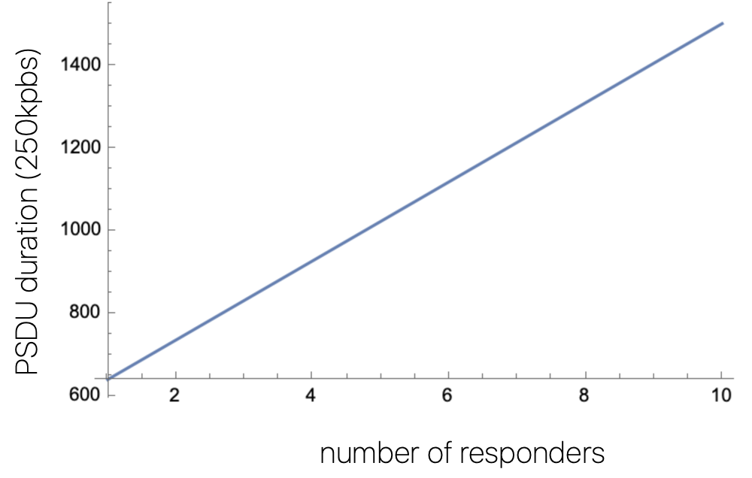
Appendix: PSDU Duration

