Slide 1
Project: IEEE P802.15 Working Group for Wireless Personal Area Networks (WPANs)
Submission Title: [CIR bitmap pattern discussion]
Date Submitted: [May, 2023]
Source: [Chenchen Liu, Bin Qian, Lei Huang, David Xun Yang] Company [Huawei Technologies]
Address [Huawei Bantian Base, Longgang District, Shenzhen, 518129 China]
E-Mail:[liuchenchen1@Huawei.com]
Re: [Task Group 4ab: UWB Next Generation]
Abstract: [The CIR bitmap patterns and corresponding signaling method will be discussed to save the CIR feedback overhead ]
Purpose: [ ]
Notice: This document has been prepared to assist the IEEE P802.15. It is offered as a basis for discussion and is not binding on the contributing individual(s) or organization(s). The material in this document is subject to change in form and content after further study. The contributor(s) reserve(s) the right to add, amend or withdraw material contained herein.
Release: The contributor acknowledges and accepts that this contribution becomes the property of IEEE and may be made publicly available by P802.15.

Slide 2





Background
According to the Latest Consensus on UWB Sensing for 802.15.4ab document [1], a limited set of reasonable bitmap options will be defined in the standard
The allowed configs are one or two continuous strings of 1s within the bitmap length
Based those consensus, some CIR bitmap patterns and corresponding signaling method are proposed
Reference Point: Earliest detected tap
Noise Threshold
$$t_{0}$$
$$t_{0}+W_{offset}$$
$t_{0}+W_{offset}$+ $W_{length}$
$${BM}_{offset}$$
$${BM}_{length}$$
Sensing window parameters defined relative to the earliest detected tap

Slide 3
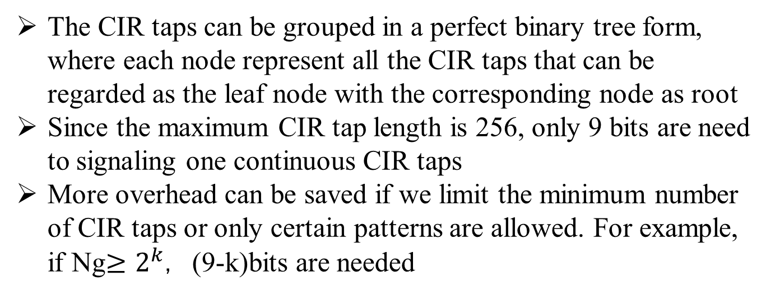
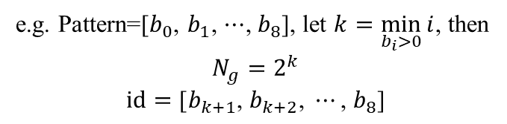
CIR bitmap pattern: Option1
The CIR taps can be grouped in a perfect binary tree form, where each node represent all the CIR taps that can be regarded as the leaf node with the corresponding node as root
Since the maximum CIR tap length is 256, only 9 bits are need to signaling one continuous CIR taps
More overhead can be saved if we limit the minimum number of CIR taps or only certain patterns are allowed. For example, if Ng$≥2^{k}$，(9-k)bits are needed
e.g. Pattern=[$b_{0}$, $b_{1}$, $⋯$, $b_{8}$], let $k=\min_{b_{i}>0}{i}$, then
$$N_{g}=2^{k}$$
$$id=\text{[}b_{k+1}\text{, }b_{k+2}\text{, }⋯\text{, }b_{8}\text{]}$$

Slide 4
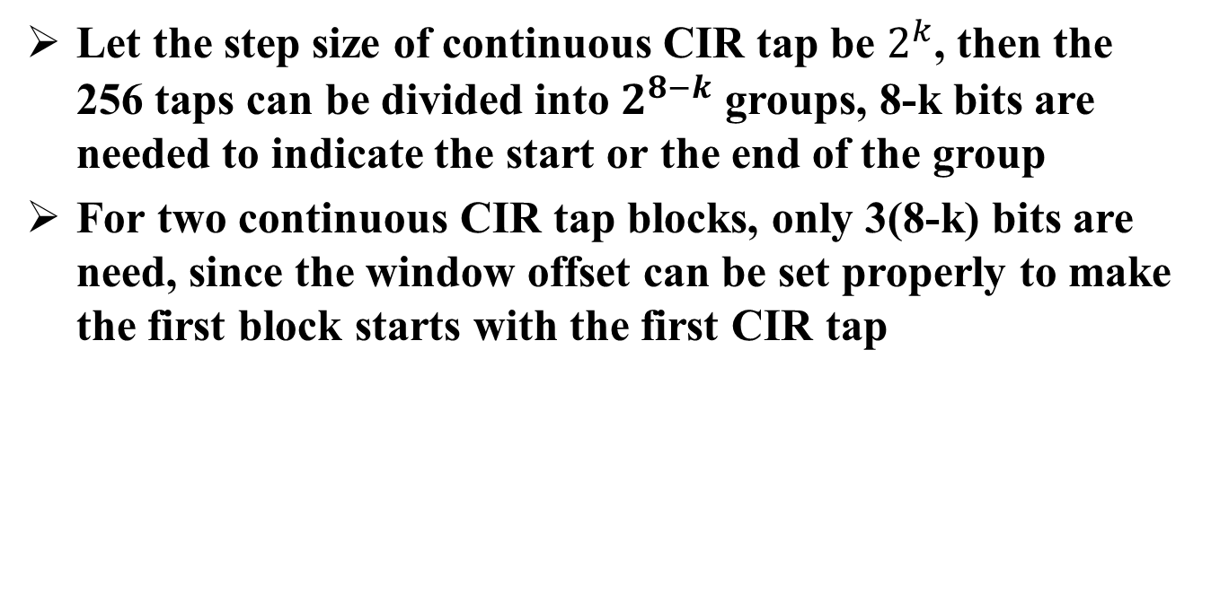
CIR bitmap pattern: Option2
Let the step size of continuous CIR tap be $2^{k}$, then the 256 taps can be divided into $2^{8−k}$ groups, 8-k bits are needed to indicate the start or the end of the group
For two continuous CIR tap blocks, only 3(8-k) bits are need, since the window offset can be set properly to make the first block starts with the first CIR tap

Slide 5
CIR bitmap pattern: Option3
The CIR bitmap patterns can be further simplified by selecting limited patterns from Option 1 and Option 2, e.g.
CIR Bitmap Pattern | Start tap1 | End tap1 | Start tap2 | End tap2
0 | 1 | 256 | n | n
1 | 1 | 128 | n | n
2 | 1 | 64 | n | n
3 | 1 | 32 | n | n
4 | 1 | 16 | n | n
5 | 1 | 8 | n | n
6 | 1 | 4 | n | n
7 | 1 | 32 | 65 | 96
8 | 1 | 32 | 97 | 128
9 | 1 | 32 | 129 | 160
10 | 1 | 32 | 161 | 192
11 | 1 | 32 | 193 | 224
12 | 1 | 32 | 225 | 256
13 | 1 | 64 | 129 | 192
14 | 1 | 64 | 193 | 256
15 | 1 | 64 | 129 | 252
…

Slide 6
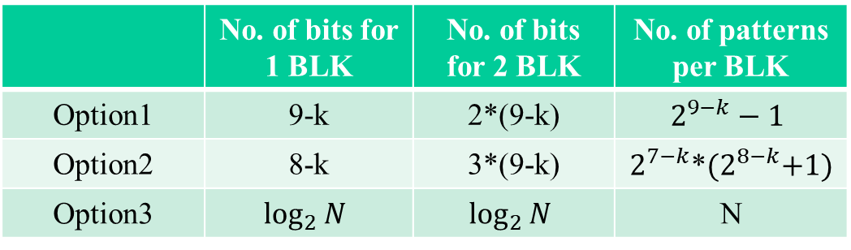
Comparison
Let the minimum feedback CIR tap block length be $2^{k}$
 | No. of bits for 1 BLK | No. of bits for 2 BLK | No. of patterns per BLK
Option1 | 9-k | 2*(9-k) | $$2^{9−k}−1$$
Option2 | 8-k | 3*(9-k) | $2^{7−k}$*${(2}^{8−k}+1)$
Option3 | $$\log_{2}{N}$$ | $$\log_{2}{N}$$ | N
Note—N denotes the number of patterns defined for option3，which is TBD

Slide 7
Summary
Three CIR bitmap pattern options are proposed in the contribution
Consider all the tradeoff between complexity and flexibility, we think Option1 is better

Slide 8
References
[1] 15-23-0079-01-04ab-latest-consensus-on-uwb-sensing-for-802-15-4ab
[2] 15-23-0120-00-04ab-cir-report-size
[3] P802.15.4z, Draft Standard for Low-Rate Wireless Networks

