Slide 1
Project: IEEE P802.15 Working Group for Wireless Personal Area Networks (WPANs)
Submission Title: [Public advertisement for NBA-MMS-UWB native discovery]
Date Submitted: [May, 2023]
Source: [Hongwon Lee, Insun Jang, Jinsoo Choi, Hangyu Cho(LG Electronics)]
Email: hongwon.lee@ lge.com
Re: []
Abstract: [Public advertisement for NBA-MMS-UWB native discovery to support various use cases]
Purpose: []
Notice: This document has been prepared to assist the IEEE P802.15. It is offered as a basis for discussion and is not binding on the contributing individual(s) or organization(s). The material in this document is subject to change in form and content after further study. The contributor(s) reserve(s) the right to add, amend or withdraw material contained herein.
Release: The contributor acknowledges and accepts that this contribution becomes the property of IEEE and may be made publicly available by P802.15.

Slide 2
PAR Objective | Proposed Solution (how addressed)
Safeguards so that the high throughput data use cases will not cause significant disruption to low duty-cycle ranging use cases
Interference mitigation techniques to support higher density and higher traffic use cases
Other coexistence improvement
Backward compatibility with enhanced ranging capable devices (ERDEVs)
Improved link budget and/or reduced air-time
Additional channels and operating frequencies
Improvements to accuracy / precision / reliability and interoperability for high-integrity ranging
Reduced complexity and power consumption
Hybrid operation with narrowband signaling to assist UWB
Enhanced native discovery and connection setup mechanisms | Public advertisement for NBA-MMS-UWB native discovery to support various use cases
Sensing capabilities to support presence detection and environment mapping
Low-power low-latency streaming
Higher data-rate streaming allowing at least 50 Mbit/s of throughput
Support for peer-to-peer, peer-to-multi-peer, and station-to-infrastructure protocols
Infrastructure synchronization mechanisms

Slide 3
Related Contributions
[1] NBA-MMS-UWB Native Discovery Concept
  A. Krebs (Apple) et al., Jan. 2023
  [2] NBA-MMS-UWB ranging text proposal for 15.4ab TFD
  A. Krebs (Apple) et al., Nov. 2022
  [3] NBA-MMS-UWB compressed psdu details
  A. Krebs (Apple) et al., May. 2023

Slide 4
Background
  According to NBA-MMS-UWB compressed psdu details[3], it is mentioned that ADV-POLL is used only for private advertisement
  This is good method to protect device fingerprint like information owned by a person
  However, some public infrastructure use cases such as mobile payment, social distancing, and so on cannot be covered by using this private advertisement
  We believe public(non-private) advertisement method is optionally necessary for various use cases
  If we see FiRa which is UWB application standard, “Bluetooth Low Energy OOB Channel Technical Specification” to support initialization and session setup is defined and this standard supports public advertisement method to cover use cases that are popularized [4]

Slide 5


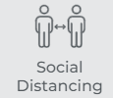
Native Discovery Use cases – public advertisement
  There are several use cases using public(non-private) advertisement for public infrastructure such as mobile payment, social distancing, transportation payment and so on

Slide 6
Recap: Native Discovery Concept [1][2]
In [1], Native Discovery Concept is introduced
To start an NBA-MMS-UWB ranging session, a pair of initiator and responder devices may engage in a initialization and setup phase [2]
    To negotiate a ranging configuration different from the default set of parameters
To establish in-band initialization, ERDEVs shall opportunistically transmit and receive on the dedicated initialization channel and PHY modulation [2]
    ADV-POLL shall be opportunistically broadcasted at initialization channel for ranging session setup

Slide 7
Proposal
  Public(non-private) advertisement method is consisted of:
    New Compressed PSDU message ID: ADV-POLL2, ADV-RESP2, SOR2
    Packet format for ADV-POLL2 , ADV-RESP2, SOR2
    Address type to choose public address or random address
    Random delay to avoid collision if there are lots of devices which try to establish session setup with an advertiser
  Secured contents would be excluded in the ADV-POLL2

Slide 8
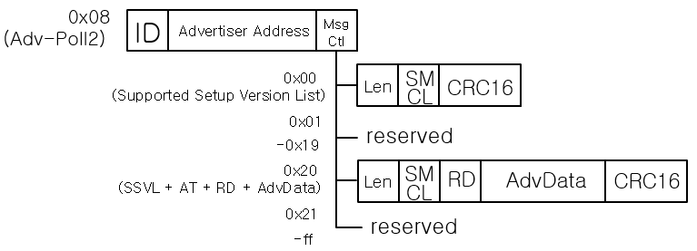
Proposed advertisement packet format – ADV-POLL2
    PSDU 9-24 octets (for now)
    1-octet message ID (0x08) → ADV-POLL2
    3-octet Advertiser Address. This may be random address and Advertiser Address can be changed periodically(e.g. every 5 min.). Advertiser Address shall be generated uniquely in a RAN and maintained during a session temporarily by an initiator
    1-octed message control, setting the following message content
    0x00: MessageContent = Len[SupportedMessageControlList] and SupportedMessageControlList =[0x00]
    0x20: MessageContent = Len[SupportedMessageControlList] and SupportedMessageControlList=[0x00] + RandomDelay[1] + AdvData[0-14]
    Random Delay: To determine when ADV-RESP2 is transmitted by a responder. The unit of Random Delay value is RSTU and Random value in range from zero to {Random Delay value - 1} can be created. This field is used to avoid collision in crowded environment
    AdvData is not defined yet. The candidate contents may be information which an initiator wants to announce such as service representation, friendly name, advertising interval, vendor specific and so on
    2-octet CRC16

Slide 9
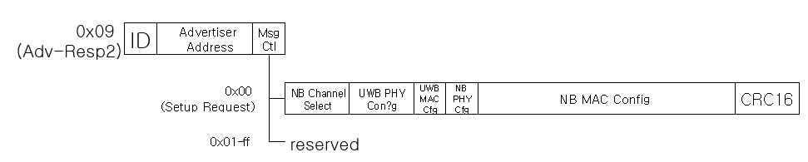
Proposed advertisement packet format – ADV-RESP2
PSDU (22 octets)
  1-octet message ID (0x09) → ADV-RESP2
  3-octet Advertiser Address known from ADV-POLL2
  1-octed message control, setting the following message content
    0x01 (Setup Request): MessageContent = [NBChannelSelect[2] + UWBPhyCfg[2] + UWBMACfg[2] + NBPHYCfg[1] + NBMACCfg[8]
  2-octet CRC16

Slide 10
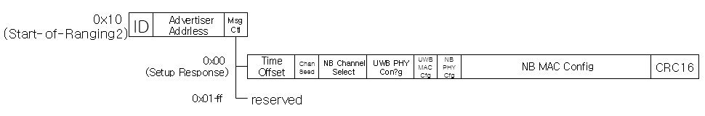
Proposed advertisement packet format – SOR2
PSDU (24 octets)
  1-octet message ID (0x10)
  3-octet Advertiser Address received from ADV-RESP2
  1-octed message control, setting the following message content
    0x01 (Setup): same fields as ADV-RESP, but prepended by TimeOffset[2] and ChannelSeed[1]
    TimeOffset is 0-65535us from end of SOR to beginning of first ranging block (POLL)
    ChannelSeed initializes channel switching function
  2-octet CRC16

Slide 11
Summary
  In NBA-MMS-UWB native discovery, we think both private and public(non-private) advertisement methods are needed to support
  Private advertisement is good method to protect device fingerprint like information owned by a person
  For public use case like mobile payment, public(non-private) advertisement method shall be supported as well because everybody wants to know information in the below:
  To discover device which supports proper service intended by an initiator
  To discover device which intents to join a service which is announced
  In this proposal, public(non-private) advertisement option which are ADV-POLL2, ADV-RESP2 and SOR2 including random address and random delay to avoid collision in crowded environment is proposed

Slide 12
References
[1] A. Kreb et al., “NBA-MMS-UWB Native Discovery Concept”, 15-23-0033-02-04ab.
[2] A. Kreb et al., “NBA-MMS-UWB ranging text proposal for 15.4ab TFD”, 15-22-0381-02-04ab.
[3] A.Kreb et al., “NBA-MMS-UWB compressed psdu details”, 15-23-0xxx-0x-04ab.
[4] FiRa Consortium Bluetooth Low Energy OOB Channel Technical Specification v1.0.0.docx, https://groups.firaconsortium.org/wg/Technical/document/2424.
[5] Bluetooth Core Specification 5.4, Vol 6, Part B, https://www.bluetooth.com/specifications/specs/core-specification-5-4/.

Slide 13
Appendix: Advertising Poll (MsgCtl=0x00) [3]
PSDU content
  1-octet message ID (0x01: ”ADV-POLL”)
  3-octet private address + 3-byte private salt
  1-octed message control, setting the following message content
    0x00: MessageContent = Len[SupportedMessageControlList] and SupportedMessageControlList=[0x00]
  2-octet CRC16

Slide 14
Appendix: Advertising Response (MsgCtl=0x00) [3]
PSDU content
  1-octet message ID (0x02: “ADV-RESP”)
  3-octet private address (PrivateSalt known from ADV-POLL)
  1-octed message control, setting the following message content
    0x00 (Setup Request): Responder requests set of MMS ranging parameters
  2-octet CRC16

Slide 15
Appendix: Start of Ranging (MsgCtl=0x00) [3]
PSDU content
  1-octet message ID (0x03: “SOR”)
  3-octet private address (PrivateSalt known from ADV-POLL)
  1-octed message control, setting the following message content
    0x00 (Setup Response): Initiator sets full set of MMS configuration parameters (same fields as ADV-RESP)
    Time Offset from end of SOR to beginning of first ranging block
    Channel Seed initializes channel switching function
  2-octet CRC16
Same fields as in ADV-RESP

Slide 16
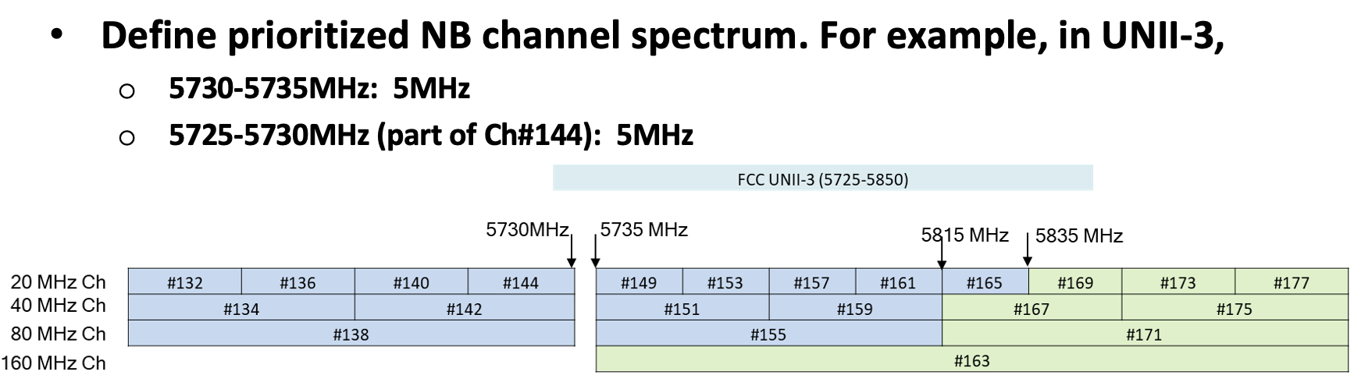
Appendix: Discovery Channels for NB [1]
Both native discovery and channel usage coordination use discovery channel for NB
2 possible NB channels in UNII-3 non-overlapping with 802.11
    Good candidate as default channel for discovery

Slide 17
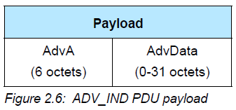
Appendix; FiRa BLE OOB technical spec. summary
  In BLE OOB Channel Technical Specification by FiRa, advertisement physical channel PDU type “ADV_IND” is used [4]
  ADV_IND packet format is described in the below [5]
    AdvA field shall contains the advertiser’s public address or random address
    AdvData field, if not empty, shall contain Advertising Data from the advertiser’s Host
  AdvData in ADV_IND may contain advertising data such as device friendly name, service UUID, vendor specific data and so on
  ADV_IND packet is not transmitted as peer-to-peer but broadcasted in advertisement channel
  Through this, FiRa would cover various use cases for initialization and session setup

