Slide 1
Project: IEEE P802.15 Working Group for Wireless Personal Area Networks (WPANs)
Submission Title: [Scheduling IE update for hyper block scheduling]
Date Submitted: [May, 2023]
Source: [Hongwon Lee, Insun Jang, Jinsoo Choi, HanGyu Cho(LG Electronics);
Kangjin Yoon(Meta Platforms, Inc.)]
Email: [hongwon.lee@ lge.com, kyoon@meta.com]
Re: [Input to the Working Group]
Abstract: [Scheduling IE update for hyper block-based mode to reduce power consumption]
Purpose: []
Notice: This document has been prepared to assist the IEEE P802.15. It is offered as a basis for discussion and is not binding on the contributing individual(s) or organization(s). The material in this document is subject to change in form and content after further study. The contributor(s) reserve(s) the right to add, amend or withdraw material contained herein.
Release: The contributor acknowledges and accepts that this contribution becomes the property of IEEE and may be made publicly available by P802.15.

Slide 2
PAR Objective | Proposed Solution (how addressed)
Safeguards so that the high throughput data use cases will not cause significant disruption to low duty-cycle ranging use cases
Interference mitigation techniques to support higher density and higher traffic use cases
Other coexistence improvement
Backward compatibility with enhanced ranging capable devices (ERDEVs)
Improved link budget and/or reduced air-time
Additional channels and operating frequencies
Improvements to accuracy / precision / reliability and interoperability for high-integrity ranging
Reduced complexity and power consumption | Adding Block scheduling information to Scheduling IE for reducing power consumption for a device
Hybrid operation with narrowband signaling to assist UWB
Enhanced native discovery and connection setup mechanisms
Sensing capabilities to support presence detection and environment mapping
Low-power low-latency streaming
Higher data-rate streaming allowing at least 50 Mbit/s of throughput
Support for peer-to-peer, peer-to-multi-peer, and station-to-infrastructure protocols
Infrastructure synchronization mechanisms

Slide 3
Related Contributions
[1] Motivation of Hyper block-based mode
  Y. So, M. Lee(Samsung) et al., Sep. 2022
[2, 3] Hyper block-based mode
  Y. So, M. Lee(Samsung) et al., Nov. 2022
  [4] Text for Scheduling IE
  K. Yoon(Meta), K. Wu(Huawei), M. Lee(Samsung) et al., Mar. 2023

Slide 4
Background
  Hyper block-based mode is useful for certain applications comprised of heterogeneous blocks (= different durations, different modes, etc.)
  The HBS IE specifies the index of the corresponding block and includes list of block durations of all blocks within the hyper block. On reception of the HBS IE with the RCM, a controlee assumes that hyper block structure is followed [3]
  However, controlees doesn’t know through this information in which block a controlee is operated and therefore, controlees wake-up in every round to get scheduling information like Scheduling IE or RDM IE in RCM
  There is no container to include Hyper block scheduling information. Scheduling IE which is new IE of 4ab is defined for only slot scheduling.
  Here, we propose Scheduling IE update for hyper block-based mode to provide Block scheduling information to controlees for power saving

Slide 5
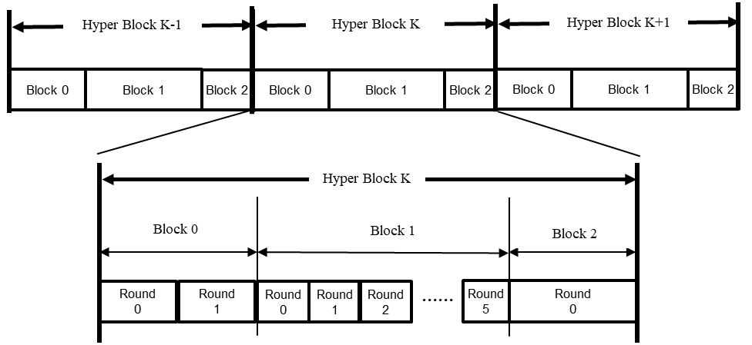
Recap: Hyper block-based mode concept [2, 3]
A hyper block is a group of blocks.
Hyper block mode uses the time structure that is periodic
Allows for the different blocks to have different configuration
  For block duration, round duration, and slot duration.

Slide 6





Recap: Motivation of hyper block-based mode [1]
Example : Public transportation use case
  When user approaches subway station gates : DL-TDoA (for localization)
  When user selects a certain gate to pass through : ranging (for gate selection)
  When user device accesses the gate for the first time : contention (for access)
Block #0
Block #1
Block #2
Block #0
Block #1
Block #2
Round #0
Round #1
Round #2
Round #0
Round #1
Round #2
Round #0
Round #1
Round #2
……
Round #0
Round #1
Round #2
Round
#0
Round
#1
Round
#2
Round
#0
Round
#1
Round
#2
……
Ex:
DL-TDoA
Ranging & Data transfer
Contention
Ex:
DL-TDoA
DL-TDoA
DL-TDoA
DL-TDoA
DL-TDoA
Ranging
Gates
[Indoor Localization Use Case Example]
[Public Transportation Use Case Example]

Slide 7
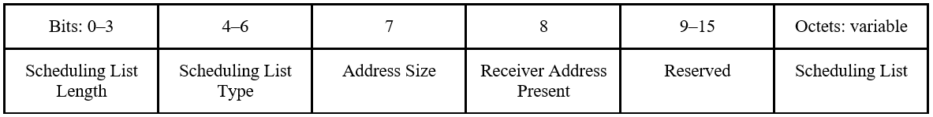
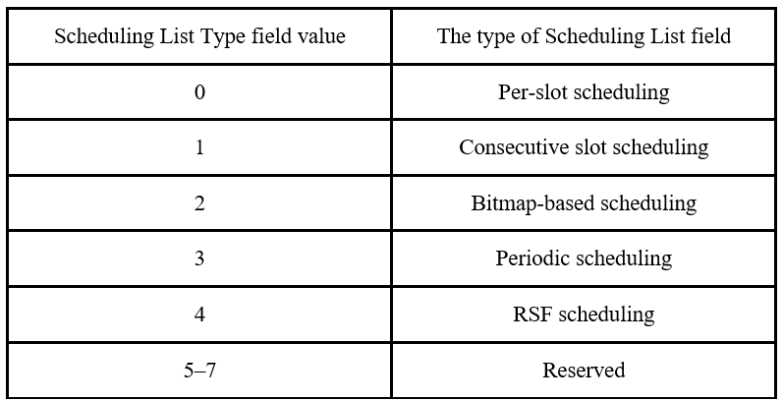
Recap: Scheduling IE [4]
In addition, the Scheduling IE is used by the controller to schedule slots to be used by intended device. The Content field of the Scheduling IE shall be formatted in the below
  Scheduling List Type field specifies how each element of the Scheduling List field is formatted. There are 5 types defined to specify scheduling method.
  Every type is defined for slot scheduling.

Slide 8
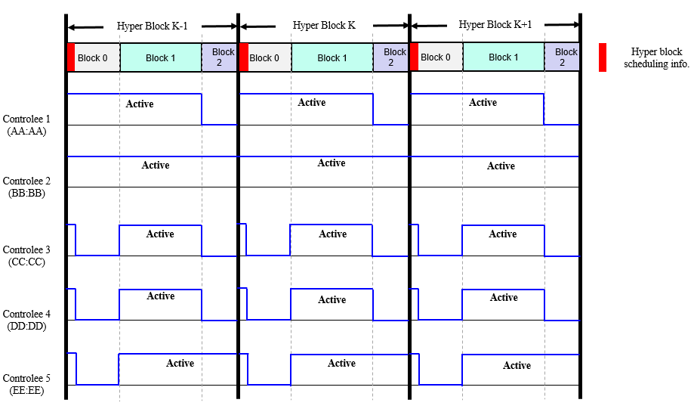
Why Hyper Block scheduling information?
Each controlee can decide to go to sleep mode if Hyper Block scheduling information is provided in the first RCM of a Hyper Block
Device | Scheduled Blocks
AA:AA | Block 0, 1
BB:BB | Block 0, 1, 2
CC:CC | Block 1
DD:DD | Block 1
EE:EE | Block 1, 2
Scheduling information provided
by a controller

Slide 9
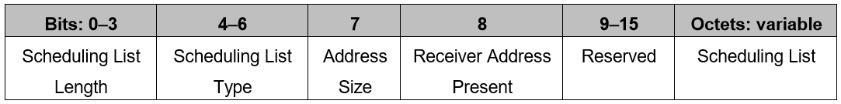
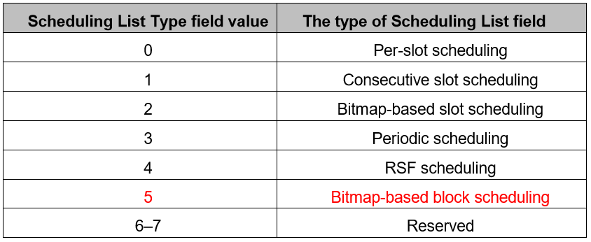
Proposal: Bitmap-based block scheduling(1/2)
Original Scheduling IE includes 5 types of Scheduling List Type
Every Scheduling List Type is for only slot scheduling, therefore new Scheduling List Type shall be defined for hyper block scheduling
By adding new Scheduling List Type, Scheduling IE may be used in not only slot scheduling but also block scheduling for hyper block structure

Slide 10
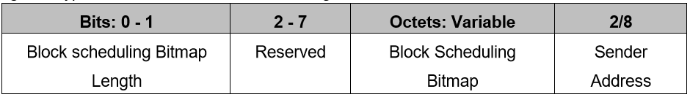
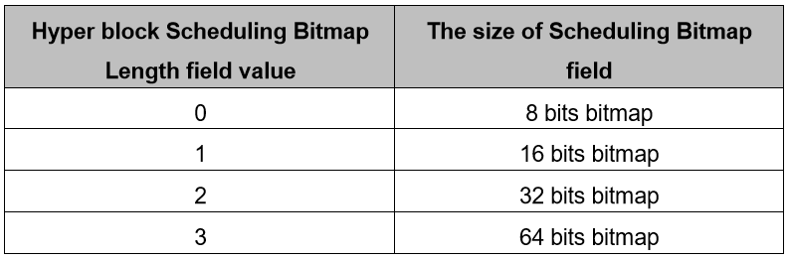
Proposal: Bitmap-based block scheduling(2/2)
When the Bitmap-based block scheduling is used, multiple blocks may be scheduled to a device by using one Scheduling List element
A bitmap in each Scheduling List element represents the pattern of scheduled blocks to a single device
When the Scheduling List Type field is set to 5(Bitmap-based block scheduling), Scheduling List elements is formatted as in the below
  Block scheduling Bitmap Length field specifies the size of the Bitmap field
  The Scheduling IE with Scheduling List Type 5 may be transmitted with same cycle of HBS IE

Slide 11
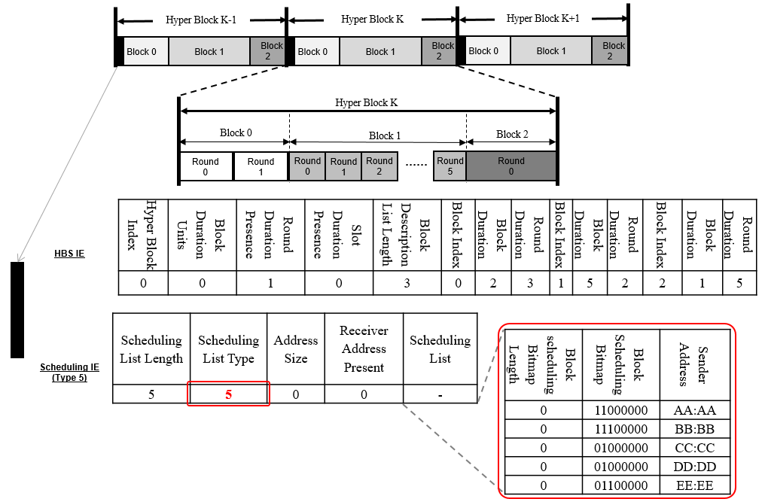
Bitmap-based block scheduling example
Every controlee gets scheduling information from updated Scheduling IE
Using this information, a controlee can make it’s duty cycle during hyper block to determine whether going to sleep or not

Slide 12
Summary
  The HBS IE specifies the index of the corresponding block and includes list of block durations of all blocks within the hyper block. On reception of the HBS IE with the RCM, a controlee assumes that hyper block structure is followed
There is no hyper block scheduling information in HBS IE and even in Scheduling IE
Proposed Scheduling IE which includes Scheduling List Type 5 is introduced to provide hyper block scheduling information
Using proposed Scheduling IE, a controlee can make it’s duty cycle during hyper block to determine whether going to sleep or not for reducing power consumption

Slide 13
References
[1] Y. So, M. Lee et al., “Motivation of Hyper block-based mode”, 15-22-0463-01-04ab.
[2] Y. So, M. Lee et al., “Update on Hyper block-based mode”, 15-22-0593-00-04ab.
[3] Y. So, M. Lee et al., “Proposed Text for 4ab MAC - Hyper Block-based Mode”, 15-23-0155-01-04ab.
[4] K. Yoon(Meta), K. Wu(Huawei), M. Lee(Samsung) et al., “Text for Scheduling IE”, 15-23-0062-03-04ab.

