Slide 1
Project: IEEE P802.15 Working Group for Wireless Specialty Networks (WSN)
Submission Title: TG 15.4ab May 2023 Interim Session Meeting Slides
Date Submitted: 14 May 2023
Source: Benjamin A. Rolfe (Blind Creek Associates)
Contact:
Voice: [deprecated], E-Mail: ben.rolfe @ ieee.org
Re: Task Group 4ab: 802.15.4 UWB Next Generation
Abstract: Mixed-mode interim session meeting slides
Purpose: Emulate organization, encourage participation and make further progress
Notice: This document has been prepared to assist the IEEE P802.15. It is offered as a basis for discussion and is not binding on the contributing individual(s) or organization(s). The material in this document is subject to change in form and content after further study. The contributor(s) reserve(s) the right to add, amend or withdraw material contained herein.
Release: The contributor acknowledges and accepts that this contribution becomes the property of IEEE and may be made publicly available by P802.15.
Notes:
Jul 12, 2010
Page 1

Slide 2

Task Group 15.4ab
Next Generation UWB Amendment
Mixed Mode Wireless Interim, May 2023
Live from Orlando FLA USA

Slide 3
Mixed Mode Logistics
Head table will project (one computer all day)
Local: queue to speak a microphone; remember remote attendees will hear you only if you use the microphone!
Remote attendees queue via chat window
Local attendees do not need to join WebEx
Local attendees when joining WebEx connect without audio!
In-room Webex with audio enabled will disrupt the meeting!
Presenters, both local and remote, will present via WebEx
For those Remote Attendees connecting to Webex, Configure Webex Audio to use “Music Mode”.
Makes sure “mute on entry” is set in WebEx
Please do not turn on video!

Slide 4
Registration for 802 LMSC Plenaries and 802 Wireless Interims
This 802.15 meeting is part of the IEEE 802 Plenary session
You must pay the registration fee in order to attend virtually or in person
If you have not already done so please register:
  Session Information & Registration Website: https://cvent.me/kqE5PN
  If you do not intend to register for this session you must leave this meeting and, if you have logged attendance on IMAT, email the appropriate WG chair or vice chairs to have your attendance cancelled

Slide 5
Deadbeat Consequences
(Deadbeat: in default of paying registration fee for a prior mtg.)
No participation credit will be granted for said session.
Any participation credit acquired before said session toward membership in any IEEE 802 LMSC group is revoked.
Membership in any IEEE 802 LMSC group is terminated.
No participation credit will be granted for attendance at any subsequent IEEE 802 LMSC session until the individual has complied with the registration requirements for all previously attended IEEE 802 LMSC sessions by the start of said subsequent session.

Slide 6

Task Group 15.4ab
Next Generation UWB Amendment
Objective: enhancements to 802.15.4 Ultra Wideband (UWB) physical layers (PHYs) medium access control (MAC) and associated ranging techniques while retaining backward compatibility with enhanced ranging capable devices (ERDEVs).

Slide 7
Task Group Organization
Chair: Benjamin Rolfe (BCA)¹
Vice Chair: Clint Powell (Meta)
Vice Chair: Clint Chaplin (SRA) [Remote]
Vice Chair and Recording Secretary: David Xun Yang (Huawei)
Lead Technical Editor: Billy Verso (Qorvo)
  Thank you to all the volunteers!
¹ Affiliation Details here: https://mentor.ieee.org/802-ec/dcn/22/ec-22-0061-00-00EC-rolfe-affiliations-by-802-activity.pdf

Slide 8
Task Group Rules
Discussion: Everyone present is welcome
Straw polls: Everyone present may vote
Formal motions: WG voters
  To make, second and vote
Patent policy for PAR activities applies
All the usual rules of conduct
Please identify yourself on first contact with name and affiliation

Slide 9
IEEE-SA Patent, Copyright, and Participation Policies
See: https://grouper.ieee.org/groups/802/sapolicies.shtml
IEEE-SA Patent Slides for Standards Development Meetings (.pdf)
https://development.standards.ieee.org/myproject/Public/mytools/mob/slideset.pdf
IEEE-SA Standards Board Patent Committee (PatCom) home page
https://standards.ieee.org/content/ieee-standards/en/about/sasb/patcom/index.html
IEEE-SA Participation Policy meeting slide set - individual method (.pdf)
https://standards.ieee.org/content/dam/ieee-standards/standards/web/documents/other/Participant-Behavior-Individual-Method.pdf
Working Group Copyright Materials
https://standards.ieee.org/ipr/copyright-materials.html
https://standards.ieee.org/content/dam/ieee-standards/standards/web/documents/other/ieee-sa-copyright-policy-2019.pdf

Slide 10
IEEE 802 Ground Rules
Respect … give it, get it
NO product pitches
NO corporate pitches
NO prices
NO restrictive notices – (no confidentially notices in email)
Presentations must be openly available

Slide 11
Task Group Agenda
Document: https://mentor.ieee.org/802.15/dcn/23/15-23-0205-04-04ab-tg4ab-agenda-may-2023.xlsx

Slide 12
Agenda
Motion to approve agenda contained in document 15-23-0205-04.
Moved by Clint Chaplin (SRA)
Second by Huan-Bang (NICT)
Discussion:

Slide 13
Approvals of Minutes
Motion to approve minutes contained in documents 15-23-0196-00 and 15-23-0235-00
Moved by: David Xun Yang (Huawei)
Second by: Clint Chaplin
March Plenary Minutes: https://mentor.ieee.org/802.15/dcn/23/15-23-0196-00-04ab-tg4ab-mar-plenary-mins.docx
Interim telecon minutes: https://mentor.ieee.org/802.15/dcn/23/15-23-0235-00-04ab-tg4ab-conf-call-mins-mar-to-may-2023.docx

Slide 14
Session Objectives
Refine and adopt proposed text for draft
Map the path to a technically complete draft

Slide 15
Mixed Mode Logistics
Head table will project (one computer all day)
Local: queue to speak a microphone; remember remote attendees will hear you only if you use the microphone!
Remote attendees please queue via chat window
Local attendees do not need to join WebEx except to present
Local attendees when joining WebEx connect without audio!
In-room Webex with audio enabled will disrupt the meeting!
Presenters, both local and remote, will present via WebEx
For those Remote Attendees connecting to Webex, Configure Webex Audio to use “Music Mode”.
Makes sure “mute on entry” is set in WebEx
Please do not turn on video.

Slide 16
Hybrid Meeting Conduct: Queues
Queue manager will interleave
1 question or comment per que slot; requeue as needed
Keep (question + answer) to 2 minutes
For more in-depth discussion use the reflector.

Slide 17
Hybrid Meeting Conduct: Other
In room breakouts:
We have the TG4ab Meeting room (physical and virtual)
We have a 2nd breakout room (physical and virtual)
In may be difficult for remote attendees – keep them in mind.
Loop in remote attendees in inconvenient time zones when able (email reflector, etc)
We will do the best we can and keep learning as we go!

Slide 18
We have a full agenda!
You are reminded NOW that all the 802 and IEEE rules you heard at the opening plenary apply to every meeting. This is your final reminder!
Meetings will start ON TIME as shown on the schedule – arrive early, finish nesting, get comfortable
Questions and discussions time may be limited: Use the email reflector to continue discussion!
Take advantage of coffee breaks and other ad hoc time as well as the reflector, and
Don’t forget about remote attendees!

Slide 19
Time Management
We will need to stay within the allocated time to get through everything
If less than the allocated time is used in a time slot, we’ll start the next time slot (accumulate any unused time to the end of the meeting)
Accumulated time will be used to continue discussion

Slide 20
Recap

Slide 21
5.2.b Scope of the project (As approved):
This amendment enhances the Ultra Wideband (UWB) physical layers (PHYs) medium access control (MAC), and associated ranging techniques while retaining backward compatibility with enhanced ranging capable devices (ERDEVs).
Areas of enhancement include:
  additional coding, preamble and modulation schemes to additional coding, preamble and modulation schemes to support improved link budget and/or reduced air-time relative to IEEE Std 802.15.4 UWB;
  additional channels and operating frequencies;
  interference mitigation techniques to support greater device density and higher traffic use cases relative to the IEEE Std 802.15.4 UWB;
  improvements to accuracy, precision and reliability and interoperability for high-integrity ranging; schemes to reduce complexity and power consumption;
  definitions for tightly coupled hybrid operation with narrowband signaling to assist UWB;
  enhanced native discovery and connection setup mechanisms;
  sensing capabilities to support presence detection and environment mapping;
  and mechanisms supporting low-power low-latency streaming as well as high data-rate streaming allowing at least 50 Mb/s of throughput.
Support for peer-to-peer, peer-to-multi-peer, and station-to-infrastructure protocols are in scope, as are infrastructure synchronization mechanisms. This amendment includes safeguards so that the high throughput data use cases do not cause significant disruption to low duty-cycle ranging use cases.
https://development.standards.ieee.org/myproject-web/app#viewpar/9081

Slide 22
Project Schedule (working baseline)
Proposed project schedule |  | May-22 | Jun-22 | Jul -22 | Aug-22 | Sep-22 | Oct-22 | Nov-22 | Dec-22 | Jan-23 | Feb-23 | Mar-23 | Apr-23 | May-23 | Jun-23 | Jul-23 | Aug-23 | Sep-23 | Oct-23 | Nov-23 | Dec-23 | Jan-24 | Feb-24 | Mar-24 | Apr-24 | May-24 | Jun-24 | Jul-24 | Aug-24 | Sep-24 | Oct-24 | Nov24 | Dec 25 | Jan 26 | Feb 26 | Mar 26 | Apr 26
Hear and evaluate proposals
Cut-off for new proposals, PHY features
Cut-off for new proposals, MAC features
Integrate poposals/contributions into TFD
Develop draft from TFD
Draft 0
TG draft review and revision
Working group pre-ballot review
Pre-ballot review and comment resolution
First letter ballot
LB Comment Resolution
WG Recirculatoin
Comment resolution, 1st recirc
Conditional approval for SA ballot
WG Recirculatoin
Comment resolution, 2nd recirc and final recirc
First SA ballot
Comment resolution, first SA ballot
SA Resirculation
Comment resolution, SA recirculation
SA Resirculation
Comment resolution, 2nd SA recirc
Conditional or unconditional approval to RevCom
Optional 3rd SA recirc if needed
RevCom meets |  |  |  |  |  |  |  |  |  |  |  |  |  |  |  |  |  |  |  |  |  |  |  |  |  |  |  |  |  |  |  |  |  |  |  |  |  | `
You are Here
Notes: SASB/RevCom schdule for 2024 a guess

Slide 23
Schedule Major Milestones
Near Term Working Milestones
 | Original Schedule | Current Schedule
Call for proposals | November 2021
Cut-off for new features (high level feature set), PHY | May 2022
Cut-off for new features (high level feature set), MAC | July 2022
Draft 0 | Post-January 2023 | Post March 2023
TG draft review and revision complete | February - March 2023 | Mar-June 2023
Working group pre-ballot review commence | March – May 2023 (following March meeting) | July 2023
First letter ballot | June 2023 (following meeting) | Oct 2023
…

Slide 24

Technical Presentations

Slide 25
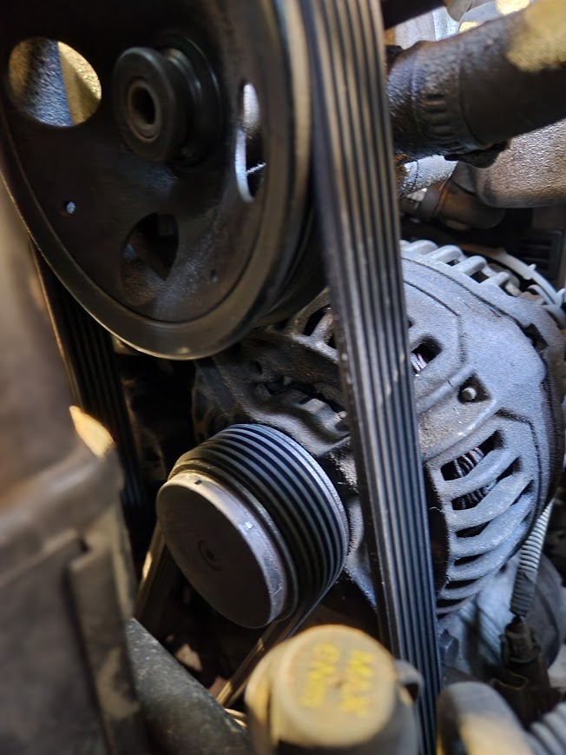
Technical Breakouts

Slide 26
Break-out Topics
Sensing (2)
MMS MAC (2)
MMS Other (1)
Device categories (1)

Slide 27
TFD updates
Updates to send to the TE:
Non-coherent PHY | 15-22-0514 | https://mentor.ieee.org/802.15/dcn/22/15-22-0514-05-04ab-non-coherent-phy-layer-proposal-for-15-4ab-tfd.docx
MMS MAC | 15-22-0381 | https://mentor.ieee.org/802.15/dcn/22/15-22-0381-05-04ab-nba-uwb-ranging-text-proposal-for-15-4ab-tfd.docx
Data Com | 15-22-0649 | https://mentor.ieee.org/802.15/dcn/22/15-22-0649-03-04ab-coherent-phy-layer-proposal-for-15-4ab-tfd.docx
Sensing | 15-22-0538 | https://mentor.ieee.org/802.15/dcn/22/15-22-0538-04-04ab-proposal-of-sensing-framework.docx
Hyperblock | 15-23-0215 | https://mentor.ieee.org/802.15/dcn/23/15-23-0215-02-04ab-block-assignment-in-hyper-block-tfd.docx

Slide 28

Next Steps

Slide 29
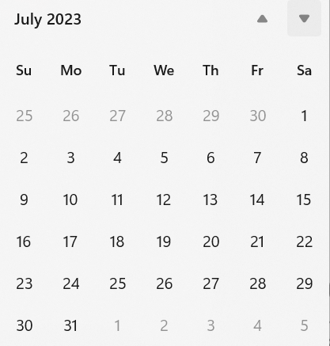
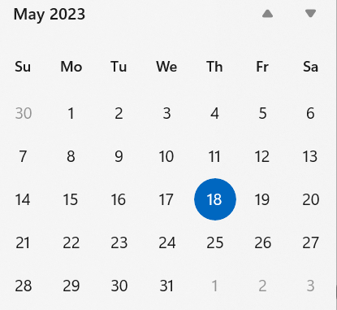
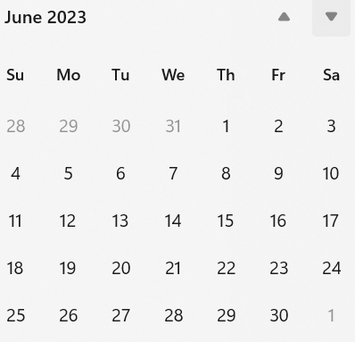
Interim Webex Schedule
Proposed: Usual time and interval: Alternate Tuesdays, 06:00 PT commencing 30-May
July Plenary
Now
Next

Slide 30
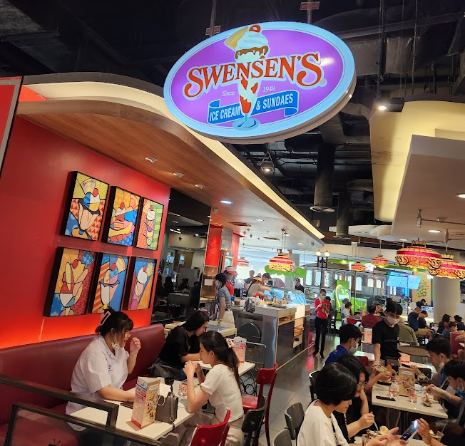
Other Business

Slide 31
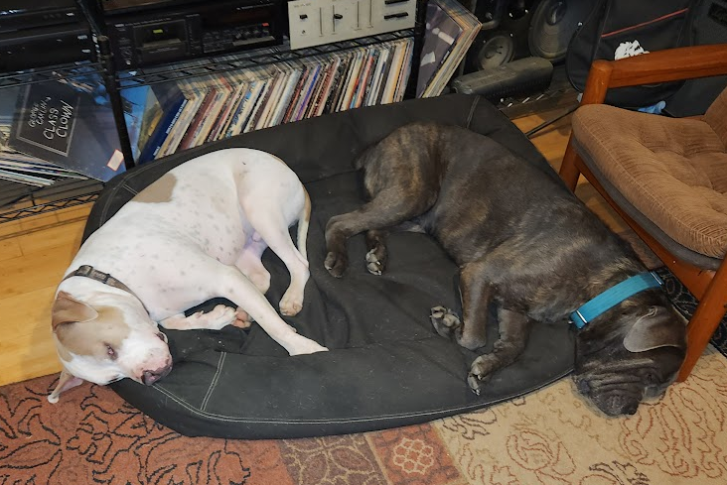
Adjourned
Thanks

