Slide 1
Project: IEEE P802.15 Working Group for Wireless Specialty Networks
Submission Title: Concept of channel coding for 15.6ma
Date Submitted: 17 May 2023
Source: Kento Takabayashi¹, Ryuji Kohno^{2,3}
Company: (1) Toyo University (2)Yokohama National University (3) YRP International Alliance Institute
Address: (1) 2100 Kujirai, Kawagoe, Saitama, Japan 351-8585, (2)79-5 Tokiwadai, Hodogaya-ku, Yokohama, 240-8501 Japan,
(3) YRP1 Blg., 3-4 Hikarinooka, Yokosuka-City, Kanagawa, 239-0847 Japan
Voice:[(1) +81-866-94-2104 , (2) +81-90-5408-0611] E-Mail:[takabayashi.kento.xp@gmail.com, kohno@ynu.ac.jp, kohno@yrp-iai.jp]
Re: In response to call for technical contributions
Abstract: The concept of error correcting codes for IEEE 802.15.6ma is provided. IEEE 802.15.6ma will deal with various QoS level data. Hence, it is required to consider an error control scheme corresponding to these QoS. We introduce the concept of applying a single error correcting code to low priority data and an outer and an inner error correcting codes to high priority data. In addition, we also consider coexistence with IEEE 802.15.4ab.
Purpose: Material for discussion in P802.15.6a TG corresponding to comments in EC Meeting
Notice: This document has been prepared to assist the IEEE P802.15. It is offered as a basis for discussion and is not binding on the contributing individual(s) or organization(s). The material in this document is subject to change in form and content after further study. The contributor(s) reserve(s) the right to add, amend or withdraw material contained herein.
Release: The contributor acknowledges and accepts that this contribution becomes the property of IEEE and may be made publicly available by P802.15.

Slide 2
Concept of channel coding for IEEE 802.15.6ma
May 2023,
Hybrid Session ,
Hilton Orlando, Lake Buena Vista Orlando, Florida
Kento Takabayashi ⁽¹⁾, Ryuji Kohno^{(2, 3)}
⁽¹⁾ Toyo University
⁽²⁾ Yokohama National University, ⁽³⁾ YRP-International Alliance Institute

Slide 3
Importance of QoS control
User priority | Traffic designation | Frame type
0 | Background (BK) | Data
1 | Best effort (BE) | Data
2 | Excellent effort (EE) | Data
3 | Video (VI) | Data
4 | Voice (VO) | Data
5 | Medical data or network control | Data or management
6 | High-priority medical data or network control | Data or management
7 | Emergency or medical implant event report | Data
In WBAN systems, a wearable vital sign sensor node can include various types of sensors with different data rates, the allowable communication error ratio and delay
Therefore, optimal error control for input data is an important feature in sensor data transmission procedures

Slide 4
Error control in current IEEE 802.15.6
IEEE 802.15.6 shall use a (63, 51) BCH code as an error correcting code in narrowband, UWB and HBC PHY
Only user priority 6 data in UWB-PHY may use a hybrid ARQ with a (126, 63) shortened BCH code
IEEE 802.15.6 based WBAN may deal with 8 levels of user priority data
Those data have a wide range of quality of service (QoS)
However, the error control scheme of the current IEEE 802.15.6 cannot deal with the QoS because of lack of flexibility

Slide 5
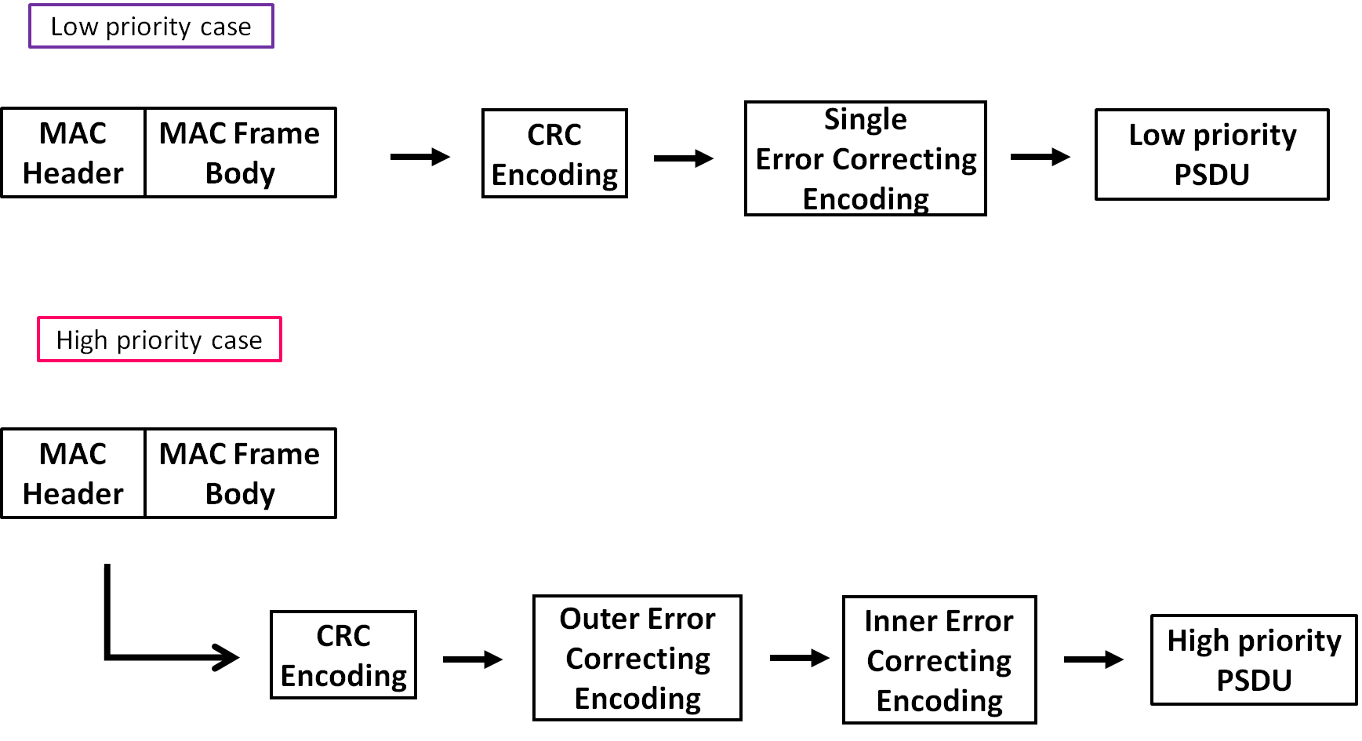
Concept of channel coding for PSDU
In a low priority QoS case, only a single error correcting code will be applied for PSDU
In a high priority QoS case, an outer and an inner error correcting codes will be serially applied for PSDU

Slide 6
Previous Plan in Jan. 2023
User priority | Inner code | Outer code | HARQ
0 | - | (31, 25) Reed-Solomon code | -
1 | - | (31, 25) Reed-Solomon code | -
2 | - | (31, 25) Reed-Solomon code | -
3 | - | (31, 25) Reed-Solomon code | -
4 | Proposed decomposable code, R=4/5 | (31, 25) Reed-Solomon code | ◯
5 | Proposed decomposable code, R=2/3 | (31, 25) Reed-Solomon code | ◯
6 | Proposed decomposable code, R=1/2 | (31, 25) Reed-Solomon code | ◯
7 | Proposed decomposable code, R=1/4 | (31, 25) Reed-Solomon code | ◯
Error correcting code and coding rate are mapped to each QoS (the above table is an example, blue color: low QoS, red color: high QoS)
As an outer code, (31, 25) Reed-Solomon (RS) code will be selected to correct burst errors due to interference from other WBANs
As an inner code, proposed decomposable codes and hybrid ARQ will be selected, and the coding rates are changed according to each QoS and channel condition

Slide 7
Updated Table #1
User priority | Inner code | Outer code | HARQ
0 | 15.4ab LDPC code (R=1/2) |  | -
1 | 15.4ab LDPC code (R=1/2) |  | -
2 | 15.4ab LDPC code (R=1/2) |  | -
3 | 15.4ab LDPC code (R=1/2) |  | -
4 | 15.4ab LDPC code (R=1/2) | (54, 46) shortened RS code | -
5 | 15.4ab LDPC code (R=1/2) | (54, 38) shortened RS code | -
6 | 15.4ab LDPC code (R=1/2) | (54, 28) shortened RS code | -
7 | 15.4ab LDPC code (R=1/2) | (54, 14) shortened RS code | -
As an outer code, shortened Reed-Solomon (RS) codes with N=54 (original code length N=63) will be selected to correct burst errors due to interference from other WBANs and the coding rates are changed according to each QoS and channel condition
As an inner code, 15.4ab LDPC codes (K=324, 648, 972, R=1/2) will be selected for the coexistence of 15.6ma and 15.4ab
This updated concept table is considered as the first priority
Notes:
N=54 shortened Reed-Solomon codes has 324 bits code length (m=6, 54*6=324)
Hence, this code length matches the information bit length of 15.4ab LDPC codes in multiples

Slide 8
Updated Table #2
User priority | Inner code | Outer code | HARQ
0 | - | 15.4ab LDPC code (R=1/2) | -
1 | - | 15.4ab LDPC code (R=1/2) | -
2 | - | 15.4ab LDPC code (R=1/2) | -
3 | - | 15.4ab LDPC code (R=1/2) | -
4 | 15.4a/z based convolutional code, R=4/5 | 15.4ab LDPC code (R=1/2) | ◯
5 | 15.4a/z based convolutional code, R=2/3 | 15.4ab LDPC code (R=1/2) | ◯
6 | 15.4a/z convolutional code, R=1/2 | 15.4ab LDPC code (R=1/2) | ◯
7 | 15.4a/z based convolutional code, R=1/4 | 15.4ab LDPC code (R=1/2) | ◯
As an outer code, 15.4ab LDPC (K=324, 648, 972, R=1/2) codes will be selected for the coexistence of 15.6ma and 15.4ab
As an inner code, 15.4a/z based convolutional codes (which are almost the same of our proposed decomposable codes) will be selected, and the coding rates are changed according to each QoS and channel condition, which can be applied to hybrid ARQ
This table is considered as the second choice

Slide 9
Thank you for your attention ! ! !

