Slide 1
Project: IEEE P802.15 Working Group for Wireless Personal Area Networks (WPANs)
Submission Title: Simulation Results for Nagoya I. T. and YRP-IAI MAC Proposal Considering Interference Model
Date Submitted: Mat 15th, 2023
Source: Daisuke Anzai¹, Ryosuke Inusuka¹, Takumi Kobayashi¹, Minsoo Kim², Marco Hernandez², Ryuji Kohno²
Company: ¹Nagoya Institute of Technology (NIT), Japan; ²Yokosuka Research Park International Alliance Institute (YRP-IAI), Japan
Address: Gokiso-cho, Showa-ku, Nagoya, 466-8555, Japan
Voice: +81-52-735-5389, FAX: +81-52-735-5389, E-Mail: anzai@nitech.ac.jp
Re: In response to call for technical contributions
Abstract: This provides fundamental MAC simulation setup and performance evaluation results for the Nagoya Institute of Technology and YRP-IAI proposal considering an interference model.
Purpose: Material for discussion in P802.15.6a TG corresponding to comments in EC Meeting
Notice: This document has been prepared to assist the IEEE P802.15. It is offered as a basis for discussion and is not binding on the contributing individual(s) or organization(s). The material in this document is subject to change in form and content after further study. The contributor(s) reserve(s) the right to add, amend or withdraw material contained herein.
Release: The contributor acknowledges and accepts that this contribution becomes the property of IEEE and may be made publicly available by P802.15.

Slide 2
Simulation Results for Nagoya I. T. and YRP-IAI MAC Proposal Considering Interference Model
Daisuke Anzai, Ryosuke Inuzuka, Takumi Kobayashi
Minsoo Kim, Marco Hernandez, and Ryuji Kohno
Nagoya Institute of Technology (NIT),
YRP International Alliance Institute (YRP-IAI)

Slide 3
Introduction
Coexistence of multiple BANs and other UWB applications (e.g. IEEE 802.15.4ab) is a key issue in providing high dependability
In multiple BAN coexistence, we propose a managed synchronous superframe structure to avoid packet collisions even between different BANs, which is optimally controlled under multiple BAN coexistence situations
We carry out fundamental MAC performance evaluation to demonstrate the importance of the proposed structure based on an interference model

Slide 4


Super frame structure (D-Channel)
Network
Management
Contention
Free
Contention
Access
Inactive
D-Beacon
・・・
・・・
・・・
・・・
$$T_{s}$$
$$T_{D}$$
time
D-Beacon from BAN2
D-Beacon from BAN1

Slide 5
Packet transmission in contention free period (CFP)
: Packet transmission (TDMA)
: Retransmission

Slide 6
Packet transmission in contention access period (CAP)
: Packet transmission (Slotted ALOHA)
: Retransmission

Slide 7
Proposal of managed synchronous superframe
Timeslot assignment perfectly controlled in TDMA (CFP)

Slide 8

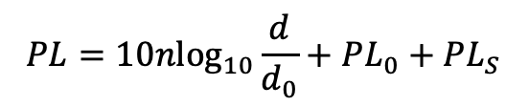
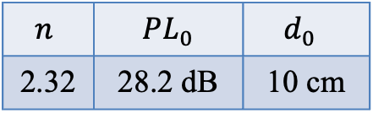

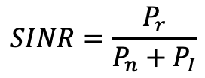

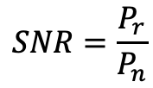
PER calculation based on received power
Parameters of the log-normal shadowing [dB]
$$n$$ | ${PL}_{0}$ | $$d_{0 }$$
2.32 | 28.2 dB | 10 cm
Head | Chest | Arm | Wrist | Thigh | Ankle
4.73 | 2.81 | 6.91 | 9.18 | 3.38 | 3.27
$$P_{t,dBm}=−10 dBm$$
Distance between a hub and each node [cm]
$$P_{N,dBm}=−105 dBm$$
 | Head | Chest | Arm | Wrist | Thigh | Ankle
BAN1 | 82 | 47 | 47 | 35 | 41 | 82
BAN2 | 96 | 68 | 76 | 70 | 72 | 102
$$PL=10nlog_{10}\frac{d}{d_{0}}+PL_{0}+PL_{S}$$
Log-normally distributed random variable
$$P_{r, dBm}=P_{t,dBm}+PL$$
$$SNR=\frac{P_{r}}{P_{n}}$$
$$SINR=\frac{P_{r}}{P_{n}+P_{I}}$$

Slide 9
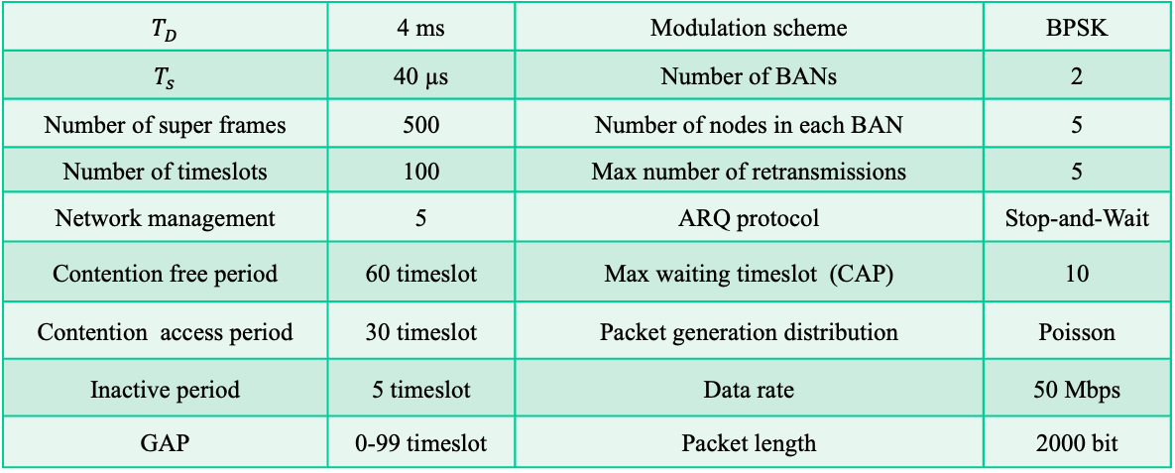
Simulation parameters
$T_{D}$ | 4 ms | Modulation scheme | BPSK
$T_{s}$ | 40 µs | Number of BANs | 2
Number of super frames | 500 | Number of nodes in each BAN | 5
Number of timeslots | 100 | Max number of retransmissions | 5
Network management | 5 | ARQ protocol | Stop-and-Wait
Contention free period | 60 timeslot | Max waiting timeslot (CAP) | 10
Contention access period | 30 timeslot | Packet generation distribution | Poisson
Inactive period | 5 timeslot | Data rate | 50 Mbps
GAP | 0-99 timeslot | Packet length | 2000 bit

Slide 10
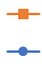
Evaluation results in CFP
Managed synchronous superframes
Asynchronous superframes
The guaranteed delay time is evaluated
as a 99%tile value of transmission delay

Slide 11
Fundamental evaluation results in CAP
Managed synchronous superframes
Asynchronous superframes
The guaranteed delay time is evaluated
as a 99%tile value of transmission delay

Slide 12
References
D. Anzai, R. Inuzuka, M. Kim, T. Kobayashi, M. Hernandez, R. Kohno, “Fundamental MAC Performance Evaluation under Multiple IEEE802.15.6ma BAN Co-Existence,” in Proc. IEEE ISMICT 2023, Lincoln, USA, Mach 2023.
D. Anzai, I. Balasingham, G. Fischer, J. Wang, “Reliable and High-Speed Implant Ultra-Wideband Communications with Transmit–Receive Diversity,” EAI/Springer Innovations in Communication and Computing, pp. 27-32, March 2020.
Y. Shimizu, D. Anzai, R. C-Santiago, P. A. Floor, I. Balasingham, and J. Wang, “Performance evaluation of an ultra-wideband transmit diversity in a living animal experiment” IEEE Trans. Microw. Theory Tech., vol. 65, no. 7, pp. 2596-2606, July 2017.
D. Anzai, K. Katsu, R. Chavez-Santiago, Q. Wang, D. Plettemeier, J. Wang, and I. Balasingham, “Experimental evaluation of implant UWB-IR transmission with living animal for body area networks,” IEEE Trans. Microw. Theory Tech., vol. 62, no. 1, pp. 183-192, Jan. 2014.
J. Shi, D. Anzai, and J. Wang, “Channel modeling and performance analysis of diversity reception for implant UWB wireless link,” IEICE Trans. Commun., no. E95-B, vol. 10, pp. 3197-3205, Oct. 2012.

