Slide 1
Project: IEEE P802.15 Working Group for Wireless Personal Area Networks (WPANs)
Submission Title: O-QPSK PHYs for NB CCA for UWB channel access
Date Submitted: May, 2023
Source: Huan-Bang Li, Takeshi Matsumura (NICT, Japan).
Address: 3-4 Hikarino-oka, Yokosuka-shi, Kanagawa, 239-0847 Japan
E-Mail: {lee, matsumura}@nict.go.jp
Abstract: present O-QPSK as NB PHYs for NB-assisted UWB channel access.
Purpose: To improve coexistence among UWB systems.
Notice: This document has been prepared to assist the IEEE P802.15. It is offered as a basis for discussion and is not binding on the authoring individual(s) or organization(s). The material in this document is subject to change in form and content after further study. The authors(s) reserve(s) the right to add, amend or withdraw material contained herein.

Slide 2
PAR Objective | Proposed Solution (how addressed)
Safeguards so that the high throughput data use cases will not cause significant disruption to low duty-cycle ranging use cases | Effective and efficient CCA reduce disruption between UWB devices
Interference mitigation techniques to support higher density and higher traffic use cases | Use NB radio to facilitate CCA so as to improve coexistence.
Other coexistence improvement | Use NB radio to improve coexistence among UWB devices.
Backward compatibility with enhanced ranging capable devices (ERDEVs)
Improved link budget and/or reduced air-time
Additional channels and operating frequencies
Improvements to accuracy / precision / reliability and interoperability for high-integrity ranging
Reduced complexity and power consumption
Hybrid operation with narrowband signaling to assist UWB | Exploiting NB PHY and concurrent operation with UWB to assist UWB channel access
Enhanced native discovery and connection setup mechanisms
Sensing capabilities to support presence detection and environment mapping
Low-power low-latency streaming
Higher data-rate streaming allowing at least 50 Mbit/s of throughput
Support for peer-to-peer, peer-to-multi-peer, and station-to-infrastructure protocols
Infrastructure synchronization mechanisms

Slide 3
Contents
A glance at NB CCA
O-QPSK in Clause 21 of IEEE 802.15.4-2020
O-QPSK in NBA TFD
NB CCA operation

Slide 4
A Glance at NB CCA for UWB Channel Access
NB CCA is based on a pair of coupled NB PHY and UWB PHY, that are operated concurrently using the same timer: either synchronized clock or MAC timer.
NB radio is used to indicate UWB channel occupancy status. CCA is performed at NB channel. UWB channel access is based on the coupled NB radio’s CCA results.
NB CCA can be conducted uniformly regardless the types of UWB signals.

Slide 5
Consideration on NB PHY
NB PHYs can be implemented with either single-carrier or multicarrier modulations (IEEE 15-23-0210-00-04ab). From viewpoint of simplicity and interoperability, we focus on O-QPSK.
O-QPSK specification in IEEE 802.15.4-2020
  Clause 12 (channel spacing: 2 MHz)
  Clause 21 (channel spacing: 200 kHz, 2 MHz, 5 MHz)
  Clause 22 (channel spacing: 100 kHz, 200 kHz, 1 MHz)

Slide 6
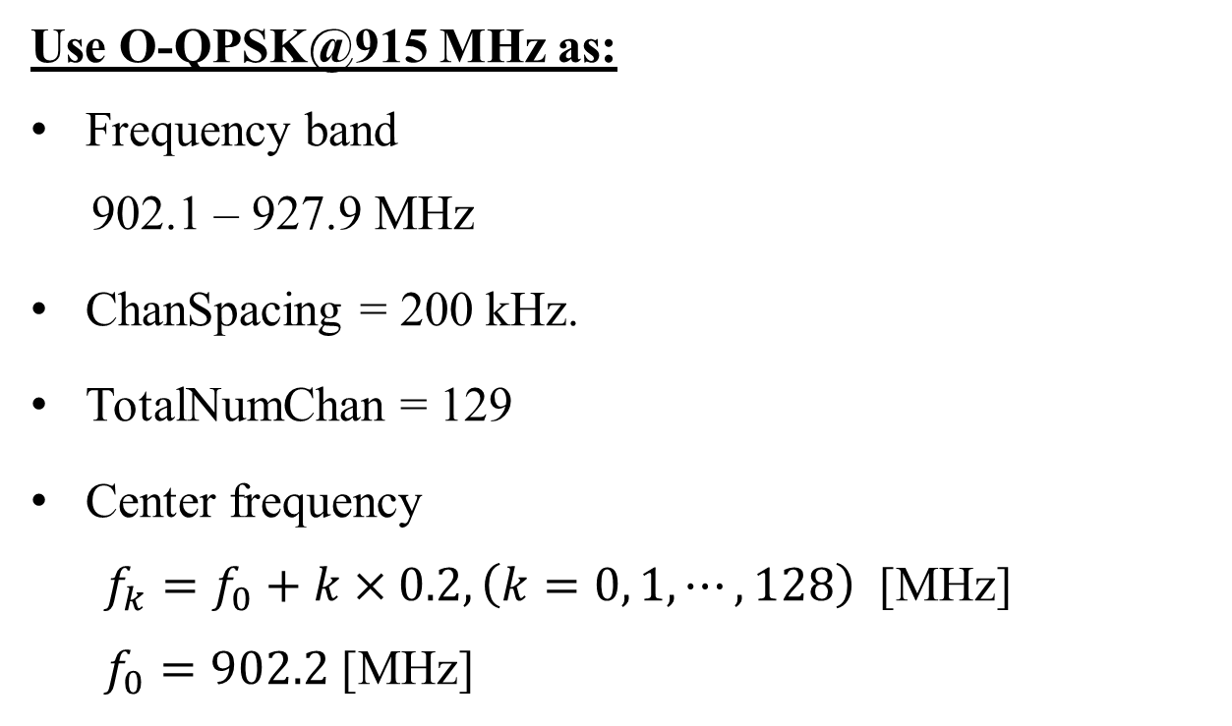
O-QPSK in Clause 21
Use O-QPSK@915 MHz as:
Frequency band
902.1 – 927.9 MHz
ChanSpacing = 200 kHz.
TotalNumChan = 129
Center frequency
  $f_{k}=f_{0}+k×0.2, \left(k=0, 1, ⋯,128\right)$ [MHz]
  $f_{0}=902.2$ [MHz]

Slide 7
PPDU and SHR Formats
SHR | PHR | PHY payload
preamble | SFD
SFD value (bits 0-15)
1110101101100010

Slide 8
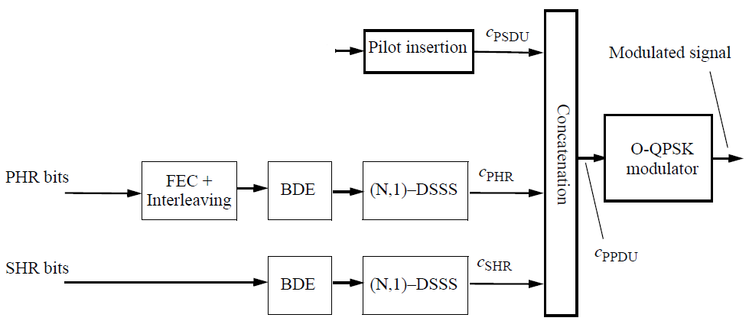
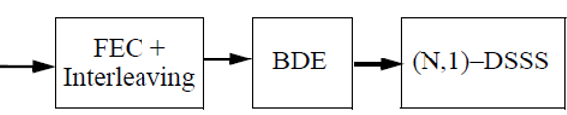
Modulation Diagram
[21.3.12]

Slide 9
Coding and Spreading Parameters
 | Chip rate (kchips/s) | Spreading mode | coding
SHR | 1000 | (64, 1)-DSSS | BDE
PHR | 1000 | (16, 1)_{0/1}-DSSS* | BDE and rate ½ FEC+interleaver [21.3.6 & 21.3.7]
PSDU | 1000 | (16, 1)_{0/1}-DSSS* Mandatory mode
*The even indexed bits E_{2k}, for k = 0, 1, …, shall be spread with (N,1)₀-DSSS
and the odd indexed bits, E_{2k +1}, for k =0, 1, …, shall be spread with (N, 1)₁-DSSS

Slide 10
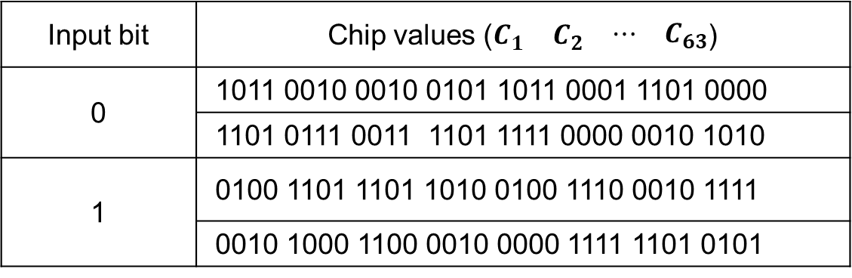
Bit-to-Chip Mapping (1)
(64, 1)-DSSS bit-to-chip mapping
Input bit | Chip values ($\begin{matrix}C_{1} & C_{2} & \begin{matrix}⋯ & C_{63}\end{matrix}\end{matrix}$)
0 | 1011 0010 0010 0101 1011 0001 1101 0000
 | 1101 0111 0011 1101 1111 0000 0010 1010
1 | 0100 1101 1101 1010 0100 1110 0010 1111
 | 0010 1000 1100 0010 0000 1111 1101 0101

Slide 11
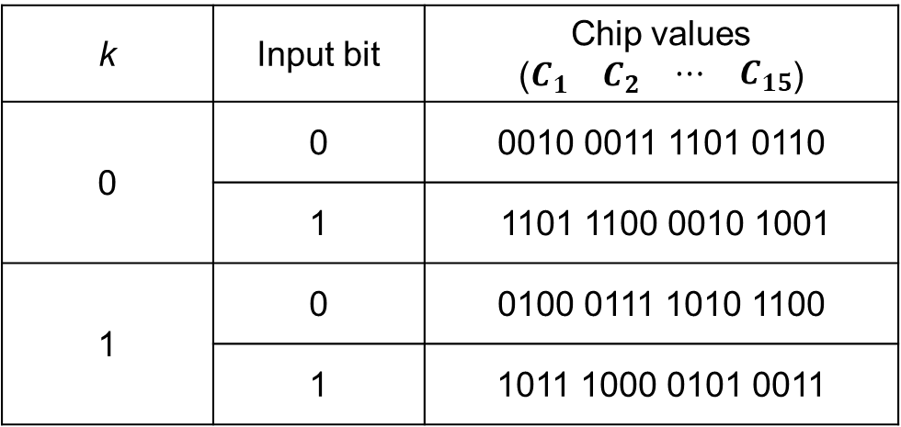
Bit-to-Chip Mapping (2)
(16, 1)_{k}-DSSS bit-to-chip mapping
k | Input bit | Chip values ($\begin{matrix}C_{1} & C_{2} & \begin{matrix}⋯ & C_{15}\end{matrix}\end{matrix}$)
0 | 0 | 0010 0011 1101 0110
 | 1 | 1101 1100 0010 1001
1 | 0 | 0100 0111 1010 1100
 | 1 | 1011 1000 0101 0011

Slide 12
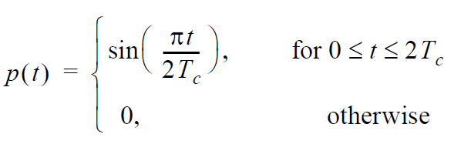
Modulation Pulse Shape
Use the half-sine pulse shape as in the follows

Slide 13
O-QPSK in NBA TFD
Use O-QPSK PHY in NBA TFD:
Frequency bands
UNII-3, UNII-5, and 2450 MHz
ChanSpacing = 2.5 MHz.
TotalNumChan
  50 @ UNII-3 and 200@UNII-5 [15-23-0100-02-04ab]

Slide 14
NB CCA Operation (Transmitter)
Each NB channel is paired with a UWB frequency channel
UWB_i UWB_j … …
frequency
NB channels
Transmit at a particular NB channel to declare occupancy of the pairing UWB channel
*NB signal length could be much shorter than that of UWB signal

Slide 15
NB CCA Operation – continue (Transmitter)
time
time
time
frequency
frequency
frequency
Transmit multiple times at the particular NB channel with different durations to create patterns that are used to declare occupancy time of the pairing UWB channel

Slide 16
NB CCA Operation (Receiver)
start
Tune to the particular NB channel
ED transmission pattern?
yes
Wait for declared time duration
no
next step

Slide 17
Discussion
Two O-QPSK PHYs provide flexibility of selection on NB CCA in according to local regulations.
Gaps on bandwidth exist between NBA radio and other radios, which raises issue on appropriate ED level.

Slide 18
Backup Slides

Slide 19
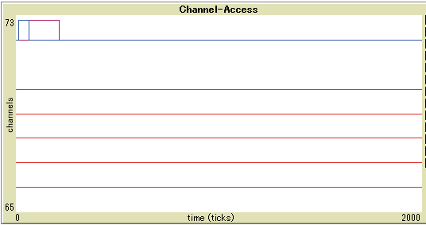
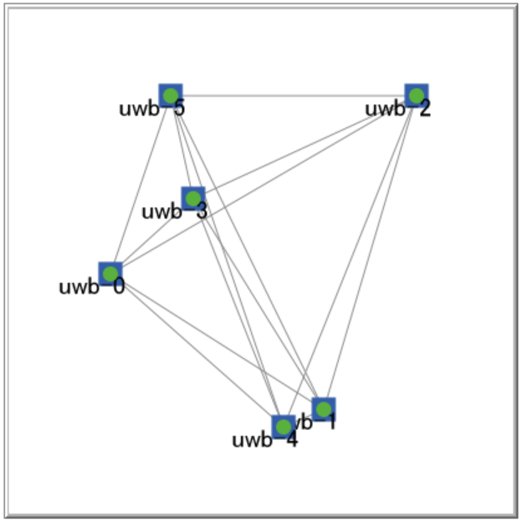
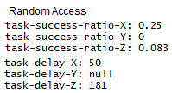
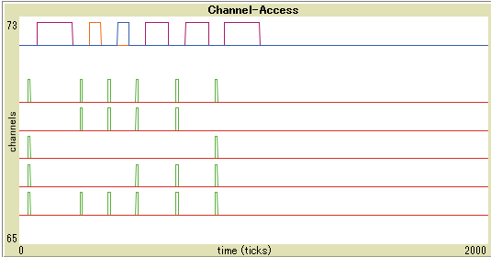
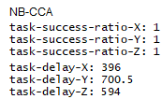
Simulation Results (1)
Five NB sub-ch UWB
ch
Six uniformly distributed UWB within communication ranges.
Each executes task X (50 ticks), Y (100 ticks), and Z (150 ticks).
Random access vs NB-CCA.
Five NB sub-ch UWB
ch

Slide 20
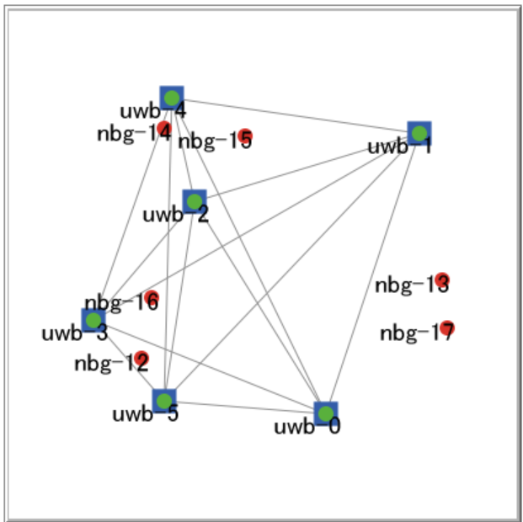
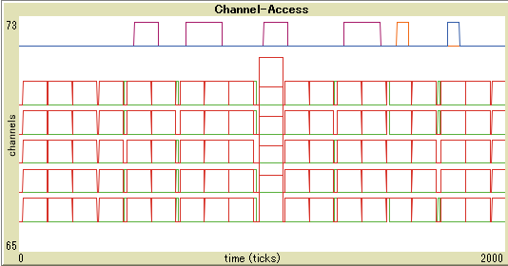
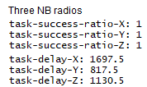
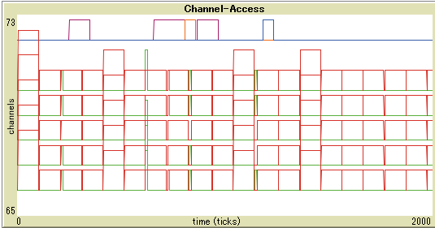
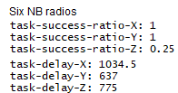
Simulation Results (2)
Five NB sub-ch UWB
ch
NB-CCA UWB and other NB radios co-exist. Each NB radio sends packets constantly that occupy all sub-ch.
Each NB radio transmits and stops alternatively every 100 ticks
Three vs. Six NB radios.
Five NB sub-ch UWB
ch

Slide 21
Proposed Text (highlighted in blue)
Add an optional CCA mode to 10.2.8 Clear channel assessment (CCA) of IEEE 802.15.4-2020 as follows (15-22-0275-00-04ab)
An HRP UWB PHY shall implement one CCA Mode 1 through CCA Mode 4 or one of the following methods:
CCA Mode 5: HRP UWB preamble sense based on the SHR of a frame. CCA shall report a busy medium upon detection of a preamble symbol as specified in 15.2.6. An idle channel shall be reported if no preamble symbol is detected up to a period not shorter than the maximum packet duration plus the maximum period for acknowledgment.
CCA Mode 6: HRP UWB preamble sense based on the packet with the multiplexed preamble as specified in 15.6. CCA shall report a busy medium upon detection of a preamble symbol as specified in 15.2.6.
CCA Mode 7: UWB medium access coupled with CCA of narrow-band assisted PHY (NBA-PHY) as specified in 15.x. Transmission or CCA conducted by the coupled NBA-PHY act as indications of the UWB-PHY medium access status. CCA shall report an idle or a busy UWB medium based on the NBA-PHY CCA results.
*Original texts are highlighted in yellow while the proposed add-on texts in blue.

