Slide 1
Project: IEEE P802.15 Working Group for Wireless Personal Area Networks (WPANs)
Submission Title: [TG15.6ma(Revision of IEEE802.15.6-2012) Opening Information for May 2023]
Date Submitted: [14th May 2023]
Source: [Ryuji Kohno] [1;Yokohama National University(YNU), 2;YRP International Alliance Institute(YRP-IAI)]
Address [1; 79-5 Tokiwadai, Hodogaya-ku, Yokohama, 240-8501 Japan
2; YRP1 Blg., 3-4 HikarinoOka, Yokosuka-City, Kanagawa, 239-0847 Japan]
Voice:[1; +81-90-5408-0611], FAX: [+81-45-383-5528],
Email:[1: kohno@ynu.ac.jp, 2: kohno@yrp-iai.jp] Re: []
Abstract: [This document contains opening information and meeting agenda for the TG15.6ma, that is a task group of Revision of IEEE802.15.6-2012, meeting in May 2023.]
Purpose: [information]
Notice: This document has been prepared to assist the IEEE P802.15. It is offered as a basis for discussion and is not binding on the contributing individual(s) or organization(s). The material in this document is subject to change in form and content after further study. The contributor(s) reserve(s) the right to add, amend or withdraw material contained herein.
Release: The contributor acknowledges and accepts that this contribution becomes the property of IEEE and may be made publicly available by P802.15.

Slide 2
IEEE 802.15 TG15.6ma
(Revision of IEEE802.15.6-2012)
Opening Information
In Personal and Interim Virtual Hybrid Interim Session
Orlando, Florida, USA
May 15^{h}, 2023
Ryuji Kohno
Yokohama National University(YNU),
YRP International Alliance Institute(YRP-IAI)

Slide 3
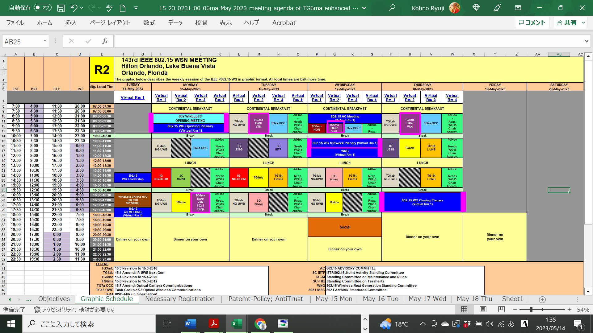
TG15.6ma Interim Session Schedule for 15-19th, May 2023
doc.:IEEE802.15.23-0107-06ma
TG15.6ma has three own sessions such as
Session1(Virtual RM#3) PM2 16:00-18:00 May 15(MON) in Orlando time(EST), 5:00-7:00 May 16(TUE) in JST
Session2(Virtual RM#2) AM1 8:00-10:00 May 16(TUE) in Orlando time (EST), 2100-23:00 May16(TUE) in JST
Session3(Virtual RM#2) AM1 8:30-10:00 May 17(WED)in Orlando time(EST), 5:30-7:00 May 18(THU) in JST
Session4(Virtual RM#2) AM1 8:00-10:00 May 18(THU) in Orlando time (EST), 2100-23:00 May19(FRI) in JST

Slide 4
TG15.6ma Interim Session Schedule for for 12-17th, March 2023
TG15.6ma has three own sessions such as
Session1(Virtual RM#3) PM2 16:00-18:00 May 15(MON) in Orlando time(EST), 5:00-7:00 May 16(TUE) in JST
Session2(Virtual RM#2) AM1 8:00-10:00 May 16(TUE) in Orlando time (EST), 2100-23:00 May16(TUE) in JST
Session3(Virtual RM#2) AM1 8:30-10:00 May 17(WED)in Orlando time(EST), 5:30-7:00 May 18(THU) in JST
Session4(Virtual RM#2) AM1 8:00-10:00 May 18(THU) in Orlando time (EST), 2100-23:00 May19(FRI) in JST
TG 15.6ma Session1, MON PM2 (Virtual Room #3)
4:00 PM - 6:00PM May 15(MON) Local Orlando Time(EST)
5:00AM -7:00AM May 16(TUE) (UTC-4:00) Japan & Korea Time,
https://ieeesa.webex.com/ieeesa/j.php?MTID=m1c06d5f6d9f21fa63d0eb956d5e56ef1
Meeting number: 2344 609 2230
Password: 80215maymtgrm3
TG 15.6ma Session2, Tue AM1 (Virtual Room #2)
8:00-10:00 May 16(TUE) Local Time(EST)
21:00 - 23:00 May 16(TUE) (UTC-4:00) Japan & Korea Time,
https://ieeesa.webex.com/ieeesa/j.php?MTID=m8c05d91c8e6f6b996eb46fc2d74a568b
Meeting number: 2343 925 1009
Password: 80215maymtgrm2
TG 15.6ma Session3, Tue AM1 (Virtual Room #2)
8:30-10:00 May 17(WED) Local Time(EST)
21:00 - 23:00 May 17(WED) (UTC-4:00) Japan & Korea Time,
https://ieeesa.webex.com/ieeesa/j.php?MTID=m8c05d91c8e6f6b996eb46fc2d74a568b
Meeting number: 2343 925 1009
Password: 80215maymtgrm2
TG 15.6ma Session4, Thu AM1 (Virtual Room #2)
8:00-10:00 May 18(THU) Local Time(EST)
21:00 - 23:00 May 18(THU) (UTC-4:00) Japan & Korea Time,
https://ieeesa.webex.com/ieeesa/j.php?MTID=m8c05d91c8e6f6b996eb46fc2d74a568b
Meeting number: 2343 925 1009
Password: 80215maymtgrm2

Slide 5
Agenda
Opening Session
  Attendance Check
  Administrative Items
  Call for Patents
  Session Schedule of This and Next Weeks
  Review minutes and approve minutes from last virtual meeting in March 2023. Doc.# 15-23-0190-00-06ma
  Current Meeting Agenda Doc.# 15-23-0231-00-06ma

Slide 6
Attendance
https://imat.ieee.org
Register
Indicate attendance
Please sign attendance sheet

Slide 7
Administrative Items
Required notices
  Affiliation FAQ - http://standards.ieee.org/faqs/affiliationFAQ.html
  Anti-Trust FAQ - http://standards.ieee.org/resources/antitrust-guidelines.pdf
  Ethics - http://www.ieee.org/portal/cms_docs/about/CoE_poster.pdf
Chair and Secretary
  Chair is Ryuji Kohno(YNU/YRP-IAI)
  Vice Chair is Marco Hernandez(YRP-IAI/CWC)
  Secretary is Takumi Kobayashi(YNU/TCU)
  Daisuke Anzai(NiTech)
  Technical Editors are Minsoo Kim(YRP-IAI) and
  Marco Hernandez(YRP-IAI/CWC)

Slide 8
Participants, Patents, and Duty to Inform
All participants in this meeting have certain obligations under the IEEE-SA Patent Policy.
  Participants [Note: Quoted text excerpted from IEEE-SA Standards Board Bylaws subclause 6.2]:
    “Shall inform the IEEE (or cause the IEEE to be informed)” of the identity of each “holder of any potential Essential Patent Claims of which they are personally aware” if the claims are owned or controlled by the participant or the entity the participant is from, employed by, or otherwise represents
      “Personal awareness” means that the participant “is personally aware that the holder may have a potential Essential Patent Claim,” even if the participant is not personally aware of the specific patents or patent claims
    “Should inform the IEEE (or cause the IEEE to be informed)” of the identity of “any other holders of such potential Essential Patent Claims” (that is, third parties that are not affiliated with the participant, with the participant’s employer, or with anyone else that the participant is from or otherwise represents)
  The above does not apply if the patent claim is already the subject of an Accepted Letter of Assurance that applies to the proposed standard(s) under consideration by this group
  Early identification of holders of potential Essential Patent Claims is strongly encouraged
  No duty to perform a patent search

Slide 9
Patent Related Links
  All participants should be familiar with their obligations under the IEEE-SA Policies & Procedures for standards development.
  Patent Policy is stated in these sources:
  IEEE-SA Standards Board Bylaws (http://standards.ieee.org/develop/policies/bylaws/sect6-7.html#6)
  IEEE-SA Standards Board Operations Manual (http://standards.ieee.org/develop/policies/opman/sect6.html#6.3)
Material about the patent policy is available at
http://standards.ieee.org/about/sasb/patcom/materials.html
If you have questions, contact the IEEE-SA Standards Board Patent Committee Administrator at patcom@ieee.org or visit http://standards.ieee.org/about/sasb/patcom/index.html
This slide set is available at https://development.standards.ieee.org/myproject/Public/mytools/mob/slideset.ppt

Slide 10
Call for Potentially Essential Patents
If anyone in this meeting is personally aware of the holder of any patent claims that are potentially essential to implementation of the proposed standard(s) under consideration by this group and that are not already the subject of an Accepted Letter of Assurance:
  Either speak up now or
  Provide the chair of this group with the identity of the holder(s) of any and all such claims as soon as possible or
  Cause an LOA to be submitted

Slide 11
Other Guidelines for IEEE WG Meetings
All IEEE-SA standards meetings shall be conducted in compliance with all applicable laws, including antitrust and competition laws.
  Don’t discuss the interpretation, validity, or essentiality of patents/patent claims.
  Don’t discuss specific license rates, terms, or conditions.
    Relative costs, including licensing costs of essential patent claims, of different technical approaches may be discussed in standards development meetings.
      Technical considerations remain primary focus
  Don’t discuss or engage in the fixing of product prices, allocation of customers, or division of sales markets.
  Don’t discuss the status or substance of ongoing or threatened litigation.
  Don’t be silent if inappropriate topics are discussed … do formally object.
---------------------------------------------------------------
See IEEE-SA Standards Board Operations Manual, clause 5.3.10 and “Promoting Competition and Innovation: What You Need to Know about the IEEE Standards Association's Antitrust and Competition Policy” for more details.

Slide 12
Instructions for Chairs of
standards development activities
At the beginning of each standards development meeting the chair or a designee is to:
  Show the following slides (or provide them beforehand)
  Advise the standards development group participants that:
  IEEE SA’s copyright policy is described in Clause 7 of the IEEE SA Standards Board Bylaws and Clause 6.1 of the IEEE SA Standards Board Operations Manual;
  Any material submitted during standards development, whether verbal, recorded, or in written form, is a Contribution and shall comply with the IEEE SA Copyright Policy;
  Instruct the Secretary to record in the minutes of the relevant meeting:
  That the foregoing information was provided and that the copyright slides were shown (or provided beforehand).

Slide 13
IEEE SA Copyright Policy
By participating in this activity, you agree to comply with the IEEE Code of Ethics, all applicable laws, and all IEEE policies and procedures including, but not limited to, the IEEE SA Copyright Policy.
  Previously Published material (copyright assertion indicated) shall not be presented/submitted to the Working Group nor incorporated into a Working Group draft unless permission is granted.
  Prior to presentation or submission, you shall notify the Working Group Chair of previously Published material and should assist the Chair in obtaining copyright permission acceptable to IEEE SA.
  For material that is not previously Published, IEEE is automatically granted a license to use any material that is presented or submitted.

Slide 14
IEEE SA Copyright Policy
The IEEE SA Copyright Policy is described in the IEEE SA Standards Board Bylaws and IEEE SA Standards Board Operations Manual
  IEEE SA Copyright Policy, see
  Clause 7 of the IEEE SA Standards Board Bylaws
  https://standards.ieee.org/about/policies/bylaws/sect6-7.html#7
  Clause 6.1 of the IEEE SA Standards Board Operations Manual
  https://standards.ieee.org/about/policies/opman/sect6.html
IEEE SA Copyright Permission
  https://standards.ieee.org/content/dam/ieee-standards/standards/web/documents/other/permissionltrs.zip
IEEE SA Copyright FAQs
  http://standards.ieee.org/faqs/copyrights.html/
IEEE SA Best Practices for IEEE Standards Development
  https://standards.ieee.org/develop/policies/best_practices_for_ieee_standards_development_051215.pdf
Distribution of Draft Standards (see 6.1.3 of the SASB Operations Manual)
  https://standards.ieee.org/about/policies/opman/sect6.html

Slide 15
[802.15-ALL] 142nd IEEE 802.15 WSN Session
Registration for this Session
This session is part of the Nov. IEEE 802 Mtg.
- You must pay the registration fee in order to attend
- If you have not already done so, you can follow the registration link below
- If you do not intend to register for this session you must leave this meeting and, if you have already logged attendance on IMAT,
email Jon Rosdahl (jrosdahl@ieee.org), or your WG leadership to have it removed

Slide 16
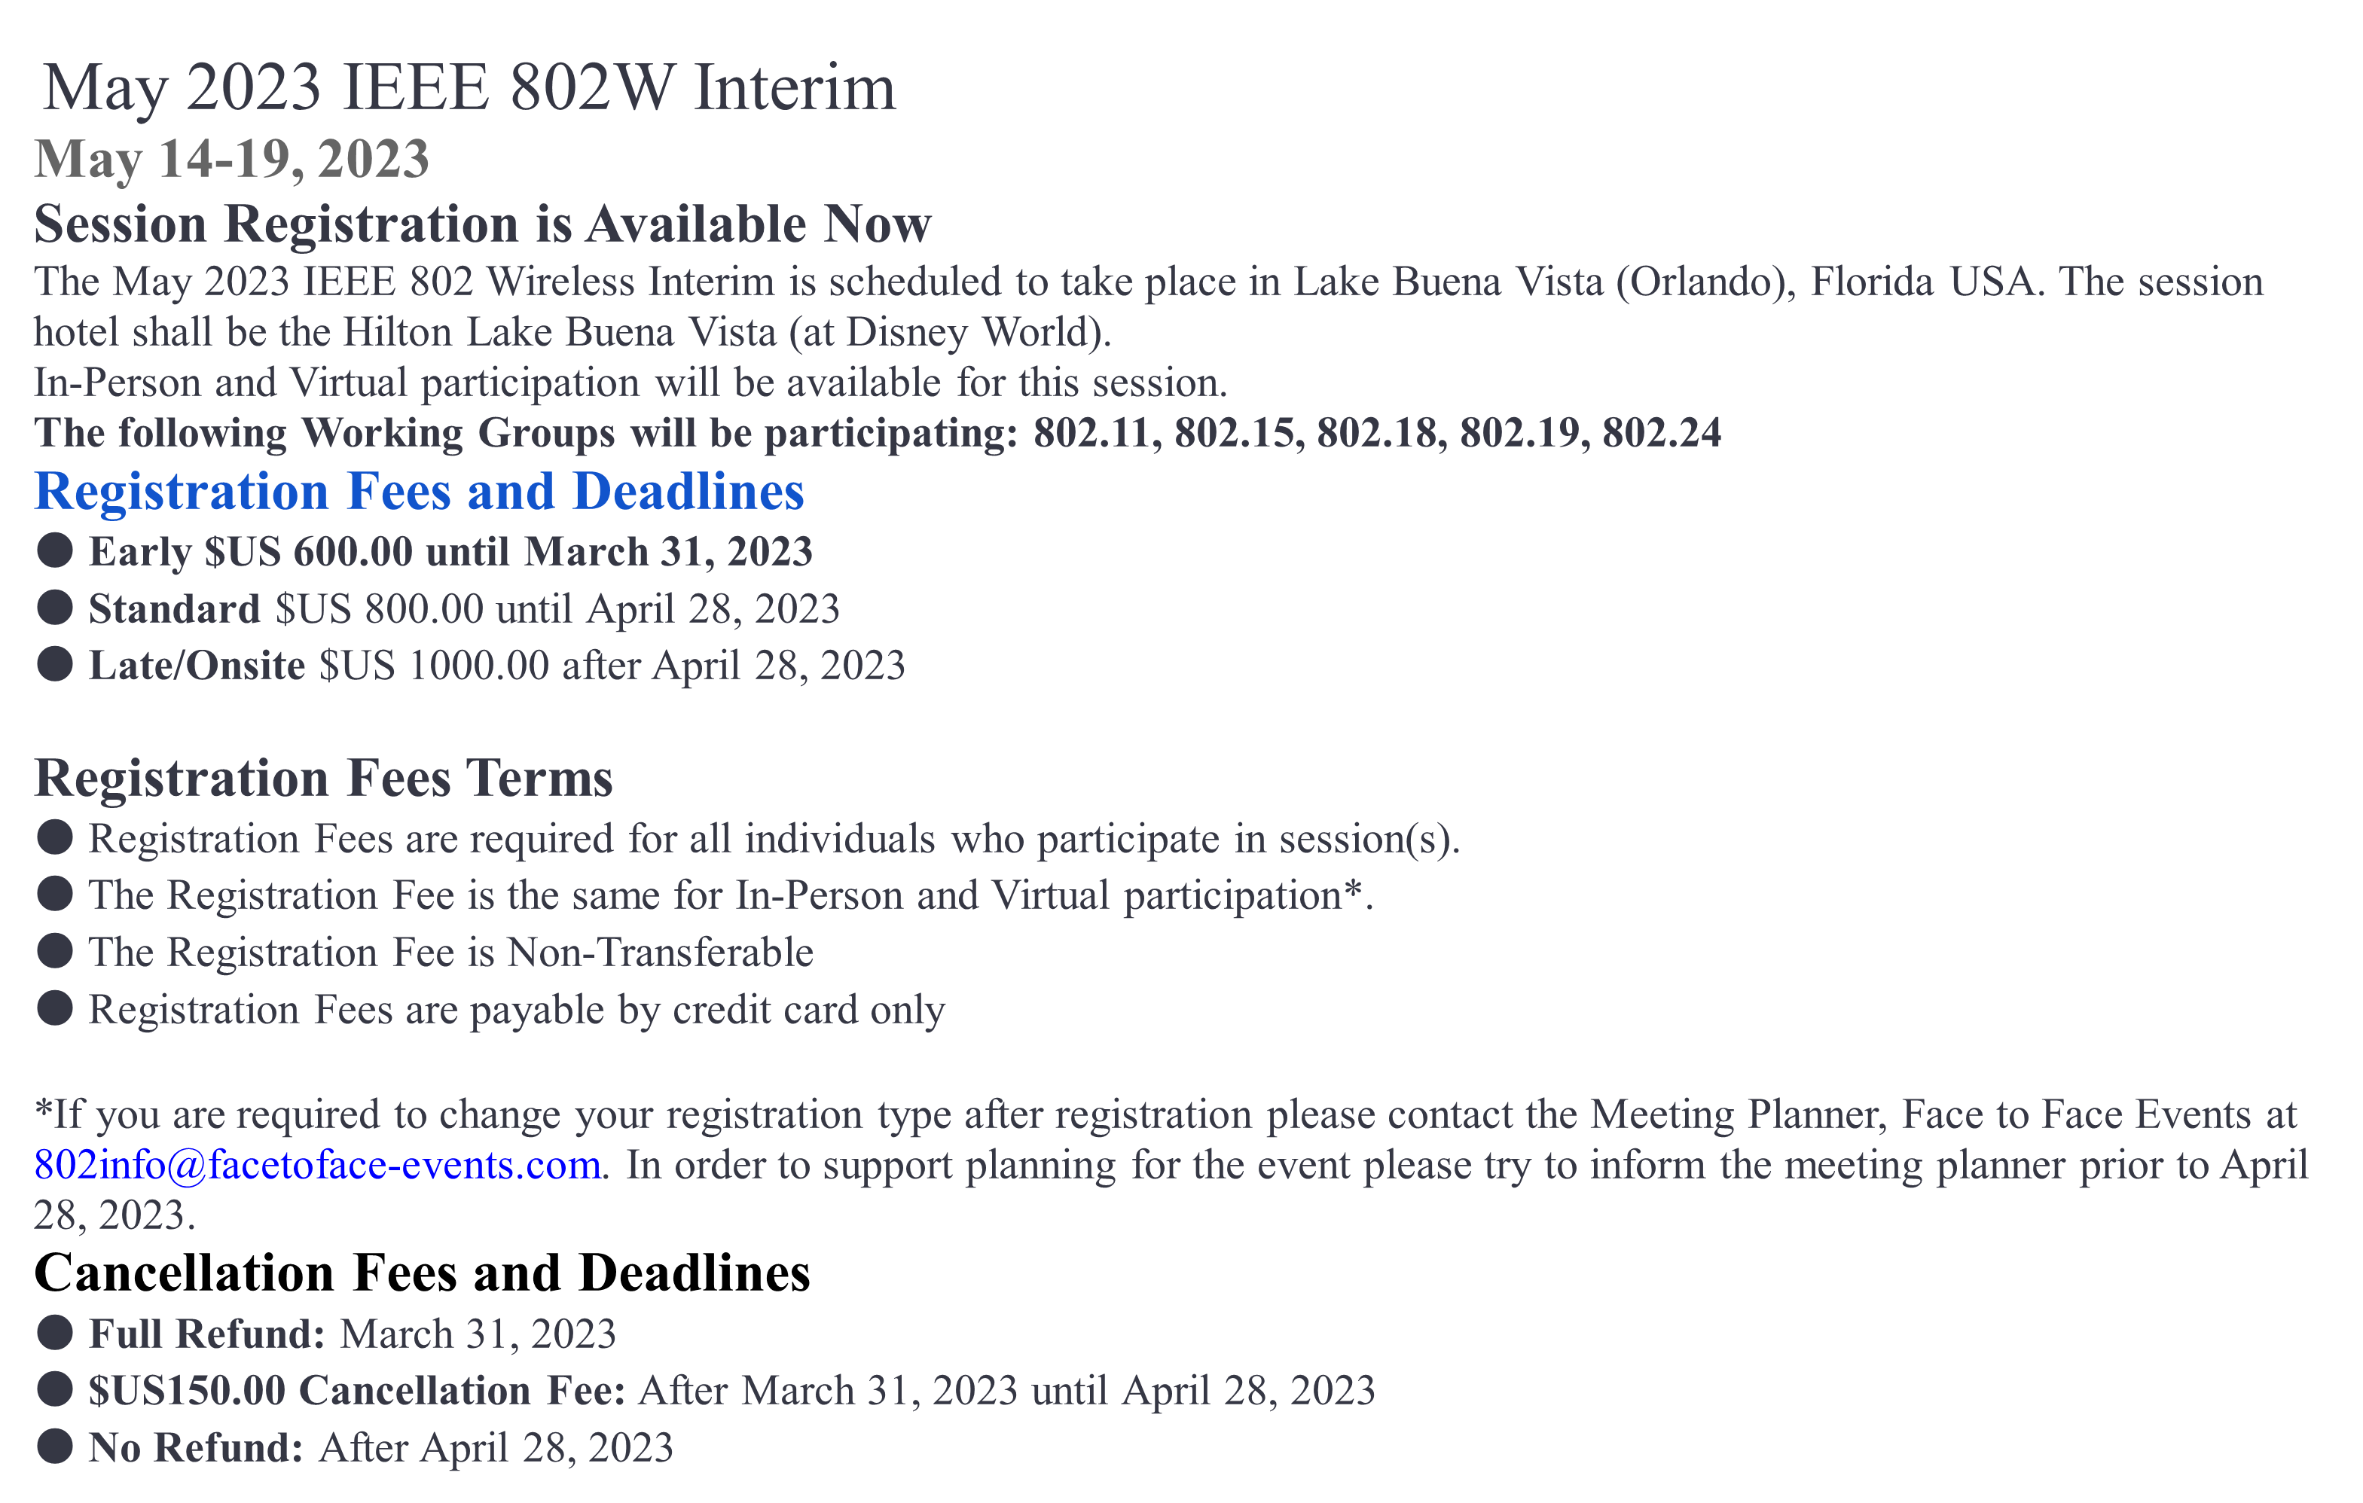
Session Registration Website
https://cvent.me/AwPbAx

Slide 17
Objectives of TG 6ma – Enhanced Dependability Body Area Network (ED-BAN)
Objective: Enhancements to the BAN Ultra Wideband (UWB) physical layer (PHY) and media access control (MAC) to support enhanced dependability to a human BAN (HBAN) and adds support for vehicle body area networks (VBAN), a coordinator in a vehicle with devices around the vehicular cabin.
Action:
Making draft#0 of Sumarried Draft Proposals
Finalize Channel and Coexisting Models
Summary of Technologies in PHY; Channel Coding According to 8 QoS Levels of Packets and Coexistence Levels, Interference Mitigation, etc.
Summary of Technologies in MAC; Channel Management, CCA, Hybrid Contention Free/Access Protocol According to 8 QoSs and Coexistences.
Harmonization or Commonality with 4ab in Coexistence and Feasible Implementation of 6ma and 4ab
Feasibility of TSN of 802.1 in MAC
Next Things to Do：
Finalize draft#1 of Integrated Proposal to Satisfy Technical Requirements

Slide 18
Agenda
Opening Session
  Attendance Check
  Administrative Items
  Call for Patents
  Session Schedule of This and Next Weeks
  Review minutes and approve minutes from last virtual meeting in March 2023. Doc.# 15-23-0190-00-06ma
  Current Meeting Agenda Doc.# 15-23-0231-00-06ma

Slide 19
Agenda items for the week
TG15.6ma meeting call to order
Call for essential patents and policies & procedures reminder
Approve last meeting minutes: TG 15.6ma Meeting Minutes for March 2023 doc.#15-23-0190-00-06ma
Agenda of TG15.6ma May Meeting doc.#15-23-0231-00-06ma
Review and Summary
  1. IG DEP, SG & TG15.6a Activity for Revision of IEEE802.15.6 BAN with Enhanced Dependability
  doc.#15-22-0339-03-06ma
  2. Technical Requirement Document of TG15.6ma doc.#15-21-0577-06-006a
  Call for Proposals doc.#15-22-0488-03-06ma
  Progress and Remained Issues in New Revision of Standard 802.15.6ma doc.#15-22-0663-03-06ma
  Presentation
  Qualitative approach to coexistence and QoS mechanisms doc.#15-23-0101-02-06ma
  Definition of Coexistence Levels and How to Support Higher Levels doc.#15-22-0631-02-06ma
  Simulation results for Nagoya I. T. and YRP-IAI MAC proposal doc.#15-23-0147-00-06ma
  MAC Protocol Proposal for Multiple BAN Environment (Level 1) doc.#15-22-0639-01-06ma
  MAC Protocol Using Negotiation among Coordinators in Coexistence of Multiple Wireless BANs 22-0633-01-06ma
  MAC Bridging for Time-Sensitive Networking of 802.15.6ma doc.#15-22-0024-03-06ma
  Preliminary harmonization with 4ab: MAC operation doc.#15-22-0634-03-06ma
  Propagation Characteristics of UWB Communication Applications for HBAN Use Cases doc.#15-23-0018-02-06ma
  Propagation Characteristics of UWB Communication Applications for VBAN Use Cases doc.#15-23-0019-02-06ma
  Propagation Simulations of UWB Communication Applications for HBAN and VBAN Use Cases 23-0020-03-06ma
  Channel Modeling Activities for BANs of TG15.6ma for Human and Vehicle Body Area Networks 23-241-00-06ma
  Summary Table of Channel and Environmental Modeling Activities for BANs on TG15.6ma doc.#15-23-0045-04-06ma
  Utilization of Channel and Environmental Model for Design and Evaluation of PHY proposals for BANs on TG15.6maary of Channel and Environmental Modeling Activities for BANs on TG15.6ma doc.#15-23-0AAA-00-06ma
  Overview of FEC proposals for 15.6ma doc.#15-22-0611-03-06ma
  Concept of channel codiing for IEEE802.15.6ma doc.#15-23-0244-00-06ma
  15. Evaluation of IEEE 802.15.6 Ultra-wideband Physical Layer Utilizing Super Orthogonal Convolutional Code
  doc.#15-22-0562-03-06ma
  17. Harmonization with 4ab: data rates & FEC doc.#15-22-0610-02-06ma
  18. Interference Mitdgation with Orthogonal Matched Filters in Time and Space Domains doc.#15-22-0575-02-06ma
  19. Soft Spectrum Aaptation(SSA) Based on Pulse Shaping for Interference Mitigation between UWB radio and Other Coexisting Radio doc.#15-22-0652-01-06ma
  20. Discussion on Harmonization with TG4ab doc.#15-23-0634-03-06ma
  21. Draft0 of IEEE802.15.6ma doc.#15.23-06xx-00-06ma
  22. Timeline of TG6ma doc.#15.23-0663-01-06ma

Slide 20
TG15.6ma Interim Session Schedule for 15-19th, May 2023
doc.:IEEE802.15.23-0107-06ma
TG15.6ma has three own sessions such as
Session1(Virtual RM#3) PM2 16:00-18:00 May 15(MON) in Orlando time(EST), 5:00-7:00 May 16(TUE) in JST
Session2(Virtual RM#2) AM1 8:00-10:00 May 16(TUE) in Orlando time (EST), 2100-23:00 May16(TUE) in JST
Session3(Virtual RM#2) AM1 8:30-10:00 May 17(WED)in Orlando time(EST), 5:30-7:00 May 18(THU) in JST
Session4(Virtual RM#2) AM1 8:00-10:00 May 18(THU) in Orlando time (EST), 2100-23:00 May19(FRI) in JST

Slide 21
Contacts and Conference call
Chair; Ryuji Kohno, YNU/YRP-IAI
kohno@ynu.ac.jp, kohno@yrp-iai.jp
Vice-Chair; Marco Hernandez, YRP-IAI/CWC
Marco.Hernandez@ieee.org
3. Secretary; Takumi Kobayashi, YNU/TCU
kobayashi-takumi-ch@ynu.ac.jp
Daisuke Anzai, NIT
anzai@nitech.ac.jp
Technical Editor; Minsoo Kim, YRP-IAI
minsoo@minsookim.com

Slide 22
Thank you for your attention

