Slide 1
doc.: 15-23-0228-01-04ab
Project: IEEE P802.15 Working Group for Wireless Personal Area Networks (WPANs)
Submission Title: Updates for Multiple Transmission
Date Submitted: May 9, 2023
Source: [Taeyoung Ha, Mingyu Lee, Youngwan So, Aniruddh Rao Kabbinale, Ankur Bansal, Clint Chaplin] Company [Samsung Electronics]
E-Mail: ty1115.ha@samsung.com
Abstract: Updates for Multiple RSF Transmissions in a Slot Scenario
Purpose: Increase air time efficiency by allowing the multiple MMRS transmission in a slot.
Notice: This document has been prepared to assist the IEEE P802.15. It is offered as a basis for discussion and is not binding on the contributing individual(s) or organization(s). The material in this document is subject to change in form and content after further study. The contributor(s) reserve(s) the right to add, amend or withdraw material contained herein.

Slide 2
PAR Objective | Proposed Solution (how addressed)
Safeguards so that the high throughput data use cases will not cause significant disruption to low duty-cycle ranging use cases
Interference mitigation techniques to support higher density and higher traffic use cases
Other coexistence improvement
Backward compatibility with enhanced ranging capable devices (ERDEVs)
Improved link budget and/or reduced air-time | Transmit RSF in a slot to reduce air-time
Additional channels and operating frequencies
Improvements to accuracy / precision / reliability and interoperability for high-integrity ranging
Reduced complexity and power consumption
Hybrid operation with narrowband signaling to assist UWB
Enhanced native discovery and connection setup mechanisms
Sensing capabilities to support presence detection and environment mapping
Low-power low-latency streaming
Higher data-rate streaming allowing at least 50 Mbit/s of throughput
Support for peer-to-peer, peer-to-multi-peer, and station-to-infrastructure protocols
Infrastructure synchronization mechanisms

Slide 3
Concerns on Multiple transmission
Power control
If body blocking occurs, significant signal attenuations can occur
If significant signal attenuations occurs, a weak signal may not be detected through the correlator
Implementation Complexity
In order to achieve multiple transmission scheme, a implementation complexity will increase

Slide 4
Experimental Environment
In order to check the impact of body blockings, RSSI values are measured in 16 cases
The location of Initiator (Receiver)'s antenna (leaned to Right or Left)
The status of Initiator's antenna (Blocked by hand or Not Blocked)
The status of Responder 1 (Right Transmitter)'s antenna (Blocked by hand or Not Blocked)
The status of Responder 2 (Left Transmitter)'s antenna (Blocked by hand or Not Blocked)

Slide 5
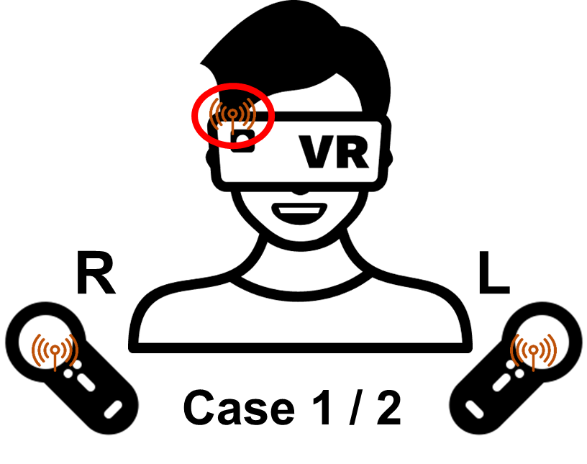
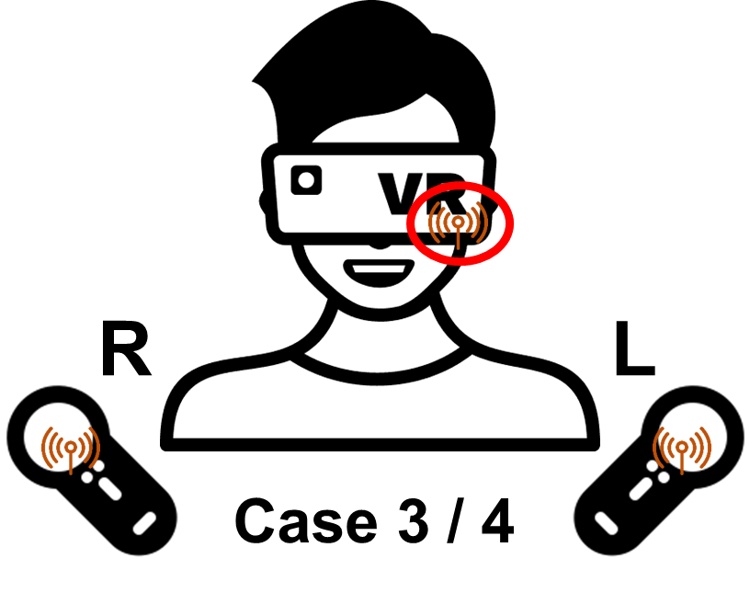
Experimental Environment
In order to check the impact of body blockings, RSSI values are measured in 16 cases
CASE 1: The antenna of Initiator is located at the upper right and not blocked.
CASE 2: The antenna of Initiator is located at the upper right and blocked by hand.
CASE 3: The antenna of Initiator is located at the lower left and not blocked.
CASE 4: The antenna of Initiator is located at the lower left and blocked by hand.

Slide 6
Experimental Results
Below figure shows the probability that the RSSI difference between Responder 1 and Responder 2 exceeds the 30 dB
(R) Not Blocked: Responder 1 is not blocked
(R) Blocked: Responder 1 is blocked by hand
(L) Not Blocked: Responder 2 is not blocked
(L) Blocked: Responder 2 is blocked by hand

Slide 7
Experimental Results
Below figure shows the probability that the RSSI difference between Responder 1 and Responder 2 exceeds the 30 dB
The worst case is that 1) the antenna of Initiator is located at the lower left and not blocked 2) Responder 1 is blocked by hand and Responder 2 is not blocked (i.e., yellow bar at the CASE 3)
In this case, the probability that the RSSI difference between Responder 1 and Responder 2 exceeds the 30 dB is about 0.006

Slide 8
Implementation Complexity
Current UWB chipsets in smartphones have multiple antenna and each antenna has its own correlator to measure AoA and etc.
If these antenna and correlator sets are used for detecting different RSFs, multiple transmission scheme can be achieved
Additional software updates or hardware may be needed

Slide 9
Summary
Power control
If body blocking occurs, significant signal attenuations can occur
If significant signal attenuations occurs, a weak signal may not be detected through the correlator
→ Based on the experimental results for VR scenario, the probability of significant signal attenuation is somewhat low
Implementation Complexity
In order to achieve multiple transmission scheme, a implementation complexity will increase
→ Current multiple antenna and correlator sets can be used
→ Additional hardware/software to implement new feature is inevitable

