Slide 1
        DOC: 15-23-0218-00-04ab
Project: IEEE P802.15 Working Group for Wireless Personal Area Networks (WPANs)
Submission Title: NBA-UWB MMS Operations
Date Submitted: May 2023
Source: Xiliang Luo, Vinod Kristem, Moche Cohen (Apple)
Address: One Apple Park Way, Cupertino, CA 95104, USA
E-Mails: xiliang_luo@apple.com
Abstract: Recommend parameter/feature sets for NBA-UWB MMS operations and provide the underlying rationale.
Purpose: Bring down the testing cost and facilitate interoperations of NBA-UWB MMS.
Notice: This document has been prepared to assist the IEEE P802.15. It is offered as a basis for discussion and is not binding on the contributing individual(s) or organization(s). The material in this document is subject to change in form and content after further study. The contributor(s) reserve(s) the right to add, amend or withdraw material contained herein.
Release: The contributor acknowledges and accepts that this contribution becomes the property of IEEE and may be made publicly available by P802.15.

Slide 2
        DOC: 15-23-0218-00-04ab
PAR Objective | Proposed Solution (how addressed)
Safeguards so that the high throughput data use cases will not cause significant disruption to low duty-cycle ranging use cases
Interference mitigation techniques to support higher density and higher traffic use cases | Periodicity-Division Multiple Access
Other coexistence improvement
Backward compatibility with enhanced ranging capable devices (ERDEVs)
Improved link budget and/or reduced air-time | MMS
Additional channels and operating frequencies
Improvements to accuracy / precision / reliability and interoperability for high-integrity ranging | MMS for high-integrity ranging
Reduced complexity and power consumption
Hybrid operation with narrowband signaling to assist UWB | NBA-MMS
Enhanced native discovery and connection setup mechanisms
Sensing capabilities to support presence detection and environment mapping
Low-power low-latency streaming
Higher data-rate streaming allowing at least 50 Mbit/s of throughput
Support for peer-to-peer, peer-to-multi-peer, and station-to-infrastructure protocols
Infrastructure synchronization mechanisms

Slide 3
Illustration of MMS Packet
        DOC: 15-23-0218-00-04ab

Slide 4
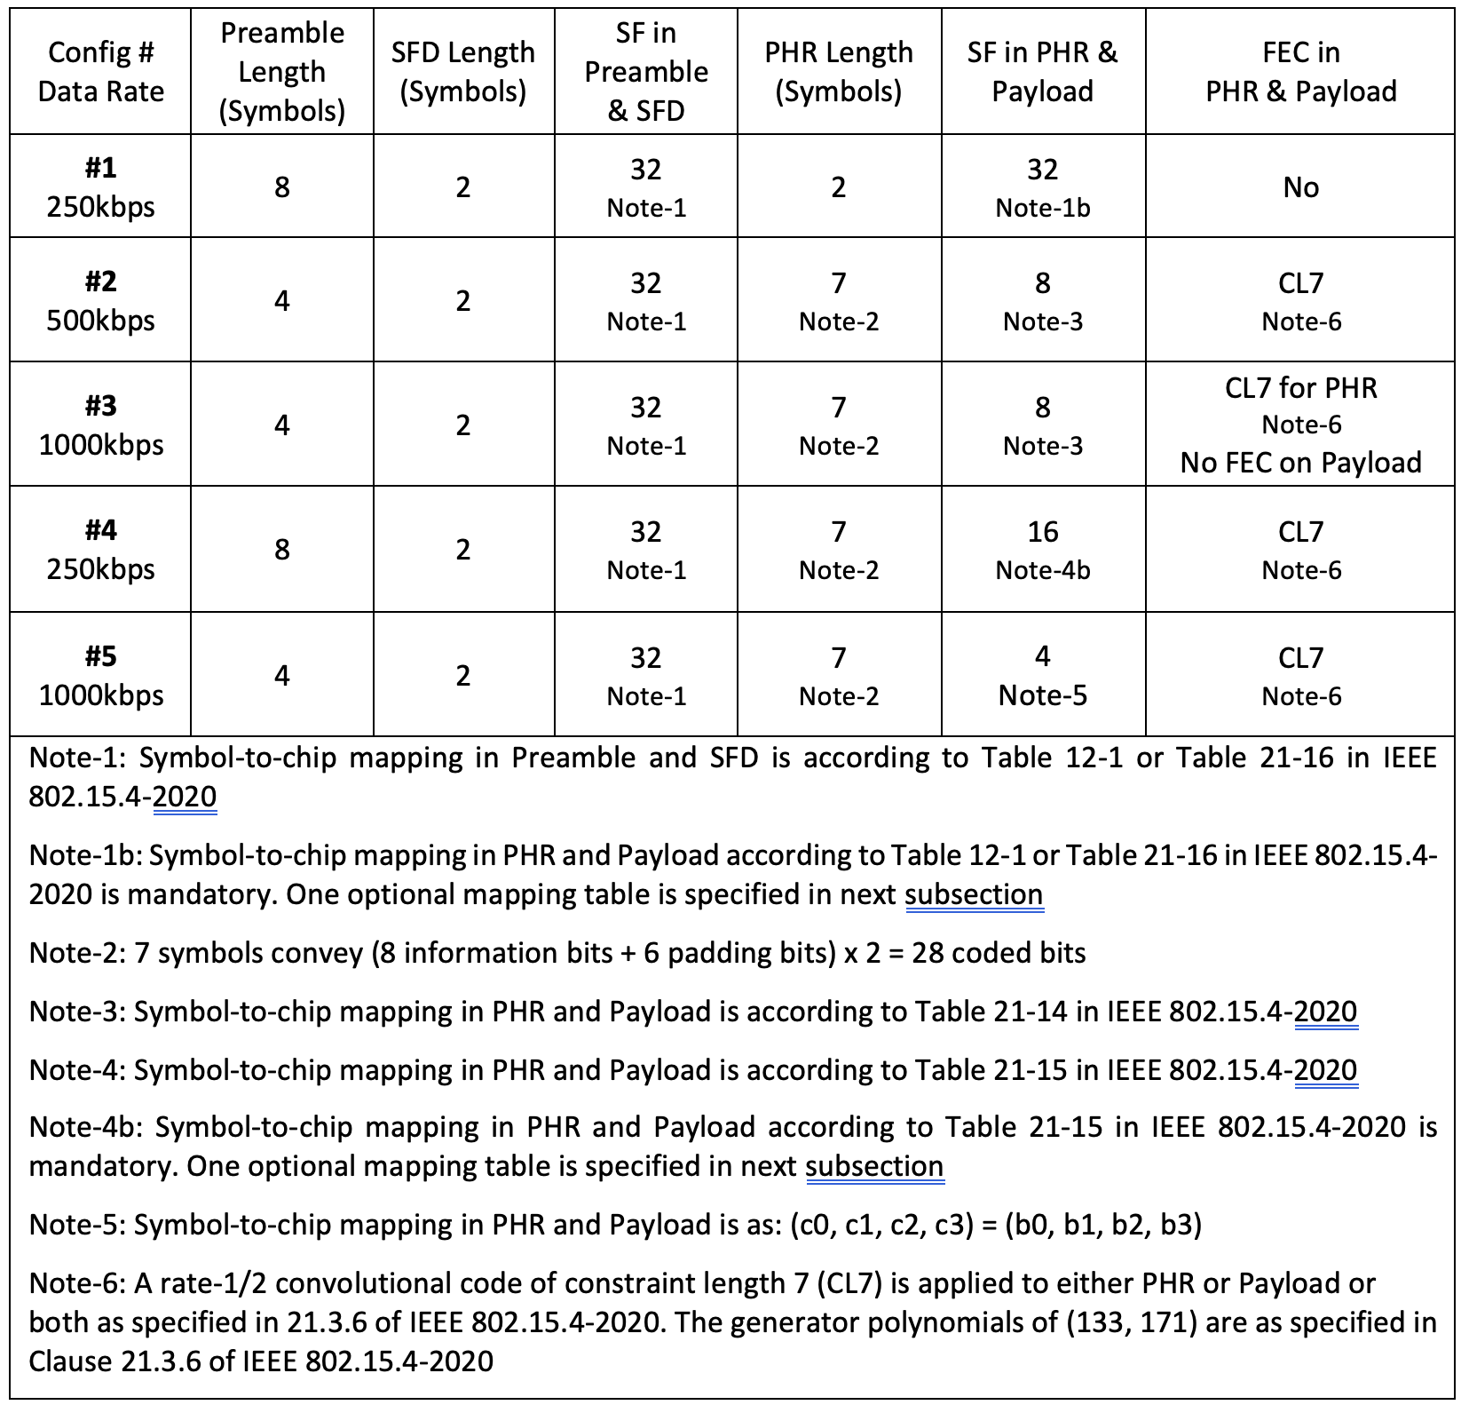
Ingredients on Table: NB Config #
        DOC: 15-23-0218-00-04ab

Slide 5
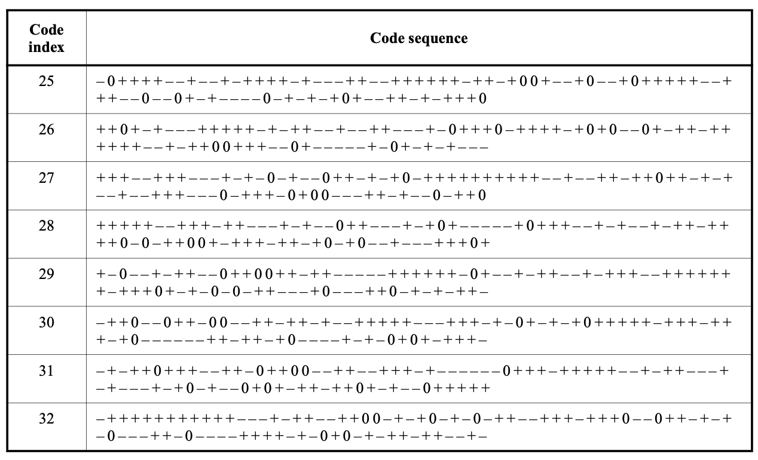
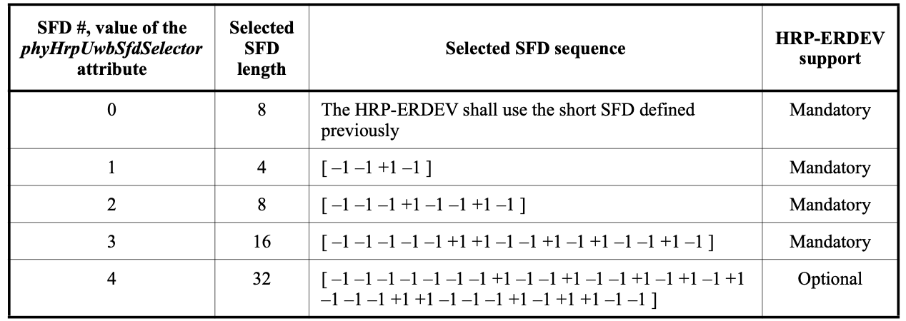
Ingredients on Table: UWB SHR
        DOC: 15-23-0218-00-04ab

Slide 6
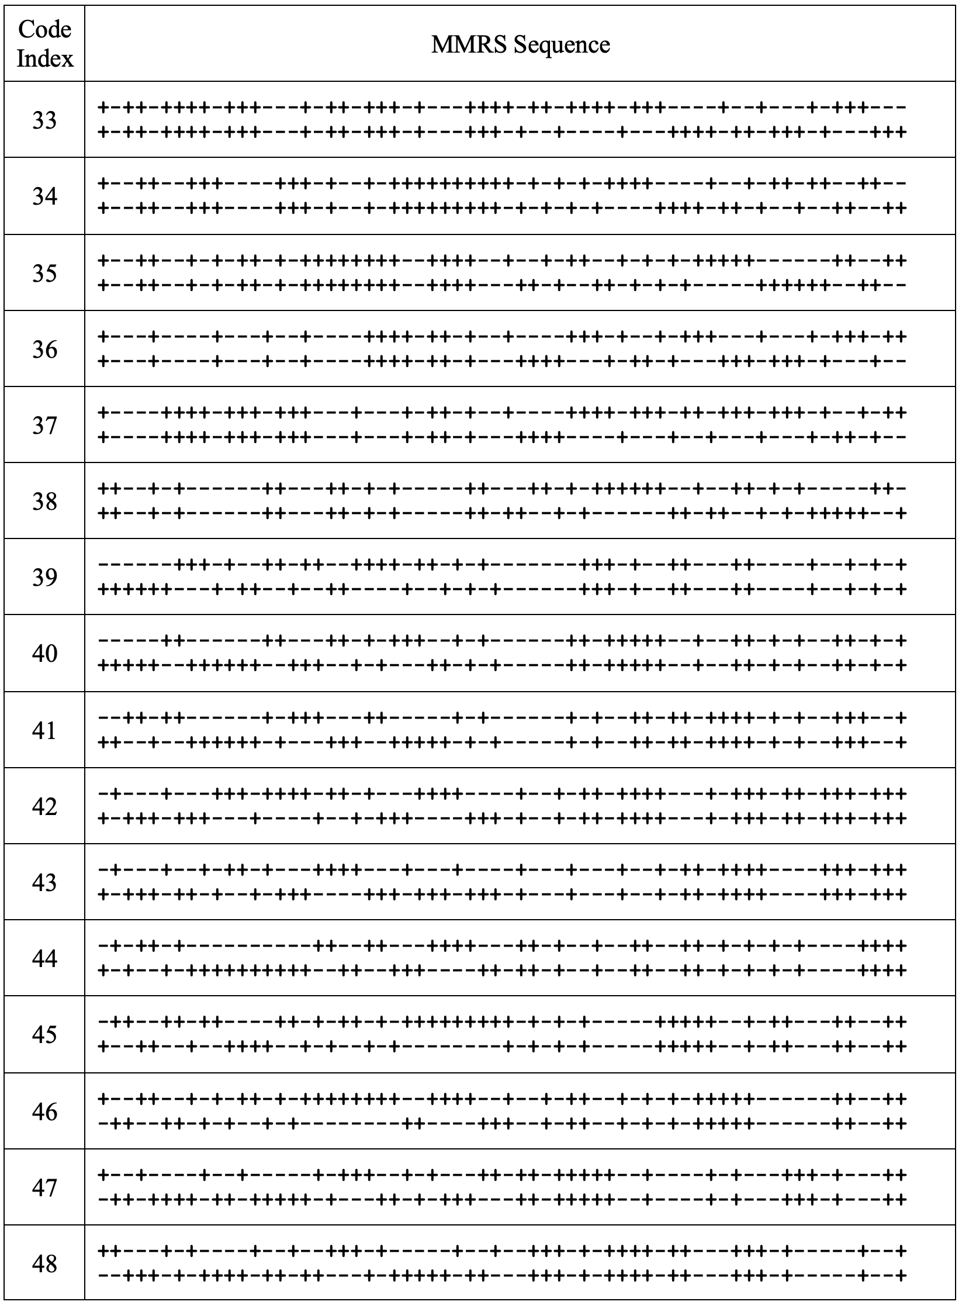
Ingredients on Table: MMRS Idx, MMRS Gap, N_MSR, Number of RSFs
        DOC: 15-23-0218-00-04ab
MMRS code index: 33~48
MMRS gap size: 0~64
The number of RSFs could be {0, 1, 2, 4, 8, 16}

Slide 7
Ingredients on Table: STS Segment Length, Number of RIFs
        DOC: 15-23-0218-00-04ab
The length of the STS segment is allowed from the set {32, 64, 128, 256} in the unit of 512 chips
The number of RIFs could be {0, 1, 2, 4, 8}

Slide 8
How to Manage All of These?
        DOC: 15-23-0218-00-04ab
MMRS configurations
  index 33~48
NBA-UWB MMS
  O-QPSK, RSF, RSF
UWB-Only MMS
  SHR, RSF, RSF
Acronyms and Abbreviations
NBA: narrow-band assistance
MMS: multi-millisecond
NBA-UWB: narrow-band assisted ultra-wideband
RSF: ranging sequence fragment
RIF: ranging integrity fragment
MMRS: multi-millisecond ranging sequence
N_MSR: number of MMRS symbol repetitions within one RSF
RSF-RMARKER: ranging marker in ranging sequence fragment
RIF-RMARKER: ranging marker in ranging integrity fragment

Slide 9
Solution-1: Advanced Ranging Device
        DOC: 15-23-0218-00-04ab
NBA-UWB MMS
  necessary to deliver the promise of 4ab on link budget improvement of 4ab wrt 4z
  UNII-3 is mandated
    5.725 – 5.850 GHz
  UNII-5 is optional
    5.925 – 6.425 GHz
UWB-Only MMS
  UNII-3/5 is not always available for NBA operations
HRP-ERDEVp
NBA-UWB MMS
1
UWB-Only MMS
2
HRP-ARDEV
Note: NB refers to O-QPSK

Slide 10
Solution-2: Mandate Min & Define Max
        DOC: 15-23-0218-00-04ab
Only mandate a minimum set of operation parameter sets
  facilitate inter-op
  lower-down test efforts
  no compromise to the features and all allowed combinations can be used whenever both parties support

Slide 11
1. MMRS Configurations
RSF PSD vs MMRS Gap Size
        DOC: 15-23-0218-00-04ab
A larger sequence period leads to smoother spectrum ⇒ enables more efficient use of the spectral mask!
Ref: ETSI EN 303 883 V1.1.1 (2016-09) : Short Range Devices (SRD) using Ultra Wide Band (UWB); Measurement Techniques

Slide 12
MMRS Configurations
        DOC: 15-23-0218-00-04ab
MMRS Config Set# | MMRS Code Index | Gap Size | MMRS Period with Gap | Note
1 ~ 6 | 33 Note-1 | 0, 2, 3, 4, 5, 7 | 128 ~ 142 | Note-2
7 ~ 12 | 33 Note-1 | 8, 9, 10, 11, 12, 15 | 144 ~ 158 | Note-2
13 ~ 18 | 33 Note-1 | 16, 17, 18, 19, 21, 22 | 160 ~ 172 | Note-2
19 ~ 24 | 33 Note-1 | 23, 24, 25, 26, 28, 30 | 174 ~ 188 | Note-2
25 ~ 30 | 33 Note-1 | 31, 32, 33, 35, 36, 37 | 190 ~ 202 | Note-2, Note-3
31 ~ 36 | 33 Note-1 | 38, 39, 42, 43, 44, 45 | 204 ~ 218 | Note-2, Note-3
37 ~ 42 | 33 Note-1 | 46, 47, 49, 50, 51, 52 | 220 ~ 232 | Note-2, Note-3
43 ~ 49 | 33 Note-1 | 54, 56, 57, 58, 59, 61, 64 | 236 ~ 256 | Note-2, Note-3
Note-1: each one of the 16 MMRS codes can be used in this table. One particular one is picked to facilitate inter-op. Note-2: all the sequence periods are coprime with {31, 91, 127} Note-3: a larger gap size enables higher energy efficiency Note-4: a subset can be chosen to enable optimum interference suppression, e.g., by ensuring the GCD among the MMRS periods to be as small as possible. One such subset of gap sizes could be {0, 3, 5, 7, 9, 15, 19, 21, 25, 33, 37, 39, 43, 45, 49, 57}. Another subset of gap sizes could be {64, 61, 59, 57, 49, 45, 43, 39, 37, 33, 25, 19, 15, 9, 7, 3}

Slide 13
2. NBA-UWB RSF-Only MMS
        DOC: 15-23-0218-00-04ab
Each configuration set will be able to maximize the link budget improvement of 4ab wrt 4z
  A total of 16 RSFs can be coherently combined
  Each RSF can utilize the energy budget efficiently
    a larger MMRS gap size is configured
Each RSF is kept around 64us to minimize the chance of collision to other MMS packets
  a larger MMRS gap is combined with a smaller N_MSR

Slide 14
NBA-UWB RSF-Only MMS
        DOC: 15-23-0218-00-04ab
RSF-Only Set# | NB Config# | Number of RSFs: X | N_MSR | MMRS Config |  | RSF Length (us) | Note
 |  |  |  | MMRS Config Set# | Gap Size
1 | 1 | 16 | 40 | 27 | 33 | 62.2 | Note-1
2 | 1 | 16 | 40 | 30 | 37 | 64.7 | Note-1
3 | 1 | 16 | 40 | 32 | 39 | 66.0 | Note-1
4 | 1 | 16 | 40 | 34 | 43 | 68.6 | Note-1
5 | 1 | 16 | 40 | 36 | 45 | 69.9 | Note-1
6 | 1 | 16 | 32 | 39 | 49 | 57.9 | Note-1
7 | 1 | 16 | 32 | 45 | 57 | 62.0 | Note-1
8 | 1 | 16 | 32 | 47 | 59 | 63.1 | Note-1
9 | 1 | 16 | 32 | 48 | 61 | 64.1 | Note-1
10 | 1 | 16 | 32 | 49 | 64 | 65.6 | Note-1
Note-1: this configuration enables the max link budget gain by 4ab wrt 4z

Slide 15
3. NBA-UWB Mixed MMS
        DOC: 15-23-0218-00-04ab
Each RSF contains the same number of UWB pulses as each RIF
A larger MMRS gap is used in RSF to optimize the energy efficiency
Each RSF duration is kept below 92us
Each RIF duration is 65.6us
Baseline modes:
  (X=Y=1,2,4,8)
  (X=1, Y=2,4,8)

Slide 16
NBA-UWB Mixed MMS
        DOC: 15-23-0218-00-04ab
Mixed MMS Set# | NB Config# | Number of RSFs: X | N_MSR | MMRS Config |  | Number of RIFs: Y | RIF: STS length | Note
 |  |  |  | MMRS Config Set# | Gap Size
1 | 1 | 1 | 64 | 21 | 25 | 1 | 64 | Note-1
2 | 1 | 1 | 64 | 21 | 25 | 2 | 64 | Note-1
3 | 1 | 1 | 64 | 21 | 25 | 4 | 64 | Note-1
4 | 1 | 1 | 64 | 21 | 25 | 8 | 64 | Note-1
5 | 1 | 2 | 64 | 21 | 25 | 2 | 64 | Note-1
6 | 1 | 4 | 64 | 21 | 25 | 4 | 64 | Note-1
7 | 1 | 8 | 64 | 21 | 25 | 8 | 64 | Note-1
Note-1: each RSF and RIF contain the same number of pulses

Slide 17
4. UWB-Only MMS
        DOC: 15-23-0218-00-04ab
A straightforward extension of 4z STS packet configuration 3
Baseline: X=0, Y=1
SYNC
S
F
D
1
us
STS
4z STS Packet Config Three
SYNC
S
F
D
STS
4ab
1ms

Slide 18
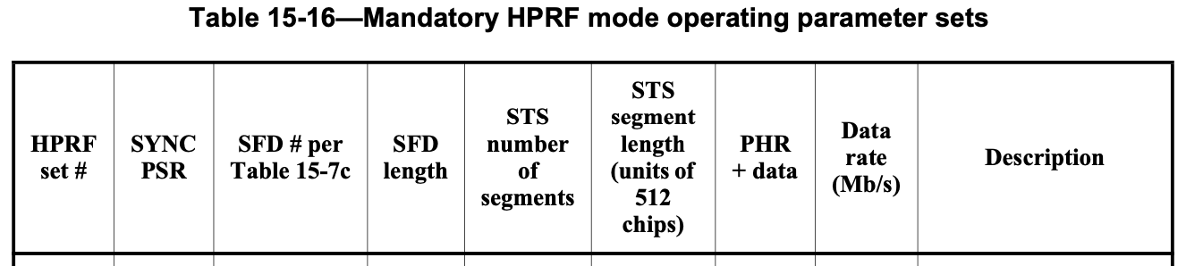
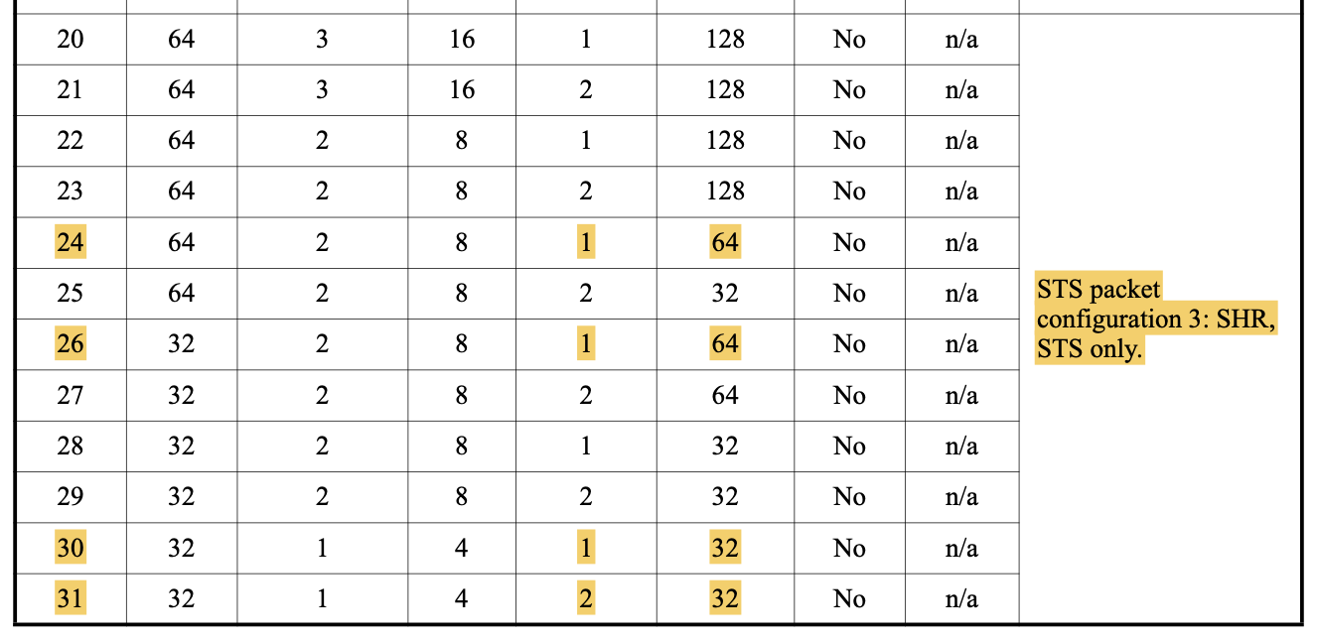
UWB-Only MMS
        DOC: 15-23-0218-00-04ab
UWB-only MMS Set# | UWB Sync PSR | UWB SFD # | SFD Length | Number of RSFs: X | Number of RIFs: Y | RIF: STS length | Note
1 | 32 | 2 | 8 | 0 | 1 | 32 | Ref to HPRF#28 in 4z Table 15-16
2 | 64 | 2 | 8 | 0 | 1 | 64 | Ref to HPRF#24 in 4z Table 15-16

