Slide 1
Project: IEEE P802.15 Working Group for Wireless Personal Area Networks (WPANs)
Submission Title: More considerations on one-to-many NBA-MMS UWB initialization
Date Submitted: May, 2023
Source: Kuan Wu, Lei Huang, Rojan Chitrakar, Yunbo Li, David Xun Yang (Huawei Technologies)
Email: wukuan2@huawei.com
Abstract: Considerations for initialization and configuration updates in one-to-many NBA-MMS UWB
Purpose: Further proposals on one-to-many NBA-MMS UWB by harmonizing latest discussion results on NBA-MMS UWB initialization and coordination
Notice: This document has been prepared to assist the IEEE P802.15. It is offered as a basis for discussion and is not binding on the contributing individual(s) or organization(s). The material in this document is subject to change in form and content after further study. The contributor(s) reserve(s) the right to add, amend or withdraw material contained herein.
Release: The contributor acknowledges and accepts that this contribution becomes the property of IEEE and may be made publicly available by P802.15.

Slide 2
PAR Objective | Proposed Solution (how addressed)
Safeguards so that the high throughput data use cases will not cause significant disruption to low duty-cycle ranging use cases
Interference mitigation techniques to support higher density and higher traffic use cases
Other coexistence improvement
Backward compatibility with enhanced ranging capable devices (ERDEVs)
Improved link budget and/or reduced air-time
Additional channels and operating frequencies
Improvements to accuracy / precision / reliability and interoperability for high-integrity ranging
Reduced complexity and power consumption
Hybrid operation with narrowband signaling to assist UWB
Enhanced native discovery and connection setup mechanisms | Follow-up on initialization and configuration considerations for one-to-many NBA-MMS UWB
Sensing capabilities to support presence detection and environment mapping
Low-power low-latency streaming
Higher data-rate streaming allowing at least 50 Mbit/s of throughput
Support for peer-to-peer, peer-to-multi-peer, and station-to-infrastructure protocols
Infrastructure synchronization mechanisms

Slide 3
Previous Contributions and references
DCN 23-0125r1 (March 2023) “Follow up on one-to-many NBA-MMS UWB”, Kuan Wu, et al.
DCN 23-0185r1 (March 2023) “Discussion on NBA-MMS-UWB MAC”, Alexander Krebs
DCN 23-0150r0 (March 2023) “Updates regarding Coordination in NBA-UWB-Ranging TFD”, Mingyu Lee, et al.
DCN 23-0216r0 (May 2023) “Secured frames for MMS ranging”, Rojan Chitrakar, et al.
DCN 22-0585r1 (November 2022) “One-to-Many Ranging using NBA-MMS”, Jinjing Jiang, et al.

Slide 4
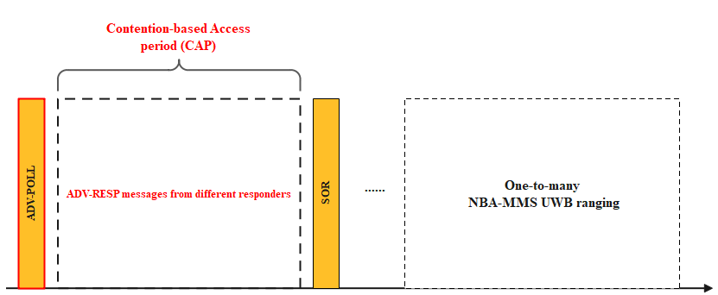
Recap: ADV-POLL in initialization for one-to-many ranging
In one-to-many NBA-MMS UWB ranging initialization and setup, following considerations are discussed [1]
  During the initialization and setup phase, initiator shall specify a contention access based period (CAP) to collect ADV-RESP messages from multiple responders
  The broadcast ADV-POLL packet shall indicate the time duration to define the CAP.

Slide 5
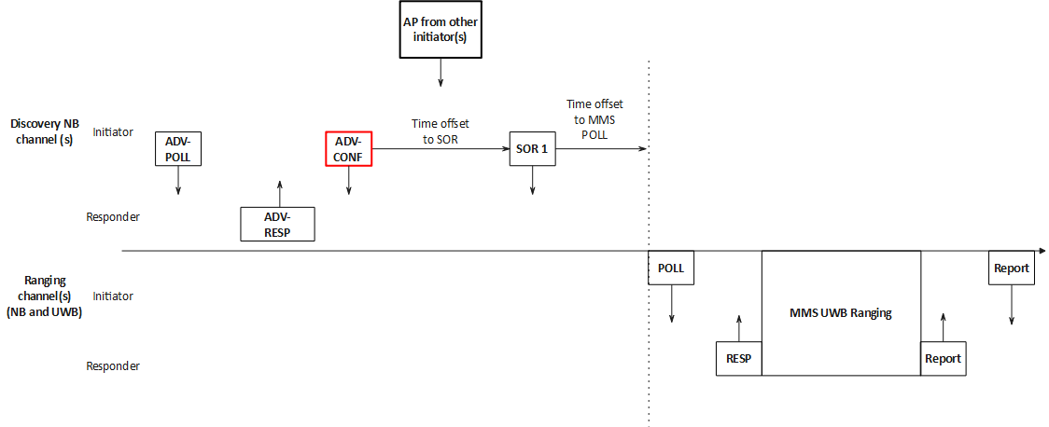
Recap: Coordination and initialization
Relationships between NBA-MMS UWB coordination and initialization are studied by 4ab discussion [2]
  By using ADV-CONF [3], initiator advertising can defer AP scanning. → For power saving considerations
  ADV-CONF defers SOR through a time offset announcement → Allowing responders to know the exact time offset to SOR.
  Initiator scans for AP information from other initiator(s) for coordination, and then sends SOR at the announced time offset.
  Initialization carries privacy sensitive information that needs to be protected. → SOR message itself is preferred for unicast transmission for each responder.
Remark: Further relationship between Coordination & Initialization and one-to-many NBA-MMS UWB ranging is not well explored.

Slide 6
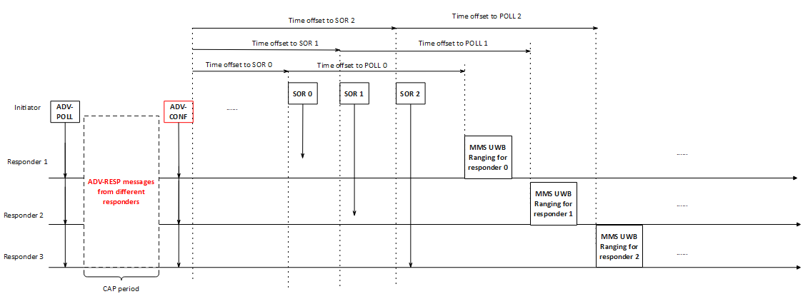
Proposal
For one-to-many ranging use case, prior to the ranging period, multiple SOR messages are transmitted by initiator to commence the configuration for each responder
  SOR message for each responder is preferred in a unicast manner for privacy concern (e.g., supporting encryption of sensitive information in the frame(s) [4]).
  Each SOR message is transmitted in a one-by-one manner.
  One-to-many ranging round can be regarded as multiple concatenated one-to-one ranging rounds.
Initiator transmits ADV-CONF message instead of SOR messages at the end of the CAP period.
  The ADV-CONF message manages the scheduling of the multiple SOR messages.

Slide 7
Proposal (cont.)
Defining a new ADV-POLL message (ID: 0x30) to define the CAP.
  CAP duration：Determining the number of the CAP slots. The size of the CAP slot can be pre-defined.
  More message content and its control fields can be added upon further discussions.
Octets :1 | TBD | TBD | TBD | TBD | 2
ID (0x30) | Addressing fields | Presence Control fields | CAP duration | TBD | CRC 16
  ADV-POLL
Example format of the new ADV-POLL message

Slide 8
Proposal (cont.)
Allowing ADV-CONF message (ID: 0x23) to manage the scheduling of the SOR messages.
  A SOR Messages Scheduling List is provided.
  More message content and its control fields can be added upon further discussions.
Octets :1 | TBD | TBD | TBD | TBD | 2
ID (0x23) | Addressing fields | Presence Control fields | SOR Messages Management | TBD | CRC 16
  ADV-CONF
Example format of the ADV-CONF message
SOR Messages Management
Bits: 0 | 1-7 | Octets: Variable
Address Type | SOR Messages Scheduling List Length | SOR Messages Scheduling List
Octets: 2 | 2 | 2 | ……
SOR Messages Scheduling List Element # 0 | SOR Messages Scheduling List Element # 1 | SOR Messages Scheduling List Element # 2
SOR Messages Scheduling List
SOR Messages Scheduling List
element
Octets: TBD | 2/8
Time offset to Next SOR | Device address

Slide 9
Summary
In this contribution, further updates on one-to-many NBA-MMS UWB ranging by considering Coordination & Initialization are proposed.
  A new ADV-POLL (ID: 0x30) message to define the CAP.
  Prior to the ranging period, multiple SOR messages are transmitted by initiator to commence the configuration for each responder.
  The ADV-CONF message manages the scheduling of the multiple SOR messages.
Further updates on the detailed message format to harmonize feedbacks from 4ab group discussions on NBA-MMS UWB MAC.

Slide 10
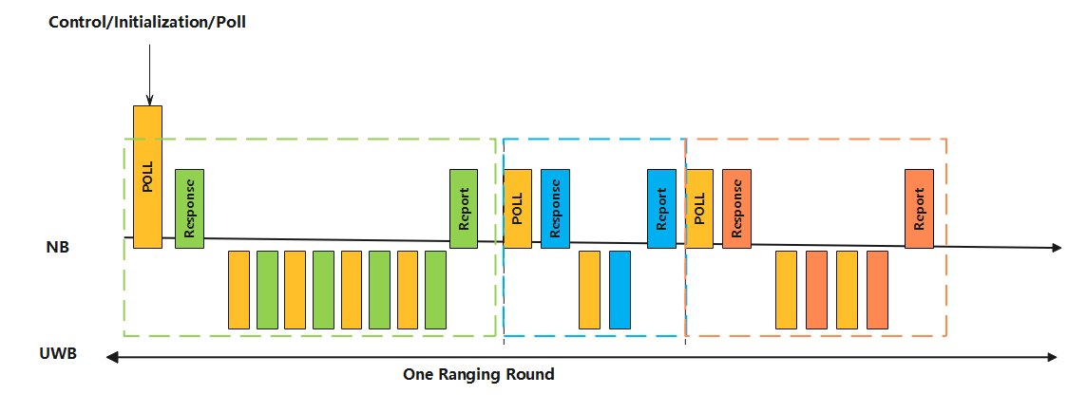
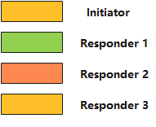
Appendix
Recap of one-to-many NBA-MMS UWB ranging [5].
  Concatenating multiple responders in NBA-MMS UWB ranging.

