Slide 1
Project: IEEE P802.15 Working Group for Wireless Personal Area Networks (WPANs)
Submission Title: Secured frames for MMS ranging
Date Submitted: 5 September, 2023
Source: Rojan Chitrakar, Lei Huang, Bin Qian, David Xun Yang (Huawei Technologies)
Email: rojan.chitrakar@huawei.com
Abstract: Considerations for security for MMS ranging.
Purpose: Considerations for security for MMS ranging.
Notice: This document has been prepared to assist the IEEE P802.15. It is offered as a basis for discussion and is not binding on the contributing individual(s) or organization(s). The material in this document is subject to change in form and content after further study. The contributor(s) reserve(s) the right to add, amend or withdraw material contained herein.
Release: The contributor acknowledges and accepts that this contribution becomes the property of IEEE and may be made publicly available by P802.15.

Slide 2
PAR Objective | Proposed Solution (how addressed)
Safeguards so that the high throughput data use cases will not cause significant disruption to low duty-cycle ranging use cases
Interference mitigation techniques to support higher density and higher traffic use cases
Other coexistence improvement
Backward compatibility with enhanced ranging capable devices (ERDEVs)
Improved link budget and/or reduced air-time
Additional channels and operating frequencies
Improvements to accuracy / precision / reliability and interoperability for high-integrity ranging
Reduced complexity and power consumption
Hybrid operation with narrowband signaling to assist UWB | Mechanism to provide security for frames used for MMS ranging (NBA or UWB)
Enhanced native discovery and connection setup mechanisms | Mechanism to provide security for frames used for MMS ranging (NBA or UWB)
Sensing capabilities to support presence detection and environment mapping
Low-power low-latency streaming
Higher data-rate streaming allowing at least 50 Mbit/s of throughput
Support for peer-to-peer, peer-to-multi-peer, and station-to-infrastructure protocols
Infrastructure synchronization mechanisms

Slide 3
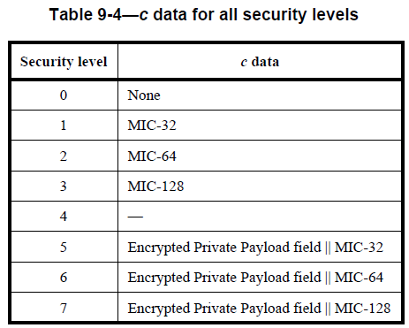
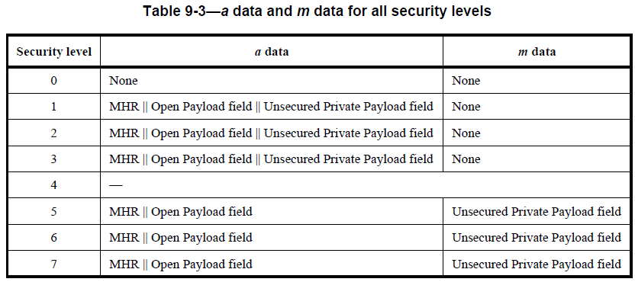
Background: Authenticated encryption with associated data (AEAD) Security Operation in 802.15.4-2020
AEAD encryption and authentication transformation (CCM* using AES-128) :
3 levels for Authentication and 3 levels for encryption are provided.
The inputs are as follows:
Key
Nonce
a data (AddAuthData: data to be authenticated)
m data (PlaintextData: data to be encrypted)
The output is c data (Ciphertext + MIC)
The Private Payload field of the original unsecured frame shall be replaced by the right-concatenation of that field and the c field if data confidentiality is not provided and shall be replaced by the c field otherwise

Slide 4
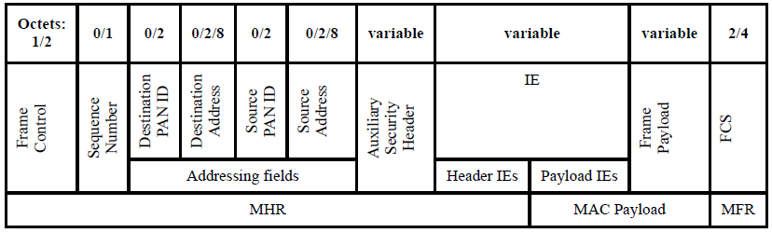
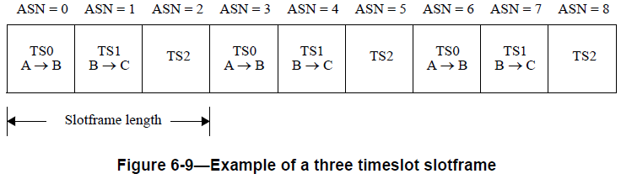
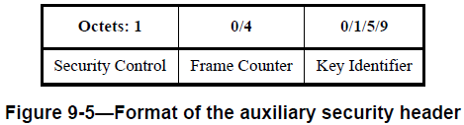
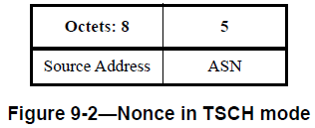
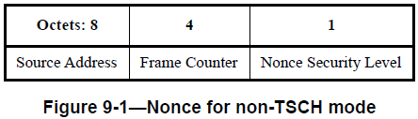
Background: Authenticated encryption with associated data (AEAD) Security Operation in 802.15.4-2020
AEAD transformation and inverse transformation:
The Nonce is constructed from the content of the MHR:
In TSCH mode, Absolute Slot Number (ASN) is used in Nonce instead of frame counter. Frame Counter is not present in the MHR.

Slide 5
Discussion
As explained earlier, 802.15.4-2020 already provides comprehensive AEAD security operation. We would like to reuse the existing AEAD operation for 802.15.4ab as much as possible for both NB and non-NB frames.
Annex B mandates that within the scope of any encryption key, the nonce value shall be unique. Two formats of nonce are provided in 802.15.4-2020 :
A key question is how to construct the variable field of the Nonce (Frame Counter or ASN), especially for compressed frames that do not carry a frame counter?
Octets: 1 | 3 | 0 or 3 | 1 | variable | 2
ID | RPA_hash | RPA_prand | Message Control | Message Content | CRC

Slide 6
Revised proposal (compared to 23/216r0)
Frames transmitted within Measurement Cycles (e.g., REPORT) may be secured.
Nonce construction:
  The Source Address field is set as the extended address of the device originating the frame.
  The indices of the Block, Round, Slot in which a secured frame is transmitted or received is used as a frame counter to construct the nonce.
Nonce
Octets: 8 | Bits: 0-7 | 8-23 | 24-39
Source Address | Frame Counter (40 bits)
 | Slot Index | Round Index | Block Index
Nonce Uniqueness:
  In order to ensure the uniqueness of the nonce, the security Key should be updated every time the block structure is restarted (re-setup). The same security Key should not be used across multiple block structures.

Slide 7
Revised proposal
Example (if an encrypted REPORT is transmitted in slot m, round 1 of block 1):
Nonce
Octets: 8 | Bits: 0-7 | 8-23 | 24-39
Source Address | Frame Counter (40 bits)
 | Slot Index = m | Round Index = 1 | Block Index = 1

Slide 8
Block Structure synchronization
To achieve block structure synchronization, initiator includes block and round indices in POLL messages.
Poll
Octets: 1 | 3 | 3 | 1 | variable | 2
ID | RPA_hash | RPA_prand | Message Control | Message Content | CRC
 | Octets: 0 or 2 | 0 or 2
… | BlockIndex | RoundIndex

Slide 9
Secured REPORT frame
Secured REPORT frame can carry encrypted payload. Secured REPORT frame includes a Key ID field to indicate Key update.
Encrypted REPORT
Octets: 1 | 3 | 1 | variable | 4/8/16
ID | RPA_hash | Message Control | Message Content | MIC
CRC is replaced by the MIC
Octets: 1 | 0 or variable | 0 or 4
PTDataLength | Unencrypted Payload (PT Data, PHY/MAC config etc.) | Encrypted Payload (RT or TAT)
ID indicates a secured frame
Bits: 0-6 | 7
Data Length | Key ID
Key ID of the key used to secure the frame (to indicate that key has been updated).

Slide 10
Summary
We discussed enabling security for selected compressed frames (REPORT).
We proposed:
The indices of the Block, Round, Slot in which a secured frame is transmitted or received is used as a frame counter to construct the nonce.
To achieve block structure synchronization, initiator includes block and round indices in POLL messages.
Secured frame includes a Key ID field to indicate Key update.

