Slide 1
Project: IEEE P802.15 Working Group for Wireless Specialty Networks (WSN)
Submission Title: TG4ab March 2023 Closing Report
Date Submitted: 16 March 2023
Source: Benjamin A. Rolfe (Blind Creek Associates)
Contact:
Voice: +1 408 395 7207, E-Mail: ben.rolfe @ ieee.org
Re: Task Group 4ab: 802.15.4 UWB Next Generation
Abstract: Mixed-mode interim session meeting slides
Purpose: Emulate organization, encourage participation and make further progress
Notice: This document has been prepared to assist the IEEE P802.15. It is offered as a basis for discussion and is not binding on the contributing individual(s) or organization(s). The material in this document is subject to change in form and content after further study. The contributor(s) reserve(s) the right to add, amend or withdraw material contained herein.
Release: The contributor acknowledges and accepts that this contribution becomes the property of IEEE and may be made publicly available by P802.15.
Notes:
Jul 12, 2010
Page 1

Slide 2
Task Group 15.4ab Next Generation UWB Amendment
Mixed Mode Plenary, March 2023
Live from
Atlanta, GA, USA,

Slide 3
Task Group 15.4ab Next Generation UWB Amendment
Objective: enhancements to 802.15.4 Ultra Wideband (UWB) physical layers (PHYs) medium access control (MAC) and associated ranging techniques while retaining backward compatibility with enhanced ranging capable devices (ERDEVs).

Slide 4
5.2.b Scope of the project (As approved):
This amendment enhances the Ultra Wideband (UWB) physical layers (PHYs) medium access control (MAC), and associated ranging techniques while retaining backward compatibility with enhanced ranging capable devices (ERDEVs). Areas of enhancement include:
additional coding, preamble and modulation schemes to additional coding, preamble and modulation schemes to support improved link budget and/or reduced air-time relative to IEEE Std 802.15.4 UWB;
additional channels and operating frequencies;
interference mitigation techniques to support greater device density and higher traffic use cases relative to the IEEE Std 802.15.4 UWB;
improvements to accuracy, precision and reliability and interoperability for high-integrity ranging; schemes to reduce complexity and power consumption;
definitions for tightly coupled hybrid operation with narrowband signaling to assist UWB;
enhanced native discovery and connection setup mechanisms;
sensing capabilities to support presence detection and environment mapping;
and mechanisms supporting low-power low-latency streaming as well as high data-rate streaming allowing at least 50 Mb/s of throughput.
Support for peer-to-peer, peer-to-multi-peer, and station-to-infrastructure protocols are in scope, as are infrastructure synchronization mechanisms. This amendment includes safeguards so that the high throughput data use cases do not cause significant disruption to low duty-cycle ranging use cases.
https://development.standards.ieee.org/myproject-web/app#viewpar/9081

Slide 5
Task Group Organization
Chair: Benjamin Rolfe (BCA)¹
Vice Chair: Clint Powell (Meta)
Vice Chair: Clint Chaplin (SRA) [Remote]
Vice Chair and Recording Secretary: David Xun Yang (Huawei)
Lead Technical Editor: Billy Verso (Qorvo)
Thank you to all the volunteers!
¹ Affiliation Details here: https://mentor.ieee.org/802-ec/dcn/22/ec-22-0061-00-00EC-rolfe-affiliations-by-802-activity.pdf

Slide 6
Task Group Agenda
Document: 15-23-0104-10-04ab-tg4ab-agenda-march-2023-plenary.xlsx
EST | PST | UTC | JST | R4 | 142nd IEEE 802.15 WSN MEETING
 |  |  |  |  | Hilton Atlanta
 |  |  |  |  | Atlanta, Georgia
 |  |  |  |  | The graphic below describes the weekly session of the IEEE P802.15 WG in graphic format. All local times are Baltimore time.
 |  |  |  | Mtg. Local Time | SUNDAY |  | MONDAY |  |  |  | TUESDAY |  |  |  | WEDNESDAY |  |  |  | THURSDAY
 |  |  |  | Atlanta | 12-Mar-2023 |  | 13-Mar-2023 |  |  |  | 14-Mar-2023 |  |  |  | 15-Mar-2023 |  |  |  | 16-Mar-2023
 |  |  |  |  | Virtual Rm 1 |  | Virtual Rm 1 | Virtual Rm 2 | Virtual Rm 3 | Virtual Rm 4 | Virtual Rm 1 | Virtual Rm 2 | Virtual Rm 3 | Virtual Rm 4 | Virtual Rm 1 | Virtual Rm 2 | Virtual Rm 3 | Virtual Rm 4 | Virtual Rm 1 | Virtual Rm 2 | Virtual Rm 3 | Virtual Rm 4
7:00 | 4:00 | 12:00 | 21:00 | 07:00-07:30 |  |  | CONTINENTAL BREAKFAST |  |  |  | CONTINENTAL BREAKFAST |  |  |  | CONTINENTAL BREAKFAST |  |  |  | CONTINENTAL BREAKFAST
7:30 | 4:30 | 12:30 | 21:30 | 07:30-08:00 |  |  |  |  |  |  |  |  |  |  | 802.15 AC Meeting (Virtual Rm 1)
8:00 | 5:00 | 13:00 | 22:00 | 08:00-08:30 |  |  | 802 LMSC OPENING MEETING |  |  |  | TG4ab NG-UWB | TG6ma BAN/ VAN | TG7a OCC | AdHoc - Reqs. WG15 Chair Approv. |  |  |  |  | TG4ab NG-UWB | SG Privacy | TG7a OCC | AdHoc - Reqs. WG15 Chair Approv.
8:30 | 5:30 | 13:30 | 22:30 | 08:30-09:00
9:00 | 6:00 | 14:00 | 23:00 | 09:00-09:30 |  |  |  |  |  |  |  |  |  |  | TG13 OWC | SG Privacy | TG7a OCC | TG3mb HDR
9:30 | 6:30 | 14:30 | 23:30 | 09:30-10:00
10:00 | 7:00 | 15:00 | 0:00 | 10:00-10:30 |  |  | Break |  |  |  | Break |  |  |  | Break |  |  |  | Break
10:30 | 7:30 | 15:30 | 0:30 | 10:30-11:00 |  |  | 802.15 WG Opening Plenary (Virtual Rm 1) |  |  |  | 802.18 Regulatory |  |  |  | 802.15 WG Midweek Plenary (Virtual Rm 1) |  |  |  | Joint TG4ab & TG6ma | TG4me |  | TG3mb HDR
11:00 | 8:00 | 16:00 | 1:00 | 11:00-11:30
11:30 | 8:30 | 16:30 | 1:30 | 11:30-12:00 |  |  |  |  |  |  |  |  |  |  | WNG (Virtual Rm 1)
12:00 | 9:00 | 17:00 | 2:00 | 12:00-12:30
12:30 | 9:30 | 17:30 | 2:30 | 12:30-13:00 |  |  | LUNCH |  |  |  | LUNCH |  |  |  | LUNCH |  |  |  | LUNCH
13:00 | 10:00 | 18:00 | 3:00 | 13:00-13:30
13:30 | 10:30 | 18:30 | 3:30 | 13:30-14:00 |  |  | TG4ab NG-UWB | SC MAINT | SC IETF | SC THz | TG4ab NG-UWB | SC MAINT | TG16t LicNB | AdHoc - Reqs. WG15 Chair Approv. | TG4ab NG-UWB | SG Privacy | TG16t LicNB | TG3mb HDR | TG4ab NG-UWB | SC MAINT | TG16t LicNB | TG3mb HDR
14:00 | 11:00 | 19:00 | 4:00 | 14:00-14:30 | 802.15 WG Leadership
14:30 | 11:30 | 19:30 | 4:30 | 14:30-15:00
15:00 | 12:00 | 20:00 | 5:00 | 15:00-15:30
15:30 | 12:30 | 20:30 | 5:30 | 15:30-16:00 |  |  | Break |  |  |  | Break |  |  |  | Break |  |  |  | Break
16:00 | 13:00 | 21:00 | 6:00 | 16:00-16:30 | WIRELESS CHAIRS MTG (see note for Webex) |  | TG4ab NG-UWB | TG4me | TG6ma BAN/ VAN | AdHoc - Reqs. WG15 Chair Approv. |  | TG4me | Joint TG3mb & SC THz | IG JS1G | TG4ab NG-UWB | TG4me | TG6ma BAN/ VAN | AdHoc - Reqs. WG15 Chair Approv. | 802.15 WG Closing Plenary (Virtual Rm 1)
16:30 | 13:30 | 21:30 | 6:30 | 16:30-17:00
17:00 | 14:00 | 22:00 | 7:00 | 17:00-17:30
17:30 | 14:30 | 22:30 | 7:30 | 17:30-18:00 | 802.15 AC MEETING (Virtual Rm 1)

Slide 7
Session Objectives
Converge and build consensus
Consider, refine and adopt proposed text for draft
Map the path to a technically complete draft

Slide 8
Session Highlights
9 Meeting slots
Divided time between Technical discussion in TG and ad-hoc breakouts for sub-topic work
All technical areas progressed
Approaching or reached “good enough” threshold for moving to draft development
Held joint meeting with TG6ma

Slide 9
Project Schedule (working baseline)
Proposed project schedule |  | May-22 | Jun-22 | Jul -22 | Aug-22 | Sep-22 | Oct-22 | Nov-22 | Dec-22 | Jan-23 | Feb-23 | Mar-23 | Apr-23 | May-23 | Jun-23 | Jul-23 | Aug-23 | Sep-23 | Oct-23 | Nov-23 | Dec-23 | Jan-24 | Feb-24 | Mar-24 | Apr-24 | May-24 | Jun-24 | Jul-24 | Aug-24 | Sep-24 | Oct-24 | Nov24 | Dec 24 | Jan 25 | Feb 25 | Mar 25 | Apr 25
Hear and evaluate proposals
Cut-off for new proposals, PHY features
Cut-off for new proposals, MAC features
Integrate poposals/contributions into TFD
Develop draft from TFD
Draft 0
TG draft review and revision
Working group pre-ballot review
Pre-ballot review and comment resolution
First letter ballot
LB Comment Resolution
WG Recirculatoin
Comment resolution, 1st recirc
Conditional approval for SA ballot
WG Recirculatoin
Comment resolution, 2nd recirc and final recirc
First SA ballot
Comment resolution, first SA ballot
SA Resirculation
Comment resolution, SA recirculation
SA Resirculation
Comment resolution, 2nd SA recirc
Conditional or unconditional approval to RevCom
Optional 3rd SA recirc if needed
RevCom meets |  |  |  |  |  |  |  |  |  |  |  |  |  |  |  |  |  |  |  |  |  |  |  |  |  |  |  |  |  |  |  |  |  |  |  |  |  | `
You are Here
Notes: SASB/RevCom schdule for 2024 a guess

Slide 10
Schedule Major Milestones
Near Term Working Milestones
Call for proposals | November 2021
Cut-off for new features (high level feature set), PHY | May 2022
Cut-off for new features (high level feature set), MAC | July 2022
Draft 0 | Post-January 2023 | Post March 2023
TG draft review and revision complete | February - March 2023 | Mar-June 2023
Working group pre-ballot review commence | March – May 2023 (following March meeting) | July 2023
First letter ballot | June 2023 (following meeting) | Oct 2023
…

Slide 11
Draft Creation Begins!
TFD Ready List: |  | Doc # | Link
 | UWB Sensing | 15-22-0538 | https://mentor.ieee.org/802.15/dcn/22/15-22-0538-03-04ab-proposal-of-sensing-framework.docx
 | PHY | 15-23-0649 | https://mentor.ieee.org/802.15/dcn/22/15-22-0649-01-04ab-coherent-phy-layer-proposal-for-15-4ab-tfd.docx
 | Hyper-block | 15-23-0155 | https://mentor.ieee.org/802.15/dcn/23/15-23-0155-01-04ab-status-update-on-hyper-block-based-mode.docx
 | Chan Access | 15-22-0486 | https://mentor.ieee.org/802.15/dcn/22/15-22-0486-02-04ab-ssbd-channel-access-tfd-text.docx
 | UWB WUR | 15-22-0654 | https://mentor.ieee.org/802.15/dcn/22/15-22-0654-00-04ab-draft-text-for-uwb-wake-up-radio.pdf
 | NBA-MMS | 15-23-0100 | https://mentor.ieee.org/802.15/dcn/23/15-23-0100-02-04ab-nba-uwb-technical-framework-for-draft0.docx
 | Scheduling IE | 15-23-0062 | https://mentor.ieee.org/802.15/dcn/23/15-23-0062-03-04ab-text-for-scheduling-ie.docx
 | PHY | 15-23-0174 | https://mentor.ieee.org/802.15/dcn/23/15-23-0174-01-04ab-text-for-uwb-discovery-and-association.docx
 | Application Control IE | 15-23-0061 | https://mentor.ieee.org/802.15/dcn/23/15-23-0061-01-04ab-text-for-application-control-ie.docx
 | AIFS | 15-23-0071 | https://mentor.ieee.org/802.15/dcn/23/15-23-0071-00-04ab-text-for-aifs.docx
 | Without ARC IE part | 15-23-0034 | https://mentor.ieee.org/802.15/dcn/23/15-23-0034-01-04ab-mac-evolution-to-support-air-time-efficient-multi-mode-many-2-many-ranging.pdf

Slide 12
Next Steps

Slide 13
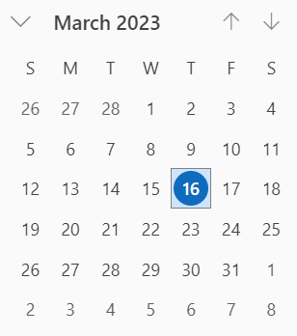
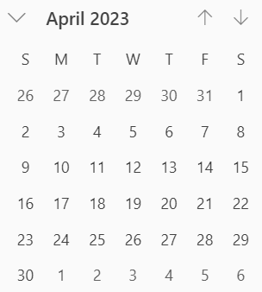
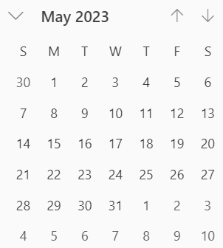
Interim Webex Schedule
Proposed: Same time and interval
Alternate Tuesdays, 06:00 PT commencing 28-March
May Interim

Slide 14
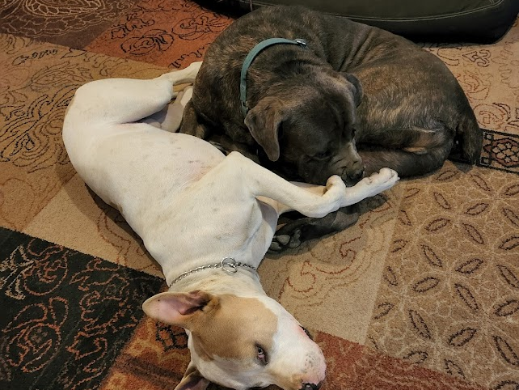
Adjourned Thanks

