Slide 1
Project: IEEE P802.15 Working Group for Wireless Personal Area Networks (WPANs)
Submission Title: [Follow-up of length 121 Ipatov sequences]
Date Submitted: [Mar, 2023]
Source: [Chenchen Liu, Bin Qian, Lei Huang, David Xun Yang] Company [Huawei Technologies]
Address [Huawei Bantian Base, Longgang District, Shenzhen, 518129 China]
E-Mail:[liuchenchen1@Huawei.com]
Re: [Task Group 4ab: UWB Next Generation]
Abstract: [Compared the MSE of CIR with different sequences and the impact of MIIT’s regulations on sensing sequences]
Purpose: [ ]
Notice: This document has been prepared to assist the IEEE P802.15. It is offered as a basis for discussion and is not binding on the contributing individual(s) or organization(s). The material in this document is subject to change in form and content after further study. The contributor(s) reserve(s) the right to add, amend or withdraw material contained herein.
Release: The contributor acknowledges and accepts that this contribution becomes the property of IEEE and may be made publicly available by P802.15.

Slide 2
Background
We agreed to use Ipatov sequences for sensing application
The CIR estimation quality is the most critical issue for sensing
The MSE of CIR estimation with different Ipatov sequences will be shown in this contribution
The impact of MIIT’s regulations on sensing sequences will be discussed

Slide 3
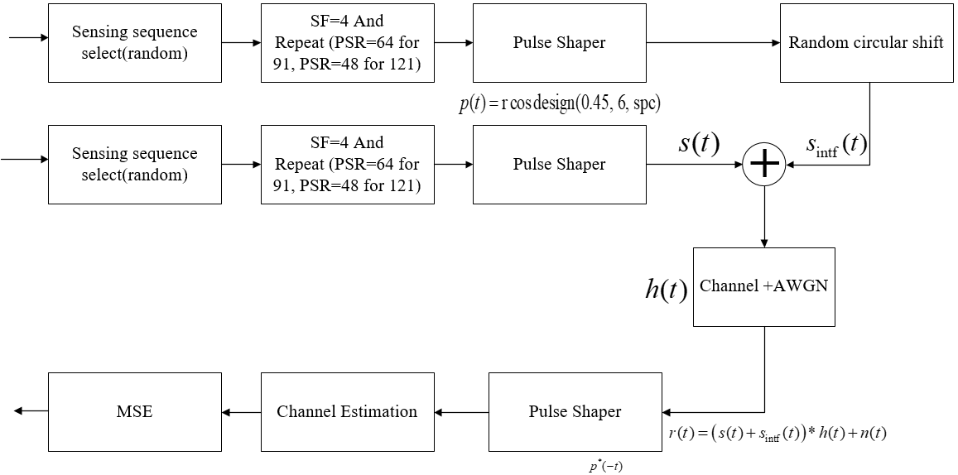
MSE of CIR Estimation Simulation
Block diagram of simulation:

Slide 4
MSE of CIR Estimation Simulation
Assumptions:
The Ipatov sequence is repeated 64 or 48 times for length 91 and 121 with SF=4 in order to keep the duration the same
The CIR estimation is averaged across all the symbols
The signal-to-interference ratios (SIR) are set to be 0dB, 3dB, 6dB and 9dB, respectively
The Tx device and interference device independently choose Ipatov sequence uniformly among 8 (91-length) or 30 (22 sequences of length 121 plus 8 sequences of length 91) Ipatov sequences
Perfect time synchronization and no CFO

Slide 5
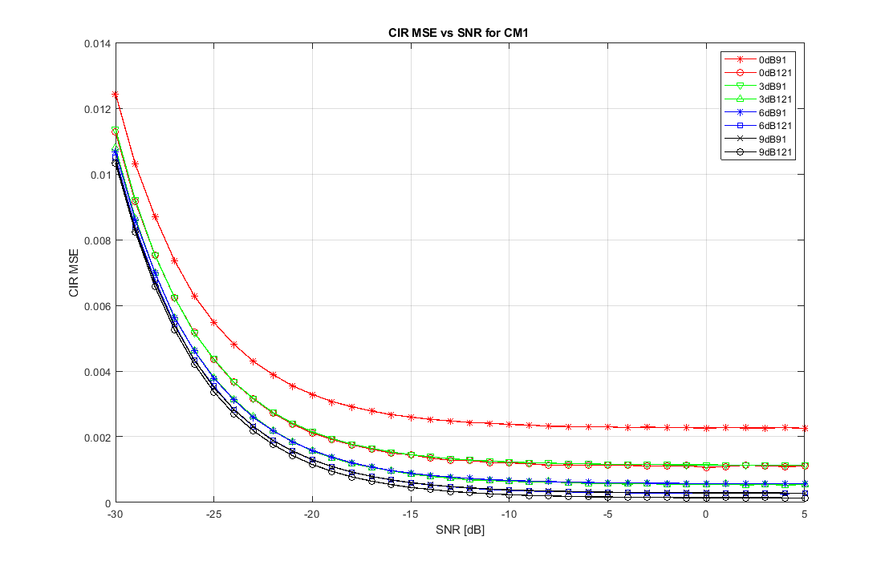
MSE of CIR Estimation in CM1
The use of length 121 sequence can greatly reduce the MSE of CIR estimation, especially when the interference is more severer

Slide 6
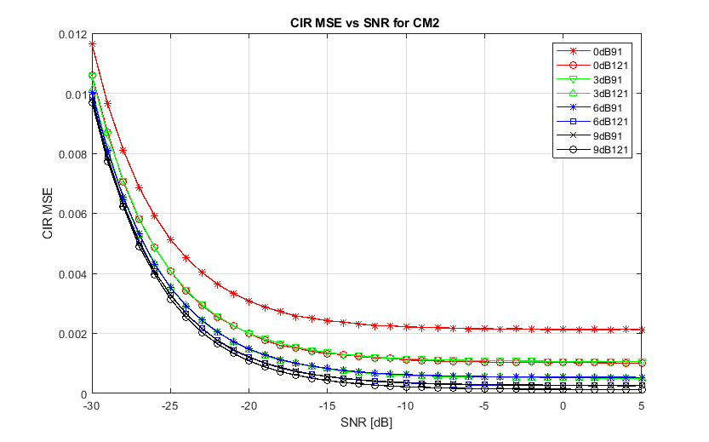
MSE of CIR Estimation in CM2
The use of length 121 sequence can greatly reduce the MSE of CIR estimation, especially when the interference is more severer

Slide 7
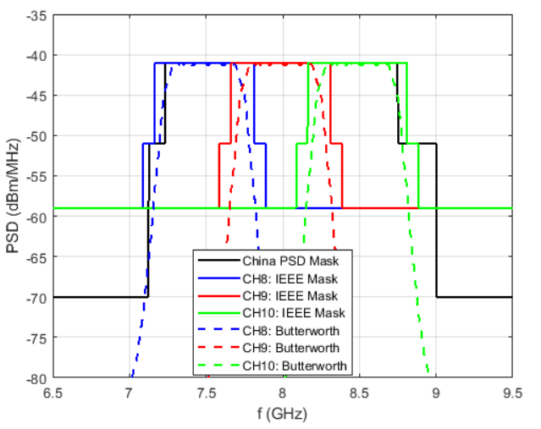
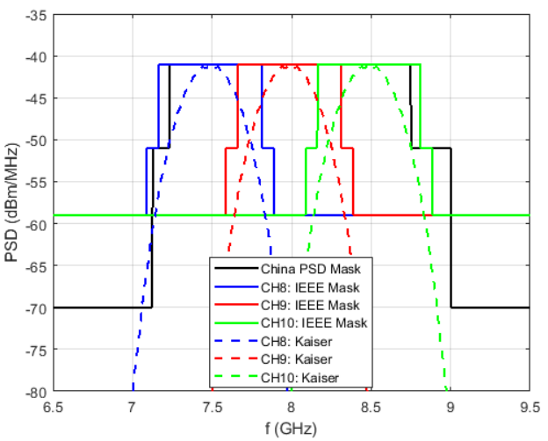
Impact of China MIIT’s Regulations
Only channel 9 can be used according to China MIIT’s Regulations for most of the UWB devices [1]
$$√$$
$$√$$
$$√$$
$$√$$
$$√$$
$$√$$
$$√$$
$$√$$

Slide 8
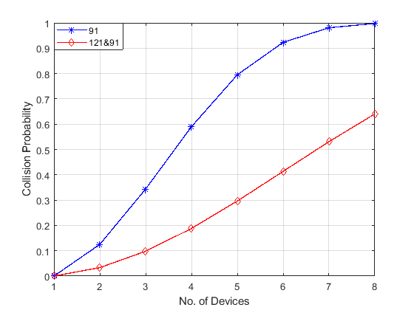
Collision Probability
The probability that uncoordinated UWB devices choose the same sequence for different cardinality
With 121-length sequences, there would be 30 sequences available which can greatly reduce the interference, especially for the dense deploy scenario

Slide 9
Summary
The MSE of CIR Estimation can be greatly reduced if the 121-length Ipatov sequence is used
Consider the future increasing of UWB devices and the new regulations of China MIIT, it is better to adopt the 121-length Ipatov sequences as an optional sequence for sensing

Slide 10
References
[1] 15-23-0023-02-04ab-china-miit-s-consultation-on-uwb
[2] 15-23-0050-01-04ab-comparison-of-ipatov-sequences-of-different-lengths
[3] P802.15.4z, Draft Standard for Low-Rate Wireless Networks

Slide 11
Appendix Ipatov sequences of length 121
Sequence | Code sequence
s1 | 1 0 0 0 -1 1 0 0 -1 0 1 0 -1 -1 1 1 -1 1 0 -1 0 0 1 -1 -1 0 1 0 1 -1 1 1 1 0 0 -1 -1 1 0 -1 1 0 1 -1 0 1 1 0 -1 1 -1 1 -1 0 0 0 0 -1 0 0 0 -1 -1 0 0 -1 1 -1 0 -1 0 0 -1 -1 -1 0 -1 1 1 -1 -1 0 -1 0 1 -1 -1 -1 1 0 1 1 0 1 1 -1 1 1 -1 0 0 -1 0 -1 0 -1 -1 -1 -1 -1 1 1 1 1 0 -1 -1 -1 1 -1 1
s2 | 1 0 -1 0 -1 1 -1 1 -1 0 0 1 -1 1 1 1 1 0 -1 0 1 1 0 1 -1 -1 -1 0 0 0 0 -1 0 1 0 0 -1 -1 -1 1 -1 -1 1 -1 1 1 0 1 1 -1 0 0 0 -1 -1 1 1 0 -1 1 1 0 0 1 0 0 0 -1 1 1 -1 0 -1 0 0 -1 1 0 -1 1 -1 0 -1 1 0 1 1 0 0 -1 0 -1 0 -1 -1 -1 0 -1 0 1 -1 0 0 -1 -1 0 1 1 -1 1 0 -1 -1 -1 -1 -1 1 1 -1 -1 -1
s3 | 1 -1 1 -1 -1 -1 0 1 1 1 1 -1 -1 -1 -1 -1 0 -1 0 -1 0 0 -1 1 1 -1 1 1 0 1 1 0 1 -1 -1 -1 1 0 -1 0 -1 -1 1 1 -1 0 -1 -1 -1 0 0 -1 0 -1 1 -1 0 0 -1 -1 0 0 0 -1 0 0 0 0 -1 1 -1 1 -1 0 1 1 0 -1 1 0 1 -1 0 1 -1 -1 0 0 1 1 1 -1 1 0 1 0 -1 -1 1 0 0 -1 0 1 -1 1 1 -1 -1 0 1 0 -1 0 0 1 -1 0 0 0 1
s4 | -1 -1 -1 1 1 -1 -1 -1 -1 -1 0 1 -1 1 1 0 -1 -1 0 0 -1 1 0 -1 0 -1 -1 -1 0 -1 0 -1 0 0 1 1 0 1 -1 0 -1 1 -1 0 1 -1 0 0 -1 0 -1 1 1 -1 0 0 0 1 0 0 1 1 -1 0 1 1 -1 -1 0 0 0 -1 1 1 0 1 1 -1 1 -1 -1 1 -1 -1 -1 0 0 1 0 -1 0 0 0 0 -1 -1 -1 1 0 1 1 0 -1 0 1 1 1 1 -1 1 0 0 -1 1 -1 1 -1 0 -1 0 1
s5 | 1 -1 0 -1 -1 -1 0 -1 1 -1 -1 1 -1 1 -1 -1 -1 0 0 -1 1 -1 0 -1 1 1 1 -1 -1 -1 -1 -1 0 1 0 0 -1 -1 -1 1 0 0 -1 1 1 -1 0 1 -1 1 -1 0 0 -1 0 1 1 -1 -1 1 1 0 0 -1 0 0 0 0 -1 -1 1 0 1 0 0 1 1 0 1 1 0 -1 -1 -1 -1 1 -1 -1 0 1 -1 -1 0 -1 0 1 0 1 0 1 -1 0 0 0 1 0 1 1 -1 1 0 -1 0 1 -1 0 1 1 0 0 0

Slide 12
Appendix Ipatov sequences of length 121
Sequence | Code sequence
s6 | 0 0 0 1 1 0 -1 1 0 -1 0 1 -1 1 1 0 1 0 0 0 -1 1 0 1 0 1 0 -1 0 -1 -1 1 0 -1 -1 1 -1 -1 -1 -1 0 1 1 0 1 1 0 0 1 0 1 -1 -1 0 0 0 0 -1 0 0 1 1 -1 -1 1 1 0 -1 0 0 -1 1 -1 1 0 -1 1 1 -1 0 0 1 -1 -1 -1 0 0 1 0 -1 -1 -1 -1 -1 1 1 1 -1 0 -1 1 -1 0 0 -1 -1 -1 1 -1 1 -1 -1 1 -1 0 -1 -1 -1 0 -1 1
s7 | 1 -1 -1 -1 1 1 -1 0 0 -1 -1 1 1 0 1 1 0 1 -1 1 -1 0 0 0 0 -1 -1 -1 -1 1 -1 0 1 1 1 0 1 0 -1 0 1 -1 1 0 1 1 1 -1 0 -1 1 1 0 -1 -1 1 -1 1 -1 -1 -1 -1 -1 0 1 -1 0 -1 0 0 -1 1 0 0 -1 -1 0 0 -1 0 -1 -1 1 0 -1 0 0 1 0 -1 -1 0 1 0 1 0 1 -1 0 1 -1 -1 1 -1 -1 0 0 0 1 0 0 0 1 -1 -1 -1 0 0 1 -1 1
s8 | 1 -1 1 0 0 -1 -1 -1 1 0 0 0 1 0 0 0 -1 -1 1 -1 -1 1 0 -1 1 0 1 0 1 0 -1 -1 0 1 0 0 -1 0 1 -1 -1 0 -1 0 0 -1 -1 0 0 1 -1 0 0 -1 0 -1 1 0 -1 -1 -1 -1 -1 1 -1 1 -1 -1 0 1 1 -1 0 -1 1 1 1 0 1 -1 1 0 -1 0 1 0 1 1 1 0 -1 1 -1 -1 -1 -1 0 0 0 0 -1 1 -1 1 0 1 1 0 1 1 -1 -1 0 0 -1 1 1 -1 -1 -1 1'
s9 | 1 -1 -1 -1 -1 0 -1 1 1 -1 1 0 -1 -1 0 0 0 0 -1 -1 -1 1 1 0 1 0 0 -1 1 -1 1 0 0 0 1 -1 -1 0 1 -1 -1 -1 0 1 0 0 0 -1 0 0 -1 0 -1 1 -1 0 -1 -1 1 -1 -1 0 0 1 1 0 1 1 1 0 0 1 1 -1 0 0 -1 1 0 -1 1 -1 -1 1 1 -1 0 -1 1 0 1 0 1 0 -1 1 0 0 -1 0 1 0 1 1 0 -1 -1 -1 -1 -1 1 0 -1 0 1 1 -1 -1 -1 1 -1
s10 | -1 1 -1 -1 -1 1 1 0 -1 0 1 -1 -1 -1 -1 -1 0 1 1 0 1 0 -1 0 0 1 -1 0 1 0 1 0 1 -1 0 -1 1 1 -1 -1 1 -1 0 1 -1 0 0 -1 1 1 0 0 1 1 1 0 1 1 0 0 -1 -1 1 -1 -1 0 -1 1 -1 0 -1 0 0 -1 0 0 0 1 0 -1 -1 -1 1 0 -1 -1 1 0 0 0 1 -1 1 -1 0 0 1 0 1 1 -1 -1 -1 0 0 0 0 -1 -1 0 1 -1 1 1 -1 0 -1 -1 -1 -1 1

Slide 13
Appendix Ipatov sequences of length 121
Sequence | Code sequence
s11 | 1 1 0 1 0 -1 0 -1 1 1 1 1 0 0 -1 -1 1 0 0 0 -1 -1 0 1 1 -1 -1 1 1 0 1 -1 0 1 1 1 0 -1 0 0 0 0 -1 1 1 -1 0 -1 1 -1 0 0 1 0 0 1 -1 0 0 -1 -1 -1 -1 -1 1 -1 0 -1 -1 1 -1 1 1 1 -1 -1 -1 0 -1 -1 -1 1 0 -1 1 0 1 0 0 -1 1 -1 1 -1 0 1 0 -1 1 1 0 -1 1 -1 -1 1 -1 -1 0 0 0 -1 0 -1 0 -1 -1 0 0 -1 0
s12 | 0 -1 0 0 -1 -1 0 -1 0 -1 0 0 0 -1 -1 1 -1 -1 1 -1 0 1 1 -1 0 1 0 -1 1 -1 1 -1 0 0 1 0 1 -1 0 1 -1 -1 -1 0 -1 -1 -1 1 1 1 -1 1 -1 -1 0 -1 1 -1 -1 -1 -1 -1 0 0 -1 1 0 0 1 0 0 -1 1 -1 0 -1 1 1 -1 0 0 0 0 -1 0 1 1 1 0 -1 1 0 1 1 -1 -1 1 1 0 -1 -1 0 0 0 1 -1 -1 0 0 1 1 1 1 -1 0 -1 0 1 0 1 1
s13 | 1 -1 1 -1 0 -1 1 1 0 -1 -1 0 0 -1 -1 -1 1 1 1 -1 1 1 1 1 0 1 0 -1 -1 -1 -1 -1 1 0 0 -1 0 -1 0 -1 -1 1 -1 0 0 -1 1 1 1 0 -1 1 -1 0 1 0 1 -1 0 1 1 -1 -1 1 0 -1 1 0 1 1 1 0 0 -1 -1 1 0 1 0 0 0 -1 0 1 -1 -1 1 -1 1 1 -1 -1 0 -1 -1 0 1 0 -1 0 0 -1 0 0 1 -1 0 0 0 -1 1 -1 -1 0 0 0 0 -1 -1 0 -1
s14 | -1 0 -1 -1 0 0 0 0 -1 -1 1 -1 0 0 0 -1 1 0 0 -1 0 0 -1 0 1 0 -1 -1 0 -1 -1 1 1 -1 1 -1 -1 1 0 -1 0 0 0 1 0 1 -1 -1 0 0 1 1 1 0 1 -1 0 1 -1 -1 1 1 0 -1 1 0 1 0 -1 1 -1 0 1 1 1 -1 0 0 -1 1 -1 -1 0 -1 0 -1 0 0 1 -1 -1 -1 -1 -1 0 1 0 1 1 1 1 -1 1 1 1 -1 -1 -1 0 0 -1 -1 0 1 1 -1 0 -1 1 -1 1
s15 | 1 0 1 0 1 -1 1 1 0 0 0 1 1 1 -1 -1 1 -1 1 -1 -1 1 0 1 0 0 -1 0 0 -1 0 1 -1 1 -1 0 1 1 -1 1 0 1 -1 0 1 -1 -1 -1 1 -1 -1 -1 0 -1 1 1 -1 -1 -1 -1 -1 0 0 1 -1 0 0 -1 1 1 0 -1 0 0 0 0 -1 0 -1 -1 -1 0 1 1 0 1 1 -1 0 0 0 1 -1 1 0 0 -1 -1 0 1 -1 0 -1 -1 0 0 -1 -1 1 1 0 1 0 -1 -1 -1 -1 1 0 -1 0

Slide 14
Appendix Ipatov sequences of length 121
Sequence | Code sequence
s16 | -1 0 -1 0 0 0 0 -1 -1 1 1 0 -1 0 0 -1 -1 0 0 1 0 0 -1 -1 -1 -1 -1 1 0 1 -1 -1 1 1 1 0 -1 -1 -1 0 0 0 -1 1 0 -1 1 -1 -1 0 -1 1 -1 0 1 1 0 -1 1 1 1 1 0 1 1 0 1 0 -1 -1 1 -1 1 1 -1 0 0 -1 0 1 -1 0 0 1 -1 -1 0 0 -1 1 -1 1 -1 0 -1 -1 -1 1 1 -1 1 1 1 -1 1 0 0 0 -1 0 -1 0 -1 -1 1 0 -1 0 1 0 1
s17 | 1 0 1 0 -1 0 1 -1 -1 0 -1 0 -1 0 0 0 1 -1 1 1 1 -1 1 1 -1 -1 -1 0 -1 1 -1 1 -1 0 0 -1 -1 1 0 0 -1 1 0 -1 0 0 -1 1 1 -1 1 -1 -1 0 1 0 1 1 0 1 1 1 1 -1 0 1 1 0 -1 1 -1 0 -1 -1 1 -1 0 1 -1 0 0 0 -1 -1 -1 0 1 1 1 -1 -1 1 0 1 -1 -1 -1 -1 -1 0 0 1 0 0 -1 -1 0 0 -1 0 1 1 -1 -1 0 0 0 0 -1 0 -1
s18 | 0 -1 0 1 -1 -1 -1 -1 0 1 0 1 1 -1 -1 0 0 -1 -1 0 -1 1 0 -1 -1 0 0 1 -1 1 0 0 0 -1 1 1 0 1 1 0 -1 -1 -1 0 -1 0 0 0 0 -1 0 1 1 -1 0 0 -1 1 0 0 -1 -1 -1 -1 -1 1 1 -1 0 -1 -1 -1 1 -1 -1 -1 1 0 -1 1 0 1 -1 1 1 0 -1 1 -1 1 0 -1 0 0 -1 0 0 1 0 1 -1 -1 1 -1 1 -1 -1 1 1 1 0 0 0 1 1 -1 1 0 1 0 1
s19 | 1 1 1 1 0 0 1 -1 1 1 -1 0 0 -1 0 0 -1 -1 1 -1 0 -1 1 -1 1 -1 0 1 -1 -1 -1 0 -1 0 1 0 0 0 -1 -1 -1 1 0 1 0 0 -1 0 -1 0 -1 -1 0 -1 1 0 0 -1 -1 0 0 0 0 -1 1 0 1 1 -1 -1 -1 1 1 0 0 -1 1 1 0 1 1 1 0 -1 -1 -1 -1 -1 1 -1 -1 0 1 0 -1 1 -1 0 0 0 -1 0 1 1 -1 0 1 1 0 -1 1 0 -1 0 -1 1 1 -1 -1 1 -1
s20 | 1 1 0 1 1 -1 0 0 -1 1 0 1 1 0 -1 -1 -1 1 0 -1 -1 0 0 -1 -1 -1 0 1 0 -1 0 0 1 1 -1 -1 1 0 1 0 1 0 -1 -1 1 -1 1 -1 -1 0 -1 1 -1 1 0 1 -1 -1 1 -1 -1 1 1 0 -1 1 0 -1 0 -1 -1 -1 -1 -1 1 -1 0 0 0 0 -1 1 1 0 0 0 -1 -1 0 -1 0 0 -1 0 1 -1 1 0 -1 1 1 1 -1 -1 -1 -1 0 0 1 0 0 0 1 0 1 -1 0 0 1 -1 1

Slide 15
Appendix Ipatov sequences of length 121
Sequence | Code sequence
s21 | -1 1 -1 -1 1 1 -1 0 -1 0 1 -1 0 1 1 0 -1 1 1 0 -1 0 0 0 -1 1 -1 0 1 0 -1 -1 1 -1 -1 -1 -1 -1 0 1 1 1 0 1 1 -1 0 0 1 1 -1 -1 -1 1 1 0 1 -1 0 0 0 0 -1 -1 0 0 1 -1 0 -1 -1 0 -1 0 -1 0 0 1 0 1 -1 -1 -1 0 0 0 1 0 -1 0 -1 -1 -1 1 0 -1 1 -1 1 -1 0 -1 1 -1 -1 0 0 -1 0 0 -1 1 1 -1 1 0 0 1 1 1 1
s22 | 1 -1 1 0 0 -1 1 0 1 0 0 0 1 0 0 -1 -1 -1 -1 1 1 1 -1 0 1 -1 1 0 -1 0 0 -1 0 -1 -1 0 0 0 1 1 -1 0 0 0 0 -1 1 -1 -1 -1 -1 -1 0 -1 0 1 -1 0 1 1 -1 -1 1 -1 -1 1 0 1 -1 1 -1 0 -1 -1 1 -1 1 -1 -1 0 1 0 1 0 1 -1 -1 1 1 0 0 -1 0 1 0 -1 -1 -1 0 0 -1 -1 0 1 -1 -1 -1 0 1 1 0 1 -1 0 0 -1 1 1 0 1 1

