Slide 1
Project: IEEE P802.15 Working Group for Wireless Personal Area Networks (WPANs)
Submission Title: Simulation Results for Nagoya I. T. and YRP-IAI MAC Proposal
Date Submitted: March 14th, 2023
Source: Daisuke Anzai¹, Ryosuke Inusuka¹, Takumi Kobayashi¹, Minsoo Kim², Marco Hernandez², Ryuji Kohno²
Company: ¹Nagoya Institute of Technology (NIT), Japan; ²Yokosuka Research Park International Alliance Institute (YRP-IAI), Japan
Address: Gokiso-cho, Showa-ku, Nagoya, 466-8555, Japan
Voice: +81-52-735-5389, FAX: +81-52-735-5389, E-Mail: anzai@nitech.ac.jp
Re: In response to call for technical contributions
Abstract: This provides fundamental MAC simulation setup and performance evaluation results for the Nagoya Institute of Technology and YRP-IAI proposal.
Purpose: Material for discussion in P802.15.6a TG corresponding to comments in EC Meeting
Notice: This document has been prepared to assist the IEEE P802.15. It is offered as a basis for discussion and is not binding on the contributing individual(s) or organization(s). The material in this document is subject to change in form and content after further study. The contributor(s) reserve(s) the right to add, amend or withdraw material contained herein.
Release: The contributor acknowledges and accepts that this contribution becomes the property of IEEE and may be made publicly available by P802.15.

Slide 2
Simulation Results for Nagoya I. T. and YRP-IAI MAC Proposal
Daisuke Anzai, Ryosuke Inuzuka,
Minsoo Kim, Takumi Kobayashi, Marco Hernandez, and Ryuji Kohno
Nagoya Institute of Technology (NIT),
YRP International Alliance Institute (YRP-IAI)

Slide 3
Introduction
Coexistence of multiple BANs and other UWB applications is a key issue to provide high dependability
In case of multiple BAN co-existence, we proposed a unified superframe structure to avoid packet collisions even between different BANs.
We carry out fundamental MAC simulations to demonstrate the importance of the synchronized and unified superframce under coexistence situation between multiple BANs

Slide 4


Super frame structure (D-Channel)
Network
Management
Contention
Free
Contention
Access
Inactive
D-Beacon
・・・
・・・
・・・
・・・
$$T_{s}$$
$$T_{D}$$
time
D-Beacon from BAN2
D-Beacon from BAN1

Slide 5
Packet transmission in contention free period (CFP)
: Packet transmission (TDMA)
: Retransmission

Slide 6
Packet transmission in contention access period (CAP)
: Packet transmission (Slotted ALOHA)
: Retransmission

Slide 7
Effect of unified superframe construction

Slide 8
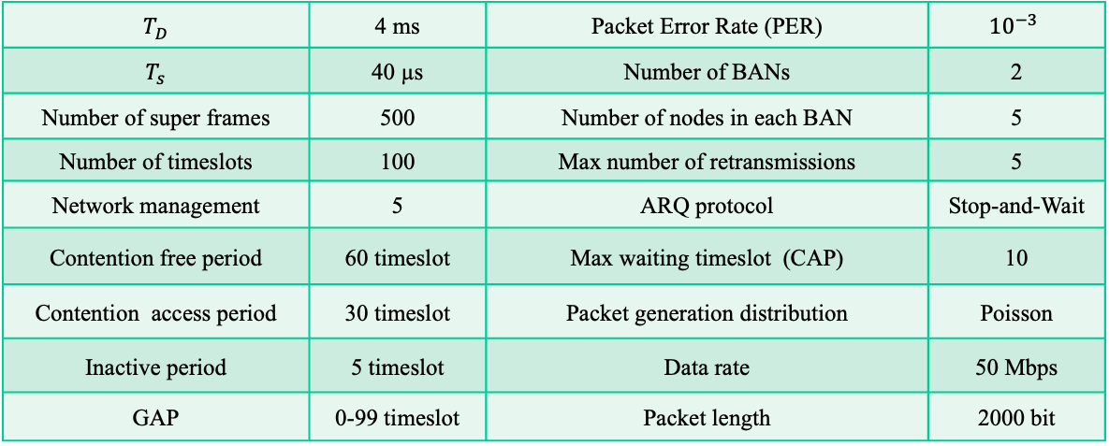
Simulation parameters
$T_{D}$ | 4 ms | Packet Error Rate (PER) | $${10}^{−3}$$
$T_{s}$ | 40 µs | Number of BANs | 2
Number of super frames | 500 | Number of nodes in each BAN | 5
Number of timeslots | 100 | Max number of retransmissions | 5
Network management | 5 | ARQ protocol | Stop-and-Wait
Contention free period | 60 timeslot | Max waiting timeslot (CAP) | 10
Contention access period | 30 timeslot | Packet generation distribution | Poisson
Inactive period | 5 timeslot | Data rate | 50 Mbps
GAP | 0-99 timeslot | Packet length | 2000 bit

Slide 9
Fundamental evaluation results in CFP

Slide 10
Fundamental evaluation results in CAP

Slide 11
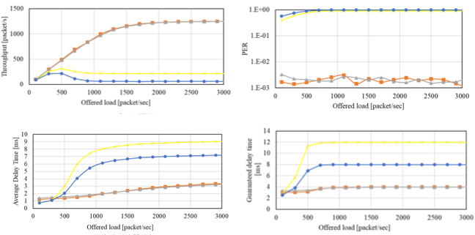
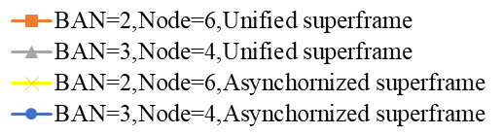
Effect of number of BANs and nodes in CFP
Offered load(CAP) = 1000 [packet/sec]

Slide 12
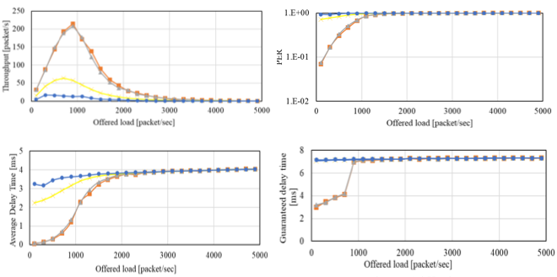
Effect of number of BANs and nodes in CAP
Offered load(CFP) = 3000 [packet/sec]

Slide 13
References
D. Anzai, I. Balasingham, G. Fischer, J. Wang, “Reliable and High-Speed Implant Ultra-Wideband Communications with Transmit–Receive Diversity,” EAI/Springer Innovations in Communication and Computing, pp. 27-32, March 2020.
Y. Shimizu, D. Anzai, R. C-Santiago, P. A. Floor, I. Balasingham, and J. Wang, “Performance evaluation of an ultra-wideband transmit diversity in a living animal experiment” IEEE Trans. Microw. Theory Tech., vol. 65, no. 7, pp. 2596-2606, July 2017.
D. Anzai, K. Katsu, R. Chavez-Santiago, Q. Wang, D. Plettemeier, J. Wang, and I. Balasingham, “Experimental evaluation of implant UWB-IR transmission with living animal for body area networks,” IEEE Trans. Microw. Theory Tech., vol. 62, no. 1, pp. 183-192, Jan. 2014.
J. Shi, D. Anzai, and J. Wang, “Channel modeling and performance analysis of diversity reception for implant UWB wireless link,” IEICE Trans. Commun., no. E95-B, vol. 10, pp. 3197-3205, Oct. 2012.

