Slide 1
Project: IEEE P802.15 Working Group for Wireless Personal Area Networks (WPANs)
Submission Title: Propagation Channel Parameters of UWB Communication Applications for Vehicle BAN (VBAN) Use Cases
Date Submitted: May 16th, 2023
Source: Daisuke Anzai, Yutaro Aoki, Takumi Kobayashi
Company: Nagoya Institute of Technology (NIT), Japan
Address: Gokiso-cho, Showa-ku, Nagoya, 466-8555, Japan
Voice: +81-52-735-5389, FAX: +81-52-735-5389, E-Mail: anzai@nitech.ac.jp
Re: In response to call for technical contributions
Abstract: This provides of fundamental propagation channel parameters including path loss characteristics for UWB communication applications for passenger bus use case.
Purpose: Material for discussion in P802.15.6a TG corresponding to comments in EC Meeting
Notice: This document has been prepared to assist the IEEE P802.15. It is offered as a basis for discussion and is not binding on the contributing individual(s) or organization(s). The material in this document is subject to change in form and content after further study. The contributor(s) reserve(s) the right to add, amend or withdraw material contained herein.
Release: The contributor acknowledges and accepts that this contribution becomes the property of IEEE and may be made publicly available by P802.15.

Slide 2
Propagation Channel Parameters of UWB Communication Applications for Vehicle BAN (VBAN) Use Cases
Daisuke Anzai, Yutaro Aoki, and Takumi Kobayashi
Nagoya Institute of Technology (NIT)

Slide 3
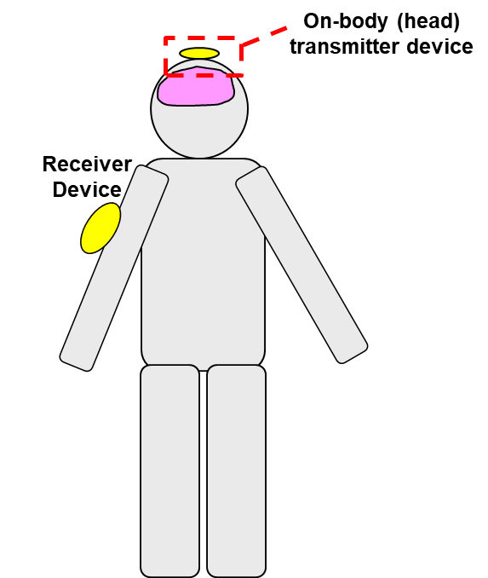
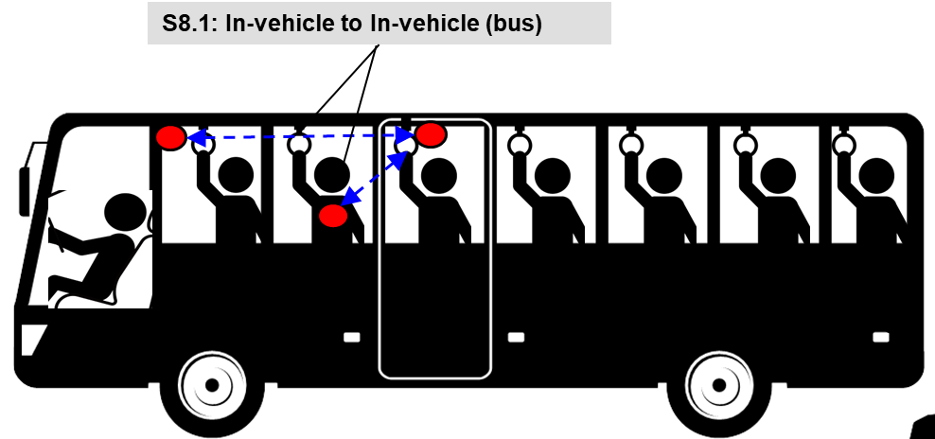
UWB communication applications
Vehicle BAN (VBAN)
Human BAN (HBAN)
Passengers bus model^{[1]}
Brain-computer interface (BCI) model^{[1]}
^{[1]}IEEE 802.15-22-0344-02-006a

Slide 4
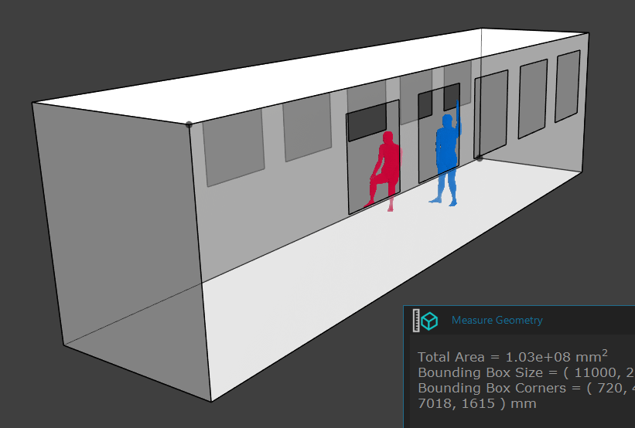
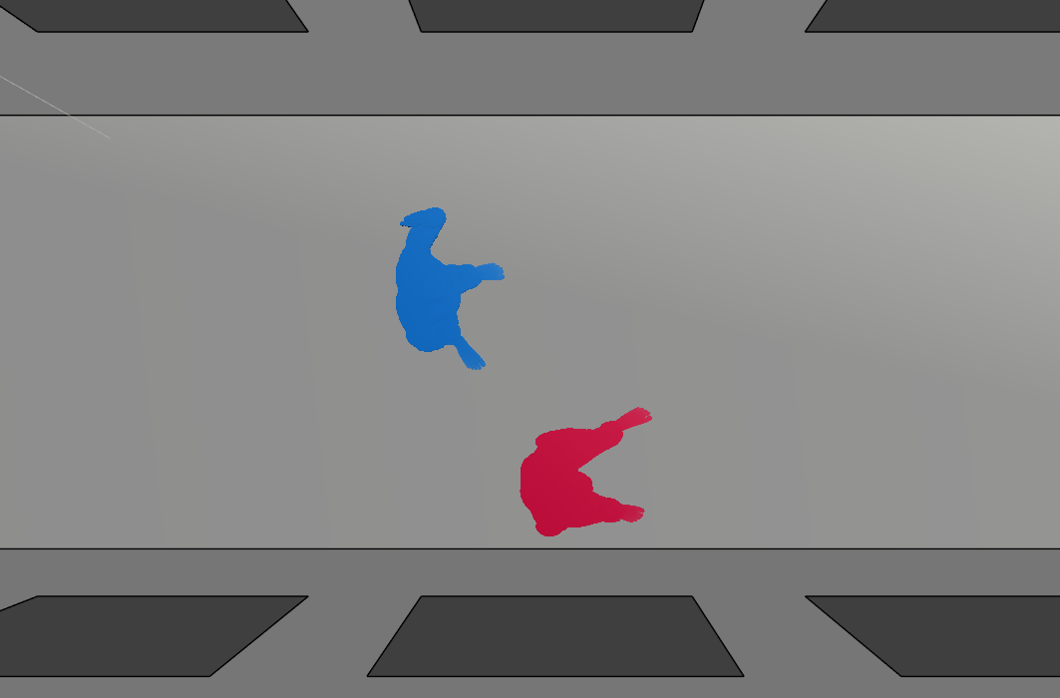
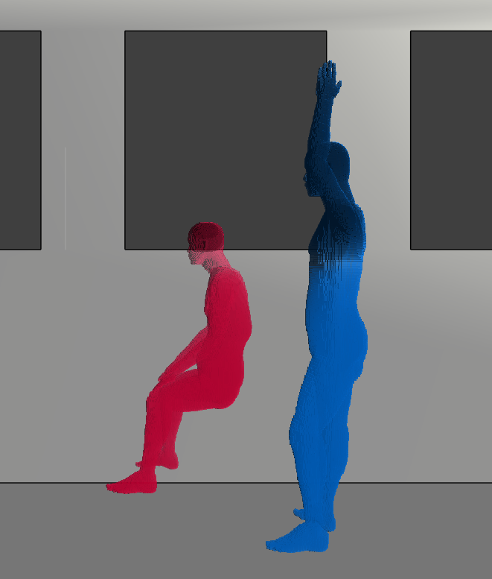
Passenger bus model
Passenger bus model^{[1]}
^{[1]} IEEE 802.15-22-0344-02-006a

Slide 5
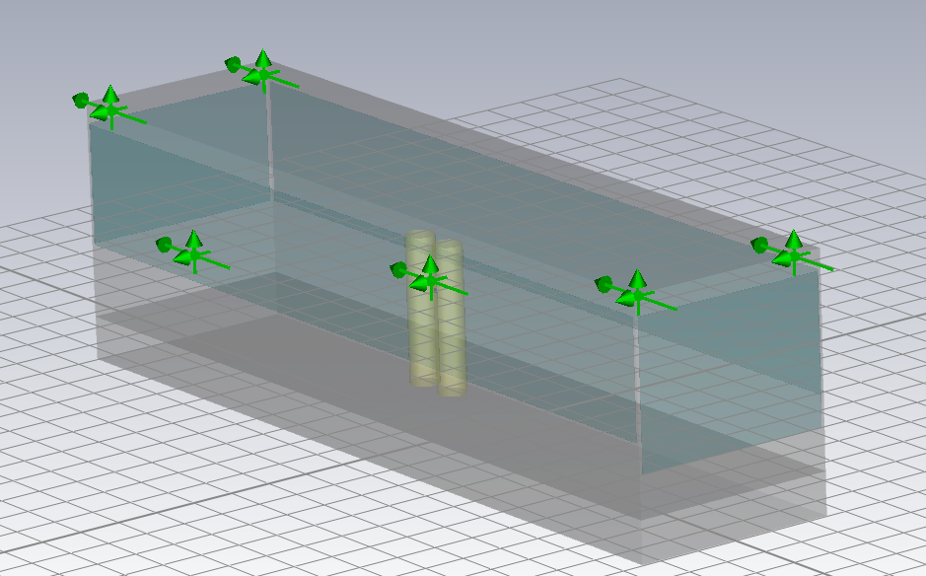
Passenger bus model
Frequency band: 3.1 – 10.6 GHz
Ray-tracing method
Cylinder model employed as a human model for simplification
HBAN node on the chest of the human model

Slide 6
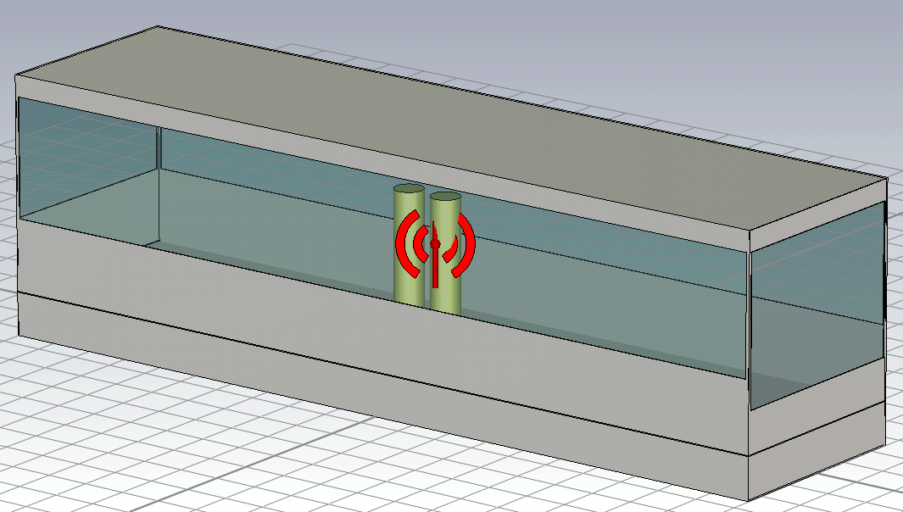
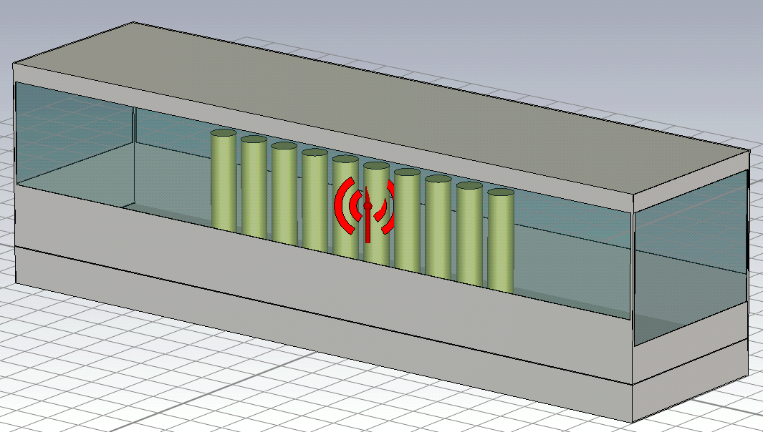
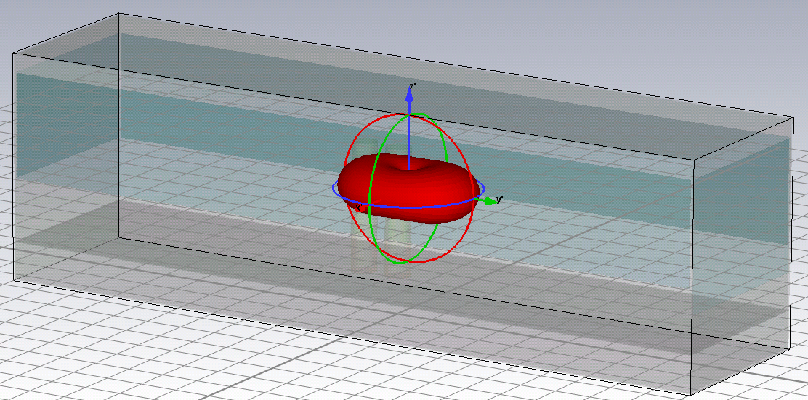
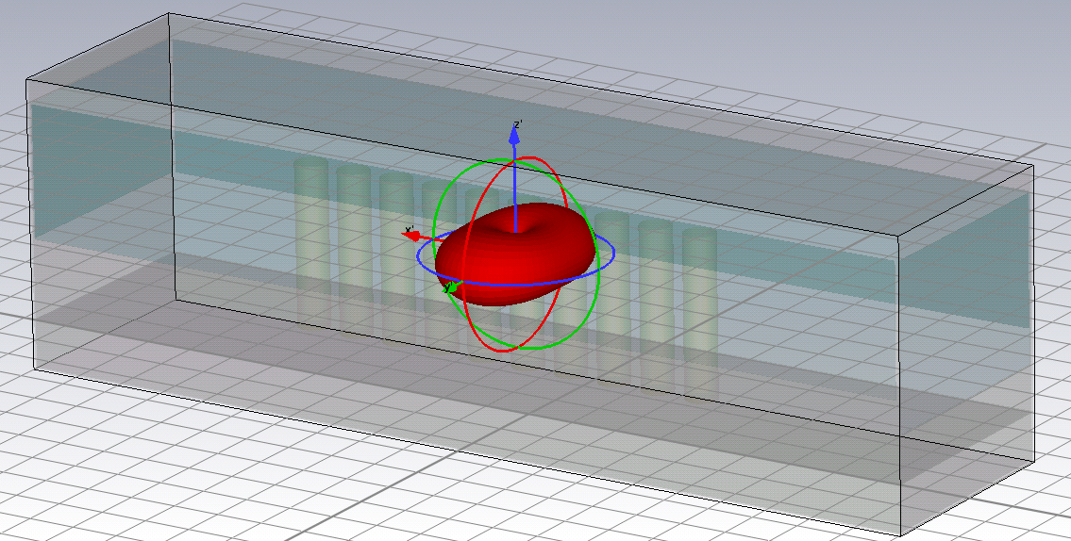
Passenger bus model (cont.)
2 persons
10 persons
Rear
Center
Front
Forward direction
Sideways direction
Wave source

Slide 7
Tx/Rx positions

Slide 8
Frequency characteristics

Slide 9
Distance characteristics

Slide 10

Distance characteristics (cont.)
d₀=1000 (mm)
Tx | Center |  |  |  | Front |  | Rear
direction | Forward |  | Sideways |  | Forward | Sideways | Forward | Sideways
persons | 10 | 2 | 10 | 2 | 10 | 10 | 10 | 10
n | 1.31 | 1.96 | 0.33 | 1.48 | 1.01 | 0.70 | 1.22 | 2.07
PL₀ [dB] | 60.98 | 63.54 | 65.03 | 73.49 | 58.31 | 63.18 | 47.21 | 52.65
$$PL=PL_{0}+10n\log_{10}\left(\frac{d}{d_{0}}\right)$$

Slide 11
Height characteristics

Slide 12
Additional simulation setup

Slide 13
Frequency characteristics

Slide 14

Distance characteristics
d₀=1000 (mm)
Tx | Driver | Getting on
n | 1.01 | 1.19
PL₀ [dB] | 70.29 | 71.82
$$PL=PL_{0}+10n\log_{10}\left(\frac{d}{d_{0}}\right) (dB)$$

Slide 15
Sedan car cabin model

Slide 16
Frequency characteristics
(Sedan car cabin model)

Slide 17

Distance characteristics
(Sedan car cabin model)
d₀=1000 (mm)
Tx | Driver | Rear seat
n | 1.28 | 1.73
PL₀ [dB] | 65.35 | 60.93
$$PL=PL_{0}+10n\log_{10}\left(\frac{d}{d_{0}}\right) (dB)$$

Slide 18
Engine room model for sedan cars
Tx position

Slide 19
Frequency characteristics
(engine room)

Slide 20
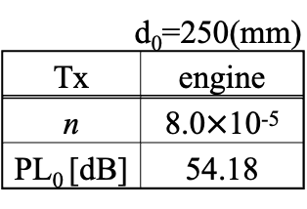

Distance characteristics
(Engine room)
d₀=250(mm)
Tx | engine
n | 8.0$×$10⁻⁵
PL₀ [dB] | 54.18
$$PL=PL_{0}+10n\log_{10}\left(\frac{d}{d_{0}}\right) (dB)$$

Slide 21
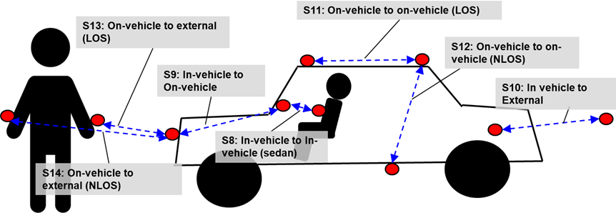
Additional VBAN use cases

Slide 22
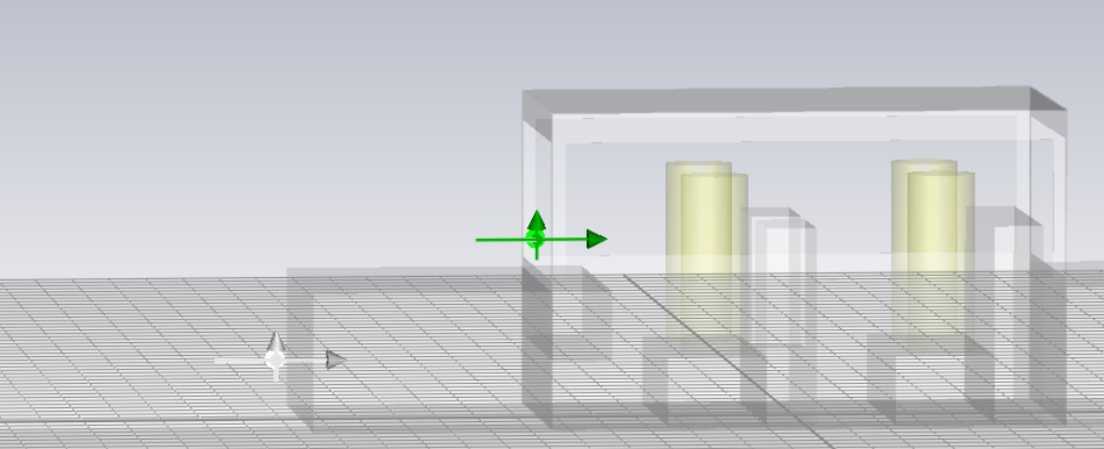
Frequency characteristics (S9, S11)
S9 (In-vehicle to On-vehicle) & S10 (In-vehicle to External)

Slide 23
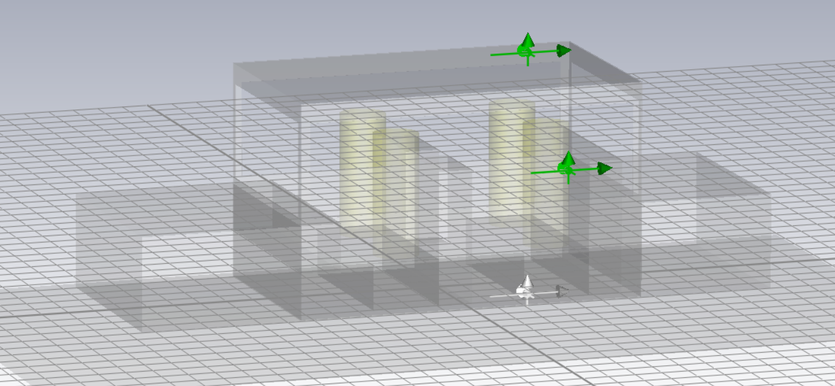
Frequency characteristics (S11, S12)
S11 LOS
S12 NLOS

Slide 24
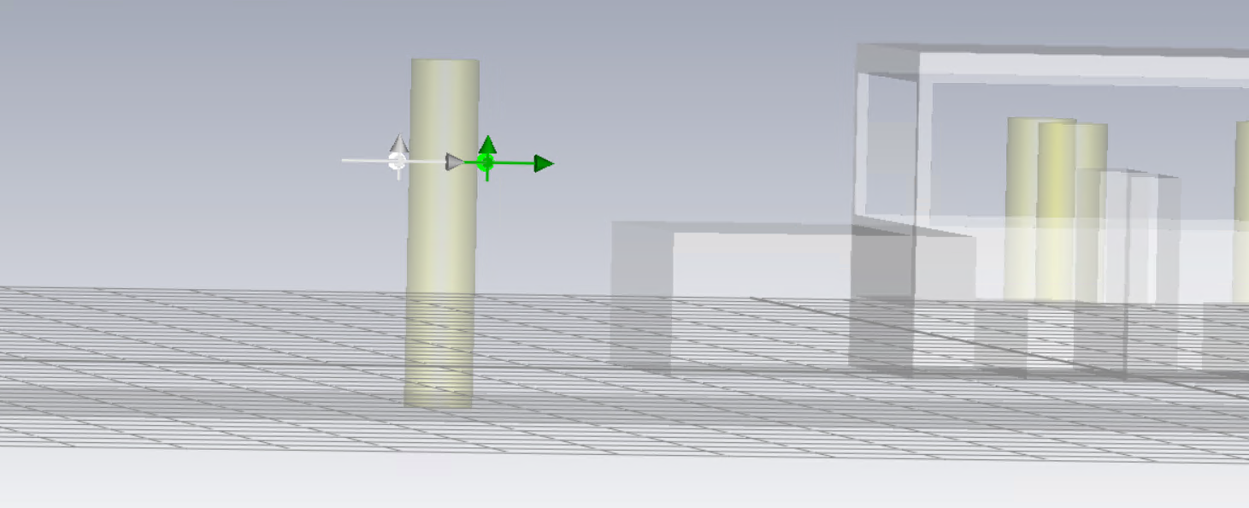
Frequency characteristics (S13, S14)
S13 LOS
S14 NLOS

Slide 25
Distance characteristics (S9-S14)
Scenario | Sight | n | PL₀ (dB) (d₀=1000 (mm))
S9 | - | 1.65 | 60.537
S10 | - | 2.97 | 64.041
S11 | LOS | 2.76 | 67.03
S12 | NLOS | 0.39 | 88.85
S13 | LOS | 1.30 | 66.00
S14 | NLOS | 0.83 | 87.78

Slide 26
References
D. Anzai, I. Balasingham, G. Fischer, J. Wang, “Reliable and High-Speed Implant Ultra-Wideband Communications with Transmit–Receive Diversity,” EAI/Springer Innovations in Communication and Computing, pp. 27-32, March 2020.
Y. Shimizu, D. Anzai, R. C-Santiago, P. A. Floor, I. Balasingham, and J. Wang, “Performance evaluation of an ultra-wideband transmit diversity in a living animal experiment” IEEE Trans. Microw. Theory Tech., vol. 65, no. 7, pp. 2596-2606, July 2017.
D. Anzai, K. Katsu, R. Chavez-Santiago, Q. Wang, D. Plettemeier, J. Wang, and I. Balasingham, “Experimental evaluation of implant UWB-IR transmission with living animal for body area networks,” IEEE Trans. Microw. Theory Tech., vol. 62, no. 1, pp. 183-192, Jan. 2014.
J. Shi, D. Anzai, and J. Wang, “Channel modeling and performance analysis of diversity reception for implant UWB wireless link,” IEICE Trans. Commun., no. E95-B, vol. 10, pp. 3197-3205, Oct. 2012.

