Slide 1
Project: IEEE P802.15 Working Group for Wireless Personal Area Networks (WPANs)
Submission Title: Propagation Channel Parameters of UWB Communication Applications for Human BAN (HBAN) Use Cases
Date Submitted: May 10th, 2024
Source: Daisuke Anzai, Sho Asano, Takumi Kobayashi
Company: Nagoya Institute of Technology (NIT), Japan
Address: Gokiso-cho, Showa-ku, Nagoya, 466-8555, Japan
Voice: +81-52-735-5389, FAX: +81-52-735-5389, E-Mail: anzai@nitech.ac.jp
Re: In response to call for technical contributions
Abstract: This provides of fundamental propagation channel parameters including path loss characteristics for UWB communication applications for BCI use case.
Purpose: Material for discussion in P802.15.6a TG corresponding to comments in EC Meeting
Notice: This document has been prepared to assist the IEEE P802.15. It is offered as a basis for discussion and is not binding on the contributing individual(s) or organization(s). The material in this document is subject to change in form and content after further study. The contributor(s) reserve(s) the right to add, amend or withdraw material contained herein.
Release: The contributor acknowledges and accepts that this contribution becomes the property of IEEE and may be made publicly available by P802.15.

Slide 2
Propagation Channel Parameters of UWB Communication Applications for Human BAN (HBAN) Use Cases
Daisuke Anzai, Sho Asano, and Takumi Kobayashi
Nagoya Institute of Technology (NIT)

Slide 3
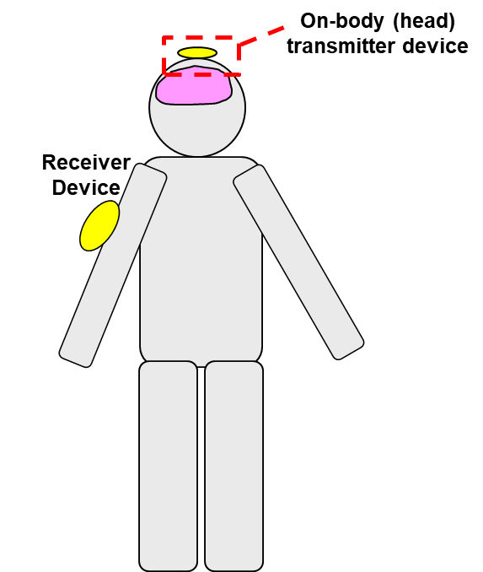
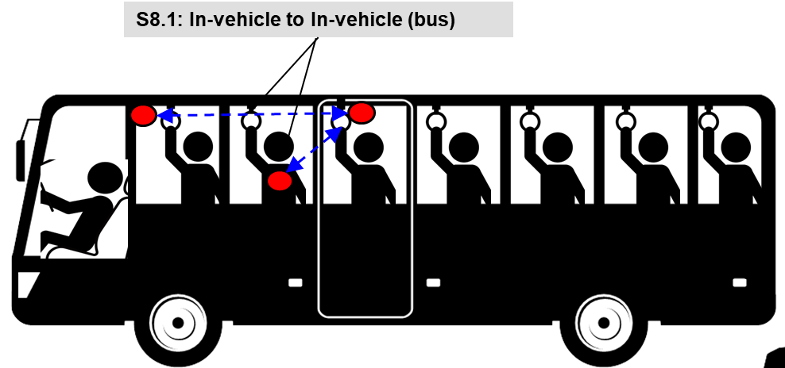
UWB communication applications
Vehicle BAN (VBAN)
Human BAN (HBAN)
Passengers bus model^{[1]}
Brain-computer interface (BCI) model^{[1]}
^{[1]}IEEE 802.15-22-0344-02-006a

Slide 4
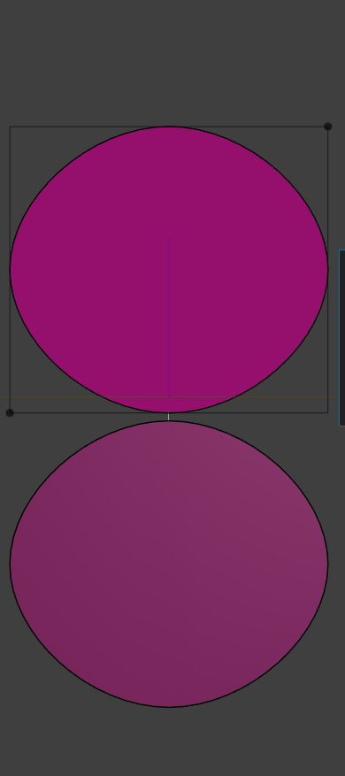
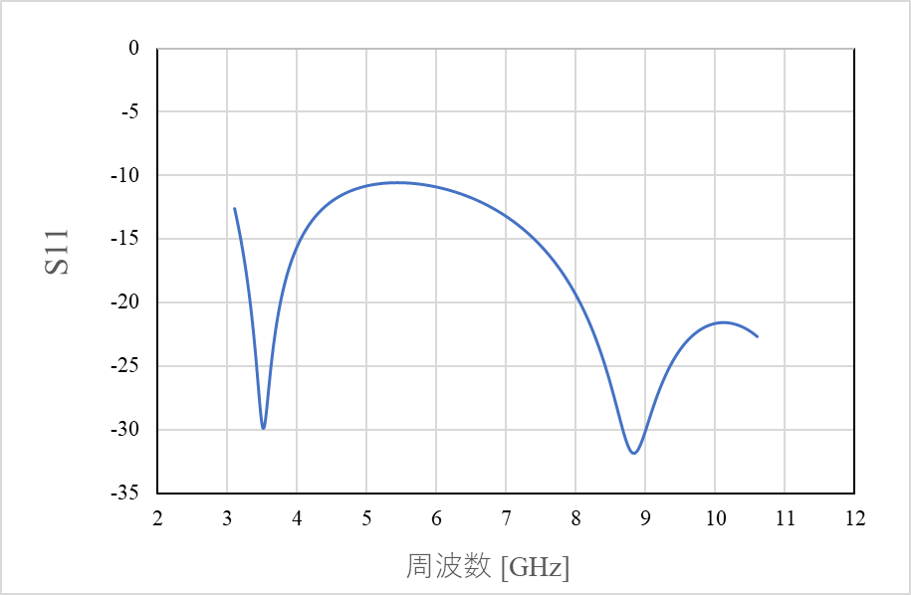
UWB antenna at 3.1 - 10.6 GHz band
20 mm
Frequency: 3.1 – 10.6 GHz
Planar elliptical dipole antenna
Element size: 20 mm x 18 mm x 1 mm
Interval between each element: 0.5 mm
18 mm
|S₁₁| [dB]
Frequency [GHz]

Slide 5
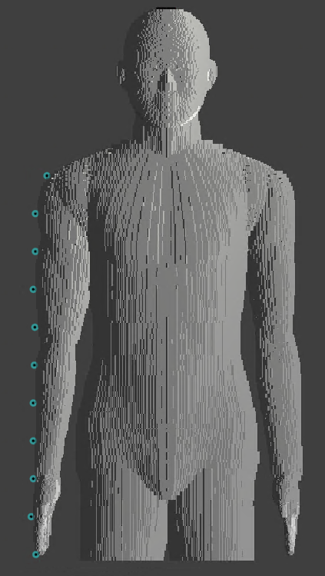



Simulation model
UWB antenna
(transmit antenna)
Frequency: 3.4 – 4.8 GHz
Frequency-dependent finite-different time-domain (FDTD) method
Multi-size voxel model (min. size: 0.5 mm)
Homogeneous human model (Japanese male developed by NICT, Japan)
$$z$$
Transmitted signal waveform
$$x$$
$$y$$

Slide 6
Dielectric constants of human model
Relative permittivity
Conductivity

Slide 7
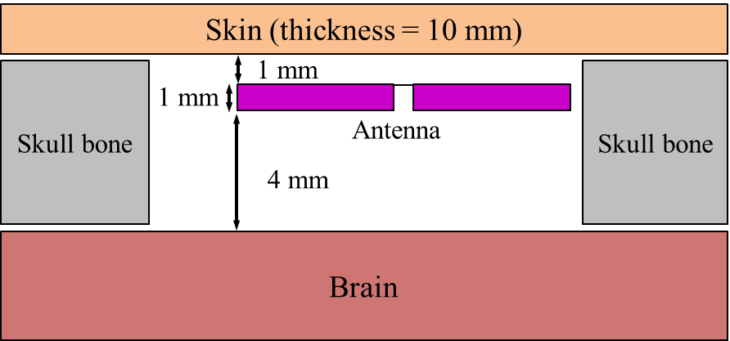
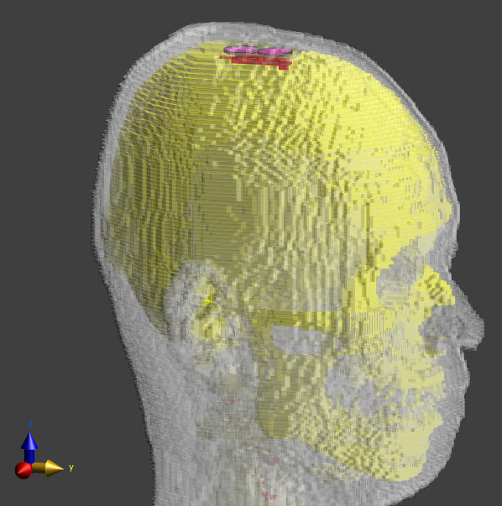
Simulation model for BCI case
(Forward antenna direction)

Slide 8
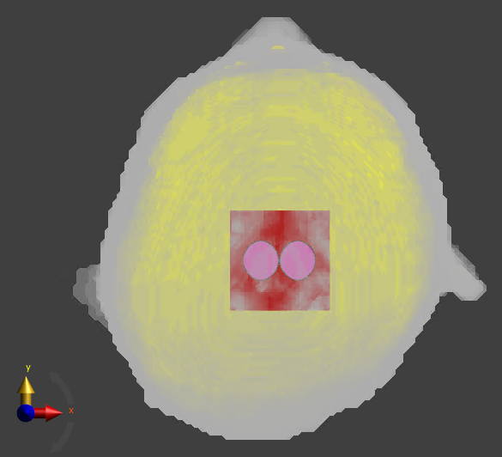
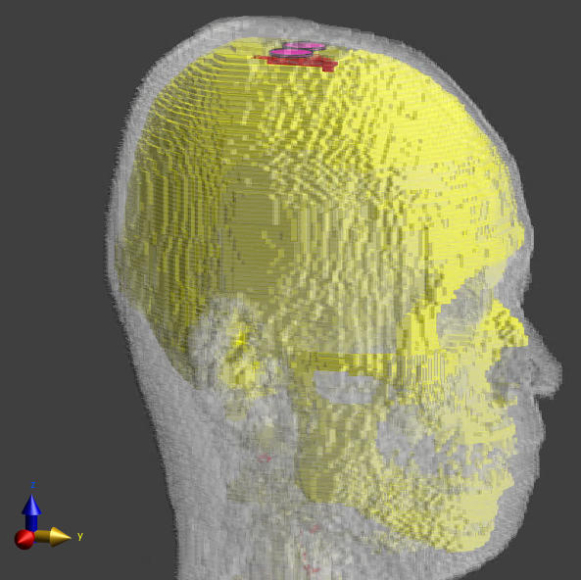
Simulation model for BCI case
(Sideways antenna direction)

Slide 9
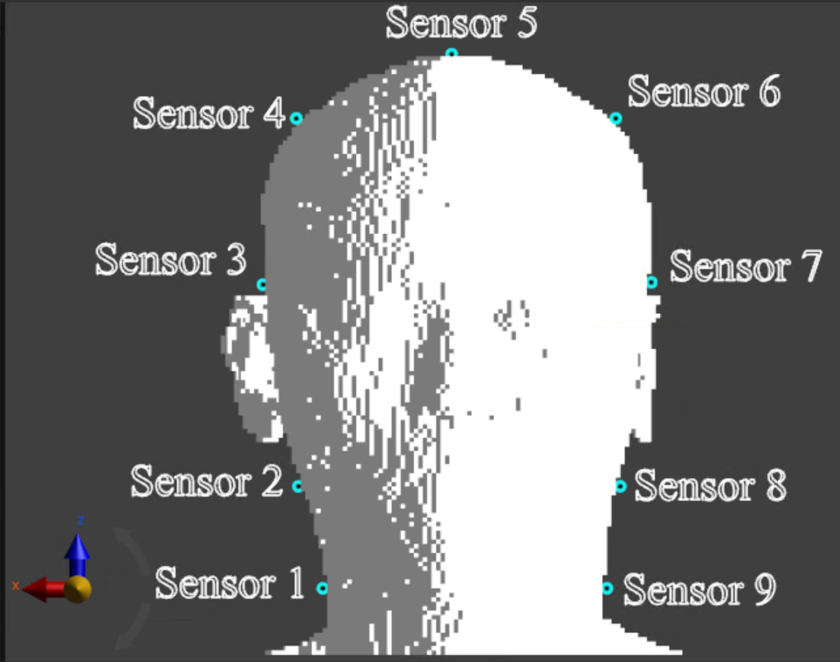
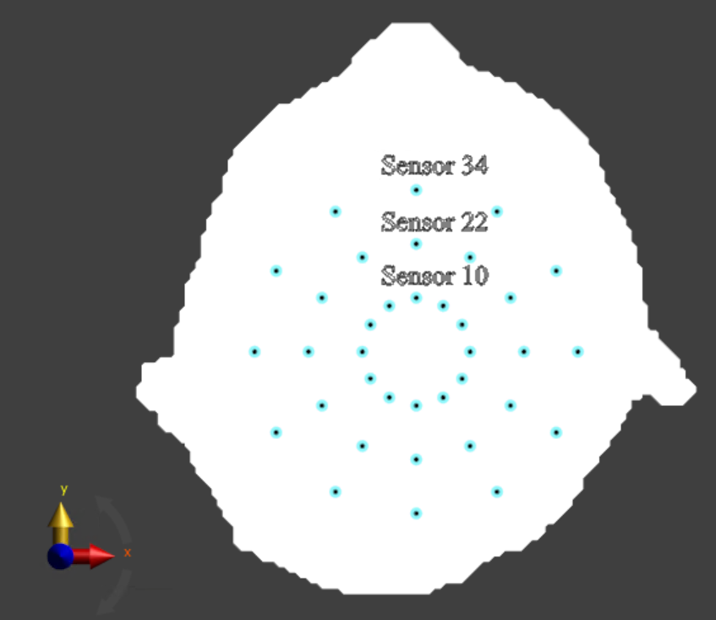
Simulation setup (Human head model)

Slide 10
Path loss characteristics (Sensor #10)
Forward antenna direction

Slide 11
Path loss characteristics (Sensor #22)
Forward antenna direction

Slide 12
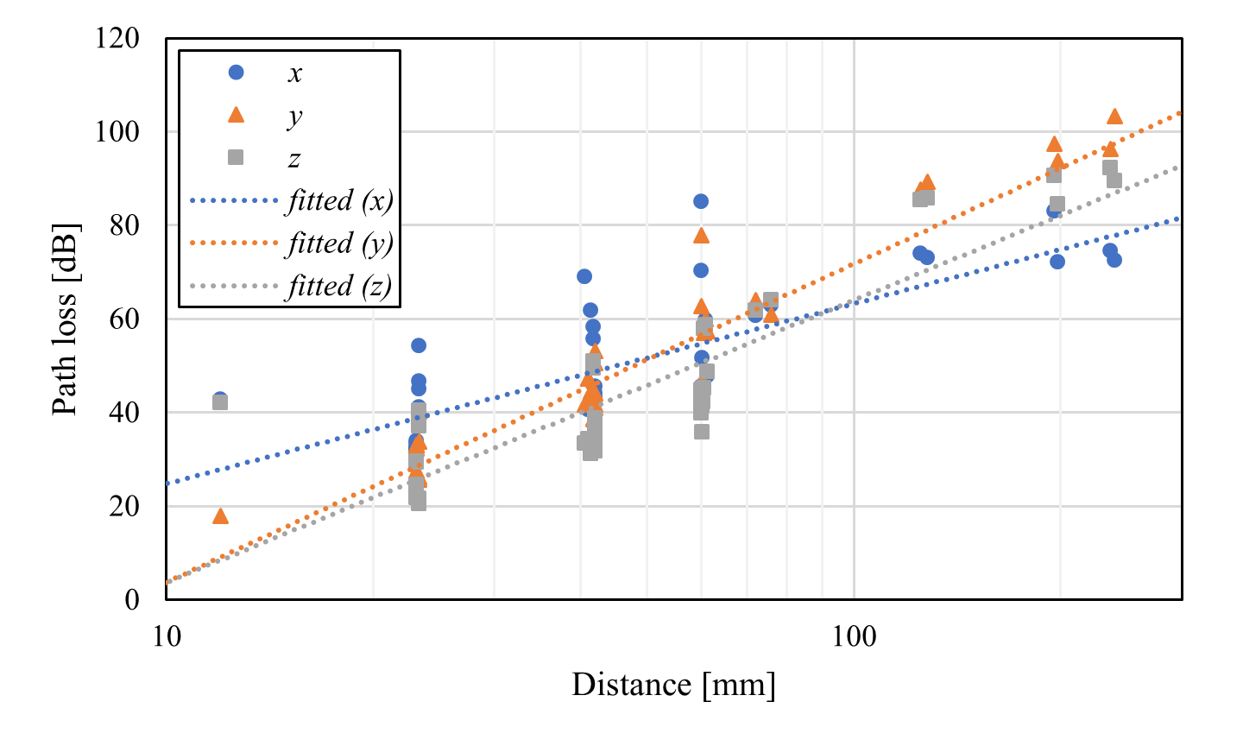

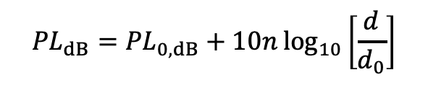
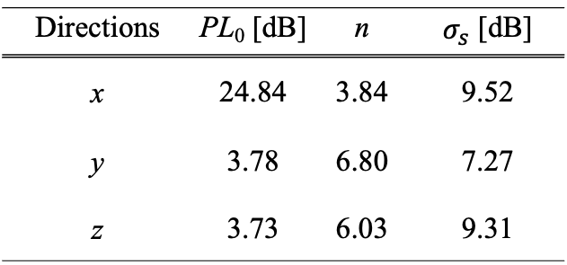
Distance characteristics (Human head, BCI)
Forward antenna direction
$${PL}_{dB}={PL}_{0,dB}+10n\log_{10}\left[\frac{d}{d_{0}}\right]$$
Directions | PL₀ [dB] | n | $σ_{s}$ [dB]
x | 24.84 | 3.84 | 9.52
y | 3.78 | 6.80 | 7.27
z | 3.73 | 6.03 | 9.31
$d_{0}=10$ mm

Slide 13
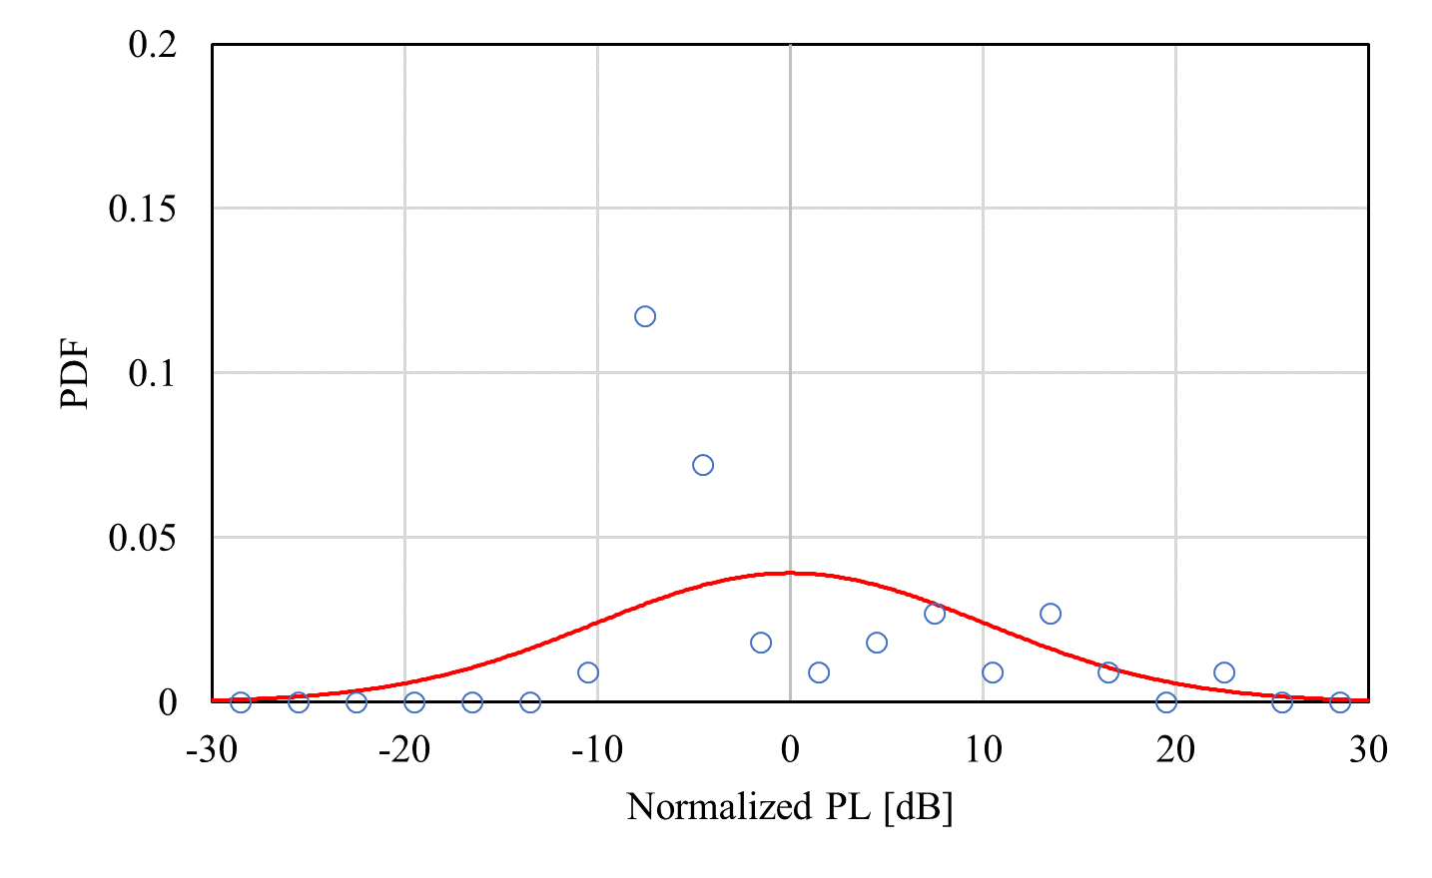
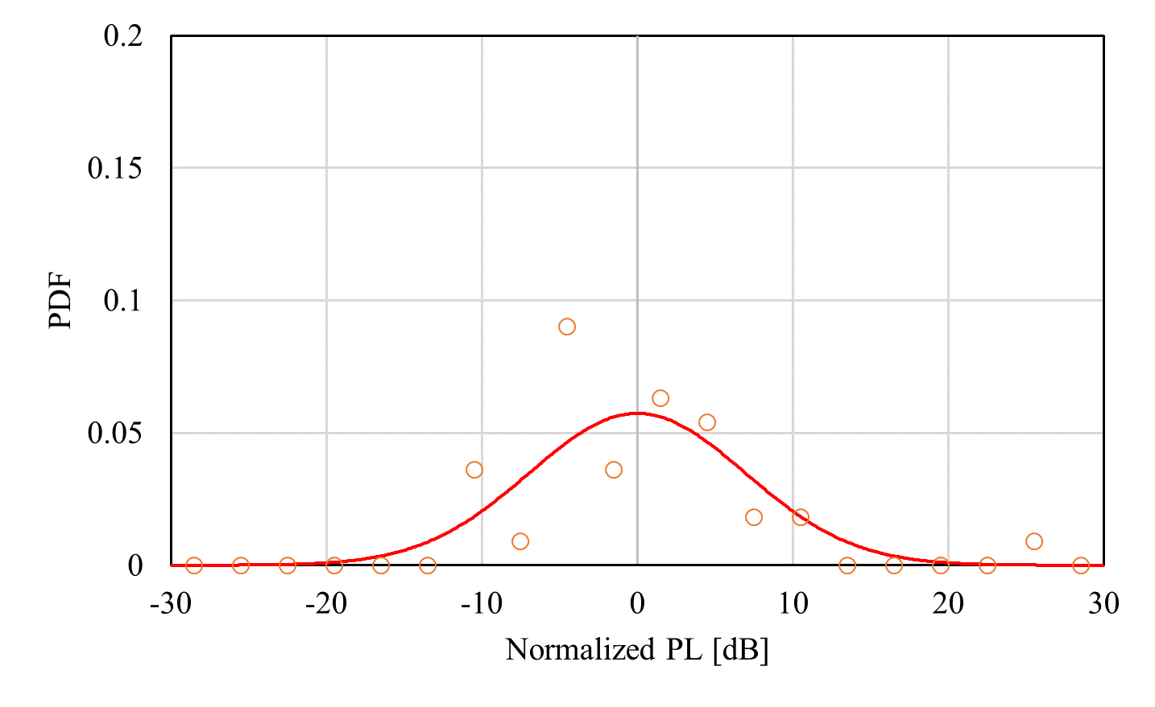
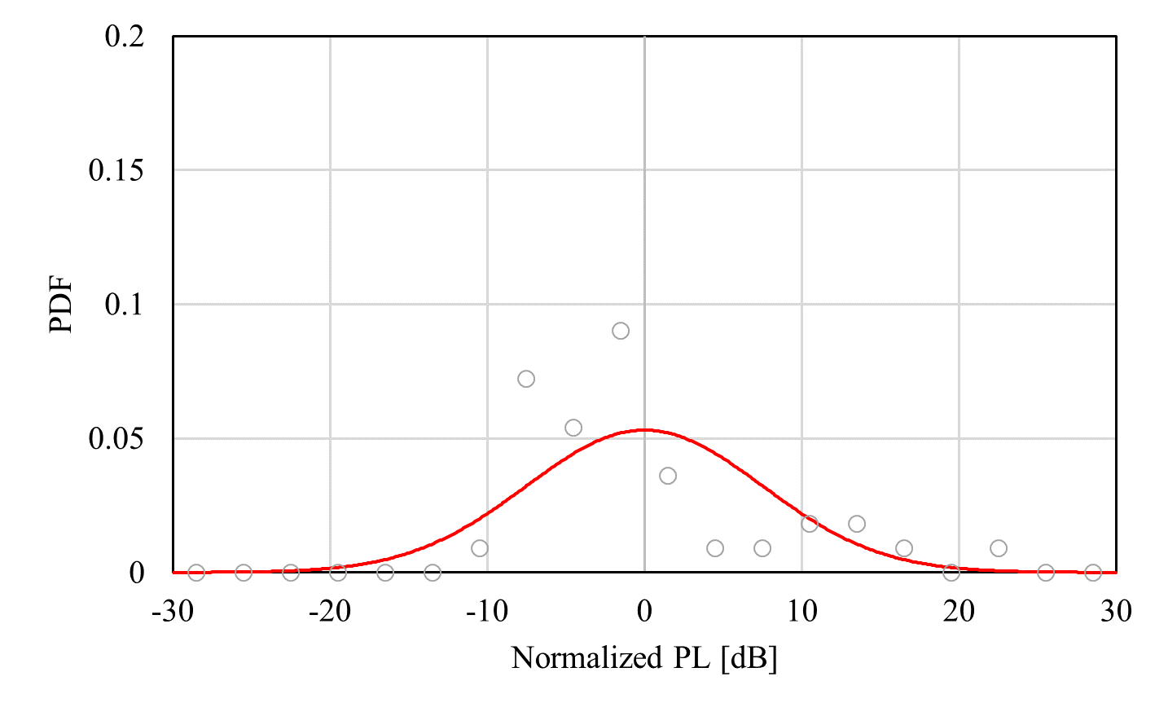



Log-normal distribution
(Human head, BCI)
Forward antenna direction
$x$-direction
$y$-direction
$z$-direction

Slide 14
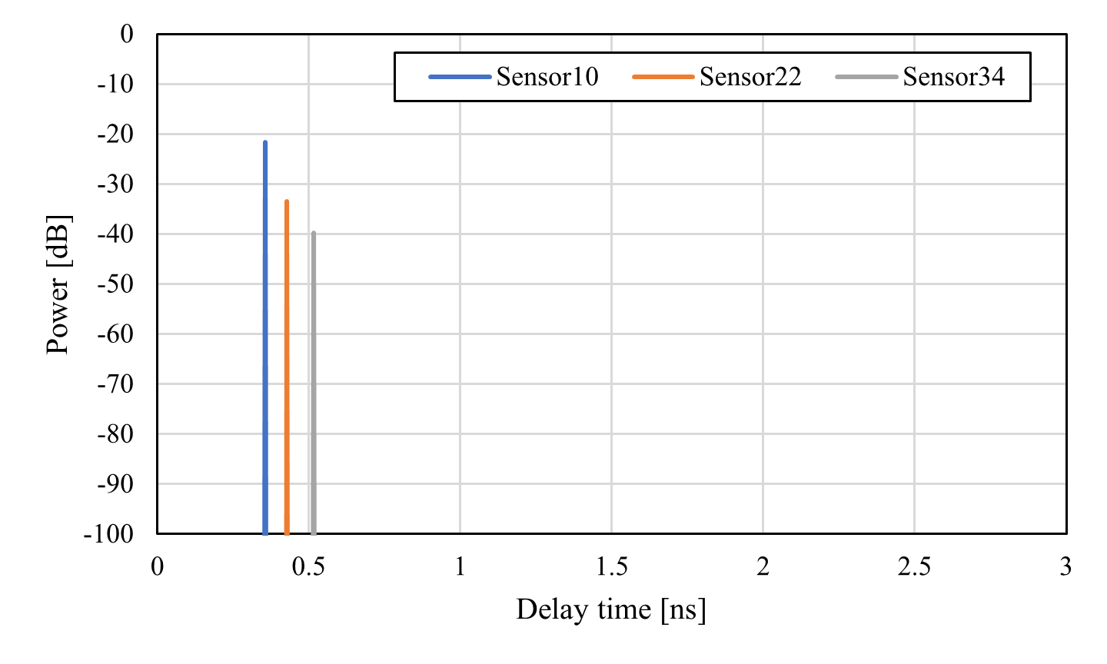
Power delay profile (Human head, BCI)
Forward antenna direction

Slide 15
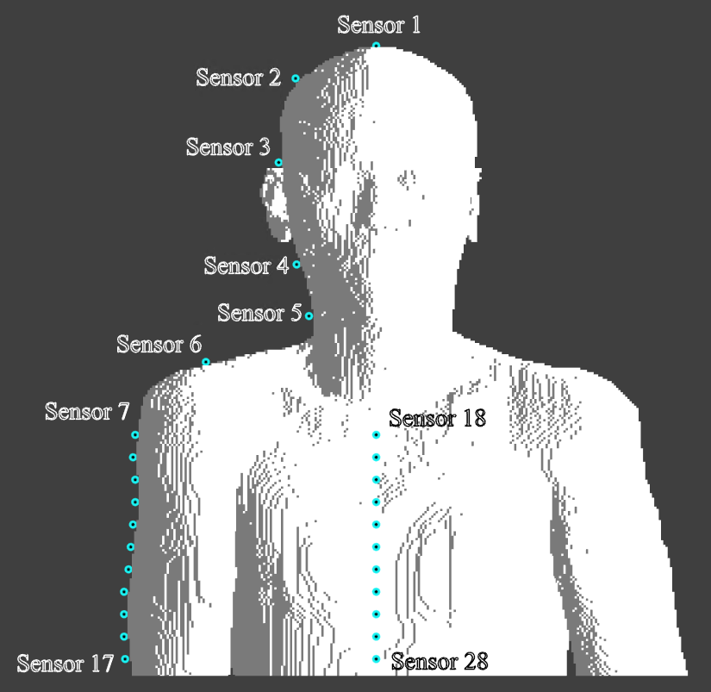
Simulation model (On-body model)
28 receivers were place on the body surface including head, arm, and chest

Slide 16
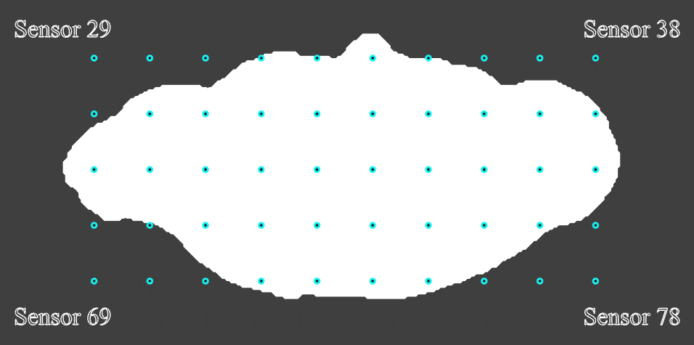
Simulation model (Off-body model)
Top view
50 receivers (#29-#78) were placed at a height of 30 mm above the transmitting antenna (the top of the human head)
The interval of each receiver was set to 5 mm

Slide 17
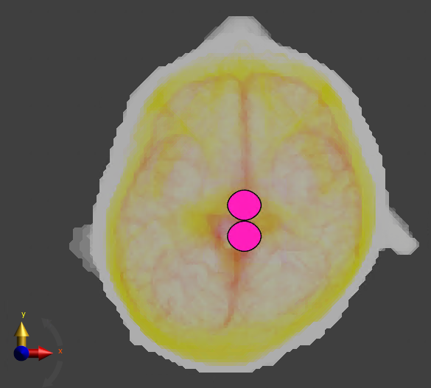
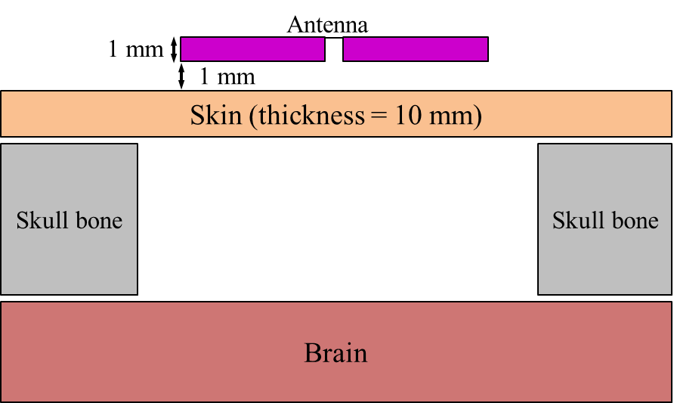
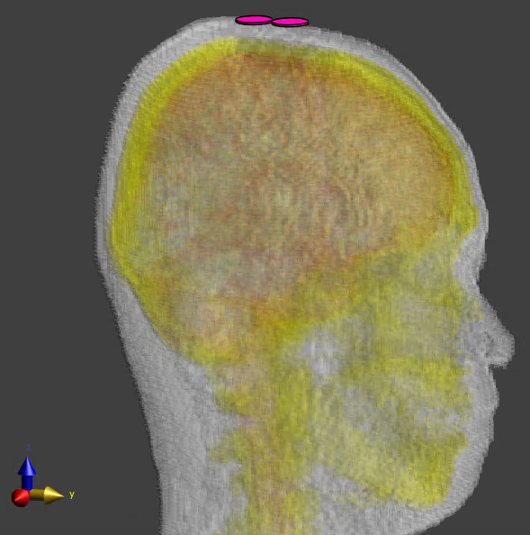
Simulation model for BMI case
(Forward antenna direction)
BMI: Brain Machine Interface

Slide 18

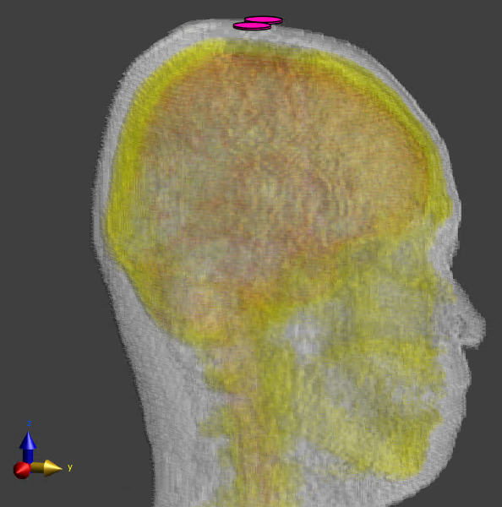
Simulation model for BMI case
(Sideways antenna direction)
BMI: Brain Machine Interface

Slide 19
Summary of channel parameters
Antenna direction | Case | Receiving direction | Receiving antenna position
 |  |  | Whole head (d₀ = 10 mm) |  |  | Scalp (d₀ = 10 mm) |  |  | Arm (d₀ = 100 mm) |  |  | Torso (front) (d₀ = 100 mm) |  |  | Off-body (d₀ = 10 mm)
 |  |  | PL₀ [dB] | n | σ_{s} [dB] | PL₀ [dB] | n | σ_{s} [dB] | PL₀ [dB] | n | σ_{s} [dB] | PL₀ [dB] | n | σ_{s} [dB] | PL₀ [dB] | n | σ_{s} [dB]
Forward | BCI | X | 24.84 | 3.84 | 9.52 | 27.13 | 3.36 | 10.18 | 23.70 | 9.76 | 0.74 | 69.31 | 3.85 | 3.02 | 48.47 | 1.45 | 9.63
 |  | Y | 3.78 | 6.80 | 7.27 | 11.44 | 5.32 | 6.96 | 102.62 | 0.57 | 8.15 | 50.24 | 2.76 | 0.65 | 19.13 | 2.67 | 2.72
 |  | Z | 3.73 | 6.03 | 9.31 | 17.58 | 3.31 | 7.52 | 104.27 | 0.59 | 4.98 | 27.52 | 8.61 | 1.98 | 22.81 | 2.69 | 7.55
 | BMI | X | 32.21 | 2.55 | 12.94 | 33.07 | 2.40 | 14.17 | 60.60 | 2.01 | 1.10 | 70.72 | 5.04 | 2.69 | 40.26 | 1.65 | 6.19
 |  | Y | 10.72 | 5.63 | 8.02 | 14.08 | 4.89 | 7.88 | 90.00 | 0.66 | 10.08 | 59.62 | 3.02 | 0.61 | 23.09 | 2.25 | 3.85
 |  | Z | 13.00 | 4.62 | 8.86 | 18.04 | 3.52 | 8.75 | 87.49 | 0.45 | 5.35 | 32.56 | 9.25 | 1.61 | 22.12 | 2.66 | 5.81
Sideways | BCI | X | 20.37 | 3.80 | 7.47 | 10.97 | 5.63 | 6.89 | 51.42 | 3.14 | 1.13 | 16.68 | 10.59 | 2.42 | 0.05 | 4.95 | 2.66
 |  | Y | 19.60 | 4.96 | 7.59 | 25.39 | 3.86 | 7.31 | 80.65 | 1.99 | 11.42 | 67.02 | 3.72 | 1.80 | 34.94 | 2.74 | 5.65
 |  | Z | 13.36 | 4.54 | 7.09 | 19.77 | 3.34 | 7.03 | 76.35 | 1.85 | 5.12 | 62.07 | 6.87 | 2.61 | 44.11 | 0.56 | 5.84
 | BMI | X | 17.71 | 4.01 | 7.33 | 14.01 | 4.84 | 7.51 | 51.22 | 3.28 | 1.09 | 15.68 | 11.30 | 2.58 | -3.03 | 5.25 | 4.76
 |  | Y | 26.20 | 4.19 | 12.94 | 33.17 | 2.65 | 12.88 | 78.08 | 2.63 | 12.69 | 56.25 | 4.89 | 1.52 | 45.33 | 1.24 | 6.31
 |  | Z | 20.14 | 4.09 | 8.89 | 23.42 | 3.39 | 9.35 | 77.09 | 1.87 | 5.07 | 36.17 | 10.07 | 1.61 | 42.50 | 0.80 | 4.96

Slide 20
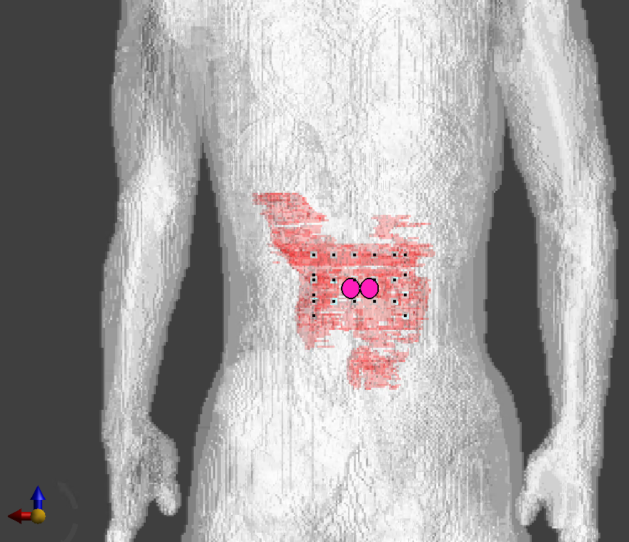
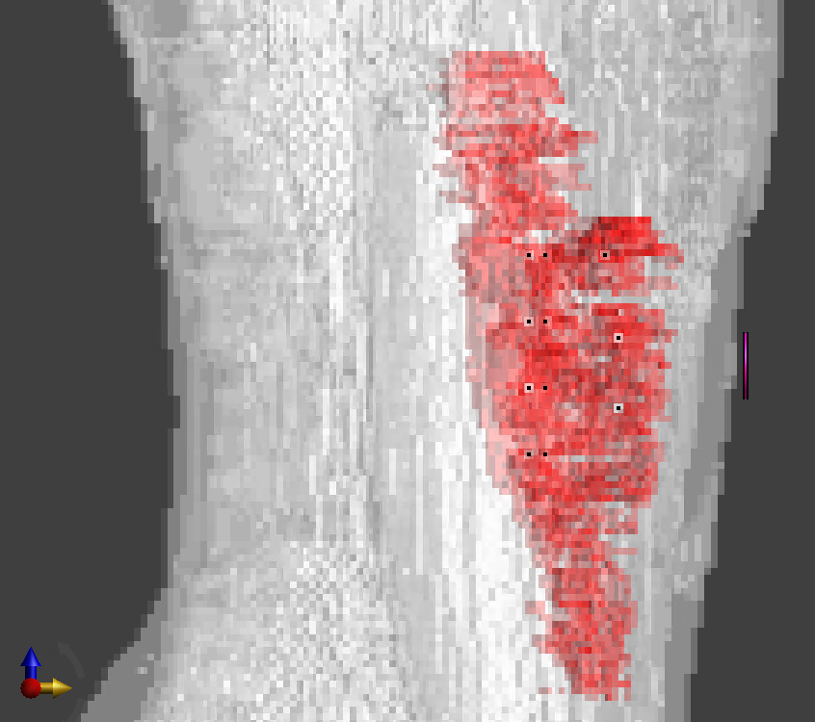

Path loss characteristics of implant (upper body) to on-body propagation
Frequency band: 3.1-10.6 GHz
Anatomical numerical male human body model developed by NICT, Japan
Frequency-dependent FDTD method
23 transmitting points were chosen inside the small intestine
Receiving antenna was put on the body surface with 1-mm spacing
20 mm
18 mm

Slide 21
Path loss characteristics (#7)

Slide 22
Path loss characteristics (#23)

Slide 23
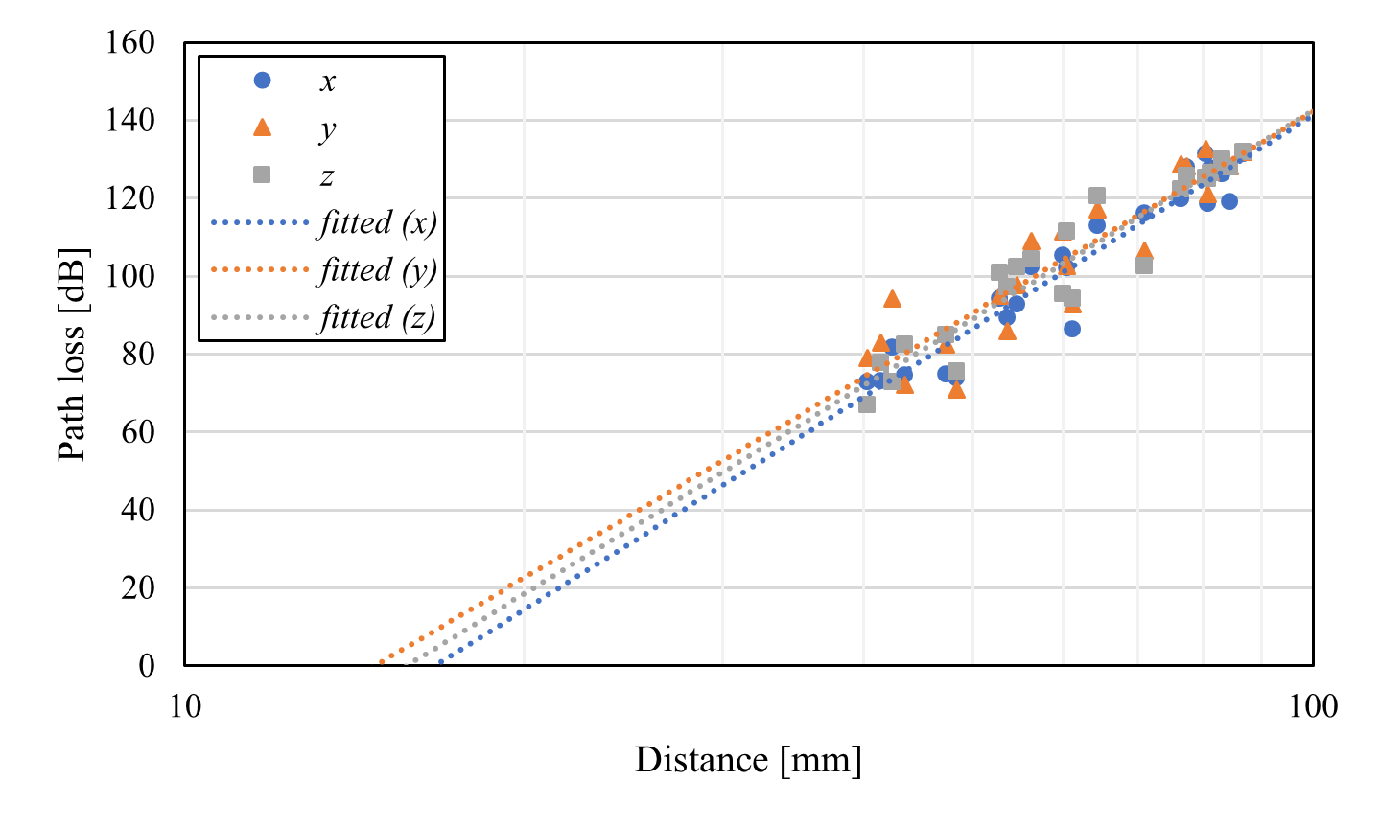
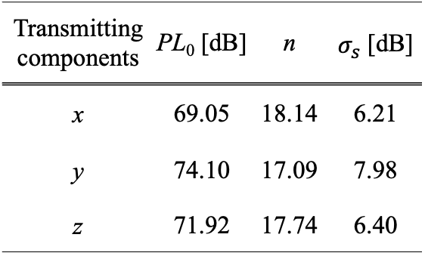

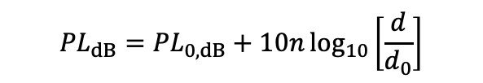
Distance characteristics
$d_{0}=10$ mm
Transmitting components | PL₀ [dB] | n | $σ_{s}$ [dB]
x | 69.05 | 18.14 | 6.21
y | 74.10 | 17.09 | 7.98
z | 71.92 | 17.74 | 6.40
$${PL}_{dB}={PL}_{0,dB}+10n\log_{10}\left[\frac{d}{d_{0}}\right]$$

Slide 24
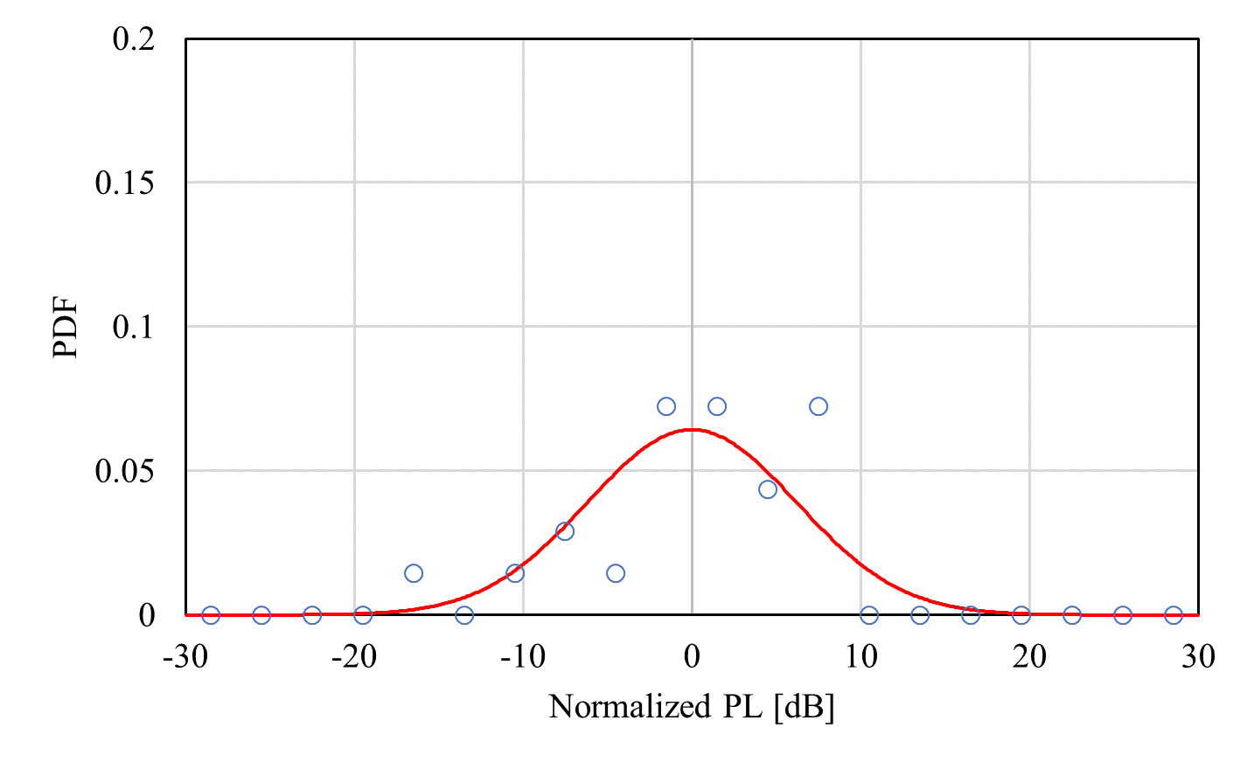
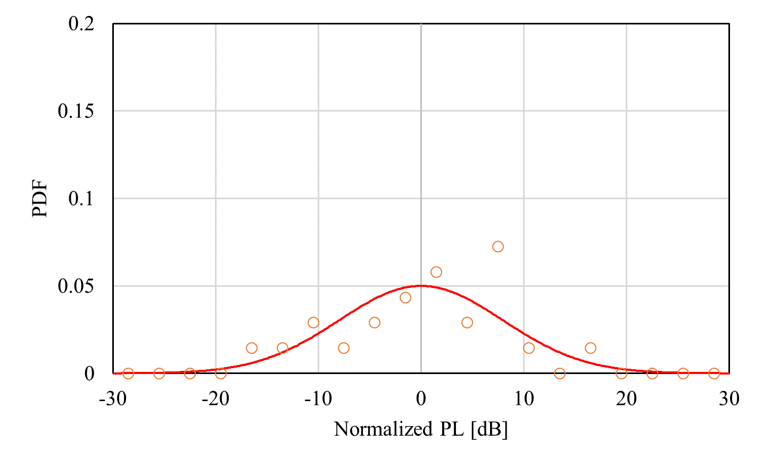
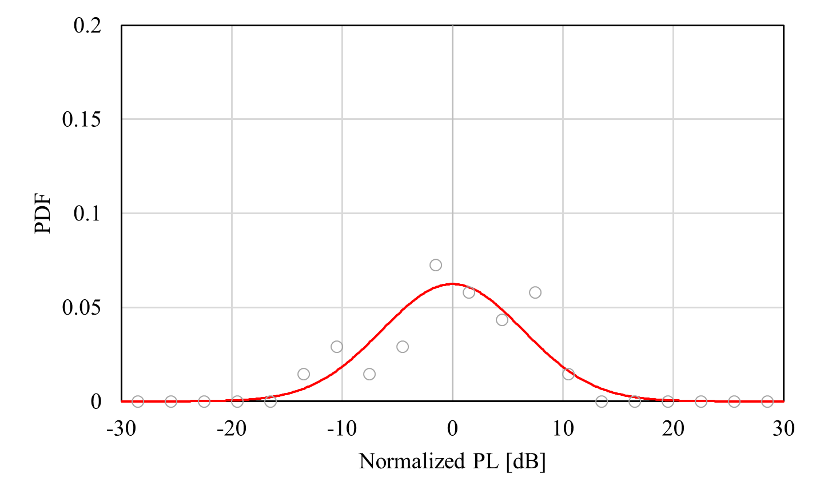
Shadow fading characteristics
Direction: x-axis
Direction: y-axis
Direction: z-axis

Slide 25
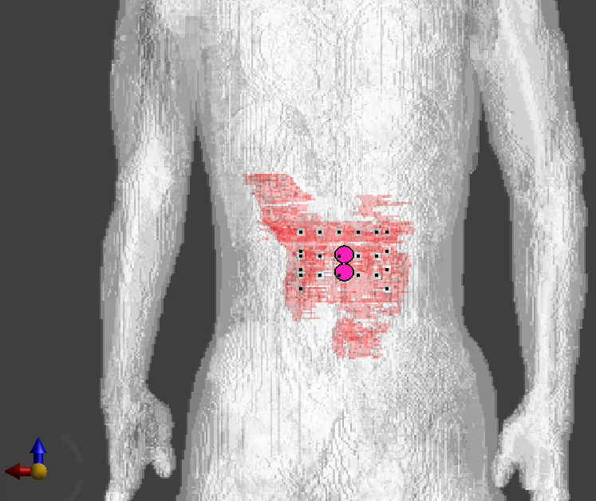
Path loss characteristics with another receiving antenna direction
Frequency band: 3.1-10.6 GHz
Anatomical numerical male human body model developed by NICT, Japan
Frequency-dependent FDTD method
23 transmitting points were chosen inside the small intestine
Receiving antenna was put on the body surface with 1-mm spacing
Horizontal arrangement
Vertical arrangement

Slide 26
Path loss characteristics with vertical arrangement (#7)

Slide 27
Path loss characteristics with vertical arrangement (#23)

Slide 28
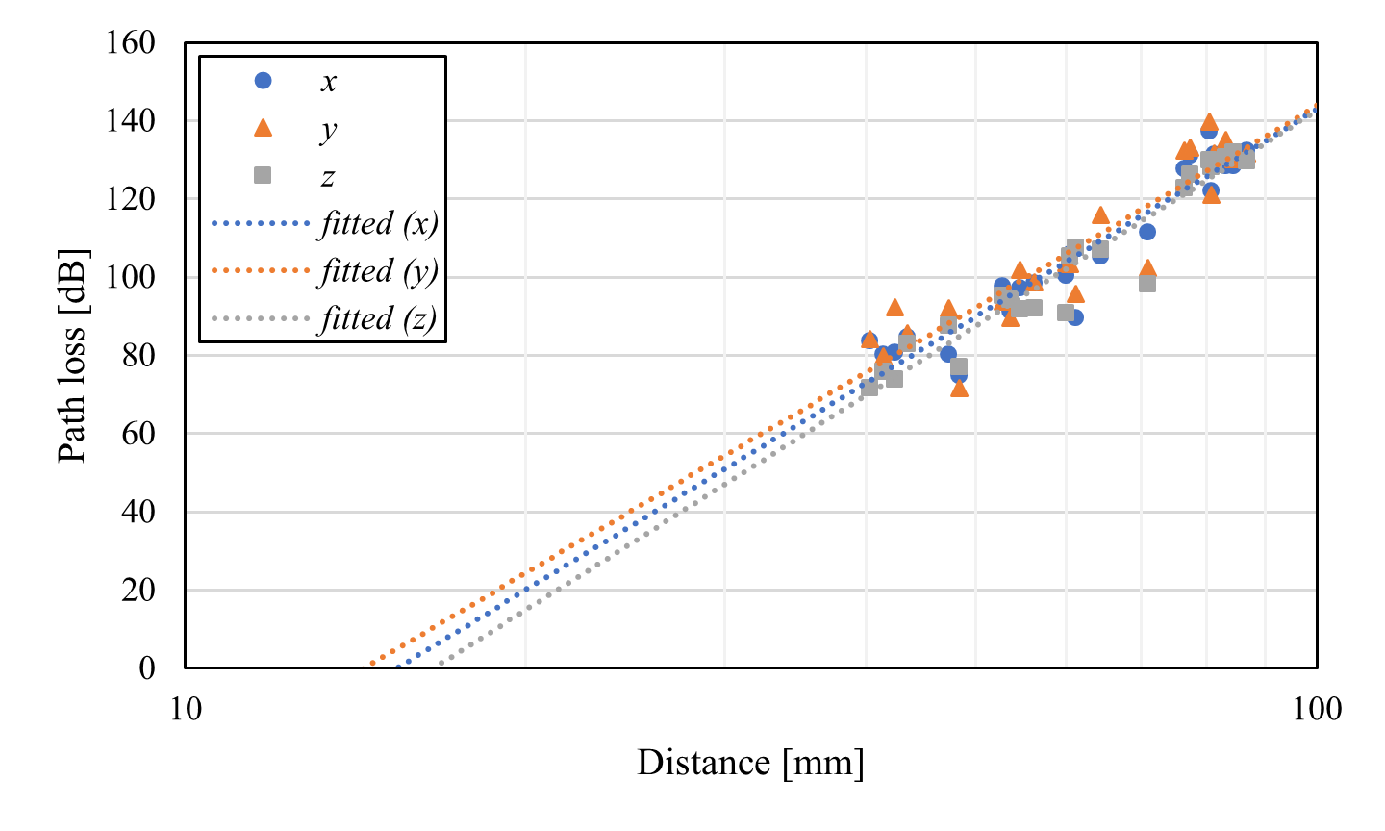
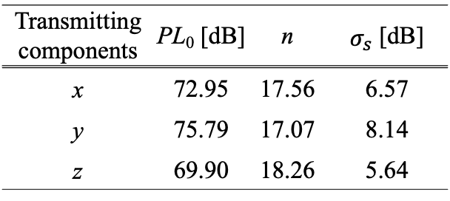

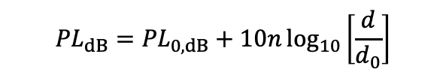
Distance characteristics
(vertical arrangement)
$d_{0}=10$ mm
Transmitting components | PL₀ [dB] | n | $σ_{s}$ [dB]
x | 72.95 | 17.56 | 6.57
y | 75.79 | 17.07 | 8.14
z | 69.90 | 18.26 | 5.64
$${PL}_{dB}={PL}_{0,dB}+10n\log_{10}\left[\frac{d}{d_{0}}\right]$$

Slide 29
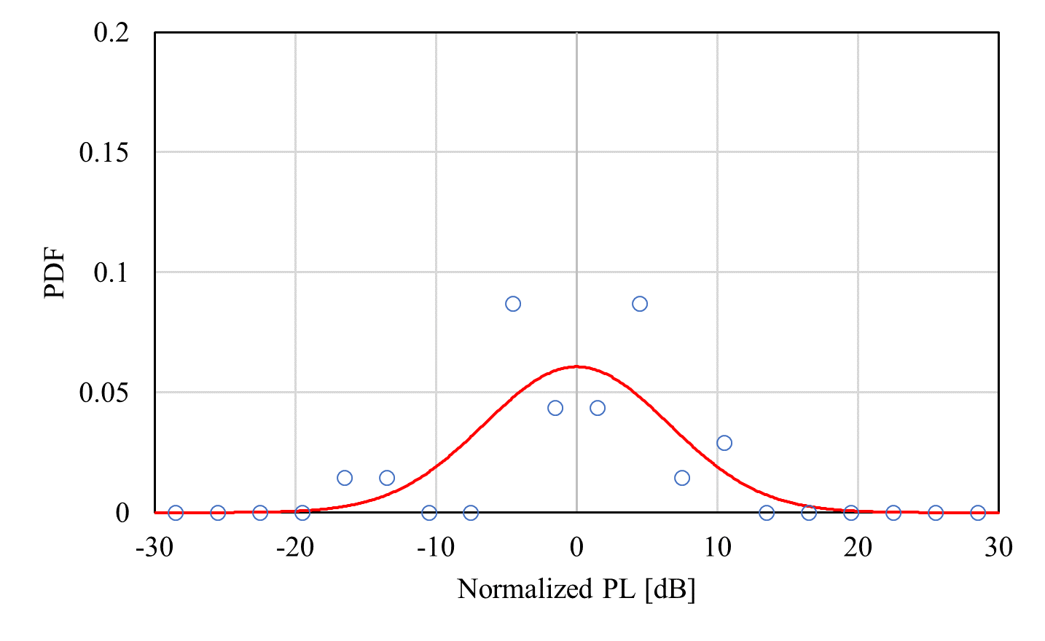
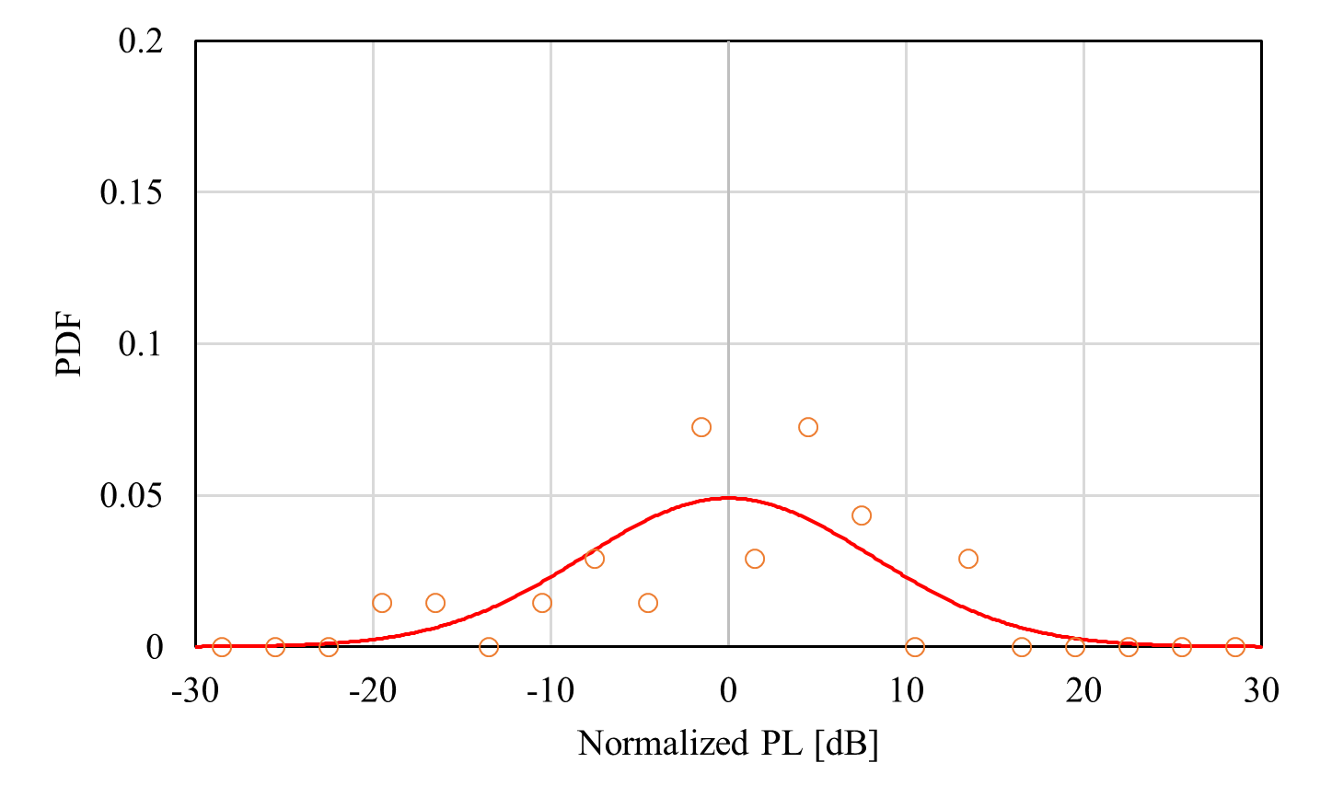
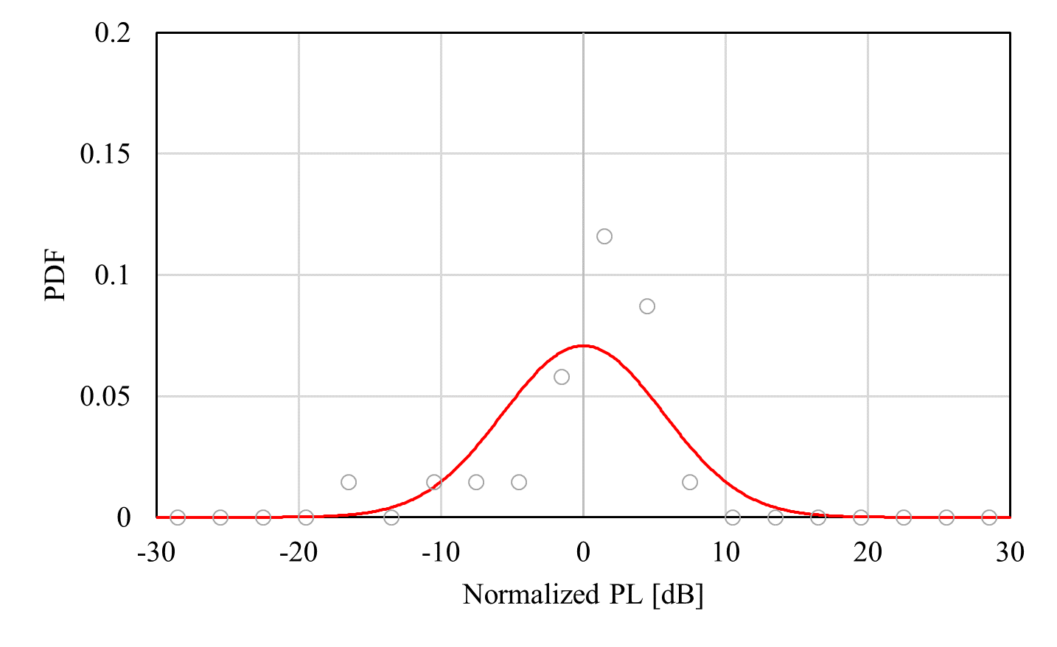
Shadow fading characteristics
(vertical arrangement)
Direction: x-axis
Direction: y-axis
Direction: z-axis

Slide 30
Antenna direction (On-body)

Slide 31


Antenna direction (On-body)
Horizontal plane ($θ=90°$)
Vertical plane ($φ=90°$)

Slide 32
Antenna direction (In-body)
The antenna was put inside the small intestine

Slide 33
Antenna direction (In-body)
Horizontal plane ($θ=90°$)
Vertical plane ($φ=90°$)

Slide 34
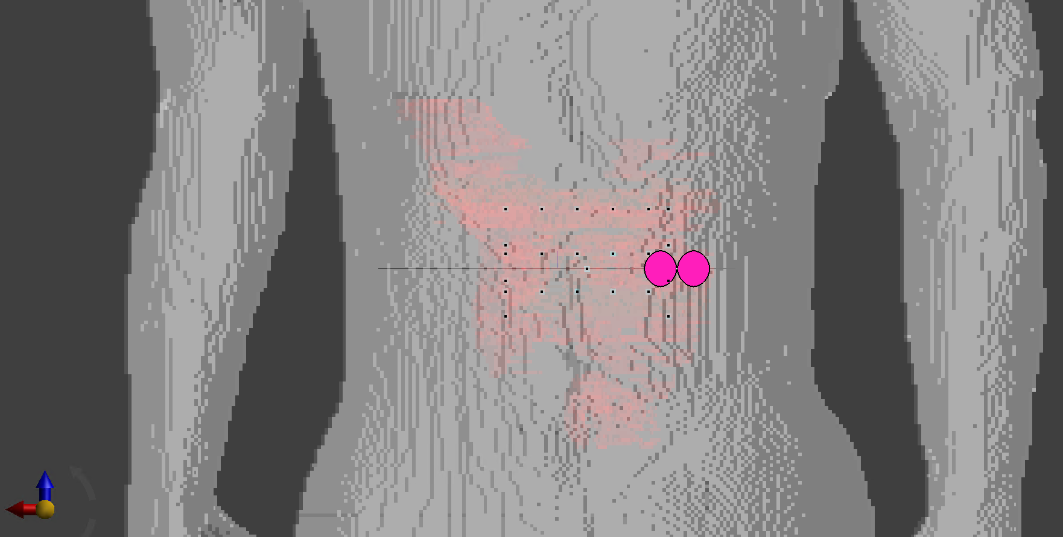
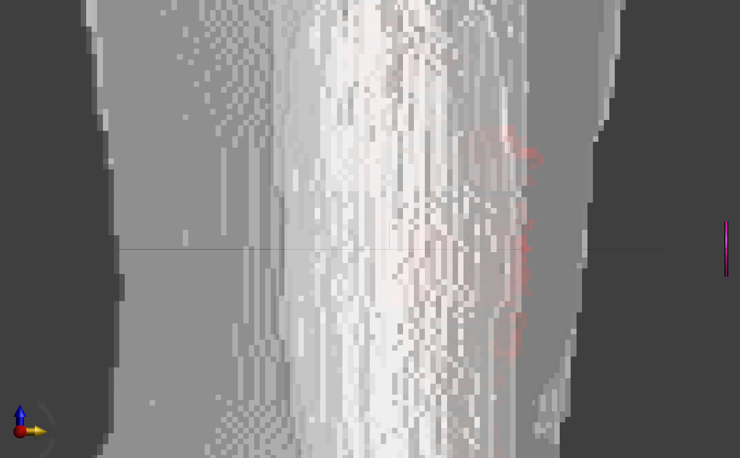
Path loss characteristics of implant (upper body) to off-body (External) propagation
Frequency band: 3.1-10.6 GHz
Anatomical numerical male human body model developed by NICT, Japan
Frequency-dependent FDTD method
23 receiving points were chosen inside the small intestine
Transmitting antenna is located in the air with 50 mm from the body surface and 50mm right from the horizontal center of the body
20 mm
18 mm
0.5 mm
50mm
50mm

Slide 35
Path loss characteristics (#7)

Slide 36
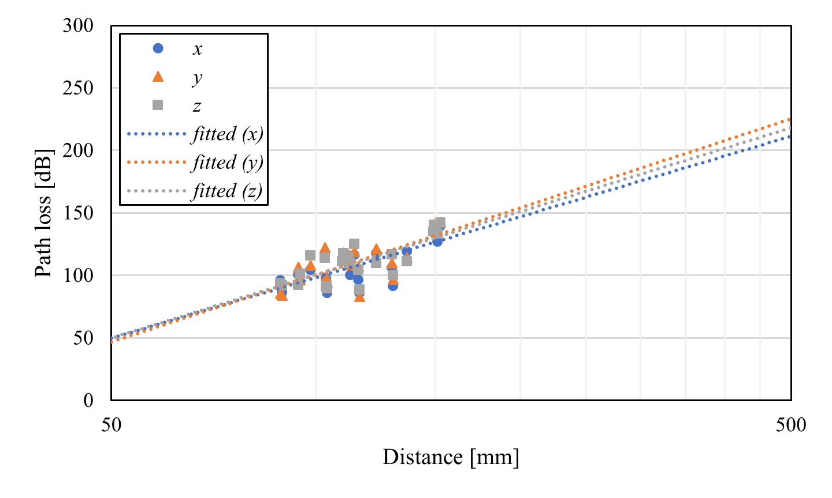
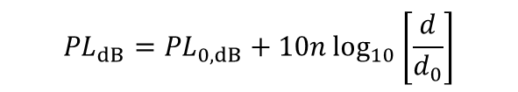
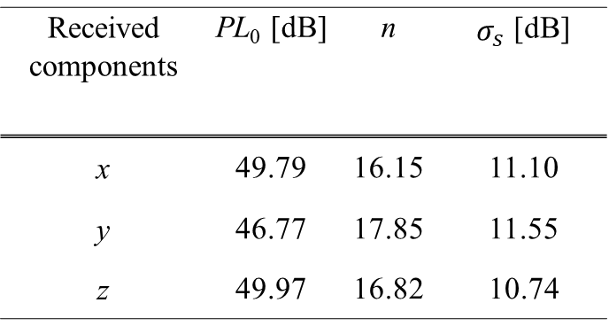
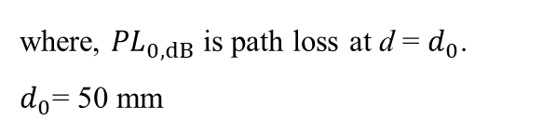
Path loss characteristics (#A-2)
Received components | PL₀ [dB] | n | $σ_{s}$ [dB]
x | 49.79 | 16.15 | 11.10
y | 46.77 | 17.85 | 11.55
z | 49.97 | 16.82 | 10.74
$${PL}_{dB}={PL}_{0,dB}+10n\log_{10}\left[\frac{d}{d_{0}}\right]$$
where, ${PL}_{0,dB}$ is path loss at d = $d_{0}$.
$d_{0}$= 50 mm

Slide 37
Acknowledgments
This work was supported in part by JST Moonshot R&D
Grant Number JPMJMS2214-06.

Slide 38
References
D. Anzai, I. Balasingham, G. Fischer, J. Wang, “Reliable and High-Speed Implant Ultra-Wideband Communications with Transmit–Receive Diversity,” EAI/Springer Innovations in Communication and Computing, pp. 27-32, March 2020.
Y. Shimizu, D. Anzai, R. C-Santiago, P. A. Floor, I. Balasingham, and J. Wang, “Performance evaluation of an ultra-wideband transmit diversity in a living animal experiment” IEEE Trans. Microw. Theory Tech., vol. 65, no. 7, pp. 2596-2606, July 2017.
D. Anzai, K. Katsu, R. Chavez-Santiago, Q. Wang, D. Plettemeier, J. Wang, and I. Balasingham, “Experimental evaluation of implant UWB-IR transmission with living animal for body area networks,” IEEE Trans. Microw. Theory Tech., vol. 62, no. 1, pp. 183-192, Jan. 2014.
J. Shi, D. Anzai, and J. Wang, “Channel modeling and performance analysis of diversity reception for implant UWB wireless link,” IEICE Trans. Commun., no. E95-B, vol. 10, pp. 3197-3205, Oct. 2012.

