Slide 1
Project: IEEE P802.15 Working Group for Wireless Personal Area Networks (WPANs)
Submission Title: Further discussion on NB CCA
Date Submitted: March 12, 2023
Source: Huan-Bang Li, Takeshi Matsumura (NICT, Japan).
Address: 3-4 Hikarino-oka, Yokosuka-shi, Kanagawa, 239-0847 Japan
E-Mail: {lee, matsumura}@nict.go.jp
Abstract: Further explanation and discussion on NB-assisted UWB channel access.
Purpose: To improve coexistence among UWB systems.
Notice: This document has been prepared to assist the IEEE P802.15. It is offered as a basis for discussion and is not binding on the authoring individual(s) or organization(s). The material in this document is subject to change in form and content after further study. The authors(s) reserve(s) the right to add, amend or withdraw material contained herein.

Slide 2
PAR Objective | Proposed Solution (how addressed)
Safeguards so that the high throughput data use cases will not cause significant disruption to low duty-cycle ranging use cases | Effective and efficient CCA reduce disruption between UWB devices
Interference mitigation techniques to support higher density and higher traffic use cases | Use NB radio to facilitate CCA so as to improve coexistence.
Other coexistence improvement | Use NB radio to improve coexistence among UWB devices.
Backward compatibility with enhanced ranging capable devices (ERDEVs)
Improved link budget and/or reduced air-time
Additional channels and operating frequencies
Improvements to accuracy / precision / reliability and interoperability for high-integrity ranging
Reduced complexity and power consumption
Hybrid operation with narrowband signaling to assist UWB | Exploiting NB PHY and concurrent operation with UWB to assist UWB channel access
Enhanced native discovery and connection setup mechanisms
Sensing capabilities to support presence detection and environment mapping
Low-power low-latency streaming
Higher data-rate streaming allowing at least 50 Mbit/s of throughput
Support for peer-to-peer, peer-to-multi-peer, and station-to-infrastructure protocols
Infrastructure synchronization mechanisms

Slide 3
Contents
Questions on NB CCA
How to use NB radio
Example of matching NB patterns to UWB
Proposed text

Slide 4
What Is NB CCA For?
For devices under a same coordinator, a superframe structure is adopted in 802.15.4 which includes both CAP and CFP. Use of CFP is managed by coordinator, whereas use of CAP is contention-based using algorithm such as CSMA/CA.
For devices out of the control of a same coordinator, random channel access may cause serious interference. LBT or DAA are usually used for interference reduction.
NB CCA can be used jointly with other algorithms such as CSMA/CA, LBT, etc. for contending channel and reducing interference.

Slide 5
Why NB CCA?
According to IEEE 802.15.4-2020, a UWB PHY shall implement a CCA mode. The effective mode considered for UWB CCA is either sensing preamble of 15.4 or sensing preamble of 15.6.
From coexistence point of view, it is desired to sense UWB operated in surroundings. As UWB penetration into different applications, requirement of sensing various UWB preambles may increase.
Compared to sensing UWB preambles, NB CCA can be conducted uniformly regardless the types of UWB preambles.

Slide 6
How to Operate NB CCA?
NB CCA is based on of a pair of coupled NB PHY and UWB PHY, that are operated concurrently based on same timer: either synchronized clock or MAC timer.
NB radio is used to indicate UWB channel occupancy status. CCA is performed at NB channel. UWB channel access is based on the coupled NB radio’s CCA results.
By introducing NB patterns, NB radio can be employed to present UWB information such as UWB channel #, duration of UWB channel occupancy, etc.

Slide 7
Conceptual View of NB Pattern and UWB Mapping

Slide 8
Use NB Radio Properly
Define a proper SINR threshold for NB radio, which matches with the sensing level of UWB radio. So that the NB radio doesn’t unnecessarily reduce the utilization of UWB channel.
NB patterns should be designed to be distinct compared to other ordinary NB radios, so that the other NB radio don’t shut up UWBs occasionally.

Slide 9
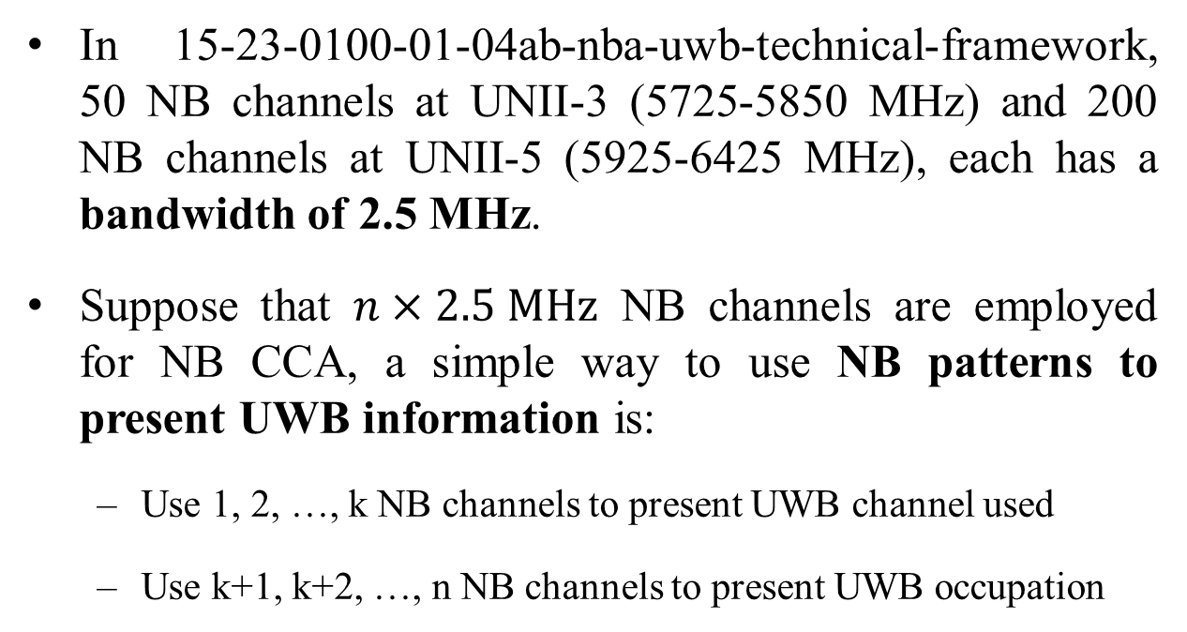
Example of using NB Radio
In 15-23-0100-01-04ab-nba-uwb-technical-framework, 50 NB channels at UNII-3 (5725-5850 MHz) and 200 NB channels at UNII-5 (5925-6425 MHz), each has a bandwidth of 2.5 MHz.
Suppose that $n×2.5 MHz$ NB channels are employed for NB CCA, a simple way to use NB patterns to present UWB information is:
  Use 1, 2, …, k NB channels to present UWB channel used
  Use k+1, k+2, …, n NB channels to present UWB occupation

Slide 10
Example of Mapping NB Pattern to UWB
ch_1 ch_2 ch_3 ch_k ch_k+1 ch_n
UWB ch UWB occupancy
By controlling transmission of each NB channel, different NB patterns can be obtained. These NB patterns are used to present UWB information such as UWB channel used, UWB occupancy time, etc.

Slide 11
Example of NB Pattern to UWB Channel
ch_1 ch_2 ch_3 ch_k
ch_1 ch_2 ch_k
ch_1 ch_2 ch_k
ch_1 ch_2 ch_k
UWB ch_#1 UWB ch_#2 UWB ch_#k
w/transmit
w/o transmit

Slide 12
Example of NB Pattern to UWB Occupancy
ch_k+1 ch_k+2 ch_n
UWB occupancy
ch_k+1 ch_k+2 ch_n
ch_k+1 ch_k+2 ch_n
ch_k+1 ch_k+2 ch_n
UWB task_#1 UWB task_#2 UWB task_#(n-k)
w/transmit
w/o transmit

Slide 13
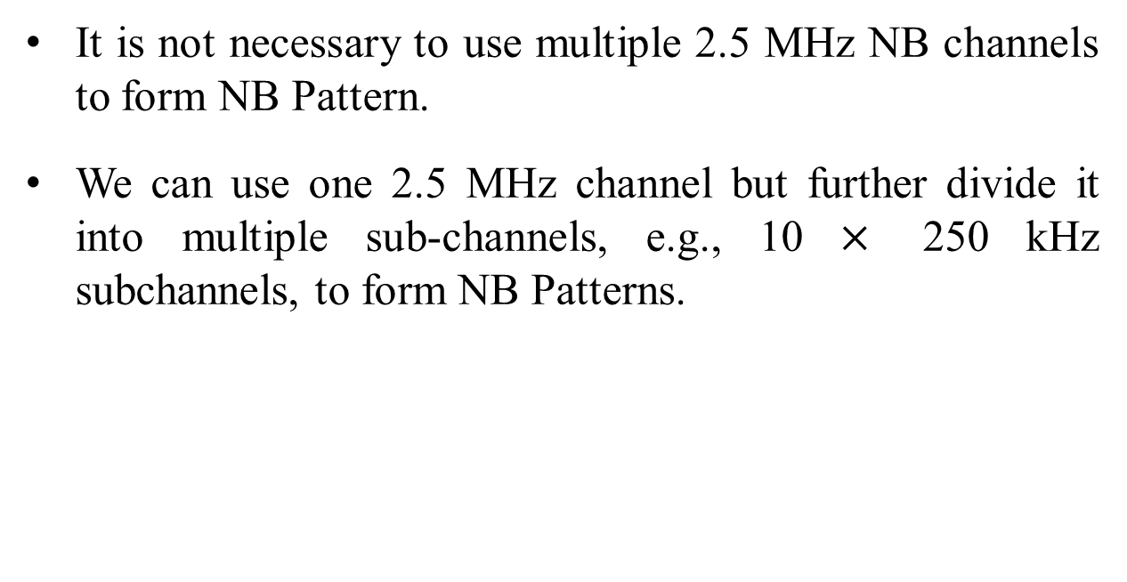
Notes On NB Patterns
It is not necessary to use multiple 2.5 MHz NB channels to form NB Pattern.
We can use one 2.5 MHz channel but further divide it into multiple sub-channels, e.g., 10 $×$ 250 kHz subchannels, to form NB Patterns.

Slide 14
Proposed Text (highlighted in blue)
Add an optional CCA mode to 10.2.8 Clear channel assessment (CCA) of IEEE 802.15.4-2020 as follows (15-22-0275-00-04ab)
An HRP UWB PHY shall implement one CCA Mode 1 through CCA Mode 4 or one of the following methods:
CCA Mode 5: HRP UWB preamble sense based on the SHR of a frame. CCA shall report a busy medium upon detection of a preamble symbol as specified in 15.2.6. An idle channel shall be reported if no preamble symbol is detected up to a period not shorter than the maximum packet duration plus the maximum period for acknowledgment.
CCA Mode 6: HRP UWB preamble sense based on the packet with the multiplexed preamble as specified in 15.6. CCA shall report a busy medium upon detection of a preamble symbol as specified in 15.2.6.
CCA Mode 7: UWB medium access coupled with CCA of narrow-band assisted PHY (NBA-PHY) as specified in 15.x. Transmission or CCA conducted by the coupled NBA-PHY act as indications of the UWB-PHY medium access status. CCA shall report an idle or a busy UWB medium based on the NBA-PHY CCA results.
*Original texts are highlighted in yellow while the proposed add-on texts in blue.

Slide 15
Summary
Adding NB CCA mode strengthens the CCA scope of the standard.
Adding NB CCA mode provides an additional choice, which is helpful for coexistence among UWB radios.
As the existing six CCA modes in IEEE 802.15.4-2020, NB CCA is an option mode and does not force to use.

Slide 16
Reference Slides

Slide 17
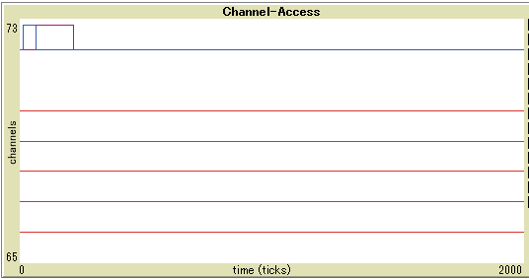
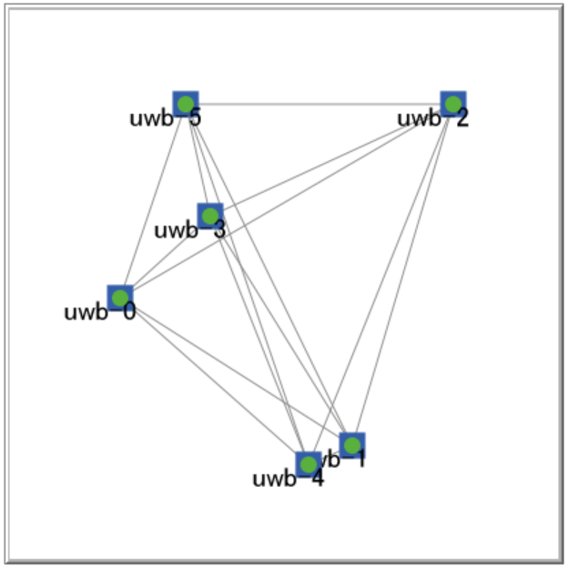
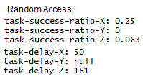
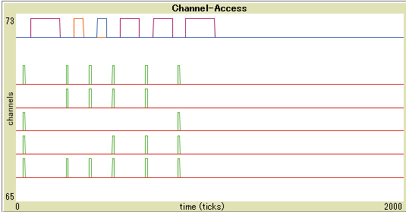
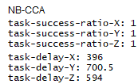
Simulation Results (1)
Five NB sub-ch UWB
ch
Six uniformly distributed UWB within communication ranges.
Each executes task X (50 ticks), Y (100 ticks), and Z (150 ticks).
Random access vs NB-CCA.
Five NB sub-ch UWB
ch

Slide 18
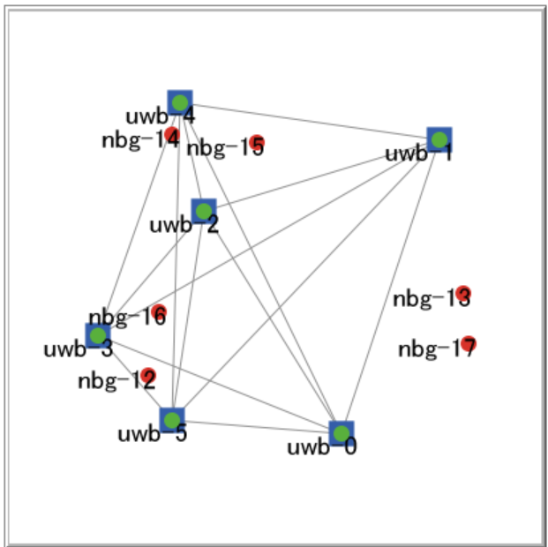
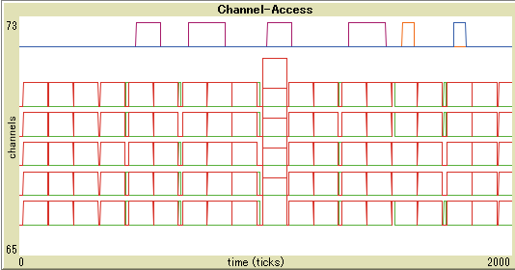
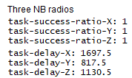
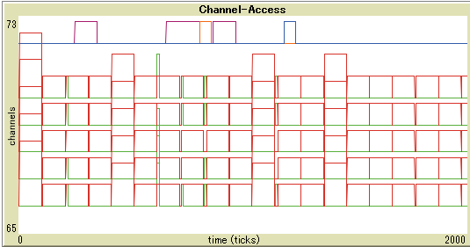
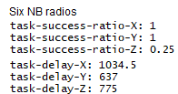
Simulation Results (2)
Five NB sub-ch UWB
ch
NB-CCA UWB and other NB radios co-exist. Each NB radio sends packets constantly that occupy all sub-ch.
Each NB radio transmits and stops alternatively every 100 ticks
Three vs. Six NB radios.
Five NB sub-ch UWB
ch

