Slide 1
Project: IEEE P802.15 Working Group for Wireless Personal Area Networks (WPANs)
Submission Title: Follow up on one-to-many NBA-MMS UWB
Date Submitted: March, 2023
Source: Kuan Wu, Lei Huang, Rojan Chitrakar, Yunbo Li, Bin Qian, David Xun Yang (Huawei Technologies)
Email: wukuan2@huawei.com
Abstract: Considerations for initialization and configuration updates in one-to-many NBA-MMS UWB
Purpose: Introducing initialization and configuration updates designs for one-to-many NBA-MMS UWB
Notice: This document has been prepared to assist the IEEE P802.15. It is offered as a basis for discussion and is not binding on the contributing individual(s) or organization(s). The material in this document is subject to change in form and content after further study. The contributor(s) reserve(s) the right to add, amend or withdraw material contained herein.
Release: The contributor acknowledges and accepts that this contribution becomes the property of IEEE and may be made publicly available by P802.15.

Slide 2
PAR Objective | Proposed Solution (how addressed)
Safeguards so that the high throughput data use cases will not cause significant disruption to low duty-cycle ranging use cases
Interference mitigation techniques to support higher density and higher traffic use cases
Other coexistence improvement
Backward compatibility with enhanced ranging capable devices (ERDEVs)
Improved link budget and/or reduced air-time
Additional channels and operating frequencies
Improvements to accuracy / precision / reliability and interoperability for high-integrity ranging
Reduced complexity and power consumption
Hybrid operation with narrowband signaling to assist UWB
Enhanced native discovery and connection setup mechanisms | Introducing initialization and configuration updates design considerations for one-to-many NBA-MMS UWB
Sensing capabilities to support presence detection and environment mapping
Low-power low-latency streaming
Higher data-rate streaming allowing at least 50 Mbit/s of throughput
Support for peer-to-peer, peer-to-multi-peer, and station-to-infrastructure protocols
Infrastructure synchronization mechanisms

Slide 3
Previous Contributions and references
1. DCN 22-0585r1 (November 2022) “One-to-Many Ranging using NBA-MMS”
2. DCN 23-0033r2 (January 2023) “NBA MMS UWB Native Discovery Concept”
3. DCN 22-0381r2 (January 2023) “NBA-MMS-UWB ranging text proposal for 15.4ab TFD”
4. DCN 23-0059r0 (Jan 2023) “Hyper block concept for use of NBA-MMS”
5. DCN 22-0378r0 (July 2022) “On the selection of number of fragments in MMS-UWB”

Slide 4
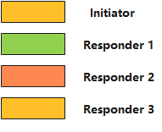
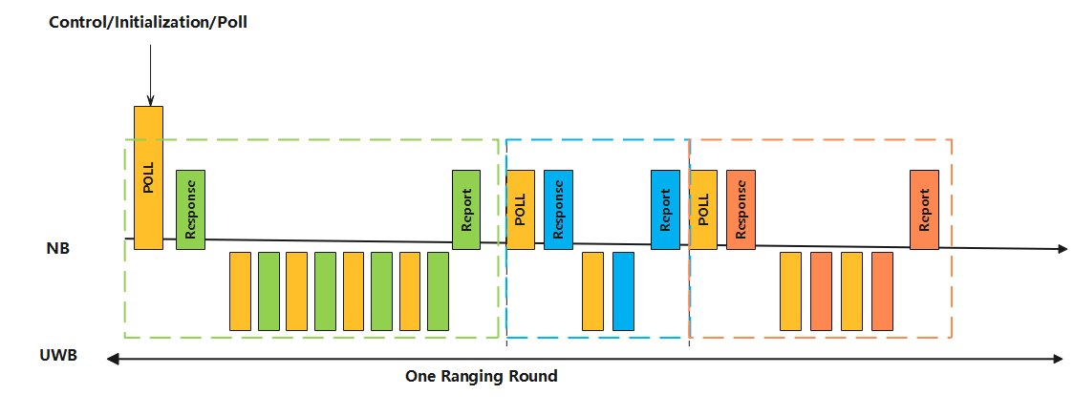
Recap: One-to-many NBA-MMS UWB ranging
Concatenating multiple responders in NBA-MMS UWB ranging [1]
  The extension of one-to-one NBA-MMS UWB ranging to multiple responders.
  Easy for implementation at the initiator side.
Responder 1
Responder 2
Responder 3

Slide 5
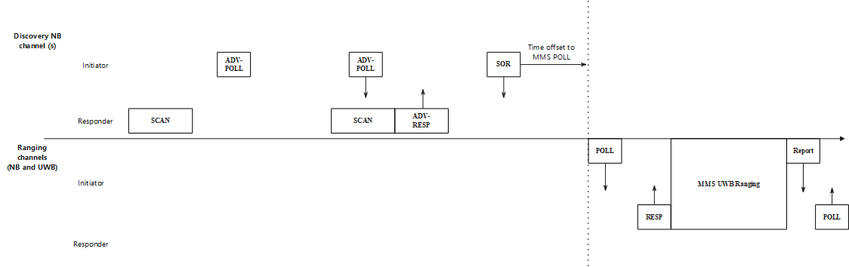
Recap: NBA-MMS UWB initialization and setup
The initialization process for NBA-MMS UWB [2]-[3] includes the exchanges of messages of advertising poll (ADV-POLL), advertising response (ADV-RESP), start of ranging (SOR) messages
  ADV-POLL: including the information of advertising identity and protocol version of the initiator
  ADV-RESP: acquisition request accompanied by a set of parameters
  SOR: final confirmation or updates of ADV-RESP parameters + time offset to MMS POLL packet
Remark: How to extent the initialization procedures to one-to-many NBA-MMS UWB ranging is not well discussed. Especially, how to deal with the ADV-RESP messages from multiple responders?

Slide 6
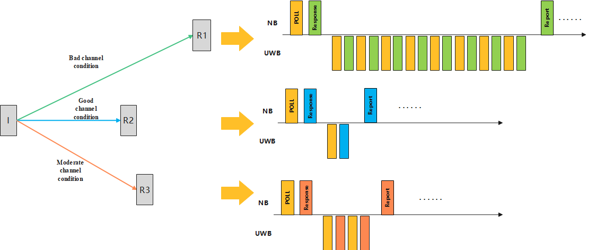
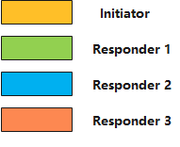
Recap: NBA-MMS UWB initialization and setup
The number of MMS ranging sequence fragments (nRSF) may differ per device in NBA-MMS UWB ranging [4]
  The determination of nRSF can be based on link condition [5], i.e., link with good channel condition may require fewer number of fragments → Each round/block may differ in terms of time duration.
Observation:
The update of nRSF may inherently change the round duration, especially in one-to-many NBA-MMS UWB → Ranging session update message(s) are needed.
When to receive the update announcement messages at responders is not well discussed. → If no explicit update indication is announced, responders may not know the exact time slot to receive the ranging session update message(s)

Slide 7
Motivation
Introducing initialization and configuration updates designs for one-to-many NBA-MMS UWB
  Initialization: dealing with the ADV-RESP messages from multiple responders and SOR message
  Configuration updates: dealing with the time slot(s) for responders to receive the update message from the initiator

Slide 8
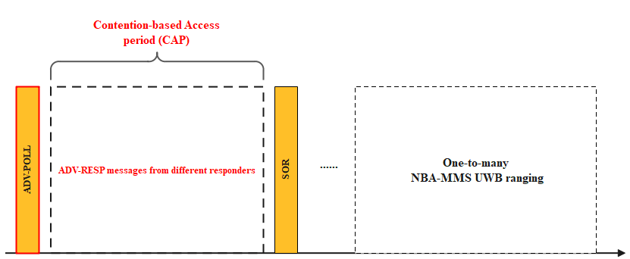
Consideration for ADV-POLL message
During the initialization and setup phase, initiator shall specify a contention access based period (CAP) to collect ADV-RESP messages from multiple responders
The broadcast ADV-POLL packet shall indicate the a timeout information to define the CAP.
  The start time of the CAP period can be defined as the end of ADV-POLL frame.
  The initiator shall only serve all or part of the responders whose ADV-RESP messages are received by initiator during the CAP.

Slide 9
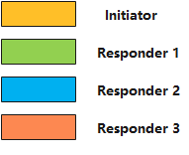
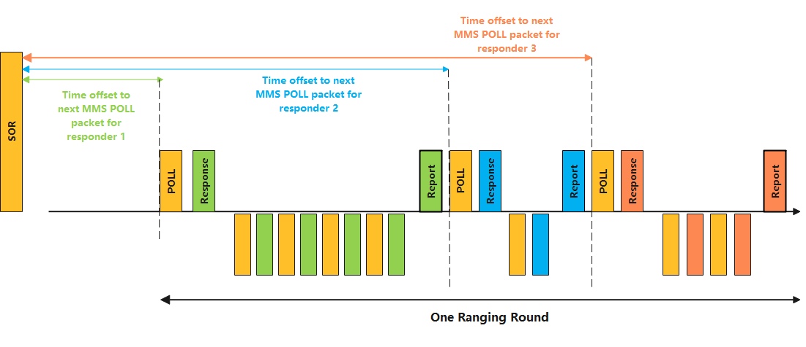
Consideration for SOR message
Further considerations for data content of SOR message in one-to-many NBA-MMS UWB
  The SOR message shall send final confirmation or updates of ADV-RESP parameters for all or part of the responders.
  Extending Time Offset to Next MMS POLL Packet field from common parameter level to per device parameter level

Slide 10
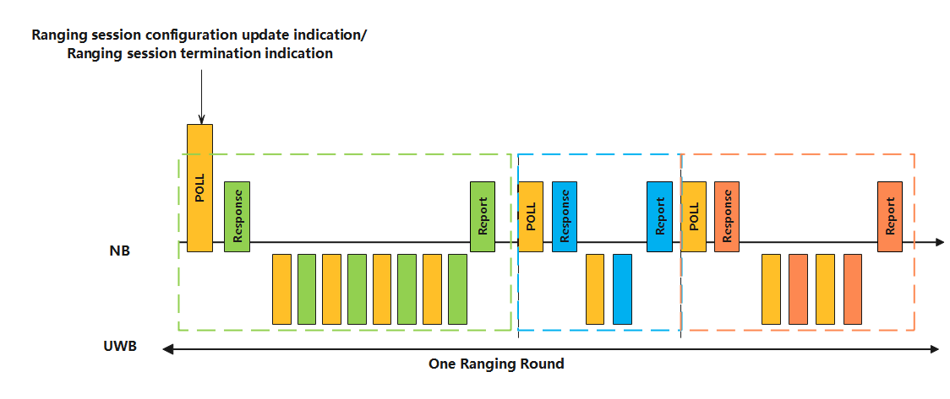
Consideration for Poll message
In a one-to-many NBA-MMS UWB ranging round, the first POLL message in the round may also indicate a ranging session configuration update or ranging session termination.
  The first POLL message shall use broadcast address

Slide 11
Summary
In this contribution, several considerations for initialization and configuration updates in one-to-many NBA-MMS UWB ranging are introduced
  During the initialization and setup phase, initiator shall specify a CAP to collect ADV-RESP messages from multiple responders
  Further considerations for data content of SOR message in one-to-many NBA-MMS UWB ranging
  The first POLL message in the round may also indicate a ranging session configuration update or ranging session termination.

Slide 12
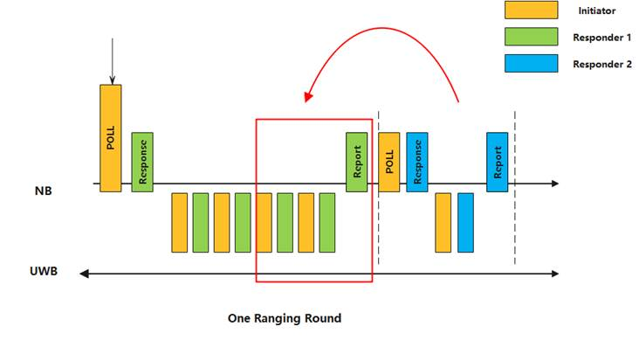
Appendix
Example of the benefit brought by using the 1st POLL message to piggyback the role of control message in one-to-many ranging
  The ranging between initiator and 1st responder may be updated by reducing the number of fragments from 4 to 2 in the new round (as highlighted by the red block in the following figure)→ Leaving some empty slots before implementing the ranging between initiator and 2nd responder.
  Therefore, by listening to the 1st POLL message, the 2nd responder may know the update in advance → These unused slots can be used by initiator and 2nd responder to perform ranging in a more timely manner.
Example in one-to-many ranging

