Slide 1
Project: IEEE P802.15 Working Group for Wireless Personal Area Networks (WPANs)
Submission Title: [UWB Native Discovery for Ranging Session and Channel Usage Coordination]
Date Submitted: [March 12, 2023]
Source: [Hong Won Lee, Jeonghwan Yoon, Insun Jang, Jinsoo Choi, Hangyu Cho(LG Electronics)]
Email: hongwon.lee@ lge.com
Re: [Input to the Working Group]
Abstract: [In-band 802.15.4 radio native discovery for Ranging Session and Channel Usage Coordination]
Purpose: []
Notice: This document has been prepared to assist the IEEE P802.15. It is offered as a basis for discussion and is not binding on the contributing individual(s) or organization(s). The material in this document is subject to change in form and content after further study. The contributor(s) reserve(s) the right to add, amend or withdraw material contained herein.
Release: The contributor acknowledges and accepts that this contribution becomes the property of IEEE and may be made publicly available by P802.15.

Slide 2
PAR Objective | Proposed Solution (how addressed)
Safeguards so that the high throughput data use cases will not cause significant disruption to low duty-cycle ranging use cases
Interference mitigation techniques to support higher density and higher traffic use cases | Unified native discovery for Ranging Session and UWB channel usage coordination
Other coexistence improvement | Unified native discovery for Ranging Session and UWB channel usage coordination
Backward compatibility with enhanced ranging capable devices (ERDEVs)
Improved link budget and/or reduced air-time
Additional channels and operating frequencies
Improvements to accuracy / precision / reliability and interoperability for high-integrity ranging
Reduced complexity and power consumption
Hybrid operation with narrowband signaling to assist UWB
Enhanced native discovery and connection setup mechanisms | Unified native discovery for Ranging Session and UWB channel usage coordination
Sensing capabilities to support presence detection and environment mapping
Low-power low-latency streaming
Higher data-rate streaming allowing at least 50 Mbit/s of throughput
Support for peer-to-peer, peer-to-multi-peer, and station-to-infrastructure protocols
Infrastructure synchronization mechanisms

Slide 3
Related Contributions
[1, 2] NBA-MMS-UWB Technical Framework and MAC
[3, 4, 5] UWB Channel Usage Coordination
  L. Verma (Apple), M. Lee (Samsung), W. Kuchler (NXP) et al., Nov. 2022
  [6] Compressed PSDU
  A. Krebs (Apple) et al., Nov. 2022

Slide 4
Background
  Initialization (or discovery) channel may be getting crowded if the number of UWB devices doing initialization/setup, and/or performing channel usage coordination increases
  Combining advertisement packet format for initialization/setup and channel usage coordination can reduce the number of advertisement packets
  Furthermore, considering wireless environment like channel status, advertisement packet should be constructed flexibly
    In case UWB channel status is good, only advertisement packets for initialization/setup are broadcasted if needed
    In case UWB channel status becomes worse, advertisement packets for initialization/setup and channel usage coordination may be broadcasted
  To reduce advertisement packet size for channel usage coordination, two-way handshake like native discovery concept [1] can be further considered in some case
  Here, we describe a native discovery enhancement for initialization/setup and channel usage coordination

Slide 5
Recap: Native Discovery Concept [1][2]
In [1] and [2], Native Discovery Concept is presented
To start an NBA-MMS-UWB ranging session, a pair of initiator and responder devices may engage in a initialization and setup phase
    To negotiate a ranging configuration different from the default set of parameters
To establish in-band initialization, ERDEVs shall opportunistically transmit and receive on the dedicated initialization channel and PHY modulation
    ADV-POLL shall be opportunistically broadcasted at initialization channel for ranging session setup

Slide 6
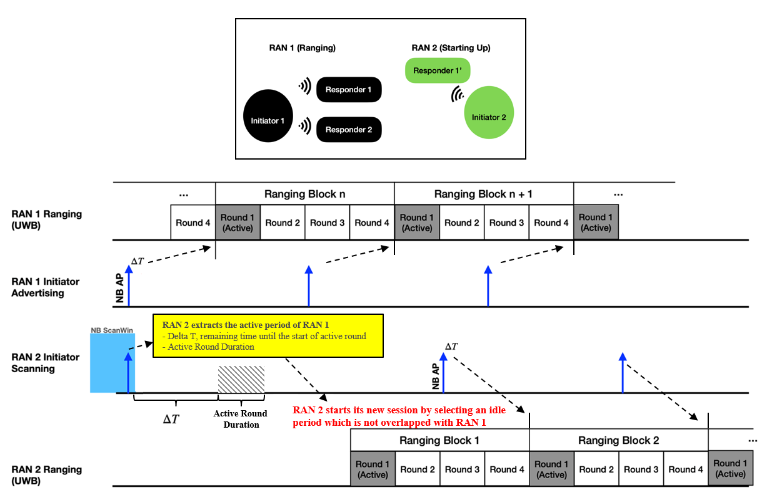
Recap: Channel Usage Coordination [3][4][5]
Coordination of UWB Channel usage is one method to facilitate better coexistence between UWB transmitters
AP(Acquisition Packet) shall be opportunistically broadcasted at initialization(or discovery) channel for channel usage coordination

Slide 7
Proposal
  Unified Native discovery for initialization/setup and channel usage coordination is consisted of:
    Unified advertisement packet format for ranging session setup and channel usage coordination
    Advertisement response packet with Request mode to choose the request for ranging session setup or channel usage coordination information
    Optionally, solicited method to obtain channel usage information(CUI) message including UWB Per-Session Info field [5] for channel usage coordination

Slide 8
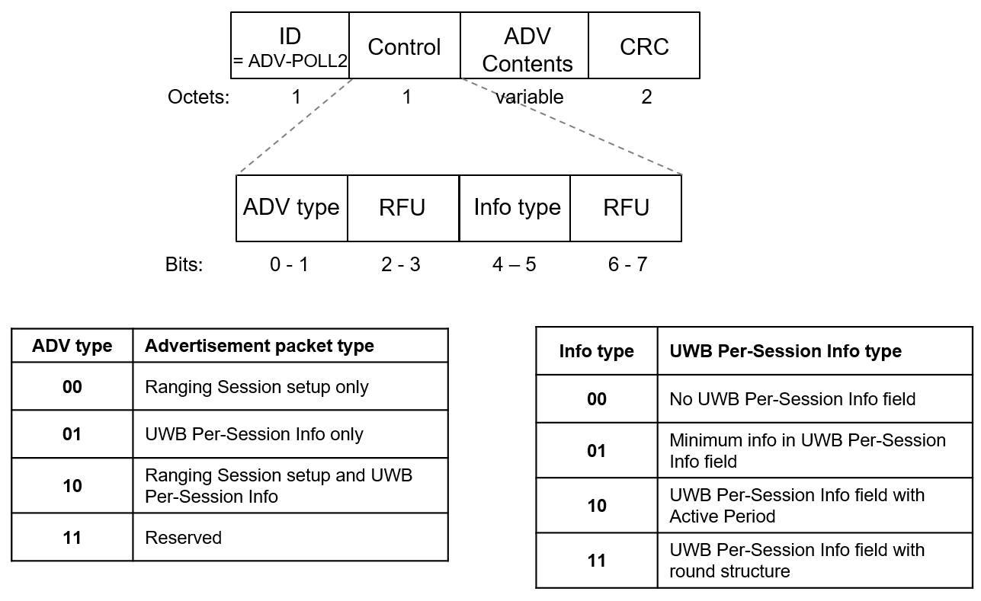
    Proposed advertisement packet format – ADV-POLL2
  Unified advertisement packet format is based on compressed PSDU [6]
  There are three options for advertising and four types of Per-Session Info field [5] for channel usage coordination
    ADV type: Advertisement packet type – Session setup only, Per-Session Info only, Both
    Info type: UWB Per-Session Info type [5] for channel usage coordination – Info type shall be set to ’00’ if ADV type is ’00’ (Initialization and setup)
* UWB Per Session Info field [5]

Slide 9
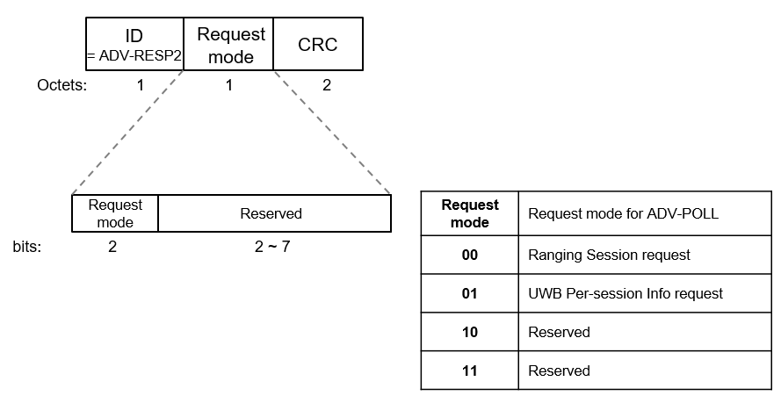
    Proposed advertisement packet format – ADV-RESP2
  Responder can make a request for Advertisement packet(ADV-POLL2) using Request mode in an ADV-RESP2
    Request mode shall be set to ‘00’ if ADV type of ADV-POLL2 = 00
    Request mode shall be set to ‘01’ if ADV type of ADV-POLL2 = 01
  In case Request mode = 00, ranging session setup is requested
  In case Request mode = 01, more channel usage information is requested
    More channel usage information may be transmitted by an initiator in the subsequence as solicited method if this Request mode is set in some case(optional)

Slide 10
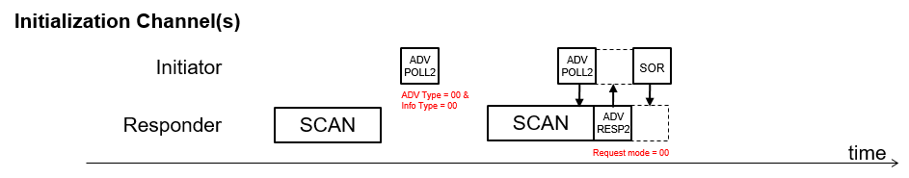
    Advertisement packet – ADV type ‘00’
  NBA-MMS-UWB ranging session setup only, Info type shall be set to ’00’
ID
= ADV-POLL2
Control
CRC
ADV type = 00
Info type = 00
Octets: 1 1 2

Slide 11
    Advertisement packet – ADV type ‘01’ or ‘10’
  In case ADV type = 01, UWB Per-Session Info only.
  In case ADV type = 10, both initialization/setup and Per-Session Info field are available in the advertisement packet.
    A responder scanning advertisement packet join RAN can request session initialization/setup using ADV-RESP2
  If UWB AP Present in Common Info field [4] is 0, Per-Session Info field [5] is included in the advertisement packet
  If UWB AP Present in Common Info field [4] is 1, Per-Session Info field [5] can be obtained either in the UWB AP(Acquisition Packet) [4] in Common Info field [4] or by requesting more channel usage information using ADV-RESP2 optionally(Solicited)
ID
= ADV-POLL2
Control
Common Info field
Per-Session Info field
CRC
ADV type = 01 or 10
Info type = 01 or 10 or 11
Octets: 1 1 1 variable 2
ID
= ADV-POLL2
Control
Common Info field
UWB AP Info field
CRC
ADV type = 01 or 10
Info type = 01
Octets: 1 1 1 4 2

Slide 12
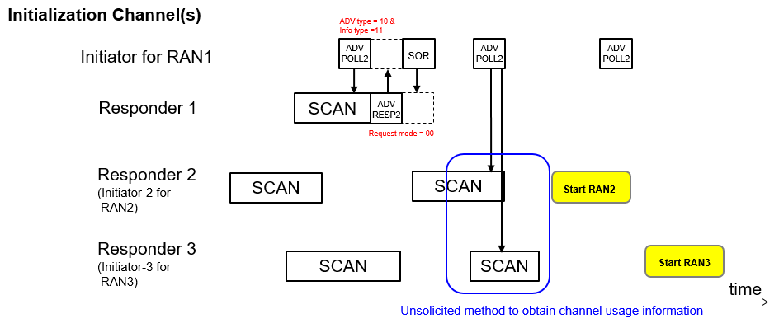
    Unified Native Discovery example – ADV type ‘01’ or ‘10’
  Here is an example when ADV type = 10 (Ranging session setup and UWB Per-Session Info) and Info type = 11 (UWB Per-Session Info field with round structure [5])
  Responder 1 is performing ranging session setup by requesting ADV-RESP2 with request mode = 00 to join RAN1
  Responder 2 and Responder 3 obtain UWB Per-Session Info filed with round structure [5] in the advertisement packet and RAN2/RAN3 start their ranging session at a time does not overlapped with RAN1

Slide 13
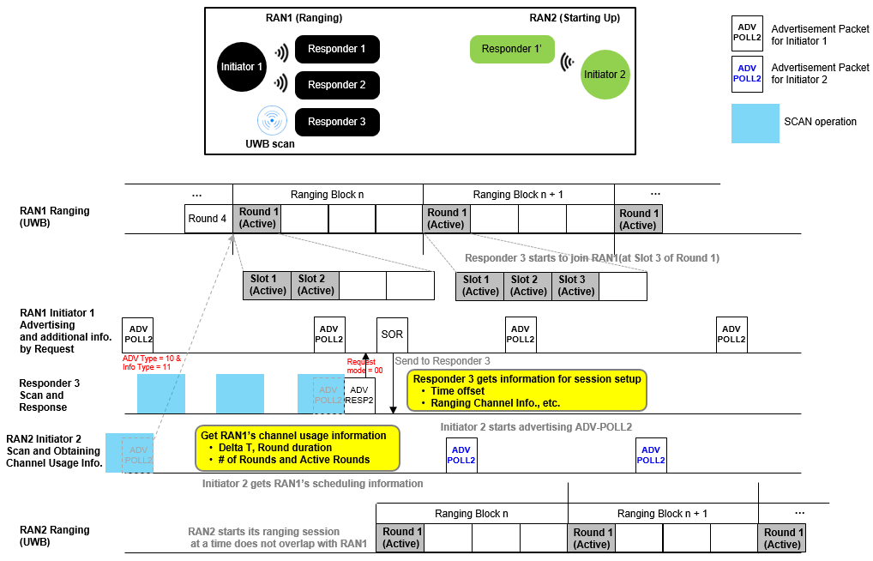
    Unified Native Discovery example – ADV type ‘01’ or ‘10’ (Cont.)

Slide 14
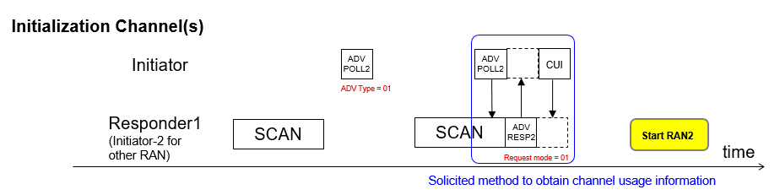
    Unified Native Discovery example – Solicited
  Here is an example when ADV type = 01(UWB Per-Session Info only) and Info type = 01(Minimum info in UWB Per-Session Info field)
  Responder 1 may obtain more channel usage information by requesting ADV-RESP2 with Request mode = 01 optionally in some case
ID
= ADV-POLL2
Control
Common Info field
Per-Session Info field
CRC
ADV type = 01
Info type = 01
Octets: 1 1 1 4 2

Slide 15
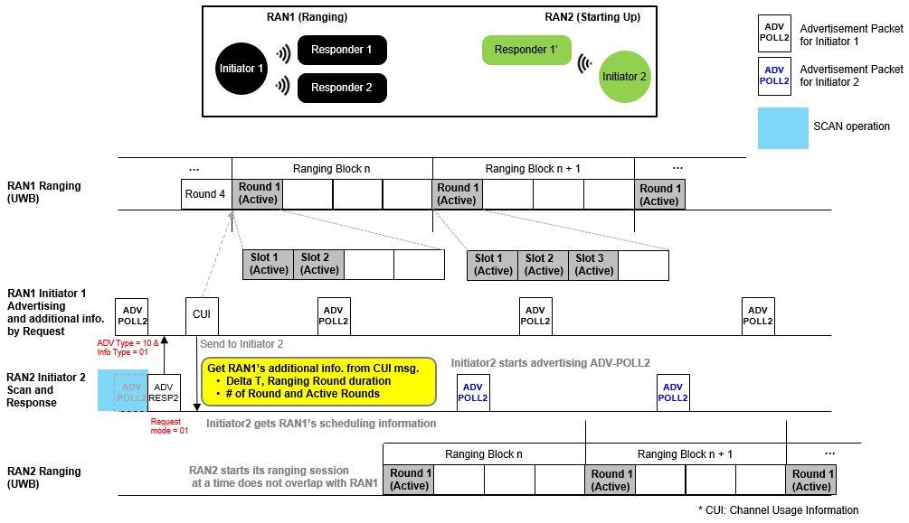
    Unified Native Discovery example – Solicited (Cont.)

Slide 16
Summary
  Unified advertisement packet format for initialization/setup and channel usage coordination can reduce the number of advertisement packets
Considering wireless environment like channel status, advertisement packet should be constructed flexibly
For these, we proposed:
    Unified advertisement packet format for ranging session setup and channel usage coordination
    Advertisement response packet format with Request mode to choose the request for ranging session setup or channel usage coordination information
    Optionally, solicited method to obtain more channel usage information for channel usage coordination

Slide 17
References
[1] A. Krebs et al., “NBA-MMS-UWB Native Discovery Concept”, 15-23-0033-02-04ab.
[2] A. Krebs(Apple Inc), Lei Huang (Huawei) et al., “NBA-MMS-UWB ranging text proposal for 15.4ab TFD”, 15-22-0381-02-04ab.
[3] L. Verma (Apple), M. Lee (Samsung), W. Kuchler (NXP), et al., “UWB Channel Usage Coordination for better UWB Coexistence”, 15-22-0456-00-04ab.
[4] L. Verma (Apple) et al., ”Follow-up on UWB Channel Usage Coordination”, 15-22-0573-00-04ab.
[5] M. Lee (Samsung), L. Verma (Apple) et al. “Updates on UWB Channel Usage Coordination”, 15-23-0067-00-04ab
[6] A. Krebs(Apple Inc) et al., “NBA-MMS-UWB Compressed PSDU”, 15-22-0604-00-04ab

Slide 18
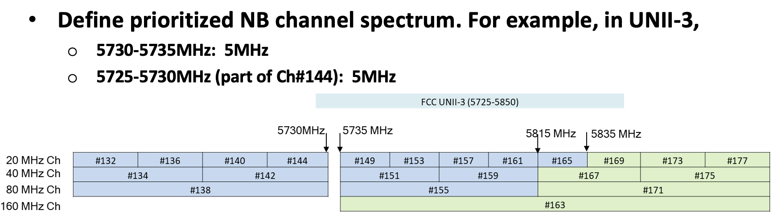
Appendix: Discovery Channels for NB [1]
Both native discovery and channel usage coordination use discovery channel for NB
2 possible NB channels in UNII-3 non-overlapping with 802.11
    Good candidate as default channel for discovery

Slide 19
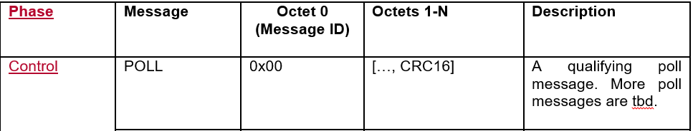
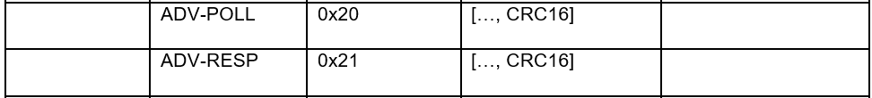
Appendix: Compressed PSDU format [2][6]
Compressed PSDU specific to NBA-MMS-UWB control and discovery frames [2][6]
    1-octet message ID (0x00=Poll, 0x01=Response, 0x20=ADV-POLL, 0x21=ADV-RESP…)
    2-octet session identifier/address
    ID specific data (variable length)
    2-octet CRC16
Compressed PSDU messages may be encapsulated in the header IE type data field [2]
….

Slide 20
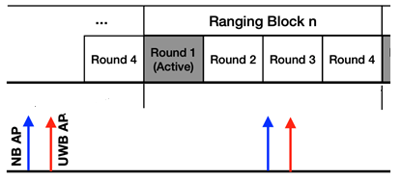
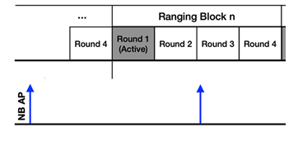
Appendix : Channel Usage Coordination
UWB AP Transmission can be indicated by UWB AP Present field [4]
Presence of UWB Session info in NB AP can be indicated by UWB Per Session Info Type Field
4 Types of UWB session info are available
  [ UWB AP Present = 1 ]
  UWB AP sent after each NB AP which includes UWB AP Info field
  [ UWB AP Present = 0 ]
  No UWB AP sent after each NB AP which has NO UWB AP Info field

Slide 21
Appendix: Channel Usage Coordination(Cont.)
In [5], UWB Per Session Info Type is introduced
  [UWB Per Session Info Type = 0 ]
  UWB Per Session Info field is not presented
  [UWB Per Session Info Type = 1]
  UWB Per Session Info field in [2] is presented. This type requires the minimum
  set of session info
MAC Payload |  | Bits | Bytes | Comments
Per-Session Info field | Block Duration | 24 | 3 | In RSTU (Ranging Scheduling Time Unit)
 | Session CH | 5 | 1 | UWB CH used by session
 | Hop Mode | 1 |  | 0: no hopping; 1: hopping. Hopping sequence NOT required to be known to all devices
 | RFU | 2 |  | RFU
 | Preamble Code | 8 | 1 | Preamble code used by session

Slide 22

Appendix: Channel Usage Coordination(Cont.)
In [5], UWB Per Session Info Type is introduced
  [UWB Per Session Info Type = 2 ]
  This type requires the start time and the duration of active period
MAC Payload |  | Bits | Bytes | Comments
Per-Session Info field 1 | Delta T | 24 | 3 | Time remaining in RSTU until the start of active period
 | UWB CH | 5 | 1 | UWB channel used by the UWB session
 | RFU | 3 |  | RFU
 | Preamble Code | 8 | 1 | Preamble code used by UWB session
 | Active Period Duration | 24 | 3 | Duration of active period of UWB session
Active Period
Duration

Slide 23
Appendix: Channel Usage Coordination(Cont.)
In [5], UWB Per Session Info Type is introduced
  [UWB Per Session Info Type = 3 ]
  This type requires the start time and the duration for the active rounds in a block
MAC Payload |  | Bits | Bytes | Comments
Per-Session Info field | Delta T | 24 | 3 | Time remaining in RSTU until the start of block
 | UWB CH | 5 | 1 | UWB CH used by session
 | Hop Mode | 1 |  | 0: no hopping; 1: hopping. Hopping sequence NOT required to be known to all devices
 | RFU | 2 |  | Unused
 | Preamble Code | 8 | 1 | Preamble code used by session
 | Round Duration | 24 | 3 | Round duration in a block of UWB session
 | Number of Rounds in a Block | 8 | 1 | In units of rounds
 | Active Rounds | 24 | 3 | Bitmap indicates the index of active rounds

