Slide 1
Project: IEEE P802.15 Working Group for Wireless Personal Area Networks (WPANs)
Submission Title: Channel Impulse Response (CIR) Scaling and Quantization
Date Submitted: March 13, 2023
Source: Steve Shellhammer, Pooria Pakrooh, Bin Tian, and Koorosh Akhavan (Qualcomm)
E-Mail:{sshellha, ppakrooh, btian, kakhavan}@qti.qualcomm.com
Abstract: Here we look at scaling and quantization to reduce the CIR report size.
Notice: This document has been prepared to assist the IEEE P802.15. It is offered as a basis for discussion and is not binding on the authoring individual(s) or organization(s). The material in this document is subject to change in form and content after further study. The authors(s) reserve(s) the right to add, amend or withdraw material contained herein.

Slide 2
PAR Objective | Proposed Solution (how addressed)
Safeguards so that the high throughput data use cases will not cause significant disruption to low duty-cycle ranging use cases
Interference mitigation techniques to support higher density and higher traffic use cases
Other coexistence improvement
Backward compatibility with enhanced ranging capable devices (ERDEVs)
Improved link budget and/or reduced air-time
Additional channels and operating frequencies
Improvements to accuracy / precision / reliability and interoperability for high-integrity ranging
Reduced complexity and power consumption
Hybrid operation with narrowband signaling to assist UWB
Enhanced native discovery and connection setup mechanisms
Sensing capabilities to support presence detection and environment mapping | Here we look at applying scaling and quantization to reduce the CIR Report size
Low-power low-latency streaming
Higher data-rate streaming allowing at least 50 Mbit/s of throughput
Support for peer-to-peer, peer-to-multi-peer, and station-to-infrastructure protocols
Infrastructure synchronization mechanisms

Slide 3
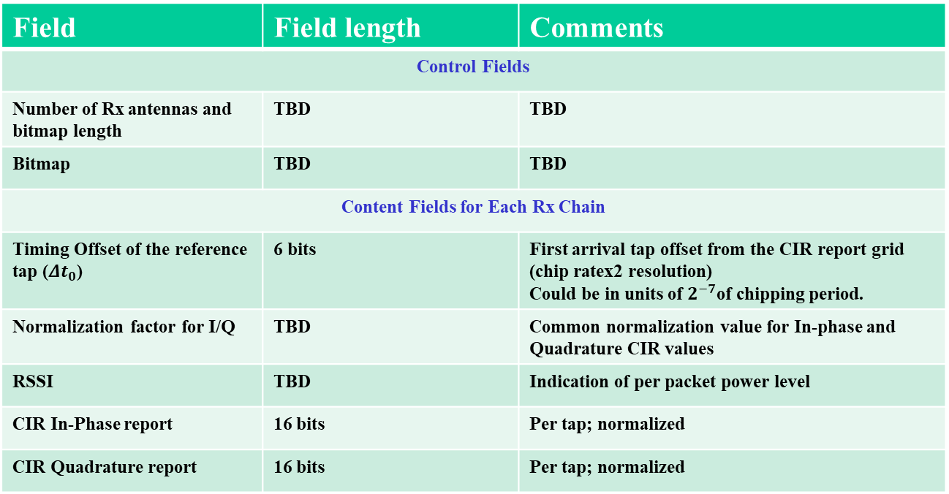
Background
The Latest Consensus on UWB Sensing for 802.15.4ab document [1] provides a table of the CIR elements (reproduced here)
Field | Field length | Comments
Control Fields
Number of Rx antennas and bitmap length | TBD | TBD
Bitmap | TBD | TBD
Content Fields for Each Rx Chain
Timing Offset of the reference tap (${Δt}_{0}$) | 6 bits | First arrival tap offset from the CIR report grid (chip ratex2 resolution) Could be in units of $2^{−7}$of chipping period.
Normalization factor for I/Q | TBD | Common normalization value for In-phase and Quadrature CIR values
RSSI | TBD | Indication of per packet power level
CIR In-Phase report | 16 bits | Per tap; normalized
CIR Quadrature report | 16 bits | Per tap; normalized
In [2] we showed that the CIR report size can be as large as 4142 octets, in the case of 256 bitmap with four RX antennas, with a duration of around 4.2 ms, when transmitted at 7.8 Mb/s

Slide 4
Background
In IEEE 802.11bf, the task group has decided to support channel state information (CSI) scaling and quantization [3]
CSI is a frequency-domain representation of the channel
This is different than the CIR time-domain representation of the channel used in UWB
Both consist of arrays of complex numbers
In 802.11 the scaled and quantized real and imaginary components of the CSI are either 8 or 10 bits in duration
Simulations were performed showing the signal-to-quantization level for these word sizes

Slide 5
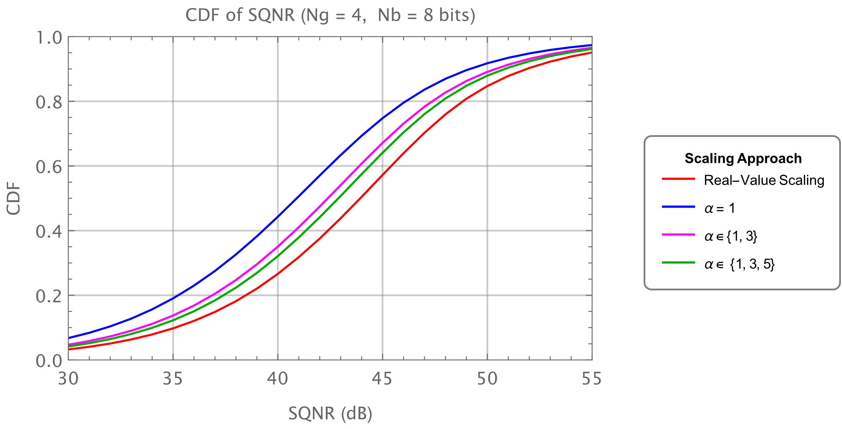
Background
802.11bf 8-bit simulations [4]

Slide 6
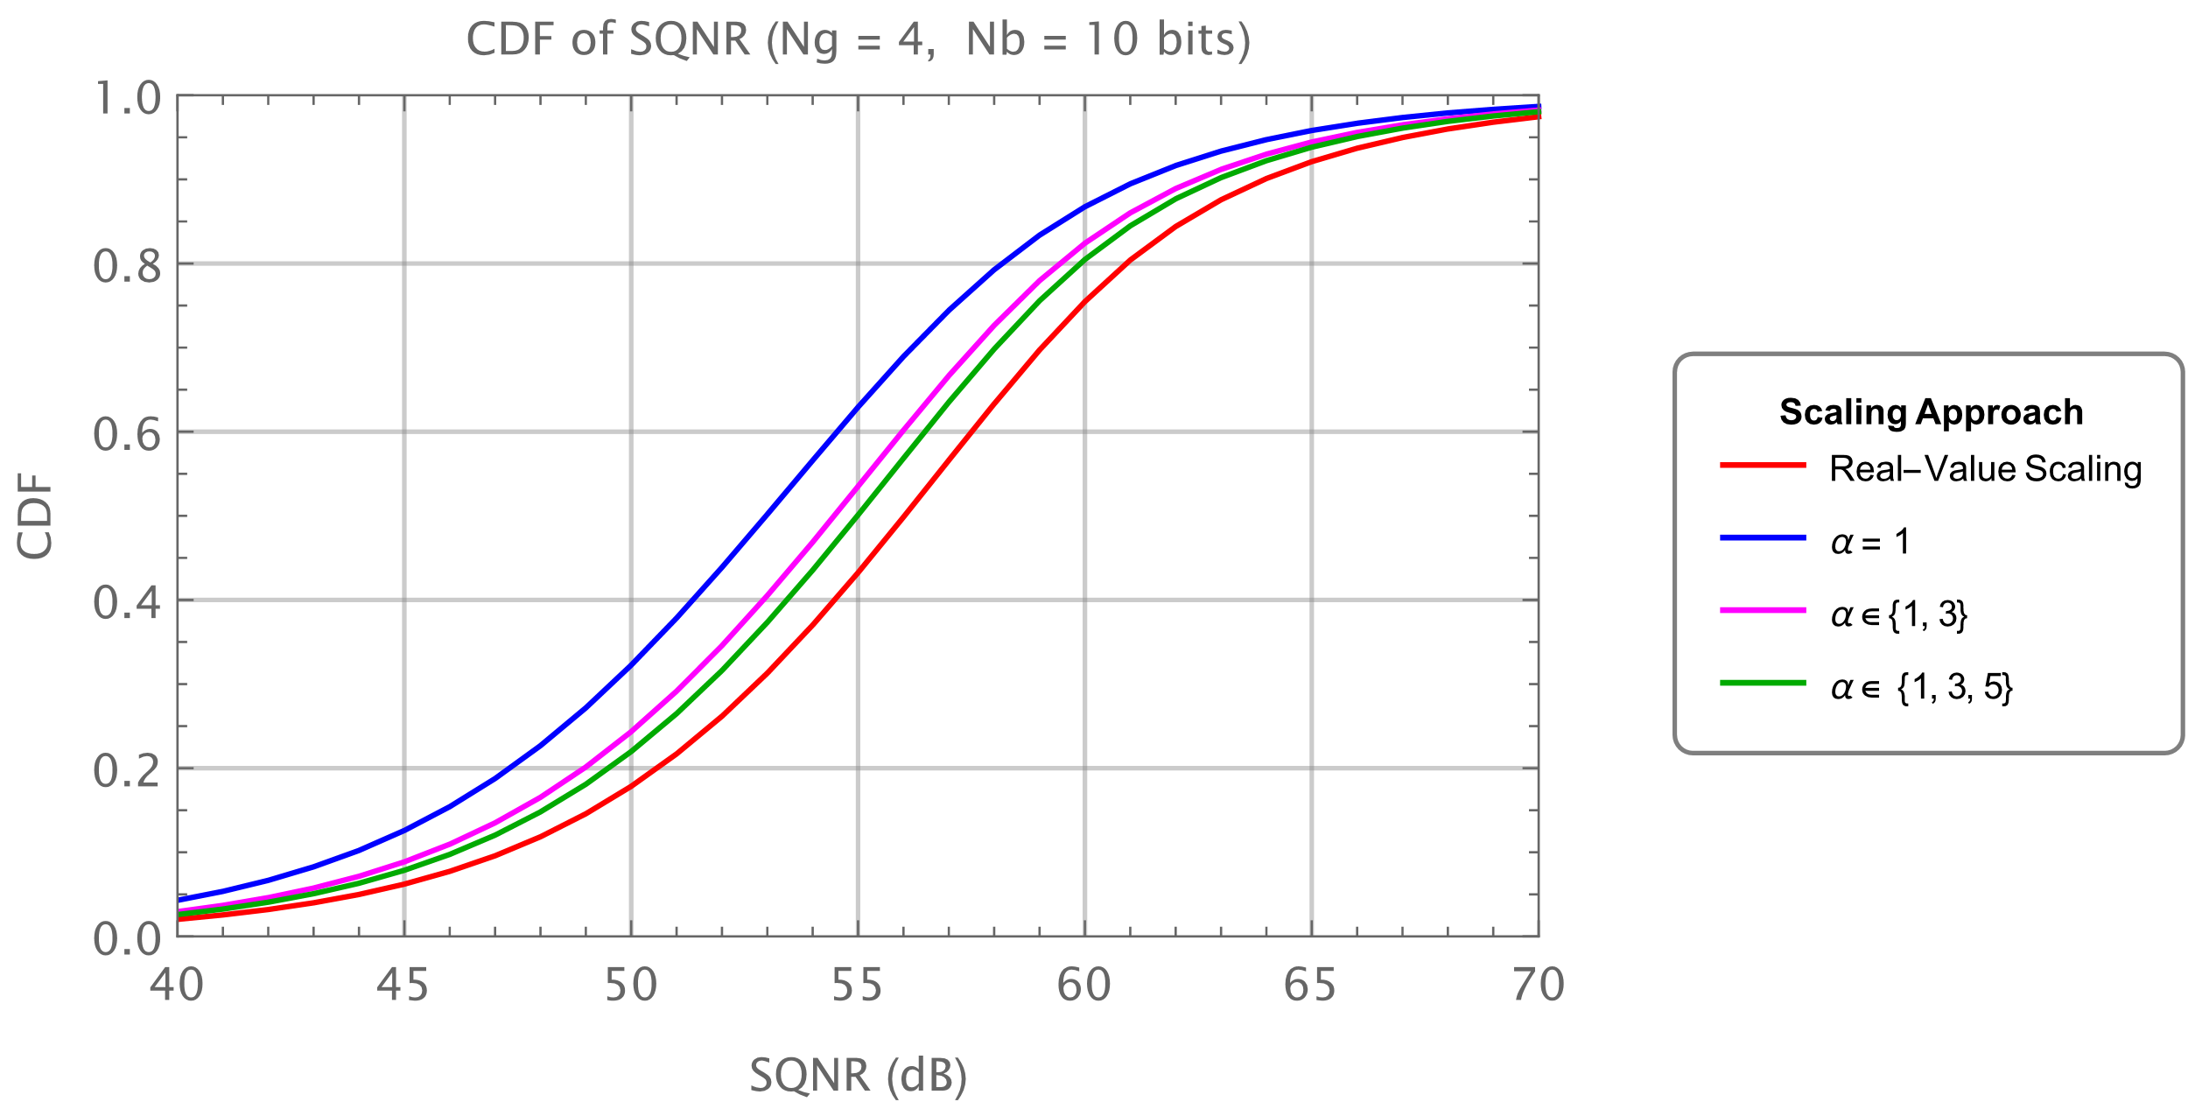
Background
802.11bf 10-bit simulations [4]

Slide 7
Overview of Scaling and Quantization
We have a set of complex numbers
In 802.11 this set is CSI for a given TX/RX Antenna pair
In 802.15.4ab this set is likely the CIR for a given RX antenna
We indicate the output word size as $N_{b}$
Recall, the largest positive number that can be represented as an $N_{b}$ bit twos-complement number is $(2^{{(N}_{b}−1)} −1)$
A good scaling algorithm scales the largest of the real and imaginary components to be close to, but no larger than, the largest positive twos-complement number (no overflow)

Slide 8
Overview of Scaling and Quantization Real-value Scaling
Let us indicate the CIR values as $h\left(k\right), k=1, 2, …K$
We then pick the largest absolute value of the real or imaginary components
$$m=\max\left(\max\left(abs\left(h_{R}\left(k\right)\right), abs\left(h_{I}\left(k\right)\right)\right)\right) ∀k∈\{1, 2, …K\}$$
Then we have the real-value scaling and quantization using
Here we show the real value of the CIR element. The same approach applies to the imaginary component.
Note, this requires multiplication and division (high complexity)
$$round\left(\left(\frac{2^{{(N}_{b}−1)}−1}{m}\right) h_{R}(k)\right)$$

Slide 9
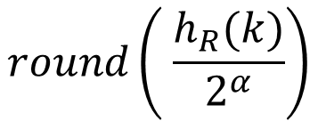
Overview of Scaling and Quantization Power-of-Two Scaling
We can use power-of-two scaling as follows
$$round\left( \frac{h_{R}(k)}{2^{α}}\right)$$
Here we choose $α$ to be the smallest value of $α$ such that:
$$2^{α}≥\frac{m}{{(2}^{{(N}_{b}−1)}−1)}$$
This ensures we have no overflow, and it provides the highest SQNR for a power-of-two scaling
On average this has a 3-dB lower SQNR than the optimum real-value scaling
The power-of-two scaling can be implemented using bit shift operations, which are low complexity

Slide 10
Recommendation
Recommend we include optional power-of-two scaling and quantization of the CIR elements in the CIR report
Recommend we allow for a few possible word sizes
For example, 8 and 10 bits, like in 802.11bf
This should provide a low-complexity approach to reduce the size of the CIR report significantly

Slide 11
References
Pooria Pakrooh, et. al., “Latest Consensus on UWB Sensing for 802.15.4ab,” IEEE 802.15-23/79r0, January 2023
Steve Shellhammer, et. al., “CIR Report Size,” IEEE 802.15-23/0120r0, March 2023
IEEE 802.11bf, Draft 1.0, January 2023
Steve Shellhammer, et. al., “Fractional Scaling Factor for Sensing Measurement Report,” IEEE 802.11-22/414r2, March 2022

