Slide 1
Project: IEEE P802.15 Working Group for Wireless Specialty Networks (WSN)
Submission Title: TG 15.4ab Agenda and Meeting Slides
Date Submitted: 07 March 2023
Source: Benjamin A. Rolfe (Blind Creek Associates)
Contact:
Voice: +1 408 395 7207, E-Mail: ben.rolfe @ ieee.org
Re: Task Group 4ab: 802.15.4 UWB Next Generation
Abstract: Teleconference (WebEx) Agenda and Meeting Slides
Purpose: Continue project progress
Notice: This document has been prepared to assist the IEEE P802.15. It is offered as a basis for discussion and is not binding on the contributing individual(s) or organization(s). The material in this document is subject to change in form and content after further study. The contributor(s) reserve(s) the right to add, amend or withdraw material contained herein.
Release: The contributor acknowledges and accepts that this contribution becomes the property of IEEE and may be made publicly available by P802.15.
Notes:
Jul 12, 2010
Page 1

Slide 2
Task Group 15.4ab Task Group 6a
Joint
Teleconference / Virtual Meeting
March 7th, 2023

Slide 3
Task Group Rules
Discussion: Everyone present is welcome
Straw polls: Everyone present may vote
Formal motions: WG voters
To make, second and vote
Patent policy for PAR activities applies
All the usual rules of conduct
Please identify yourself on first contact with name and affiliation

Slide 4
IEEE-SA Patent, Copyright, and Participation Policies
See: https://grouper.ieee.org/groups/802/sapolicies.shtml
IEEE-SA Patent Slides for Standards Development Meetings (.pdf)
https://development.standards.ieee.org/myproject/Public/mytools/mob/slideset.pdf
IEEE-SA Standards Board Patent Committee (PatCom) home page
https://standards.ieee.org/content/ieee-standards/en/about/sasb/patcom/index.html
IEEE-SA Participation Policy meeting slide set - individual method (.pdf)
https://standards.ieee.org/content/dam/ieee-standards/standards/web/documents/other/Participant-Behavior-Individual-Method.pdf
Working Group Copyright Materials
https://standards.ieee.org/ipr/copyright-materials.html
https://standards.ieee.org/content/dam/ieee-standards/standards/web/documents/other/ieee-sa-copyright-policy-2019.pdf

Slide 5
Participants have a duty to inform the IEEE
Participants shall inform the IEEE (or cause the IEEE to be informed) of the identity of each holder of any potential Essential Patent Claims of which they are personally aware if the claims are owned or controlled by the participant or the entity the participant is from, employed by, or otherwise represents
Participants should inform the IEEE (or cause the IEEE to be informed) of the identity of any other holders of potential Essential Patent Claims
Early identification of holders of potential Essential Patent Claims is encouraged

Slide 6
Ways to inform IEEE
Cause an LOA to be submitted to the IEEE SA (patcom@ieee.org); or
Provide the chair of this group with the identity of the holder(s) of any and all such claims as soon as possible; or
Speak up now and respond to this Call for Potentially Essential Patents
If anyone in this meeting is personally aware of the holder of any patent claims that are potentially essential to implementation of the proposed standard(s) under consideration by this group and that are not already the subject of an Accepted Letter of Assurance, please respond at this time by providing relevant information to the WG Chair
08 June 2021 – Slide 2

Slide 7
Other Guidelines for IEEE Working Group Meetings
All IEEE SA standards meetings shall be conducted in compliance with all applicable laws, including antitrust and competition laws.
Don’t discuss the interpretation, validity, or essentiality of patents/patent claims.
Don’t discuss specific license rates, terms, or conditions.
Relative costs of different technical approaches that include relative costs of patent licensing terms may be discussed in standards development meetings.
Technical considerations remain the primary focus.
Don’t discuss or engage in the fixing of product prices, allocation of customers, or division of sales markets.
Don’t discuss the status or substance of ongoing or threatened litigation.
Don’t be silent if inappropriate topics are discussed. Formally object to the discussion immediately.
---------------------------------------------------------------
For more details, see IEEE SA Standards Board Operations Manual, clause 5.3.10 and Antitrust and Competition Policy: What You Need to Know at http://standards.ieee.org/develop/policies/antitrust.pdf

Slide 11
IEEE SA Copyright Policy
By participating in this activity, you agree to comply with the IEEE Code of Ethics, all applicable laws, and all IEEE policies and procedures including, but not limited to, the IEEE SA Copyright Policy.
Previously Published material (copyright assertion indicated) shall not be presented/submitted to the Working Group nor incorporated into a Working Group draft unless permission is granted.
Prior to presentation or submission, you shall notify the Working Group Chair of previously Published material and should assist the Chair in obtaining copyright permission acceptable to IEEE SA.
For material that is not previously Published, IEEE is automatically granted a license to use any material that is presented or submitted.

Slide 12
IEEE SA Copyright Policy
The IEEE SA Copyright Policy is described in the IEEE SA Standards Board Bylaws and IEEE SA Standards Board Operations Manual
IEEE SA Copyright Policy, see Clause 7 of the IEEE SA Standards Board Bylaws https://standards.ieee.org/about/policies/bylaws/sect6-7.html#7 Clause 6.1 of the IEEE SA Standards Board Operations Manual https://standards.ieee.org/about/policies/opman/sect6.html
IEEE SA Copyright Permission
https://standards.ieee.org/content/dam/ieee-standards/standards/web/documents/other/permissionltrs.zip
IEEE SA Copyright FAQs
https://standards.ieee.org/faqs/copyrights/
IEEE SA Best Practices for IEEE Standards Development
http://standards.ieee.org/content/dam/ieee-standards/standards/web/documents/other/best_practices_for_ieee_standards_development_051215.pdf
Distribution of Draft Standards (see 6.1.3 of the SASB Operations Manual)
https://standards.ieee.org/about/policies/opman/sect6.html

Slide 13
IEEE 802 Ground Rules
Respect … give it, get it
NO product pitches
NO corporate pitches
NO prices
NO restrictive notices – (no confidentially notices in email)
Presentations must be openly available

Slide 14
Proposed Agenda
Opening and meeting preamble
UWB PHY for 802.15.6
Required characteristics
Commercial and Practical considerations
???
Next steps
Any other Business

Slide 15
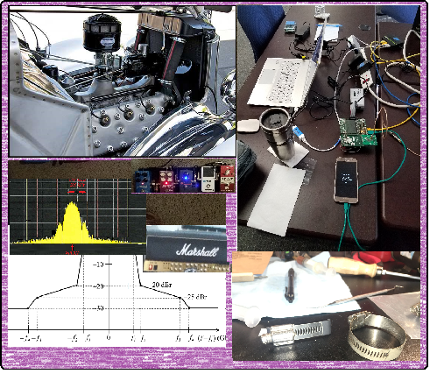
Technical Discussion

Slide 16
Next Steps

Slide 17
Next Steps
Where do we go from here?
Plans for March Interim and beyond?

Slide 18
Calendar
March ‘23
S | M | T | W | T | F | S
 |  |  | 1 | 2 | 3 | 4
5 | 6 | 7 | 8 | 9 | 10 | 11
12 | 13 | 14 | 15 | 16 | 17 | 18
19 | 20 | 21 | 22 | 23 | 24 | 25
26 | 27 | 28 | 29 | 30 | 31
Joint w/TG6a
802 Plenary

Slide 19
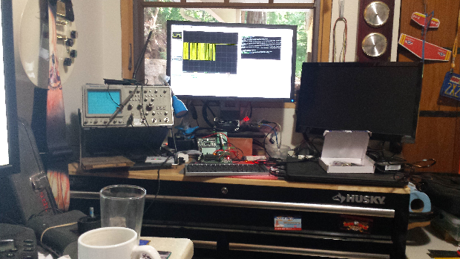
Other Business?

Slide 20
Adjourned Thanks

